Slide 1


Robolectric and Espresso
By: Swrajit Paul

Slide 2
Android Testing
Manual Testing vs Automated Testing
Manual testing is tedious and prone to error.
Manual testing is time consuming
Automated testing allows for running the same test every time after modifying the app
Preventing Regression

Slide 3
Android Testing
How do you know if an app works as expected ?
In order to check whether or not the app is functioning, you have to test the logic and the UI of the app.
Unit tests, Integration tests, end to end tests.
Unit tests are considered small tests
Integration tests are considered medium tests
End to end tests are Large tests

Slide 4
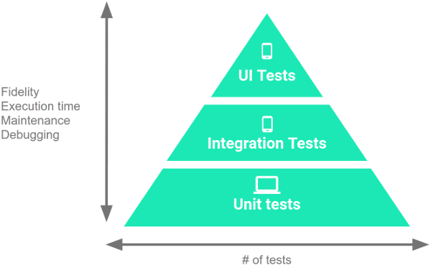
Android Testing

Slide 5
Android Testing
JVM
Device

Slide 6
Android Testing
 | JVM | DEVICE
NON UI
UI

Slide 7
Android Testing
 | JVM | DEVICE
NON UI | JVM UNIT TEST
UI

Slide 8
Android Testing
 | JVM | DEVICE
NON UI | JVM UNIT TEST | INSTRUMENTATION UNIT TEST Asset Manager, SQLiteDatabase
UI

Slide 9
Android Testing
 | JVM | DEVICE
NON UI | JVM UNIT TEST (Pure logic) | INSTRUMENTATION UNIT TEST (Logic with context)
UI |  | INSTRUMENTATION UI TEST

Slide 10
Android Testing
 | JVM | DEVICE
NON UI | JVM UNIT TEST | INSTRUMENTATION UNIT TEST
UI |  | ESPRESSO

Slide 11

Espresso
What is Espresso?
Espresso is a testing framework that has APIs for writing UI tests
to simulate user interactions.

Slide 12
Espresso
How does Espresso work?
Espresso installs a test APK next to App APK.
The Test APK sends UI events to the App APK and observes
how it functions.
UI events are actions like typing, scrolling, swiping etc.

Slide 13
Espresso
Advantages of using Espresso
Android Testing Support Library
Gray box testing
Synchronization
Supports JUnit4

Slide 14
ESPRESSO
Configuring Espresso
android {
defaultConfig {
testInstrumentationRunner "android.support.test.runner.AndroidJUnitRunner"
}
}
dependencies {
testImplementation 'junit:junit:4.12'
androidTestImplementation 'com.android.support.test:runner:1.0.2'
androidTestImplementation 'com.android.support.test.espresso:espressocore:3.0.2'
}

Slide 15
ESPRESSO
onView(ViewMatcher)
.perform(ViewAction)
.check(ViewAssertion);
onView(withId(R.id.firstName))
.perform(typeText(“Swrajit”))
.check(matches(withText(“Swrajit Paul”));
Swrajit

Slide 16
ESPRESSO
onView(ViewMatcher)
.perform(ViewAction)
.check(ViewAssertion);
onData(ObjectMatcher)
.DataOptions
.perform(ViewAction)
.check(ViewAssertion);

Slide 17
ESPRESSO
onView(ViewMatcher)
.perform(RecyclerViewAction)

Slide 18
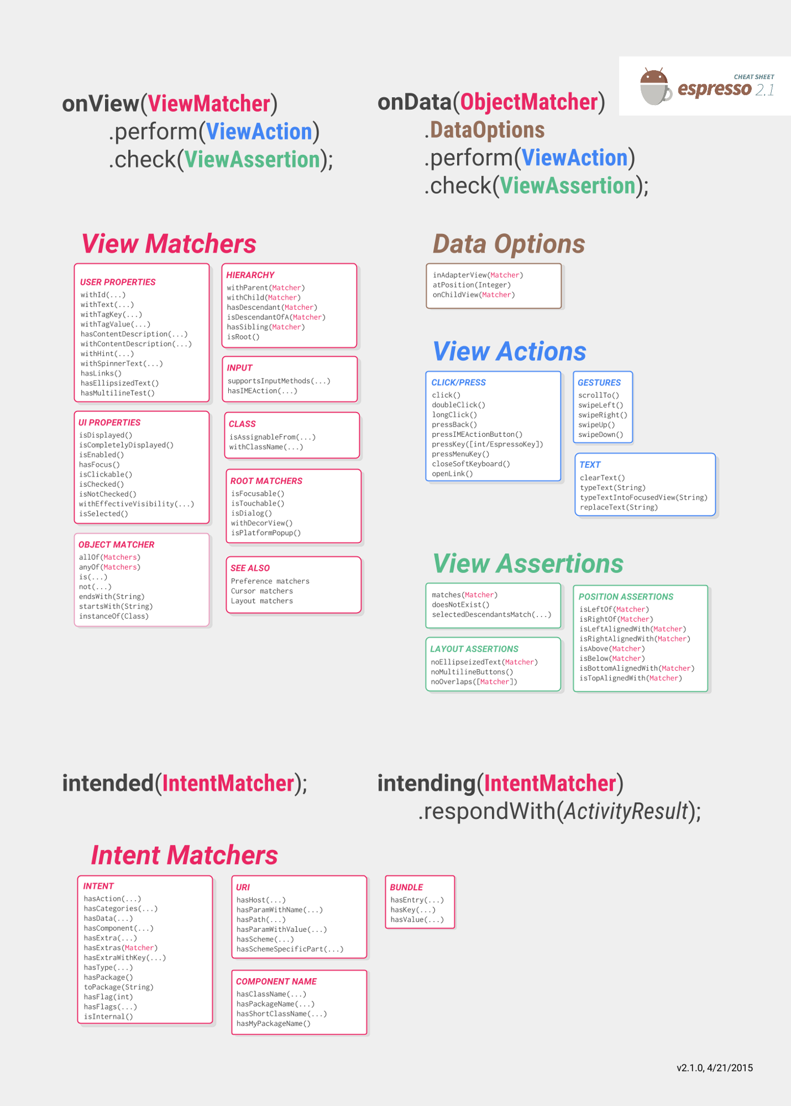

Slide 19
-----------------------------

Slide 20
Android testing
 | JVM | DEVICE
NON UI | JVM UNIT TEST | INSTRUMENTATION UNIT TEST
UI |  | ESPRESSO

Slide 21
Android testing
 | JVM | DEVICE
NON UI | JVM UNIT TEST | INSTRUMENTATION UNIT TEST
UI | ? | ESPRESSO

Slide 22
Robolectric
What is Robolectric ?
It is a framework that allows you to write unit tests and run it on JVM by having stub implementations of Android classes.
Robolectric 4.0
Enabled API support for AndroidX and the AndroidJUnitRunner, ActivityTestRule and Espresso for interacting UI components.
Supports binary resources

Slide 23
Robolectric 3.x style test
A Robolectric 3.x style test:
@RunWith(RobolectricTestRunner::class)
class RobolectricTest {
@Test fun clickingOnTitle_shouldLaunchEditAction() {
val activity = Robolectric.setupActivity(NoteListActivity::class.java)
ShadowView.clickOn(activity.findViewById(R.id.title));
assertThat(ShadowApplication.getInstance().peekNextStartedActivity().action)
.isEqualTo("android.intent.action.EDIT")
}
}

Slide 24
Robolectric 4.x/instrumentation test
@RunWith(AndroidJUnit4::class)
class OnDeviceTest {
@get:Rule val rule = ActivityTestRule(NoteListActivity::class.java)
@Test fun clickingOnTitle_shouldLaunchEditAction() {
onView(withId(R.id.button)).perform(click())
intended(hasAction(equalTo("android.intent.action.EDIT")))
}
}

Slide 25
THE END

Slide 26
References
“Espresso | Android Developers.” Android Developers, developer.android.com/training/testing/espresso.
Zelenchuk, Denys. Android Espresso Revealed: Writing Automated UI Tests. Apress, 2019.
Chan, Chiu-Ki. “Automated Testing | LinkedIn Learning, Formerly Lynda.com.” LinkedIn Learning, 20 Mar. 2018, www.linkedin.com/learning/android-espresso-essential-training/automated-testing?u=35653204.
Espresso Testing Tutorial, www.tutorialspoint.com/espresso_testing/index.htm.
Gerrish, Jonathan. “Jonathan Gerrish, Brett Chabot, and Christian Williams.” Robolectric, 25 Oct. 2018, robolectric.org/blog/2018/10/25/robolectric-4-0/.

