Slide 1
Samza Modification

Slide 2
Original Design

Slide 3
Run with StreamProcessors
Use WikipediaApplication as example:
1. Run application with run-wikipedia-zk-application.sh script
1.
run-wikipedia-zk-application.sh
WikipediaZkLocalApplication
2. Script run main() in WikipediaZkLocalApplication
3.
WikipediaApplication
3. WikipediaZkLocalApplication create a LocalApplicationRunner instance and a WikipediaApplication instance.
hello-samza
4.
3.
LocalApplicationRunner
Samza
4. WikipediaZkLocalApplication use LocalApplicationRunner to run the application

Slide 4
LocalApplicationRunner
In LocalApplicationRunner:
StreamApplication
1.
1. Like RemoteApplicationRunner, generates JobGraph from StreamApplication
LocalApplicationRunner
JobGraph
2. For each JobNode in the JobGraph, create a StreamProcessor with the JobNode’s JobConfig
JobConfig
2.
3. Start all StreamProcessors
3.
StreamProcessors

Slide 5
StreamProcessor
StreamApplication
1. StreamProcessor start the JobCoordinator and JobCoordinatorListener
StreamProcessor
1.
JobCoordinatorListener
2. When JobCoordinator get new JobModel, it will call JobCoordinatorListener’s OnNewJobModel method.
New JobModel
New JobModel
2.
3. JobCoordinatorListener will first shutdown the old SamzaContainer(if exists), and then start a new SamzaContainer with the new JobModel.
3.
New JobModel
JobCoordinator
1.
SamzaContainer
ZooKeeper Server
ZkJobCoordinator
2.
4. JobCoordinatorListener runs the new SamzaContainer on a new thread

Slide 6
ZkJobCoordinator
JobCoordinatorListener
1. ZkJobCoordinator will start a ZkControllerImpl which is the API class of ZooKeeper server
ZkJobCoordinator
3.1)
3.2)
Logic when JobModel changes
Logic when Processors changes
(only leader do this)
2. ZkJobCoordinator use ZkControllerImpl to register itself on ZooKeeper server:
1)Register this processor in ZooKeeper Server
2)Use LeaderElector to try to become leader
3)Subscribe to JobModel changes in ZooKeeper server
onNewJobModelAvailable()
onNewJobModelConfirmed()
onProcessorChange()
3.1)
3.2)
3. If JobModel in ZooKeeper server changed:
the ZkJobCoordinator’s onNewJobModelAvailable() method will be called by ZkControllerImpl. ZkJobCoordinator will call JobCoordinatorListener’s onJobModelExpired() method to stop the running SamzaContainer. Then it will update the barrier for JobModel and wait for other processors.
When all registered ZkJobCoordinator updated the barrier, then the ZkControllerImpl will call the onNewJobModelConfirmed() method and new SamzaContainer will be started with the new JobModel
ZkControllerImpl
1.
LeaderElectorListener
3.1)
LeaderElector
2.3)
2.2)
3.1)
2.1)
3.2)
ZooKeeper Server
JobModel
Processors
Leader
Barrier

Slide 7
ZkJobCoordinator(Leader part)
JobCoordinatorListener
4. If one ZkJobCoordinator became leader, it will get informed by LeaderElectorListener
ZkJobCoordinator
5. Leader will subscribe to processors changes
Logic when JobModel changes
Logic when Processors changes
(only leader do this)
6. If processors changes(processors go online or offline):
ZkControllerImpl will call ZkJobCoordinator’s onProcessorChange() method
In onProcessorChange() method, new JobModel will be calculated according to the list of processors. The new JobModel will be published to ZooKeeper server. A barrier for JobModel update will be create
onNewJobModelAvailable()
onNewJobModelConfirmed()
onProcessorChange()
6.1)
ZkControllerImpl
LeaderElectorListener
LeaderElector
6.2)
6.2)
6.1)
5.
4.
ZooKeeper Server
JobModel
Processors
Leader
Barrier

Slide 8
Create ClusterBasedJobCoordinator
1. Read the CoordinatorSystemConfig from the container’s environment variables
AM Container
1.
CoordinatorSystemConfig
2. Create CoordinatorStreamManager from coordinatorSystemConfig to read and write CoordinatorSystemStream(Consumer and Producer)
ClusterBasedJobCoordinator
CoordinatorSystemStream
2.
CoordinatorStreamManager
3.
3. Read latest checkpoint SystemStreamPartition-to-Task mapping from CoordinatorSystemStream
SystemStreamPartitions
4.
ChangelogPartitionMapping
4.
4. Read the ChangelogPartitionMapping and combine it with SystemStreamPartition to build the JobModel
JobModel
5.
JobModelManager
JobModel
5. JobModelManager start a web server to share the JobModel for tasks running

Slide 9
Create ClusterBasedJobCoordinator
6. Create PartitionMonitor, which will monitor the SystemStream and throw Exception to YARN when SystemStream’s partition number changing
AM Container
ClusterBasedJobCoordinator
6.
PartitionMonitor
7. Create ContainerProcessManager, which create the ClusterResourceManager(YarnClusterResourceManager) and ContainerAllocator according configs. ContainerProcessManager will start the ContainerAllocator on a new thread
7.
ContainerProcessManager
ContainerAllocator
8.
ResourceRequestState
8. ContainerAllocator will maintain ResourceRequestState to store information about resource requests(container) and resource allocated by the cluster.
9.
YarnClusterResourceManager
9. ContainerAllocator keeps run containers on allocated resource until it shutdown
ContainerAllocator use YarnClusterResourceManager to interact with YARN(send requests; receive resource allocated by YARN; run containers on nodes)
RM
NM
NM
…

Slide 10
LocalContainerRunner
YARN Container
1.
run-container.sh
In YARN container:
1. run-container.sh will be run and start a LocalContainerRunner
LocalContainerRunner
2.
JobModelManager
JobModel
2. LocalContainerRunner reads JobModel from JobModelManager’s url
3.
StreamApplication
3. Build the StreamApplication according to JobConfig
4. Run the StreamApplication in a SamzaContainer
4.
SamzaContainer

Slide 11
Follower

Slide 12
FollowerStreamProcessorRunner
Combine the LocalContainerRunner and LocalApplicationRuner
YARN Container
1. run-container now start a FollowerStreamProcessorRunner
1.
run-container.sh
FollowerStreamProcessorRunner
2. Use the LocalContainerRunner’s logic to read JobModel, StreamApplication and JobConfig
JobModelManager
JobModel
2.
StreamApplication
3. Use the LocalApplicationRunner’s logic to start StreamProcessor
JobConfig
3.
StreamProcessor

Slide 13
YARN Container
run-container.sh
YARN Container
1.
run-container.sh
LocalContainerRunner
JobModelManager
JobModel
FollowerStreamProcessorRunner
JobModelManager
JobModel
StreamApplication
StreamApplication
SamzaContainer
JobConfig
LocalApplicationRunner
JobGraph
StreamProcessor
JobConfig
StreamProcessors

Slide 14
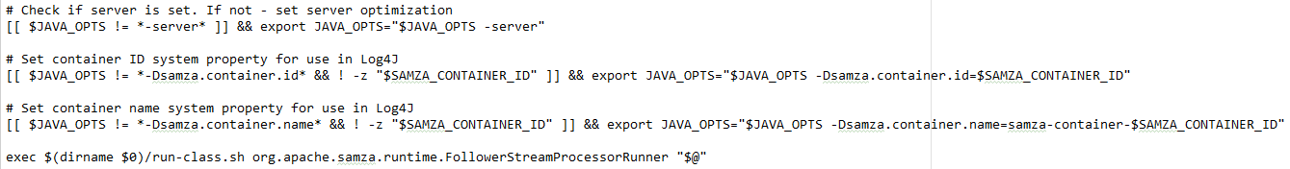
run-container.sh
In each container, the run-container.sh script will be called. It will start FollowerStreamProcessorRunner

Slide 15
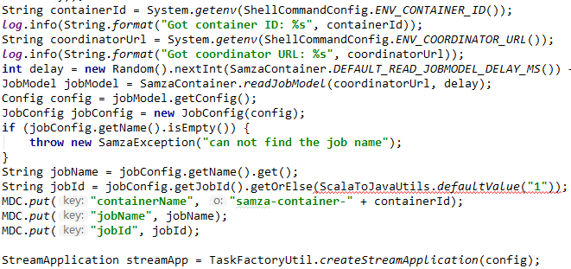
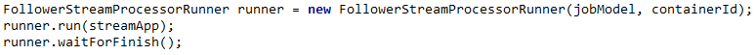
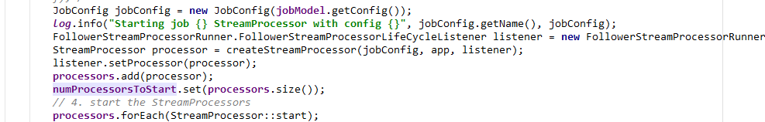
FollowerStreamProcessorRunner
Use the logic from LocalContainerRunner to read JobModel and config from JobModelManager url and build the StreamApplication
Use the logic from WikipediaZkLocalApplication to start FollowerStreamProcessorRunner
Compare to LocalApplicationRunner, we remove the logic of generating JobGraph and JobConfig since we already have the them in the JobModel
Logic from LocalContainerRunner
Logic from WikipediaZkLocalApplication
The FollowerStreamProcessorListener does nothing for now
Logic from LocalApplicationRunner

Slide 16
StreamProcessor
StreamApplication
1. StreamProcessor start the JobCoordinator and JobCoordinatorListener
StreamProcessor
1.
JobCoordinatorListener
2. When JobCoordinator get new JobModel, it will call JobCoordinatorListener’s OnNewJobModel method.
New JobModel
New JobModel
2.
3. JobCoordinatorListener will first shutdown the old SamzaContainer(if exists), and then start a new SamzaContainer with the new JobModel.
3.
New JobModel
JobCoordinator
1.
SamzaContainer
ZooKeeper Server
FollowerZkJobCoordinator
2.
4. JobCoordinatorListener runs the new SamzaContainer on a new thread

Slide 17
FollowerZkJobCoordinator
JobCoordinatorListener
1. FollowerZkJobCoordinator will start a FollowerZkControllerImpl which is the API class of ZooKeeper server
FollwerZkJobCoordinator
3.1)
3.2)
Logic when JobModel changes
Leader part removed!
2. FollowerJobCoordinator use FollowerZkControllerImpl to register itself on ZooKeeper server:
1)Register this processor in ZooKeeper Server
2)Subscribe to JobModel changes in ZooKeeper server
onNewJobModelAvailable()
onNewJobModelConfirmed()
3.1)
3. If JobModel in ZooKeeper server changed:
the FollowerZkJobCoordinator’s onNewJobModelAvailable() method will be called by FollowerZkControllerImpl. FollowerZkJobCoordinator will call JobCoordinatorListener’s onJobModelExpired() method to stop the running SamzaContainer. Then it will update the barrier for JobModel and wait for other processors.
When all registered FollowerZkJobCoordinator updated the barrier, then the FollowerZkControllerImpl will call the onNewJobModelConfirmed() method and new SamzaContainer will be started with the new JobModel
3.2)
FollowerZkControllerImpl
1.
3.1)
LeaderElector removed!
2.2)
3.1)
2.1)
3.2)
ZooKeeper Server
Processors
Leader removed!
Barrier
JobModel

Slide 18
JobCoordinatorListener
JobCoordinatorListener
ZkJobCoordinator
FollwerZkJobCoordinator
3.1)
3.2)
3.1)
3.2)
Logic when JobModel changes
Logic when Processors changes
(only leader do this)
Logic when JobModel changes
Leader part removed!
onNewJobModelAvailable()
onNewJobModelAvailable()
onNewJobModelConfirmed()
onProcessorChange()
onNewJobModelConfirmed()
3.1)
3.1)
3.2)
3.2)
ZkControllerImpl
FollowerZkControllerImpl
1.
LeaderElectorListener
3.1)
1.
3.1)
LeaderElector removed!
LeaderElector
2.3)
2.2)
2.2)
3.1)
2.1)
3.2)
3.1)
2.1)
3.2)
ZooKeeper Server
ZooKeeper Server
Processors
Leader removed!
Barrier
JobModel
Processors
Leader
Barrier
JobModel

Slide 19
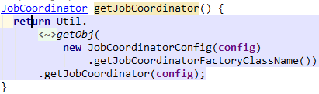
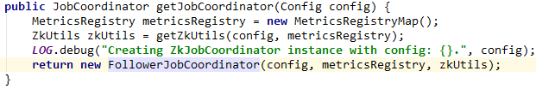
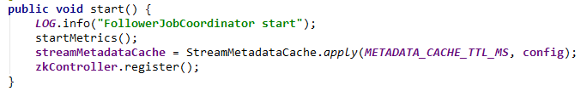

FollowerZkJobCoordinator
In StreamProcessor, it will choose JobCoordinatorFactory according to config
FollowerJobCoordinatorFactory is almost the same as ZkJobCoordinatorFactory. But it generate FollowerZkJobCoordinator instead of ZkJobCoordinator
Logic from ZkJobCoordinatorFactory
FollowerJobCoordinator is almost the same as the ZkJobCoordinator. But it does not have LeaderElector and use FollowerControllerImpl instead of ZkControllerImpl. When registering with FollowerControllerImpl, isLeader value will always be false and therefore the onProcessorsChange() method will never be called.
Logic from ZkJobCoordinator
Logic from ZkControllerImpl

Slide 20
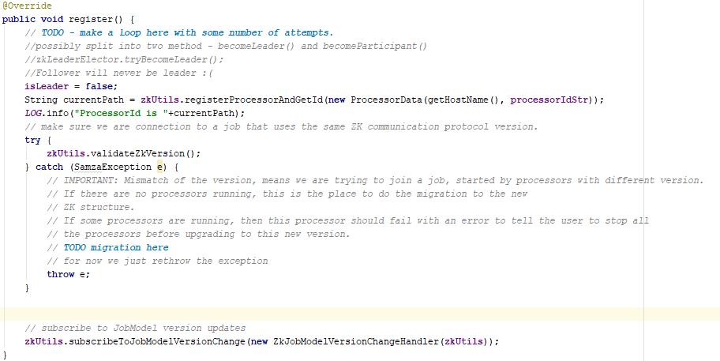
LeaderControllerImpl
The FollowerControllerImpl is almost the same as ZkControllerImpl
Since we already have a fixed leader, so we replace the ZkLeaderElector with a indicating boolean variable isLeader.

Slide 21
Leader part

Slide 22
run-jc.sh
Run ClusterBasedApplicationMaster

Slide 23
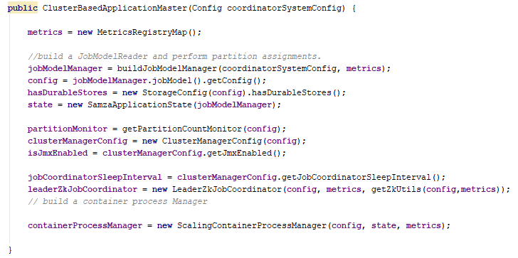

ClusterBasedApplicationMaster
ClusterBasedJobCoordinator
CoordinatorStreamManager
JobModelManager
Insert a LeaderZkJobCoordinator to ClusterBasedJobCoordinator
PartitionMonitor
ContainerProcessManager
ClusterBasedApplicationMaster
CoordinatorStreamManager
JobModelManager
PartitionMonitor
ContainerProcessManager
LeaderZkJobCoordinator

Slide 24
LeaderZkJobCoordinator
JobCoordinatorListener
3.
1. LeaderZkJobCoordinator will start a LeaderZkControllerImpl which is the API class of ZooKeeper server
LeaderZkJobCoordinator
Logic when Processors changes
2. LeaderZkJobCoordinator use LeaderZkControllerImpl subscribe to processors changes
JobModel part(follower part) removed!
newJobModel
3. The newJobModel is not calculated outside of the LeaderZkJobCoordiantor instead of onProcessorChange() method
onProcessorChange()
ContainerToProcessorMap
4. If processors changes(processors go online or offline) or new JobModel send to LeaderZkJobCoordinator :
LeaderZkControllerImpl will call LeaderZkJobCoordinator’s onProcessorChange() method
In onProcessorChange() method, the newJobModel will do a remapping according to ContainerToProcessorMap (introduced in next pages) and then be published to ZooKeeper server. A barrier for JobModel update will be create
4.1)
LeaderZkControllerImpl
1.
LeaderElector removed!
4.2)
4.2)
4.1)
2.
ZooKeeper Server
Processors
Leader removed!
Barrier
JobModel

Slide 25
JobCoordinatorListener
JobCoordinatorListener
ZkJobCoordinator
LeaderZkJobCoordinator
Logic when JobModel changes
Logic when Processors changes
(only leader do this)
Logic when Processors changes
JobModel part(follower part) removed!
onNewJobModelAvailable()
newJobModel
onNewJobModelConfirmed()
onProcessorChange()
onProcessorChange()
ContainerToProcessorMap
6.1)
4.1)
ZkControllerImpl
LeaderZkControllerImpl
LeaderElectorListener
LeaderElector
1.
LeaderElector removed!
6.2)
6.2)
4.2)
6.1)
5.
4.
4.2)
4.1)
2.
ZooKeeper Server
ZooKeeper Server
JobModel
Processors
Leader
Barrier
Processors
Leader removed!
Barrier
JobModel

Slide 26
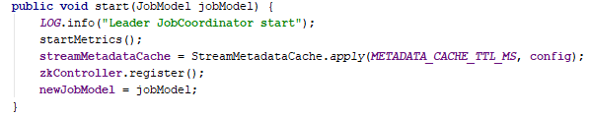

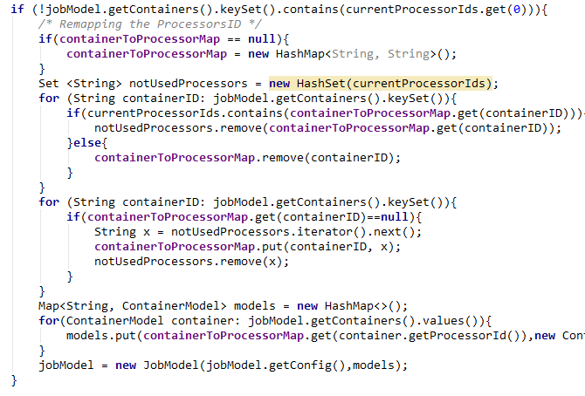
LeaderJobCoordinator
LeaderJobCoordinator implements JobCoordinator interface and ZkControllerListener interface
We use LeaderFollowerControllerImpl as the API to register with ZooKeeper
In LeaderJobCoordinator, we store the list of current processors. Because the doOnProcessorChange() method need the list of processors as parameter to publish JobModel to ZooKeeper.
The JobModel passed to LeaderJobCoordinator may not contain correct StreamProcessorId. This is because the ClusterBasedApplicationMaster which generates JobModel does not know the StreamProcessorId information. So it has to be a mapping from containerId to StreamProcessorId on JobModel before publishing
The containerToProcessorMap maintains the previous mapping from containerId to StreamProcessorId. So that the same container will be mapping to the same StreamProcessor next time and thus save migration time

Slide 27
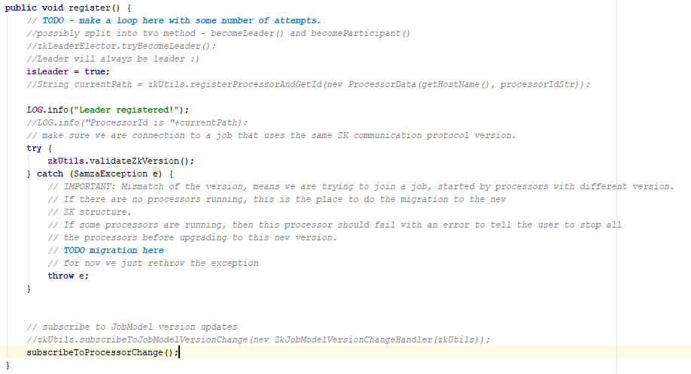
LeaderControllerImpl
The LeaderControllerImpl is almost the same as ZkControllerImpl
Since we already have a fixed leader, so we replace the ZkLeaderElector with a indicating boolean variable isLeader.
Leader will not register itself in the list of processors since it doesn’t have StreamProcessor.
Leader will not subscribe to JobModel changes since it doesn’t run the application.
Leader will subscribe to processors chages

Slide 28
Progress ends here

Slide 30
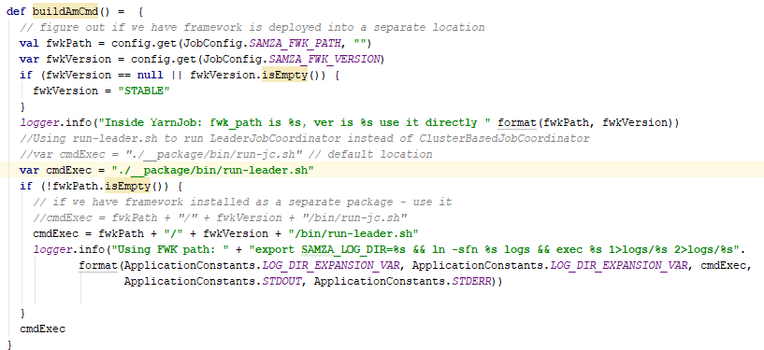
YarnJob.scala
buildAmCmd() changed, so that the run-leader.sh script will be run in AM container

Slide 31
run-leader.sh
Run ClusterBasedApplicationMaster

Slide 32

LeaderJobCoordinator
LeaderJobCoordinator implements JobCoordinator interface and ZkControllerListener interface
We use LeaderFollowerControllerImpl as the API to register with ZooKeeper
In LeaderJobCoordinator, we store the list of current processors. Because the doOnProcessorChange() method need the list of processors as parameter to publish JobModel to ZooKeeper.
The JobModel passed to LeaderJobCoordinator may not contain correct StreamProcessorId. This is because the ClusterBasedApplicationMaster which generates JobModel does not know the StreamProcessorId information. So it has to be a mapping from containerId to StreamProcessorId on JobModel before publishing
The containerToProcessorMap maintains the previous mapping from containerId to StreamProcessorId. So that the same container will be mapping to the same StreamProcessor next time and thus save migration time

Slide 33

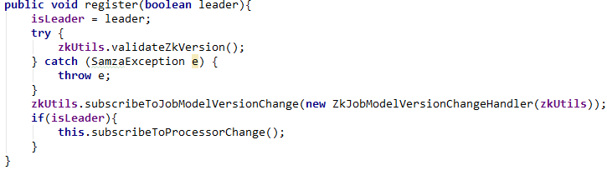
LeaderFollowerIControllerImpl
The LeaderFollowerControllerImpl is almost the same as ZkControllerImpl
Since we already have a fixed leader, so we replace the ZkLeaderElector with a indicating boolean variable isLeader. And we have a special register() method just for leader, so that its isLeader variable will be set to be true
Logic from ZkControllerImpl

Slide 34
FollowerJobCoordinator
In StreamProcessor, it will choose JobCoordinatorFactory according to config
FollowerJobCoordinatorFactory is almost the same as ZkJobCoordinatorFactory. But it generate FollowerJobCoordinator instead of ZkJobCoordinator
Logic from ZkJobCoordinatorFactory
FollowerJobCoordinator is almost the same as the ZkJobCoordinator. But it does not have LeaderElector and use LeaderFollowerControllerImpl instead of ZkControllerImpl. When registering with LeaderFollowerControllerImpl, FollowerJobCoordinator’s isLeader value will always be false and therefore the onProcessorsChange() method will never be called.
Logic from ZkJobCoordinator
Logic from ZkControllerImpl

Slide 35
ClusterBasedApplicationMaster
1.
run-leader.sh
ClusterBasedApplicationMaster
1. In AM container, the run-leader.sh script will be run and the ClusterBasedApplicationMaster will be started.
(Same things in ClusterBasedJobCoordinator)
2.
2. Start all old components: JobModelManager, ContainerProcessManager, etc.
3.
LeaderJobCoordinator
newJobModel
currentProcessors
3. Start LeaderJobCoordinator. LeaderJobCoordinator will publish JobModel to ZooKeeper server for all StreamProcessors to read.
containerToProcessorMap
ZkUtils
ShellCommandConfig.scala file has been modify so that AbstractContainerAllocator will run run-follower.sh instead of run-container.sh when containers start.
LeaderFollowerControllerImpl

Slide 36
LeaderJobCoordinator
3. Start LeaderJobCoordinator
Use ZkUtils and LeaderFollowerControllerImpl to register with ZooKeeper server.
LeaderFollowerControllerImpl will subscribe to change of online processors. If the list of online processors changes, the ZooKeeper server will inform LeaderJobCoordinator through callback method (onProcessorsChange)
LeaderJobCoordinator will publish the newJobModel to ZooKeeper server when the number of processors are equal to the number of containers in the newJobModel.
LeaderJobCoordinator will also start a Barrier in ZooKeeper server, which will wait until all StreamProcessors knows the newJobModel.
AM can set the newJobModel to be published in LeaderJobCoordinator
5)
LeaderJobCoordinator
newJobModel
currentProcessors
containerToProcessorMap
ZkUtils
FollowerControllerImpl
1)
2)
3)
4)
ZooKeeper Server
Processors
JobModel
Barrier

Slide 37
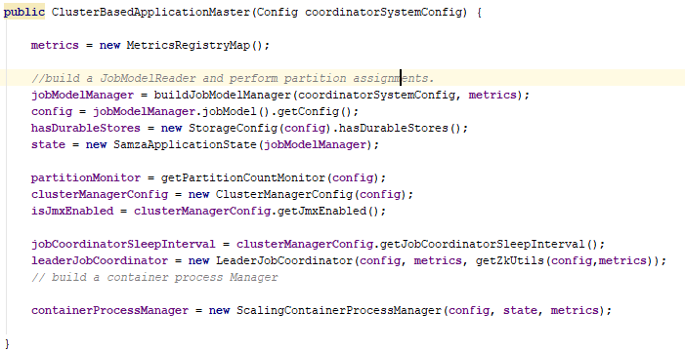

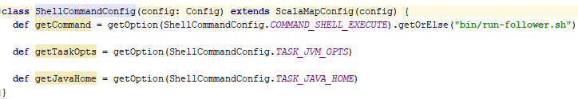
ClusterBasedApplicationMaster
1. In AM container, the run-leader.sh script will be run and the ClusterBasedApplicationMaster will be started.
2. Start all old components: LeaderJobCoordinator, ContainerProcessManager, etc.
3. Start LeaderJobCoordinator. LeaderJobCoordinator will publish JobModel to ZooKeeper server for all StreamProcessors to read.
ShellCommandConfig.scala file has been modify so that LeaderJobCoordinator will run run-follower.sh instead of run-container.sh when containers start.

Slide 38
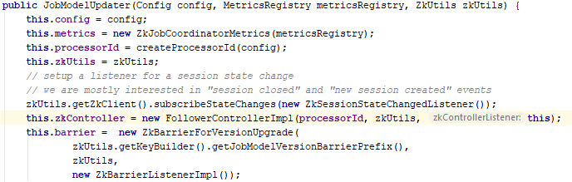
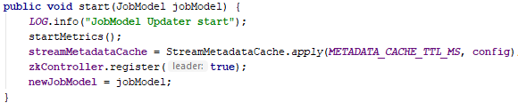
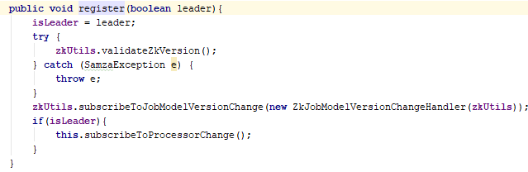
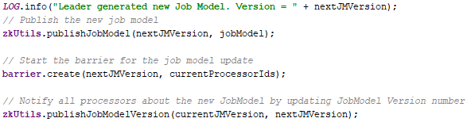

LeaderJobCoordinator
3. Start LeaderJobCoordinator
Use ZkUtils and LeaderFollowerControllerImpl to register with ZooKeeper server.
LeaderFollowerControllerImpl will subscribe to change of online processors. If the list of online processors changes, the ZooKeeper server will inform LeaderJobCoordinator through callback method (onProcessorsChange)
LeaderJobCoordinator will publish the newJobModel to ZooKeeper server when the number of processors are equal to the number of containers in the newJobModel.
JobModelUpdater will also start a Barrier in ZooKeeper server, which will wait until all StreamProcessors knows the newJobModel.
ClusterBasedApplicationMaster can set the newJobModel to be published in JobModelUpdater

Slide 39
StreamProcessor
1.
run-follower.sh
1. In each container, run-follower.sh script will be run.
2. FollowerStreamProcessorRunner will be started by run-follower.sh script. It will read job-config from JobModelManager server and run the StreamProcessor.
The FollowerStreamProcessorLifeCycleListener is the callback function that will be called when StreamProcessor’s running status changing. In our current implementation, it will never be called.
2.
FollowerStreamProcessorRunner
FollowerStreamProcessorLifeCycleListener
StreamProcessor
3.
FollowerJobCoordinator
3. StreamProcessor will start FollowerJobCoordinator. FollowerJobCoordinator will register with ZooKeeper server and watch for JobModel changes.
ZkUtils
FollowerControllerImpl
4.
JobCoordinatorListener
4. JobCoordinatorListener is the callback function that will be called by FollowerJobCoordinator when JobModel changes. It will set up and run the new SamzaContainer when FollowerJobCoordinator call onNewJobModel() method.
SamzaContainer

Slide 40
FollowerJobCoordinator
StreamProcessor
3)
4)
3. Start FollowerJobCoordinator.
JobCoordinatorListener
1) Use ZkUtils and FollowerControllerImpl to register with ZooKeeper server.
FollowerJobCoordinator
ZkUtils
2) FollowerControllerImpl will subscribe to JobModel changes. If the JobModel in ZooKeeper server changed (by LeaderJobCoordinator, step 3) ), FollowerControllerImpl will be notified.
3) It then calls onNewJobModelAvailable() method in FollowerJobCoordinator, which will stop current SamzaContainer through JobCoordinatorListener’s onJobModelExpired() method and update the Barrier in ZooKeeper server.
4) When the Barrier is done(all StreamProcessors are notified), it will call the onNewJobModelConfirmed() method through ZkBarrierListenerImpl. This method will start a new SamzaContainer through JobCoordinatorListener’s onNewJobModel() method.
FollowerControllerImpl
1)
2)
3)
4)
ZooKeeper Server
Processors
JobModel
Barrier

Slide 41
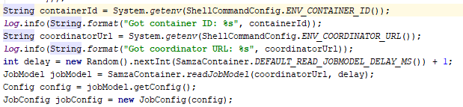
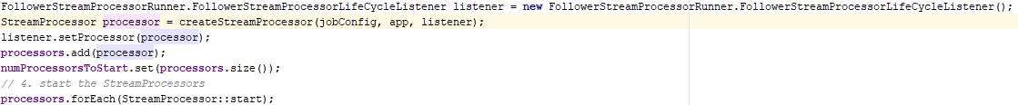
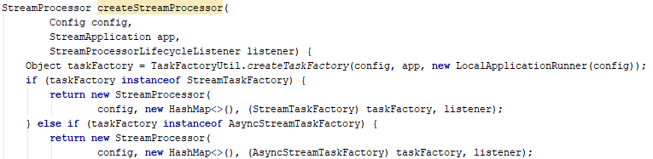
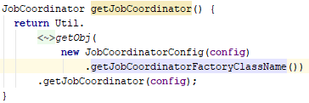
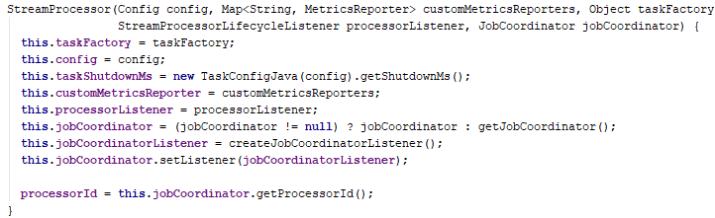

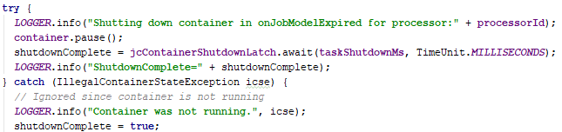
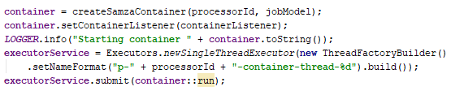
StreamProcessor
1. In each container, run-follower.sh script will be run.
2. FollowerStreamProcessorRunner will be started by run-follower.sh script. It will read job-config from JobModelManager server and run the StreamProcessor.
The FollowerStreamProcessorLifeCycleListener is the callback function that will be called when StreamProcessor’s running status changing. In our current implementation, it will never be called.
3. StreamProcessor will start FollowerJobCoordinator. FollowerJobCoordinator will register with ZooKeeper server and watch for JobModel changes.
4. JobCoordinatorListener is the callback function that will be called by FollowerJobCoordinator when JobModel changes. It will set up and run the new SamzaContainer when FollowerJobCoordinator call onNewJobModel() method.

Slide 42
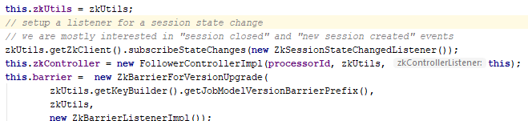
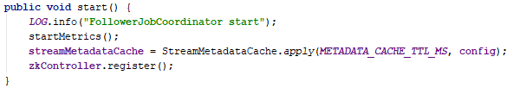
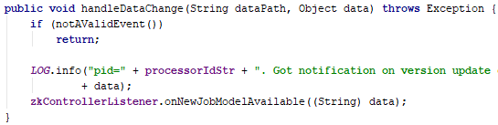
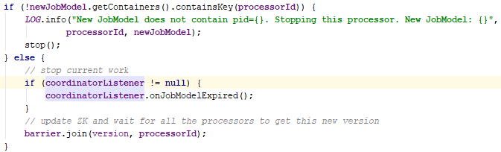
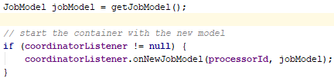
FollowerJobCoordinator
3. Start FollowerJobCoordinator.
1) Use ZkUtils and FollowerControllerImpl to register with ZooKeeper server.
2) FollowerControllerImpl will subscribe to JobModel changes. If the JobModel in ZooKeeper server changed (by LeaderJobCoordinator, step 3) ), FollowerControllerImpl will be notified.
3) It then calls onNewJobModelAvailable() method in FollowerJobCoordinator, which will stop current SamzaContainer through JobCoordinatorListener’s onJobModelExpired() method and update the Barrier in ZooKeeper server.
4) When the Barrier is done(all StreamProcessors are notified), it will call the onNewJobModelConfirmed() method through ZkBarrierListenerImpl. This method will start a new SamzaContainer through JobCoordinatorListener’s onNewJobModel() method.

