Slide 1
DM structure

Slide 2
StreamSwitch
Our ScalableYarnJob extends YarnJob.
ScalableYarnJob will start StreamSwitch after submitting the job to YARN.
Scheduler will keeps running (infinite loop) until being killed.
JobRunner
ScalableYarnJobFactory
JobConfig
ScalableYarnJob
ClientHelper
StreamSwitch

Slide 3
StreamSwitch
The StreamSwitch has three logical components:
Decision Making Model
Decision Dispatcher
Metrics Retriever
StreamSwitch
Decision Making Model
Dispatcher
Metrics Retriever
Application

Slide 4
StreamSwitch
Metrics Retriever
Retrieve metrics information from application.
Currently we are using RMI retriever
StreamSwitch
Decision Making Model
Dispatcher
Metrics Retriever
Metrics
Application

Slide 5
StreamSwitch
Decision Dispatcher
Send scaling decision and rebalance decision to application.
Currently the decision is transmit via RMI, and send to LeaderJobCoordinator.
StreamSwitch
Decision Making Model
Dispatcher
Metrics Retriever
JobModel
Application

Slide 6
StreamSwitch
Decision Making Model
Make scaling or rebalance decision based on metrics information.
Detailed introduction in later part.
StreamSwitch
Decision Making Model
Dispatcher
JobModel
Metrics
Metrics Retriever
Application

Slide 7
StreamSwitch’s main logic
Scheduler Start
StreamSwitch does following things periodically:
Retrieve metrics periodically
During the loop, if it is time to make decision (just the minimal time interval between decisions, not the actual delay constraints), ask the decision making model for a decision.
The actual delay constraints are dealing by the decision making model.
Retrieve metrics and update them to decision making model
Check whether decision can be made:
AM is online
Time interval from last decision making call is greater than the DECISION_INTERVAL
Both are true
If yes
If not
Make decision according to model and deploy
Sleep for metrics interval

Slide 8
Structure Overview
JobRunner
1.
ScalableYarnJob
1. JobRunner starts ScalableYarnJob by ScalableYarnJobFactory
2. ScalableYarnJob starts StreamSwitch in a new thread
StreamSwitch infinitely periodically do following things:
3. Check whether application is running (passive)
4. Retrieve metrics
5. Update DecisionModel with metrics
6. Make rebalance or scaling decision and deploy
7. Sleep for a user-defined interval, then start from 3. again
2.
StreamSwitch
DecisionMakingModel
6.
Dispatcher
5.
MetricsRetriever
3.
7.
4.
AM
LeaderJobCoordinator
Container
FollowerJobCoordinator

Slide 9





Structure Overview
1.
1. JobRunner starts ScalableYarnJob by ScalableYarnJobFactory
2. ScalableYarnJob starts StreamSwitch in a new thread
StreamSwitch infinitely periodically do following things:
3. Check whether application is running (passive)
4. Retrieve metrics
5. Update DecisionModel with metrics
6. Make rebalance or scaling decision and deploy
7. Sleep for a user-defined interval, then start from 3. again
2.

Slide 10




Structure Overview
1. JobRunner starts ScalableYarnJob by ScalableYarnJobFactory
2. ScalableYarnJob starts StreamSwitch in a new thread
StreamSwitch infinitely periodically do following things:
3. Check whether application is running (passive)
4. Retrieve metrics
5. Update DecisionModel with metrics
6. Make rebalance or scaling decision and deploy
7. Sleep for a user-defined interval, then start from 3. again

Slide 11
Structure Overview
1. JobRunner starts ScalableYarnJob by ScalableYarnJobFactory
2. ScalableYarnJob starts StreamSwitch in a new thread
StreamSwitch infinitely periodically do following things:
3. Check whether application is running (passive)
4. Retrieve metrics
5. Update DecisionModel with metrics
6. Make rebalance or scaling decision and deploy
7. Sleep for a user-defined interval, then start from 3. again

Slide 12
Structure Overview
1. JobRunner starts ScalableYarnJob by ScalableYarnJobFactory
2. ScalableYarnJob starts StreamSwitch in a new thread
StreamSwitch infinitely periodically do following things:
3. Check whether application is running (passive)
4. Retrieve metrics
5. Update DecisionModel with metrics
6. Make rebalance or scaling decision and deploy
7. Sleep for a user-defined interval, then start from 3. again

Slide 13
Structure Overview
1. JobRunner starts ScalableYarnJob by ScalableYarnJobFactory
2. ScalableYarnJob starts StreamSwitch in a new thread
StreamSwitch infinitely periodically do following things:
3. Check whether application is running (passive)
4. Retrieve metrics
5. Update DecisionModel with metrics
6. Make rebalance or scaling decision and deploy
7. Sleep for a user-defined interval, then start from 3. again

Slide 14
Structure Overview
1. JobRunner starts ScalableYarnJob by ScalableYarnJobFactory
2. ScalableYarnJob starts StreamSwitch in a new thread
StreamSwitch infinitely periodically do following things:
3. Check whether application is running (passive)
4. Retrieve metrics
5. Update DecisionModel with metrics
6. Make rebalance or scaling decision, change JobModel then ask Leader to deploy the new JobModel.
7. Sleep for a user-defined interval, then start from 3. again

Slide 15
Start StreamSwitch
JobRunner
ScalableYarnJobFactory
ScalableYarnJob
1. JobRunner starts ScalableYarnJob by ScalableYarnJobFactory

Slide 16

Start StreamSwitch
1. JobRunner starts ScalableYarnJob by ScalableYarnJobFactory
Application.properties

Slide 17
Start StreamSwitch
ScalableYarnJob
StreamSwitch
Dispatcher
Model
2. ScalableYarnJob starts StreamSwitch in a new thread
StreamSwitch create and initialize dispatcher, metrics retriever and decision making model
Metrics Retriever
RMIServer

Slide 18
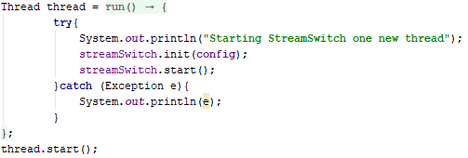
Start StreamSwitch
2. ScalableYarnJob starts StreamSwitch in a new thread
StreamSwitch create and initialize dispatcher, metrics retriever and decision making model

Slide 19
Start StreamSwitch
StreamSwitch
Dispatcher
Model
2. ScalableYarnJob starts StreamSwitch in a new thread
Metrics retriever starts locality server and offset server during initialization.
Each container will send its host address to locality server.
Later metrics retriever can pull metrics information from these hosts.
Metrics Retriever
RMIServer
container1, 192.168.0.2
container2, 192.168.0.5
Container 1
Container 2

Slide 20
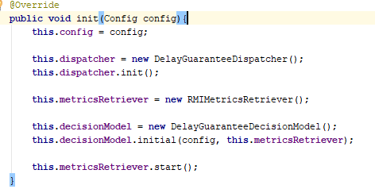

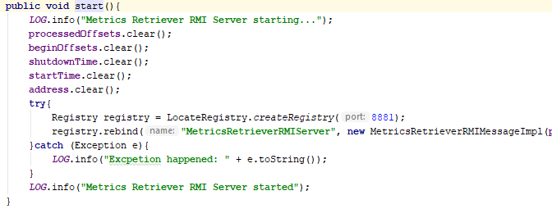
Start StreamSwitch
2. ScalableYarnJob starts StreamSwitch in a new thread
MetricsRetriever starts RMIserver during initialization.
Each container will send container’s host IP address to RMIserver.
Later MetricsRetriever can pull containers’ metrics information from these hosts.
RMIMetricsRetriever.java
MetricsRetrieverRMIServer.java
Listen to port 8881

Slide 21
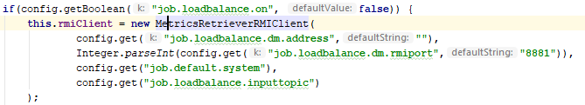

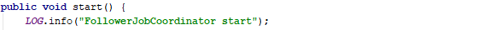

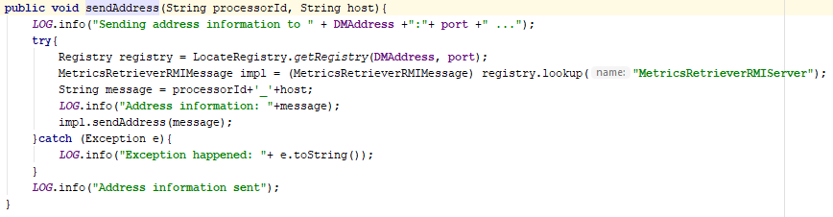

Start StreamSwitch
Application.properties
FollowerJobCoordinator.java
2. ScalableYarnJob starts StreamSwitch in a new thread
MetricsRetriever starts RMIserver during initialization.
Each container will send container’s host IP address to RMIserver.
Later MetricsRetriever can pull containers’ metrics information from these hosts.
MetricsRetrieverRMIClient.java
MetricsRetrieverRMIMessageImpl.java
Message is in “containerId_address” format
All containerIds are 6 characters long
this.address here is actually the HashMap in rmiServer.

Slide 22
Start StreamSwitch
StreamSwitch
Dispatcher
Model
2. ScalableYarnJob starts StreamSwitch in a new thread
RMIServer also maintains application’s input stream’s begin offset information and processed offset information.
The information is used to calculate # of messages arrived and processed.
Metrics Retriever
RMIServer
Partition 1: Begin 7, Processed 16
Partition 3: Begin 13, Processed 26
Container 1
Container 2

Slide 23
Offset information
The reason we need to maintain this information is:
By default, SamzaContainer maintains ‘begin offset’ and ‘processed offset’ information of the input stream’s partitions .
But when SamzaContainer restart due to rebalancing or scaling, the ‘begin offset’ will be overwritten to the new coming offset.
Some messages will be missed in this case.
Restart
…
10
11
12
13
14
…
10
11
12
13
14
15
Begin
Processed
Unprocessed
Missed!
New Begin

Slide 24
Offset information
The reason we need to maintain this information is:
So we store the ‘begin offset’ and ‘processed offset’, so that no messages will be missed.
Restart
…
10
11
12
13
14
…
10
11
12
13
14
15
Begin
Processed
New Begin
= Processed + 1
Unprocessed

Slide 25
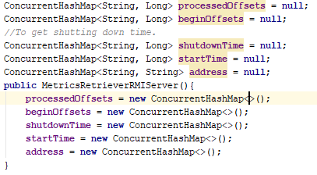
Start StreamSwitch
2. ScalableYarnJob starts StreamSwitch in a new thread
RMIServer also maintains application’s input stream’s begin offset information and processed offset information.
For each partition in the input topic, RMIServer maintains the begin offset and processed offset information.
The information is used to calculate # of messages arrived and processed.

Slide 26
Start StreamSwitch
StreamSwitch
Dispatcher
Model
2. ScalableYarnJob starts StreamSwitch in a new thread
When a container start to run, it will first retrieve the begin offset and processed offset from the RMIserver.
Container will update metrics based on the offset information.
Metrics Retriever
RMIServer
Partition 1: Begin 7, Processed 16
Partition 3: Begin 13, Processed 26
Container 1
Container 2

Slide 27

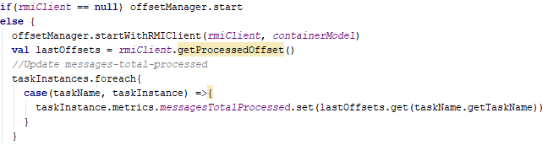
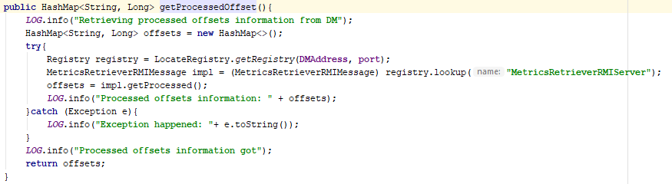
Start StreamSwitch
SamzaContainer.java
2. ScalableYarnJob starts StreamSwitch in a new thread
When a container start to run, it will first retrieve the begin offset and processed offset from the RMIserver.
Container will update metrics based on the offset information.
MetricsRetrieverRMIClient

Slide 28
Start StreamSwitch
StreamSwitch
Dispatcher
Model
2. ScalableYarnJob starts StreamSwitch in a new thread
When a container need to restart or shutdown (due to JobModel change), it will send newest offset information to RMIServer.
Metrics Retriever
RMIServer
Partition 1: Begin 7, Processed 16
Partition 3: Begin 13, Processed 26
Container 1
Container 2

Slide 29
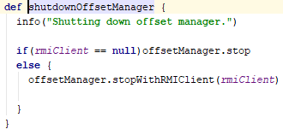
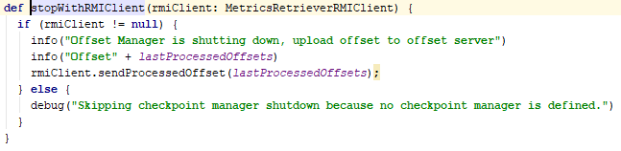
Start StreamSwitch
SamzaContainer.scala
2. ScalableYarnJob starts StreamSwitch in a new thread
When a container need to restart or shutdown (due to JobModel change), it will send newest offset information to RMIServer.
OffsetManager.scala

Slide 30





Start StreamSwitch
2. ScalableYarnJob starts StreamSwitch in a new thread
Start StreamSwitch’s runloop

Slide 31
Check Application Status
StreamSwitch
Dispatcher
Model
3. Check whether application is running (passive)
1)When starting, Leader will send Leader’s address to the RMIServer
Metrics Retriever
RMIServer
Leader: 192.168.0.16
AM
LeaderJobCoordinator
Container 1
Container 2

Slide 32
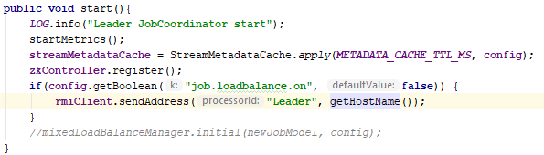
Check Application Status
3. Check whether application is running (passive)
1)When starting, Leader will send Leader’s address to the RMIServer

Slide 33

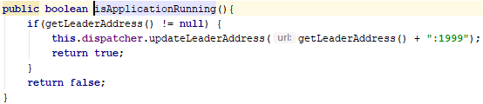

Check Application Status
3. Check whether application is running (passive)
2)MetricsRetriever checks whether Leader write its address to MetricsRetriever’s RMIServer to see whether application starts

Slide 34
Retrieve Metrics
StreamSwitch
Dispatcher
Model
4. Retrieve metrics
1)Each container starts a MetricsRMIServer, expose container’s metrics to client
Metrics Retriever
RMIServer
MetricsRMIClient
Container Metrics
AM
LeaderJobCoordinator
Container 1
Container 2
MetricsRMIServer

Slide 35

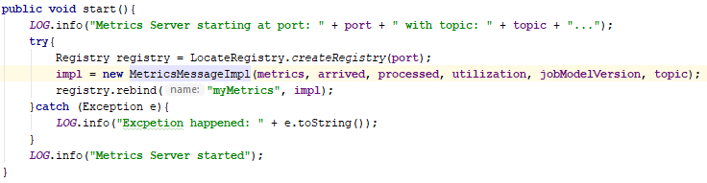
Retrieve Metrics
4. Retrieve Metrics. 1)Each container starts a MetricsRMIServer, expose container’s metrics to client

Slide 36
Retrieve Metrics
StreamSwitch
Dispatcher
Model
4. Retrieve Metrics. 2)StreamSwitch call Model’s retrieveMetrics() function.
Model call MetricsRetriever’s retrieveMetrics() function. MetricsRetriever then retrieve metrics from containers.
Metrics Retriever
RMIServer
MetricsRMIClient
Container Metrics
AM
LeaderJobCoordinator
Container 1
Container 2

Slide 37



Retrieve Metrics
4. Retrieve metrics
2) StreamSwitch call Model’s retrieveMetrics() function.
Model call MetricsRetriever’s retrieveMetrics() function. MetricsRetriever then retrieve metrics from containers.

Slide 38
Retrieve Metrics
StreamSwitch
Dispatcher
Model
4. Retrieve metrics
3) MetricsRetriever stores the container utilization, partition’s # of messages arrived, partition’s # of messages processed information.
Metrics Retriever
Metrics
MetricsRMIClient
Container Metrics
AM
LeaderJobCoordinator
Container 1
Container 2

Slide 39


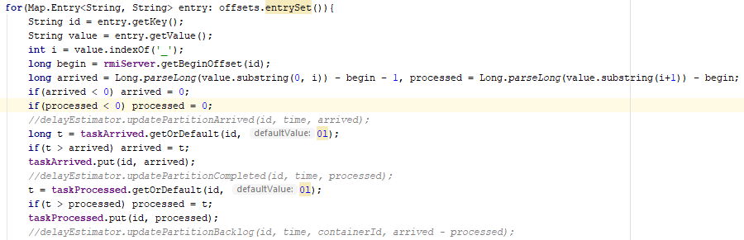
Retrieve Metrics
4. Retrieve metrics
3) MetricsRetriever stores the container utilization, partition’s # of messages arrived, partition’s # of messages processed information.

Slide 40
Update Model
StreamSwitch
Dispatcher
Model
5. Update DecisionModel with metrics
StreamSwitch calls Model’s updateModel().
1)Update DelayEstimator
Model gets PartitionArrived ,PartitionProcessed and ContainerUtilization from Metrics retriever, then uses them to update DelayEstimator
Metrics Retriever
Metrics
Metrics
DelayEstimator
MetricsRMIClient
5.1)
AM
LeaderJobCoordinator
Container 1
Container 2

Slide 41
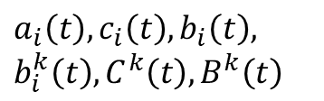
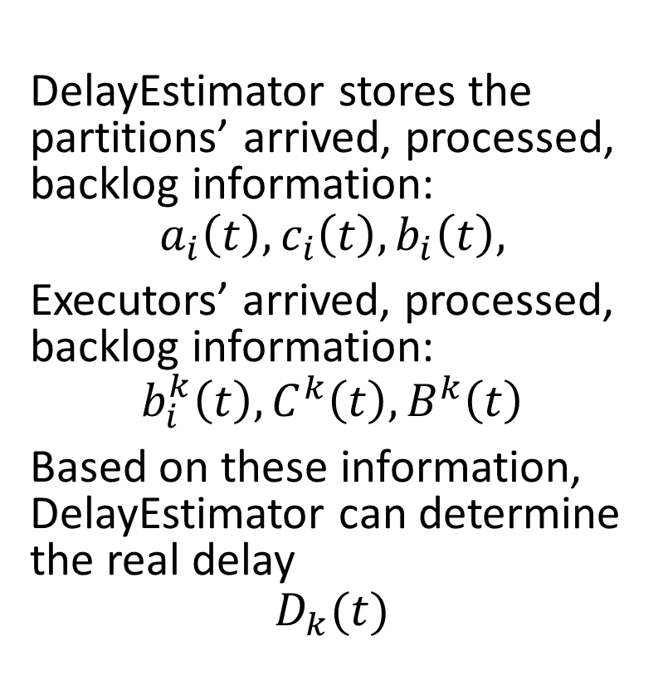



DelayEstimator
DelayEstimator
$a_{i}\left(t\right), c_{i}\left(t\right), b_{i}\left(t\right),$ $b_{i}^{k}\left(t\right), C^{k}\left(t\right), B^{k}\left(t\right)$
DelayEstimator stores the partitions’ arrived, processed, backlog information:
$$a_{i}\left(t\right), c_{i}\left(t\right), b_{i}\left(t\right),$$
Executors’ arrived, processed, backlog information:
$$b_{i}^{k}\left(t\right), C^{k}\left(t\right), B^{k}\left(t\right)$$
Based on these information, DelayEstimator can determine the real delay
$$D_{k}(t)$$
# of messages
$$a(t)$$
$$c(t)$$
$$b(t)$$
time(s)

Slide 42
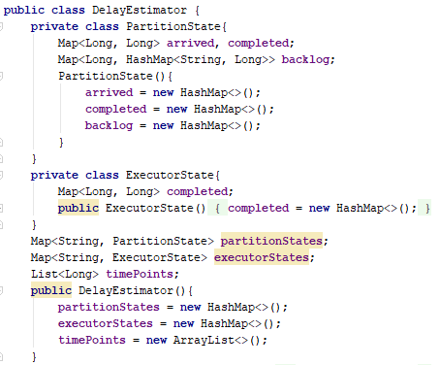
DelayEstimator
DelayEstimator stores the partitions’ arrived, processed, backlog information:
$$a_{i}\left(t\right), c_{i}\left(t\right), b_{i}\left(t\right),$$
Executors’ arrived, processed, backlog information:
$$b_{i}^{k}\left(t\right), C^{k}\left(t\right), B^{k}\left(t\right)$$
Based on these information, DelayEstimator can determine the real delay
$$D_{k}(t)$$

Slide 43
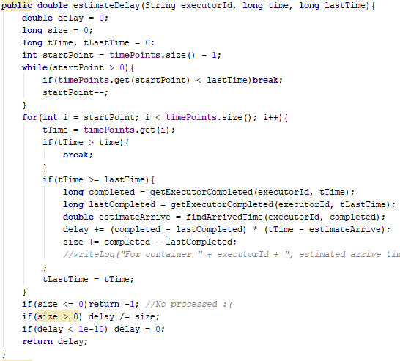
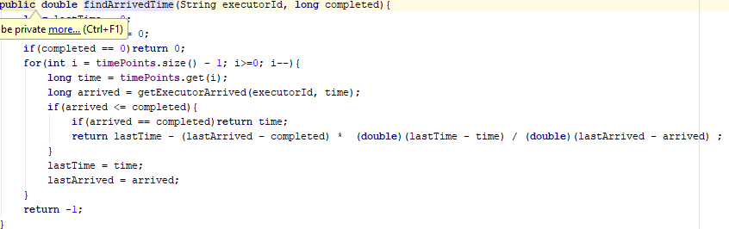
DelayEstimator
DelayEstimator stores the partitions’ arrived, processed, backlog information:
$$a_{i}\left(t\right), c_{i}\left(t\right), b_{i}\left(t\right),$$
Executors’ arrived, processed, backlog information:
$$b_{i}^{k}\left(t\right), C^{k}\left(t\right), B^{k}\left(t\right)$$
Based on these information, DelayEstimator can determine the real delay
$$D_{k}(t)$$

Slide 44

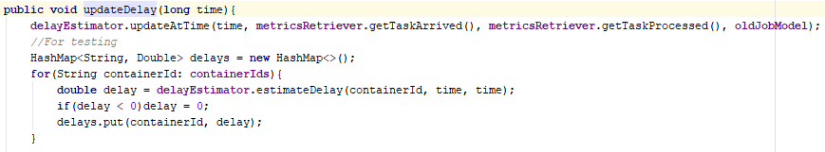
Update Model
5. Update DecisionModel with metrics
StreamSwitch calls Model’s updateModel().
1)Update DelayEstimator
Model gets PartitionArrived ,PartitionProcessed and ContainerUtilization from Metrics retriever, then uses them to update DelayEstimator

Slide 45
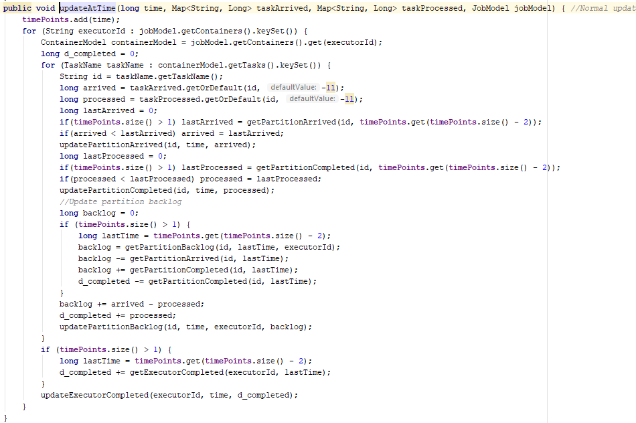
Update Model
5. Update DecisionModel with metrics
StreamSwitch calls Model’s updateModel().
1)Update DelayEstimator
Model gets PartitionArrived ,PartitionProcessed and ContainerUtilization from Metrics retriever, then uses them to update DelayEstimator

Slide 46
Update Model
StreamSwitch
Dispatcher
Model
5. Update DecisionModel with metrics
StreamSwitch calls Model’s updateModel().
2)Update ModelingData
Model updates ModelingData based on DelayEstimator’s information.
ModelingData
Metrics Retriever
5.2)
Metrics
DelayEstimator
MetricsRMIClient
AM
LeaderJobCoordinator
Container 1
Container 2

Slide 47
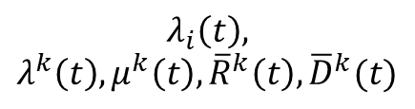
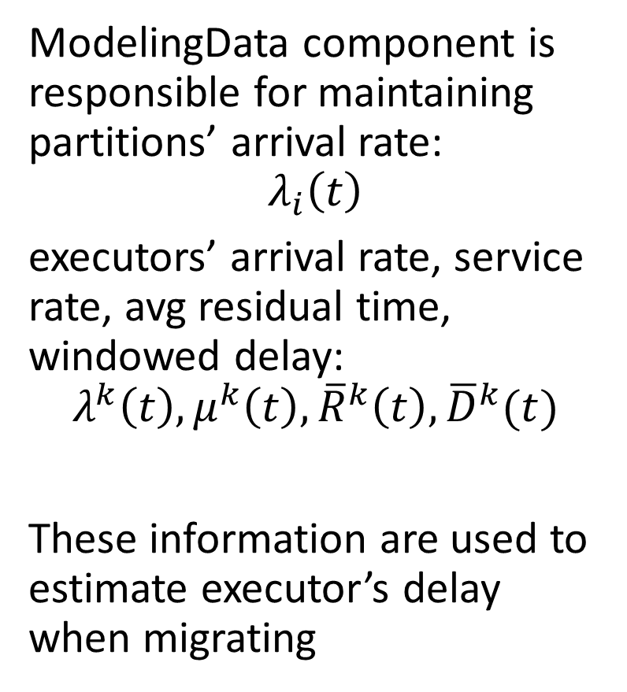
ModelingData
ModelingData component is responsible for maintaining partitions’ arrival rate:
$$λ_{i}\left(t\right)$$
executors’ arrival rate, service rate, avg residual time, windowed delay:
$$λ^{k}\left(t\right), μ^{k}\left(t\right), {\overline{R}}^{k}\left(t\right),{\overline{D}}^{k}(t)$$
These information are used to estimate executor’s delay when migrating
ModelingData
$$λ_{i}\left(t\right),$$
$$λ^{k}\left(t\right), μ^{k}\left(t\right), {\overline{R}}^{k}\left(t\right),{\overline{D}}^{k}(t)$$

Slide 48
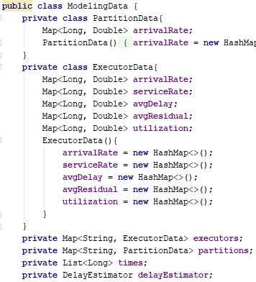
ModelingData
ModelingData component is responsible for maintaining partitions’ arrival rate:
$$λ_{i}\left(t\right)$$
executors’ arrival rate, service rate, avg residual time, windowed delay:
$$λ^{k}\left(t\right), μ^{k}\left(t\right), {\overline{R}}^{k}\left(t\right),{\overline{D}}^{k}(t)$$
These information are used to estimate executor’s delay when migrating

Slide 49
Structure Detail
5. Update DecisionModel with metrics
StreamSwitch calls Model’s updateModel().
2)Update ModelingData
Model updates ModelingData based on DelayEstimator’s information.

Slide 50
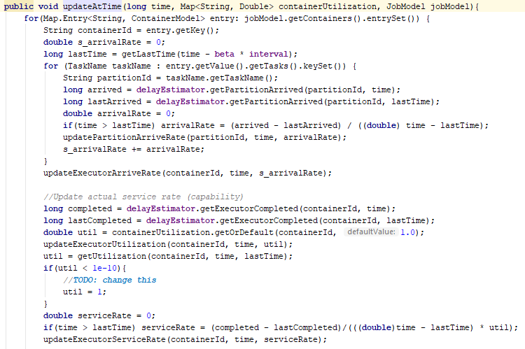
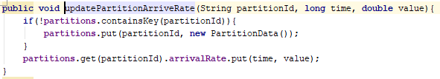
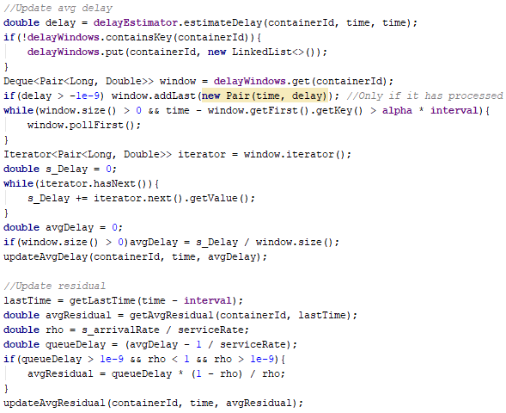
Update Model
5. Update DecisionModel with metrics
StreamSwitch calls Model’s updateModel().
2)Update ModelingData
Model updates ModelingData based on DelayEstimator’s information and container’s utilization.

Slide 51
Make Decision
StreamSwitch
6. Make rebalance or scaling decision and deploy
1) If the time interval after last rebalancing is longer than rebalancingInterval set by application, Model’s “tryToRebalance”.
Dispatcher
6.1)
Model
ModelingData
Metrics Retriever
Metrics
DelayEstimator
MetricsRMIClient
AM
LeaderJobCoordinator
Container 1
Container 2

Slide 52


Make Decision
6. Make rebalance or scaling decision and deploy
1) If the time interval after last rebalancing is longer than rebalancingInterval set by application, Model’s “tryToRebalance”.

Slide 53

Make Decision
6. Make rebalance or scaling decision and deploy
tryToRebalance()’s main logic is like this

Slide 54
Make Decision
6. Make rebalance or scaling decision and deploy
tryToRebalance()’s main logic is like this
2) Check whether any executor’s delay exceeds threshold.

Slide 55
Make Decision
6. Make rebalance or scaling decision and deploy
tryToRebalance()’s main logic is like this
3) If 2) exceeds threshold, try to rebalance the JobModel.

Slide 56
Make Decision
6. Make rebalance or scaling decision and deploy
tryToRebalance()’s main logic is like this
4) If 3) cannot find a way to rebalance, scale out by one container.

Slide 57
Make Decision
6. Make rebalance or scaling decision and deploy
tryToRebalance()’s main logic is like this
5) If 2) does not exceed threshold, try to scale in by one container.

Slide 58
Make Decision
Scheduler
Dispatcher
Model
6. Make rebalance or scaling decision and deploy
2) Check whether any executor’s delay exceeds threshold.
ModelingData
Metrics Retriever
6.2)
Metrics
DelayEstimator
MetricsRMIClient
AM
LeaderJobCoordinator
Container 1
Container 2

Slide 59

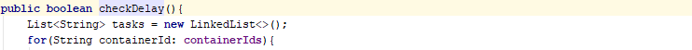

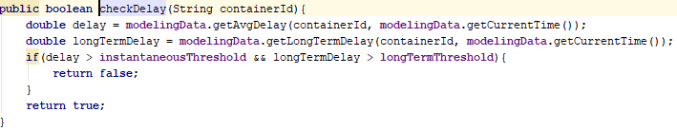
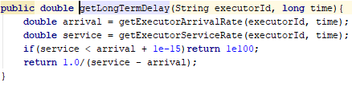
Make Decision
6. Make rebalance or scaling decision and deploy
2) Check whether any executor’s delay exceeds threshold.

Slide 60
Make Decision
StreamSwitch
6. Make rebalance or scaling decision and deploy
3) If 2) exceeds threshold, try to rebalance the JobModel.
Algorithm: Find the source executor which has maximal delay.
Find the target executor which makes ideal delay minimal.
Use DFS to check: is it possible to migrate some partitions from the source executor to target executor, and the estimated delay after migrating does not exceed threshold.
Algorithm is implemented in MigratingOnceBalancer.
Dispatcher
Model
ModelingData
Metrics Retriever
MigratingOnceBalancer
Metrics
DelayEstimator
MetricsRMIClient
AM
LeaderJobCoordinator
Container 1
Container 2

Slide 61
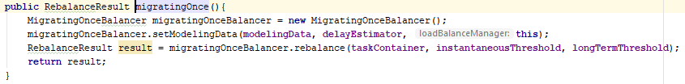

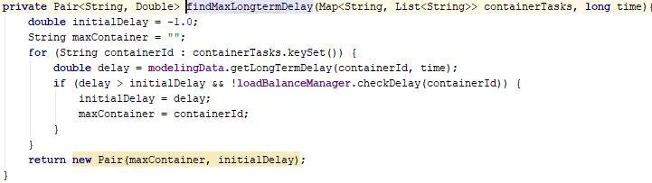
Make Decision
6. Make rebalance or scaling decision and deploy
3) If 2) exceeds threshold, try to rebalance the JobModel.
Algorithm: Find the source executor which has maximal delay.
Find the target executor which makes ideal delay minimal.
Use DFS to check: is it possible to migrate some partitions from the source executor to target executor, and the estimated delay after migrating does not exceed threshold.
Algorithm is implemented in MigratingOnceBalancer.

Slide 62
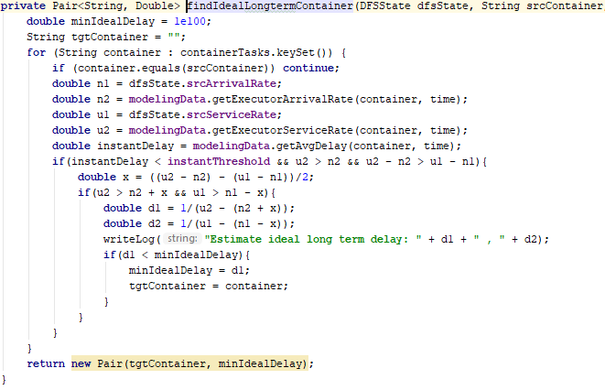
Make Decision
6. Make rebalance or scaling decision and deploy
3) If 2) exceeds threshold, try to rebalance the JobModel.
Algorithm: Find the source executor which has maximal delay.
Find the target executor which makes ideal delay minimal(by solving equation).
Use DFS to check: is it possible to migrate some partitions from the source executor to target executor, and the estimated delay after migrating does not exceed threshold.
Algorithm is implemented in MigratingOnceBalancer.

Slide 63
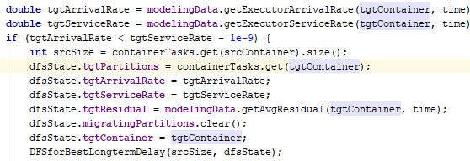
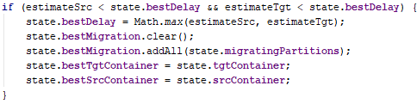

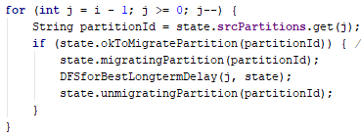
Make Decision
6. Make rebalance or scaling decision and deploy
3) If 2) exceeds threshold, try to rebalance the JobModel.
Algorithm: Find the source executor which has maximal delay.
Find the target executor which makes ideal delay minimal(by solving equation).
Use DFS to check: is it possible to migrate some partitions from the source executor to target executor, and the estimated delay after migrating does not exceed threshold.
Algorithm is implemented in MigratingOnceBalancer.

Slide 64
Make Decision
StreamSwitch
6. Make rebalance or scaling decision and deploy
4) If 3) cannot find a way to rebalance, scale out by one container.
Migrate half of maximal delay executor’s partitions to the scaled out executor.
Dispatcher
Model
ModelingData
Metrics Retriever
MigratingLargestScaler
Metrics
DelayEstimator
MetricsRMIClient
AM
LeaderJobCoordinator
Container 1
Container 2

Slide 65
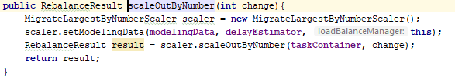

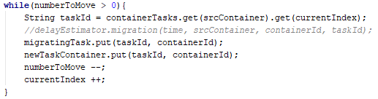
Make Decision
6. Make rebalance or scaling decision and deploy
4) If 3) cannot find a way to rebalance, scale out by one container.
Migrate half of maximal delay executor’s partitions to the scaled out executor.

Slide 66
Make Decision
Scheduler
6. Make rebalance or scaling decision and deploy
5) If 2) does not exceed threshold, try to scale in by one container.
Algorithm: enumerate through all pairs of executors,
check whether all partitions in one executor can be migrated to the other executor without exceeding delay threshold.
Dispatcher
Model
ModelingData
Metrics Retriever
MigratingLargestScaler
Metrics
DelayEstimator
MetricsRMIClient
AM
LeaderJobCoordinator
Container 1
Container 2

Slide 67

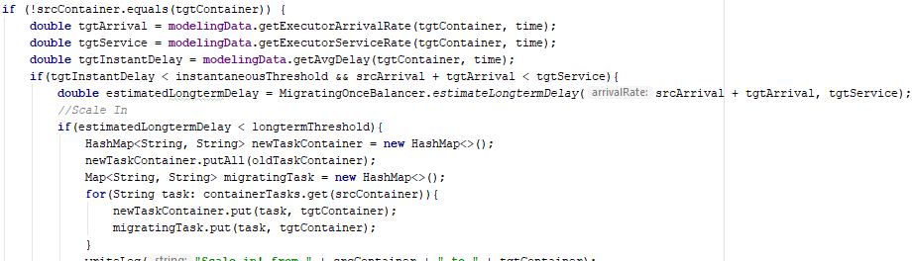

Make Decision
6. Make rebalance or scaling decision and deploy
5) If 2) does not exceed threshold, try to scale in by one container.
Algorithm: enumerate through all pairs of executors,
check whether all partitions in one executor can be migrated to the other executor without exceeding delay threshold.

Slide 68
Make Decision
StreamSwitch
6. Make rebalance or scaling decision and deploy
6) If 3) find a way to migrate/scale out/scale in, generate new JobModel according to the partition-executor mapping after migrating.
Deploy the new JobModel by Dispatcher using RMI
Dispatcher
MigratingLargestScaler
/MigratingOnceBalancer
Model
DMRMIClient
ModelingData
7.6)
JobModel
DelayEstimator
Metrics Retriever
7.6)
AM
LeaderJobCoordinator
Container 1
Container 2
DMListenerRMI

Slide 69

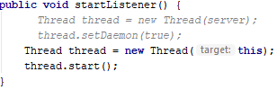
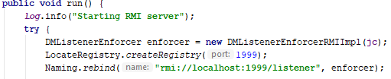
Make Decision
6. Make rebalance or scaling decision and deploy
YarnApplicationMaster will start a DMListenerRMI waiting for new JobModel

Slide 70



Make Decision
6. Make rebalance or scaling decision and deploy
6) If 3) find a way to, generate new JobModel according to the partition-executor mapping after migrating.
Send the new JobModel to LeaderJobCoordinator by Dispatcher using RMI
RMI, remote call

Slide 71


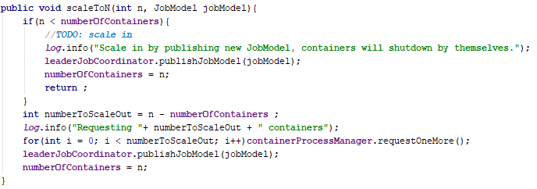
Make Decision
6. Make rebalance or scaling decision and deploy
6) If 4) or 5) find a way to scale out/scale in, generate new JobModel according to the partition-executor mapping after migrating.
Deploy the new JobModel by Dispatcher using RMI

Slide 72
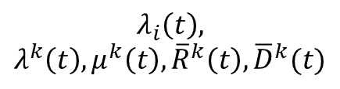
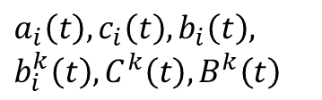
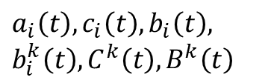
Decision Making Model
Raw metrics (partition arrived, processed, executor utilization)
Decision Making Model
The decision making model has two part:
Data pre-processing
Transform the metrics to the data which the model needs.
Check P13-P17 of this slides for detailed introduction
DelayEstimator
$a_{i}\left(t\right), c_{i}\left(t\right), b_{i}\left(t\right),$ $b_{i}^{k}\left(t\right), C^{k}\left(t\right), B^{k}\left(t\right)$
$a_{i}\left(t\right), c_{i}\left(t\right), b_{i}\left(t\right),$ $b_{i}^{k}\left(t\right), C^{k}\left(t\right), B^{k}\left(t\right)$
ModelingData
$$λ_{i}\left(t\right),$$
$$λ^{k}\left(t\right), μ^{k}\left(t\right), {\overline{R}}^{k}\left(t\right),{\overline{D}}^{k}(t)$$

Slide 73
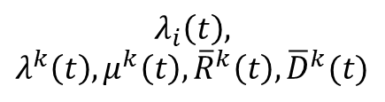
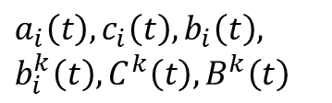
Decision Making Model
Decision Making Model
The decision making model has two part:
2) Decision making
When scheduler call the model to make a decision
Check P13-P17 of this slides for detailed introduction
DelayEstimator
ModelingData
$a_{i}\left(t\right), c_{i}\left(t\right), b_{i}\left(t\right),$ $b_{i}^{k}\left(t\right), C^{k}\left(t\right), B^{k}\left(t\right)$
$$λ_{i}\left(t\right),$$
$$λ^{k}\left(t\right), μ^{k}\left(t\right), {\overline{R}}^{k}\left(t\right),{\overline{D}}^{k}(t)$$
Rebalancer
Scaler
Find minimal delay scaling out
Find possible scaling in
Find minimal delay migrating

Slide 74
Decision Making Model
Scheduler ask for a decision
At least one container violate instantaneous and long-term delay constraints at the same time
No
Yes
Try to rebalance
Try to scale in
Migrating partitions from the executor with largest long-term delay.
Find the target executor and migrating partitions set with minimal estimated long-term delay.
Enumerate through all pairs of executors:
1)If the target executor’s instantaneous delay is smaller than threshold
2)And long-term delay after migrating all partitions from source executor to target executor is smaller than threshold
Then scale in the source executor and stop the enumeration
Yes
Still violate long-term delay constraint
No
Yes
Possible to scale in?
No
Scaling out
Scaling out by one executor. Migrating half of largest delay executor’s partitions to the new executor.
Migrating/Scaling decision is made. Return new assignment to Scheduler.
Tell scheduler, no decision is made

Slide 75
Structure Detail
Scheduler
Runloop
Leader’s host address
“retrieve metrics”
2. Scheduler runloop
2) Retrieve metrics
Besides the Arrived, Processed, Utilization information, MetricsRetriever also retrieves containers’ JobModel version number information.
Model
“retrieve metrics”
MetricsRetriever
MetricsRetriever
Partition
Processed
PartitionArrived
PartitioProcessed
JobModel
Version
Container
Utilization
Partition
Arrived
JobModel Version
Container
Container

Slide 76
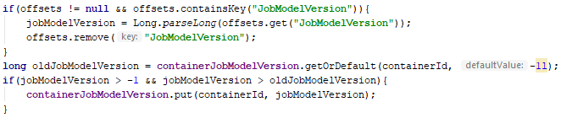
Structure Detail
2. Scheduler runloop
2) Retrieve metrics
Besides the Arrived, Processed, Utilization information, MetricsRetriever also retrieves containers’ JobModel version number information.

Slide 77
Structure Detail
Scheduler
Runloop
Leader’s host address
“retrieve metrics”
2. Scheduler runloop
2) Retrieve metrics
If JobModel version number changes, it means the new JobModel (generated by last migration) actually deploy on containers.
Then Model can confirm the newJobModel, and call DelayEstimator’s migrate() method to modify the data correspondingly.
Model
DelayEstimator
migrate()
“deployed: true”
MetricsRetriever
MetricsRetriever
Partition
Processed
PartitionArrived
PartitioProcessed
JobModel
Version
Container
Utilization
Partition
Arrived
JobModel Version
Container
Container

Slide 78
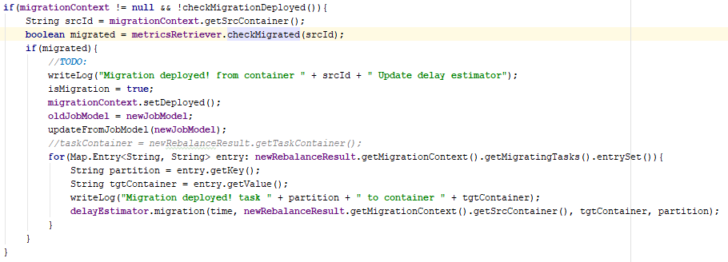

Structure Detail
2. Scheduler runloop
2) Retrieve metrics
If JobModel version number changes, it means the new JobModel (generated by last migration) actually deploy on containers.
Then Model can confirm the newJobModel, and call DelayEstimator’s migrate() method to modify the data correspondingly.

