Slide 1
Samza Modification

Slide 2
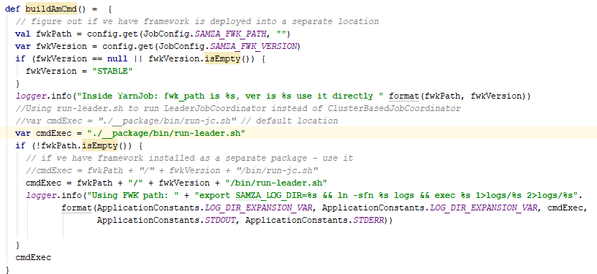
YarnJob.scala
buildAmCmd() changed, so that the run-leader.sh script will be run in AM container

Slide 3
run-leader.sh
Run ClusterBasedApplicationMaster

Slide 4
ClusterBasedApplicationMaster
1.
run-leader.sh
ClusterBasedApplicationMaster
1. In AM container, the run-leader.sh script will be run and the ClusterBasedApplicationMaster will be started.
(Same things in ClusterBasedJobCoordinator)
2.
2. Start all old components: JobModelManager, ContainerProcessManager, etc.
3.
LeaderJobCoordinator
newJobModel
currentProcessors
3. Start LeaderJobCoordinator. LeaderJobCoordinator will publish JobModel to ZooKeeper server for all StreamProcessors to read.
ZkUtils
ShellCommandConfig.scala file has been modify so that AbstractContainerAllocator will run run-follower.sh instead of run-container.sh when containers start.
LeaderFollowerControllerImpl

Slide 6
LeaderJobCoordinator
3. Start LeaderJobCoordinator
Use ZkUtils and LeaderFollowerControllerImpl to register with ZooKeeper server.
LeaderFollowerControllerImpl will subscribe to change of online processors. If the list of online processors changes, the ZooKeeper server will inform LeaderJobCoordinator through callback method (onProcessorsChange)
LeaderJobCoordinator will publish the newJobModel to ZooKeeper server when the number of processors are equal to the number of containers in the newJobModel.
LeaderJobCoordinator will also start a Barrier in ZooKeeper server, which will wait until all StreamProcessors knows the newJobModel.
AM can set the newJobModel to be published in LeaderJobCoordinator
5)
LeaderJobCoordinator
newJobModel
currentProcessors
ZkUtils
FollowerControllerImpl
1)
2)
3)
4)
ZooKeeper Server
Processors
JobModel
Barrier

Slide 7
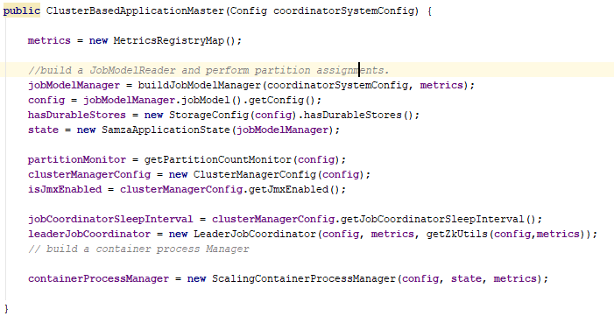

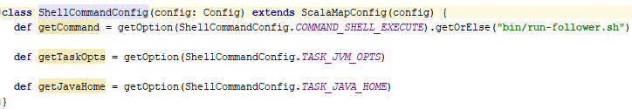
ClusterBasedApplicationMaster
1. In AM container, the run-leader.sh script will be run and the ClusterBasedApplicationMaster will be started.
2. Start all old components: LeaderJobCoordinator, ContainerProcessManager, etc.
3. Start LeaderJobCoordinator. LeaderJobCoordinator will publish JobModel to ZooKeeper server for all StreamProcessors to read.
ShellCommandConfig.scala file has been modify so that LeaderJobCoordinator will run run-follower.sh instead of run-container.sh when containers start.

Slide 8
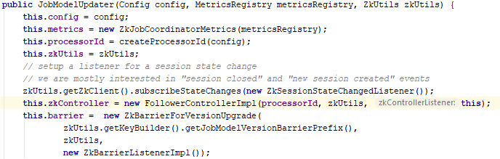
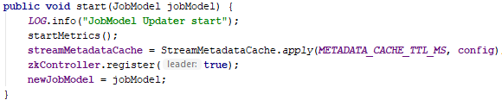
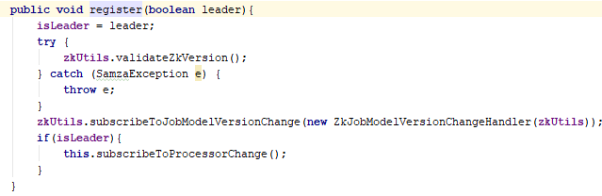
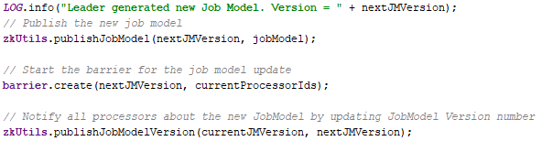

LeaderJobCoordinator
3. Start LeaderJobCoordinator
Use ZkUtils and LeaderFollowerControllerImpl to register with ZooKeeper server.
LeaderFollowerControllerImpl will subscribe to change of online processors. If the list of online processors changes, the ZooKeeper server will inform LeaderJobCoordinator through callback method (onProcessorsChange)
LeaderJobCoordinator will publish the newJobModel to ZooKeeper server when the number of processors are equal to the number of containers in the newJobModel.
JobModelUpdater will also start a Barrier in ZooKeeper server, which will wait until all StreamProcessors knows the newJobModel.
ClusterBasedApplicationMaster can set the newJobModel to be published in JobModelUpdater

Slide 9
StreamProcessor
1.
run-follower.sh
1. In each container, run-follower.sh script will be run.
2. FollowerStreamProcessorRunner will be started by run-follower.sh script. It will read job-config from JobModelManager server and run the StreamProcessor.
The FollowerStreamProcessorLifeCycleListener is the callback function that will be called when StreamProcessor’s running status changing. In our current implementation, it will never be called.
2.
FollowerStreamProcessorRunner
FollowerStreamProcessorLifeCycleListener
StreamProcessor
3.
FollowerJobCoordinator
3. StreamProcessor will start FollowerJobCoordinator. FollowerJobCoordinator will register with ZooKeeper server and watch for JobModel changes.
ZkUtils
FollowerControllerImpl
4.
JobCoordinatorListener
4. JobCoordinatorListener is the callback function that will be called by FollowerJobCoordinator when JobModel changes. It will set up and run the new SamzaContainer when FollowerJobCoordinator call onNewJobModel() method.
SamzaContainer

Slide 10
FollowerJobCoordinator
StreamProcessor
3)
4)
3. Start FollowerJobCoordinator.
JobCoordinatorListener
1) Use ZkUtils and FollowerControllerImpl to register with ZooKeeper server.
FollowerJobCoordinator
ZkUtils
2) FollowerControllerImpl will subscribe to JobModel changes. If the JobModel in ZooKeeper server changed (by LeaderJobCoordinator, step 3) ), FollowerControllerImpl will be notified.
3) It then calls onNewJobModelAvailable() method in FollowerJobCoordinator, which will stop current SamzaContainer through JobCoordinatorListener’s onJobModelExpired() method and update the Barrier in ZooKeeper server.
4) When the Barrier is done(all StreamProcessors are notified), it will call the onNewJobModelConfirmed() method through ZkBarrierListenerImpl. This method will start a new SamzaContainer through JobCoordinatorListener’s onNewJobModel() method.
FollowerControllerImpl
1)
2)
3)
4)
ZooKeeper Server
Processors
JobModel
Barrier

Slide 11
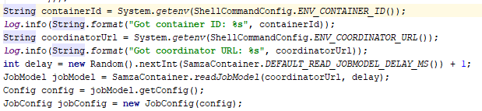
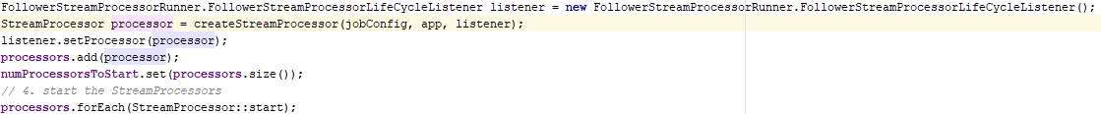
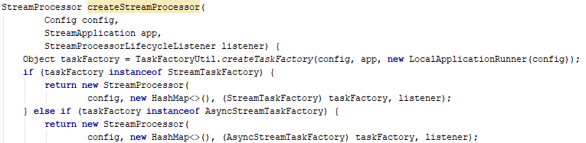
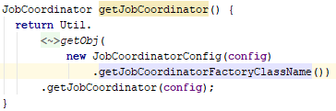
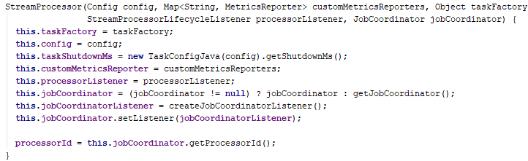

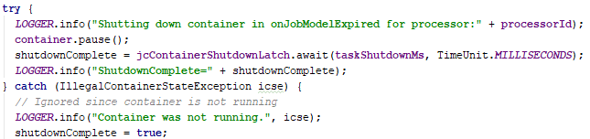
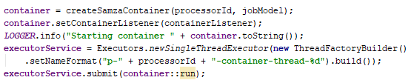
StreamProcessor
1. In each container, run-follower.sh script will be run.
2. FollowerStreamProcessorRunner will be started by run-follower.sh script. It will read job-config from JobModelManager server and run the StreamProcessor.
The FollowerStreamProcessorLifeCycleListener is the callback function that will be called when StreamProcessor’s running status changing. In our current implementation, it will never be called.
3. StreamProcessor will start FollowerJobCoordinator. FollowerJobCoordinator will register with ZooKeeper server and watch for JobModel changes.
4. JobCoordinatorListener is the callback function that will be called by FollowerJobCoordinator when JobModel changes. It will set up and run the new SamzaContainer when FollowerJobCoordinator call onNewJobModel() method.

Slide 12
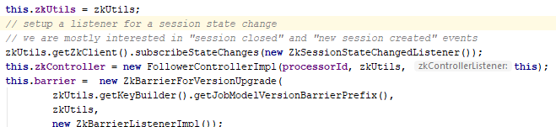
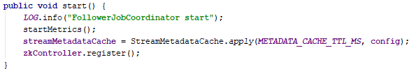
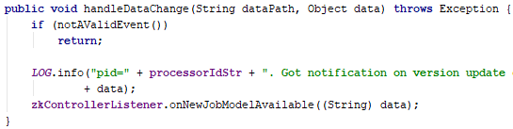
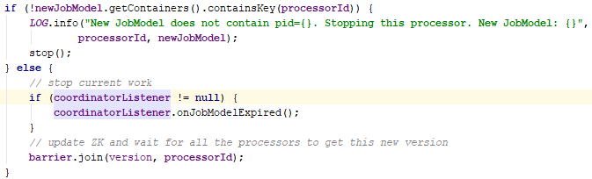
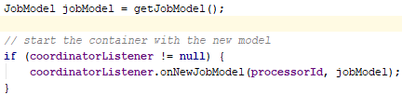
FollowerJobCoordinator
3. Start FollowerJobCoordinator.
1) Use ZkUtils and FollowerControllerImpl to register with ZooKeeper server.
2) FollowerControllerImpl will subscribe to JobModel changes. If the JobModel in ZooKeeper server changed (by LeaderJobCoordinator, step 3) ), FollowerControllerImpl will be notified.
3) It then calls onNewJobModelAvailable() method in FollowerJobCoordinator, which will stop current SamzaContainer through JobCoordinatorListener’s onJobModelExpired() method and update the Barrier in ZooKeeper server.
4) When the Barrier is done(all StreamProcessors are notified), it will call the onNewJobModelConfirmed() method through ZkBarrierListenerImpl. This method will start a new SamzaContainer through JobCoordinatorListener’s onNewJobModel() method.

