Slide 1
Samza Modification

Slide 2
Original Design

Slide 3
Run with StreamProcessors
Use WikipediaApplication as example:
1. Run application with run-wikipedia-zk-application.sh script
1.
run-wikipedia-zk-application.sh
WikipediaZkLocalApplication
2. Script run main() in WikipediaZkLocalApplication
3.
WikipediaApplication
3. WikipediaZkLocalApplication create a LocalApplicationRunner instance and a WikipediaApplication instance.
hello-samza
4.
3.
LocalApplicationRunner
Samza
4. WikipediaZkLocalApplication use LocalApplicationRunner to run the application

Slide 4
LocalApplicationRunner
In LocalApplicationRunner:
StreamApplication
1.
1. Like RemoteApplicationRunner, generates JobGraph from StreamApplication
LocalApplicationRunner
JobGraph
2. For each JobNode in the JobGraph, create a StreamProcessor with the JobNode’s JobConfig
JobConfig
2.
3. Start all StreamProcessors
3.
StreamProcessors

Slide 5
StreamProcessor
StreamApplication
1. StreamProcessor start the JobCoordinator and JobCoordinatorListener
StreamProcessor
1.
JobCoordinatorListener
2. When JobCoordinator get new JobModel, it will call JobCoordinatorListener’s OnNewJobModel method.
New JobModel
New JobModel
2.
3. JobCoordinatorListener will first shutdown the old SamzaContainer(if exists), and then start a new SamzaContainer with the new JobModel.
3.
New JobModel
JobCoordinator
ZkJobCoordinator in other place
1.
SamzaContainer
ZkJobCoordinator
2.
4. JobCoordinatorListener runs the new SamzaContainer on a new thread

Slide 7
Modification

Slide 8
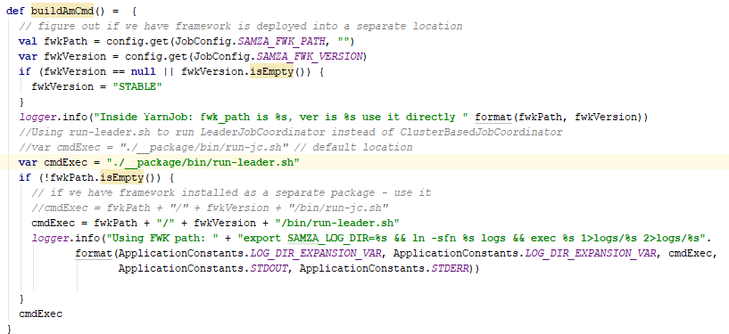
YarnJob.scala
buildAmCmd() changed, so that the run-leader.sh script will be run in AM container

Slide 9
run-leader.sh
Run ClusterBasedApplicationMaster

Slide 10


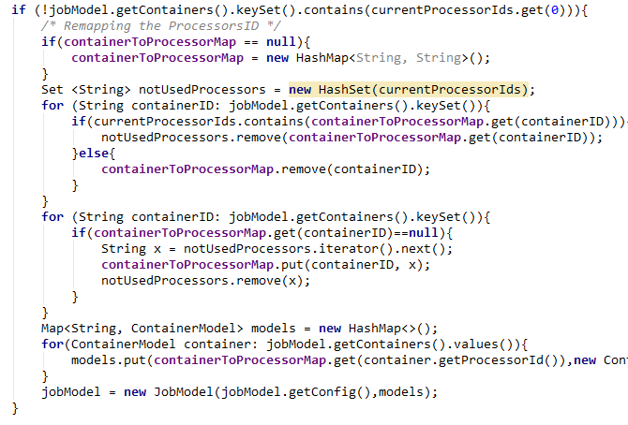
LeaderJobCoordinator
LeaderJobCoordinator implements JobCoordinator interface and ZkControllerListener interface
We use LeaderFollowerControllerImpl as the API to register with ZooKeeper
In LeaderJobCoordinator, we store the list of current processors. Because the doOnProcessorChange() method need the list of processors as parameter to publish JobModel to ZooKeeper.
The JobModel passed to LeaderJobCoordinator may not contain correct StreamProcessorId. This is because the ClusterBasedApplicationMaster which generates JobModel does not know the StreamProcessorId information. So it has to be a mapping from containerId to StreamProcessorId on JobModel before publishing
The containerToProcessorMap maintains the previous mapping from containerId to StreamProcessorId. So that the same container will be mapping to the same StreamProcessor next time and thus save migration time

Slide 11

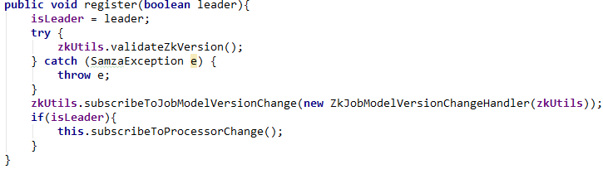
LeaderFollowerIControllerImpl
The LeaderFollowerControllerImpl is almost the same as ZkControllerImpl
Since we already have a fixed leader, so we replace the ZkLeaderElector with a indicating boolean variable isLeader. And we have a special register() method just for leader, so that its isLeader variable will be set to be true
Logic from ZkControllerImpl

Slide 12
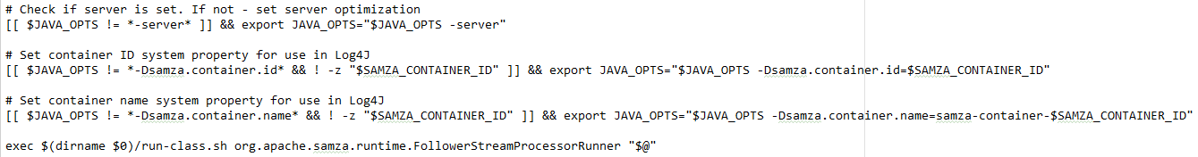
run-follower.sh
In each container, the run-follower.sh script will be called. It will start FollowerStreamProcessorRunner

Slide 13
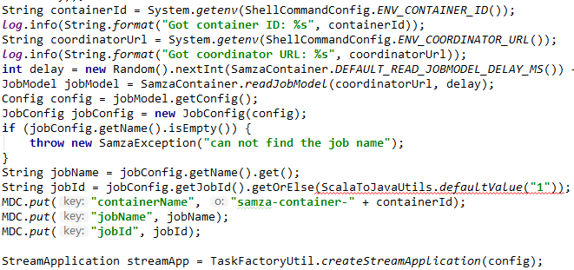
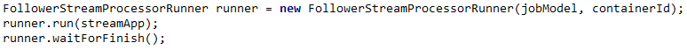
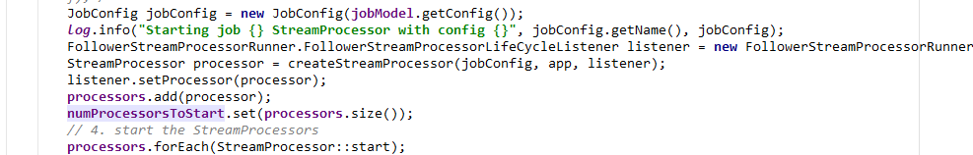
FollowerStreamProcessorRunner
Uthe logic from LocalContainerRunner to read JobModel and config from JobModelManager url and build the StreamApplication
Use the logic from WikipediaZkLocalApplication to start FollowerStreamProcessorRunner
Compare to LocalApplicationRunner, we remove the logic of generating JobGraph and JobConfig since we already have the them in the JobModel
Logic from LocalContainerRunner
Logic from WikipediaZkLocalApplication
The FollowerStreamProcessorListener does nothing for now
Logic from LocalApplicationRunner

Slide 14
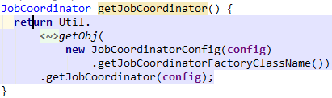
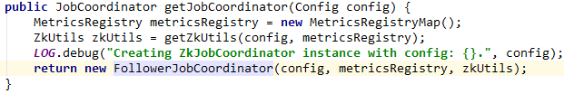
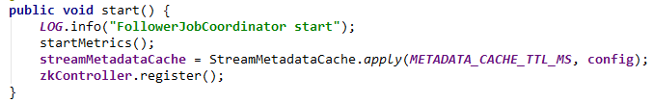

FollowerJobCoordinator
In StreamProcessor, it will choose JobCoordinatorFactory according to config
FollowerJobCoordinatorFactory is almost the same as ZkJobCoordinatorFactory. But it generate FollowerJobCoordinator instead of ZkJobCoordinator
Logic from ZkJobCoordinatorFactory
FollowerJobCoordinator is almost the same as the ZkJobCoordinator. But it does not have LeaderElector and use LeaderFollowerControllerImpl instead of ZkControllerImpl. When registering with LeaderFollowerControllerImpl, FollowerJobCoordinator’s isLeader value will always be false and therefore the onProcessorsChange() method will never be called.
Logic from ZkJobCoordinator
Logic from ZkControllerImpl

Slide 15
ClusterBasedApplicationMaster
1.
run-leader.sh
ClusterBasedApplicationMaster
1. In AM container, the run-leader.sh script will be run and the ClusterBasedApplicationMaster will be started.
(Same things in ClusterBasedJobCoordinator)
2.
2. Start all old components: JobModelManager, ContainerProcessManager, etc.
3.
LeaderJobCoordinator
newJobModel
currentProcessors
3. Start LeaderJobCoordinator. LeaderJobCoordinator will publish JobModel to ZooKeeper server for all StreamProcessors to read.
containerToProcessorMap
ZkUtils
ShellCommandConfig.scala file has been modify so that AbstractContainerAllocator will run run-follower.sh instead of run-container.sh when containers start.
LeaderFollowerControllerImpl

Slide 16
LeaderJobCoordinator
3. Start LeaderJobCoordinator
Use ZkUtils and LeaderFollowerControllerImpl to register with ZooKeeper server.
LeaderFollowerControllerImpl will subscribe to change of online processors. If the list of online processors changes, the ZooKeeper server will inform LeaderJobCoordinator through callback method (onProcessorsChange)
LeaderJobCoordinator will publish the newJobModel to ZooKeeper server when the number of processors are equal to the number of containers in the newJobModel.
LeaderJobCoordinator will also start a Barrier in ZooKeeper server, which will wait until all StreamProcessors knows the newJobModel.
AM can set the newJobModel to be published in LeaderJobCoordinator
5)
LeaderJobCoordinator
newJobModel
currentProcessors
containerToProcessorMap
ZkUtils
FollowerControllerImpl
1)
2)
3)
4)
ZooKeeper Server
Processors
JobModel
Barrier

Slide 17
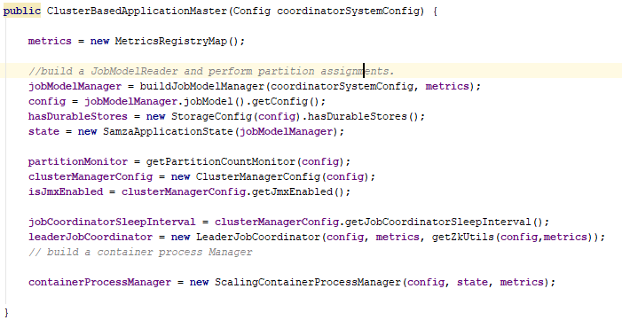

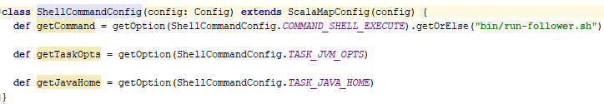
ClusterBasedApplicationMaster
1. In AM container, the run-leader.sh script will be run and the ClusterBasedApplicationMaster will be started.
2. Start all old components: LeaderJobCoordinator, ContainerProcessManager, etc.
3. Start LeaderJobCoordinator. LeaderJobCoordinator will publish JobModel to ZooKeeper server for all StreamProcessors to read.
ShellCommandConfig.scala file has been modify so that LeaderJobCoordinator will run run-follower.sh instead of run-container.sh when containers start.

Slide 18
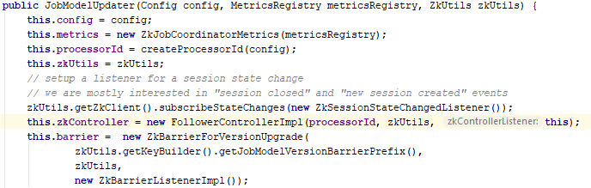
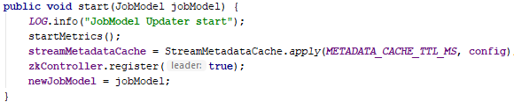
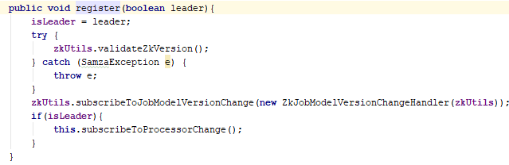
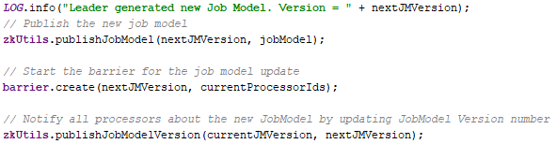

LeaderJobCoordinator
3. Start LeaderJobCoordinator
Use ZkUtils and LeaderFollowerControllerImpl to register with ZooKeeper server.
LeaderFollowerControllerImpl will subscribe to change of online processors. If the list of online processors changes, the ZooKeeper server will inform LeaderJobCoordinator through callback method (onProcessorsChange)
LeaderJobCoordinator will publish the newJobModel to ZooKeeper server when the number of processors are equal to the number of containers in the newJobModel.
JobModelUpdater will also start a Barrier in ZooKeeper server, which will wait until all StreamProcessors knows the newJobModel.
ClusterBasedApplicationMaster can set the newJobModel to be published in JobModelUpdater

Slide 19
StreamProcessor
1.
run-follower.sh
1. In each container, run-follower.sh script will be run.
2. FollowerStreamProcessorRunner will be started by run-follower.sh script. It will read job-config from JobModelManager server and run the StreamProcessor.
The FollowerStreamProcessorLifeCycleListener is the callback function that will be called when StreamProcessor’s running status changing. In our current implementation, it will never be called.
2.
FollowerStreamProcessorRunner
FollowerStreamProcessorLifeCycleListener
StreamProcessor
3.
FollowerJobCoordinator
3. StreamProcessor will start FollowerJobCoordinator. FollowerJobCoordinator will register with ZooKeeper server and watch for JobModel changes.
ZkUtils
FollowerControllerImpl
4.
JobCoordinatorListener
4. JobCoordinatorListener is the callback function that will be called by FollowerJobCoordinator when JobModel changes. It will set up and run the new SamzaContainer when FollowerJobCoordinator call onNewJobModel() method.
SamzaContainer

Slide 20
FollowerJobCoordinator
StreamProcessor
3)
4)
3. Start FollowerJobCoordinator.
JobCoordinatorListener
1) Use ZkUtils and FollowerControllerImpl to register with ZooKeeper server.
FollowerJobCoordinator
ZkUtils
2) FollowerControllerImpl will subscribe to JobModel changes. If the JobModel in ZooKeeper server changed (by LeaderJobCoordinator, step 3) ), FollowerControllerImpl will be notified.
3) It then calls onNewJobModelAvailable() method in FollowerJobCoordinator, which will stop current SamzaContainer through JobCoordinatorListener’s onJobModelExpired() method and update the Barrier in ZooKeeper server.
4) When the Barrier is done(all StreamProcessors are notified), it will call the onNewJobModelConfirmed() method through ZkBarrierListenerImpl. This method will start a new SamzaContainer through JobCoordinatorListener’s onNewJobModel() method.
FollowerControllerImpl
1)
2)
3)
4)
ZooKeeper Server
Processors
JobModel
Barrier

Slide 21
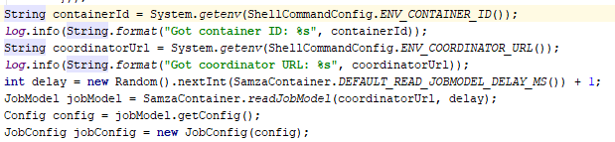
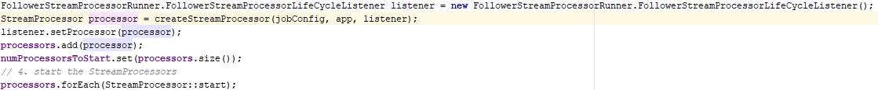
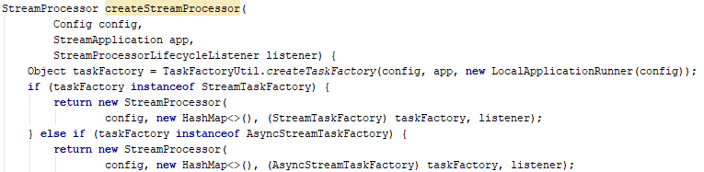
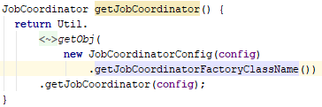
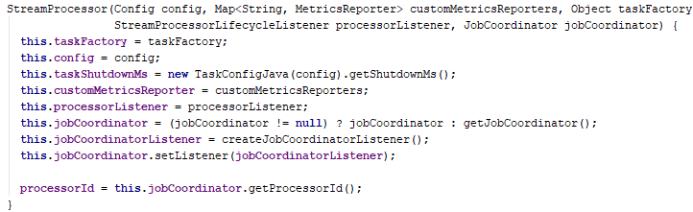

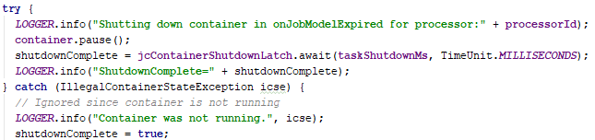
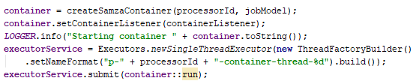
StreamProcessor
1. In each container, run-follower.sh script will be run.
2. FollowerStreamProcessorRunner will be started by run-follower.sh script. It will read job-config from JobModelManager server and run the StreamProcessor.
The FollowerStreamProcessorLifeCycleListener is the callback function that will be called when StreamProcessor’s running status changing. In our current implementation, it will never be called.
3. StreamProcessor will start FollowerJobCoordinator. FollowerJobCoordinator will register with ZooKeeper server and watch for JobModel changes.
4. JobCoordinatorListener is the callback function that will be called by FollowerJobCoordinator when JobModel changes. It will set up and run the new SamzaContainer when FollowerJobCoordinator call onNewJobModel() method.

Slide 22
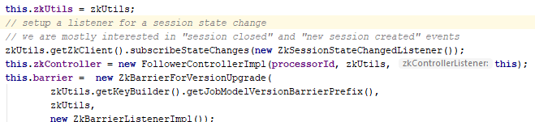
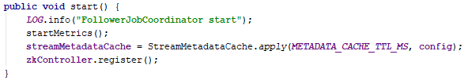
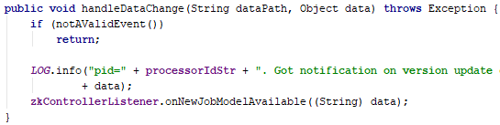
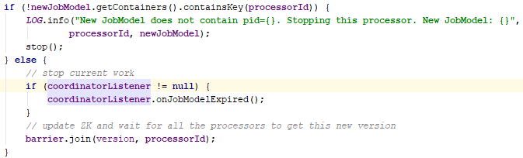
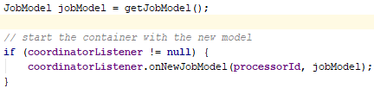
FollowerJobCoordinator
3. Start FollowerJobCoordinator.
1) Use ZkUtils and FollowerControllerImpl to register with ZooKeeper server.
2) FollowerControllerImpl will subscribe to JobModel changes. If the JobModel in ZooKeeper server changed (by LeaderJobCoordinator, step 3) ), FollowerControllerImpl will be notified.
3) It then calls onNewJobModelAvailable() method in FollowerJobCoordinator, which will stop current SamzaContainer through JobCoordinatorListener’s onJobModelExpired() method and update the Barrier in ZooKeeper server.
4) When the Barrier is done(all StreamProcessors are notified), it will call the onNewJobModelConfirmed() method through ZkBarrierListenerImpl. This method will start a new SamzaContainer through JobCoordinatorListener’s onNewJobModel() method.

