Slide 2
Some pages in this slides are deprecated (marked with red ‘deprecated’ in the up-left corner). There could be some mistakes or omissions in the deprecated pages.
There are new pages in other place of this slides which can replace the deprecated pages. (But I just want to keep the track of my thoughts so I left them undeleted)

Slide 3
Index
YARN
Concepts
Deployment
Architecture
Application Example
Detail
Run a application
Run a job (Run application actually use the same JobRunner)

Slide 4
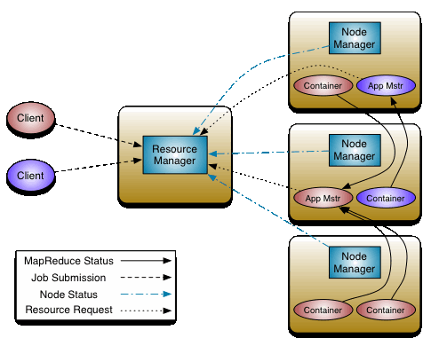
YARN
The fundamental idea of YARN is to split up the functionalities of resource management and job scheduling/monitoring into separate daemons. The idea is to have a global ResourceManager (RM) and per-application ApplicationMaster (AM). An application is either a single job or a DAG of jobs.
http://hadoop.apache.org/docs/current/hadoop-yarn/hadoop-yarn-site/YARN.html

Slide 5
YARN
ResourceManager (RM)
Schedule and arbitrating all resources among all applications.
Two main components: Scheduler and Application Manager(not Application Master).
ApplicationMaster (AM)
A instance of framework-specific library.
Every application has its own instance of an AM (AM code write by users).
Responsible for negotiating resources from RM and working with NodeManagers to execute and monitor the containers and resources consumption.

Slide 6
YARN
NodeManager (NM)
Per-machine agent to monitor containers and report to RM
ResourceRequest and Container
An application can make specific ResourceRequests to RM
A ResourceRequest contains resource-name(host name, rack name), priority(intra-application), memory and CPU requirements, number of such containers required.
Container is the resource allocation, which is the successful result of RM granting a specific ResourceRequest. A Container grants an application to use a specific amount of resources on a specific host.
AM needs to present the Container to the NM managing the host which the Container was allocated, to use the resources and launch its tasks.

Slide 7
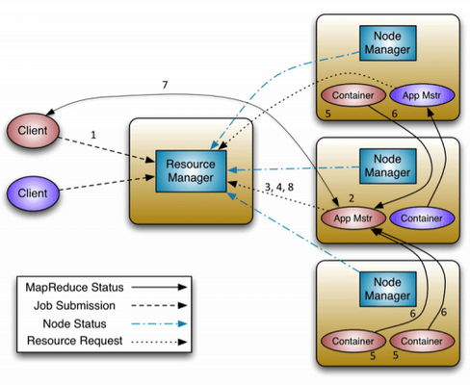
YARN
A client program submits the application, including the necessary specifications to launch the application-specific ApplicationMaster itself.
The ResourceManager assumes the responsibility to negotiate a specified container in which to start the ApplicationMaster and then launches the ApplicationMaster.
The ApplicationMaster, on boot-up, registers with the ResourceManager – the registration allows the client program to query the ResourceManager for details, which allow it to directly communicate with its own ApplicationMaster.
During normal operation the ApplicationMaster negotiates appropriate resource containers via the resource-request protocol.
On successful container allocations, the ApplicationMaster launches the container by providing the container launch specification to the NodeManager. The launch specification, typically, includes the necessary information to allow the container to communicate with the ApplicationMaster itself.
The application code executing within the container then provides necessary information (progress, status etc.) to its ApplicationMaster via an application-specific protocol.
During the application execution, the client that submitted the program communicates directly with the ApplicationMaster to get status, progress updates etc. via an application-specific protocol.
Once the application is complete, and all necessary work has been finished, the ApplicationMaster deregisters with the ResourceManager and shuts down, allowing its own container to be repurposed.
https://hortonworks.com/blog/apache-hadoop-yarn-concepts-and-applications/

Slide 8
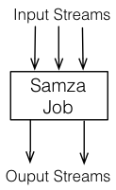
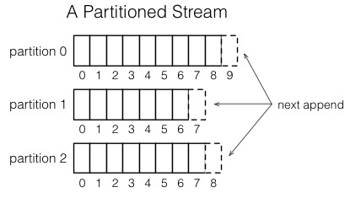
Concepts
https://samza.apache.org/learn/documentation/0.14/introduction/concepts.html
PS: Some of documents are deprecated in the official websites
Streams
A stream is composed of immutable messages (example: all the clicks on a website)
A stream can have any number of consumers. Reading messages doesn’t delete them.
Samza supports pluggable system which implements the Streams: Kafka
Jobs
A job is code that performs logical transformation on input streams and append these messages to output streams
Partitions
This definition is coming from Kafka.
Each stream is broken into one or more partitions.
Each partition is a totally ordered sequence of messages.
Each message in a partition has a identifier called offset.
Each message is only appended to one partition.
The assignment of messages is done with a key chosen by writer.

Slide 9
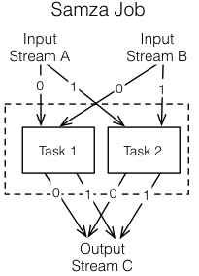
Concepts
Tasks
A job is scaled by breaking into multiple tasks. Task is the unit of parallelism of the job.
Each task consumes messages from one partition of each input stream.
A task processes messages in the order of message offset. But there is no defined ordering across partitions.
Number of tasks in a job is determined by the number of input partitions. There cannot be more tasks than input partitions or there will be some tasks have no input.
The assignment of partitions to tasks never changes.

Slide 10
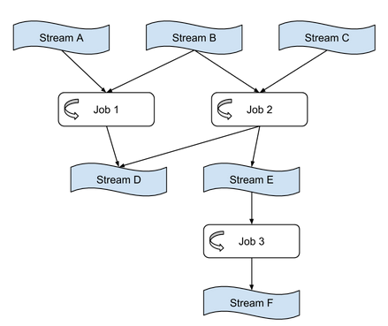
Concepts
Dataflow Graphs
Compose mutiple jobs to a dataflow graphs
Edges are stream, nodes are jobs.
Graphs are often acyclic, but it is possible to create cyclic graphs.
The dataflow model: a practical approach to balancing correctness, latency, and cost in massive-scale, unbounded, out-of-order data processing, VLDB2015

Slide 11
Concepts
Stream A
SamzaContainers
Partitions and tasks are logical units of parallelism. Containers are the unit of physical parallelism.
A container is a essentially a Unix process(or Linux cgroup).
Each container runs one or more tasks.
The number of containers is specified by the user at run time and can be changed at any time.
Container
Container
Task1
Task2
Task3
Stream B

Slide 12
Architecture
Streaming
Samza is made up of three parts:
Streaming layer: messages delivery
Execution layer: cluster computing resources
Processing layer: providing stream processing API to users
Usually we have:
Kafka for streaming layer
YARN for execution layer
Samza API for processing layer
Kafka
(Others)
Processing
Samza API
Execution
YARN
Mesos

Slide 13
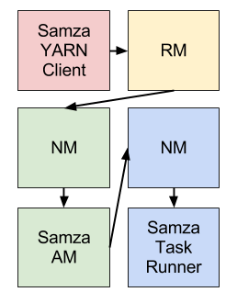
Architecture
How Samza and YARN integrated:
Samza prepared a YARN ApplicationMaster(AM) and a YARN JobRunner.
When Samza wants to start a new application(or job), it talks to YARN ResourceManager(RM).
RM will talks to a YARN NodeManager(NM) to allocate space (one container) for Samza AM on the cluster.
After allocating, NM starts the AM. The AM then asks RM for one or more YARN containers to run SamzaContainers.
RM works with NMs to allocate required containers. NMs then start the SamzaContainers.
The JobRunner will run application’s processing code in those containers.
Different colors indicate different host machine

Slide 14
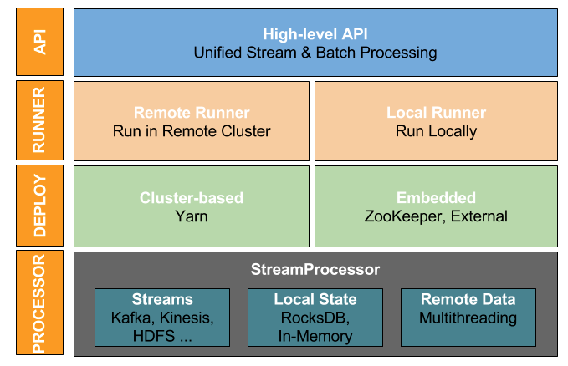
Architecture
The high-level API (Since 0.13.0) provides the libraries for user to define their applications’ logic. Users implement applications’ logic in StreamApplication
Samza use ApplicationRunner to run a StreamApplication:
Remote Runner for running on the cluster (Cluster mode)
Local Runner for running on local machine (Standalone mode)
In execution layer, there are two kinds of execution models:
Cluster-based execution:YARN, Mesos
Embedded execution: ZooKeeper, External
StreamProcessor is the smallest execution unit of a StreamApplication. It reads configs from ApplicationRunner and processes input partitions.
http://samza.apache.org/startup/preview/

Slide 15
Wikipedia Application
This is the Hello-Samza project’s example application
This application read realtime events from Wikipedia website, and write the statistics information of these events into a Kafka topic
Wikipedia server
wikipedia
wiktionary
WikipediaApplication
wiki-stats topic
wikinews

Slide 16
Wikipedia Application
Procedure:
Read realtime events from three wiki sources stream
Merge three streams into one stream
Parse these events to a structured format
Aggregate events’ stats(total number of certain word, number of modification, etc) over 10 seconds window
Format each window’s output
Send window output to Kafka topic named ‘wikipedia-stats’
en-wikipedia
formatOutput
mergeAll
WikiParser
window
en-wiktionary
wikipedia-stats
en-wikinews

Slide 17
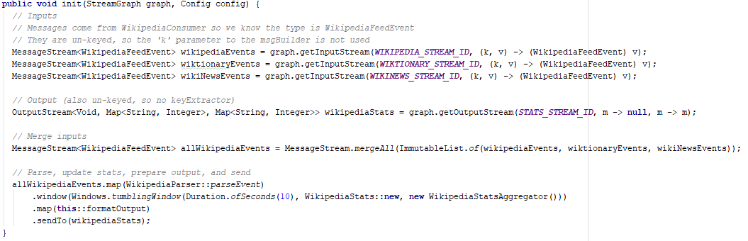
Wikipedia Application
The application’s logic is mainly contained in the init method of Application class:
Set up input Streams
Set up output Streams
Merge three input streams
Parse the input events
Aggregate the stats informtion in the time window
Format window’s output
Send to output Kafka topic

Slide 18
Deployment and example
Please check out the ClusterModeSamzaDeployment.pdf
https://github.com/Swrrt/Samza/blob/master/Documentation/ClusterModeSamzaDeployment.pdf

Slide 19
Complete Abstract
submit application
RemoteApplicationRunner
config file
config file
run-app.sh
ApplicationRunnerMain
ExecutionPlanner
Read old configs
Write configs
JobRunner
coordinatorSystemProducer
submit JavaEnv, commands,
configs
ClientHelper
CoordinatorSystemStream
submit
run-jc.sh
ApplicationContext
coordinatorSystemConsumer
YarnClient
YarnJob
Local
AM container
Read configs to get jobmodel
ClusterBasedJobCoordinator
ContainerProcessManager
JobModelManager
ContainerAllocator
YarnClusterResourceManager
On a new thread
call
Store jobModel, start a HTTP server for others to read it
launchStreamProcessor
Read commands and configs from jobModel url
YarnContainerRunner
ContainerProcessManager
run-container.sh
containerLaunchContext
NMClient
NodeManager

Slide 20
Submit Application
Hello-Samza Application Package
1. Clients submit application package to FileSystem(HDFS for now)
Application package contains the application’s code and all dependencies(including Samza environment). Packaging usually done by Maven
Application code
Samza environment
Hadoop client
Other dependencies
HDFS
2. Clients run the run-app.sh with configuration file(WikipediaApplication.properties) as parameters on local machine to start the application
Configs
./run-app.sh wikipedia.application.WikipediaApplication --config-factory=org.apache.samza.config.factories.PropertiesConfigFactory --config-path=wikipediaApplication.properties
run-app.sh
ApplicationRunnerMain
3.run-app.sh runs ApplicationRunnerMain.java class

Slide 21
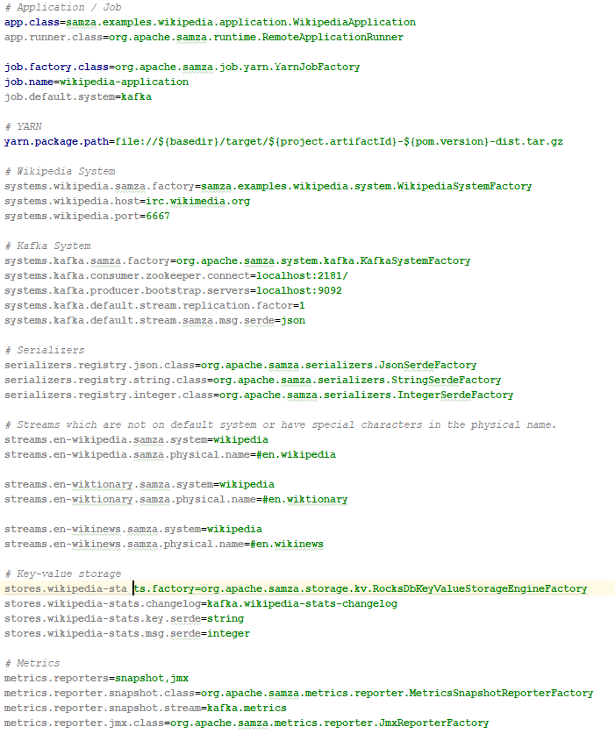
Configuration file example
configuration file: wikipediaApplication.properties
XML format
Defines which class will be sent to YARN clusters as application, which cluster client are using, which stream system are using, etc.

Slide 22
ApplicationRunnerMain
4. Run ApplicationRunnerMain
Configs
(1)Parse input parameters to get the configs
ApplicationRunnerMain
(1)
Configs
Configs
(2)Create ApplicationRunner based on configs(RemoteApplicationRunner)
(2)
(3)
ApplicationRunner
StreamApplication
(3)Generate the instance of StreamAppplication class based on configs, ‘wikipediaApplication.java’ for example
(2)
(3)
RemoteApplicationRunner
wikipediaApplication
(4)ApplicationRunner run StreamApplication
(4)
(5)If submit config is a job not a application, then use JobRunner directly (same as run-job.sh)
Goto 5.

Slide 23

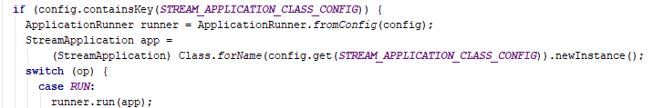


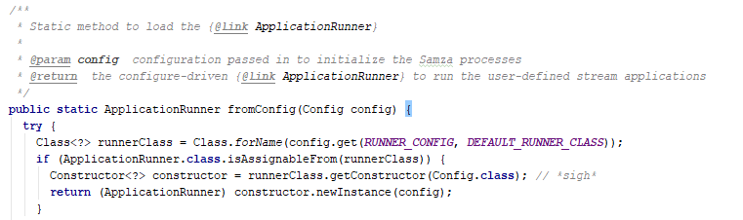
ApplicationRunnerMain
Read configuration from commandline
4. Run ApplicationRunnerMain
(1)Parse input parameters to get the configs
(2)Create ApplicationRunner based on configs(RemoteApplicationRunner)
(3)Generate the instance of StreamAppplication class based on configs, ‘wikipediaApplication.java’ for example
(4)ApplicationRunner run StreamApplication
(5)If submit config is a job not a application, then use JobRunner directly (same as run-job.sh)

Slide 24
RemoteApplicationRunner
5.ApplicationRunnerMain builds RemoteApplicationRunner
ApplicationRunnerMain
(1)Setup RemoteApplicationRunner based on config (store config in RemoteApplicationRunner)
(1)
config
RemoteApplicationRunner
(2)Initialize StreamManager and ExecutionPlanner
config
(2)
StreamManager
ExecutionPlanner
Goto 6.

Slide 25


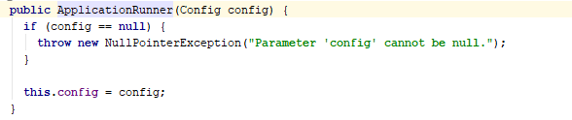
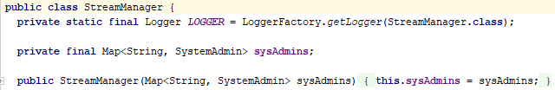
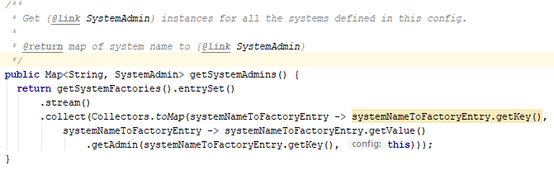
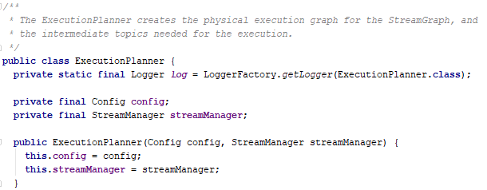
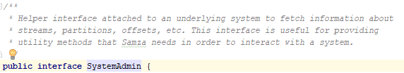
RemoteApplicationRunner
5.Build RemoteApplicationRunner
(1)Setup RemoteApplicationRunner based on config
(2)Initialize StreamManager and ExecutionPlanner (will be explained late)
SystemAdmin can create ChangelogStream, CoordinatorStream, Stream, etc.

Slide 26


StreamManager
StreamManager is used to manage the Stream’s informatin for ApplicationRunner.
StreamManager
It stores the mapping from Stream name(Kafka, Kestrel, etc.) string to the Streams’ interfaces which called SystemAdmin.
sysAdmins
Kafka SystemAdmin
Kinesis SystemAdmin
…
StreamManager can create a list of streams on specified systems like Kafka by using SystemAdmin.
Kafka System
Kinesis
System
StreamManager can obtain the stream partition count information from SystemAdmin.

Slide 27
Build StreamGraph
ApplicationRunnerMain
StreamApplication
(WikipediaApplication)
6.RemoteApplicationRunner builds StreamGraph from the StreamApplication
6.
(1)Create a empty StreamGraph(implemented by StreamGraphImpl) based on ApplicationRunner and config
RemoteApplicationRunner
(1)
(2)Pass the StreamGraph and Configs to StreamApplication(wikipediaApplication). StreamApplication will fill the StreamGraph with its application logic.
StreamGraph
configs
(2)
StreamGraphImpl
(2)
StreamApplication
(WikipediaApplication)
(3)In StreamApplication, set up the application logic in StreamGraph (see StreamApplication)
(3)
StreamGraph
Application’s logic
7.
ExecutionPlanner

Slide 28
StreamGraph
In StreamApplication, the computation logic is expressed in a dataflow graph called StreamGraph(in Samza).
A StreamGraph has two kinds of components
MessageStreams: Stream of messages
OperatorSpecs: Operators like map, window, partitionBy(reduce), join, merge which transform one or more streams to some streams. Some of the operators have transform function as parameters
en-wikipedia
formatOutput
mergeAll
WikiParser
window
en-wiktionary
wikipedia-stats
en-wikinews

Slide 29
StreamGraph
The application defines the logic in the form of MessageStreams
In StreamGraph, there are OperatorSpec(build by OperatorSpecs) and MessageStreams(implemented by MessageStreamImpl):
OperatorSpecs transform messages read from input MessageStreams and produce the output MessageStreams
StreamGraph
en-wikipedia
formatOutput
mergeAll
WikiParser
window
en-wiktionary
wikipedia-stats
en-wikinews
The MessageStream and OperatorSpec both are template class.
Input operator
MessageStream
Map operator
Some OperatorSpec will run application-defined functions (map, flatMap)
Merge operator
Window operator
Each MessageStream is associated with the one OperatorSpec where it comes from and records all OperatorSpecs it goes to.
See example aplication

Slide 30
StreamGraph
There are several OperatorSpec:
input, map, flat_map, filter, sink, send_to, join, window, merge, partition_by, output
But in general they can be divided into two types:
“Hello world”
“Hello”
“World”
The first type OperatorSpecs are similar to map.
Map is the simplest operator: for each input message, use the transform function to transform it and generate zero or more messages, then output these messages
.map(parse)
“Alice”
“Alice”
“Alice”
“Alice”, 1
“Alice”, 2
The second type of OperatorSpecs are like Window: window operator is a stateful operator since it need to aggregate the input messages come in a certain amount of time
00:05
00:01
00:00
00:06
00:03
window(3s,count)
The first type OperatorSpecs are streaming since once it received messages, it will do the transformation immediately.
The second type OperatorSpecs are batching: since it needs to wait to a certain barrier (time window in this example) before the transformation.

Slide 31
StreamGraph
There are two special OperatorSpec(add Broadcast after 0.14.0):
‘A’, 95
Join
Join operator will join two message streams using user provided JoinFunction.
These two message stream need to have same number of partitions and should be partitioned by the join key.
There is time duration limit in parameters.
‘B’, 87
‘A’, ‘Tom’
‘B’, ‘Bob’
‘A’, ‘Tom’,95
‘B’, ‘Bob’,87
Join(Key = Level)
PartitionBy
PartitionBy operator will do repartition on the input message stream with user given key.
This operatorSpec will create intermediate stream in JobGraph since the repartition will done by the intermediate stream.
The number of partitions are equal to the joined stream if there is Join operator after PartitionBy. Otherwise, equal to the job.intermediate.stream.partitions in conf. If not exist, set to the max number of partitions in all input and output streams.
PartitionBy

Slide 32

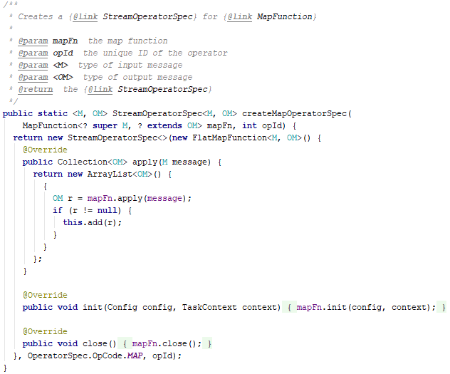
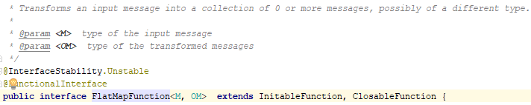
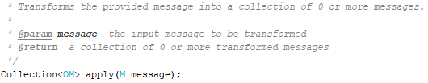

StreamGraph
OperatorSpecs transform messages read from input MessageStreams and produce the output MessageStreams
Rewrite map function to flatmap function
OperatorSpec stores opcode and functions
Create new MessageStream with this OperatorSpec

Slide 33
RemoteApplicationRunner
6.RemoteApplicationRunner builds StreamGraph from StreamAppplication:
ApplicationRunnerMain
(1)Create a empty StreamGraph(implemented by StreamGraphImpl) based on ApplicationRunner and config
StreamApplication
(WikipediaApplication)
6.
RemoteApplicationRunner
(1)
(2)Pass the StreamGraph and Configs to StreamApplication(wikipediaApplication). StreamApplication will fill the StreamGraph (will be explained late) with its application logic.
StreamGraph
configs
(2)
StreamGraphImpl
(2)
StreamApplication
(WikipediaApplication)

Slide 34
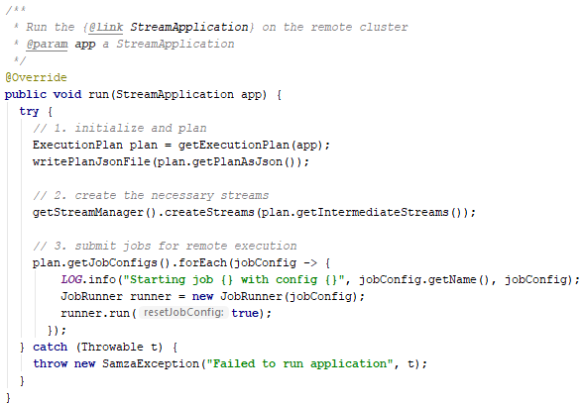
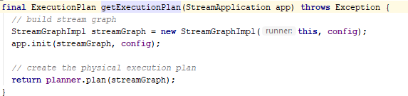
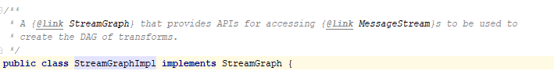
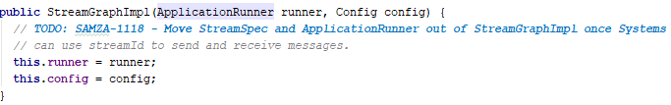
Build StreamGraph
6.RemoteApplicationRunner builds StreamGraph from StreamAppplication:
(1)Create a new StreamGraph(implemented by StreamGraphImpl) based on ApplicationRunner and config
(2)Pass the StreamGraph and Configs to StreamApplication(wikipediaApplication)

Slide 35
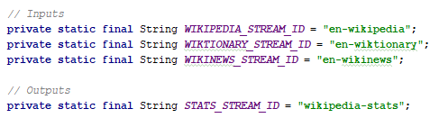
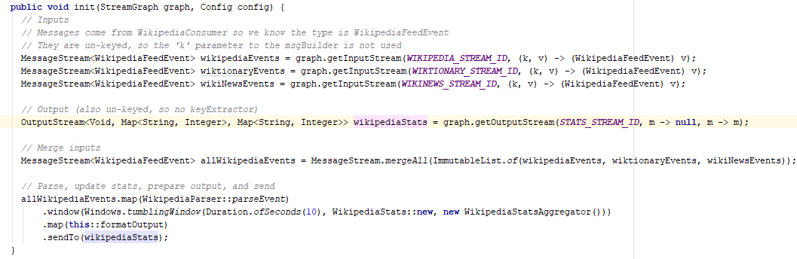
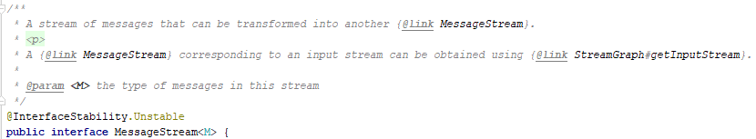
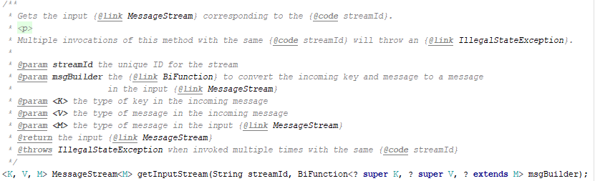
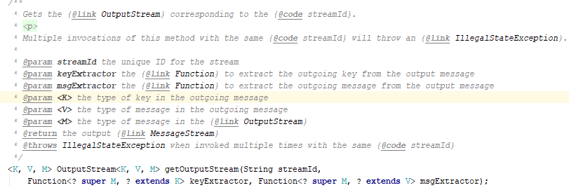
StreamGraph to JobGraph
6.RemoteApplicationRunner builds StreamGraph from StreamAppplication:
(2)Pass the StreamGraph and Configs to StreamApplication(wikipediaApplication)
(3)In StreamApplication, set up the application logic in StreamGraph (InputStream, OutputStream, the intermediate transformations of MessageStreams)

Slide 36
Build StreamGraph
ApplicationRunnerMain
StreamApplication
(WikipediaApplication)
6.
6.RemoteApplicationRunner builds StreamGraph from StreamAppplication:
RemoteApplicationRunner
(1)
(2)Pass the StreamGraph and Configs to StreamApplication(wikipediaApplication)
StreamGraph
configs
(2)
StreamGraphImpl
(2)
(3)In StreamApplication, set up the application logic in StreamGraph (see StreamApplication)
StreamApplication
(WikipediaApplication)
Application’s logic defined by user’s code
(3)
StreamGraph
Application’s logic

Slide 37
StreamGraph to JobGraph
RemoteApplicationRunner
StreamGraph
(1)
7.
7.RemoteApplicationRunner build ExecutionPlan(JobGraph) from StreamGraph
ExecutionPlanner
StreamGraph
(2)
(1)Pass the StreamGraph built by StreamApplication to ExecutionPlanner
JobGraph
JobNode
(2)Building the ExecutionPlan(JobGraph) from StreamGraph for actual running
StreamManager
(3)
JobGraph
(3) Get the partition count of source and sink streams from StreamManager(SystemAdmins)
JobNode
(4) If there are Intermediate Streams, calculate the partitions for them
JobGraph
JobNode
Goto 8.

Slide 38
StreamGraph to JobGraph
StreamGraph
(1)
7.RemoteApplicationRunner use ExecutionPlanner to get JobGraph from StreamGraph:
ExecutionPlanner
StreamGraph
Config
(2)
(1)Pass the StreamGraph built by StreamApplication to ExecutionPlanner
ExecutionPlan
JobGraph
(2)Building the JobGraph from StreamGraph for actual running
(2)
StreamGraph
formatOutput
en-wikipedia
mergeAll
WikiParser
window
Config
en-wiktionary
wikipedia-stats
en-wikinews
JobGraph
SourceStreams
JobGraph is used to divide the application into Samza Jobs for running and build the real message streams between them
JobID
SinkStreams
JobNode
IntermediateStream
JobName

Slide 39
JobGraph
JobGraph is the physical execution graph of Samza application
JobGraph
Source Streams
Sink Streams
It contains the topology of jobs connected with streams(source streams, sink streams and intermediate streams)
JobNode
Partition
Partition
Partition
Partition
Partition
Application’s logic
(StreamGraph)
The high level APIs (StreamGraph) will be transformed into JobGraph for planning, validation and execution.
Partition
Partition
Partition
Partition
Partition
For now, JobGraph only have one job node which contains the whole application’s logic.
Intermediate Streams

Slide 40
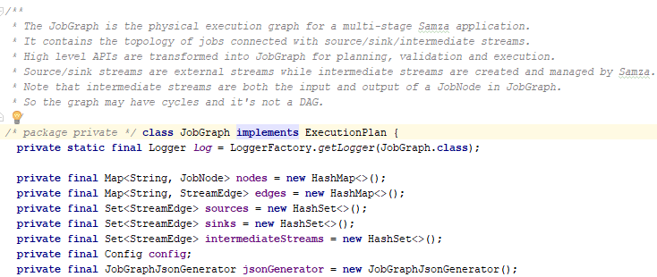
JobGraph

Slide 41
StreamGraph to JobGraph
7.RemoteApplicationRunner use ExecutionPlanner to get JobGraph from StreamGraph:
StreamGraph
InputStreams
other MessageStreams and Operators
OutputStreams
(2)Building the JobGraph from StreamGraph for actual running:
a)List all source streams, sink streams and intermediate streams(created by PartitionBy and Broadcast, see StreamGraph)
b)Set up JobName and JobId based on configurations
(2a)
(2a)
(2a)
SourceStreams
IntermediatStreams
SinkStreams
conf
(2b)
JobGraph
JobId
JobName

Slide 42
StreamGraph to JobGraph
7.RemoteApplicationRunner use ExecutionPlanner to get JobGraph from StreamGraph:
(2)Building the JobGraph from StreamGraph for actual running:
c)Create JobNode using JobId and JobName, which store StreamGraph and Confs
(2c)
StreamGraph
JobGraph
JobNode
JobId
Conf
StreamGraph
JobName

Slide 43
StreamGraph to JobGraph
7.RemoteApplicationRunner use ExecutionPlanner to get JobGraph from StreamGraph:
SourceStreams
JobGraph
Edges
Sources
(2)Building the JobGraph from StreamGraph for actual running:
d)Add all source streams, sink streams, intermediate streams to JobGraph’s Edges collection(sources, sinks, intermediateStreams collection respectively)
e)Validate whether the JobGraph has correct topology: sources from external streams; sinks are going to external streams; nodes are connected with intermediate streams; all nodes are reachable from sources(using BFS).
(2d)
SinkStreams
Sinks
JobNode
Intermediates
IntermediatStreams
JobGraph
(2e)
Edges
Sources
Sinks
JobNode
Intermediates

Slide 44
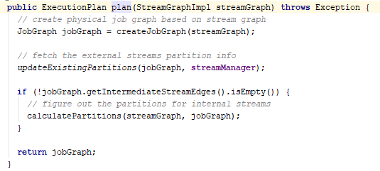
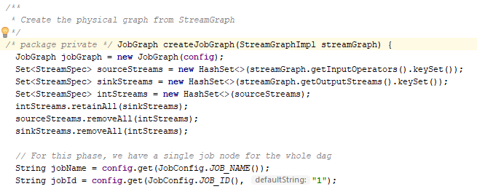

StreamGraph to JobGraph
7.RemoteApplicationRunner use ExecutionPlanner to get JobGraph from StreamGraph:
(1)Pass the StreamGraph built by StreamApplication to ExecutionPlanner
(2)Building the JobGraph from StreamGraph for actual running:
a)List all source streams, sink streams and intermediate streams: the streams created by PartitionBy and Broadcast(implemented in 0.14.0)
b)Set up JobName and JobId based on configurations

Slide 45

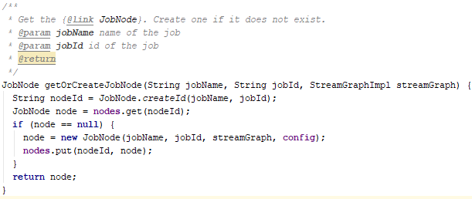
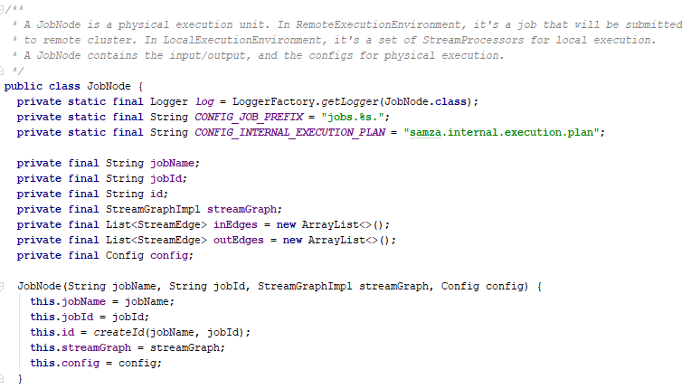
StreamGraph to JobGraph
7.RemoteApplicationRunner use ExecutionPlanner to get JobGraph from StreamGraph:
(2)Building the JobGraph from StreamGraph for actual running:
c)Create JobNode, which store StreamGraph and Confs

Slide 46
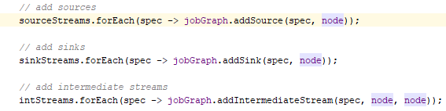
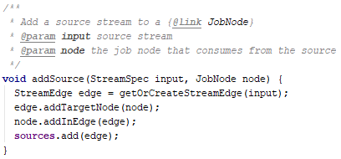
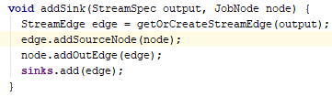
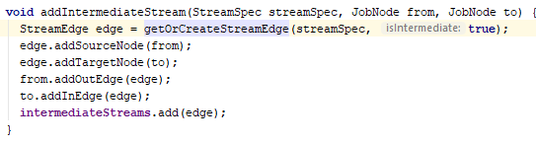
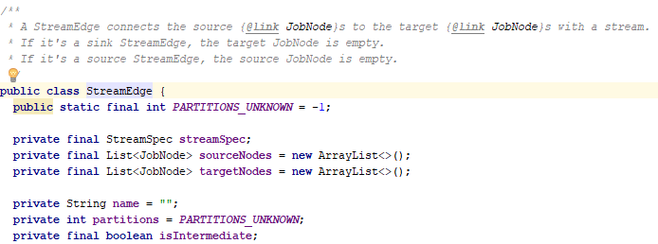
StreamGraph to JobGraph
7.RemoteApplicationRunner use ExecutionPlanner to get JobGraph from StreamGraph:
2)Building the JobGraph from StreamGraph for actual running:
d)Add all source streams, sink streams, intermediate streams to JobGraph’s Edges collection(sources, sinks, intermediateStreams collection respectively)

Slide 47
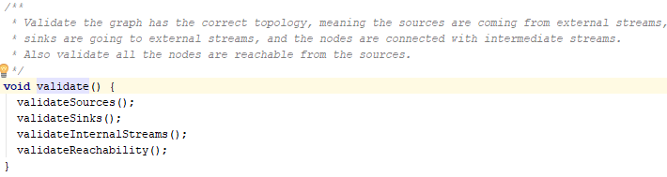
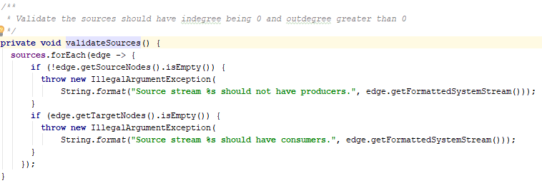
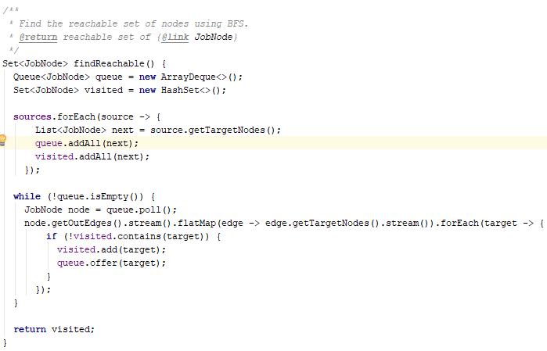
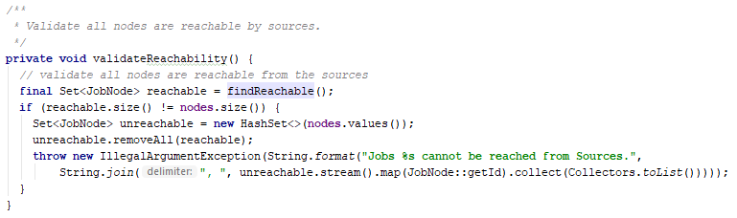
StreamGraph to JobGraph
7.RemoteApplicationRunner use ExecutionPlanner to get JobGraph from StreamGraph:
2)Building the JobGraph from StreamGraph for actual running:
e)Validate whether the JobGraph has correct topology: sources from external streams; sinks are going to external streams; nodes are connected with intermediate streams; all nodes are reachable from sources(using BFS).

Slide 48
StreamGraph to JobGraph
7.RemoteApplicationRunner use ExecutionPlanner to get JobGraph from StreamGraph:
(3) Get the partition count information of source and sink streams from SystemStreams’ metadata in StreamManager(SystemAdmins)
StreamManager
SystemAdamins
system 1
system 2
…
(3)
JobGraph
Edges
Sources
Sinks
JobNode
Intermediates

Slide 49
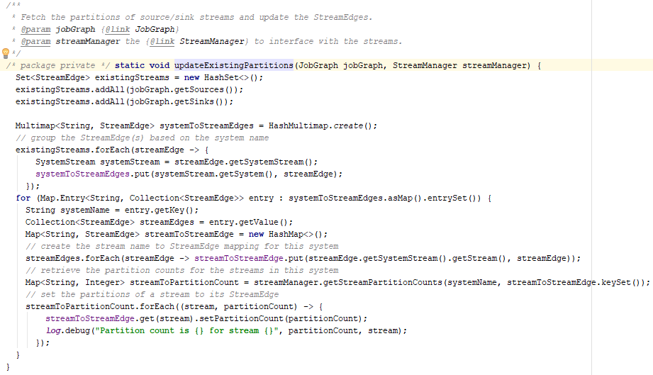
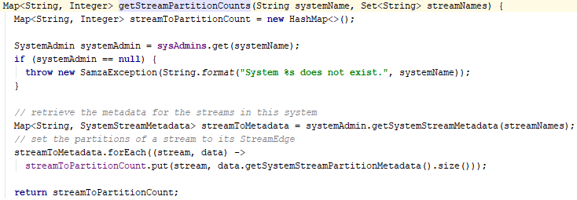
StreamGraph to JobGraph
7.RemoteApplicationRunner use ExecutionPlanner to get JobGraph from StreamGraph:
(3) Get the partition count information of source and sink streams from StreamManager(SystemAdmins)

Slide 50
StreamGraph to JobGraph
7.RemoteApplicationRunner use ExecutionPlanner to get JobGraph from StreamGraph:
JobGraph
Edges
(4) If there are Intermediate Streams, calculate the partitions for them:
Sources
Sinks
JobNode
a) Input streams of join operator
(4)
Intermediates
b) Other intermediate streams
(4a) Input stream of Join
(4b) Other Intemediate Streams

Slide 51
StreamGraph to JobGraph
7.RemoteApplicationRunner use ExecutionPlanner to get JobGraph from StreamGraph:
StreamGraph
Input 1
Input 2
Join 2
(4) If there are Intermediate Streams, calculate the partitions for them:
Join 3
Input 3
a) Input streams of join operator
Input 4
Join 1
Loop through all input StreamEdges.
Traverse the StreamGraph to find all joins reachable from each input StreamEdge.
Record all visited Join which has at least one input StreamEdge’s partition number is known. Start a BFS from these Joins and update partition number joins’ intermediate streams one by one.
Input 1 | Join 2, Join 3
Input 2 | Join 2, Join 3
Input 3 | Join 1, Join 3
Input 4 | Join 1, Join 3
Reachable Join
(Question:BFS is not needed since all joins can be found in the first traverse?)

Slide 52
Calculate Partition Count
No. of Partitions
3
Input 1
?
Input 2
Join 2
Join 3
?
Input 3
3
Input 4
Join 1
Join Queue: Join 2, Join 1, Join 3
Input 1 | Join 2, Join 3
Input 2 | Join 2, Join 3
Input 3 | Join 1, Join 3
Input 4 | Join 1, Join 3

Slide 53
Calculate Partition Count
No. of Partitions
3
Input 1
3
?
Input 2
Join 2
Join 3
?
Input 3
3
Input 4
Join 1
Join Queue: Join 2, Join 1, Join 3
Input 1 | Join 2, Join 3
Input 2 | Join 2, Join 3
Input 3 | Join 1, Join 3
Input 4 | Join 1, Join 3
Set JoinOperator’s partition equal to the known input StreamEdge’s partition

Slide 54
Calculate Partition Count
No. of Partitions
3
Input 1
3
3
Input 2
Join 2
Join 3
?
Input 3
3
Input 4
Join 1
Join Queue: Join 2, Join 1, Join 3
Input 1 | Join 2, Join 3
Input 2 | Join 2, Join 3
Input 3 | Join 1, Join 3
Input 4 | Join 1, Join 3
Set this join operator’s other StreamEdges’ partition equal to the join’s partition

Slide 55
Calculate Partition Count
No. of Partitions
3
Input 1
3
3
Input 2
Join 2
Join 3
?
Input 3
3
Input 4
Join 1
Join Queue: Join 2, Join 1, Join 3
Input 1 | Join 2, Join 3
Input 2 | Join 2, Join 3
Input 3 | Join 1, Join 3
Input 4 | Join 1, Join 3

Slide 56
Calculate Partition Count
No. of Partitions
3
Input 1
3
3
Input 2
Join 2
Join 3
?
Input 3
3
3
Input 4
Join 1
Join Queue: Join 2, Join 1, Join 3
Input 1 | Join 2, Join 3
Input 2 | Join 2, Join 3
Input 3 | Join 1, Join 3
Input 4 | Join 1, Join 3

Slide 57
Calculate Partition Count
No. of Partitions
3
Input 1
3
3
Input 2
Join 2
Join 3
3
Input 3
3
3
Input 4
Join 1
Join Queue: Join 2, Join 1, Join 3
Input 1 | Join 2, Join 3
Input 2 | Join 2, Join 3
Input 3 | Join 1, Join 3
Input 4 | Join 1, Join 3

Slide 58
Calculate Partition Count
No. of Partitions
3
Input 1
3
3
3
Input 2
Join 2
Join 3
3
Input 3
3
3
Input 4
Join 1
Join Queue: Join 2, Join 1, Join 3
Input 1 | Join 2, Join 3
Input 2 | Join 2, Join 3
Input 3 | Join 1, Join 3
Input 4 | Join 1, Join 3

Slide 59
StreamGraph to JobGraph
7.RemoteApplicationRunner use ExecutionPlanner to get JobGraph from StreamGraph:
(4)If there are Intermediate Streams, calculate the partitions for them:
b) Other intermediate streams
Intermediate Streams created by PartitionBy, will be the default value in Config, otherwise will be the max of sources and sinks’ partitions.
See PartitionBy

Slide 60
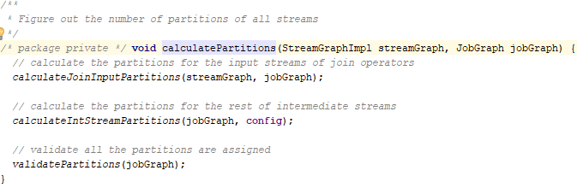
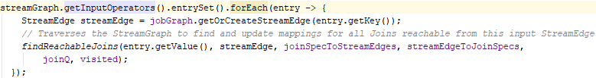
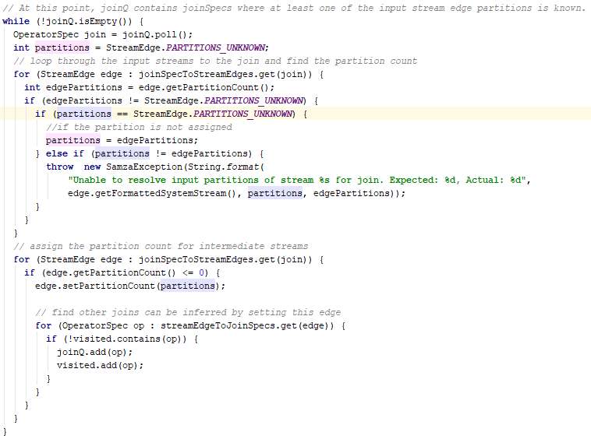
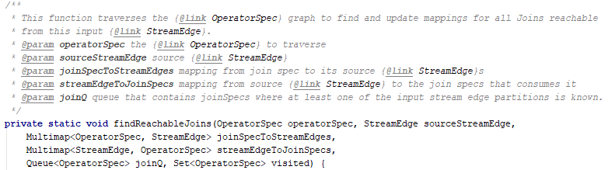
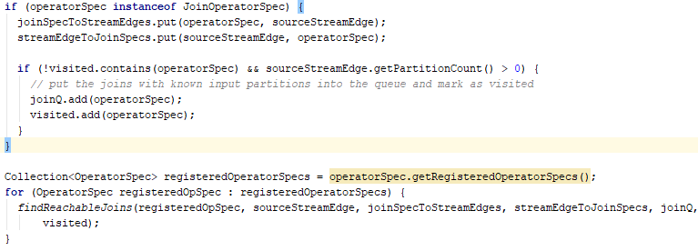
StreamGraph to JobGraph
7.RemoteApplicationRunner use ExecutionPlanner to get JobGraph from StreamGraph:
(4) If there are Intermediate Streams, calculate the partitions for them:
a) Calculate partitions of join operators’ input streams:
For each input StreamEdge, traverse the StreamGraph recursively and find all Joins reachable from it.
From all these joins, update their partitions(equal to input partitions) and extend downstream unvisited joins(BFS)

Slide 61


StreamGraph to JobGraph
7.RemoteApplicationRunner use ExecutionPlanner to get JobGraph from StreamGraph:
(4) If there are Intermediate Streams, calculate the partitions for them:
b)IntermediateStreams’ partitions can be obtain from Input and Output Streams’ partitions.
c)Check if there is any stream doesn’t assigned partitions

Slide 62
RemoteApplicationRunner
RemoteApplicationRunner
8.
8. Write the ExecutionPlan(JobGraph) to a file in JSON form.
JSON file
JobGraph
9. Create the intermediate streams physically by using StreamManager
JobNode
10. According to ExecutionPlan(JobGraph), run all jobs(JobNode) one by one using respective JobRunner.
10.
JobRunner
JobRunner
JobRunner
JobNode
JobNode
JobNode
…
(Not useful for now since there is only one JobNode in JobGraph)

Slide 63


RemoteApplicationRunner
8. Write the ExecutionPlan(JobGraph) to a file in JSON form.
9. Create the intermediate streams physically and store them in StreamManager
10. According to ExecutionPlan(JobGraph), run all jobs(JobNode) one by one using respective JobRunner.

Slide 64




Divide JobGraph into Jobs
10. According to ExecutionPlan(JobGraph), run all jobs(JobNode) one by one using respective JobRunner.
(1) Get json representation of JobGraph
(2) Sort all JobNodes topological order
(3) For each JobNode, generate its JobConfig from whole json config

Slide 65
JobRunner
RemoteApplicationRunner
JobConfig
(from JobGraph json file)
1. For each job, RemoteApplicationRunner create JobRunner using the job config get from JobGraph.
1.
JobRunner
2. JobRunner update the job config in coordinator stream for other nodes to use
3.
YarnJobFactory
Timer
JobConfig
2.
3. JobRunner create a instance of JobFactory according to configs
JobConfig
4.
CoordinatorSystemStream
YarnJob
6.
4. JobRunner create the actual Job using JobConfig and JobFactory
ClientHelper
5. YarnJob use ClientHelper to build and submit ApplicationSubmissionContext to YARN to start the YARN application
Local
5.
ApplicationSubmissionContext
Remote
6. JobRunner waits submit result for 500ms and quit.
YARN Application
YARN cluster
ClientHelper is the last station on local machine.

Slide 66
Configs to CoordinatorStream
2. JobRunner update the job config in coordinator stream for jobs and tasks in cluster to use
JobRunner
(1)Get CoordinatorStreamSystemProducer and CoordinatorStreamSystemConsumer from Config
CoordinatorSreamSystemProducer
CoordinatorSreamSystemConsumer
(1)
(2)Create the CoordinatorSystemStream by using SystemFactory (KafkaSystemFactory) if it doesn’t exists
(2)
KafkaSystemFactory
(3) If reset flag is true(true by default), write configurations to CoordinatorSystemStream by using CoordinatorStreamProducer
new Configs
delete Configs
all Configs
SystemAdmin
(4)
(2)
(4) Read all configs (new and old) from CoordinatorSystemStream by using Consumer
(3)
(5)
CoordinatorSystemStream
(Using Kafka System)
(5) If reset flag is true, delete old configs in CoordinatorSystemStream that are not defined in new configs by using Producer
Configs
K-V pair
K-V pair
K-V pair
…
If reset flag is false, configs will not be written to the coordinator stream?

Slide 67






Configs to CoordinatorStream
2. JobRunner update the job config in coordinator stream for jobs and tasks in cluster to use
(1)Get CoordinatorStreamSystemProducer and CoordinatorStreamSystemConsumer from Config
(2)Create the CoordinatorSystemStream by using SystemFactory (KafkaSystemFactory) if it doesn’t exists
(3) If reset flag is true(true by default), write configurations to CoordinatorSystemStream by using CoordinatorStreamProducer
(4) Read all configs (new and old) from CoordinatorSystemStream by using Consumer
(5) If reset flag is true, delete old configs in CoordinatorSystemStream that are not defined in new configs by using Producer

Slide 68
Create YarnJob
3. JobRunner create a instance of JobFactory according to configs
JobRunner
3.
YarnJobFactory
4. JobRunner create the actual Job using JobConfig and JobFactory
Configs
4.(1)
HConfigs
(1) JobFactory translate FileSystem configs into FileSystem format(Hadoop: HConfigs)
4.(2)
YarnJob
(2) JobFactory create Job(YarnJob) according to configs and hConfigs.
YarnJob store the configs and setup ClientHelper(a helper class contains YarnClient, connected to RM in YARN cluster) using hConfigs
Configs
ClientHelper
YarnClient
Local
Remote
RM

Slide 69




Create YarnJob
3. JobRunner create a instance of JobFactory according to configs
4. JobRunner create the actual Job using JobConfig and JobFactory
(1) JobFactory translate FileSystem configs into FileSystem format(Hadoop: HConfigs)
(2) JobFactory create Job(YarnJob) according to configs and hConfigs.
YarnJob store the configs and setup ClientHelper(a helper class contains YarnClient, connected to RM in YARN cluster) using hConfigs

Slide 70
Submit Job to Cluster
YarnJob
5. YarnJob use ClientHelper to build and submit ApplicationSubmissionContext to YARN to start the YARN application
(1)
Cmds
(2)
(1) YarnJob set up the command lines(run-jc.sh) which will be running in YARN cluster to start AM
ClientHelper
(3)
ApplicationSubmissionContext
(2) YarnJob pass command lines and environment variables to ClientHelper
ContainerLauchContext
(3)ClientHelper put all command lines, environments and configs into ContainerLaunchContext and ApplicationSubmissionContext
YarnClient
(4)ClientHelper submit the ApplicationSubmissionContext with YarnClient to start the application in YARN
ApplicationSubmissionContext
(4)
ContainerLauchContext
YARN Cluster

Slide 71







Submit Job to Cluster
5. YarnJob use ClientHelper to build and submit ApplicationSubmissionContext to YARN to start the YARN application
(1) YarnJob set up the command lines(run-jc.sh) which will be running in YARN cluster to start AM
(2) YarnJob pass command lines and environment variables to ClientHelper,
(3)ClientHelper put all command lines, environments and configs into ContainerLaunchContext and ApplicationSubmissionContext
(4)ClientHelper submit the ApplicationSubmissionContext with YarnClient to start the application in YARN

Slide 72
ContainerLaunchContext and ApplicationSubmissionContext
ContainerLaunchContext
ContainerLaunchContext contains all of the information needed by NodeManager to launch a container.
It includes: ContainerId, Resource(no. of cpus, memory) allocated, User, LocalResource(binaries, jar and other things for running the container), Environment variables, Commandline( to launch the container).
Container
The actual program running in the container (Jobs, tasks, etc)
ApplicationSubmissionContext
ApplicationSubmissionContext contains all of the information needed by ResourceManager to launch the ApplicationMaster
ContainerLaunchContext
Container
It includes: ApplicationId, User, Priority, ContainerLaunchContext of the AM container, etc.
ApplicationMaster

Slide 73
In YARN cluster
YarnJob
1. ClientHelper send ApplicationSubmissionContext to RM in YARN cluster
ClientHelper
YarnClient
2.RM calls a NM to start a container, and send the ApplicationSubmissionContext to the node
ResourceManager
Local
ApplicationSubmissionContext
1.
YARN Cluster
3. NM runs the ApplicationMaster(ClusterBasedJobCoordinator) contained in ApplicationSubmissionContext in the container
ResourceManager
ApplicationSubmissionContext
2.
Node
NodeManager
Container
ClusterBasedJobCoordinator
3.

Slide 74
Create ClusterBasedJobCoordinator
1. Read the CoordinatorSystemConfig from the container’s environment variables
AM Container
1.
CoordinatorSystemConfig
2. Create CoordinatorStreamManager from coordinatorSystemConfig to read and write CoordinatorSystemStream(Consumer and Producer)
ClusterBasedJobCoordinator
CoordinatorSystemStream
2.
CoordinatorStreamManager
3.
3. Read latest checkpoint SystemStreamPartition-to-Task mapping from CoordinatorSystemStream
SystemStreamPartitions
4.
ChangelogPartitionMapping
4.
4. Read the ChangelogPartitionMapping and combine it with SystemStreamPartition to build the JobModel
JobModel
5.
JobModelManager
JobModel
5. JobModelManager start a web server to share the JobModel for tasks running

Slide 75
Create ClusterBasedJobCoordinator
6. Create PartitionMonitor, which will monitor the SystemStream and throw Exception to YARN when SystemStream’s partition number changing
AM Container
ClusterBasedJobCoordinator
6.
PartitionMonitor
7. Create ContainerProcessManager, which create the ClusterResourceManager(YarnClusterResourceManager) and ContainerAllocator according configs. ContainerProcessManager will start the ContainerAllocator on a new thread
7.
ContainerProcessManager
ContainerAllocator
8.
ResourceRequestState
8. ContainerAllocator will maintain ResourceRequestState to store information about resource requests(container) and resource allocated by the cluster.
9.
YarnClusterResourceManager
9. ContainerAllocator keeps run containers on allocated resource until it shutdown
ContainerAllocator use YarnClusterResourceManager to interact with YARN(send requests; receive resource allocated by YARN; run containers on nodes)
RM
NM
NM
…

Slide 76
Read JobModel
ClusterBasedJobCoordinator
3.Read latest checkpoint SSPS from CoordinatorStream
(1) Read the number of containers from configs. Create same number of Processors.
CoordinatorSystemStream
StreamMetadataCache
(2) Get the StreamMetadataCache for all input SystemStreams from CoordinatorSystemStream
SystemStreamPartitions
SystemStreamPartitionGrouper
(3) Read all SystemStreamPartitions from StreamMetadataCache
GroupByPartition
(4) Get the Grouper (GroupByPartition) according to confgis. And use it to group SystemStreamPartations to Tasks
SystemStream groups
Task1
Task2
Task3
Task4
SSP1
SSP1
SSP1
SSP1
…
SSP2
SSP2
SSP2
SSP2
…
…
…
…

Slide 77
Read JobModel
following last page
ClusterBasedJobCoordinator
4.Build JobModel
SystemStream groups
(5) Create ChangelogStreamManager. Use it to read the TaskName-to-Partition mapping from CoordinatorSystemStream
CoordinatorSystemStream
(5)
ChangelogStreamManager
TaskName-Partition Mapping
(6)Combine the Changlog TaskName-Partition mapping with Task-SSP mapping, get the TaskModel for each task.
(6)
TaskModels
(7) Create the ContainerGrouper according to configs. Use the ContainerGrouper to group the TaskModels with containers and get the ContainerModel for each container(If host-affinity enabled, use balance method instead of group)
ContainerGrouper
(7)
GroupByContainerCount
ContainerModels
(8) Build the JobModel using ContainerModels and configs.(If host-affinity enabled, also use LocalityManager)
(8)
JobModel

Slide 78
StreamMetadataCache
StreamMetadataCache cache some SystemStreams’ metadata (offset and partition informations)
Cache can prevent high frequency requests from harming the actual systems.
SystemStreamPartition
A pair of <SystemStream, Partition ID>, representing one specific partition in one system stream

Slide 79

ContainerGroup
Containers
Tasks
Container 1
1
2
3
4
ContainerGrouper will determine how tasks assigned to containers
5
6
7
8
Container 2
The default grouper, GroupByContainerCount will group according to the number of Containers and number of tasks: each containers has the same number of tasks, which is $\left\lceil \frac{TasksNum}{ContainersNum}\right\rceil$(except the remainder one)
Container 3
Group
Container 1
Container 2
Container 3
1
2
3
4
5
6
7
8
The GroupByContainerCount grouper is a BalacingGrouper, which means instead of re-group, it has the functionality to balance the assignment when number of containers changed
If adding a new conatiner
Balance
The balance functionality is only used when AM is re-starting in this version!
Container 1
Container 2
Container 3
Container 4
1
2
4
5
7
8
3
6
Grouper will keep the Task-Container mapping in CoordinatorStream. Balance method will keep the host-affinity when re-starting

Slide 80
TaskModel
TaskModel
TaskModel will be used by the SamzaContainer
TaskName
SSP1
SSP2
Each TaskModel contains TaskName, the set of associated SystemStreamPartition and the associated ChangelogPartition.
ChangelogPartition
SSP3
…
ContainerModel
ContainerModel
TaskModel 1
ContainerModel is used to define which TaskModels a SamzaContainer should process
Container ID
TaskModel 2
Each ContainerModel contains a containerID and a set of TaskModels
TaskModel 3
…
JobModel
JobModel
The data model used in JobCoordinator and SamzaContainer to determine how to execute Samza job
ContainerModel 1
ContainerModel 2
Container-to-Host Mapping
Each JobModel contains a set of ContainerModels, and a LocalityMapping from ContainerID to HostKey for host-affinity.
ContainerModel 3
…

Slide 81
ContainerAllocator
ContainerAllocator
Allocator Start
9. ContainerAllocator will keeps doing following things until it shutdown:
1)Check ResourceRequestState to find next pending resource request(container) and hosts still have available resource
2)Use YarnClusterResourceManager to run the resource request(container) on the host which have available resource
3)If no more pending resource request, release allocated extra resources
4)Sleep for time_interval to wait the cluster allocate resource
yes
Allocator Shutdown
Shutdown?
no
1)
no
yes
2) Run the request(container) on resource
3) Release extra resource
4)Sleep for the time_interval time

Slide 82
ResourceRequestState
ResourceRequestState maintains all resource requests(containers) and all resources allocated by the cluster
Resource requests are stored in a priority queue and ordered according to their time-stamps
There is a host-to-resources map to store all allocated resource on each host in the cluster (For host-affinity)
This class is thread safe, and could be written concurrently

Slide 83






Create ClusterBasedJobCoordinator
1. Read the CoordinatorSystemConfig from the container’s environment variables
2. Create CoordinatorStreamManager from coordinatorSystemConfig to read and write CoordinatorSystemStream(Consumer and Producer)
3. Read latest checkpoint SystemStreamPartition-to-Task mapping from CoordinatorSystemStream
4. Read the ChangelogPartitionMapping and combine it with SystemStreamPartition to build the JobModel
5. JobModelManager start a web server to share the JobModel for tasks running

Slide 84





Read JobModel
3.Read latest checkpoint SSPS from CoordinatorStream
(1) Read the number of containers from configs. Create same number of Processors.
(2) Get the StreamMetadataCache for all input SystemStreams from CoordinatorSystemStream
(3) Read all SystemStreamPartitions from StreamMetadataCache
(4) Get the Grouper (GroupByPartition) according to confgis. And use it to group SystemStreamPartations to Tasks

Slide 85




Read JobModel
4.Build JobModel
(5) Create ChangelogStreamManager. Use it to read the TaskName-to-Partition mapping from CoordinatorSystemStream
(6)Combine the Changlog TaskName-Partition mapping with Task-SSP mapping, get the TaskModel for each task.
(7) Create the ContainerGrouper according to configs. Use the ContainerGrouper to group the TaskModels with containers and get the ContainerModel for each container(If host-affinity enabled, use balance method instead of group)
(8) Build the JobModel using ContainerModels and configs.(If host-affinity enabled, also use LocalityManager)

Slide 86
Create ClusterBasedJobCoordinator
6. Create PartitionMonitor, which will monitor the SystemStream and throw Exception to YARN when SystemStream’s partition number changing
7. Create ContainerProcessManager, which create the ClusterResourceManager(YarnClusterResourceManager) and ContainerAllocator according configs. ContainerProcessManager will start the ContainerAllocator on a new thread
8. ContainerAllocator will maintain ResourceRequestState to store information about resource requests(container) and resource allocated by the cluster.
9. ContainerAllocator keeps run containers on allocated resource until it shutdown
ContainerAllocator use YarnClusterResourceManager to interact with YARN(send requests; receive resource allocated by YARN; run containers on nodes)

Slide 88
Progress ends here
Following slides need to be re-organized.

Slide 89


Slide 90
RemoteApplicationRunner
StreamManager

Slide 91


Application example
Wikipedia application:

Slide 93
Complete Abstract
In container
Container
run-container.sh
LocalContainerRunner
SamzaContainer
Read jobModel from url
Run ContainerHeartbeatMonitor
Read offset for each input partition
Instantialize StreamTask for each input partition
Continuously take messages from input stream to StreamTasks
ContainerHeartbeatMonitor
Listen to JobCoordinator(sam url as jobModel)
Stop container if JobCoordinator
given signal

Slide 94
ClusterBasedJobCoordinator.java
YarnJob
ClusterBasedJobCoordinator
JobModelManager
ContainerProcessManager
ResouceManagerFactory
Config
ClusterResourceManager
YARN
Mesos

Slide 95
JobModelManager
ClusterBasedJobCoordinator
JobModelManager
Coordinator Stream
Config
JobRunner
ChangelogPartitionManager
LocalityManager

Slide 96



Application example
The WikipediaStatsAggregator class used in window
FoldLeftFunction are used to increment values like number of visits

Slide 97
RemoteApplicationRunner
In AbstractApplicationRunner
In ApplicationRunner

Slide 98




AbstractApplicationRunner
Runs the code in application
ExecutionPlanner

Slide 99






ExecutionPlanner
JobGraph

Slide 100




JobRunner
Scala’s syntax
Read CoordinatorStream Information from configs
Using KafkaSystemFactory here
Write new configs coordinatorSystemStream

Slide 101








JobRunner
Delete old configs
Using YARNJobFactory here
YarnJob
Check the applicationStatus every second
more in next page

Slide 102







YarnJob
run-jc.sh is from here

Slide 103








ClientHelper
YarnClient class for interact with YARN

Slide 104





ClientHelper
YarnClientApplication
ApplicationSubmissionContext
ContainerLaunchContext

Slide 105




ClientHelper
Resource
LocalResource

Slide 106









ClientHelper
ApplicationSubmissionContext
Node label is a way to group nodes with similar characteristics and applications can specify where to run.
https://hadoop.apache.org/docs/r2.7.3/hadoop-yarn/hadoop-yarn-site/NodeLabel.html
same as ‘switch’ in C++ and Java
FileSystem
DistributedFileSystem

Slide 107






ClientHelper
ApplicationSubmissionContext
ContainerLaunchContext

Slide 108






ClientHelper
ContainerLaunchContext
Skip the security part
Samza
ApplicationSubmissionContext
YarnClient

Slide 110
Stand alone model with Zookeeper
ZkLocalApplication
new LocalApplicationRunner
new StreamApplication
LocalApplicationRunner.java
run(StreamApplication)
AbstractApplicationRunner.java
StreamManager.java
ExecutionPlanner.java

Slide 111

Samza Container

Slide 112
Task
SamzaJob
Envolope
Envolope
StreamTask
Output Collector

Slide 113
WikipediaFeed
WikipediaFeed Job
WikipediaFactory
WikiPedia
WikipediaConsumer
Listen
WikipediaFeedStreamTask
Wikipedia-raw
WikipediaFeed

Slide 114
Definition
Deprecated
Class names end with ???
Classes need to be analyze
Samza class
Hadoop class
Zookeeper class
Your own code
abstract Samza class
abstract Hadoop class
Samza
Things actually done
Hadoop
Things actually done

Slide 115
Run a job
Deprecated
./run-job.sh –config-factory=org.apache.samza.config.factories.PropertiesConfigFactory –config-path=wikipedia-feed.properties
./run-class.sh org.apache.samza.job.JobRunner
wikipedia-feed.properties
job.factory.class
job.name
yarn.package.path
task.class
task.inputs
serializer.registry.json.class
systems.kafka.samza.factory
systems.kafka.samza.msg.serde
systems.kafka.consumer.zookeeper.connect
systems.kafka.producer.bootstrap.servers
job.coordinator.system
JobRunner.scala
Run:

Slide 116
Run a job
Deprecated
App
JobRunner.scala
Run:
ApplicationRunnerMain.java???
CoordinatorStreamSystemFactory.scala
StreamJobFactory.class
StreamJob.java
submit
Wait for job start and exit
CoordinatorSreamSystemConsumer.java???
CoordinatorSreamSystemProducer.java???
YarnJobFactory.scala
getJob
new YarnJob
YarnJob.scala
submit
FileSystemImplConfig.java
Convert Samza config into Hadoop config
YarnJob.scala
Start Application Manager
ClientHelper.scala
submitApplication
new
new
YarnClient.java
createApplication
YarnJobUtil.scala
JobContext
Path.java
getFileSystem
package
fs.getFileStatus
Resource.java
setMemory
…???
LocalResource.java???
LocalizerResourceMapper.java???
setupSecurityToken
Interact with Hadoop.security???
ContainerLaunchContext.java???
YarnClient.java
submitApplication
YarnClientImpl.java
createApplication???
Store job’s meta data
Resouce required by container
Information for node manager.
YarnClientImpl.java
Resources on cluster
Map used by Container Launch Context

Slide 117
Run a job
Deprecated
submit configuration file
Wrap everything and submit to YARN
run-job.sh
JobRunner
YarnJob
ClientHelper
run-jc.sh
call
new
pass cmds as a parameter
submit in context
Make requests for physical resources,
run a container on resources
call
Translate requests for Yarn Resource Manager
Request containers, handle failures
request
YarnClusterResourceManager
ContainerAllocator
ContainerProcessManager
ClusterBasedJobCoordinator
contain
contain
commandBuilder
Is not normal JobCoordinator
commandBuilder
tell which and how to run the samza container
launchStreamProcessor
YarnContainerRunner
YARN Node Manager

Slide 118
YarnClient.java
Deprecated
YarnClient.java
submitApplication
YarnClientImpl.java
submitApplication
SubmitApplicationRequest.java???
addTimelineDelegationToken
When security enabled
ApplicationClientProtocol.java???
submitApplication
YarnApplicationState.java
ResourceManager fails before save applications’ state, clients need to re-submit.
Protocol between clients and ResourceManager
ResourceManager reflect immediately.
Proto\ApplicationClientProtocol.java
rpc submitApplication

Slide 119
Submit a task
Deprecated
Job Properties File
Job factory class
Job name
package path
PropertyConfigFactory
Task class
Task inputs
Serializers
Kafka’s property
Job Coordinator
Factory
Servers address
…
…
Other system’s property

Slide 120


Factory
Deprecated
Factory implement both consumer and producer
Container use Consumer to read message and pass them to StreamTask
Producer writes messages from StreamTask to outside systems

Slide 121
ProcessJob
Deprecated
ProcessJobFactory
ProcessJob
JobModelManager
JobCoordinator???

Slide 122
Run-app.sh
Deprecated
./run-app.sh wikipedia.application.WikipediaApplication --config-factory=org.apache.samza.config.factories.PropertiesConfigFactory --config-path=wikipediaApplication.properties
ApplicationRunnerMain
Read configuration from commandline
Generate the instance of StreamAppplication class, ‘wikipediaApplication.java’ for example

Slide 123
ApplicationRunner
Deprecated
Here we use RemoteApplicationRunner class

