Slide 1


Dublin Meetup

Slide 2
Agenda
Build your own Jenkins2 Master
Install Blue Ocean (Optional but really cool)
What is a Pipeline ?
Create “HelloWorld” pipeline
Create more complex pipeline
What is a seed file ?
Create Jenkins jobs using a seed file

Slide 3
Build your own Jenkins2 Master
(Requires docker 1.12 and docker compose 1.6.2 to be installed)
git clone https://github.com/tomwillfixit/jenkins2ci
make start
make status
make health
Jenkins Master available at : http://localhost
Notes:
Jenkins 2.14, alpine 3.4, 4 containers data, master, slave and nginx

Slide 4
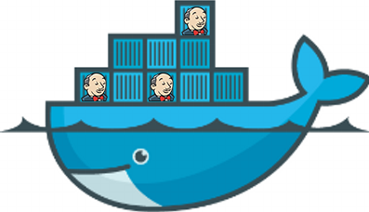
Why run Jenkins in a container?
Portable
Defined in code
Lightweight
Easy to build and deploy
Everyone can have their own Jenkins for experimenting
Enables more agile CI/CD practices
Notes:
Jenkins 2.14, alpine 3.4, 4 containers data, master, slave and nginx

Slide 5
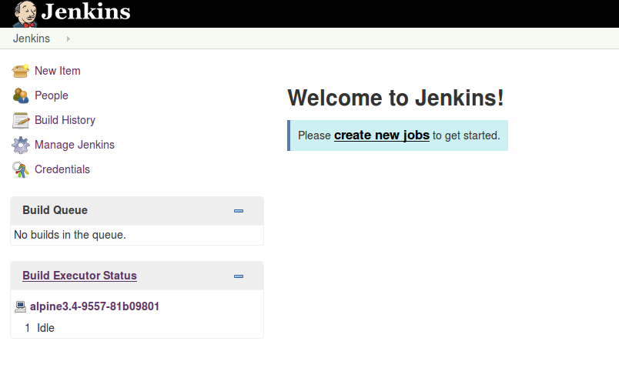
Notes:
Jenkins version, plugins, containers used

Slide 6
Install Blue Ocean
What is Blue Ocean?
How do I install it?
Open a browser and go to : http://localhost
Manage Jenkins → Manage Plugins → Advanced Tab
Change : http://updates.jenkins-ci.org/update-center.json
To : http://updates.jenkins-ci.org/experimental/update-center.json
Click : Submit button

Slide 7
Install Blue Ocean (Contd)
This next step will update the plugin manifest for experimental plugins
Manage Jenkins → Manage Plugins → Advanced Tab → Click “Check Now”
Install Blue Ocean plugins
Manage Jenkins → Manage Plugins → Available tab → Filter box : blueocean
Tick all Blue Ocean plugins and click “Download now and install after restart”
Tick “Restart Jenkins when installation is complete and no jobs are running”

Slide 8
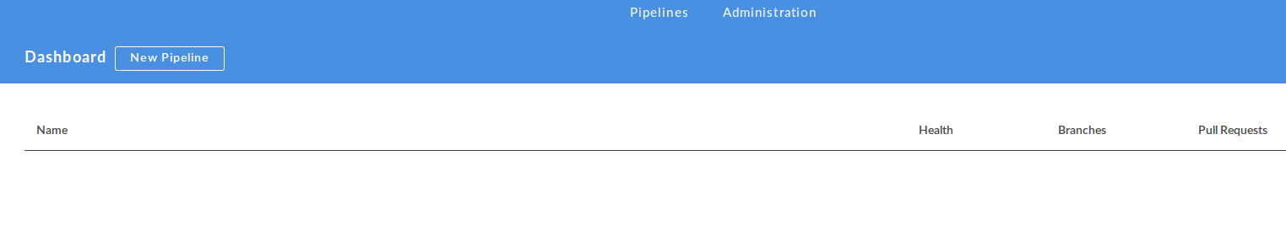
Blue Ocean Dashboard

Slide 9
What is a Pipeline ?
“Pipelines enable you to define the whole application lifecycle”
“Pipeline functionality helps Jenkins to support continuous delivery (CD). The Pipeline plugin was built with requirements for a flexible, extensible, and script-based CD workflow capability in mind.”
Source : https://jenkins.io/doc/pipeline/

Slide 10
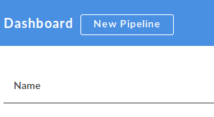
Create a new pipeline
We will use the Blue Ocean UI for this but the steps are the same with the current Jenkins UI
Start at : http://localhost/blue/pipelines
Select “New Pipeline”

Slide 11
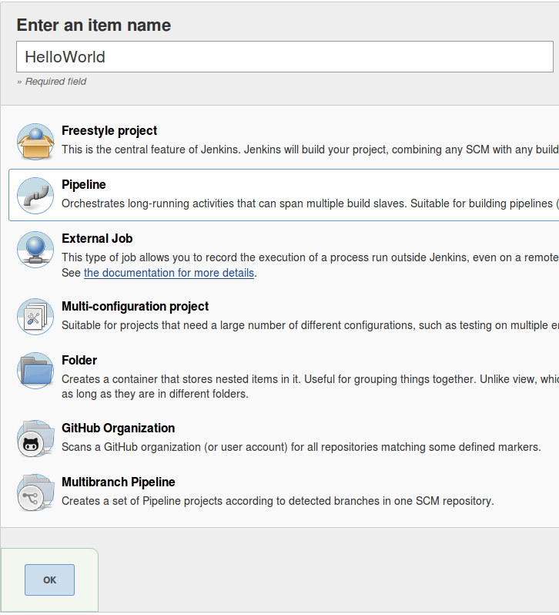
Name the pipeline “HelloWorld”

Slide 12
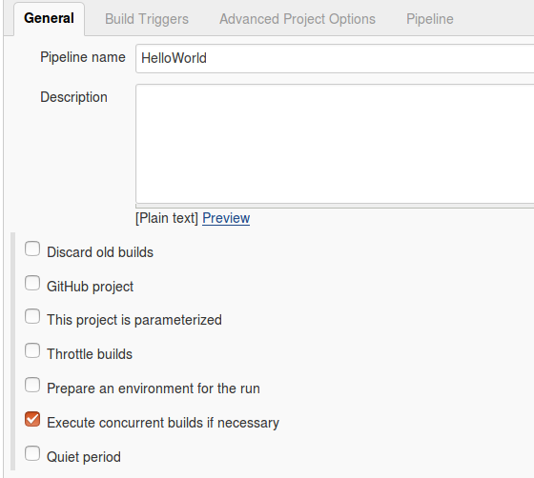
Configure the pipeline

Slide 13
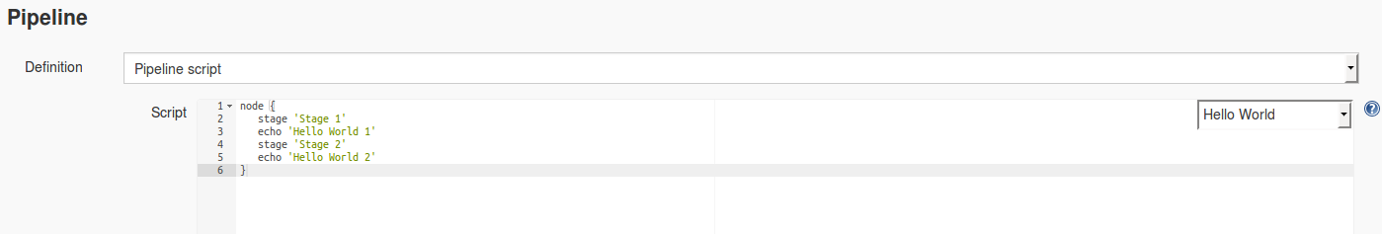
Configure the pipeline (contd)
There is a built-in Hello World sample Pipeline. Select this sample from the drop down and click save.

Slide 14
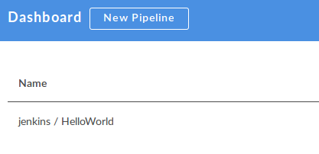
Select pipeline from dashboard
Start at : http://localhost/blue/pipelines
Select “Hello World Pipeline”

Slide 15
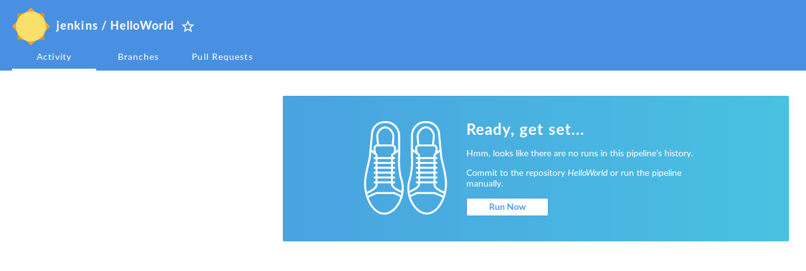
Running your first pipeline build

Slide 16
Disclaimer :
The Blue Ocean plugin is currently in Alpha. Some of the steps performed in the Blue Ocean UI may not work as expected
If a step is not working then you can fall back to the old UI at : http://localhost

Slide 17
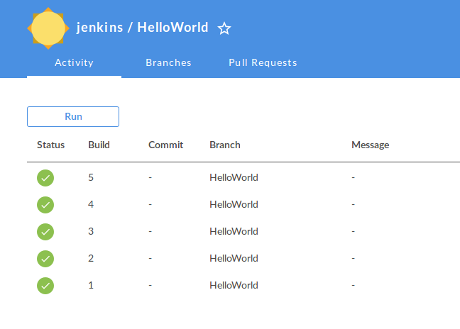
Pipeline dashboard

Slide 18
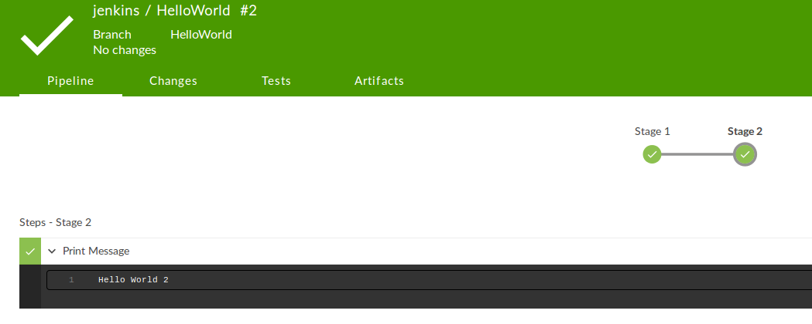
Individual Build Status

Slide 19
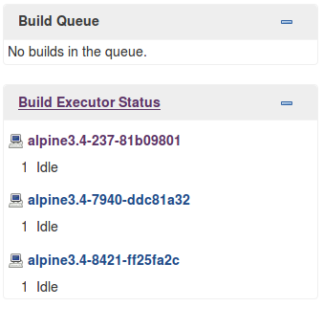
Creating a more complex pipeline
Firstly we want to add more slaves so we can run parallel tasks. If you are using the code in jenkins2ci then you can simply run :
docker-compose scale jenkinslave=3
After a few seconds you will now have 3 Jenkins Slaves available, all labelled “alpine”

Slide 20


Slide 21
Creating a more complex pipeline
Create a pipeline called “PokemonGoApp” by following the same steps as the “HelloWorld” pipeline
Instead of selecting a sample groovy snippet we will copy the contents of :
https://github.com/tomwillfixit/jenkins2ci/blob/master/meetup/PokemonGoApp.pipeline
into the script window.
Click Save and start a build.

Slide 22
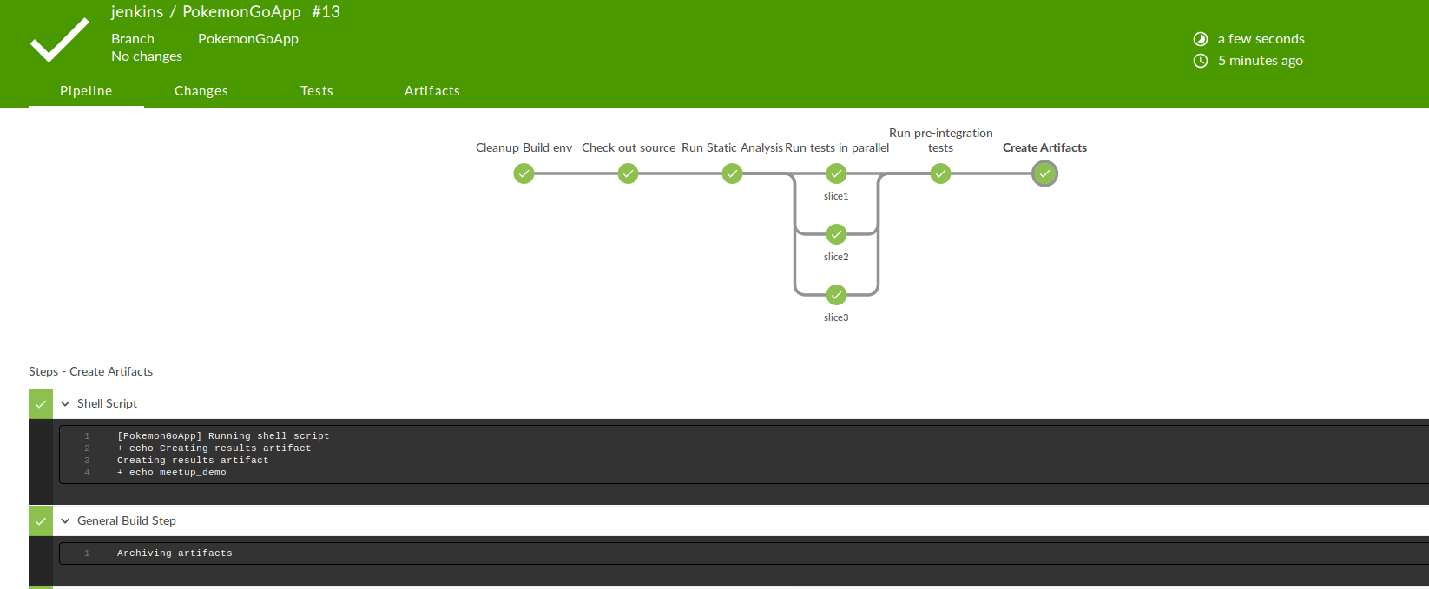

Slide 23
Pipeline in depth
node { // no label specified, will run on first node found without a label, it this case it’s the jenkins master
stage "Cleanup Build env" // define a stage
sh "rm -rf jenkins2ci" // create a shell script task
stage "Check out source"
sh "git clone https://github.com/tomwillfixit/jenkins2ci.git"
stage "Run Static Analysis"
sh "echo Running static analysis;sleep 2"
stage "Run tests in parallel"
parallel (
slice1: { node('alpine') { //provide a node label to ensure tests run on the correct slaves
sh "echo running tests in slice1 ; sleep 3"
}},
slice2: { node('alpine') {
sh "echo running tests in slice2 ; sleep 4"
}},
slice3: { node('alpine') {
sh "echo running tests in slice3 ; sleep 5"
}}
)
stage "Create Artifacts"
sh "echo Creating results artifact; echo meetup_demo > ${env.BUILD_NUMBER}.results" // Using build environment variable
step([$class: 'ArtifactArchiver', artifacts: '*.results', fingerprint: false])
}

Slide 24
Pipeline examples
https://github.com/jenkinsci/pipeline-examples

Slide 25
What is a seed file?
“A seed aims to help automating the generation and management of pipelines for branches of a project in Jenkins.”
It’s all groovy.
Example can be found here :
https://github.com/tomwillfixit/jenkins2ci/blob/master/meetup/seed.groovy

Slide 26
How to use a seed file ?
Open a browser and go to : http://localhost:80
New Item → Freestyle Project → Enter Project name : MeetupSeed
On the configuration screen scroll down to the “Build” section
Select Process Job DSL and tick Use the provided DSL script
Paste the contents of https://github.com/tomwillfixit/jenkins2ci/blob/master/meetup/seed.groovy into the script window
Click Save.
Click “Build Now” from Dashboard

Slide 27
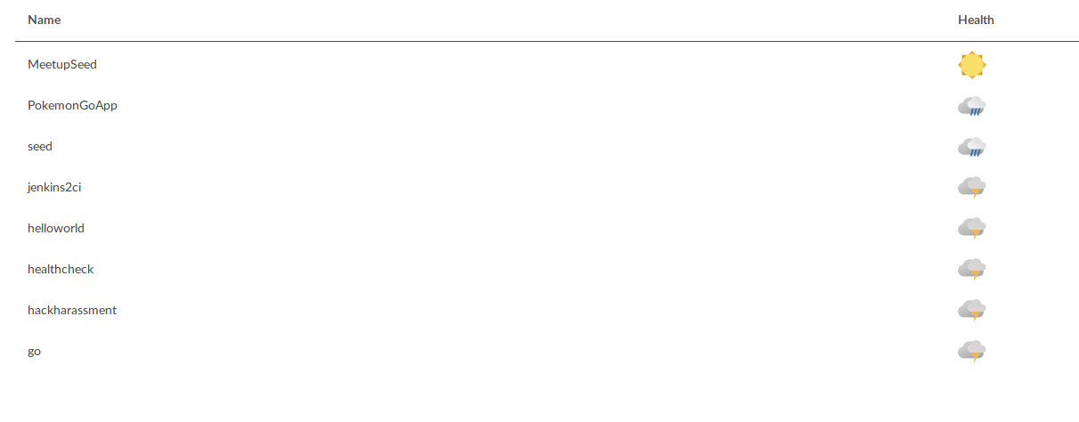
What just happened ?

Slide 28
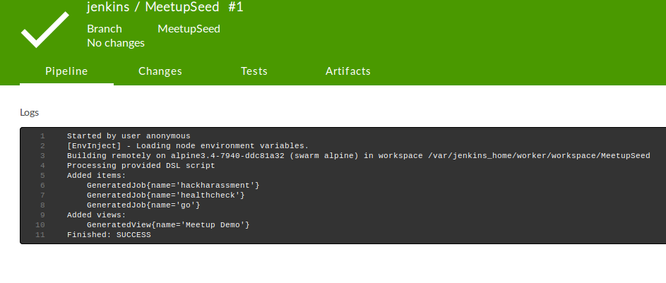
What just happened ?

Slide 29
Why are seed files useful ?
When a pipeline is defined in code, the number of pipelines will increase
Managing all projects from a single seed file makes addition/removal of projects simple
Redundancy.
Less clicking ( Yes, that’s directed at you Bamboo )

Slide 30
We are hiring !!

Slide 31
Questions ?

