Slide 1
THE RESEARCH WORKSPACE, A → Z
Throughline
One connected workflow from the first hunch to a submission-ready manuscript —
with methodological rigor built into every handoff.
Discover
Frame
Measure
Collect
Analyze
Write
Publish
“Strava for the research process.”
throughline-studio.vercel.app · Syed Asrar · June 2026

Slide 2
Research breaks at the handoffs
A social-science researcher stitches one project across a reference manager, a notes app, a survey platform, a stats package, and a word processor. Each is good at its slice. None of them know about each other.
Reference manager
✕
manual re-typing
Notes app
✕
The construct you operationalized isn’t linked to the theory you chose.
✕
manual re-typing
✕
The test you ran isn’t linked to the gap you claimed in your introduction.
Survey platform
The decision-chain lives only in your head — it leaks at every copy-paste.
✕
manual re-typing
✕
Stats package
Students lose marks and papers get desk-rejected — not because the idea was bad, but because the chain broke.
✕
manual re-typing
Word processor
Throughline · 2

Slide 3
One workspace. Seven stages. The chain holds.
A project advances along one spine — every stage carries its output forward as structured data, not a PDF you re-type.
Discover
Measure
Analyze
Publish
Search 9,388 hand-coded papers; build the reading list
Compose instruments from 332 validated scales
Textbook-verified statistics with APA write-ups
Preregistration + journal targeting
Frame
Collect
Write
Question, gap & hypotheses with a 632-theory lens
Power-based sample target, consent, survey handoff
IMRaD draft assembled from your own chain
The handoffs are the product. A gap found while reading seeds the question; the theory filters the scales; the instrument arrives in the survey pre-matched; the analysis lands in the draft as Methods + Results.
Throughline · 3

Slide 4
Grounded in real records — nothing invented
The AI suggests; the libraries ground it. Every citation, DOI, author and effect size in the suite is real and hand-verified.
9,388
632
332
hand-coded papers
curated theories
validated scales
DOI-keyed · 167 constructs · Scopus-graded
propositions, citations, influence map
items, reliability, APA citations
288
1,959
48
reference books
Scopus journals
method pitfalls
141,077 pages, full-text searchable
turnaround data, every value sourced
hand-cited paradoxes, fallacies & biases
Hard rule across the suite: fewer verified entries beat inflated counts — a made-up citation can retract a real paper.
Throughline · 4

Slide 5
What “connected” actually means
1
A gap you spot in Discover → seeds the research question and hypotheses in Frame.
2
The theory you choose in Frame → filters which validated scales Measure offers you.
3
The instrument you compose in Measure → arrives in Collect with consent and a sample-size target.
4
The analyses you run in Analyze → land in Write as Methods and Results, APA write-up attached.
Nothing is re-typed, so nothing silently drifts. The hypothesis still matches the design; the scale still matches the construct; the test still matches the data.
Throughline · 5

Slide 6
Every point has a free competitor. The line doesn’t.
THE POINTS
THE LINE
Zotero
Research Rabbit
1 The connected workflow Value compounds across stages. No single competitor spans the arc — and the switching cost is the whole chain. 2 Rigor as a first-class citizen Grounded catalogs, hand-verified statistics, citations everywhere. It nudges you toward defensible research.
JASP / SPSS
Qualtrics
Google Docs
ChatGPT
Each is excellent at its slice — and free. None of them know what the others decided.
We don’t out-feature the points. We own the line between them.
Throughline · 6

Slide 7
The wedge: research-methods education
G
Graduate students
M
Methods instructors
Running a first thesis or dissertation. They feel the broken chain hardest — and can’t afford five separate subscriptions.
Need students to see the research process as one coherent arc — and to grade work where the decision-chain is visible.
WHY THIS WEDGE
The pain is sharpest here — methods is where marks are lost and desk-rejections happen.
The buyers are concentrated and reachable: departments and methods instructors.
Rigor reads as a feature in education; in industry it can read as friction.
Habit seeds early — today’s grad student is tomorrow’s PI and tomorrow’s reviewer.
Then widen → independent researchers · small labs · UX research · people analytics · policy evaluation
Throughline · 7

Slide 8
Why now
✦
!
↓
AI without grounding is confidently wrong
Rigor is under scrutiny
The build cost collapsed
Generic AI invents citations and effect sizes. Throughline’s AI is grounded in its own verified libraries — and cites them. That only works because the tools are connected.
After the replication crisis, reviewers and committees ask for an explicit, auditable decision-chain. Throughline makes the chain the interface.
One shared AI backend powers every stage; connected suites are now cheap to build. The cost of trusting an un-grounded one has gone up.
Grounding is the antidote — and grounding only compounds when the steps are connected.
Throughline · 8

Slide 9
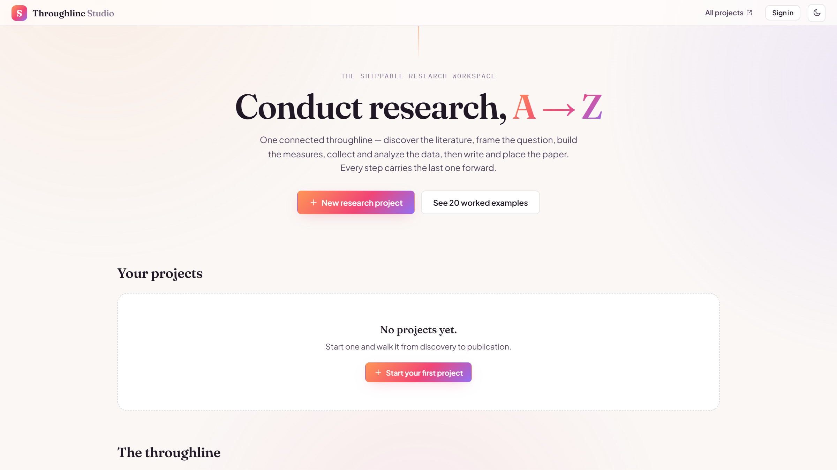
Not a deck — a deployed product
✓
All 7 stages live, working on the real libraries — corpus, theories, scales.
✓
Statistics engine verified against textbook values: 13/13 numerical checks pass.
✓
20 worked examples — classic studies walked A→Z, every paper DOI-verified.
✓
The full suite deployed behind it: 6 workflow tools + 4 reference libraries.
throughline-studio.vercel.app — live today
Throughline · 9

Slide 10
THE ASK
One methods cohort. End to end.
Run one graduate research-methods cohort through Throughline — real students, real projects,
from first hunch to submitted manuscript — and publish an honest account of where the chain held and where it broke.
Pilot cohort
→
Identity & sync
→
Metering & billing
→
Collaboration
The product exists. The pilot proves it.
Syed Asrar · asrarsaa@gmail.com · throughline-studio.vercel.app

