Slide 1



VIKTOR SMART ROUTER
NO WAY HOME

Slide 2
WHAT WE ACHIEVED
Slashing Input Cost by 55.4% with
0 switches

Slide 3
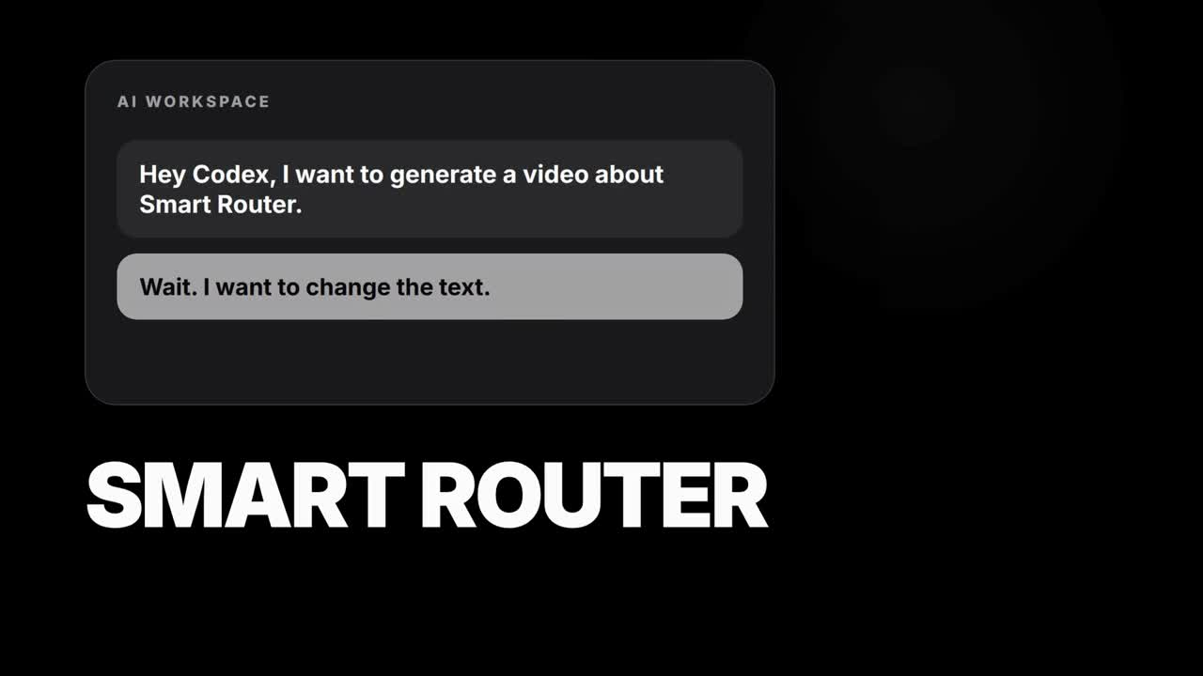

Slide 4


Reroute before Call 1—not between calls
Logged data
C1
Opus
C2
Opus
C3
Opus
C4
Opus
C5
Opus
C6
Opus
C7
Opus
C8
Opus
$0.016872
claude-opus-4-8 · 197b…
logged input cost
Call-1 classifier chooses the cheap sibling once
Smart route
C1
Sonnet
C2
Sonnet
C3
Sonnet
C4
Sonnet
C5
Sonnet
C6
Sonnet
C7
Sonnet
C8
Sonnet
$0.006749
claude-sonnet-5 · same task
smart input cost · −60.0%
What “0 switches” means: this trajectory was rerouted from Opus to Sonnet, then Sonnet served every call. The model changed versus the log—but never inside our route—so the growing prefix stayed cache-readable.

Slide 5
What the router looks at
Structure in the traces
Cache before 1st Call
A logistic classifier reads the opening call only:
presence of reasoning items,
input images,
position in the trajectory, and
task category.
It predicts whether the logged model’s next action is a simple, low-complexity tool call.
At call_index = 1, an opening call with no reasoning items and no image content scores high on the “simple action” signal, and routes the whole trajectory to the cheap sibling model before any tokens are spent on premium reasoning.

Slide 6
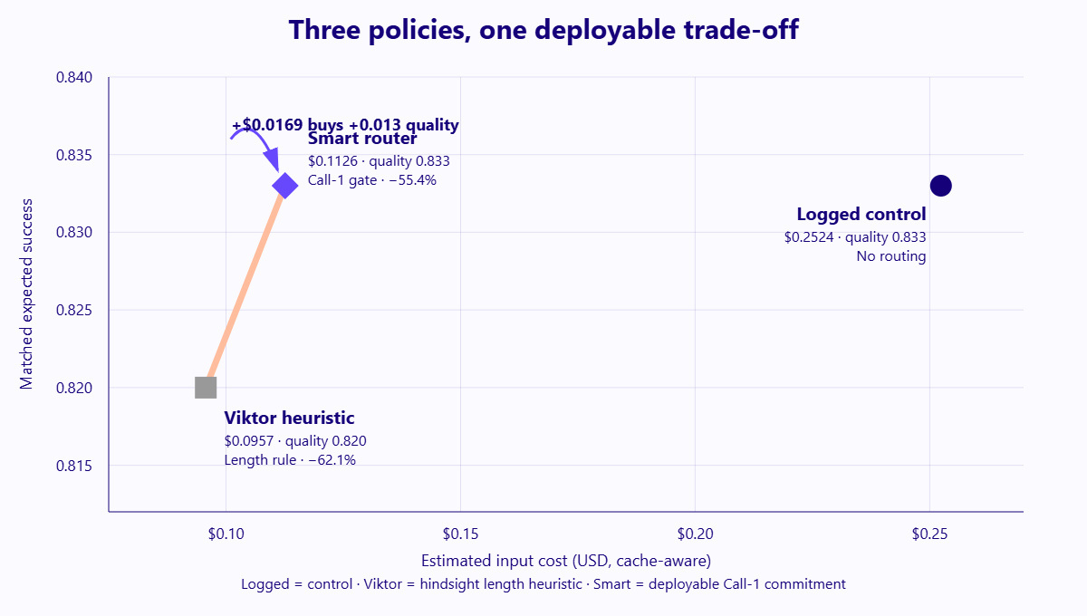
15/25 tasks moved to cheaper models. None switched mid-task.
LOGGED POLICY
$0.2524
no routing, full price
SMART ROUTER
$0.1126
−55.4% · 0 switches · 0.833 success
Source: results/frontier_2.csv

Slide 7
The trade-off we chose
COST vs. SUCCESS
We optimized for cost reduction while holding expected task success roughly flat, because Viktor’s traffic is dominated by many cheap, repeatable tool-call steps where premium-model quality is rarely needed.
0.833
matched expected success
vs. 0.820 baseline

Slide 8
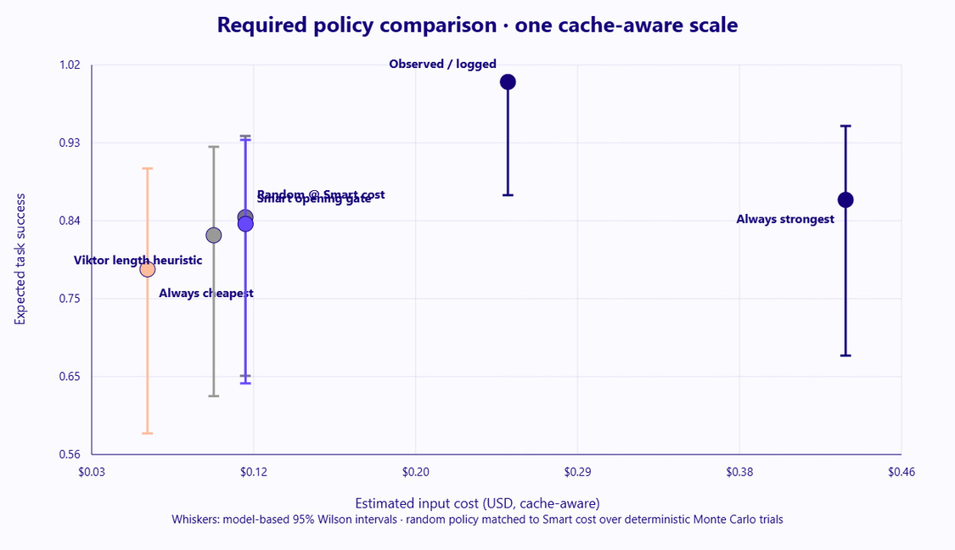
6 Policies
Policy | Cost | Quality
Observed / logged | $0.2524 | 1.000 observed
Always cheapest | $0.0604 | 0.780
Always strongest | $0.4324 | 0.861
Random @ Smart cost | $0.1125 | 0.841
Viktor heuristic | $0.0957 | 0.820
Smart router (ours) | $0.1126 | 0.833

Slide 9
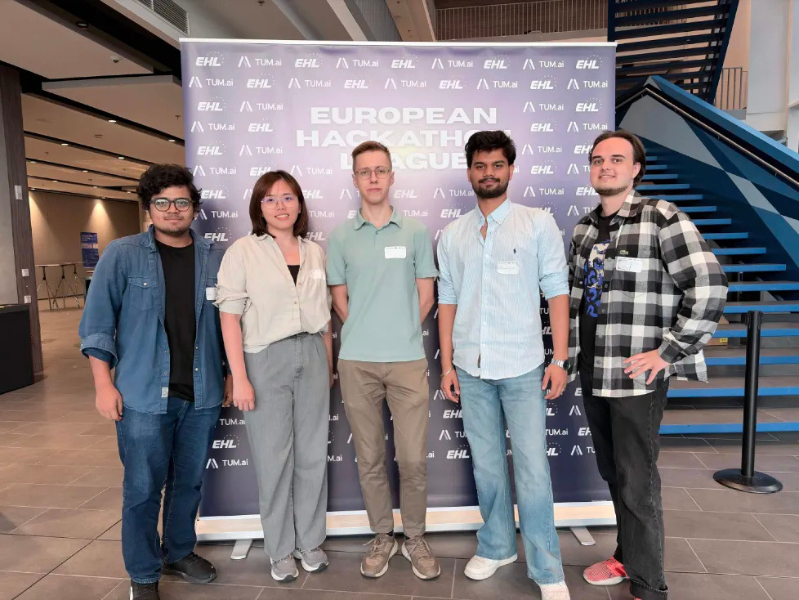
THANK YOU
NO WAY HOME

