Slide 1
DryadSynth: A Concolic SyGuS Solver
Kangjing Huang, Xiaokang Qiu, Qi Tian, Yanjun Wang
Purdue University
SYNT Workshop
July, 2018

Slide 2
DryadSynth
Is input problem in one of the decidable fragments?
Attempting the decidable procedures
Yes
CEGIS-based search approach
Concolic (Concrete + Symbolic) search
Decision-tree representation
Similar to EUSolver
One solver for two tracks
CLIA + INV
Two decidable fragments for speeding up
One in CLIA and one in INV
Decidable procedure attempted before falling back to search
Done
Failed
Output results
No
Invoking CEGIS search procedures
Done
Notes:
This slide is about the overall design of DryadSynth
Key point is the utilization of decidable fragments, which are auto detected and attempted to speed up the synthesis rather than use pure search approach.

Slide 3



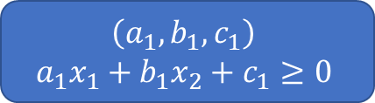
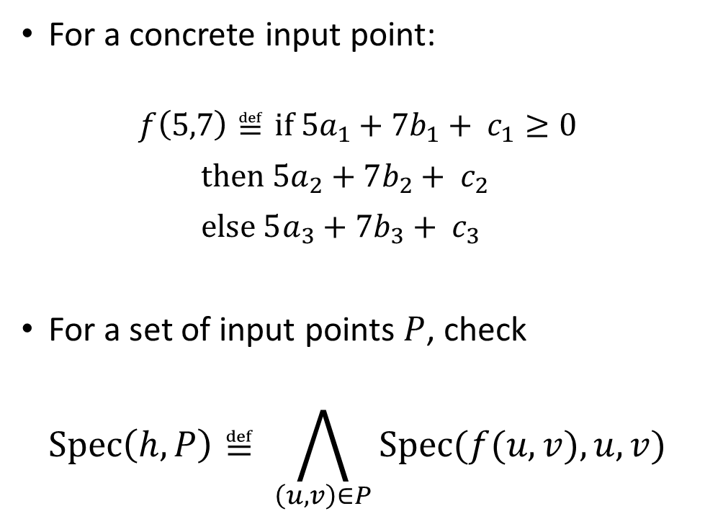
CEGIS: Symbolic Search for Fixed Tree Height
Decision-Tree representation
Synthesizing $f(x_{1},x_{2})$, $h=2$:
For a concrete input point:
$$f\left(5,7\right)≝\text{if} 5a_{1}+7b_{1}+ c_{1}≥0$$
$\text{then} 5a_{2}+7b_{2}+ c_{2}$
$\text{e}\text{lse} 5a_{3}+7b_{3}+ c_{3}$
For a set of input points $P$, check
$$\text{Spec}\left(h, P\right)≝ \bigwedge_{\left(u,v\right)∈P}{\text{Spec}(f(u,v), u, v)}$$
$$\left(a_{1},b_{1},c_{1}\right)$$
$$a_{1}x_{1}+b_{1}x_{2}+c_{1}≥0$$
true
false
$$\left(a_{2},b_{2},c_{2}\right)$$
$$a_{2}x_{1}+b_{2}x_{2}+c_{2}$$
$$\left(a_{3},b_{3},c_{3}\right)$$
$$a_{3}x_{1}+b_{3}x_{2}+c_{3}$$
Notes:
This slide is about the fallback CEGIS algorithm’s symbolic search part.
Symbolic search is performed based on fixed height decision-tree representation of candidate functions.

Slide 4

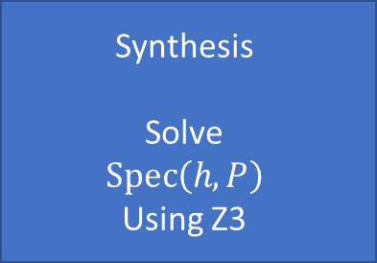



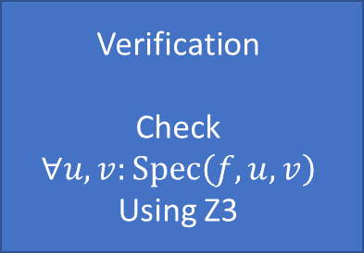

CEGIS: Enumeration from Smallest Height
Candidate implementation $f$
succeed
Synthesis
Solve
$$\text{Spec}\left(h, P\right)$$
Using Z3
fail
Verification
Check
$$∀u, v:\text{Spec}\left(f, u, v\right)$$
Using Z3
$$h≔h+1$$
succeed
Done
Height $h$
Input points $P$
Add counterexample to $P$
Notes:
This slide is about the fallback CEGIS algorithm’s concrete search part.
Concrete search is performed from the smallest height, which is increased in a CEGIS procedure.

Slide 5


CLIA Decidable Fragment: SSI
Example for $\text{max}\text{2}(x,y)$ :
$\text{Spec}\text{(}f(x,y)\text{) =}$
$f\left(x,y\right)≥x ∧f\left(x,y\right)≥y∧(f\left(x,y\right)=x∨f\left(x,y\right)=y)$
Candidates: $x, y$
Constructed solution:
$f\left(x,y\right)=\text{if} \text{Spec}\text{(}x) \text{then} x$
$\text{else} \text{if} \text{Spec}\text{(}y) \text{then} y$
$\text{else}\text{ 0}$
Result: $\text{Spec}\text{(}x) ⇒x≥y, \text{Spec}\text{(}y)⇒y≥x$
SSI: Strong Single Invocation
Stronger version of Single Invocation (SI)
59 out of our 73 tested CLIA benchmarks are SSI
SSI criterion: $\text{Spec}\left(f, x, y\right)$
$f$ only occurs in $\text{Spec}$ as one certain invocation $f(t_{1},t_{2})$
In each atomic formula, $f(t_{1},t_{2})$ occurs at most once
All atomic formula then has form:
$f\left(t_{1},t_{2}\right)≥T_{i}(x, y)$
Construct solution using $T_{i}(x, y)$ as candidates for different branches
Polynomial complexity, better than SI
Notes:
This slide is about our decidable fragment for CLIA track: SSI
SSI is an improved version of the well-known SI strategy (Which is used in CVC4, through CEGQI, Counterexample-Guided Quantifier Instantiation procedures), with improved complexity and scalability.
Could elaborate more on this slide, since DryadSynth benefits greatly through this algorithm to win in CLIA track. I included an example for detailed explanation.

Slide 6
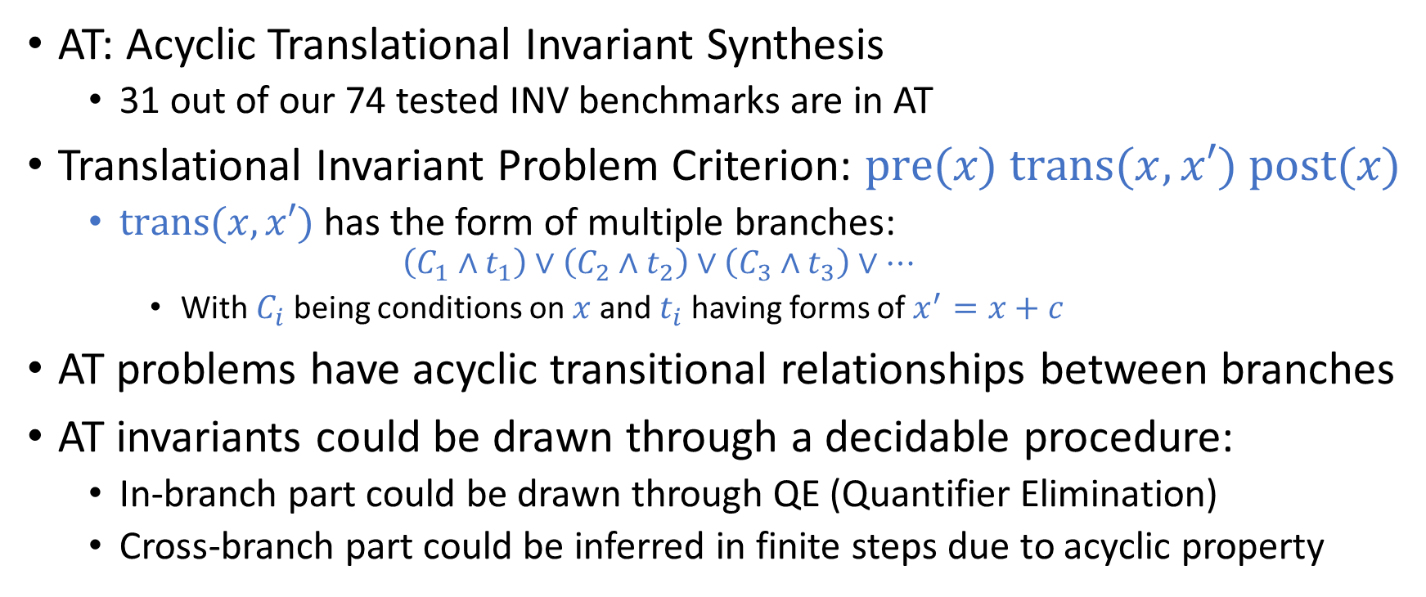
INV Decidable Fragment: AT
AT: Acyclic Translational Invariant Synthesis
31 out of our 74 tested INV benchmarks are in AT
Translational Invariant Problem Criterion: $\text{pre}\text{(}x\text{) }\text{trans}\text{(}x, x′\text{) }\text{post}\text{(}x\text{)}$
$\text{trans}\text{(}x, x′\text{)}$ has the form of multiple branches:
$$\left(C_{1}∧t_{1}\right)∨\left(C_{2}∧t_{2}\right)∨\left(C_{3}∧t_{3}\right)∨⋯$$
With $C_{i}$ being conditions on $x$ and $t_{i}$ having forms of $x^{′}=x+c$
AT problems have acyclic transitional relationships between branches
AT invariants could be drawn through a decidable procedure:
In-branch part could be drawn through QE (Quantifier Elimination)
Cross-branch part could be inferred in finite steps due to acyclic property
Notes:
This slide is about our decidable fragment for INV track: AT
Details of this algorithm contains complex procedures and proofs, so I didn’t elaborate much on this slide.
As more attentions should be cast on SSI slide, could be faster on this slide omitting some details
Could mention that the details of this algorithm would be included in our future publication.

Slide 7
Thank you!

