Slide 1
Energy Dashboard
Design
15.04.2015
All Informations or definitions are based on Full-HD Slides (1920x1080 px)

Slide 2
Basic Information
Colors
In the following slides these colors are used:
Black #000000
Grey #585858
Light Grey #a0a0a1
Red #e81716
Blue #1e6cbb
Green #89ac00
Orange #ef4e23
white #ffffff
Position/Grid
Please take the design-screens of the several slides to define the position of elements in development

Slide 3
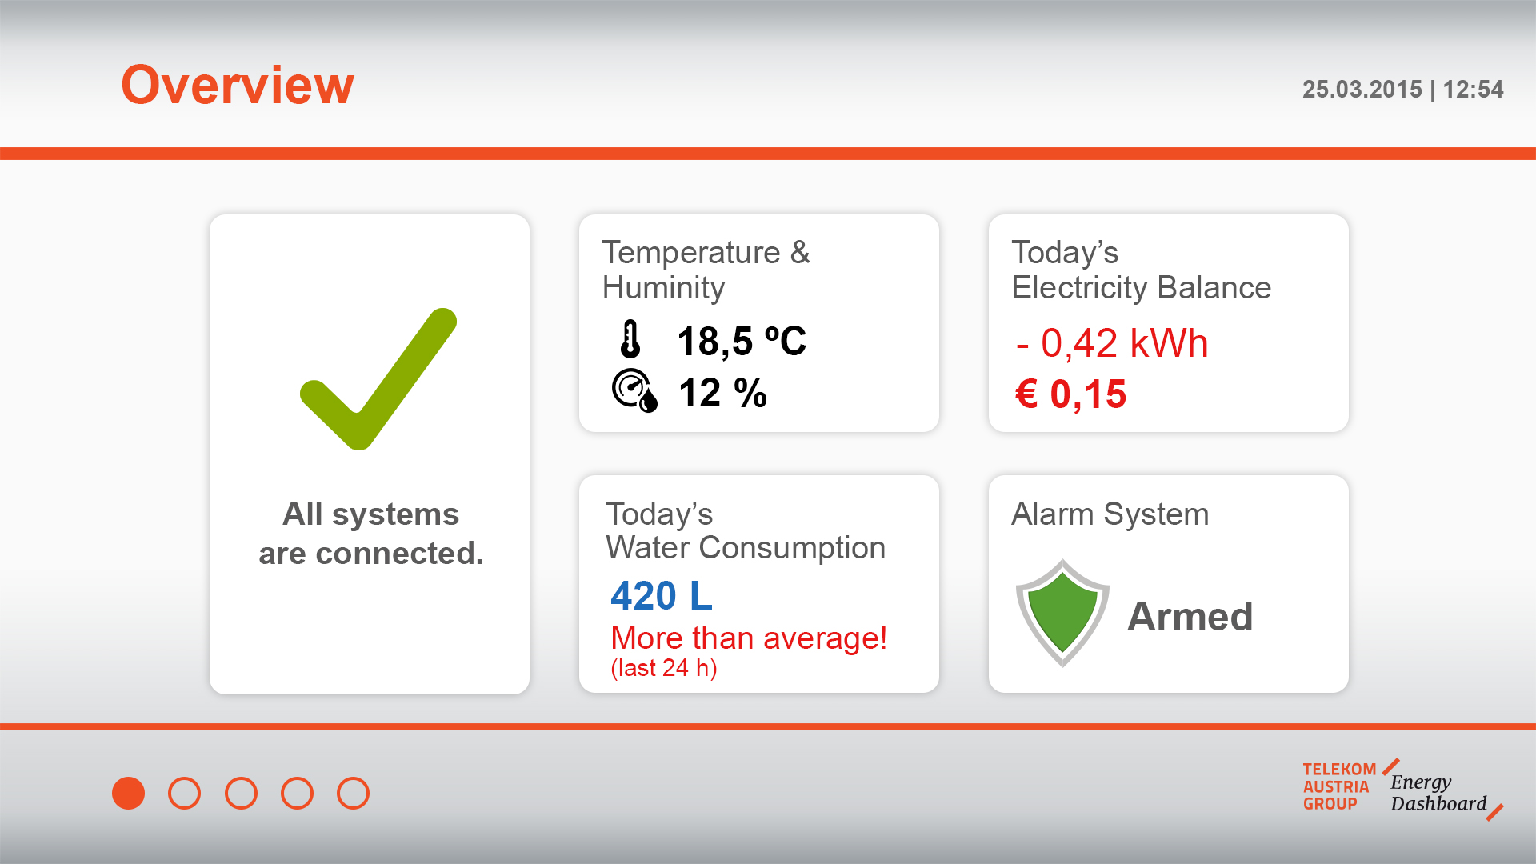
Slide 1: Overview
Headline:
Arial bold, 66 px,
Orange
Headlines:
Arial bold, 30 px,
Grey
Arial bold, 50 px,
Black
Headlines:
Arial regular, 40 px,
Grey
Arial bold, 40 px,
Grey
Arial regular/bold, 50 px,
Red
Arial bold, 40 px,
Blue
Arial bold, 40 px,
Grey
Arial regular, 40 px/30 px
Red

Slide 4
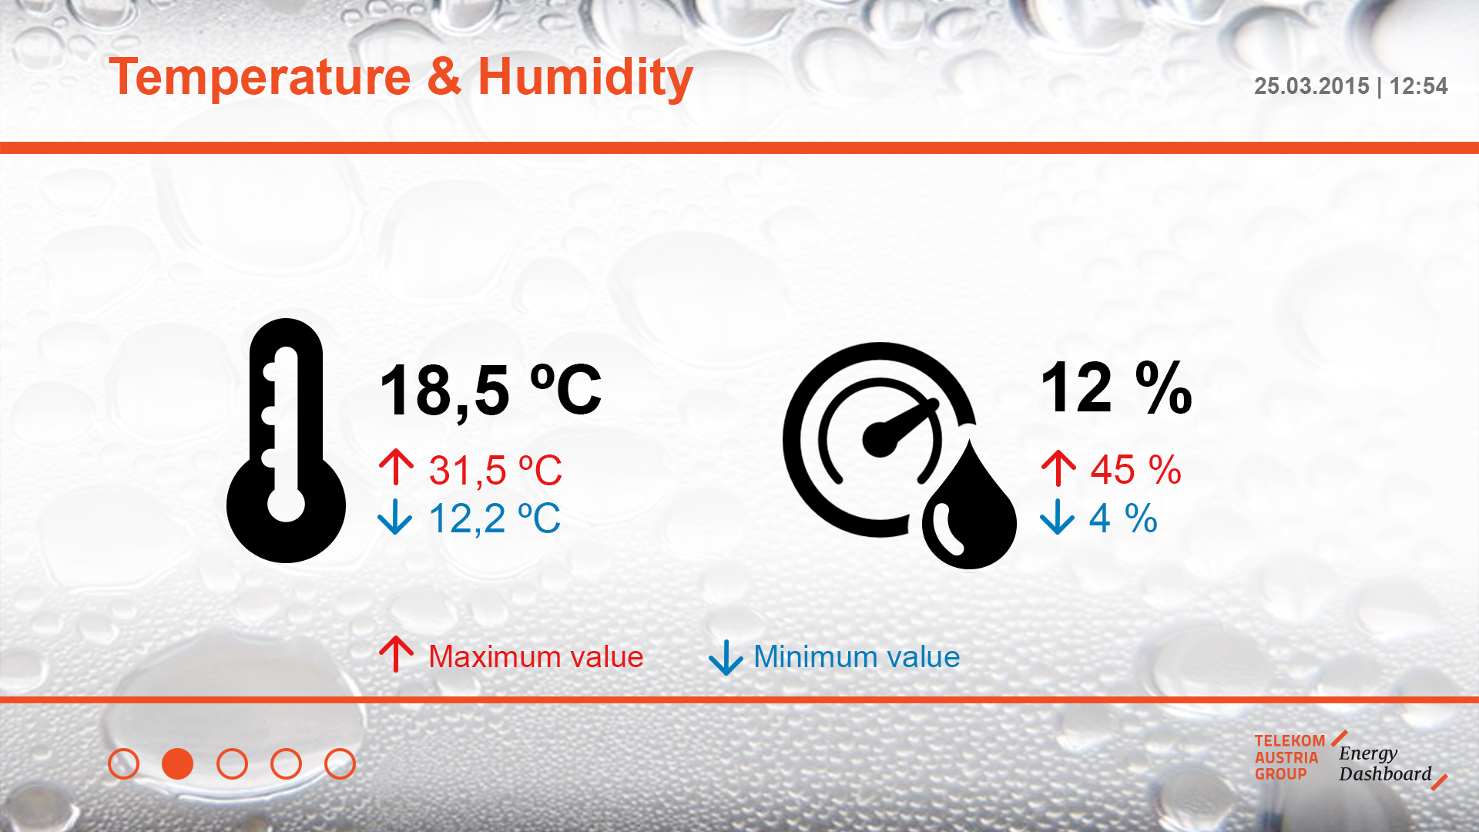
Slide 2: Temperature & Huminity
Arial bold, 90 px,
Black
Arial regular, 50 px,
Red/Blue
Arial regular, 40 px,
Red/Blue

Slide 5
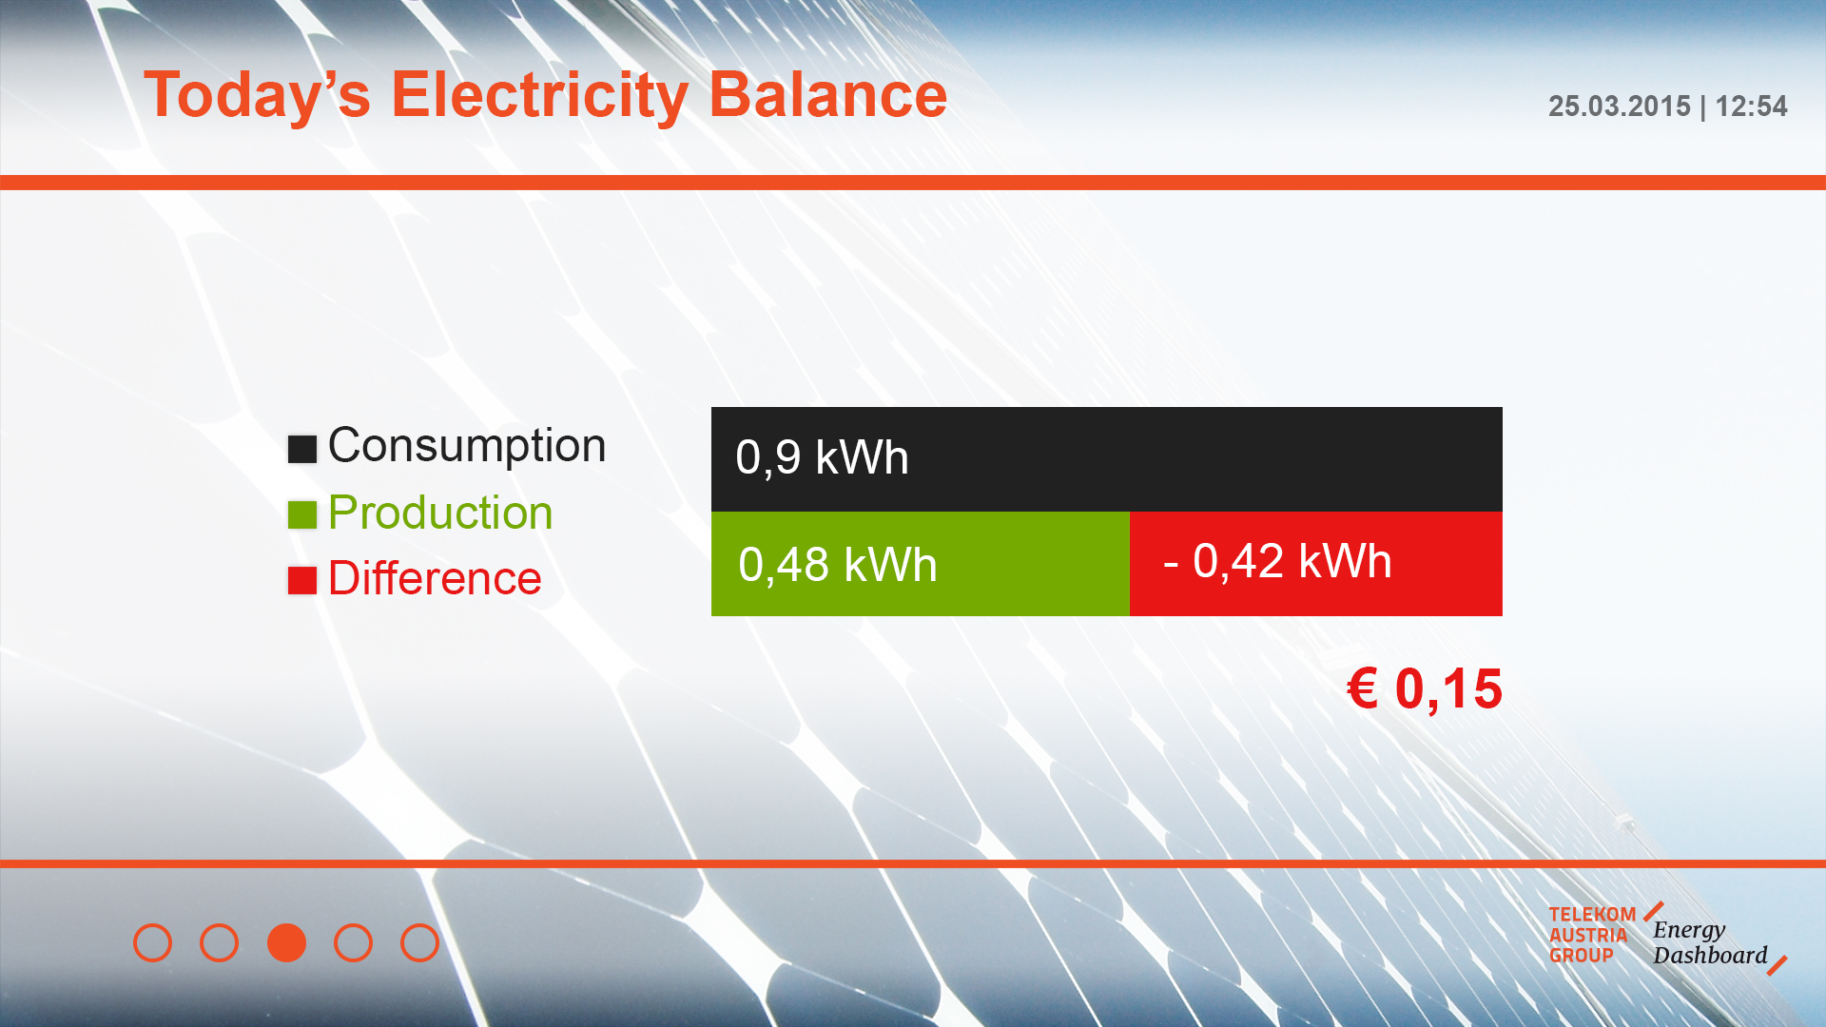
Slide 3: Electricity
Arial bold, 60 px,
red
Arial regular, 50 px
Black/Green/Red
Arial regular, 50 px
white

Slide 6
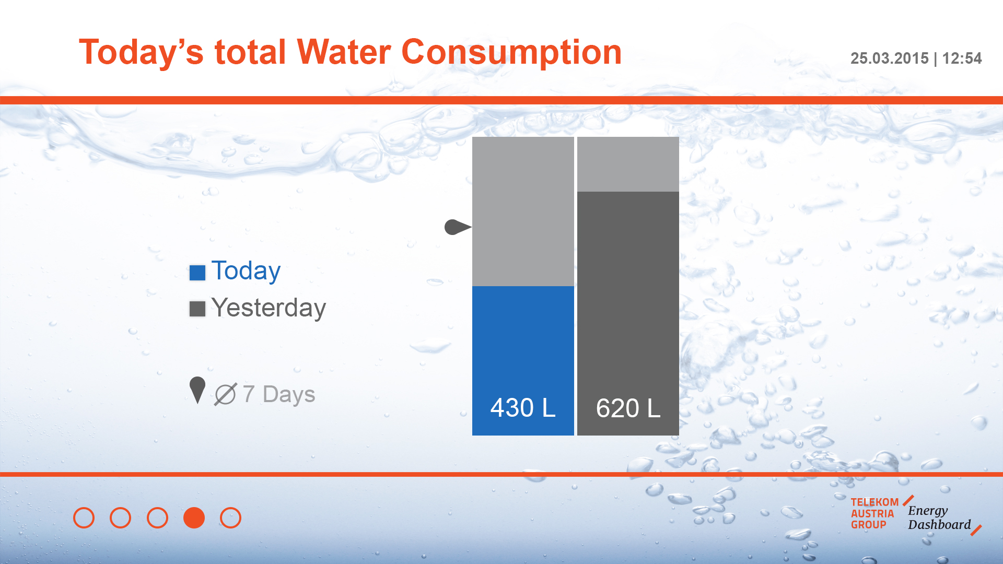
Slide 4: Water
Arial regular, 50 px
Blue/Grey/Light grey
Arial regular, 50 px
white

Slide 7

Slide 5: Alarm
Arial bold, 70 px,
grey
Arial bold, 40 px
Red
Arial regular, 50 px
Red

Slide 8
Thanks!

