Slide 1
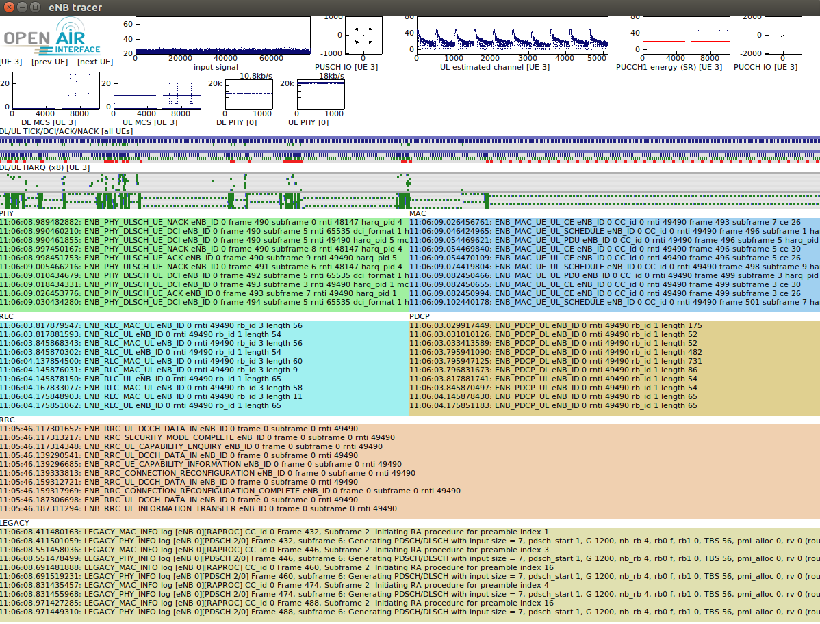
Select the
UE to monitor
Time signal
power
Pusch
I/Q Modulation
Channel
delay spread
Selected UE
energy
PUCCH
I/Q Modulation
Selected UE graphs
Time chart 1
Time chart 2
MAC level traces
PHY level traces
RLC level traces
PDCP level traces
RRC level traces
LOG_x traces

