Slide 1
GAME310 Lesson 02
Artificial Intelligence
Wed, Sep 11th, 2019
Professor: Majid Moghadam

Slide 2
Objectives
Udemy Tutorials:
Section 1: Introduction
4. Not So Scary Vector Mathematics
Section 2: Moving
7. Vectors and Moving in a Straight Line

Slide 3
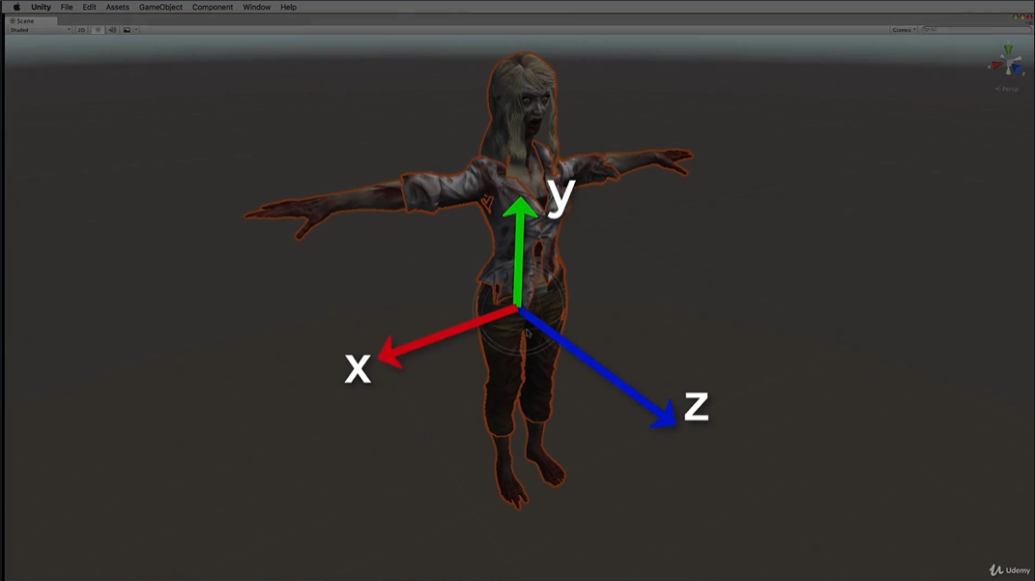
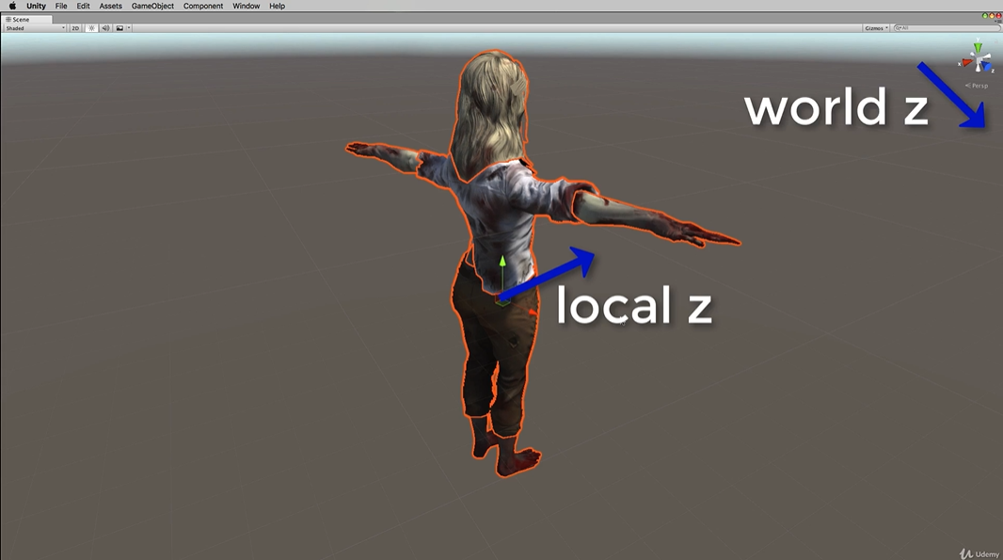
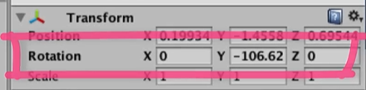
Section 1: 4. Not So Scary Vector Mathematics
NPC forward direction lies along its local Z-axis
Initially its local axis is aligned with the world Z-axis unless it is rotated

Slide 4
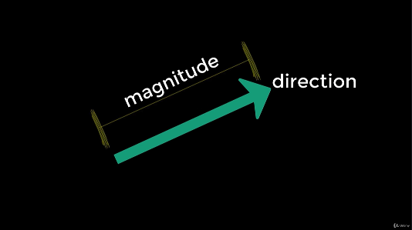
Section 1: 4. Not So Scary Vector Mathematics (cont’d)
Vectors represent real word quantities that have a direction and a magnitude
displacement, velocity, force and acceleration can be vectors (when direction is given)
Distance, speed, mass and height are not vectors. They are simple numbers, or scalars, with no direction

Slide 5
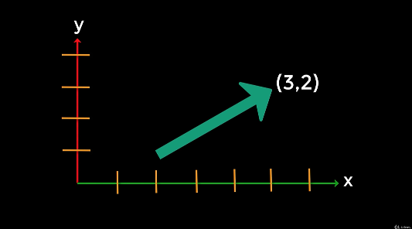
Section 1: 4. Not So Scary Vector Mathematics (cont’d)
The vector (3, 2) refers to a vector with x-component 3 and y-component 2.
It does not refer to its start or end positions
In the diagram, the vector (3,2) just happens to start at the position (2,1) and end at the position (5,3)
(5,3)
Vertical component
(2,1)
Horizontal component

Slide 6
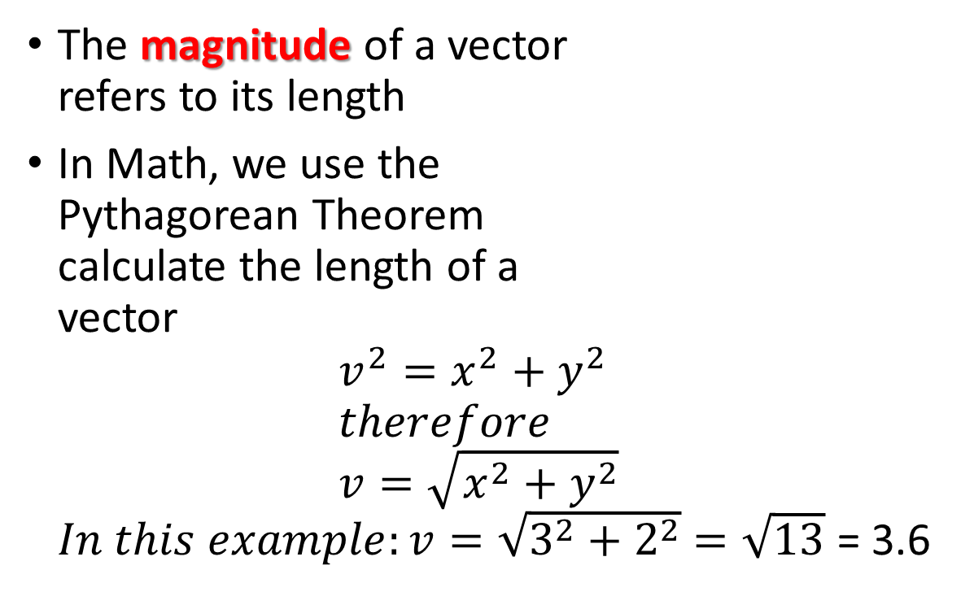
Section 1: 4. Not So Scary Vector Mathematics (cont’d)
The magnitude of a vector refers to its length
In Math, we use the Pythagorean Theorem calculate the length of a vector ${v^{2}=x}^{2}+y^{2}$ $therefore$ $v=\sqrt{x^{2}+y^{2}}$ $In this example:v=\sqrt{3^{2}+2^{2}}$ $=\sqrt{13}$ = 3.6
(5,3)
v
y
(2,1)
x

Slide 7
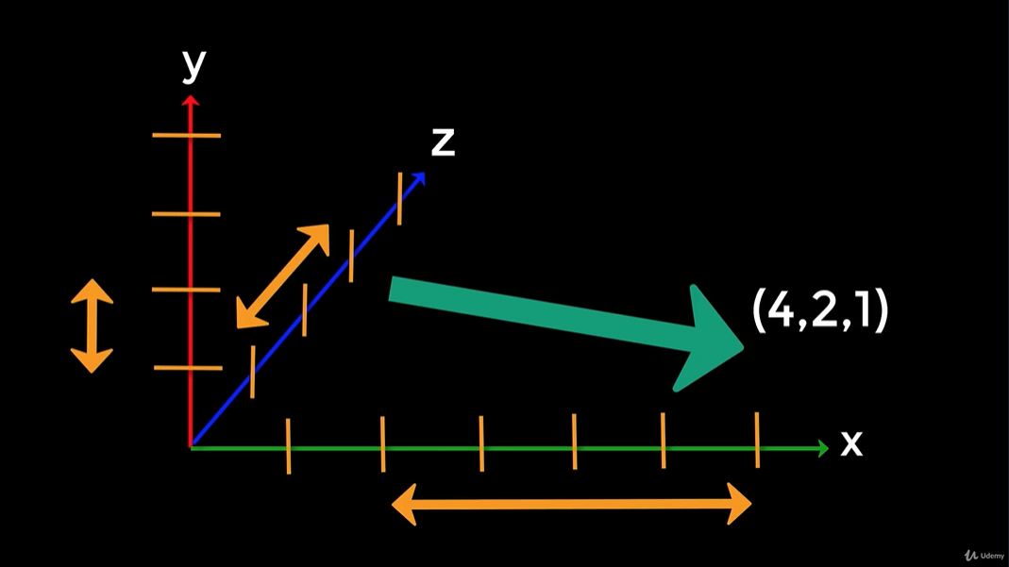
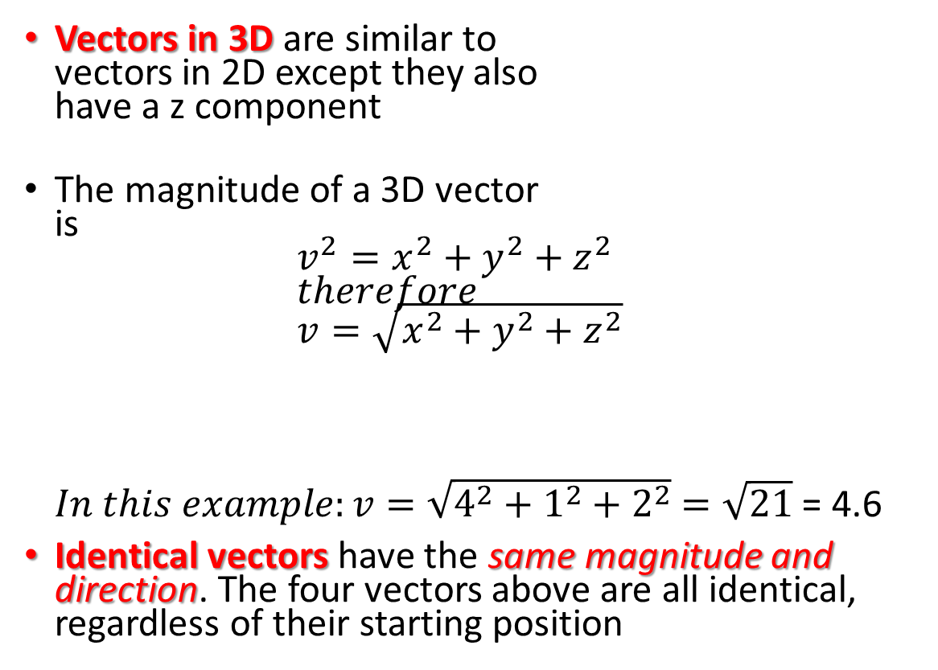
Section 1: 4. Not So Scary Vector Mathematics (cont’d)
(4,1,2)
Vectors in 3D are similar to vectors in 2D except they also have a z component
The magnitude of a 3D vector is ${v^{2}=x}^{2}+y^{2}+z^{2}$ $therefore$ $v=\sqrt{x^{2}+y^{2}+z^{2}}$ $In this example:v=\sqrt{4^{2}+1^{2}+2^{2}}$ $=\sqrt{21}$ = 4.6
Identical vectors have the same magnitude and direction. The four vectors above are all identical, regardless of their starting position
(4,1,2)
z = 2
(4,1,2)
y = 1
(4,1,2)
x = 4

Slide 8
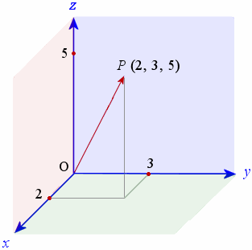
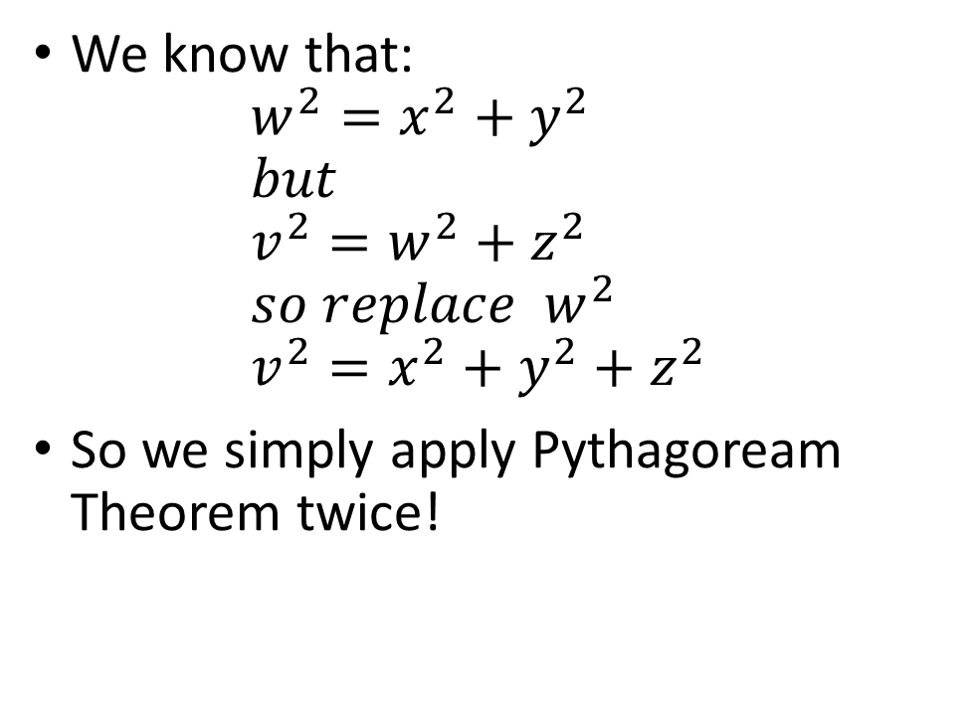
“Proof” of 3D Magnitude Formula
We know that: ${w^{2}=x}^{2}+y^{2}$ $but$ ${v^{2}=w}^{2}+z^{2}$ $so replace { w}^{2}$ ${v^{2}=x}^{2}+y^{2}+z^{2}$
So we simply apply Pythagoream Theorem twice!
v
z = 5
w
x = 2
y = 3

Slide 9
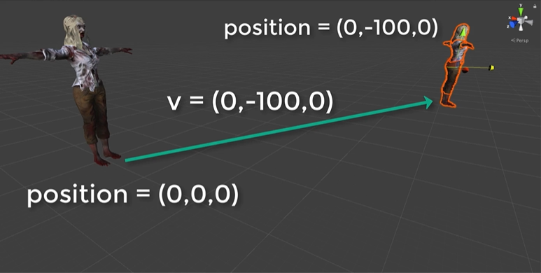
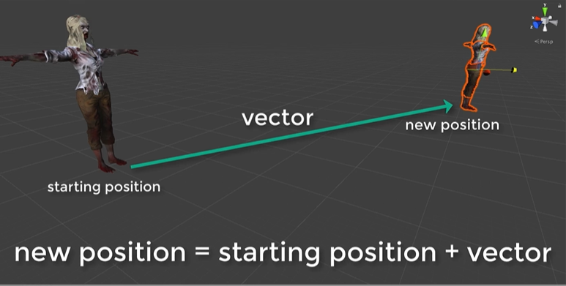
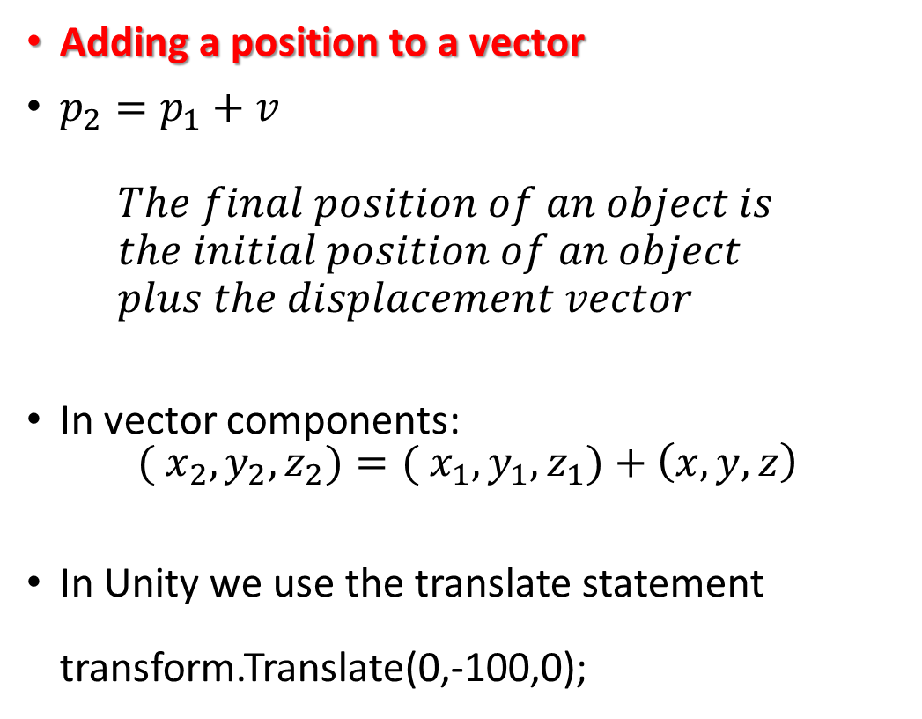
Section 1: 4. Not So Scary Vector Mathematics (cont’d)
Adding a position to a vector
$p_{2}=p_{1}+v$ $The final position of an object is$ $the initial position of an object$ $plus the displacement vector$
In vector components: ${( x}_{2},y_{2},z_{2})={( x}_{1},y_{1},z_{1})+\left(x,y,z\right)$
In Unity we use the translate statement transform.Translate(0,-100,0);
p2
p1

Slide 10
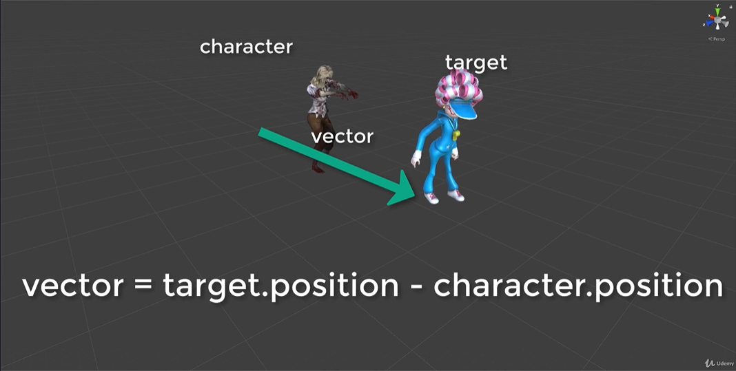
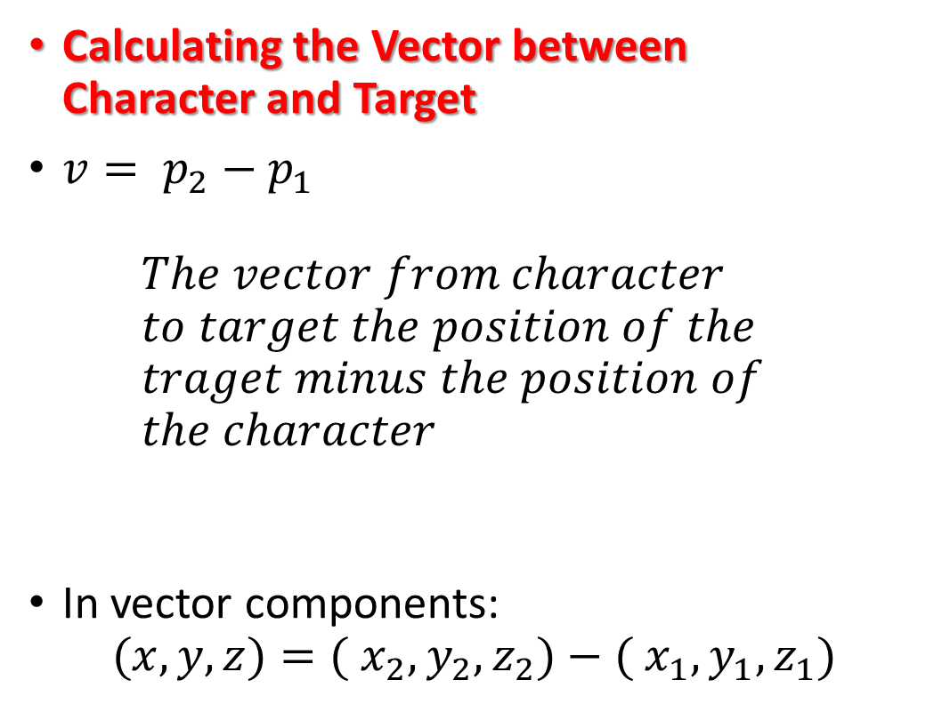
Section 1: 4. Not So Scary Vector Mathematics (cont’d)
Calculating the Vector between Character and Target
${v= p}_{2}−p_{1}$ $The vector from character$ $to target the position of the$ $traget minus the position of$ $the character$
In vector components: $(x,y,z)={( x}_{2},y_{2},z_{2})−{( x}_{1},y_{1},z_{1})$

Slide 11
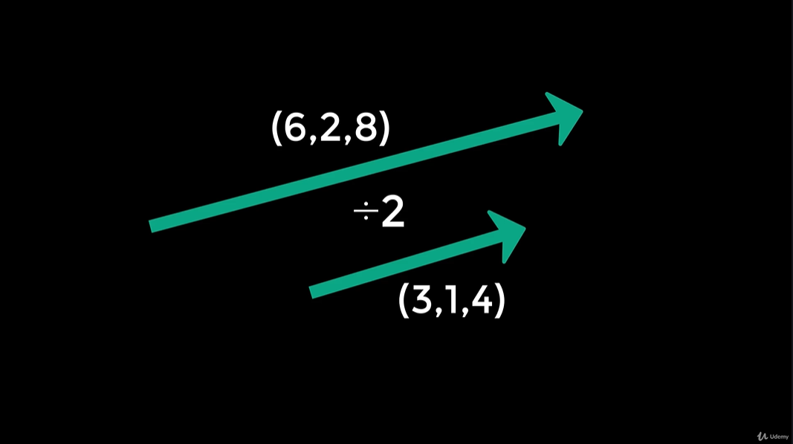
Section 1: 4. Not So Scary Vector Mathematics (cont’d)
Scaling a vector
You can scale a vector (make it bigger or smaller, but keeping the same direction) by multiply or dividing by a number
Multiplying by a number larger than 1 increases the size
Dividing by a number larger than 1 makes the vector smaller

Slide 12
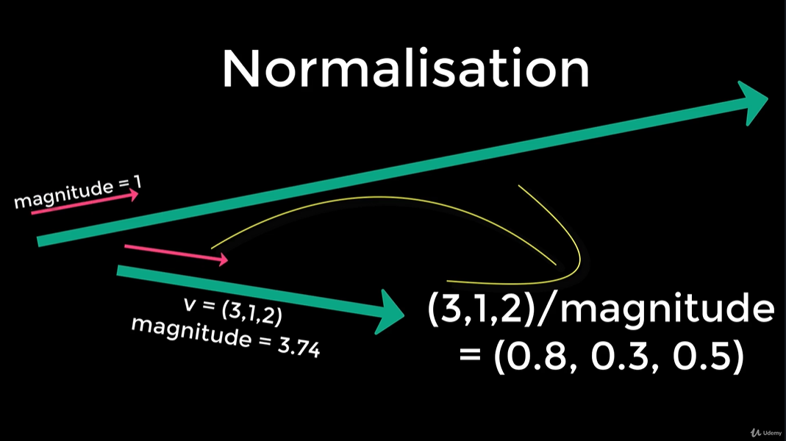
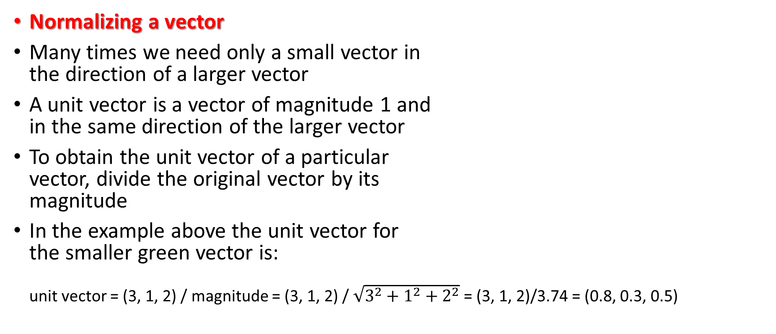
Section 1: 4. Not So Scary Vector Mathematics (cont’d)
Normalizing a vector
Many times we need only a small vector in the direction of a larger vector
A unit vector is a vector of magnitude 1 and in the same direction of the larger vector
To obtain the unit vector of a particular vector, divide the original vector by its magnitude
In the example above the unit vector for the smaller green vector is: unit vector = (3, 1, 2) / magnitude = (3, 1, 2) / $\sqrt{3^{2}+1^{2}+2^{2}}$ = (3, 1, 2)/3.74 = (0.8, 0.3, 0.5)

Slide 13
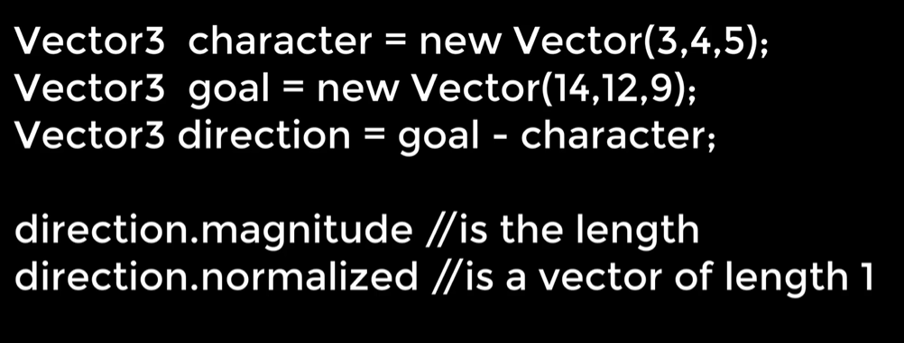
Section 1: 4. Not So Scary Vector Mathematics (cont’d)
Vector Math in Unity
The Unity library has many libraries / methods that make the Math easy!
ON the right are some of the similar methods we would use to do vector calculations:

Slide 14
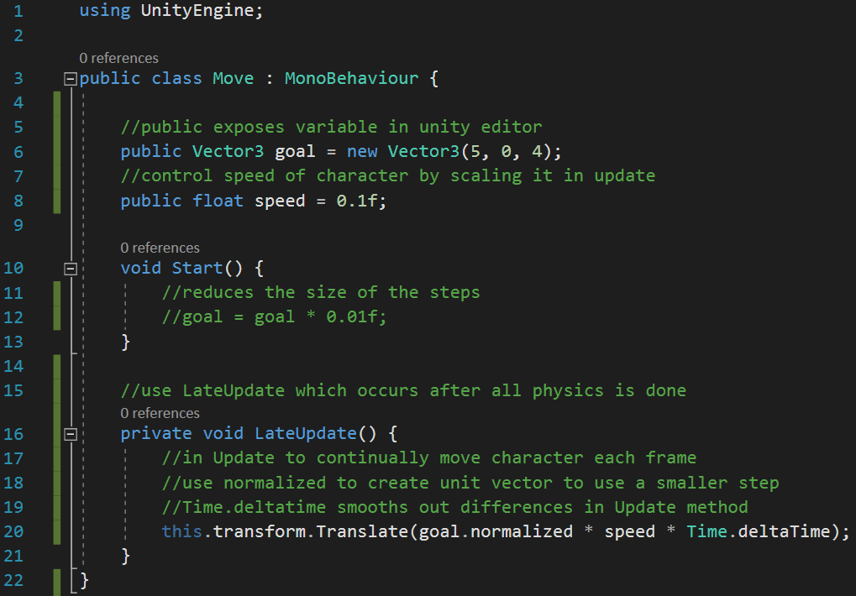
Section 2: Moving 7. Vectors and Moving in a Straight Line
You need to comment any changes made to the starter code using your own words
The sample to the is a good sample to follow
Not too verbose
Not too skimpy
Not stating the obvious
Comment out old code or code that is replaced (can also delete it if you want)

