Slide 1
GAME310 Lesson 03
Artificial Intelligence
Wed, Sep 18th, 2019
Professor: Majid Moghadam

Slide 2
Objectives
Test #1 – Friday, September 27th, 2019
Udemy Tutorials
Section 2: Moving
8. Travelling to a Goal Location
9. Pushing the Character Forward
10. Slerping
Quaternions vs. Euler Angles
Slerp vs. Lerp

Slide 3
Test #1
Friday, September 27th, 2019
15 Multiple Choice
Sections 1, 2 and 3 of the Udemy Tutorial Series
1. Introduction
2. Moving
3. Cars

Slide 4
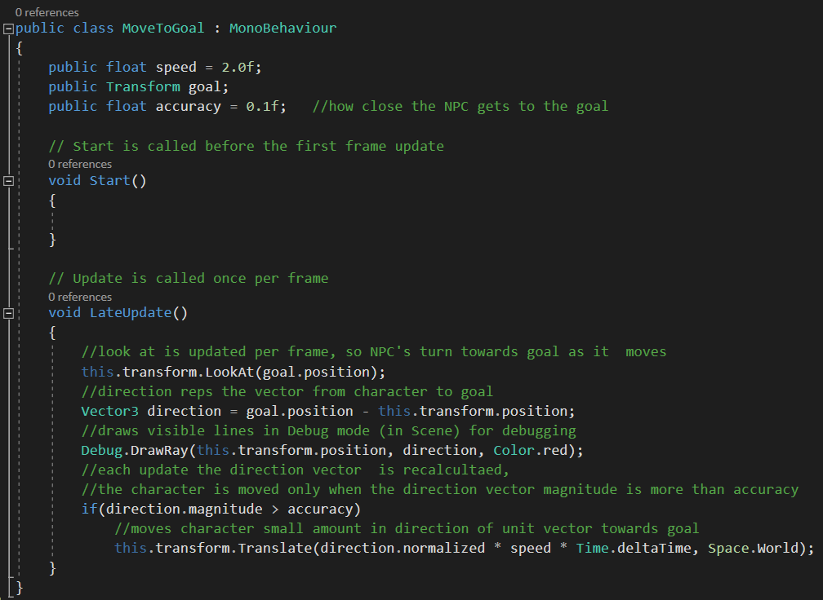
Section 2: Moving 8. Travelling to a Goal Location
This code improves on section 7 by calculating the direction vector between the NPC and the goal each frame. It’s not fixed.
Debug.DrawRay helps us to see this direction in debug mode
Translate move the NPC
What is the significance of Space.World? How does it work?
Let’s go to the code and find out

Slide 5
Section 2: Moving 8. Travelling to a Goal Location (cont’d)
If Space.World is the World coordinate system. If left out then the local coordinate system of the NPC is implied.
What is the “this” in this.transform.LookAt(…)?
“this” refers to the object to which the script is attached to. Can do without it, I prefer it there
More discussion: https://www.reddit.com/r/Unity3D/comments/63zcn4/does_thistransform_make_much_difference_from_just/

Slide 6
Section 2: Moving 8. Travelling to a Goal Location (cont’d)
Position vs. Vector
The variable direction is clearly of type Vector3
What type of variable is position? As in goal.position and this.transform.position?
They must be both Vector3 because the compiler would not allow you to assign anything but a Vector3 to direction.
But isn’t position a “point in space”? Kind of.
It is also a vector, starting from the origin to the point in space.
y
Start position
direction vector
Goal position
x
origin

Slide 7
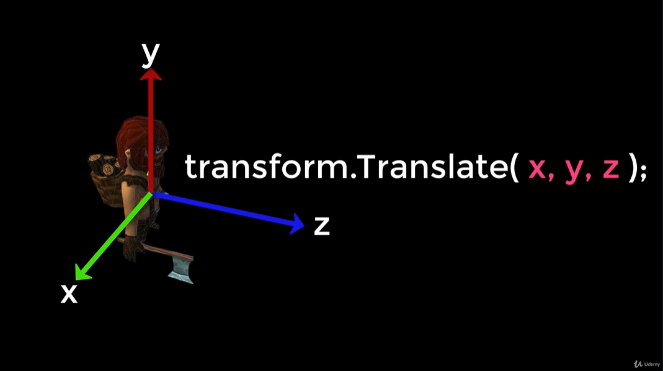
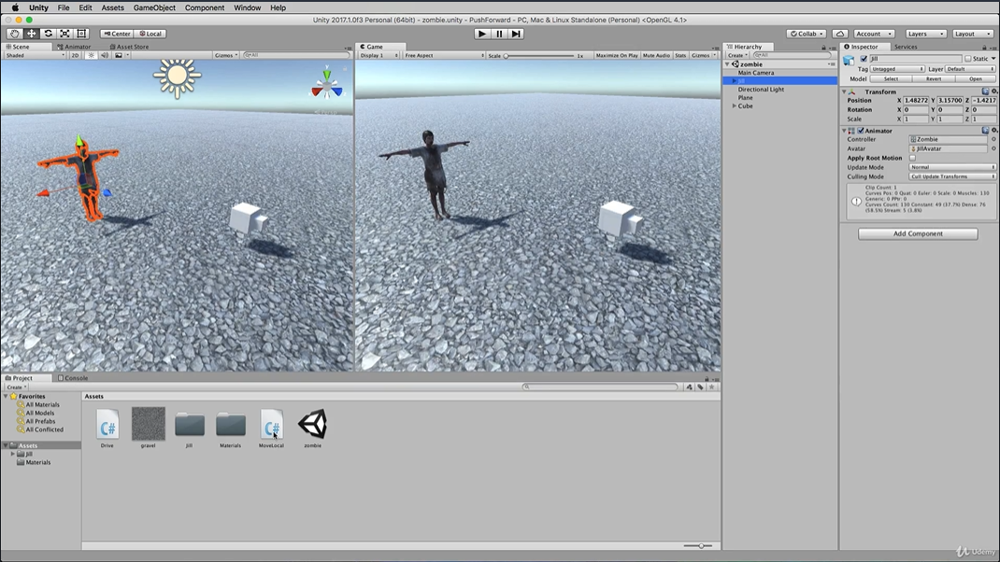
Section 2: Moving 9. Pushing the Character Forward
Characters in unity can move along their own local axes, the x, y and z.
We move them using transform.Translate(x, y, z)

Slide 8
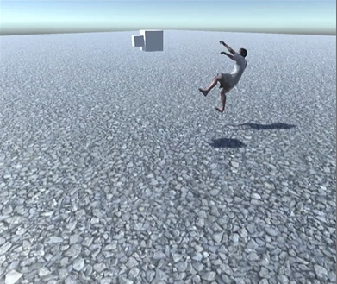
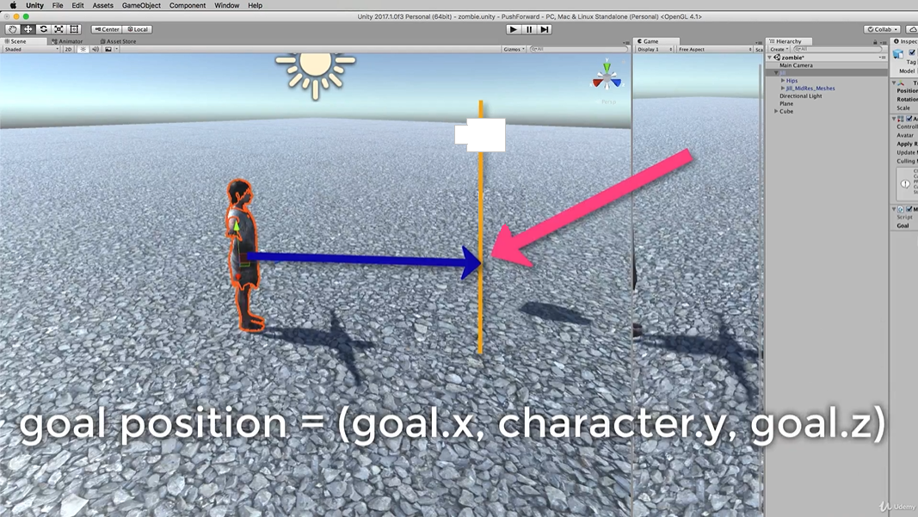
Section 2: Moving 9. Pushing the Character Forward
We want to have the Zombie follow the white box along the x-z axes and if the box moves up, the zombie does not follow upwards.
To achieve this, we create a new goal location using the x, z-coordinates of the goal, but use the y-coordinate of the Zombie
This way it move towards the x,z of the goal, but keeps level headed.

Slide 9
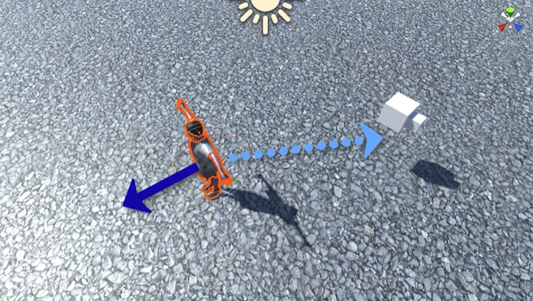
Section 2: Moving 10. Slerping
The problem with LookAt method of Transform is that it makes the zombie snap instantly around and not gradually
Now we want to improve his movement so that it slowly turns around from its forward direction to the goals direction
It does this over a particular time period, a small rotation each period
This slow rotation is called Spherical Linear Interpolation or SLERP for short
This requires the use of the Quaternion class or object in Unity.

Slide 10
Section 2: Moving 10. Slerping (cont’d)
Quaternion.Slerp
Quaternions can be used to represent the orientation or rotation of a GameObject. Unless you are particularly interested in delving into the mathematics of Quaternions, you only really need to know that a Quaternion represents a rotation in 3D space and you never normally need to know or modify the x, y & z properties.

Slide 11

Rotation and Orientation in Unity
Rotations in 3D applications are usually represented in one of two ways: Quaternions or Euler angles.
Each has its own uses and drawbacks.
Unity uses Quaternions internally, but shows values of the equivalent Euler angles in the Inspector to make it easy for you to edit.

Slide 12
Euler angles and quaternions
Euler angles are represented by three angle values for X, Y and Z that are applied sequentially. To apply a Euler rotation to a particular GameObject, each rotation value is applied in turn, as a rotation around its corresponding axis.
Benefit: Euler angles have an intuitive “human readable” format, consisting of three angles.
Benefit: Euler angles can represent the rotation from one orientation to another through a turn of more than 180 degrees
Limitation: Euler angles suffer from Gimbal Lock. When applying the three rotations in turn, it is possible for the first or second rotation to result in the third axis pointing in the same direction as one of the previous axes. This means a “degree of freedom” has been lost, because the third rotation value cannot be applied around a unique axis.

Slide 13
More on Quaternions
In the same way that a Vector can represent either a position or a direction (where the direction is measured from the origin), a Quaternion can represent either an orientation or a rotation - where the rotation is measured from the rotational “origin” or “Identity”. It is because the rotation is measured in this way - from one orientation to another - that a quaternion can’t represent a rotation beyond 180 degrees.
Benefit: Quaternion rotations do not suffer from Gimbal Lock.
Limitation: A single quaternion cannot represent a rotation exceeding 180 degrees in any direction.
Limitation: The numeric representation of a Quaternion is not intuitively understandable.

Slide 14
Quaternion.Slerp
public static Quaternion Slerp(Quaternion a, Quaternion b, float t);
Spherically interpolates between a and b by t.
The parameter t is clamped to the range [0, 1].

Slide 15
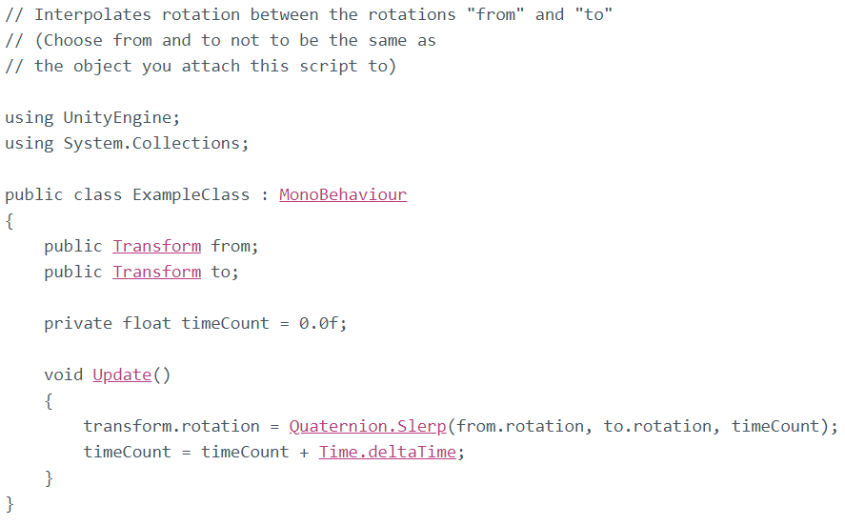
Quaternion.Slerp (cont’d)

Slide 16
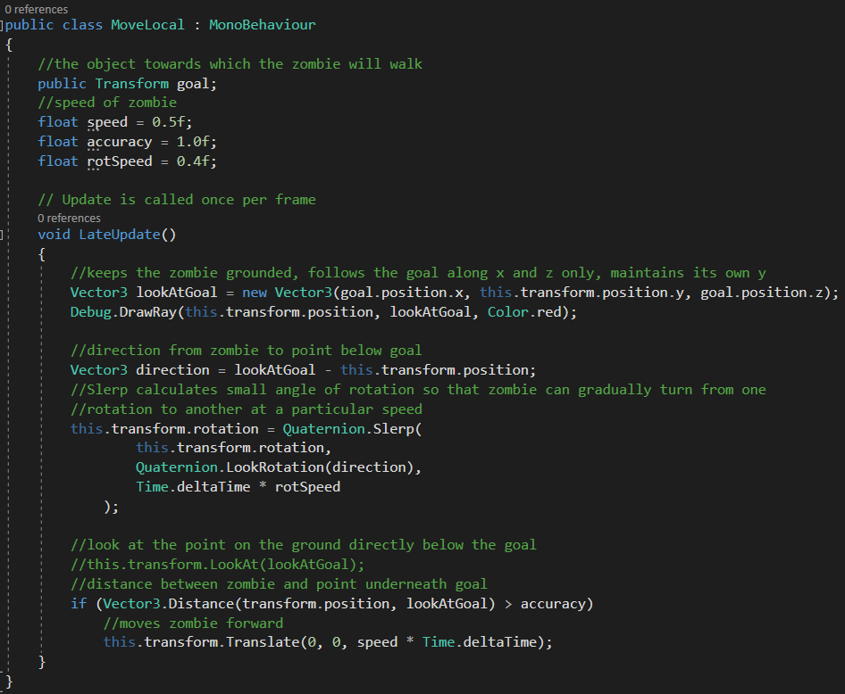
Section 2: Moving 10. Slerping (cont’d)

Slide 17
Section 2: Moving 10. Slerping (cont’d)
The Difference between Slerp and Lerp
https://www.youtube.com/watch?v=pNPuMMR5cSk

