Slide 1
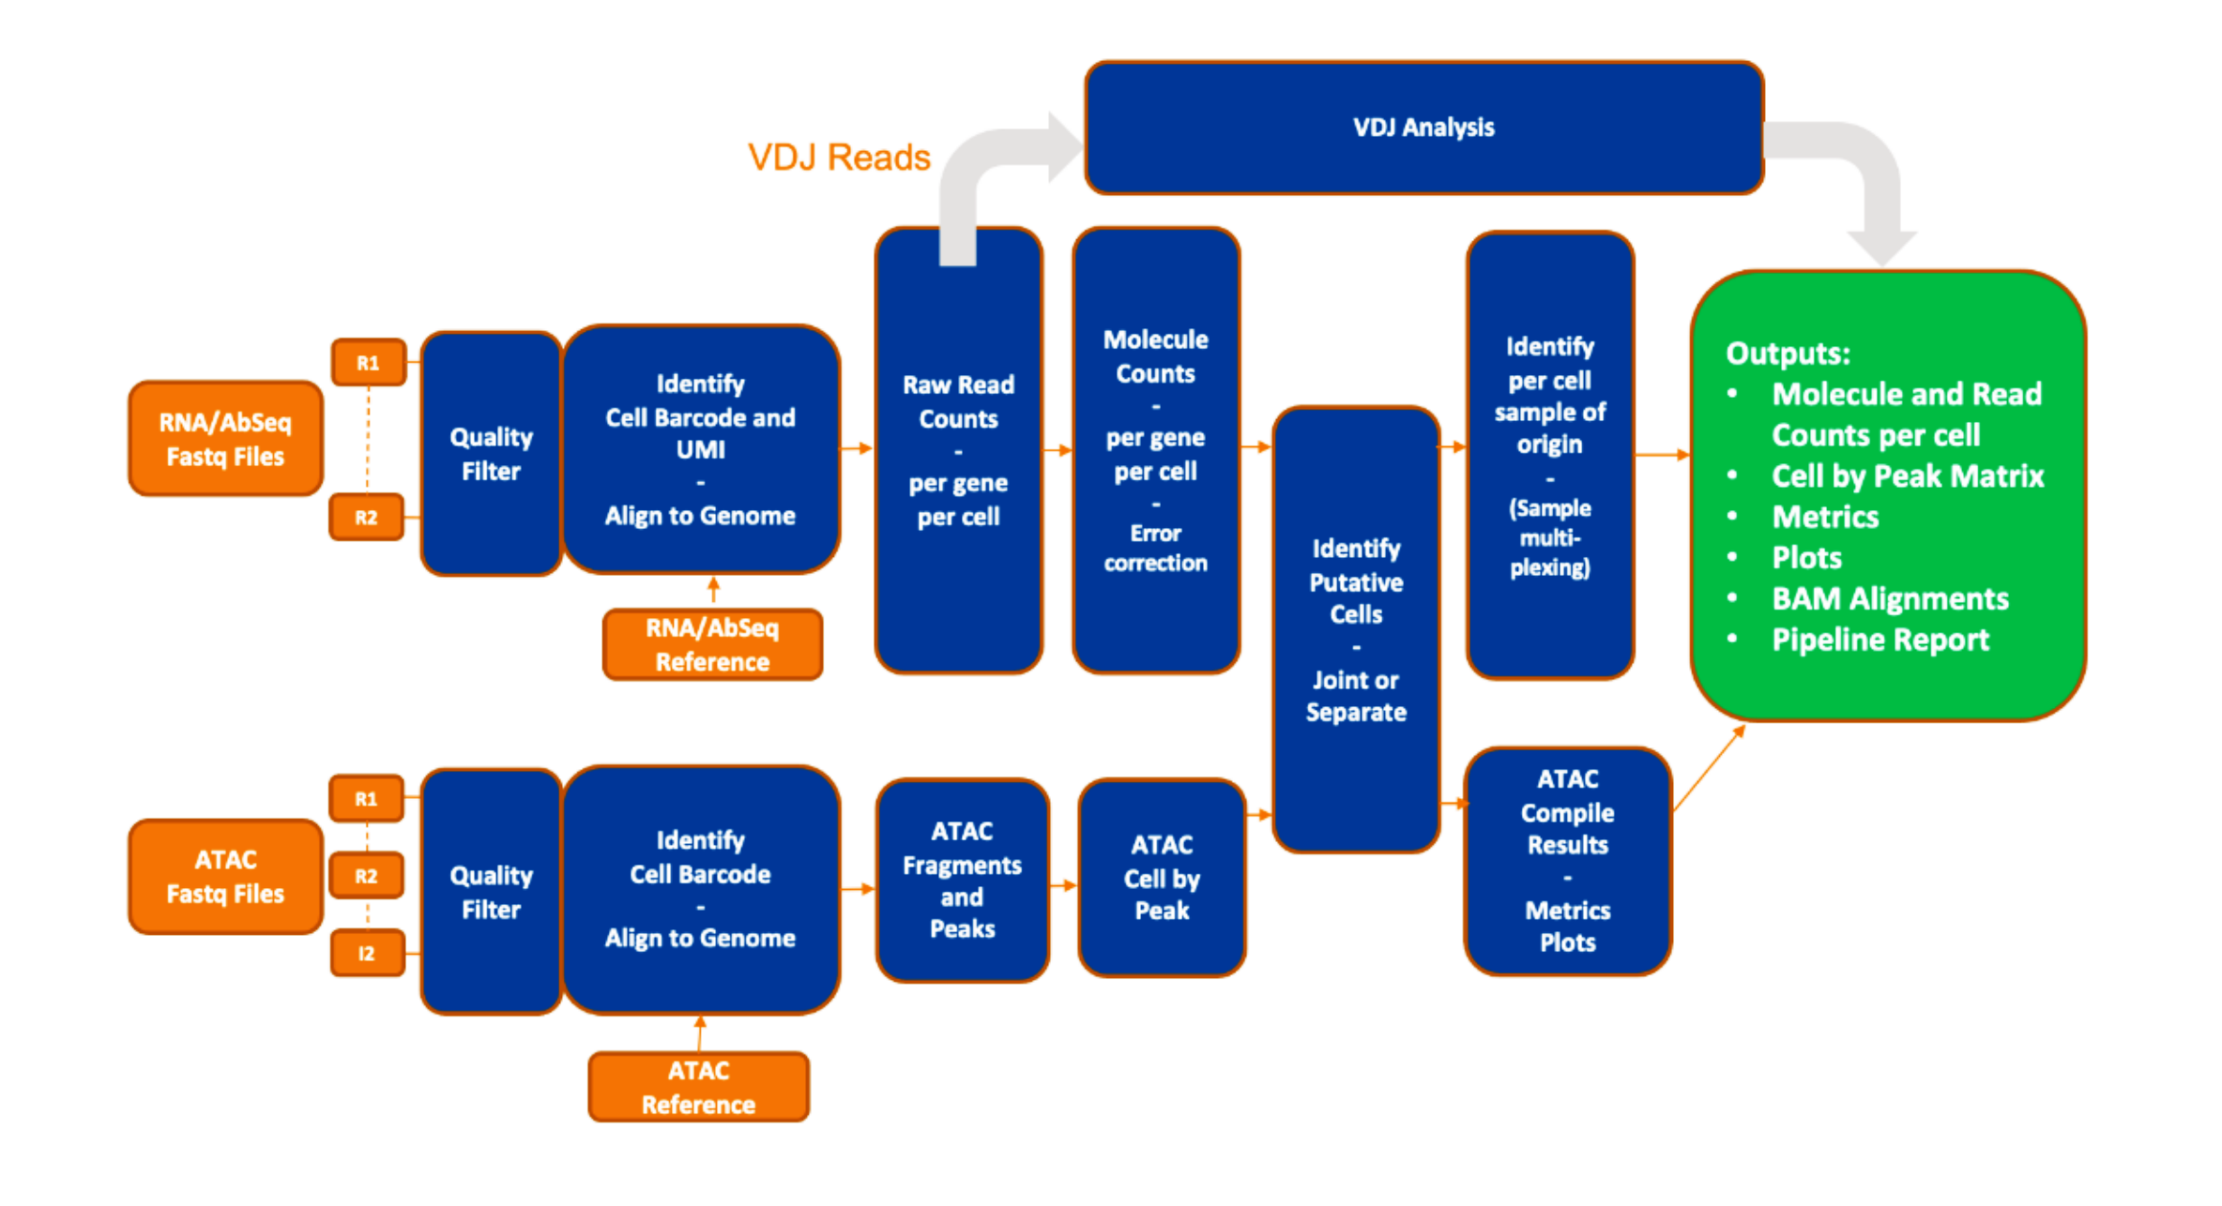

Slide 2
VDJ setting activated
WTA/Targeted/ AbSeq Reference
VDJ Analysis
Quality FIlter
Identify cell barcode and UMI
–
Align to Genome
Raw read counts
-
Per gene per cell
Molecule counts
-
Per gene per cell
-
Error Correction
Putative cell calling
-
mRNA
Or
Joint mRNA + ATAC
Identify sample of origin
OUTPUT
files
FASTQ files
R1
R2
R1
Quality FIlter
Identify cell barcode and UMI
–
Align to Genome
ATAC Fragments and peaks
ATAC Cell by Peaks
SMK setting activated
FASTQ files
R2
I2
ATAC / WTA_ATAC Reference

Slide 3
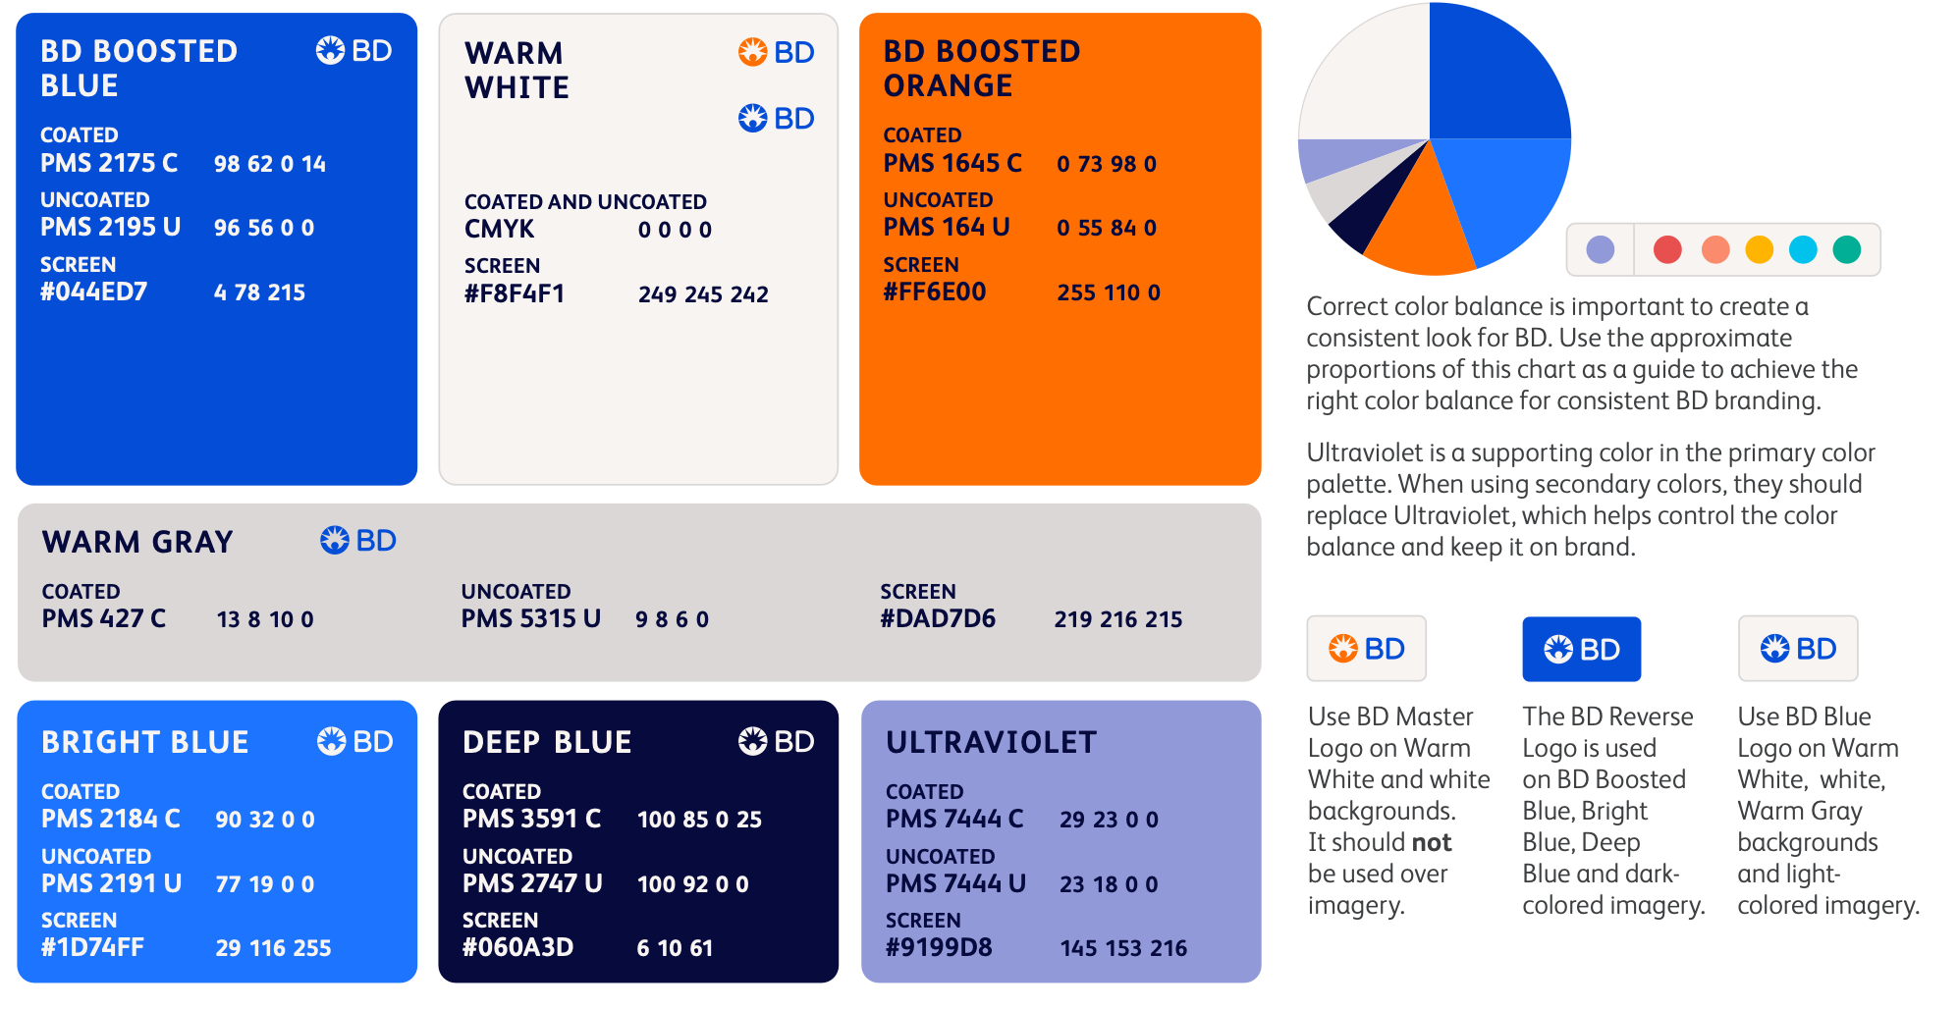

Slide 4
