Slide 1
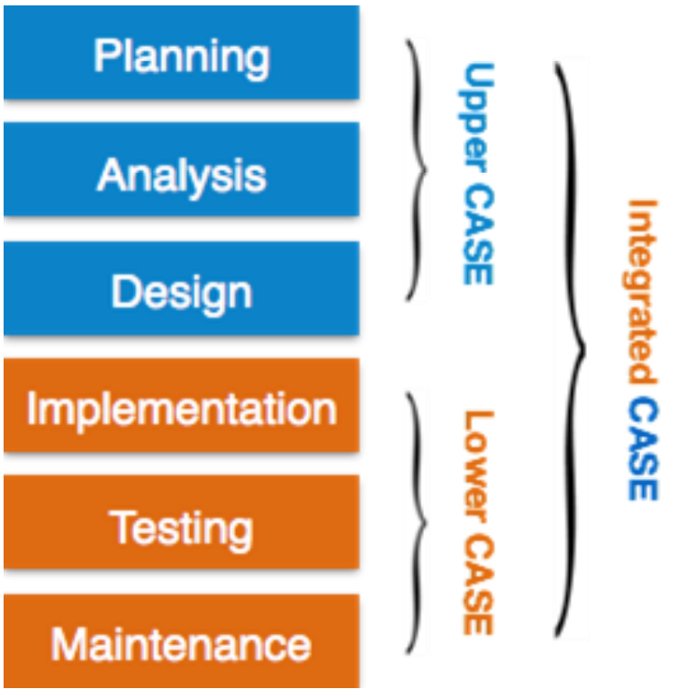
Computer-Aided Software Engineering (CASE)
As a productivity tools for system analyst
To enhance their regular activities by using automated support
set of software applications designed to help developers create, maintain, and manage software more efficiently.
Analyst and designers
combining all the tasks and stages related to a project or product's life cycle to ensure smooth progression and coordination."
REASONS
Increasing productivity
Improve
Communication
programmers
Integrating Life Cycle Activities
Accurately Assessing Maintenance Changer
Create & modify the system design
Modeling organizational requirements and defining system boundaries
Support prototyping of screen and report designs
correctly figuring out what needs to be fixed or updated in something to keep it working well. It's about making sure you understand exactly what changes are needed for maintenance.
creating a clear picture of what a company needs and where the limits of a system lie."
combining activities related to the life cycle
Help create sample screen and report designs.
Lower CASE tools Generate computer source code from the CASE design
Generated in several languages (Source Code)
-PHP -TypeScript
-Ruby -Swift -Kotlin

