Slide 1
LSB Steganography
Python Implementation
Implementation of Digital Image Steganography
Using the Least Significant Bit (LSB) Method
for Python-Based Secret Message Hiding
[Author Name] | [Student ID] | [Institution] | [Year]
Notes:
Welcome slide. Introduce yourself, your institution, and the topic: implementing digital image steganography using the LSB method in Python. This is an academic proposal/project presentation.

Slide 2
BACKGROUND
Background
Why does this research matter?
The Problem
The Solution
Internet transmits massive data across borders
Public networks are vulnerable to eavesdropping and theft
Data confidentiality and integrity are at risk
Need for robust information security techniques is critical
Steganography hides the existence of a message
Unlike cryptography which encrypts content
LSB method embeds data in image pixel bits
Undetectable to the human eye — changes ≤ 1 out of 255
Python + Pillow + NumPy: easy to implement & evaluate
Notes:
Explain that in today's digital era, data security is critical. Steganography is one solution — it hides the very existence of a message, unlike cryptography which only hides the content. The LSB method is the simplest and most studied approach, implemented here in Python.

Slide 3
PROBLEM STATEMENT
Problem Statement
Three core research questions
01
System Design
How can an LSB steganography system be designed and implemented in Python (Pillow + NumPy) to hide text messages inside PNG images?
02
Embedding Capacity
What is the maximum message capacity that can be embedded without causing visually detectable degradation, measured by PSNR and MSE?
03
Robustness
How robust is the system against compression and format transformation? Can LSB histogram analysis reveal hidden messages (steganalysis)?
Notes:
Three key research questions: (1) implementation in Python, (2) embedding capacity vs. quality metrics, and (3) robustness against compression. These guide the research scope.

Slide 4
OBJECTIVES
Research Objectives
General Objective
Implement and evaluate a Python-based LSB steganography system using standardized image quality parameters.
Specific Objectives
Build an encoder module — embed text into PNG images using LSB manipulation with a user-friendly CLI
Build a decoder module — accurately extract hidden messages from stego-images without data loss
Measure stego-image quality using PSNR and MSE metrics, compared against scientific thresholds
Determine maximum embedding capacity for various image sizes as a practical reference guide
Analyze robustness against JPEG compression and LSB histogram-based steganalysis
Notes:
Five specific objectives build toward the general goal. They cover: encoder, decoder, quality measurement, capacity analysis, and robustness testing.

Slide 5
LITERATURE REVIEW
What is Steganography?
The art of hidden writing
Definition
3 Main Components
From Greek: steganos ("hidden") + graphein ("to write"). Steganography conceals the very existence of a message inside a carrier medium (image, audio, video, text) — so third parties don't even know a secret exists.
Cover Object
Secret Message
Stego Object
The carrier image
The text to hide
Image with hidden data
🔐 Cryptography
🕵️ Steganography
Hides the content of the message
Message is visible but unreadable
Relies on encryption keys
Hides the existence of the message
Message is invisible inside the carrier
No obvious sign a secret is present
Notes:
Explain steganography vs cryptography: crypto hides the content; stego hides the existence. A steganography system involves three components: the cover object, the secret message, and the stego object.

Slide 6
LITERATURE REVIEW
Why the LSB Method?
Comparison of steganography techniques
Feature
LSB ✅
DCT
DWT
Spread Spectrum
Implementation
Simple ⭐⭐⭐
Complex
Complex
Very complex
Capacity
High ⭐⭐⭐
Medium
Medium
Low
Imperceptibility
High ⭐⭐⭐
High
Very High
High
Robustness
Low ⚠
High
Very High
Very High
Best Format
PNG (lossless)
JPEG
PNG/JPEG
Any
LSB is chosen for its simplicity, high capacity, and strong educational value as a foundation for steganography study.
Notes:
LSB excels in implementation simplicity and high embedding capacity. Its main weakness is lower robustness against compression. DCT/DWT are more robust but complex. For this educational project, LSB is the ideal starting point.

Slide 7
LITERATURE REVIEW
Why PNG, Not JPEG?
Format choice is critical for LSB steganography
❌ JPEG
✅ PNG
Joint Photographic Experts Group
Portable Network Graphics
Uses lossy DCT-based compression
Actively modifies pixel values when saving
LSB data is destroyed after save
Hidden message is corrupted — unrecoverable
Smaller file size but NOT suitable for LSB
Uses lossless DEFLATE compression
Pixel values preserved intact after saving
LSB data remains exactly as embedded
Hidden message can be recovered perfectly
24/32-bit color with manageable file size
⚠ BMP also lossless but produces very large files. PNG gives the best balance of lossless quality + manageable size.
Notes:
PNG uses lossless compression so pixel values are never changed — critical for LSB. JPEG uses lossy compression that modifies pixels on save, destroying any embedded LSB data. Always use PNG for LSB steganography.

Slide 8
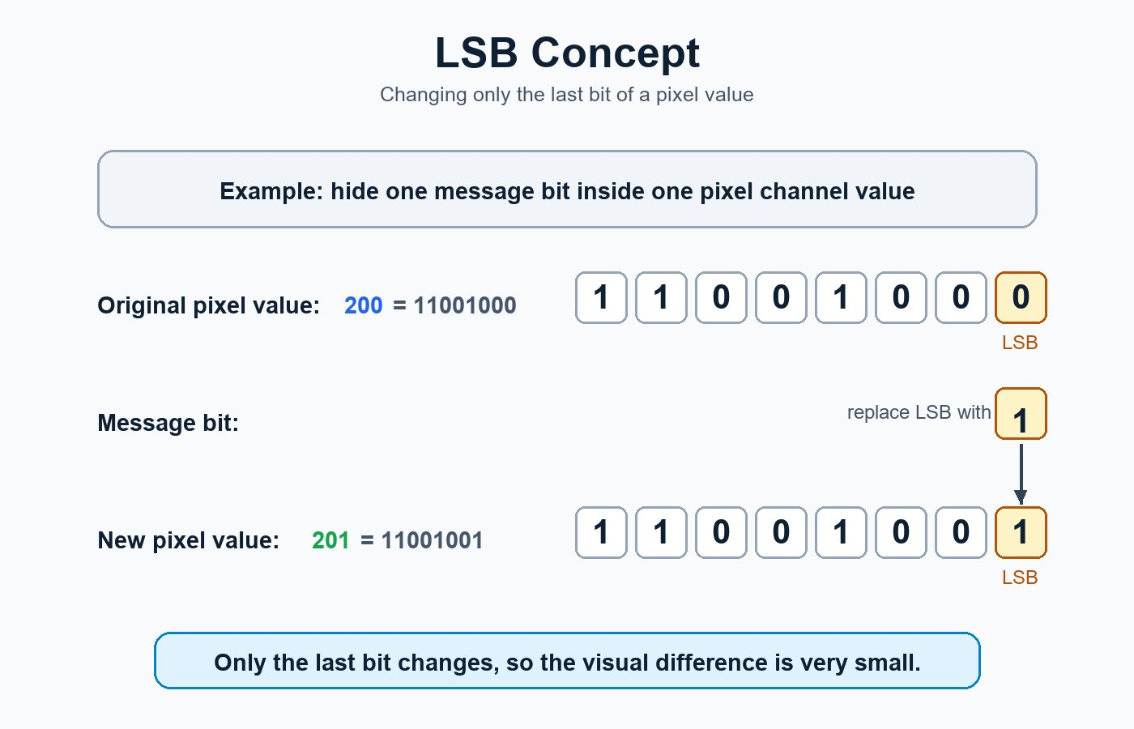
LSB METHOD
The LSB Concept
Only the last bit of each pixel channel is modified
Key Insight
Pixel value 200 → 11001000
Replace LSB with message bit '1'
New value: 201 → 11001001
Change = only 1 out of 255 levels
Human eye cannot detect this
Bitwise operation in code:
(pixel & 0xFE) | bit
Notes:
The LSB method replaces only the rightmost bit (bit 0) of each pixel channel. Changing a pixel from 200 to 201 is a change of less than 0.4% — completely invisible. The bitwise operation (pixel & 0xFE) | bit clears the LSB then sets it to the message bit.

Slide 9
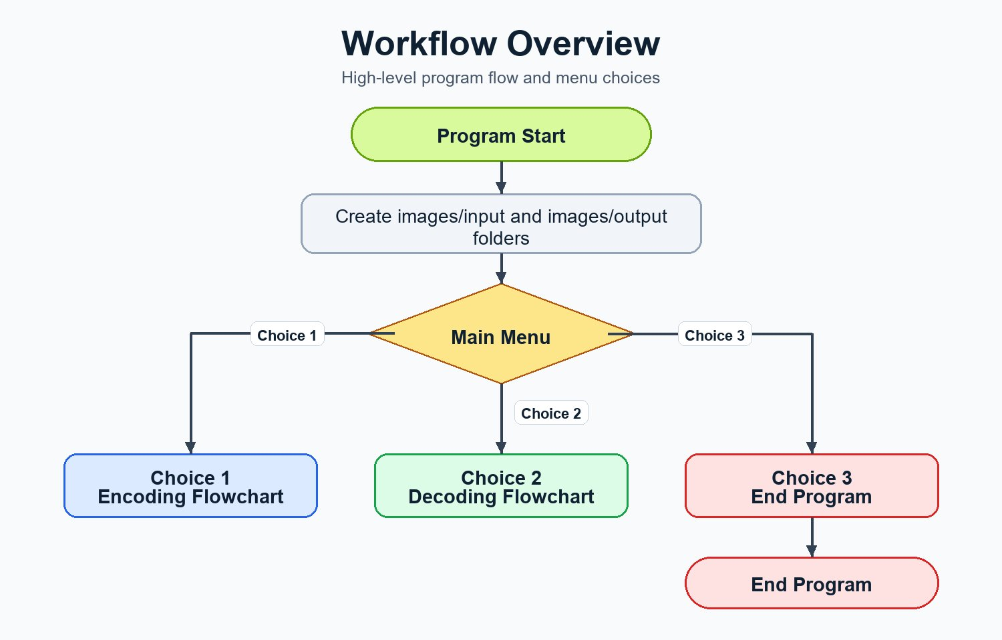
SYSTEM DESIGN
System Overview
High-level program flow and menu choices
Notes:
The program starts, creates input/output folders, then presents a main menu. Choice 1 launches the encoding workflow, Choice 2 launches decoding, and Choice 3 exits the program. This is the overall system architecture.

Slide 10
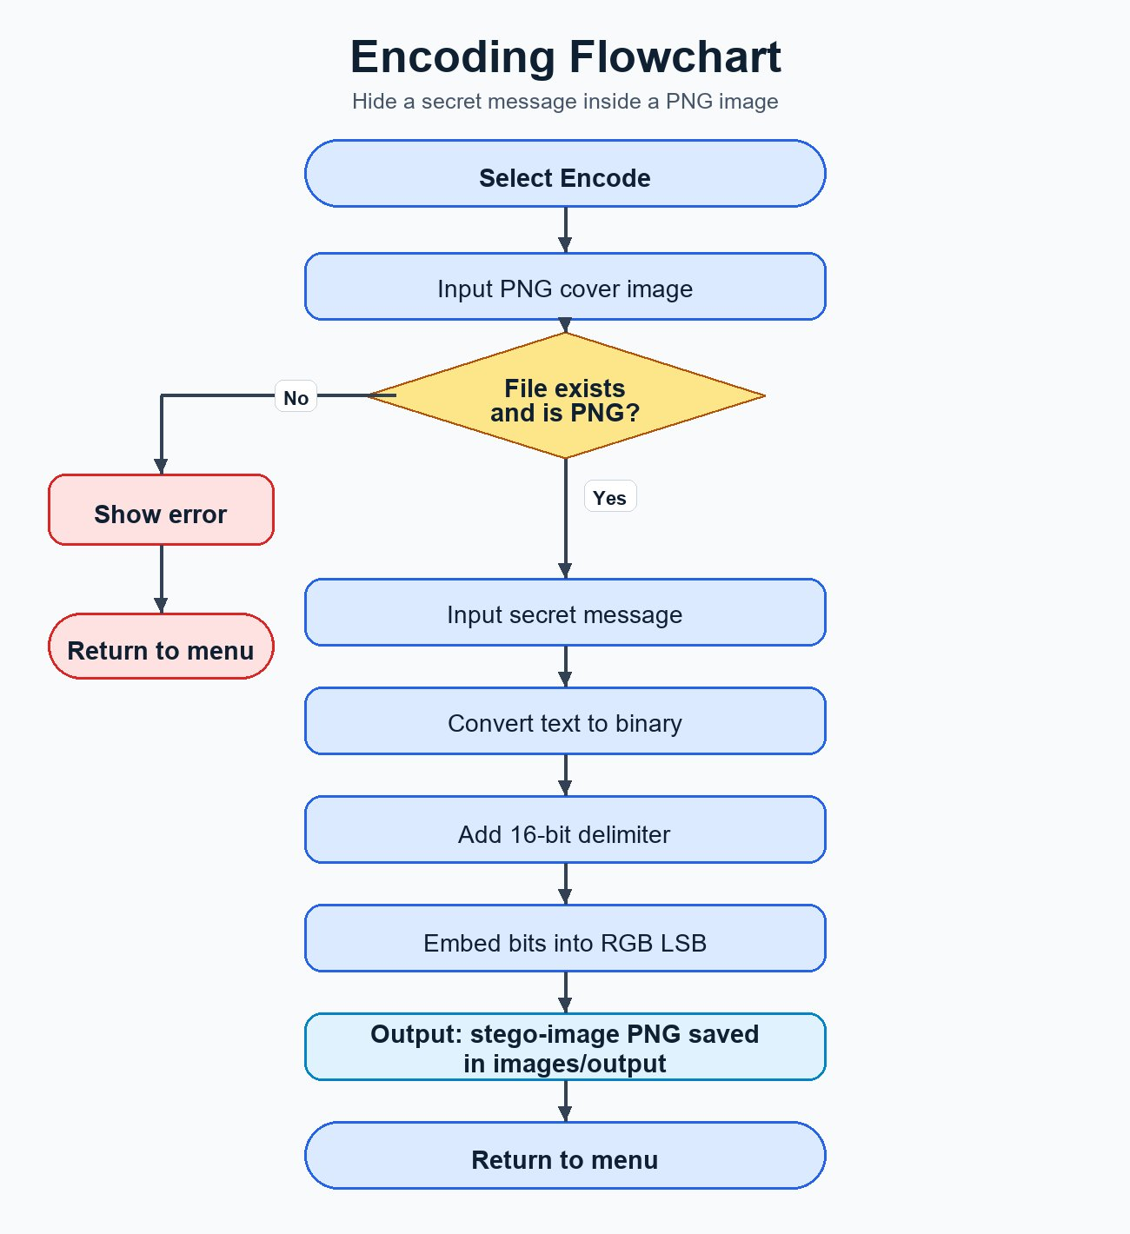
ENCODING
Encoding Workflow
Hiding a secret message inside a PNG image
Step-by-Step
1
Input PNG cover image + secret message
2
Validate file exists and is PNG format
3
Convert each character to 8-bit binary
4
Append 16-bit delimiter (0000000000000000)
5
Embed bits into pixel LSBs: R, G, B per pixel
6
Save result as stego-image PNG
Capacity: C = (W × H × 3) / 8 bytes
Notes:
Walk through each encoding step. Key point: each pixel channel (R, G, B) stores one bit. A 16-bit zero delimiter marks the end of the message. The capacity formula shows how many characters fit: width × height × 3 channels ÷ 8 bits per character.

Slide 11
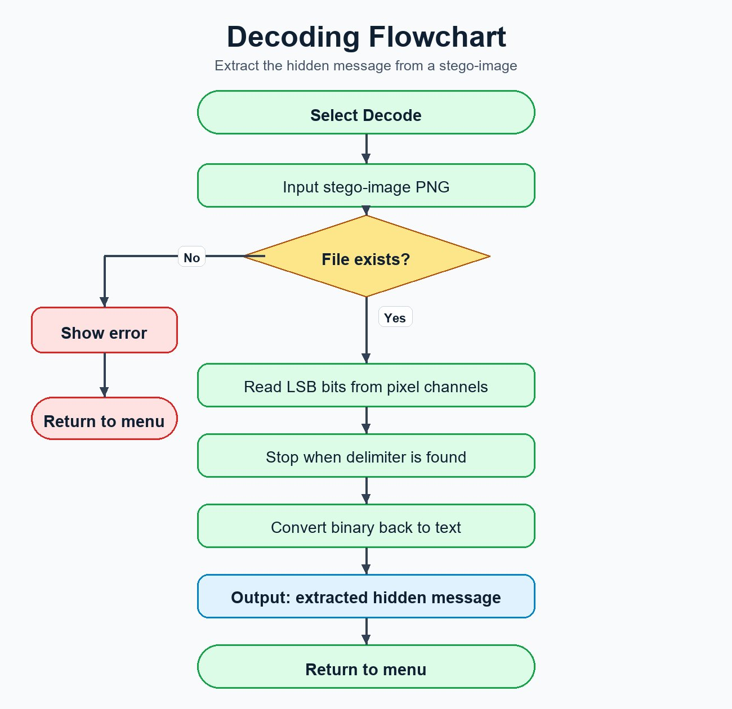
DECODING
Decoding Workflow
Extracting the hidden message from a stego-image
Step-by-Step
1
Input stego-image PNG path
2
Validate the file exists
3
Read pixels row by row — extract LSB from R, G, B
4
Accumulate bits; group every 8 bits into a character
5
Detect 16-bit delimiter (0000000000000000) to stop
6
Output the fully reconstructed hidden message
LSB extraction: bit = pixel_value & 0x01
Notes:
Decoding is the reverse of encoding: read LSBs, group into 8-bit bytes, convert to characters, stop when delimiter is found. The bitwise AND with 0x01 extracts the last bit from any pixel value.

Slide 12
IMPLEMENTATION
Project Structure
Modular Python architecture
lsb-steganography/
├── main.py
├── encoder.py
├── decoder.py
├── utils.py
├── README.md
└── images/
├── input/
└── output/
main.py
Entry point — CLI menu, user input, routing to encoder/decoder
encoder.py
Reads image, converts text to binary, embeds bits into RGB LSB
decoder.py
Reads stego-image, extracts LSBs, detects delimiter, returns text
utils.py
Helper functions: text↔binary, delimiter, capacity calculator
Notes:
The project is neatly separated into four modules: main.py handles the CLI, encoder.py does the hiding, decoder.py does the extraction, and utils.py provides shared helper functions. Images are organized into input and output folders.

Slide 13
IMPLEMENTATION
main.py — CLI & Menu
Program entry point and user interaction
Key Features
def show_menu():
print("=" * 50)
print(" LSB Steganography")
print("[1] Encode - Hide message")
print("[2] Decode - Extract message")
print("[3] Exit")
while True:
choice = input("Choose [1/2/3]: ")
if choice == '1': run_encoder()
elif choice == '2': run_decoder()
elif choice == '3': break
Menu Loop
Runs until user exits — choices 1, 2, or 3
Input Validation
Checks file path exists and is .png format
Auto Directories
Creates images/input and images/output automatically
Error Handling
Friendly error messages; never crashes silently
Notes:
main.py is the entry point. It runs a while-True loop showing the menu, routes to run_encoder() or run_decoder() based on input, and handles validation before passing data to the modules.

Slide 14
IMPLEMENTATION
encoder.py — Embedding Logic
How messages are hidden in pixel channels
How It Works
# Key encoding operation
binary_msg = text_to_binary(message)
+ get_delimiter()
for row in range(height):
for col in range(width):
for channel in range(3): # R,G,B
if bit_index < total_bits:
pv = pixel_array[row,col,channel]
bit = int(binary_msg[bit_index])
# Clear LSB, set to message bit
pixel_array[row,col,channel]
= (pv & 0xFE) | bit
bit_index += 1
Convert
Each character → 8-bit binary string
Delimiter
16 zero bits appended as end marker
Iterate
Pixels row by row, R → G → B per pixel
Bit Mask
(pixel & 0xFE) clears LSB; OR sets new bit
Save
stego_image.save(output, format='PNG')
Notes:
The core operation is (pixel & 0xFE) | bit. 0xFE in binary is 11111110 — it clears the last bit. Then OR with the message bit sets it to 0 or 1. This preserves all other 7 bits of the pixel exactly.

Slide 15
IMPLEMENTATION
decoder.py — Extraction Logic
Reading hidden bits back from the stego-image
How It Works
# Key decoding operation
binary_string = ''
delimiter = get_delimiter() # 16 zeros
for row in range(height):
for col in range(width):
for channel in range(3): # R,G,B
# Extract LSB from pixel
lsb = pixel_array[row,col,channel]
& 0x01
binary_string += str(lsb)
# Check every 8 bits for delimiter
if binary_string[-16:] == delimiter:
return binary_to_text(
binary_string[:-16])
Extract
pixel & 0x01 gives the LSB (0 or 1)
Accumulate
Bits are appended to a growing string
Group
Every 8 bits = 1 character (1 byte)
Detect End
Check last 16 bits for delimiter sequence
Return
Strip delimiter, convert binary → text
Notes:
The decoder mirrors the encoder. pixel & 0x01 extracts the LSB. After every new bit, it checks whether the last 16 bits match the delimiter. When found, it stops and converts the collected bits back to text characters.

Slide 16
IMPLEMENTATION
utils.py — Helper Functions
Shared utilities used by encoder and decoder
text_to_binary(text)
binary_to_text(binary)
Converts each character to its 8-bit binary representation using ord(). Returns a concatenated binary string.
Groups every 8 bits and converts each byte to its corresponding character using chr(int(byte, 2)).
'Hi' → '0100100001101001'
'01000001' → 'A'
get_delimiter()
calculate_max_capacity(w, h)
Returns the 16-bit end-of-message marker: '0000000000000000' (two null characters). Signals where the message ends.
Calculates how many text characters an image can hold: (width × height × 3) ÷ 8 bytes.
returns '0000000000000000'
800×600 image → 180,000 chars
Notes:
utils.py contains four helper functions shared by encoder and decoder. text_to_binary and binary_to_text handle character conversion. get_delimiter provides the stop marker. calculate_max_capacity tells users how much text their image can hold.

Slide 17
DEMO / RESULTS
Implementation Demo
Expected output and placeholder for screenshots
ENCODING OUTPUT
DECODING OUTPUT
$ python main.py
[1] Encode [2] Decode [3] Exit
Choose: 1
Enter cover image: flower.png
Enter secret message: Hello World!
Enter output path: output/stego.png
[OK] Encoding successful!
- Cover : flower.png (800x600 px)
- Message: 12 chars (112 bits used)
- Stego : output/stego.png
$ python main.py
[1] Encode [2] Decode [3] Exit
Choose: 2
Enter stego-image PNG: output/stego.png
[OK] Decoding successful!
- Stego : output/stego.png
- Message: 12 characters found
[HIDDEN MESSAGE FOUND]:
Hello World!
📸 Screenshot / Demo Placeholder
Replace this area with screenshots of your actual program output:
original cover image → stego-image side-by-side, terminal output, or PSNR/MSE measurement results.
Notes:
Show the expected terminal output for both encoding and decoding. Replace the bottom placeholder with actual screenshots of your program running, the cover image vs stego-image comparison, or PSNR/MSE measurement results once testing is complete.

Slide 18
EVALUATION
Strengths & Limitations
Honest analysis of the LSB approach
✅ Strengths
⚠ Limitations
Simple to implement — minimal code required
High embedding capacity — up to (W×H×3)/8 characters
Imperceptible changes — max ±1 pixel value
PSNR typically > 40 dB — excellent quality
Lossless recovery — no data corruption
PNG format ensures pixel integrity
Not robust against compression — JPEG destroys LSB data
Vulnerable to steganalysis — LSB histogram analysis can detect embedding
No encryption — message is hidden but not encrypted
Only PNG supported — other formats not handled
No alpha channel — only RGB channels used
Sequential embedding — no randomization or spread spectrum
Notes:
Be transparent about both strengths and weaknesses. The LSB method is excellent for educational purposes and simple use cases, but is not production-grade for adversarial environments. Future work could add encryption, randomized pixel selection, or DCT/DWT techniques.

Slide 19
Conclusion
🔍
LSB steganography effectively hides text messages in PNG images with imperceptible visual changes (PSNR > 40 dB expected).
🐍
Python + Pillow + NumPy provides an accessible, clean implementation of both encoding and decoding modules.
📐
Embedding capacity is predictable: (W × H × 3) / 8 characters per image, supporting large messages.
⚠
Key limitation: not robust against lossy compression. PNG format must be preserved end-to-end.
🚀
Future work: add AES encryption, randomized pixel selection, or frequency-domain methods (DCT/DWT) for better robustness.
Thank you | Questions?
Notes:
Wrap up with five key takeaways. Invite questions. You can also mention that the project is open for extension — adding encryption, randomized embedding, or GUI interface — for future versions.

