Slide 1
CPSC 4576 — Database Systems
E-Commerce Online
Store Database System
Design, Development & Implementation using Microsoft SQL Server
Syamala Rao Gudipudi & Akshitha Sanapuri

Slide 2
Project Overview
6
3
3
3
3
✔
Normalized
Tables
Analytical
Views
Stored
Procedures
Scalar
Functions
Database
Triggers
End-to-End
Tested
What is ECommerceDB?
A comprehensive relational database system built using Microsoft SQL Server that manages the complete lifecycle of an online retail store — product catalog, customer registration, order processing, inventory tracking, and review managet
Microsoft SQL Server
VS Code + mssql
T-SQL
6 Tables
Stored Procedures
Triggers & Functions
Technology Stack

Slide 3
Section 1 — Introduction & Objectives
Purpose
ECommerceDB provides a centralized, structured data store supporting an online store's core business operations — transaction processing, product management, customer relationship tracking, and business reporting.
Objectives
Efficient Storage & Retrieval
Business Intelligence
Normalized relational tables for product, customer, and order data
Views aggregate sales, customer behavior, and product performance data
Data Integrity
Primary Keys, Foreign Keys, CHECK, NOT NULL, and UNIQUE constraints
Referential Integrity
Business Logic Automation
Stored Procedures, Functions & Triggers reduce application-layer complexity
Six interrelated tables covering the complete e-commerce domain

Slide 4
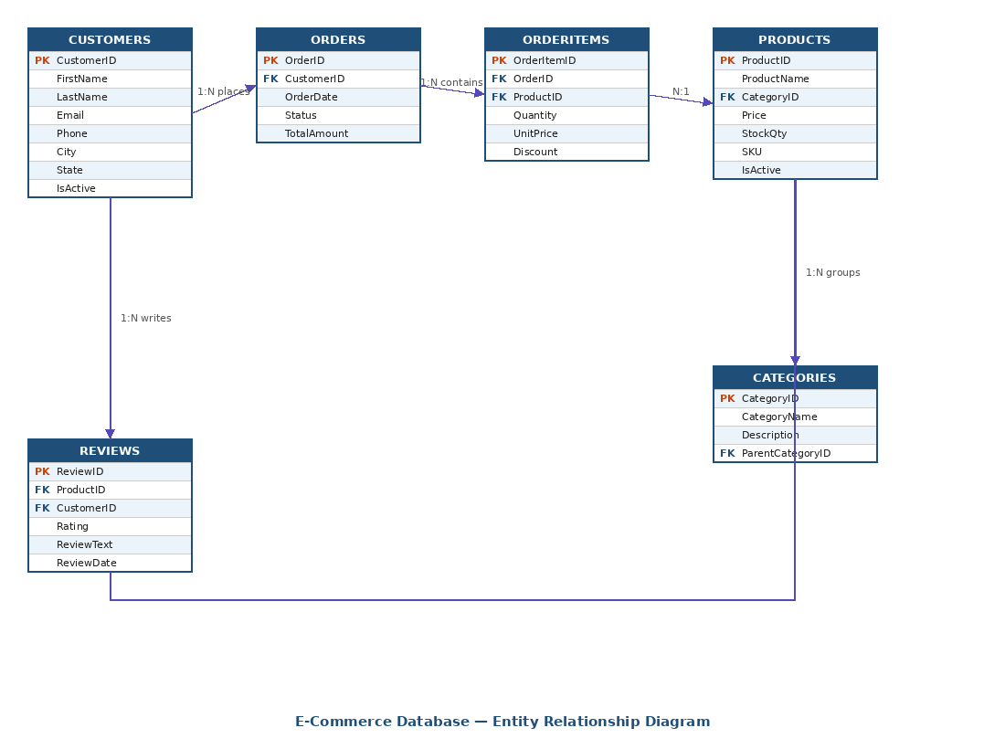
Sections 2 & 3 — ER Diagram & Database Relationships
CUSTOMERS
1 ──────── ∞
ORDERS
One customer places many orders
ORDERS
1 ──────── ∞
ORDERITEMS
One order contains many line items
1 ──────── ∞
ORDERITEMS
One product appears in many order items (junction)
1 ──────── ∞
PRODUCTS
One category groups many products
CUSTOMERS
1 ──────── ∞
REVIEWS
One customer writes many reviews
PRODUCTS
1 ──────── ∞
REVIEWS
One product receives many reviews
All tables enforce: PRIMARY KEY · FOREIGN KEY · NOT NULL · UNIQUE · CHECK constraints

Slide 5
Section 4.1 — Table Creation (Tables 1–3)
Table 1: Customers
Table 2: Categories
Table 3: Products
CustomerID INT PK IDENTITY(1,1)
CategoryID INT PK IDENTITY(1,1)
ProductID INT PK IDENTITY(1,1)
FirstName / LastName NVARCHAR(50) NOT NULL
CategoryName NVARCHAR(100) NOT NULL UNIQUE
ProductName NVARCHAR(200) NOT NULL
Email NVARCHAR(100) NOT NULL UNIQUE
Description NVARCHAR(500)
CategoryID INT NOT NULL FK → Categories
Phone, Address, City, State, ZipCode
ParentCategoryID INT FK → Categories(CategoryID)
Price DECIMAL(10,2) NOT NULL
CreatedAt DATETIME DEFAULT GETDATE()
StockQty INT NOT NULL DEFAULT 0
IsActive BIT DEFAULT 1
SKU NVARCHAR(50) NOT NULL UNIQUE
CHECK: Email LIKE '%@%.%'
Self-referencing FK (supports subcategories)
CHECK: Price >= 0 | CHECK: StockQty >= 0

Slide 6
Section 4.1 — Table Creation (Tables 4–6)
Table 4: Orders
Table 5: OrderItems
Table 6: Reviews
OrderID INT PK IDENTITY(1,1)
OrderItemID INT PK IDENTITY(1,1)
ReviewID INT PK IDENTITY(1,1)
CustomerID INT NOT NULL FK → Customers
OrderID INT NOT NULL FK → Orders
ProductID INT NOT NULL FK → Products
OrderDate DATETIME DEFAULT GETDATE()
ProductID INT NOT NULL FK → Products
CustomerID INT NOT NULL FK → Customers
Status NVARCHAR(20) NOT NULL DEFAULT 'Pending'
Quantity INT NOT NULL
Rating INT NOT NULL
TotalAmount DECIMAL(10,2) NOT NULL DEFAULT 0
UnitPrice DECIMAL(10,2) NOT NULL
ReviewText NVARCHAR(1000)
Discount DECIMAL(5,2) DEFAULT 0
ReviewDate DATETIME DEFAULT GETDATE()
CHECK: Status IN (Pending, Processing, Shipped, Delivered, Cancelled)
CHECK: Quantity > 0 | CHECK: Discount 0–100
CHECK: Rating BETWEEN 1 AND 5

Slide 7
Section 4.1 — Sample Data Inserted (5+ rows per table)
8
9
12
8
15
8
Customers
Categories
Products
Orders
OrderItems
Reviews
Chicago-area customers
Electronics, Clothing, Sports…
Laptops, phones, books, shoes
April–May 2026
Line items across all orders
Ratings 1–5 stars
Sample Products Inserted:
Product Name | Category | Price | Stock | SKU
Dell Inspiron 15 Laptop | Laptops | $799.99 | 25 | DELL-INS-15
Apple MacBook Air M2 | Laptops | $1,099.99 | 15 | APPLE-MBA-M2
Samsung Galaxy S24 | Smartphones | $899.99 | 40 | SAM-S24
iPhone 15 Pro | Smartphones | $1,199.99 | 20 | APL-IP15P
Men's Running Shoes | Sports | $89.99 | 60 | MRS-001

Slide 8
Section 4.2 — CREATE VIEW Statements (3 Views)
vw_CustomerOrderSummary
→ Customer loyalty & tier analysis
Aggregates each customer's total number of orders, total amount spent, and last order date. Useful for customer loyalty analysis.
Columns: CustomerName · Email · TotalOrders · TotalSpent · LastOrderDate
→ Product performance dashboards & inventory decisions
vw_ProductSalesPerformance
Joins Products, Categories, OrderItems & Reviews to show each product's total units sold, total revenue generated, and average customer rating.
Columns: ProductName · CategoryName · Price · StockQty · TotalUnitsSold · TotalRevenue · AvgRating
vw_OrderDetailReport
→ Order auditing, invoicing & customer service
Full line-item breakdown of every order joining Orders, Customers, OrderItems & Products. Includes discount-adjusted LineTotal.
Columns: OrderID · OrderDate · Status · CustomerName · ProductName · Quantity · UnitPrice · Discount · LineTotal

Slide 9
Section 4.3 — Stored Procedures (3 Procedures)
1
sp_PlaceOrder
Parameters: IN: CustomerID, ProductID, Quantity | OUT: NewOrderID
Accepts CustomerID, ProductID & Quantity. Validates stock availability, creates an Order record, inserts an OrderItem, reduces inventory, and returns the new OrderID as an output parameter. Raises RAISERROR if stock is insufficient.
2
sp_GetCustomerOrders
Parameters: IN: CustomerID | OUT: OrderCount, TotalSpent
Retrieves a customer's full order history with product details ordered by date descending. Returns aggregate output parameters — total number of orders and total amount spent.
3
sp_UpdateOrderStatus
Parameters: IN: OrderID, NewStatus | OUT: Success (BIT)
Validates the new status against allowed values (Pending / Processing / Shipped / Delivered / Cancelled). Updates the record and returns Success=1, or raises RAISERROR for invalid status.

Slide 10
Section 4.4 — User-Defined Functions (3 Functions)
fn_GetDiscountedPrice
fn_GetDiscountedPrice(@ProductID INT, @DiscountPct DECIMAL(5,2)) RETURNS DECIMAL(10,2)
▶ fn_GetDiscountedPrice(1, 10) → $719.99 (10% off Dell Inspiron @ $799.99)
Looks up the product's base price from the Products table and returns the price after applying the given percentage discount, rounded to 2 decimal places using ROUND().
fn_GetCategoryRevenue
fn_GetCategoryRevenue(@CategoryID INT) RETURNS DECIMAL(12,2)
▶ fn_GetCategoryRevenue(1) → Total revenue from all Electronics category orders
SUMs the revenue (Quantity × UnitPrice) from all OrderItems linked to products in a given category. Excludes cancelled orders. Returns 0 if no revenue using COALESCE().
fn_GetCustomerTier
fn_GetCustomerTier(@CustomerID INT) RETURNS NVARCHAR(20)
▶ fn_GetCustomerTier(1) → 'Gold' (James Carter — spending $1,000–$1,999)
SUMs non-cancelled order spending for a customer. Returns tier via CASE: Bronze (<$500) · Silver ($500+) · Gold ($1,000+) · Platinum ($2,000+).

Slide 11
Section 4.5 — Triggers (3 Triggers)
trg_OrderItems_AfterInsert
AFTER INSERT on OrderItems
Fires after each INSERT on OrderItems. Automatically recalculates and updates TotalAmount on the parent Orders record — accounting for Quantity × UnitPrice × (1 – Discount/100). Correlated subquery handles multiple rows inserted at once.
✔ Order totals always accurate — no manual recalculation needed
trg_Customers_PreventDelete
INSTEAD OF DELETE on Customers
Prevents deletion of any customer who has existing orders. Uses the 'deleted' pseudo-table to check Orders. Raises RAISERROR and ROLLBACK TRANSACTION to protect referential integrity. Encourages IsActive=0 soft-delete instead.
✔ Confirmed: "Cannot delete customer with existing orders. Deactivate instead."
trg_Products_LowStock
AFTER UPDATE on Products
Fires after every product stock update. Reads the 'inserted' pseudo-table and inserts an alert record into StockAlerts when StockQty < 5 units — enabling inventory managers to reorder without any application-layer code.
✔ StockAlerts record auto-inserted when qty dropped to 3

Slide 12
Section 5 — Testing — All Results Verified
5.1 Stored Procedures
5.2 Functions
5.3 Triggers
✓
sp_PlaceOrder
✓
fn_GetDiscountedPrice(1,10)
✓
trg_OrderItems_AfterInsert
NewOrderID returned (CustomerID=2, ProductID=12, Qty=3)
→ $719.99 ✔
TotalAmount auto-updated after INSERT into OrderItems
✓
sp_GetCustomerOrders
✓
fn_GetCategoryRevenue(1)
✓
trg_Customers_PreventDelete
TotalOrders & TotalSpent returned for CustomerID=1
→ Electronics total revenue ✔
"Cannot delete customer with existing orders" error raised
✓
sp_UpdateOrderStatus
✓
fn_GetCustomerTier(1)
✓
trg_Products_LowStock
UpdateSuccess = 1 for OrderID=5 → 'Processing'
→ 'Gold' tier returned ✔
StockAlerts record created after StockQty set to 3
Tested in VS Code using mssql extension | Server: localhost:1434 | Database: ECommerceDB

Slide 13
Section 6 — Conclusions, Key Features & Challenges
Key Features Implemented
Challenges Encountered
Six normalized tables with full constraint enforcement (PK, FK, CHECK, NOT NULL, UNIQUE)
Self-Referencing FK in Categories
Careful INSERT ordering required — parent categories must be inserted before child subcategories to avoid FK violations.
Three analytical Views: Customer spending · Product sales · Order line-item details
Three Stored Procedures: Order placement · Customer history · Status updates
INSTEAD OF DELETE Trigger
ROLLBACK TRANSACTION logic needed careful placement to prevent partial deletes while still allowing valid customer deletions.
Three Scalar Functions: Discounted price · Category revenue · Customer loyalty tier
Triggers & the 'inserted' Table
Three Triggers: Auto order totals · Delete protection · Low-stock alerts
Correlated subquery approach required since multiple rows can be inserted at once — simple SELECT from 'inserted' would only get one row.

Slide 14
Thank You!
Questions?
Syamala Rao Gudipudi & Akshitha Sanapuri
CPSC 4576 — Database Systems | Governors State University | Spring 2026
References
Coronel & Morris (2023). Database Systems: Design, Implementation & Management (14th ed.). Cengage.
Microsoft Docs — Transact-SQL Reference & SSMS Documentation (2024).
W3Schools SQL Tutorial · Stack Overflow SQL Server Community
6
3
3
3
3
✔
Tables
Views
Procs
Functions
Triggers
Tested

