Slide 1
PREDICTING ACCIDENT SEVERITY

Slide 2
PREDICTING ACCIDENT SEVERITY
Accidents prediction on roadways is quite a difficult task as they are caused by wide variety of reasons like road conditions, road designs, user behaviours, traffic rules, vehicle conditions, weather conditions etc.
Gathering data about such attributes or their relevant proxies help us build some hypothesis and build statistical models of prediction around them.
The total number of accidents happening and the severity level of accidents have been and can be applied as one of the many possible indicators to measure the efficiency of road network system services.
INTEREST
The resulting models can help the respective government road transport agencies to identify and rectify the accident factors by answering the question
“What are all the factors which increases the probability of severity in accidents?”

Slide 3
DATA PREPARATION
Data acquired from Data / Metadata
Total 194673 rows and 38 columns
Removed all irrelevant and redundant data attributes like OBJECT ID, SHAPE, INCKEY, COLDETKEY, INTKEY, LOCATION, EXCEPTRSNCODE, EXCEPTRSNDESC, SEVERITY DESC etc.
Finalized data attributes considered for data modelling
1. Severity Code (Property damage, injury, fatality)
2. Location data (Coordinates, address type etc)
3. Collision Type (Pedestrians, Vehicles, cycles, junction etc.)
4. Persons Involved (Pedestrians, Cyclists etc)
5. Vehicle Count
6. Date and Time
7. Junction Type
8. Inattention, Under Influence and Speeding
9. Weather and Road Conditions

Slide 4
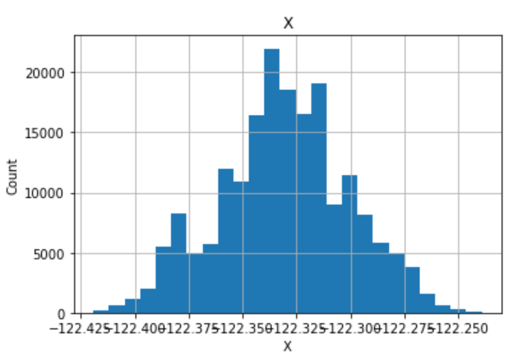
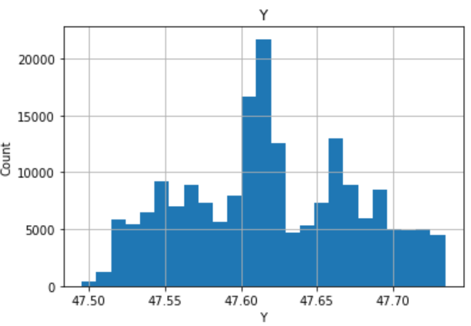
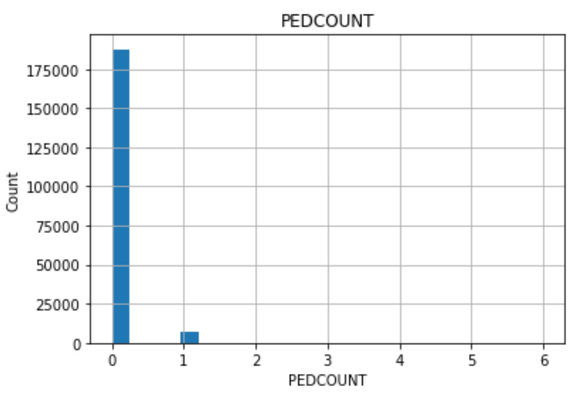
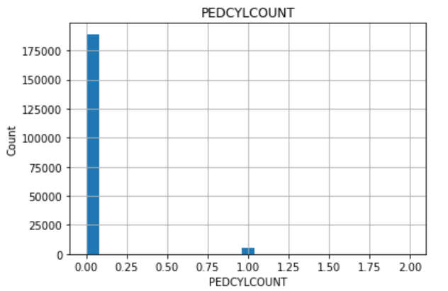
FURTHER DATA CLEANING
After exploratory analysis, it is found that initially shortlisted data attributes like location data, Pedestrian Count and Pedestrian Cyclist Count can be dropped as location data is normally distributed based on population and other have more than 90% values as zero.

Slide 5
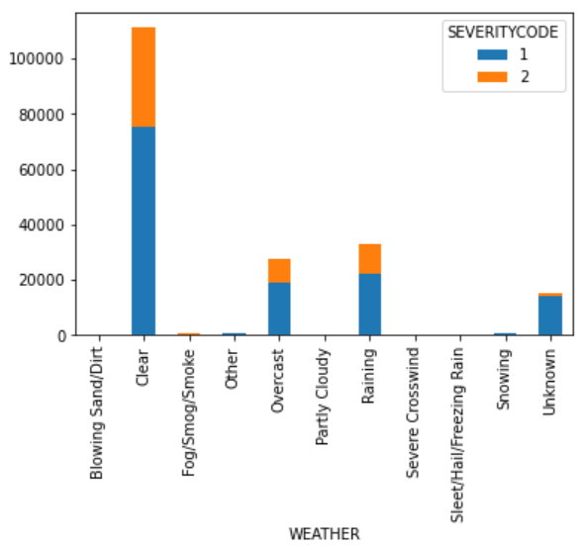
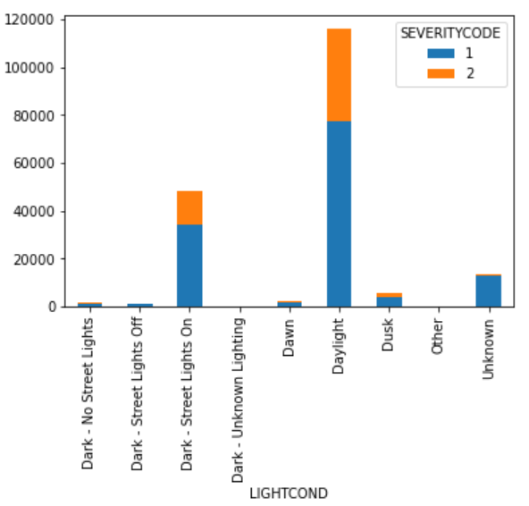
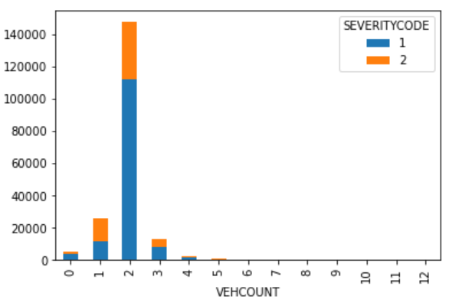
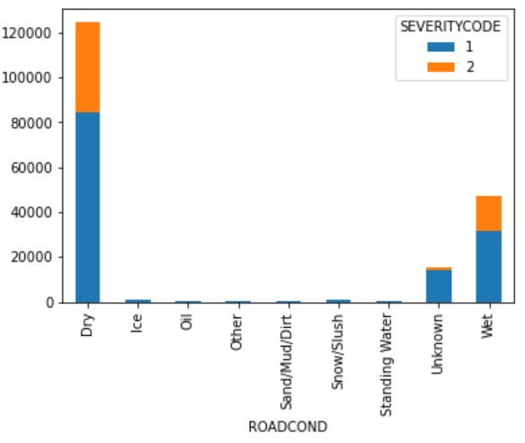
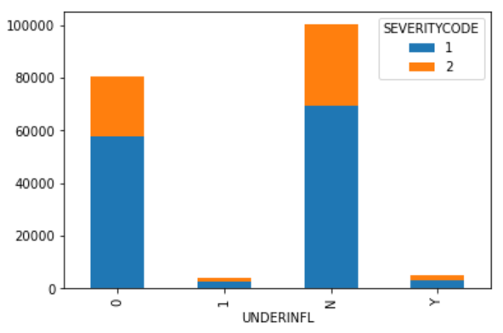
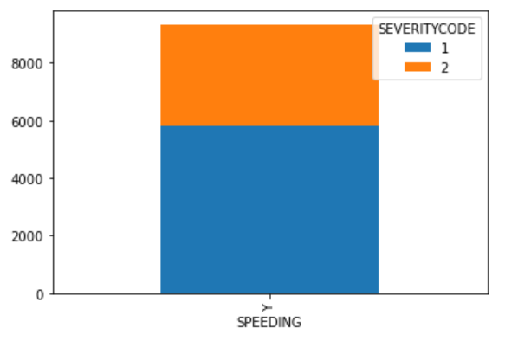
Performance of each independent variable against dependent variable(Severity Code) (Slide: 1/3)

Slide 6
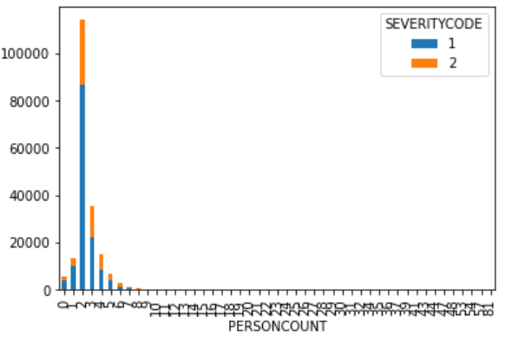
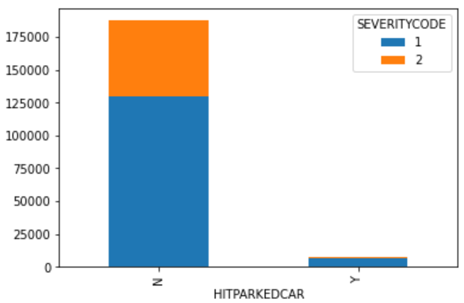
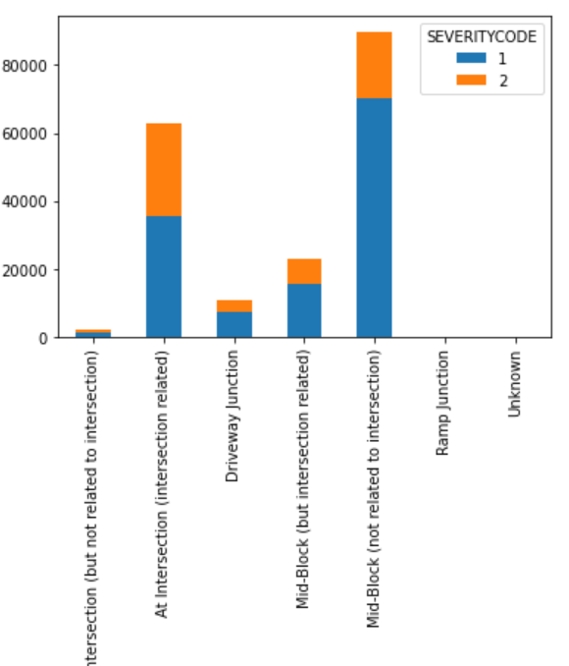
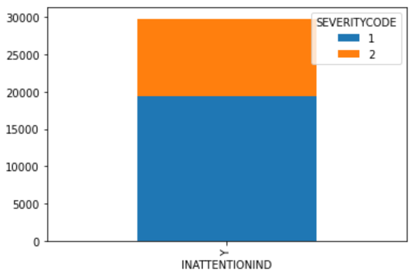
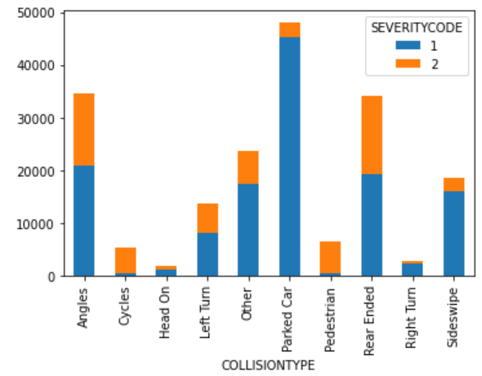
Performance of each independent variable against dependent variable(Severity Code) (Slide: 2/3)

Slide 7
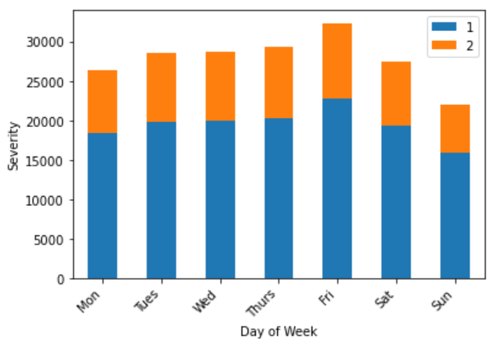
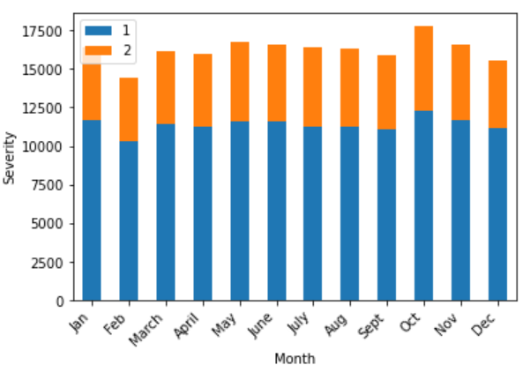
Performance of each independent variable against dependent variable(Severity Code) (Slide: 3/3)
All independent chosen variables relation with the dependent variables is considerable with minimum outliers.
From the above figures it is also clear that timeframe of accident like day of week or month didn’t play any significant role and can be dropped from the final set

Slide 8
FINAL DATASET
Address type
Collision Type
Person Count
Vehicle Count
Junction Type
Inattention
Weather
Road Condition
Light Condition
Hit Parked Car
Speeding
Under Influence
DATA SPLIT
Train Data = 80% | Test Data = 20%

Slide 9
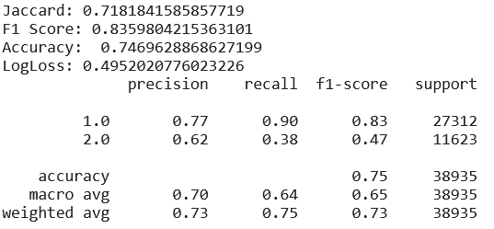
REGRESSION MODEL PERFORMANCE
Logistic Regression

Slide 10
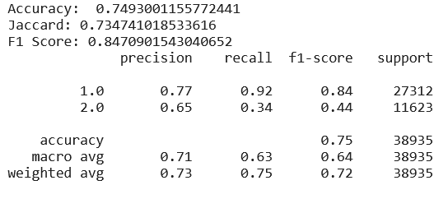
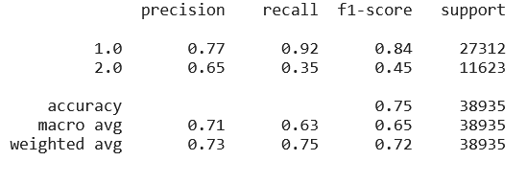
CLASSIFICATION MODEL PERFORMANCE
Decision Tree Results
Random Forest Results

Slide 11
CONCLUSION AND RECOMMENDATIONS
Similar results in different models suggest that the attributes considered are significant contributors to accidents and severity.
Mainly Under Influence, Inattention, Parked cars emerged out as some of the leading contributing attributes which can be controlled.
Road Control and Safety agencies should consider these avoidable factors and imbibe improved measures
a. Re-designed parking spaces to avoid accidents due to parked cars.
b. Improvised and strict norms to avoid driving under influence.
c. Education and display signs to users to be attentive

