Slide 1

SREENIVASA INSTITUTE OF TECHNOLOGY AND MANAGEMENT STUDIES
(Autonomous)
DEPARTMENT OF CSE-ARTIFICIAL INTELLIGENCE
(2025-2026)
A PROJECT PRESENTATION
ON
AI-Powered Secure Chat System with Automated Steganography Detection
BY
G V SYAM PRASAD | 23755A3101
V LOKENDRA | 23755A3101
Y MANOJ | 22751A3172
S MOKSHITH REDDY | 22751A3163
Under the Guidance of
Ms. M. DEEPIKA
Assistant Professor
Department of CSE-Artificial Intelligence,
Sreenivasa Institute of Technology and
Management Studies, Chittoor, A.P.

Slide 2
Abstract
Steganography allows secret information to be hidden inside digital images without visibly altering the image. While this technique can be used for secure communication, it can also be misused to transmit hidden malicious code or sensitive data. This project proposes a secure chat system that automatically detects hidden information in images using steganography detection techniques. The system extracts embedded data and analyzes it to determine whether it contains programming code, thereby improving communication security.

Slide 3
Introduction
Steganography is a technique used to hide secret information inside images.
Hidden data cannot be easily detected by the human eye.
Attackers may use steganography to hide malicious code or sensitive information.
Traditional messaging systems do not check images for hidden content.
Therefore, a system is required to detect hidden data in images for secure communication.

Slide 4
Problem Statement
Images can be used to secretly transmit hidden data.
Hidden information may contain malicious scripts or programming code.
Existing chat systems lack automatic steganography detection mechanisms.
This creates security vulnerabilities in digital communication.

Slide 5
Project Objectives
Detect hidden data embedded inside images using steganography techniques.
Extract the concealed information from stego images.
Analyze the extracted content to identify programming code.
Alert the user if suspicious or malicious code is detected.
Improve the security of image-based communication systems.

Slide 6
Project Objectives
Detect hidden data embedded inside images using steganography techniques.
Extract the concealed information from stego images.
Analyze the extracted content to identify programming code.
Alert the user if suspicious or malicious code is detected.
Improve the security of image-based communication systems.

Slide 7
Existing System
Existing systems for image-based communication primarily focus on secure transmission through encryption and access control. Images are shared without analyzing their internal content for hidden data. Traditional steganalysis methods rely on basic statistical features or offline inspection and are not integrated into real-time systems. As a result, images containing concealed information can easily pass through communication channels without detection.
Disadvantages of Existing System
No automatic detection of hidden data in images.
Vulnerable to LSB-based steganographic attacks.
Hidden malicious code can be transmitted undetected.
Traditional methods show low detection accuracy.
Lack of real-time monitoring and alert mechanisms.

Slide 8
Proposed System
A secure chat-based communication system that automatically scans images for hidden data.
When an image is received, it undergoes preprocessing such as format verification, resizing, and normalization.
The system performs steganography detection to identify whether hidden information exists in the image.
If hidden data is detected, the system extracts the embedded payload using LSB extraction.
The extracted content is analyzed to determine whether it contains programming code.
If suspicious code is found, the system generates a security alert and logs the detection event.

Slide 9
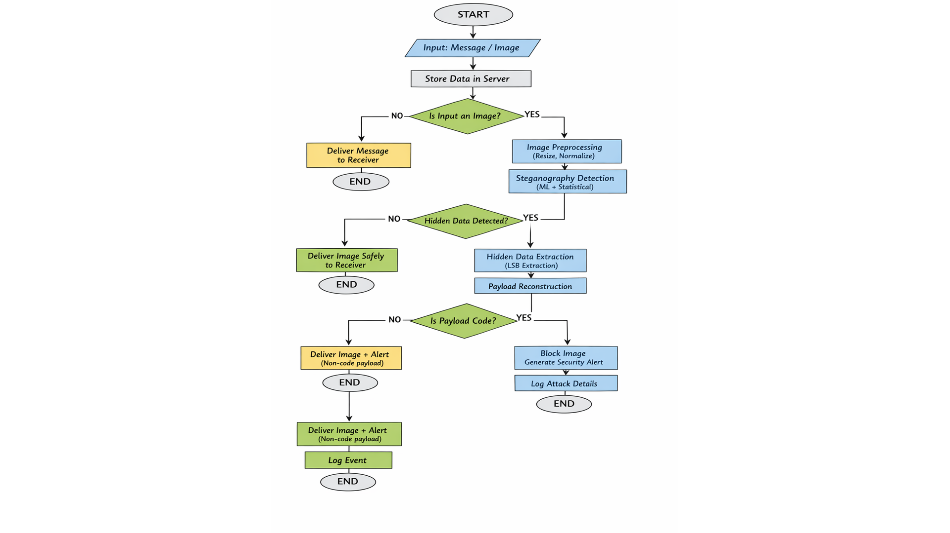

Slide 10
System Workflow
User Sends Message
Client transmits text or image through encrypted channel to server
Server Receives Data
Backend validates, authenticates, and queues content for processing
Image Analysis Initiated
Steganography detection module examines pixel data and bit patterns
Payload Extraction
Hidden data is decoded and extracted from image if detected
User Notification
System alerts recipient if suspicious code or data is identified

Slide 11
Dataset Used
The BOSSBase dataset was used for training and testing the steganography detection system.
BOSSBase contains 10,000 grayscale images commonly used for steganalysis research.
The images are stored in PGM (Portable Gray Map) format.
Stego images were generated by embedding hidden data using LSB steganography techniques.
The dataset includes both cover images (normal images) and stego images (images with hidden data) for model evaluation.

Slide 12
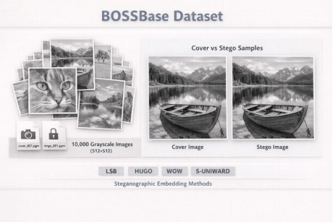

Slide 13
Model Architecture
The system processes the input steganographic image (224 × 224 × 3) through a preprocessing stage.
The image is then analyzed using the SRNet deep learning model, which is designed for steganography detection.
The model applies multiple convolution + ReLU layers to learn pixel-level patterns and identify suspicious modifications caused by hidden data.
If the probability of steganography is high, the system performs LSB payload extraction to retrieve the hidden binary data.
The extracted payload is reconstructed and passed to a programming code classification module.
The classifier determines whether the payload contains programming code or normal hidden data, and generates the final detection result.

Slide 14
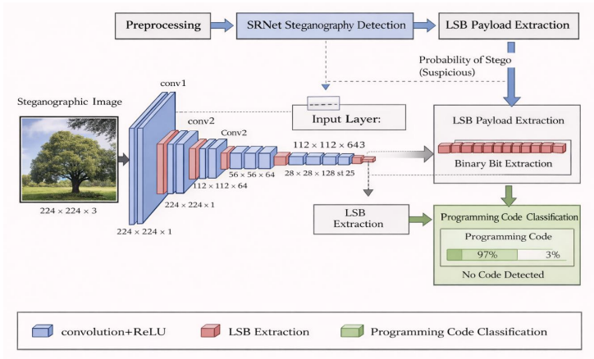

Slide 15
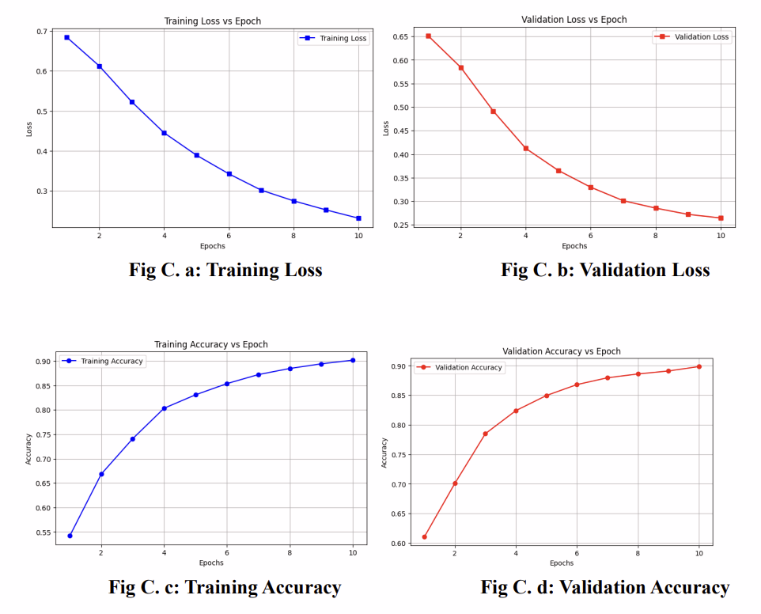


Results

Slide 16
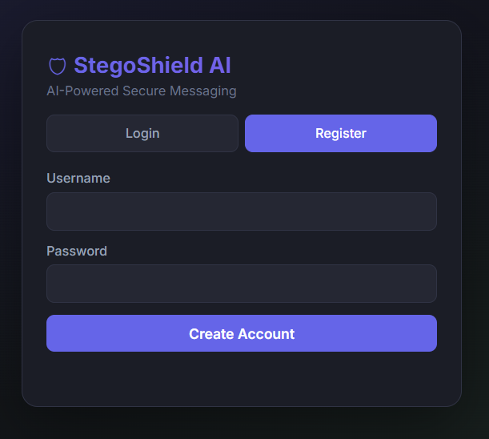
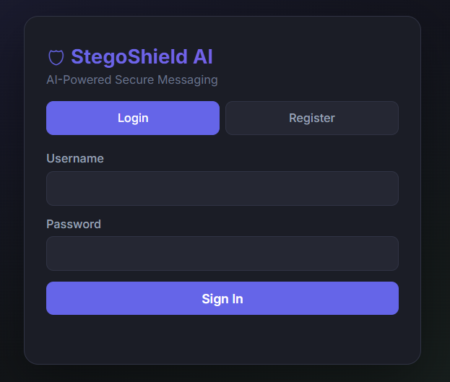


Outputs

Slide 17

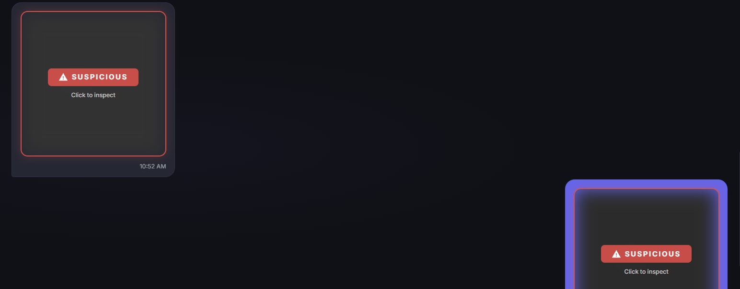

Slide 18
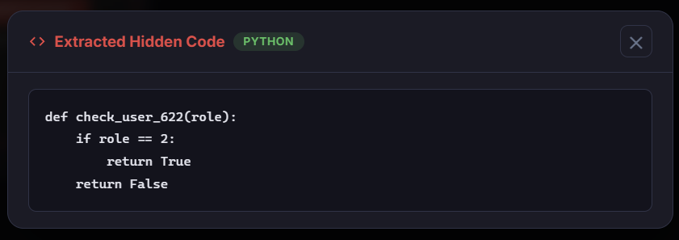
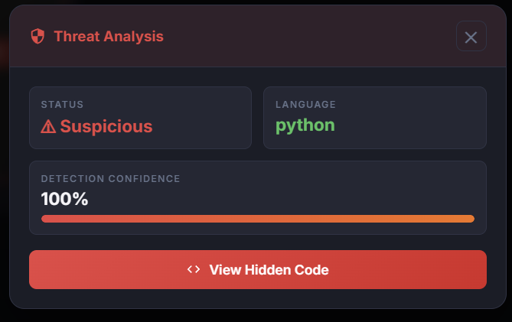
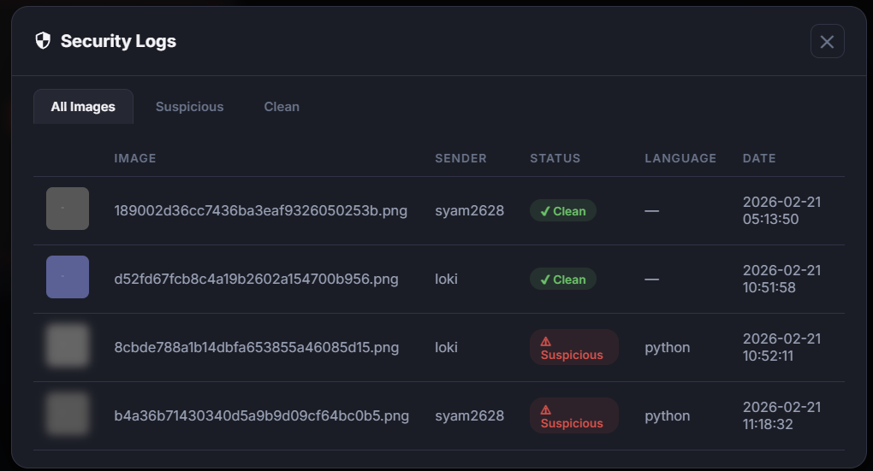

Slide 19
Future Enhancements
Real-Time Chat
Implement instant messaging with WebSocket connections, typing indicators, and message synchronization across devices.
Advanced AI Detection
Deploy deep learning models for detecting novel steganography techniques, adversarial attacks, and zero-day embedding methods.
Mobile Application
Native iOS and Android apps with offline capabilities, push notifications, and optimized image processing for mobile devices.

Slide 20
Literature Survey
Paper Title | Authors & Year | Methodology Used | Key Findings
Deep Learning-Based Multi-Class Detection of LSB Steganography in Digital Images | A. M. Almhlbdi et al., 2025 | CNN | CNN achieved high detection accuracy; preserving image resolution significantly improved performance.
CNN-Based Detection of Hidden Data in Spatial Domain Images | J. Ntivuguruzwa, T. Ahmad, 2023 | Convolutional Neural Network | CNN models effectively learned pixel-level artifacts and outperformed traditional machine learning approaches.
Detection of Steganographic Threats in Digital Images Using Machine Learning | L. Cassavia et al., 2022 | Machine learning classifiers with feature extraction | Demonstrated that ML techniques can detect steganographic threats, but performance depends on feature quality and dataset.

Slide 21
Conclusion
A secure system was developed to detect hidden data in images using steganography analysis.
The SRNet model was used to identify suspicious patterns in images.
Hidden information was successfully extracted using the LSB extraction method.
The extracted payload was analyzed to determine whether it contained programming code.
The proposed system improves security in image-based communication by detecting hidden malicious content.

