Slide 1
VLSI Implementation of CORDIC Architecture
This project is done under the guidance of Mr.Irfan Ali Sir & Mr.Shyam Sir
by
N150404 N150421 N150428 N150435 N150620

Slide 2
CORDIC COordinate Rotation DIgital Computer

Slide 3
Mathematical Formulas:

Slide 4
The above functions can be implemented by taylor series with some approximations.It includes multiplication of x with x.
1011*1011=
-----------------------------------------
1011
1011+
0000+
1011+
-----------------------------------------
1111001

Slide 5
A simple multiplication needs many adders,which in turn increase hardware.
We want a multiplierless hardware with greater speed and lower
power consumption.

Slide 6

How is this possible?

Slide 7
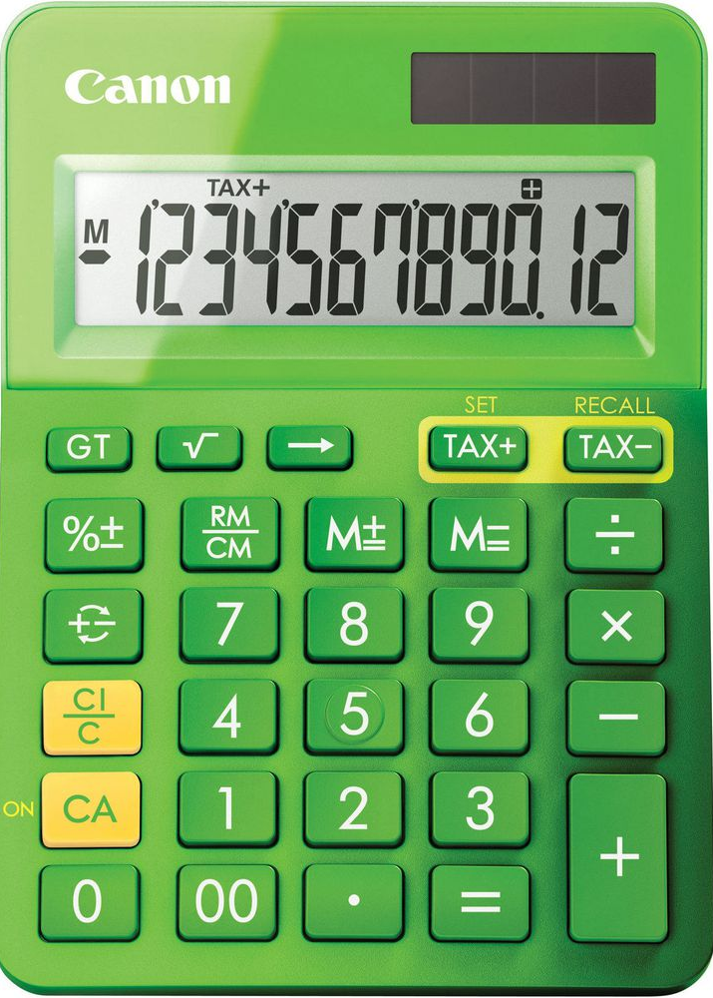
calculator using cordic algorithm

Slide 8
Cordic Algorithm was proposed by Volder in 1959.It is improved by Walther in 1971.
It is widely used hardware efficient iterative algorithm for computation of elementary functions such as hyperbolic,arithematic,trigonometric,exponential, logorithmic functions.

Slide 9
Basic concept of this algorithm is
* To decompose the desired rotation angle into sum of set of predefined elementary rotation angles(lookup table).
*Such that rotation through each of them can be accomplished
with simple shift and add operations,which reduces hardware cost.
For this Cordic algoritm we require only
*3 adders
*1 look up table (register to store predefined values)
*2 shift registers

Slide 10
Cordic algorithm generally works by rotating the coordinate system through a constant set of angles until the angle is reduced to zero.
For example,to track 60 degrees
60=45+26.6-14+7 These are predefined angles( )
when ,it tracks the angle 60 degrees.

Slide 11
= 60-45=15 (+ve)
= 15-26.6=-11 (-ve)
=-11+14=3 (+ve
= .
=.
till to track required angle

Slide 12
Where is the scaling factor to reduce the equation

Slide 13
Then

Slide 14
For n iterations,

Slide 15
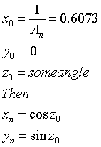
Then we take

Slide 16
LOOK UP TABLE:
i
0 | 45
1 | 26.6
2 | 14
3 | 7.1
4 | 3.6
5 | 1.8
6 | 0.9
7 | 0.4
8 | 0.2
9 | 0.1

Slide 17
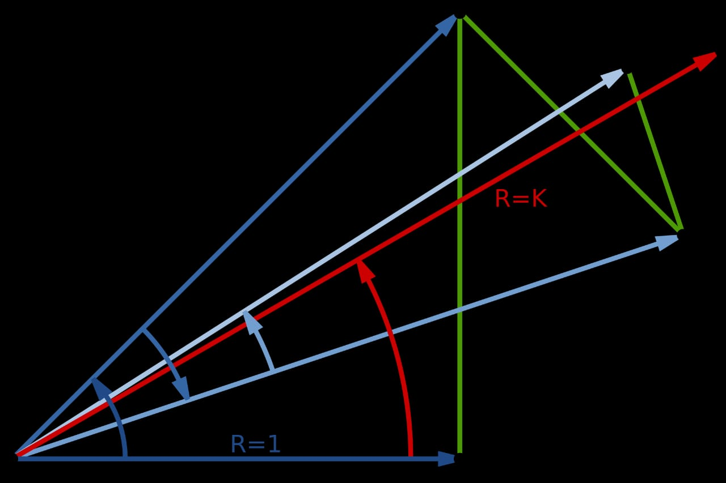

Slide 18
i | d_i | α_i | z_i | x_i | y_i
0 | +1 | 45 | 60 | 0.6073 | 0
1 | +1 | 26.6 | 15 | 0.6073 | 0.6073
2 | -1 | 14 | -11.6 | 0.30365 | 0.91095
3 | +1 | 7.1 | 2.4 | 0.53138 | 0.835037
4 | -1 | 3.6 | -4.7 | 0.427 | 0.901459
5 | -1 | 1.8 | -1.1 | 0.4833 | 0.87477
6 | +1 | 0.9 | 0.7 | 0.51063 | 0.8588
7 | +1 | 0.4 | 0.3 | 0.5039 | 0.86677
8 | +1 | 0.2 | 0.1 | 0.4971 | 0.87071
9 |  | 0.1 | 0 | 0.4997 | 0.8661

Slide 19
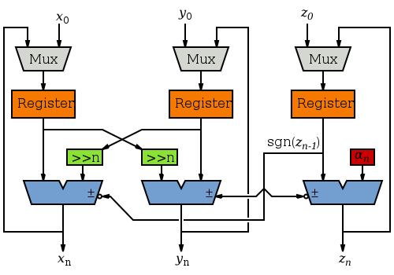
ARCHITECTURE OF CORDIC ALGORITHM

Slide 21
Vectoring Mode:
you have seen 'Rotation Mode' based on the rotation of angle z_{i} .
Now in Vectoring mode according to the position vector of point (x_{i},y_{i})
we accumulate angle in z_{i} this is the basic funda of this mode.
Equations:
x_{i+1}=x_{i}-d_{i}.y_{i}.2^{-i}
y_{i+1}=y_{i}+d_{i}.x_{i}.2^{-i}
z_{i+1}=z_{i}-d_{i}.a_{i} ;a_{i} is ith elementary angle
Note that here ;d_{i} =-sign(y_{i})

Slide 22
Now let us find tan⁻¹(1/3) to know how vectoring mode works
x_{i+1}=x_{i}-d_{i}.y_{i}.2^{-i} | y_{i+1}=y_{i}+d_{i}.x_{i}.2^{-i} | z_{i}=z_{i}-d_{i}.a_{i} | d_{i}=-sign(yi)
0
3 | 1 | 0 | -1
1
4 | -2 | 45⁰ | 1
2
5 | 0 | 45⁰-26.565 = 18.4349 | -
y
(3,1)
(5,0)
x
(4,-2)

Slide 23
Cordic Algorithm
Circular
Coordiniate system
Hyperbolic
Coordiniate system
Linear Coordinate
system
Rotation Mode:
sin(θ),cos(θ)
Vectoring Mode:
tan⁻¹(x),
Rotation Mode:
sinh(θ),cosh(θ)
Vectoring Mode:
tanh⁻¹(x),
Rotation Mode:
x.z
Vectoring Mode:
y/x

Slide 24
Circular Co-ordinate System:
In Rotation Mode: In Vectoring Mode:
x
Cordic
x
Cordic
k_{n}[x.cos(z)-y.sin(z)]
sqrt(x²+y²)
y
k_{n}[x.sin(z)+y.cos(z)]
y
0
z
0
z

Slide 25
Linear Co-ordinate System:
In Rotation Mode: In Vectoring Mode:
x
Cordic
x
x
Cordic
x
y
y+(x.z)
y
0
z
0
z

Slide 26
Hyperbolic Co-ordinate System:
In Rotation Mode: In Vectoring Mode:
x
Cordic
x
Cordic
k_{n}[x.cosh(z)-y.sinh(z)]
sqrt(x²⁻y²)
y
k_{n}[x.sinh(z)+y.cosh(z)]
y
0
z
0
z

Slide 27
Implementation of other important functions

Slide 28
Representation of numbers
we are using 32 bit in our program.If bit size increases precision increases.
Scale the values with

Slide 31
Implementing cos(θ) and sin(θ)
x
Cordic
k_{n}[x.cos(z)-y.sin(z)]
y
k_{n}[x.sin(z)+y.cos(z)]
z
0

Slide 32
Look up table for cos(θ) and sin(θ) :
i | αᵢ=
0 | 45
1 | 26.6
2 | 14
3 | 7.1
4 | 3.6
5 | 1.8
6 | 0.9
7 | 0.4
8 | 0.2
9 | 0.1

Slide 33
decimal | binary | hexcode
45 | 00101101000000000000000000000000 | 2d000000
26.6 | 00011010100100001010001111000000 | 1a90a3c0
14 | 00001110000010010011011101001011 | 0e09374b
7.1 | 00000111001000000000000000000000 | 07200000
3.6 | 0000001110010011011101001011110 | 039374bc
1.8 | 00000001110010100011110101110000 | 01ca3d70
0.9 | 00000000110110011001100110011001 | 00d99999
0.4 | 00000000011100101011000000100000 | 0072b020
0.2 | 0000000000111001010110000001000 | 00395810
0.1 | 00000000000111001010110000001000 | 001cac08
0.6073 | 10011011011110000000000011 | 09b7800

Slide 34

Prerequisites:
*Representation of numbers
*generate Loop,genvar,block identifier of generate loop
ex:
genvar i;
generate
for(i=1;i<=width;i=i+1)
begin:xyz
....
....
end
endgenerate
*shifting

Slide 35
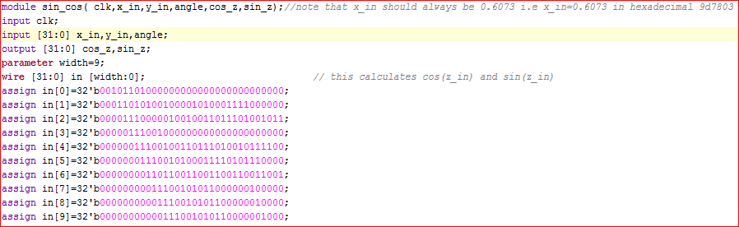
sine and cose code:

Slide 36
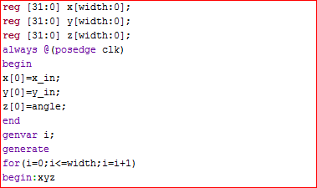

Slide 37
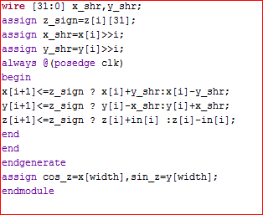

Slide 38
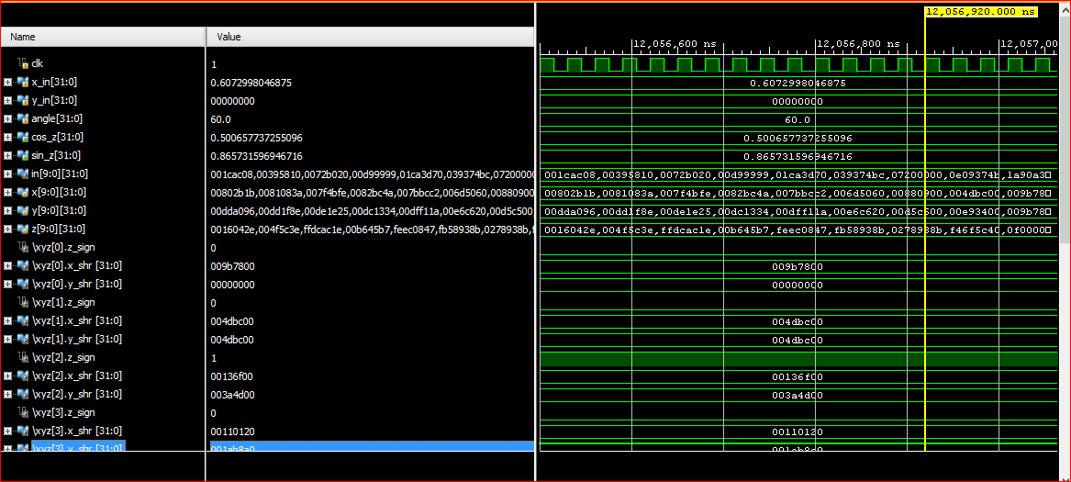
Simulation result:

Slide 39
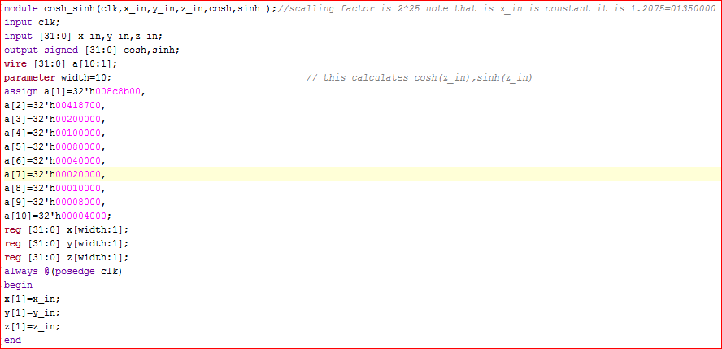
coshx and sinhx code:

Slide 40
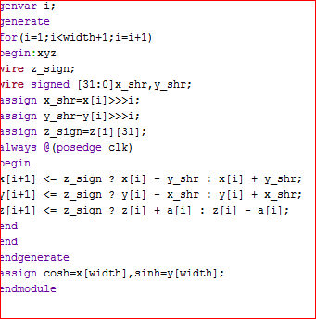

Slide 41
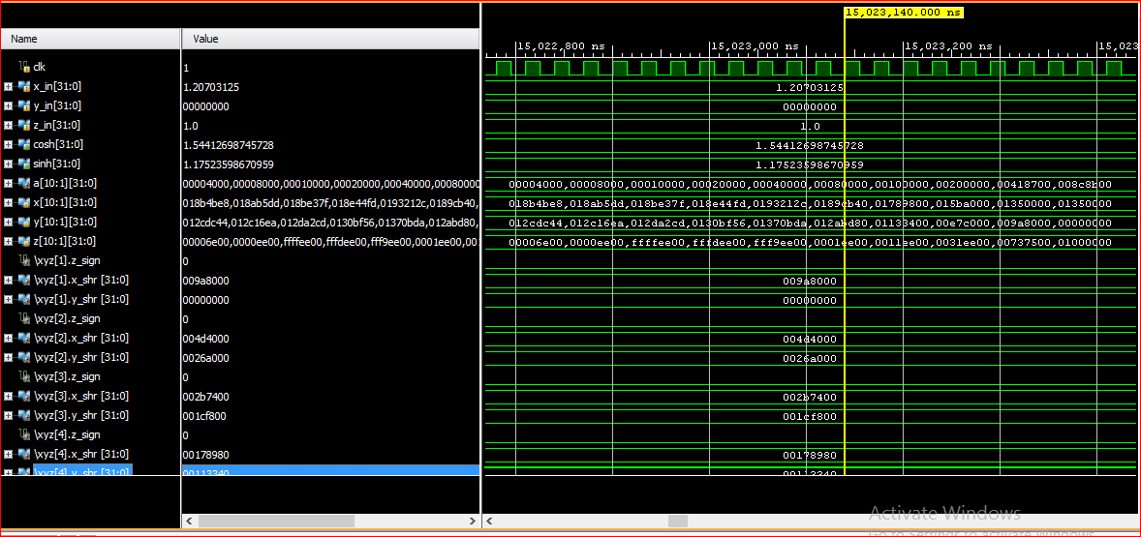
simulation result:

Slide 42
Linear Co-ordinate System
In Rotation Mode: In Vectoring Mode:
x
Cordic
Multiplication
Cordic
x
x
x
y
y+(x.z)
y
0
z
0
z
Put Y=0

Slide 43

Generalized Cordic defined as
X_{i+1} = X_{i} - μ d_{i} Y_{i} 2^{-i}
Y_{i+1} = Y_{i} + d_{i} X_{i} 2^{-i}
Z_{i+1} = Z_{i} - d_{i} E_{i}
Defining μ and E_{i} gives
μ = 1 Circular rotations (basic) E_{i} = tan⁻¹2^{-i}
μ = 0 Linear rotations E_{i} = 2^{-i}
μ = -1 Hyperbolic rotations E_{i} = tanh⁻¹2^{-i}
X_{i+1} = X_{i}
Y_{i+1} = Y_{i} + d_{i} X_{i} 2^{-i}
Z_{i+1} = Z_{i} - d (2^{-i} )

Slide 44
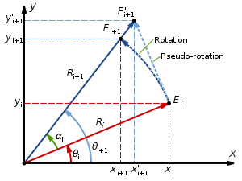
Take Y_{i}=0
Take inputs X_{in} and Z_{in}
Create look up table with 2^{-i} (i=….-2,-1,0,1,2,…..)
X_{i+1} = X_{i}
Y_{i+1} = Y_{i} + d_{i} X_{i} 2^{-i}
Z_{i+1} = Z_{i} - d (2^{-i} )

Slide 45
LOOK UP TABLE
For i=-4 a[-4]=36'h010000000
For i=-3 a[-3]=36'h008000000,
For i=-2 a[-2]=36'h004000000,
For i=-1 a[-1]=36'h002000000,
For i=0 a[0]=36'h001000000,
For i=1 a[1]=36'h000800000,
For i=2 a[2]=36'h000400000,
For i=3 a[3]=36'h000200000,
For i=4 a[4]=36'h000100000,
For i=5 a[5]=36'h000080000,
For i=6 a[6]=36'h000040000,
For i=7 a[7]=36'h000020000,
For i=8 a[8]=36'h000010000,
For i=9 a[9]=36'h000008000,
For i=10 a[10]=36'h00004000;
a[i]= 2^{-i}

Slide 46

CODE FOR MULTIPLICATION
module multiplication(clk,x_in,z_in,out);
input clk;
input [35:0] x_in,z_in;
output reg [35:0] out;
wire [35:0]a[-4:10];
assign
a[-4]=36'h010000000,//fraction part is 12-bits
a[-3]=36'h008000000,
a[-2]=36'h004000000,
a[-1]=36'h002000000,
a[0]=36'h001000000,
a[1]=36'h000800000,
a[2]=36'h000400000,
a[3]=36'h000200000,
a[4]=36'h000100000,
a[5]=36'h000080000,
a[6]=36'h000040000,
a[7]=36'h000020000,
a[8]=36'h000010000,
a[9]=36'h000008000,
a[10]=36'h00004000;

Slide 47
reg [35:0] y [-4:7];
reg [35:0] z [-4:7];
always @(posedge clk)
begin
y[-4]<=0;
z[-4]<=z_in;
end
genvar i;
generate
for(i=-4;i<=7;i=i+1)
begin:yz
wire z_sign;
wire [35:0] x_shr;
assign z_sign =z[i][35];
if(i[31]==1)
begin
assign x_shr=x_in<<-i;
end
else
begin
assign x_shr=x_in>>i;
end
X_{i+1} = X_{i}
Y_{i+1} = Y_{i} + d_{i} X_{i} 2^{-i}
Z_{i+1} = Z_{i} - d (2^{-i} )

Slide 48
always @(posedge clk)
begin
y[i+1]=z_sign ? y[i]-x_shr :y[i]+x_shr;
z[i+1]=z_sign ? z[i]+a[i] :z[i]-a[i];
if(z[i]==0)
out=y[i];
end
end
endgenerate
endmodule
X_{i+1} = X_{i}
Y_{i+1} = Y_{i} + d_{i} X_{i} 2^{-i}
Z_{i+1} = Z_{i} - d (2^{-i} )

Slide 49
Multiplication Inputs: xin=fa800000 (-5.5) yin=0 zin=02000000 (2)

Slide 50
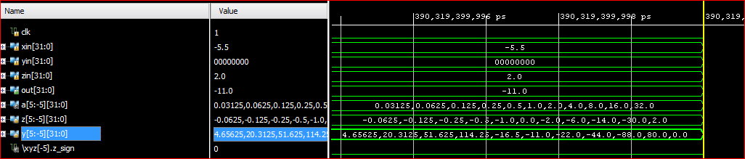
Output of multiplication

Slide 51
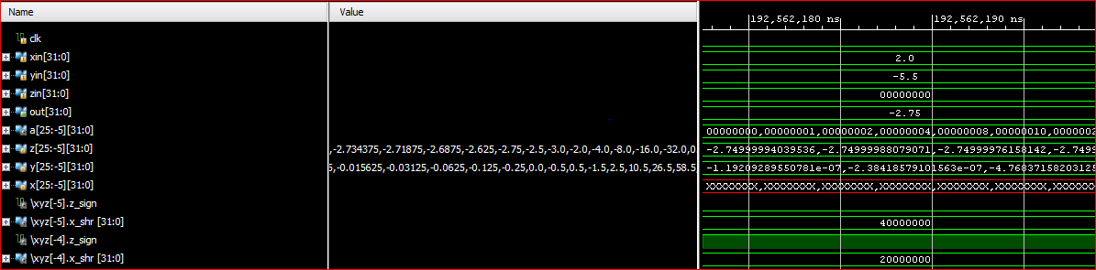
Output of division

Slide 52
CODE FOR FACTORIAL
module factorial(clk,f,out);
input clk;
input [35:0] f;
output reg [35:0] out;
reg [35:0] a [10:1];
reg [35:0] x [10:1];
wire [35:0] y [10:1];
always @(posedge clk)
begin
a[1]=f-36'h001000000;
x[1]=f;
end
genvar i;
generate
for(i=1;i<=10;i=i+1)
begin:xyz
multiplication u2(clk,x[i],a[i],y[i]);

Slide 53
always @(posedge clk)
begin
x[i+1]=y[i];
a[i+1]=a[i]-36'h001000000;
if(a[i]==0)
begin
if(y[i]==0 )
out=36'h001000000;
else
out=y[i-1];
end
end
end
endgenerate
endmodule

Slide 54

Uses:
Cordic algorithm used calculations of
Trigonometric functions
Inverse trigonometric functions
square roots
Hyperolic functions
Division and multiplication
Logorithmic functions
Exponential functions

Slide 55

^{Applications:}
DSP(for MAC blocks)
Image processing
3D Graphics
Robotics
Digital filters
Solving linear systems

Slide 56
Thank you

