Slide 1
VLSI Implementation of Discrete Cosine Transform(DCT) using OBC in Verilog for Image Compression

Slide 2
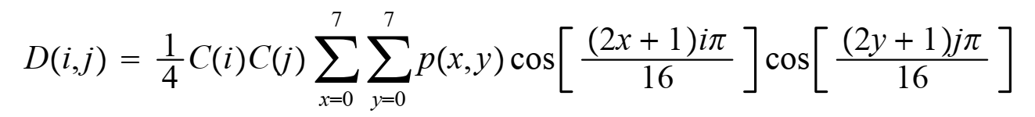
Discrete Cosine Transform(DCT):
It is linear transform of real data into energy compact form.So storage size of image will decrease then it could be transfer easily.DCT performed mathematically as
DCT(i,j)
without calculating this huge formula for every element in DCT use matrix form DCT calculation.

Slide 3
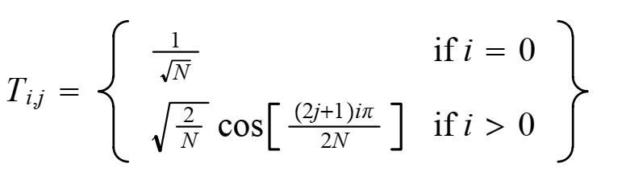
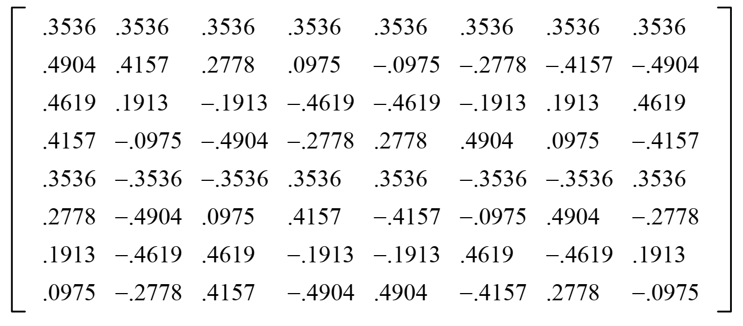
DCT in matrix form:
DCT=CXC^{T}
where C is the coefficient matrix it is calculate by
C_{i,j}
This is constant for a given size so for 8x8 matrix C is
C=

Slide 4
Matrix Multiplication
1 | 2 | 3 | 4 | 5 | 6 | 7 | 8
1 | 2 | 3 | 4 | 5 | 6 | 7 | 8
1 | 2 | 3 | 4 | 5 | 6 | 7 | 8
1 | 2 | 3 | 4 | 5 | 6 | 7 | 8
1 | 2 | 3 | 4 | 5 | 6 | 7 | 8
1 | 2 | 3 | 4 | 5 | 6 | 7 | 8
1 | 2 | 3 | 4 | 5 | 6 | 7 | 8
1 | 2 | 3 | 4 | 5 | 6 | 7 | 8
1 | 2 | 3 | 4 | 5 | 6 | 7 | 8
1 | 2 | 3 | 4 | 5 | 6 | 7 | 8
1 | 2 | 3 | 4 | 5 | 6 | 7 | 8
1 | 2 | 3 | 4 | 5 | 6 | 7 | 8
1 | 2 | 3 | 4 | 5 | 6 | 7 | 8
1 | 2 | 3 | 4 | 5 | 6 | 7 | 8
1 | 2 | 3 | 4 | 5 | 6 | 7 | 8
1 | 2 | 3 | 4 | 5 | 6 | 7 | 8
A=
B=
Let D=AxB
1
1
1
1
1
1
1
1
1 2 3 4 5 6 7 8
=1x1+2x1+3x1+4x1+5x1+6x1+7x1+8x1=36
D[1][1]=
These type of array multiplications could be done by OBC quickly.

Slide 5
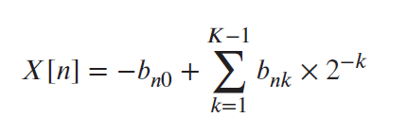
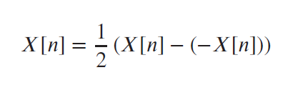
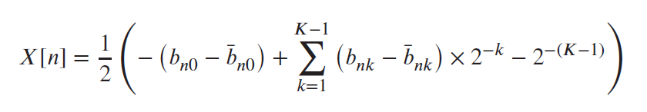
Representation of OBC

Slide 6
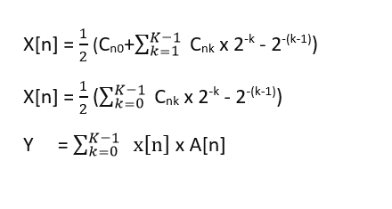
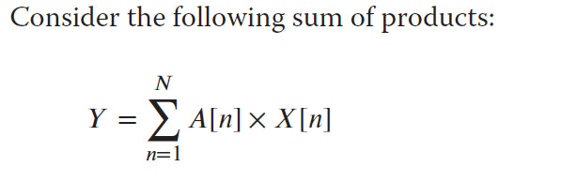
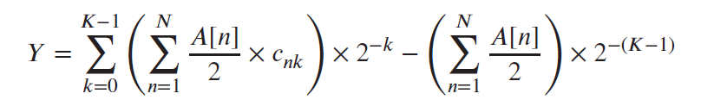
Representation of OBC contd..
b1 | b2 | b3 | b4 | Y
0 | 0 | 0 | 0 | -1/2(A[1]+A[2]+A[3]+A[4])
0 | 0 | 0 | 1 | -1/2(A[1]+A[2]+A[3]-A[4])
0 | 0 | 1 | 0 | -1/2(A[1]+A[2]-A[3]+A[4])
0 | 0 | 1 | 1 | -1/2(A[1]+A[2]-A[3]-A[4])
0 | 1 | 0 | 0 | -1/2(A[1]-A[2]+A[3]+A[4])
0 | 1 | 0 | 1 | -1/2(A[1]-A[2]+A[3]-A[4])
0 | 1 | 1 | 0 | -1/2(A[1]-A[2]-A[3]+A[4])
0 | 1 | 1 | 1 | -1/2(A[1]-A[2]-A[3]-A[4])
1 | 0 | 0 | 0 | 1/2(A[1]-A[2]-A[3]-A[4])
1 | 0 | 0 | 1 | 1/2(A[1]-A[2]-A[3]+A[4])
1 | 0 | 1 | 0 | 1/2(A[1]-A[2]+A[3]-A[4])
1 | 0 | 1 | 1 | 1/2(A[1]-A[2]+A[3]+A[4])
1 | 1 | 0 | 0 | 1/2(A[1]+A[2]-A[3]-A[4])
1 | 1 | 0 | 1 | 1/2(A[1]+A[2]-A[3]+A[4])
1 | 1 | 1 | 0 | 1/2(A[1]+A[2]+A[3]-A[4])
1 | 1 | 1 | 1 | 1/2(A[1]+A[2]+A[3]+A[4])
Offset quantity

Slide 7
Hardware realization of OBC
b1 | b2 | b3 | b4 | Y
0 | 0 | 0 | 0 | -1/2(A[1]+A[2]+A[3]+A[4])
0 | 0 | 0 | 1 | -1/2(A[1]+A[2]+A[3]-A[4])
0 | 0 | 1 | 0 | -1/2(A[1]+A[2]-A[3]+A[4])
0 | 0 | 1 | 1 | -1/2(A[1]+A[2]-A[3]-A[4])
0 | 1 | 0 | 0 | -1/2(A[1]-A[2]+A[3]+A[4])
0 | 1 | 0 | 1 | -1/2(A[1]-A[2]+A[3]-A[4])
0 | 1 | 1 | 0 | -1/2(A[1]-A[2]-A[3]+A[4])
0 | 1 | 1 | 1 | -1/2(A[1]-A[2]-A[3]-A[4])
1 | 0 | 0 | 0 | 1/2(A[1]-A[2]-A[3]-A[4])
1 | 0 | 0 | 1 | 1/2(A[1]-A[2]-A[3]+A[4])
1 | 0 | 1 | 0 | 1/2(A[1]-A[2]+A[3]-A[4])
1 | 0 | 1 | 1 | 1/2(A[1]-A[2]+A[3]+A[4])
1 | 1 | 0 | 0 | 1/2(A[1]+A[2]-A[3]-A[4])
1 | 1 | 0 | 1 | 1/2(A[1]+A[2]-A[3]+A[4])
1 | 1 | 1 | 0 | 1/2(A[1]+A[2]+A[3]-A[4])
1 | 1 | 1 | 1 | 1/2(A[1]+A[2]+A[3]+A[4])
b_{1k}
b₁₀ ….……X[1]…….. b_{1,k-1}
+/-
b_{2k}
b₂₀ ………X[2]…..….b_{2,k-1}
>>1
b_{3k}
b₃₀ …….…X[3]……… b_{3,k-1}
Sign ctrl
b_{4k}
b₄₀ ………X[4]….… b_{4,k-1}
Accumulator
1 0
- A[1]+A[2]+A[3]+A[4]
Address generator
init

Slide 8
“LUT” Optimization
b1 | b2 | b3 | b4 | Y
0 | 0 | 0 | 0 | -1/2(A[1]+A[2]+A[3]+A[4])
0 | 0 | 0 | 1 | -1/2(A[1]+A[2]+A[3]-A[4])
0 | 0 | 1 | 0 | -1/2(A[1]+A[2]-A[3]+A[4])
0 | 0 | 1 | 1 | -1/2(A[1]+A[2]-A[3]-A[4])
0 | 1 | 0 | 0 | -1/2(A[1]-A[2]+A[3]+A[4])
0 | 1 | 0 | 1 | -1/2(A[1]-A[2]+A[3]-A[4])
0 | 1 | 1 | 0 | -1/2(A[1]-A[2]-A[3]+A[4])
0 | 1 | 1 | 1 | -1/2(A[1]-A[2]-A[3]-A[4])
1 | 0 | 0 | 0 | 1/2(A[1]-A[2]-A[3]-A[4])
1 | 0 | 0 | 1 | 1/2(A[1]-A[2]-A[3]+A[4])
1 | 0 | 1 | 0 | 1/2(A[1]-A[2]+A[3]-A[4])
1 | 0 | 1 | 1 | 1/2(A[1]-A[2]+A[3]+A[4])
1 | 1 | 0 | 0 | 1/2(A[1]+A[2]-A[3]-A[4])
1 | 1 | 0 | 1 | 1/2(A[1]+A[2]-A[3]+A[4])
1 | 1 | 1 | 0 | 1/2(A[1]+A[2]+A[3]-A[4])
1 | 1 | 1 | 1 | 1/2(A[1]+A[2]+A[3]+A[4])
b1 | b2 | b3 | b4 | Y
0 | 0 | 0 | 0 | -1/2(A[1]+A[2]+A[3]+A[4])
0 | 0 | 0 | 1 | -1/2(A[1]+A[2]+A[3]+A[4])
0 | 0 | 1 | 0 | -1/2(A[1]+A[2]+A[3]+A[4])
0 | 0 | 1 | 1 | -1/2(A[1]+A[2]+A[3]+A[4])
0 | 1 | 0 | 0 | -1/2(A[1]+A[2]+A[3]+A[4])
0 | 1 | 0 | 1 | -1/2(A[1]+A[2]+A[3]+A[4])
0 | 1 | 1 | 0 | -1/2(A[1]+A[2]+A[3]+A[4])
0 | 1 | 1 | 1 | -1/2(A[1]+A[2]+A[3]+A[4])
Use b1 as a control signal

Slide 9
Optimized form of OBC
b2 | b3 | b4 | y
0 | 0 | 0 | -1/2(A[1]+A[2]+A[3]+A[4])
0 | 0 | 1 | -1/2(A[1]+A[2]+A[3]-A[4])
0 | 1 | 0 | -1/2(A[1]+A[2]-A[3]+A[4])
0 | 1 | 1 | -1/2(A[1]+A[2]-A[3]-A[4])
1 | 0 | 0 | -1/2(A[1]-A[2]+A[3]+A[4])
1 | 0 | 1 | -1/2(A[1]-A[2]+A[3]-A[4])
1 | 1 | 0 | -1/2(A[1]-A[2]-A[3]+A[4])
1 | 1 | 1 | -1/2(A[1]-A[2]-A[3]-A[4])
b₁₀ ….……X[1]…….. b_{1,k-1}
b_{1k}
+/-
b₂₀ ………X[2]…..….b_{2,k-1}
>>1
b_{2k}
b₃₀ …….…X[3]……… b_{3,k-1}
Sign ctrl
b_{3k}
b₄₀ ………X[4]….… b_{4,k-1}
Accumulator
b_{4k}
1 0
- A[1]+A[2]+A[3]+A[4]
Address generator
Sign
init

Slide 10
Main advantages of using OBC in DCT:
1)Multiplier less implementation of inner product of two vectors.
2)Speed of DCT operation increases.

Slide 11
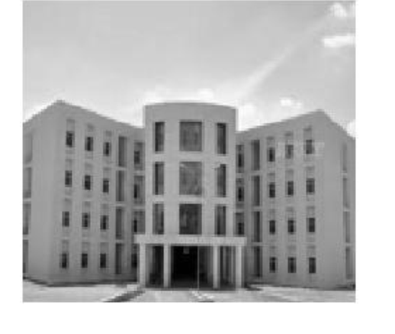
Implementation of DCT Construction and Resconstruction:
Original Image
Image should be grayscale.If not convert it into grayscale using matlab.

Slide 12
Generation of Original Image Matrix
Matlab forms matrix of any image
and returns it in .coe format
Source Image
Using Block Generator Memory in Xilinx store image matrix
Xilinix loads image data serially
X
Since Xilinx cannot generate image matrix itself ,matlab helps to generate image matrix in “.coe” format.This can load in block memory generator in Xilinx.

Slide 13
Block Diagram of DCT Construction and Resconstruction:
Original Image
Segment into 8x8 blocks
1st
8×8 matrix
2nd
8×8 matrix
3rd
8×8 matrix
8th
8×8 matrix
........................................
9th
8×8 matrix
16th
8×8 matrix
17th
8×8 matrix
24th
8×8 matrix
Convert 64x64 image into 64 8x8 matrices
X=
57th
8×8 matrix
58th
8×8 matrix
59th
8×8 matrix
64th
8×8 matrix
........................................

Slide 14
Block Diagram of DCT Construction and Resconstruction:
Original Image
Segment into 8x8 blocks
Forward DCT Transform
DCT=CXC^{T}

Slide 15
1st
8×8 matrix
2nd
8×8 matrix
3rd
8×8 matrix
8th
8×8 matrix
8x8
DCT Coe. Matrix
8x8
DCT Coe. Matrix
8x8
DCT Coe. Matrix
........................................
8x8
DCT Coe. Matrix
9th
8×8 matrix
16th
8×8 matrix
17th
8×8 matrix
24th
8×8 matrix
8x8
DCT Coe. Matrix
C
C=
X=
57th
8×8 matrix
58th
8×8 matrix
59th
8×8 matrix
64th
8×8 matrix
8x8
DCT Coe. Matrix
........................................

Slide 16
1st
8×8 matrix
2nd
8×8 matrix
3rd
8×8 matrix
8th
8×8 matrix
........................................
9th
8×8 matrix
16th
8×8 matrix
17th
8×8 matrix
24th
8×8 matrix
CX=
8x8
DCT Coe. Matrix
C^{T}=
57th
8×8 matrix
58th
8×8 matrix
59th
8×8 matrix
64th
8×8 matrix
........................................

Slide 17
DCT=CXC^{T}
In this parallel DCT ,although CX is completely computed (CX)C^{T} starts this is another advantage.
1 | 2 | 3 | 4 | 5 | 6 | 7 | 8
1 | 2 | 3 | 4 | 5 | 6 | 7 | 8
1 | 2 | 3 | 4 | 5 | 6 | 7 | 8
1 | 2 | 3 | 4 | 5 | 6 | 7 | 8
1 | 2 | 3 | 4 | 5 | 6 | 7 | 8
1 | 2 | 3 | 4 | 5 | 6 | 7 | 8
1 | 2 | 3 | 4 | 5 | 6 | 7 | 8
1 | 2 | 3 | 4 | 5 | 6 | 7 | 8
1 | 2 | 3 | 4 | 5 | 6 | 7 | 8
1 | 2 | 3 | 4 | 5 | 6 | 7 | 8
1 | 2 | 3 | 4 | 5 | 6 | 7 | 8
1 | 2 | 3 | 4 | 5 | 6 | 7 | 8
1 | 2 | 3 | 4 | 5 | 6 | 7 | 8
1 | 2 | 3 | 4 | 5 | 6 | 7 | 8
1 | 2 | 3 | 4 | 5 | 6 | 7 | 8
1 | 2 | 3 | 4 | 5 | 6 | 7 | 8
1 | 2 | 3 | 4 | 5 | 6 | 7 | 8
1 | 2 | 3 | 4 | 5 | 6 | 7 | 8
1 | 2 | 3 | 4 | 5 | 6 | 7 | 8
1 | 2 | 3 | 4 | 5 | 6 | 7 | 8
1 | 2 | 3 | 4 | 5 | 6 | 7 | 8
1 | 2 | 3 | 4 | 5 | 6 | 7 | 8
1 | 2 | 3 | 4 | 5 | 6 | 7 | 8
1 | 2 | 3 | 4 | 5 | 6 | 7 | 8
X(8,8)=
C=
C^{T}=
Whenever first eight elements comes in CX matrix CXC^{T} starts computing without waiting untill total 8x8 matrix computed

Slide 18
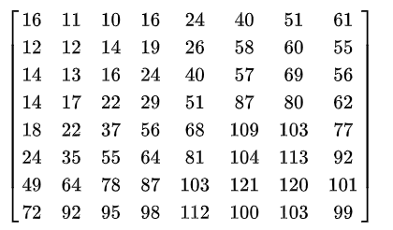
Block Diagram of DCT Construction and Resconstruction:
Original Image
Segment into 8x8 blocks
Forward DCT Transform
Quantize
DCTQ
DCT=CXC^{T}
After performing DCT each pixel is indicated with large range of real numers so to make it into small range perform quantization.
DCTQ(i,j) =
;elemental division of DCT and quatization matrix
Q(i,j)=

Slide 19
Block Diagram of DCT Construction and Resconstruction:
Original Image
Segment into 8x8 blocks
Forward DCT Transform
Quantize
Channel
Dequantization
Channel
DCT(i,j) =DCTQ(i,j)xQ(i,j)

Slide 20
Block Diagram of DCT Construction and Resconstruction:
Original Image
Segment into 8x8 blocks
Forward DCT Transform
Quantize
Channel
Dequantization
Inverse DCT Transform
Channel
This is similar as forward DCT but the oder of multiplication of coffecient matrix has changed
(DCT)⁻¹=C^{T}XC

Slide 21
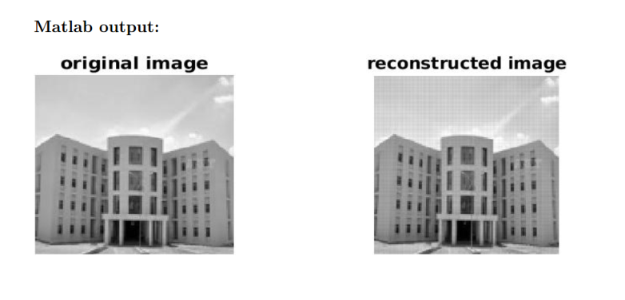
Block Diagram of DCT Construction and Resconstruction:
Original Image
Segment into 8x8 blocks
Forward DCT Transform
Quantize
Channel
Dequantization
Inverse DCT Transform
Combine 8x8 blocks
Channel
X
Reconstructed image

Slide 22
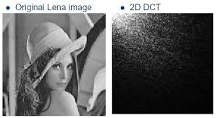
Advantage of DCT
1)Energy Compaction: is the ability to pack the energy of the spatial sequence into as few
frequency coefficients as possible.
Obeserve that 2D DCT of Lena image all the frequencies compenents in white are concentrated at origin.

Slide 23
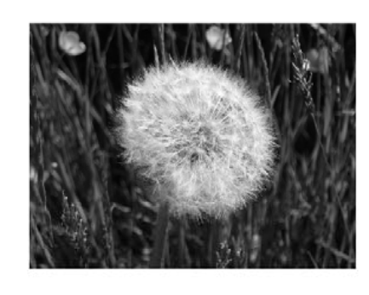
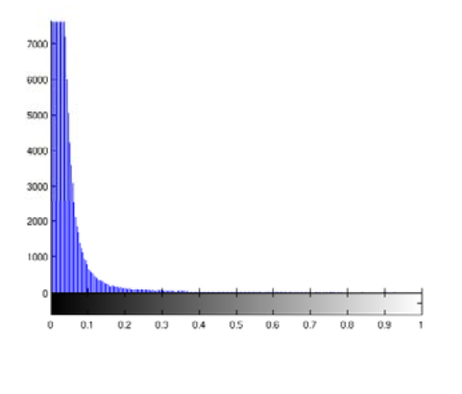
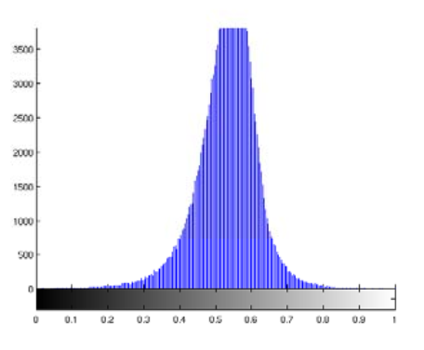
Consider the DFT and DCT of this flower image
Image
DFT
DCT
Amplitude Sepctra of DFT and DCT
Observe that DCT have concentrate the information at lower bandwith i.e, DCT image is easy to transfer.

Slide 24
Disadvantage of DCT
Comparision between Original Image and Reconstructed Image
In the reconstructed image some of the pixels intensities varies suddenly is due to quantization this is the main lossy operation in the whole DCT process.

Slide 25

THANKS

