Slide 1
Developing Visualizations using Top 10000 Popular Movies Data Set
Group 06
DSCI 5360.003 Data Visualization for Analytics – Dr. Chih-Hao Ku

Slide 2
Introduction
This project is inclined towards analyzing a dataset which containing information about the “Top 10000 Popular Movies”. The main motivation behind selecting this topic lies on our fascination with the world of cinema and the desire to understand the present trends, factors, and characters they play in the movie. We seek to answer intriguing questions about the film industry by examining aspects such as language, genre, release date, runtime, vote count, vote average, popularity, and revenue.

Slide 3
About Data Set
The first dataset we used in this project is Top10000_Movies.csv. This dataset contains information about 10,000 movies and appears to be a subset of the larger dataset available on the Movie Database (TMDb), a community-built movie and TV database.
We found this dataset in Kaggle which is collected and published by OMKAR BORIKAR on 27th September 2021.
https://www.kaggle.com/datasets/omkarborikar/top-10000-popular-movies
This dataset contains 10015 rows (Cases) and 14 columns (Variables).

Slide 4
We used attributes like revenue, movie name, vote count, popularity, release date to form questions like below:
Which movies make up the elite Top 5 in terms of revenue, and what financial feats have they achieved in the cinematic world?
Which movie holds the top spot for the highest number of votes?
Were there particular years that saw a notable spike or dip in movie popularity? If so, what might have contributed to these fluctuations?
Unveiling Movie Counts in Every Languages?
How has the number of movies released and run time changed over the past decade, and are there any noticeable trends?

Slide 5
In this data set we have cleaned some junk values and we have corrected data type formats in original title as it taking in a date format
We also included a new variable(column) called ‘Country’ which tells the country in which the film was originally released.
We have also joined another dataset “ISO 639 1 Language Codes.csv” to this dataset which contains the ISO language codes which resembles the original language in which the film was originally created/dubbed.

Slide 6
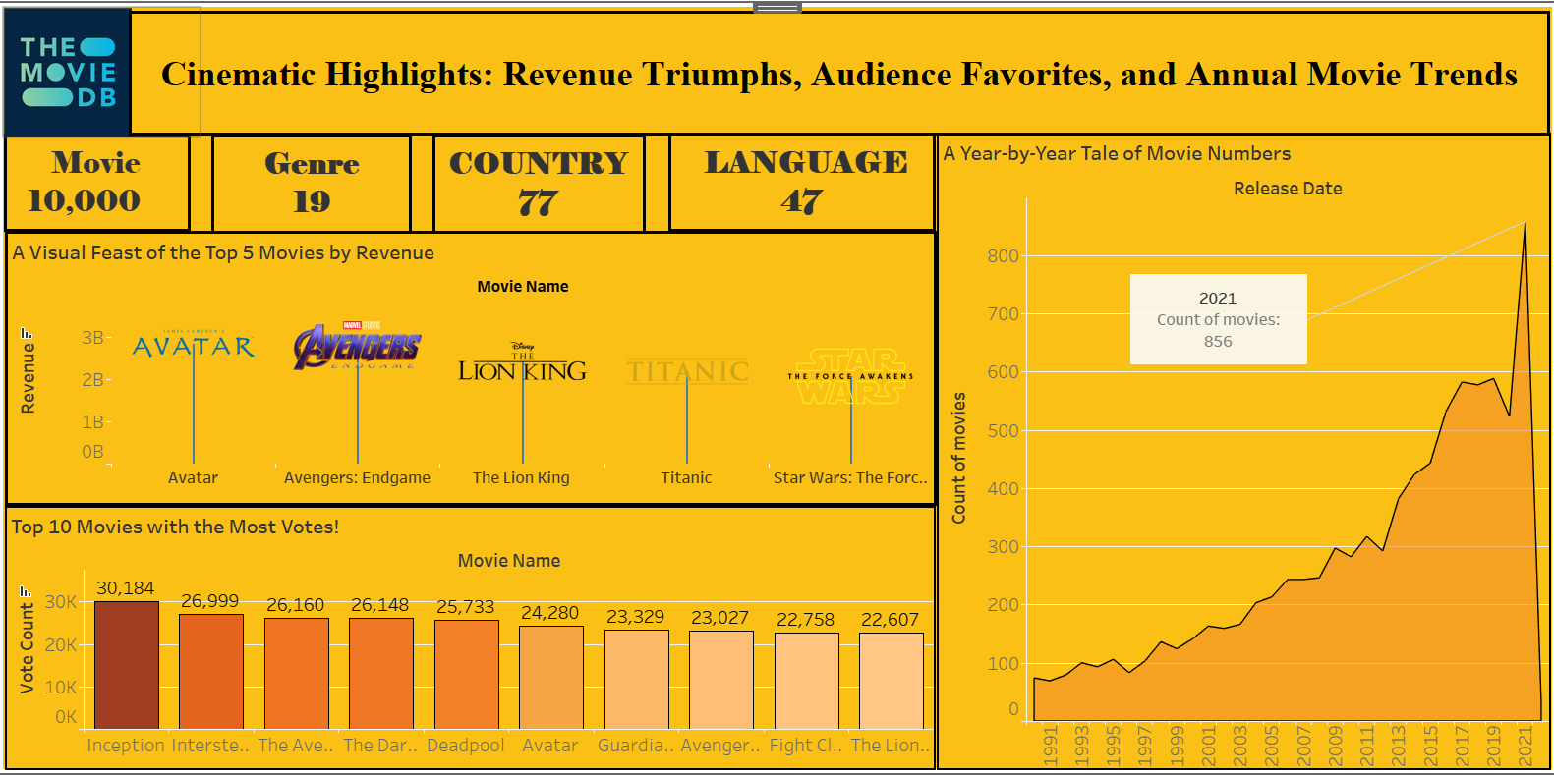
Story telling using dash boards:

Slide 7
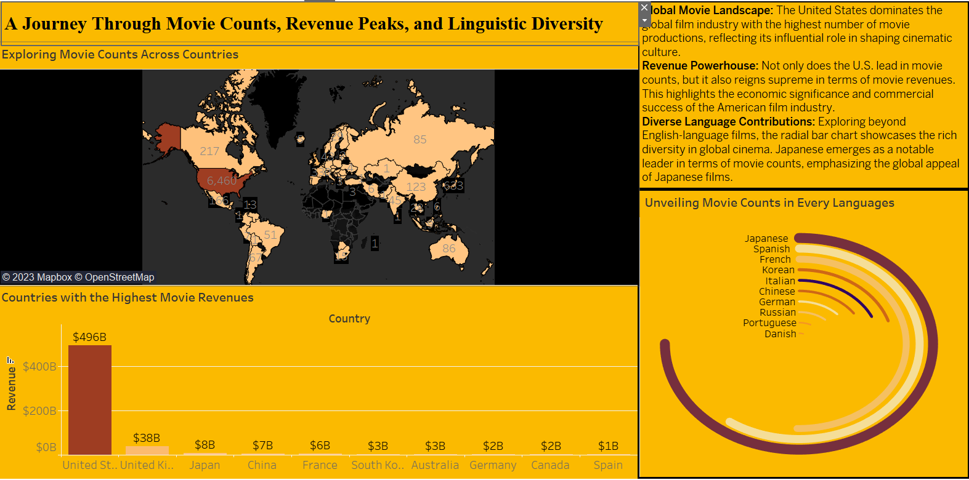

Slide 8
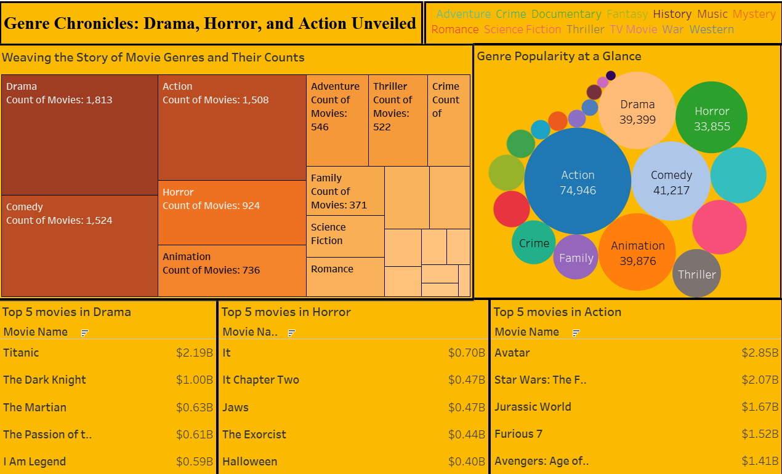

Slide 9
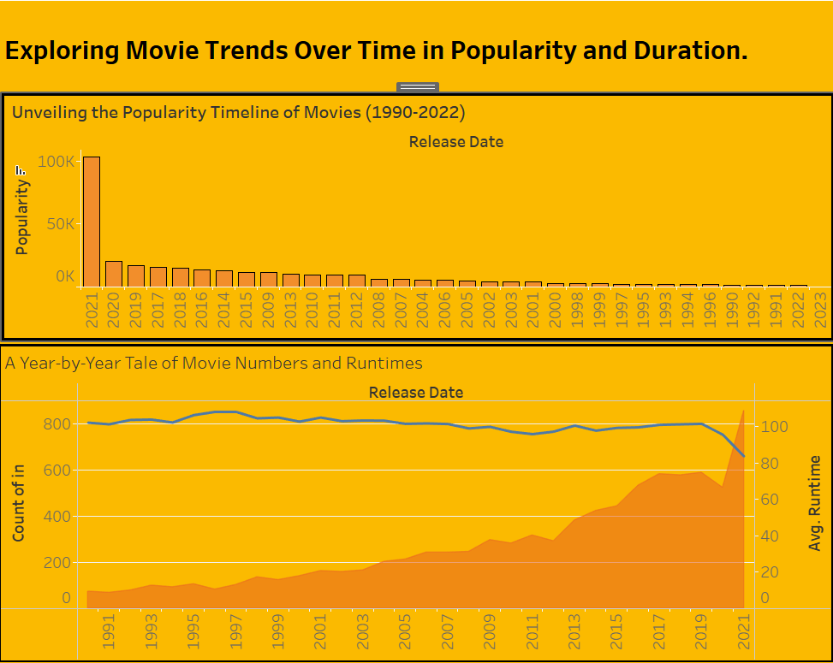

Slide 10
Conclusion:
To conclude, this project showcases the effectiveness of data analysis in identifying patterns and trends within a particular industry, like the film business.
It shows the revenue terms, audience favorites, annual movie trends, exploring movie counts across countries, genre chronicles/popularity and movie trends overtime.
Further research could entail a more thorough examination of the dataset, looking at things like language and genre distribution, the popularity of a film's runtime in relation to its movie numbers, and other possible trends and correlations.

Slide 11
Teamwork:
Pravallika Pabbineedi
Data Transformation
Data Cleaning
Syam Sundar Akina
Finding the Data Set
Research
Data Visualization using tableau.
Teja Siva Akhil Chamana
Research
Data Visualization
Modification of Dataset
Swetha Priya Gadikota
Data Stories
Research
Visualization Plan
Vamsi Medidi
Derived the Questions
Conclusions
Phalguni Mantripragada
Research
Data Visualization

Slide 12
Thank you

