Slide 1

Manufacturing of Glass Water Bottle-GlasSSpring
GlassSpring offers a premium, eco-friendly alternative to plastic water bottles, tapping into the growing demand for sustainable, health-conscious products—while helping to reduce plastic waste and improve consumer well-being
Date:4th Dec 2024
Your contact info – syam191199@gmail.com
Audience : Investors

Slide 2
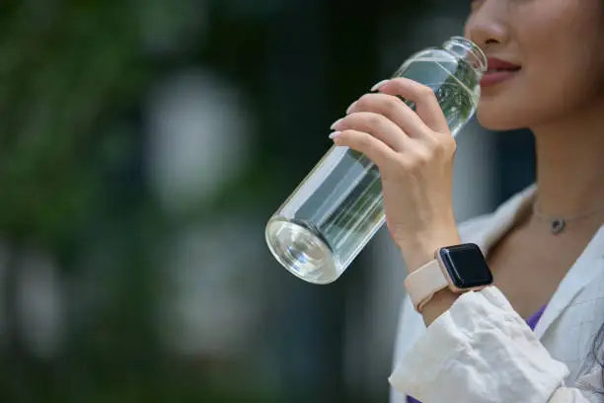
Our Purpose
At GlassSpring, we’re changing the way people drink water by making it healthier and more sustainable. Our eco-friendly glass bottles are designed to replace harmful plastic, offering a durable, stylish alternative that supports both personal well-being and a cleaner planet

Slide 3
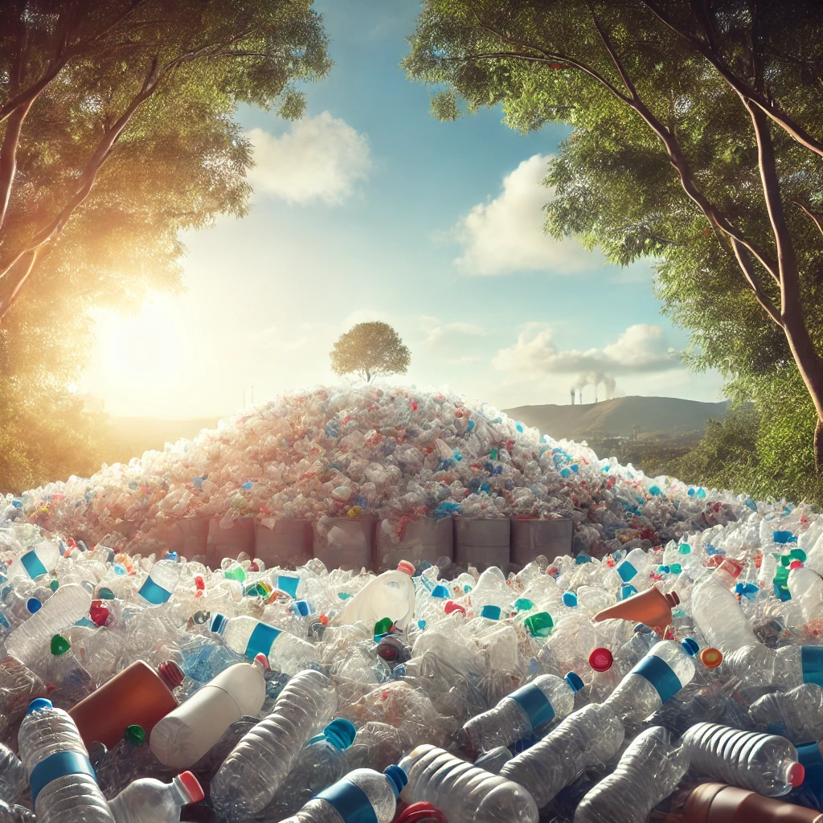
The Problem We Discovered
Plastic waste is overwhelming the planet, with millions of bottles discarded daily
Microplastics harm both health and the environment.
Consumers are searching for sustainable and healthy alternatives

Slide 4
Solution
GlassSpring offers high-quality, chemical-free, and 100% recyclable glass bottles.
Designed for durability and style, our bottles cater to eco-conscious and health-focused individuals.
- A healthier, premium alternative to plastic.

Slide 5
Business Model
At GlassSpring, we’re creating a healthier, more sustainable way to hydrate. Our eco-friendly glass water bottles offer a stylish, chemical-free alternative to plastic, helping reduce waste and support a cleaner planet.
How We Make Money:
Direct Sales through our website and retail stores.
Bulk Orders for businesses like gyms and restaurants.
Subscription Service for easy bottle replacements.
Who We Serve: We’re here for fitness enthusiasts, health-conscious individuals, and anyone who cares about the planet.
What Makes Us Different: Our bottles are not only durable and reusable, but they also reflect a lifestyle focused on health, sustainability, and style—offering a simple solution for people who want to make a positive impact on both their health and the environment

Slide 6
Your Ask
We are seeking $100,000 to bring GlassSpring to market and scale our operations. These funds will enable us to:
Product Development & Manufacturing: Ramp up production of our eco-friendly glass bottles while maintaining premium quality.
Marketing & Brand Building: Raise awareness about our mission and attract customers through digital campaigns and strategic retail partnerships.
Operational Expansion: Build a robust supply chain and distribution system to meet growing demand efficiently.

Slide 7
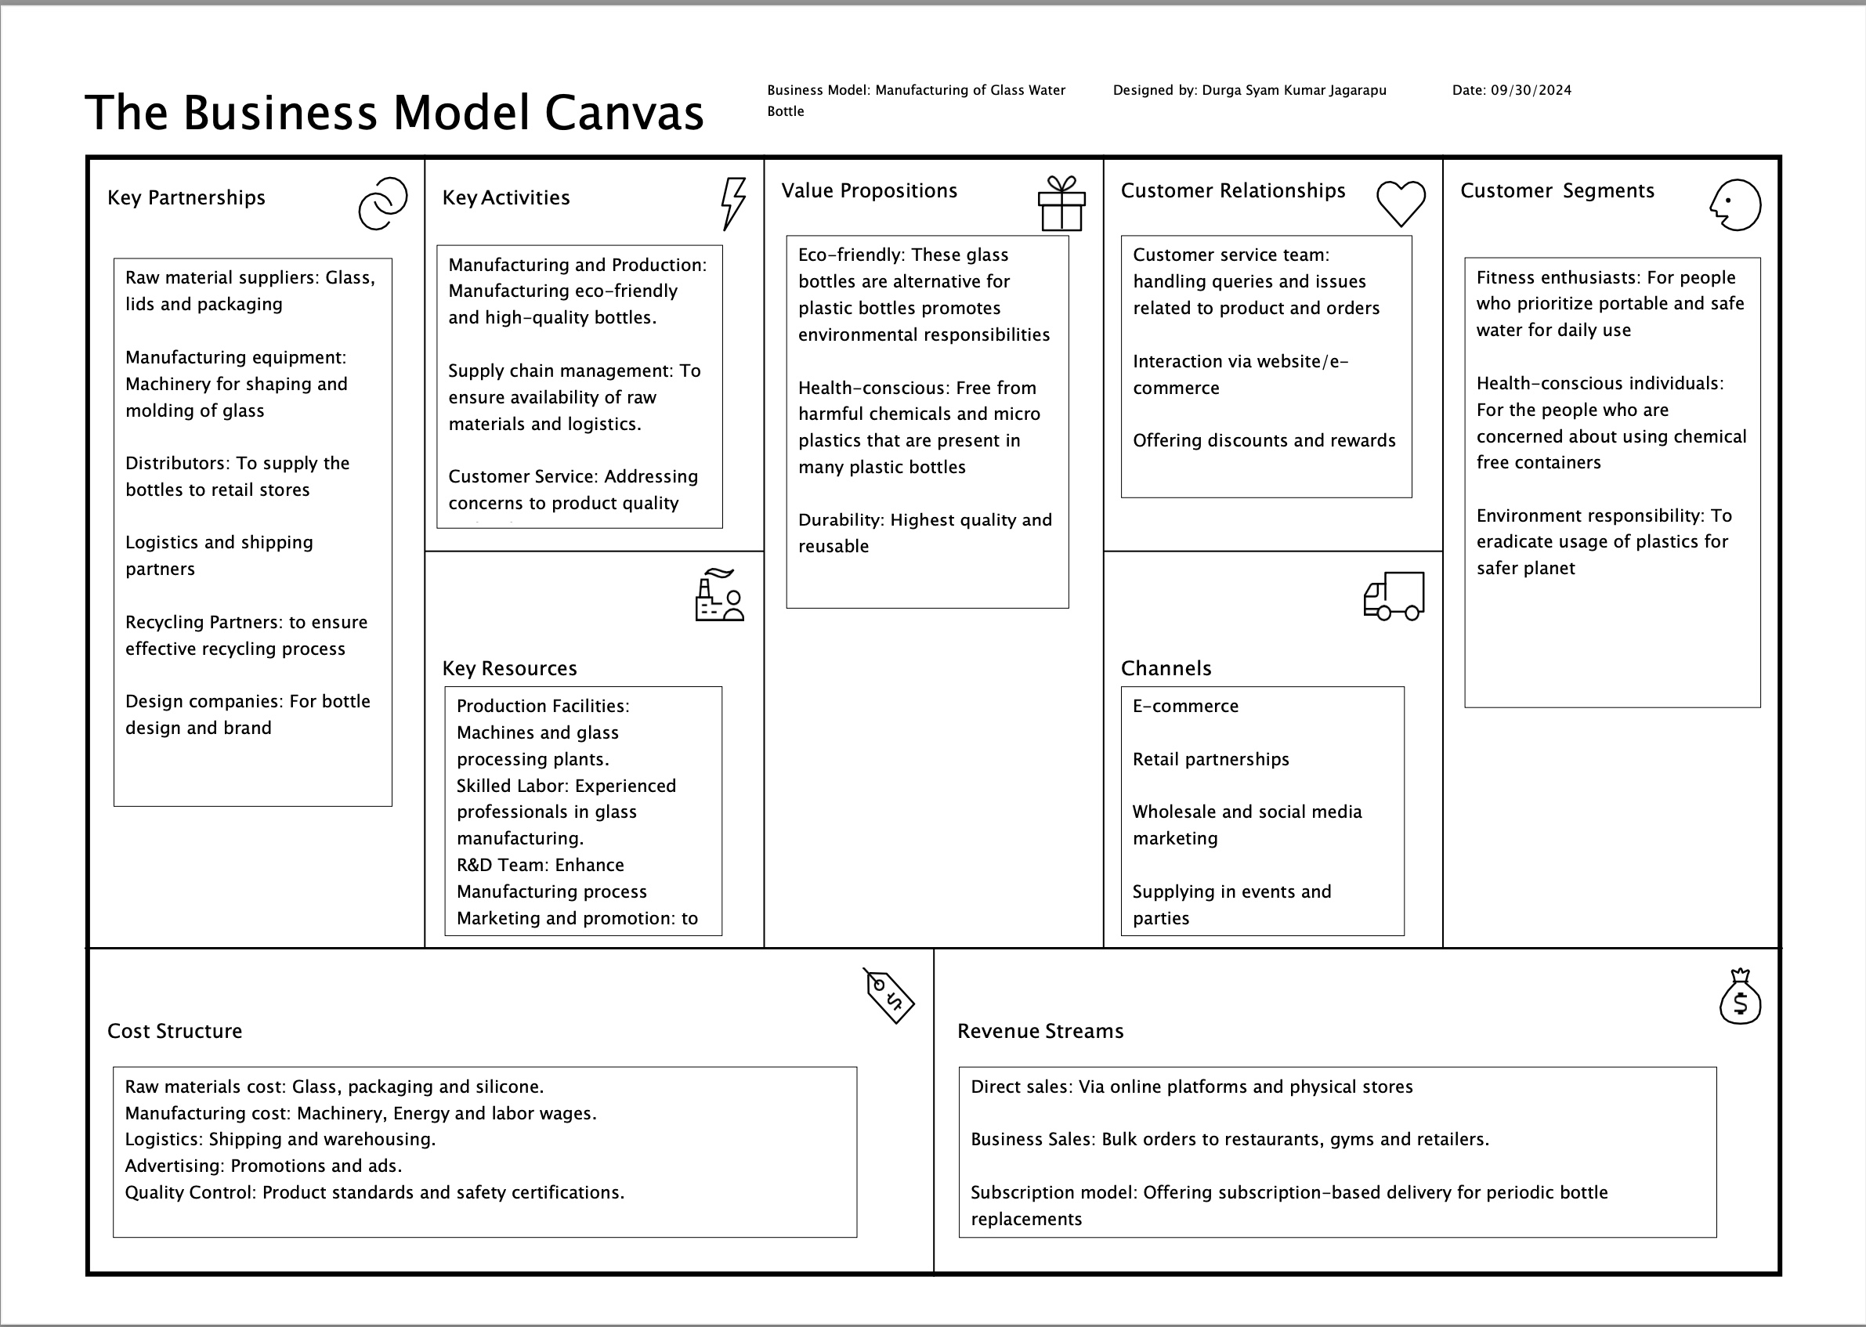
Key Insights
Enabled by the BMC
A Clear Focus on the Right Customers
Capitalizing on the Sustainability Movement
Building a Strong, Recognizable Brand

Slide 8
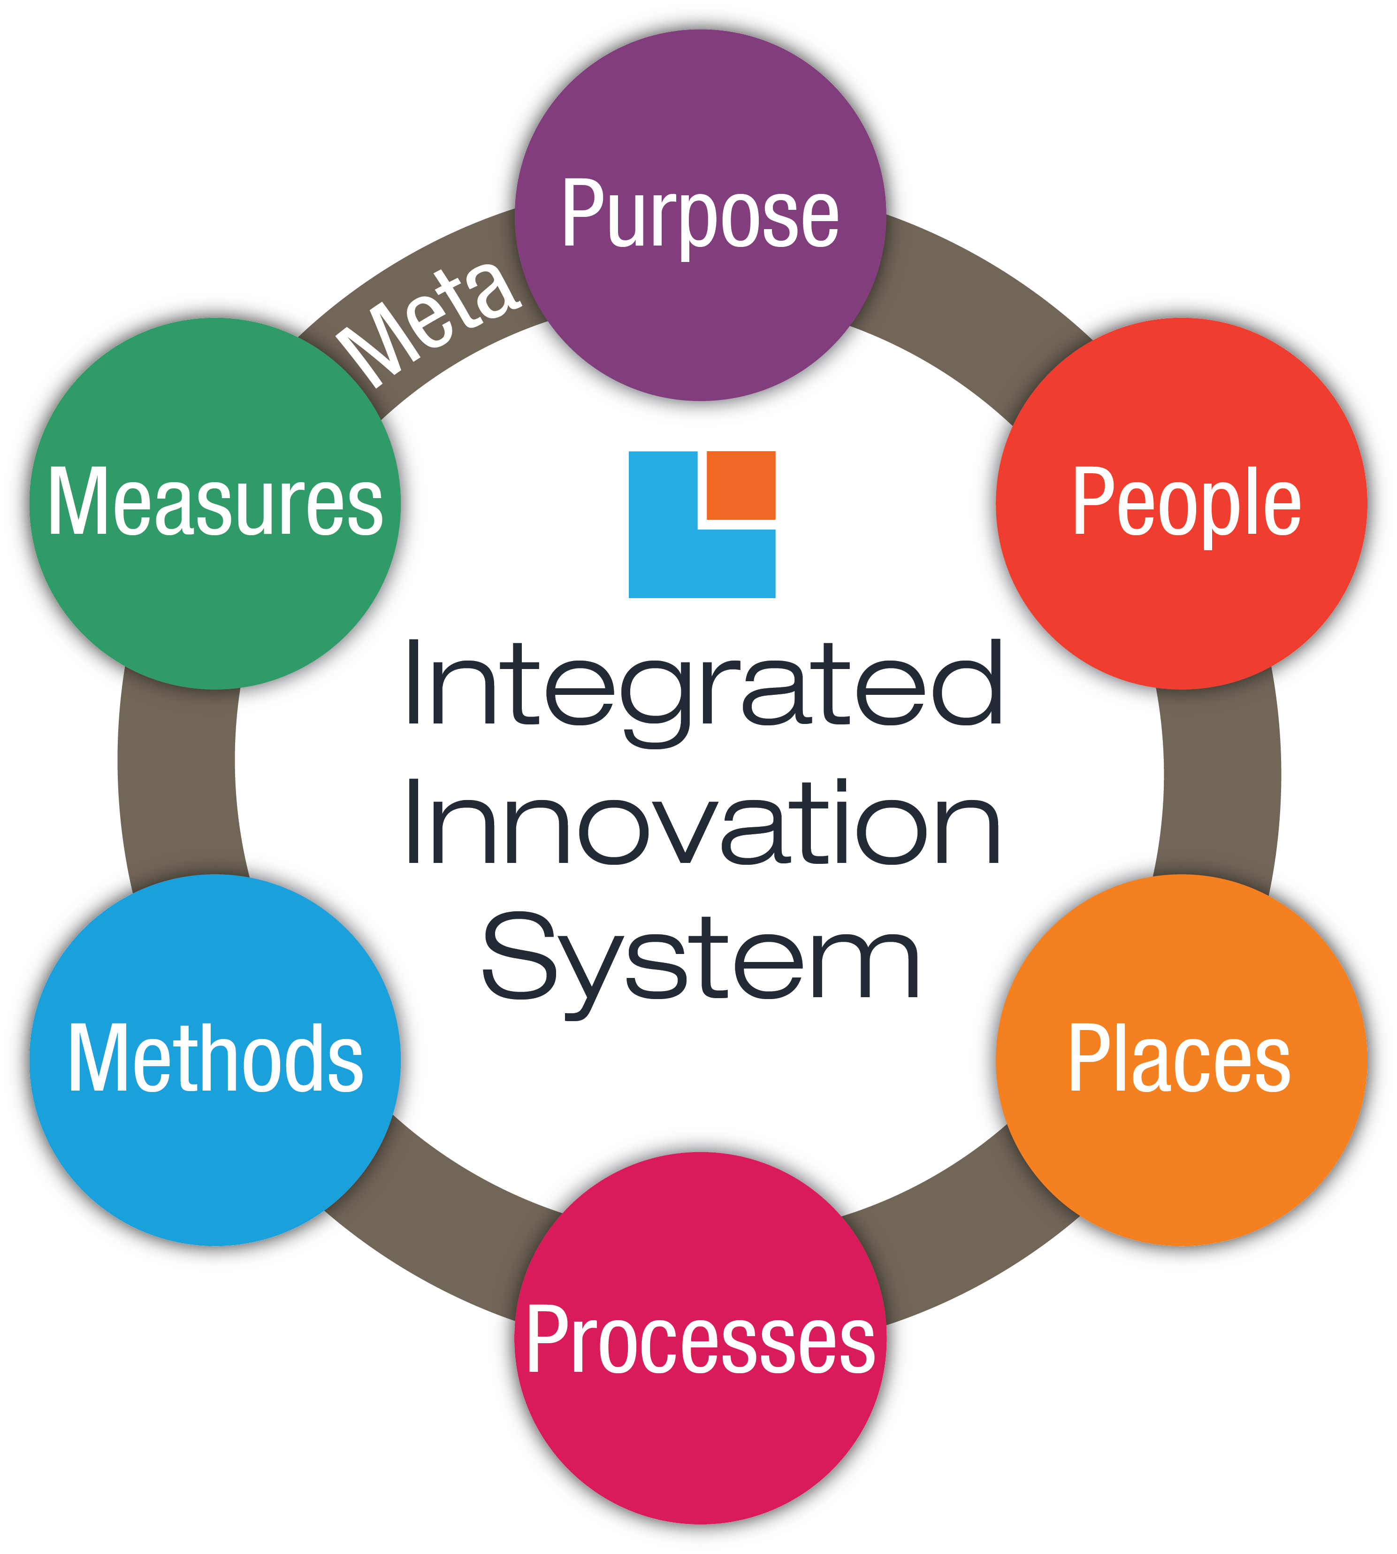
Key Insights
Enabled by the IIS
1) Health
2) Sustainability
3) Scalability
Eco-Friendly
Environment impact
Health Concisions Individuals
Retailers
Sustainable Production
Supply chain
Meta : Transforming hydration, reducing waste

Slide 9
Conclusion
GlassSpring is more than a product—it’s a step toward healthier living and a cleaner planet. By replacing harmful plastics with stylish, sustainable glass bottles, we’re creating real impact. With your support, we can scale this vision and make a difference for people and the environment—one bottle at a time.

Slide 10

Thankyou for your time

