Slide 1
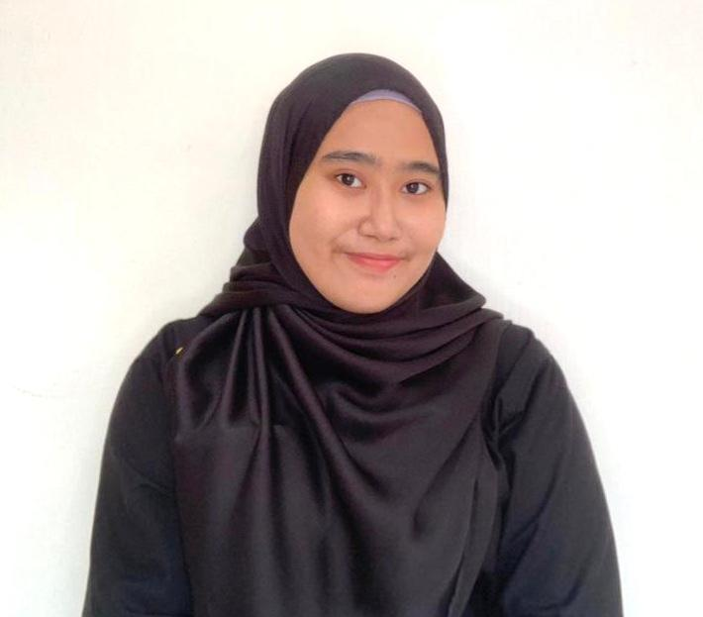
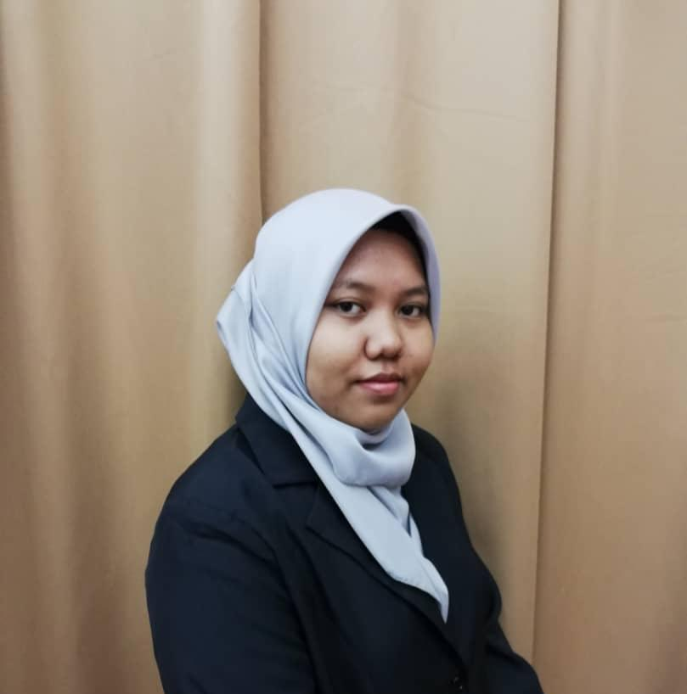
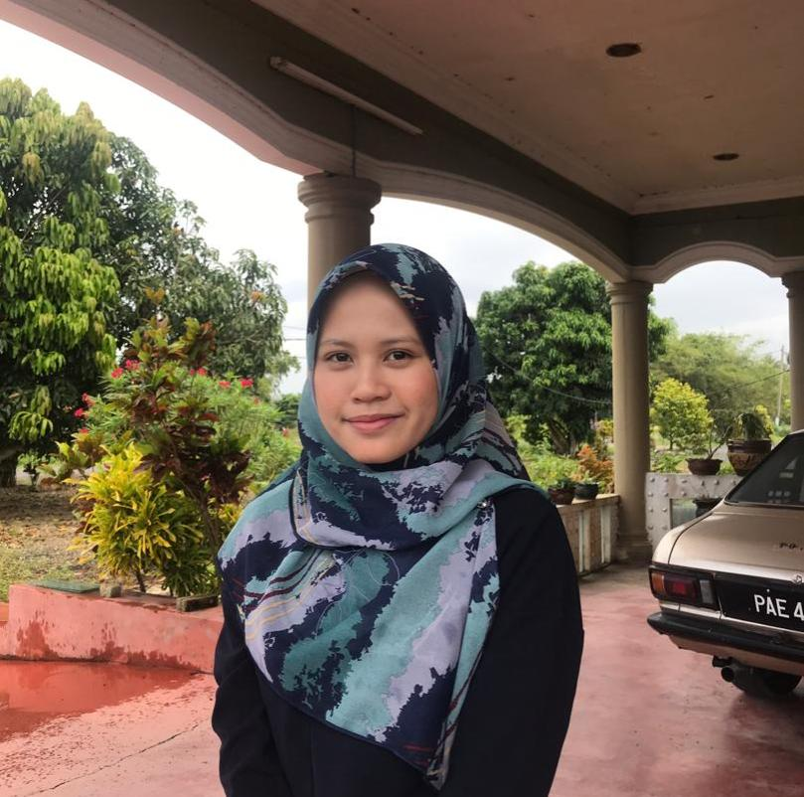
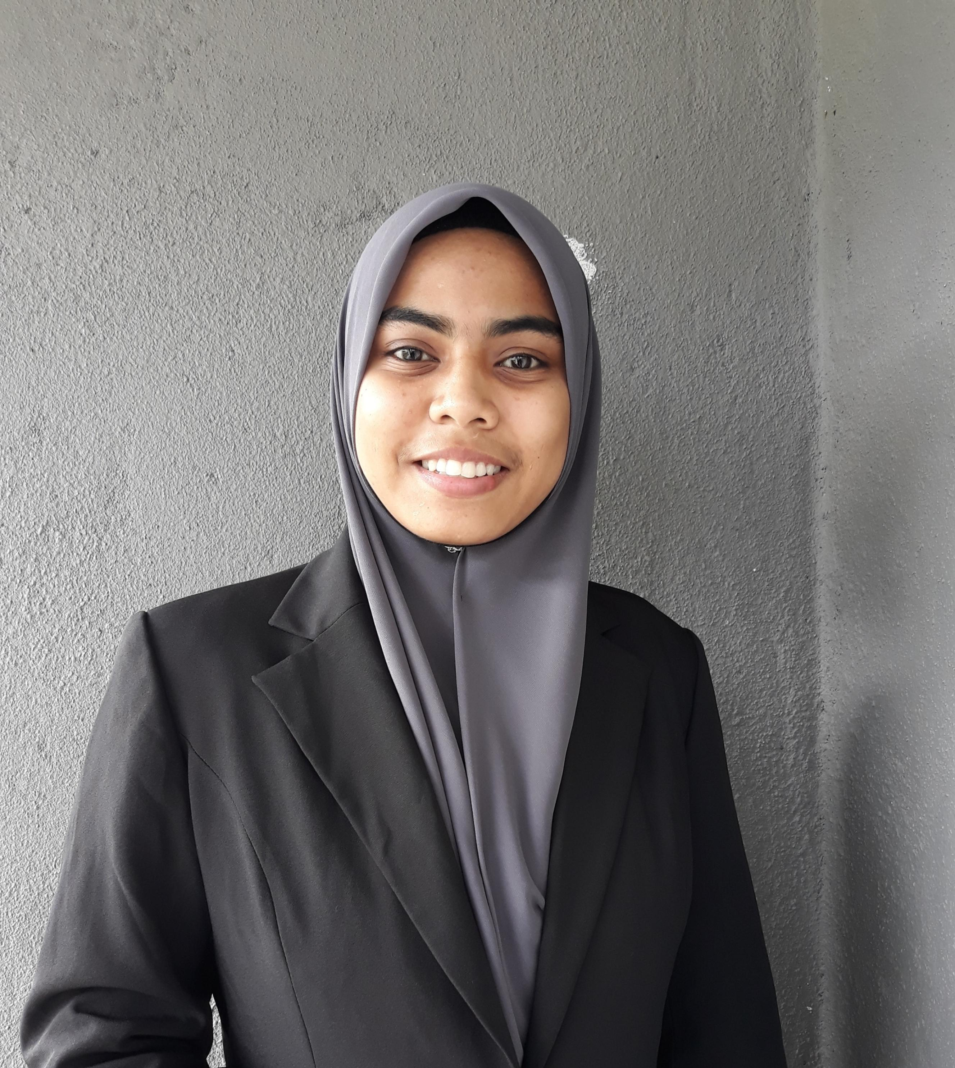
ORGANIZATIONAL CHART
General Manager
ATIQA SYHUHADA
Marketing Manager
NURUL SYAQINAH
Accounting Manager
NURUL AZMIN
Operational Manager
NORHIJRAH

