Slide 1

SMART LOCK system
By Syarif & Simon
09.11.2017 University of Basel

Slide 2
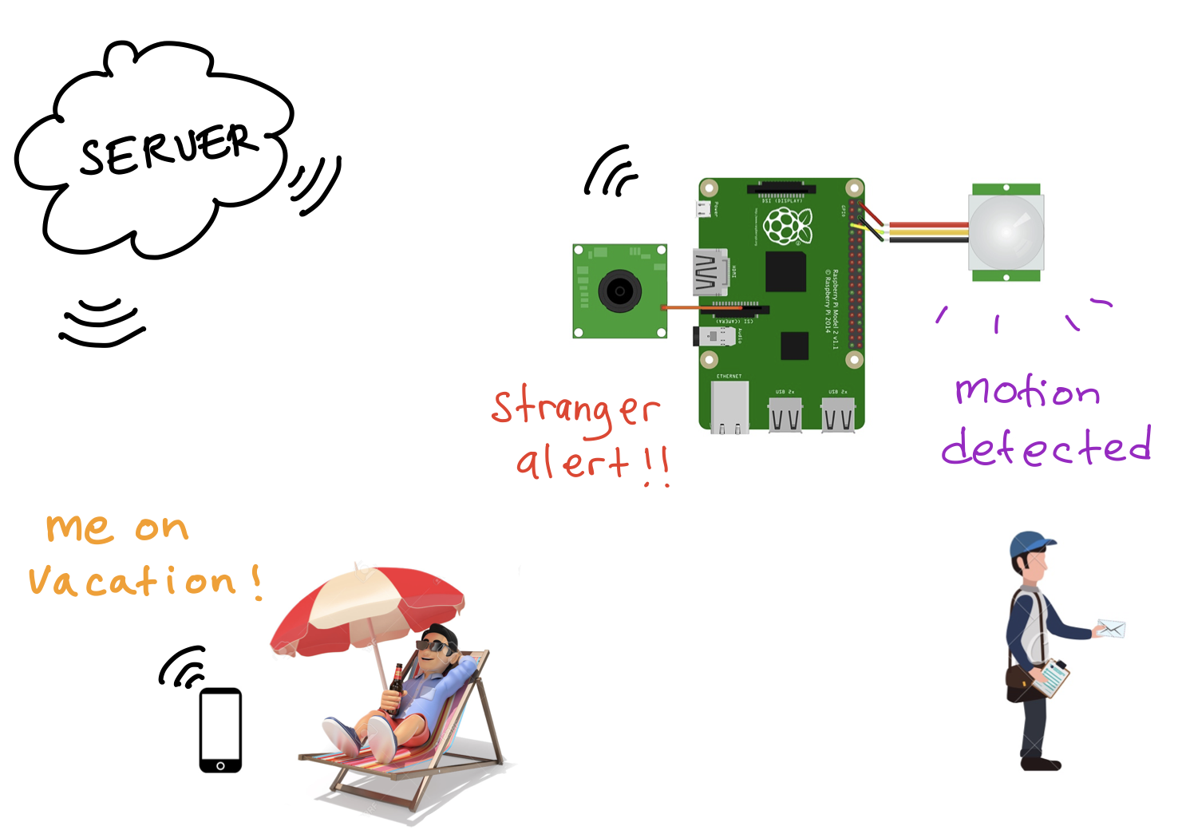
PROJECT IDEA
Image taken from: www.girliemac.com www.canva.com www.123rf.com www.thenounproject.com

Slide 3
Responsibilities
Server - Client communication: Syarif
Main application for the Raspberry Pi: Syarif
Android Client: Syarif
Arduino Client: Simon
Hardware: Simon
Documentation and organization: Simon

Slide 4

Estimated Budget
Raspberry Pi 3 | 80 EUR
LCD | 8 EUR
Arduino Wemos Mini D1 | 17 EUR
Pi Camera | 30 EUR
Relais | 10 EUR
TOTAL | 145 EUR

Slide 5
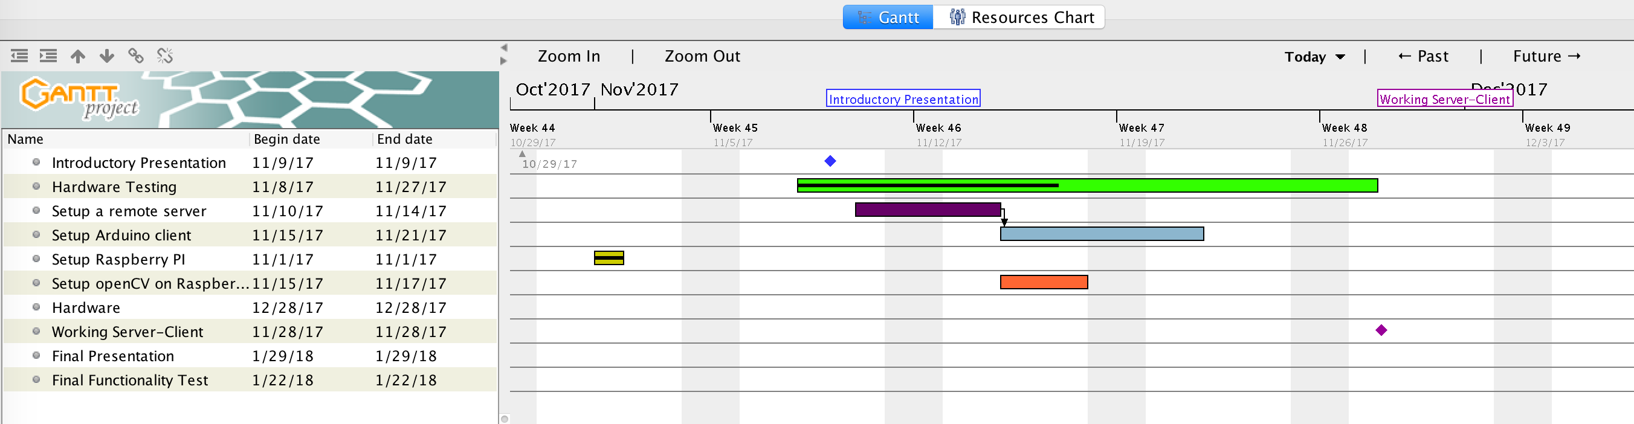
Time management
Milestones:
Project idea presentation: Today
Working server-client: 28/11/17
Hardware: 28/12/17
Final functionality test: 22/01/18
Final presentation: 29/01/18

Slide 6
Questions ?
Project link: https://github.com/SyarifZapata/CAOS.git
Blog & Tutorial: https://smartduinoproject.blogspot.ch

