Slide 1
XENXIBLE CREATOR - DATA ANALYTICS ·
Device Identifier
PROJECT BRIEFING
Prepared by Siti Syaziyah · Data Analyst Executive · 02 September 2026
Notes:
Opening slide. Set expectation: this is a status briefing, ~14 minutes, and I will be direct about what is not finished.

Slide 2
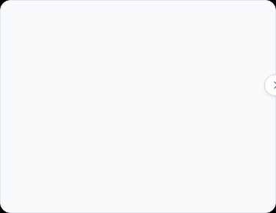

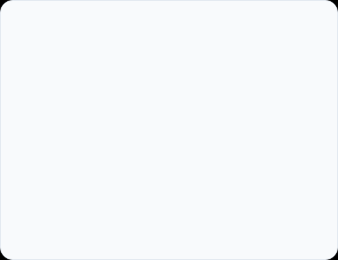



01 · WHAT WE BUILT
Identify Device Type
Predict Section & Cluster
Logic Quota Allocation
Parses leading tag letters instantly against standardized reference set
Evaluates candidates through two linked Machine Learning models
Applies cluster capacity limits per device category
Resolves raw tags into 23 distinct device classifications
Outputs ranked candidate sections with real-time confidence scores
Fits ML predictions into target engineering composition
Notes:
If pressed on "AI": this is pattern recognition trained on our own historical projects, not a general-purpose AI. It learns our conventions specifically.

Slide 3
02 · HOW IT WORKS
FIRST PASS
SECOND PASS
THIRD PASS
Fill to quota
Measure the gap
Try second choices
Each cluster takes its best-matching devices, up to its target count.
Identify which clusters are still short, and by how much.
Unplaced devices try their next-ranked clusters, strongest device first.

Slide 4
03 · WHERE WE ARE NOW
The engine is complete and verified. Tested against a live database and the real trained models. Server and local runs agree exactly.
✓
The whole pipeline is one function call
✓
Nothing is hardcoded any more
The developer call one method and receive the results
Quota patterns now live in a database table an engineer can edit directly
Everything the system produces is written back to SQL Server. The interface reads from the database.

Slide 5

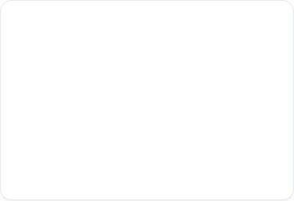




04 · WHERE IT RUNS
Deployed across two servers
Dedicated Model Server
Shared SQL Database
Azure DevOps Source
Fast Execution
Pre-loaded into memory once for instant API access
All predictions write directly to central SQL Server
Developers clone and build directly from source
Zero setup: No Python or model files needed on engineer laptops
No manual files: UI reads centralized data automatically

Slide 6
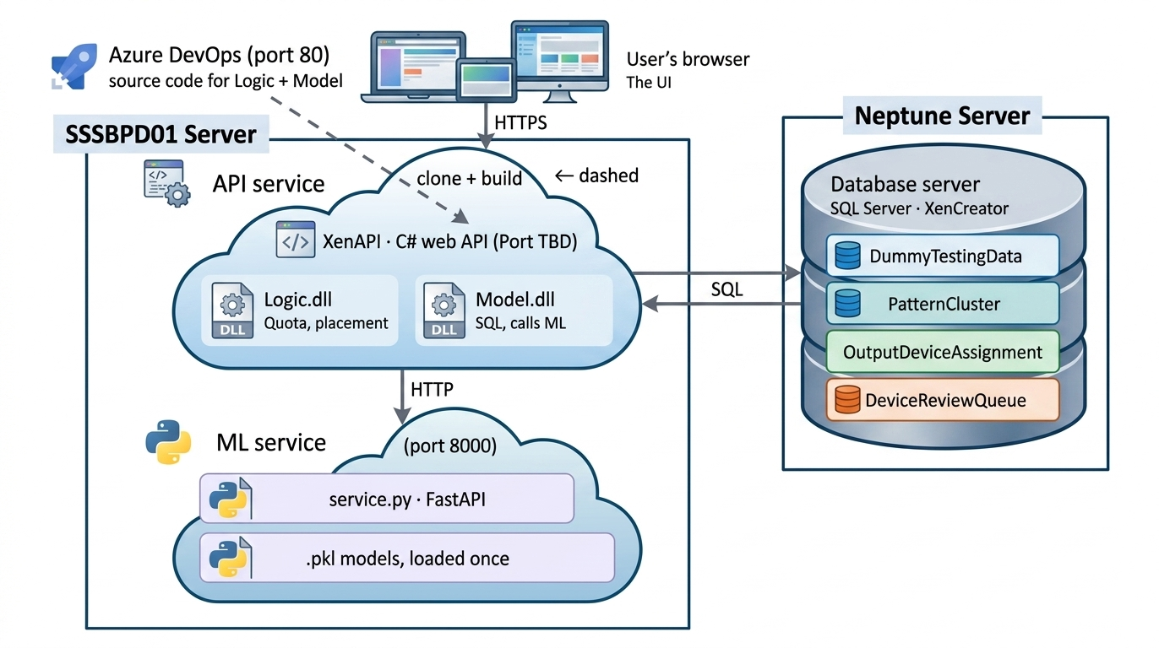

Slide 7




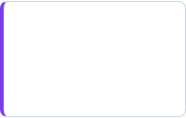




OPERATING ARCHITECTURE
System Execution Flowchart
OUTPUT
A. Interactive CLI
STEP 01
Manual prompt launcher with auto URL binding.
Placed Devices
Prerequisites
Assigned devices automatically written to:
.NET 10 (Win x64), XenCreator DB & ML Network Access.
CORE ENGINE
B. Headless (Unattended)
ML Service Prediction
Automated batch for scheduled nightly jobs.
Runs prediction model via HTTPPredictionClient to evaluate device clusters.
STEP 02
DB Tables Init
C. Custom UI / API
Review Queue
Run PatternCluster.sql, DeviceReviewQueue.sql and OutputDeviceAssignment.sql once(Guarded & Safe).
Programmatic integration into custom apps.
Exceptions routed for manual human review:
Flowchart.md
The system runs flexibly in 3 modes while automatically outputting clean assignments vs. review exceptions.

Slide 8
05 · CONSTRAINTS
BLOCKER
BLOCKER
Quota patterns are dummy
Dataset are dummy
GAP
Validated on representative, not live, data
We need a run against a completed project where the answer is already known, so accuracy is measured rather than estimated.
Notes:
Be direct here. Credibility comes from naming these plainly rather than being asked.

Slide 9
The End
Notes:
Close on the ask, not on the technology. Then open the floor.

Slide 10
01 · WHY THIS PROJECT EXISTS
Each device must be identified by type, assigned to a process section and grouped into a cluster before any downstream work can begin.
Today an engineer does this by hand.
It is slow, repetitive, and two engineers working the same list will not always produce the same answer.
WHAT A DEVICE LIST LOOKS LIKE
HT27PF1B
Heater
LL37PL1
Low level switch
TC37PR1
Temperature transmitter
V09CF2DA
On/off valve
Hundreds per project · sorted by hand today
Notes:
Open on the problem, not the technology. If asked how long the manual sort takes today — we have not measured it. Worth getting that number.

