Slide 1
XENXIBLE CREATOR - DATA ANALYTICS . [1st SEPT 2026].
Xenxible Creator - Device Identifier
Full Progress Update
Prepared by Siti Syaziyah · Data Analyst Executive · September 2026

Slide 2
Project Progress
MACHINE LEARNING MODELS
SQL INTEGRATION
DEPLOYMENT PACKAGE
USER INTERFACE
Complete
Complete
Complete
Not started

Slide 3
01 · PROJECT STAGE
5 stages complete, 1 remaining
✓
✓
✓
✓
✓
6
Data Extraction
& Preparation
Model Research
& Benchmarking
Model Development
& Training
System Integration
(C# + SQL)
Deployment &
Handover Package
Validation &
Production Rollout
Complete
Complete
Complete
Complete
Complete
In progress
WE ARE HERE
Stage 6 — Validation and Production Rollout
The ML engine is built, integrated and handed over.
Remaining = reference data from engineering
= validation run against a project whose correct answer is already known.
Device Identifier · Progress Report · September 2026
2

Slide 4
02 · WORK COMPLETED
6 components
1
2
3
Data Extraction & Cleaning
Device Type Lookup
Section & Cluster Models
Per-project extraction from SQL Server, tag normalisation, de-duplication and structured datasets built from raw client I/O lists.
A deterministic prefix dictionary. A prefix either matches or the device goes to review.
Chained XGBoost classifiers using 27+ engineered features, with out-of-distribution confidence penalties.
4
5
6
Quota Allocation Engine
C# Integration & DLLs
Feedback and retraining
Three-pass constrained assignment that fits model output to each cluster’s designed composition.
2 class libraries wrapping SQL access, Python invocation and full pipeline orchestration.
An engineer correction updates the prefix dictionary at once. Section and cluster corrections queue for the next retrain.
Device Identifier · Progress Report · September 2026
3

Slide 5
03 · SYSTEM ARCHITECTURE
How data moves through the system
DATA SOURCE SQL Server · XenCreator database · device list filtered by Project Code
STEP 1
STEP 2
STEP 3
STEP 4
STEP 5
Device Type
Section
Cluster
Quota Allocation
Placement
PYTHON
PYTHON
PYTHON
C#
C#
Prefix dictionary lookup. Matched or UNKNOWN.
XGBoost
XGBoost chained on the predicted section. Returns a top-3 ranking.
Three passes fitting predictions to the designed composition.
Groups assigned devices; splits the rest for review.
dbo.OutputDeviceAssignment
dbo.DeviceReviewQueue
Devices successfully placed into a cluster.
Sent for engineer review.
Both outcomes are written back to SQL Server, so a user interface reads results from the database rather than from files.
Device Identifier · Progress Report · September 2026
4

Slide 6
04 · METHOD IN DETAIL
Device Type
Clean the tag
Uppercase, trim, normalise
1
THE WHOLE RULE
prefix in dictionary
→ 1.00, else UNKNOWN
Extract the leading letter prefix
V001.21 → V
2
Look the prefix up in the dictionary
92 prefixes · 23 device types
3
Prefix found
Device type · confidence 1.00
4
Prefix not found
UNKNOWN · 0.00 → review queue
5
Device Identifier · Progress Report · September 2026
5

Slide 7
04 · METHOD IN DETAIL
Section and Cluster — chained XGBoost
Engineered
features
XGBoost
model 1
Predicted
SECTION
Features +
Section
XGBoost
model 2
Predicted
CLUSTER
The section prediction becomes an input to the cluster model — the two stages are chained, not independent.
Out-of-distribution (OOD) check
Confidence chaining
Ranked top-3 candidates
A k-NN distance test compares each device to the training data. The further it sits from anything seen before, the more its confidence is cut.
If section confidence falls below 0.60, cluster confidence is multiplied by it. A weak section can never yield a confidently wrong cluster.
The model returns each device’s three best clusters with probabilities, not just the winner. Allocation uses the whole ranking.
Device Identifier · Progress Report · September 2026
6

Slide 8
04 · METHOD IN DETAIL
Quota allocation
A cluster can only hold so many devices of each type.
PASS 1
PASS 2
PASS 3
Fill to quota
Build the floating pool
Reassign, device first
Each Section–Cluster–DeviceType bucket takes its highest-scoring matching devices, up to its target count.
Every device not claimed in the first pass is pooled including confident predictions that simply found no room.
Strongest device first, each one tries its own ranked cluster candidates in order and takes the first that still has space.
WHAT IS LEFT OVER IS NOT FORCED ANYWHERE
Category: UnknownPrediction
Category: Unallocated
Cannot identify the category.
The model found a category, but there is no available space.
Both are written to dbo.DeviceReviewQueue with the model’s own suggestions attached.
Quota patterns are loaded live from dbo.PatternCluster per customer — an engineer can change target composition without a developer.
Device Identifier · Progress Report · September 2026
7

Slide 9
06 · DEPLOYMENT ARCHITECTURE
How the models reach the product
Caller
Console app today; a user interface next
ONE CALL RUNS EVERYTHING
var result = await
DevicePipeline.RunAsync(
sqlReader, client, logic,
projectCode: "A9998");
Logic.dll
Orchestration, quota allocation, placement, review queue
Model.dll
SQL Server access, and predictions over HTTP or via local Python
RUNTIME REQUIREMENTS
.NET 10 · Windows x64
SQL Server · ML service reachable
ML service
FastAPI on 128.100.8.213:8000 — models loaded once, held in memory
SQL Server
HANDOVER PACKAGE DELIVERED
XenCreator — source table, quota table, two output tables
2 DLLs + 22 dependencies
Trained models and 3 SQL scripts
API reference, quick guide, launcher
Each layer depends only on the one beneath it.
Device Identifier · Progress Report · September 2026
9

Slide 10
07 · HUMAN IN THE LOOP
The system improves as engineers correct it
1
2
3
4
5
Prediction is made
Low confidence goes to the review queue
Engineer assigns the correct value
The dictionary is updated
The next run already knows
DEVICE TYPE
SECTION & CLUSTER — QUEUED FOR RETRAINING
The correction is written straight into the prefix dictionary and saved atomically with an automatic backup. The very next prediction uses it, there is no model to retrain.
XGBoost cannot learn incrementally, so corrections are stored and applied at the next training cycle rather than changing the live model mid-run.
Buffered flush every 50 records; manual assignments persist at once.
No silent drift: the model changes only when deliberately retrained.
Device Identifier · Progress Report · September 2026
10

Slide 11
09 · STATUS DETAIL
Component-by-component status
Eleven of fifteen components are complete and verified against live data and real trained models.
COMPONENT | STATUS | NOTE
Data extraction & preparation | Complete | SQL-driven, filtered per project code
Device type prediction | Complete | Prefix dictionary, 23 device types
Section prediction | Complete | XGBoost with out-of-distribution penalty
Cluster prediction | Complete | Chained XGBoost, returns a top-3 ranking
Quota allocation | Complete | Three passes; quotas read live from SQL
Placement & cluster grouping | Complete | Final assignment written back to SQL
SQL integration (read & write) | Complete | Four tables, MERGE-based upserts
C# service integration | Complete | Model.dll and Logic.dll, .NET 10
Incremental learning | Complete | Device type applies immediately
Unattended / scheduled runs | Complete | Headless mode, no prompts
Handover package & documentation | Complete | DLLs, models, SQL scripts, API reference
Quota reference data | Partial | Real figures for 1 of 8 sections
Accuracy validation | Not started | Needs a completed project to measure against
Automated test suite | Not started | Verification is manual live runs today
User interface | Not started | Handed to software development
Device Identifier · Progress Report · September 2026
12

Slide 12
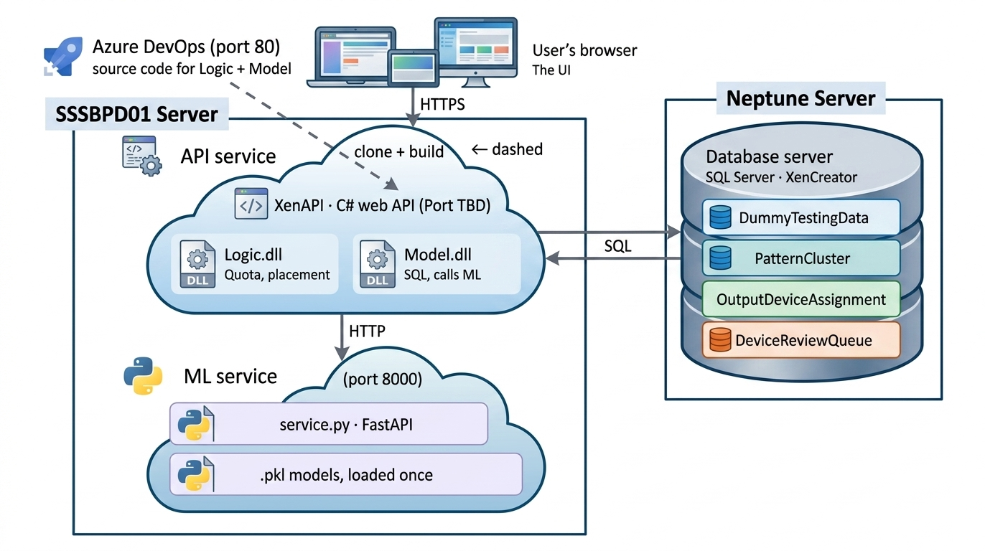

Slide 13




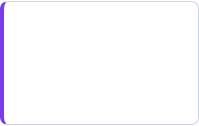




OPERATING ARCHITECTURE
System Execution Flowchart
OUTPUT
A. Interactive CLI
STEP 01
Manual prompt launcher with auto URL binding.
Placed Devices
Prerequisites
Assigned devices automatically written to:
.NET 10 (Win x64), XenCreator DB & ML Network Access.
CORE ENGINE
B. Headless (Unattended)
ML Service Prediction
Automated batch for scheduled nightly jobs.
Runs prediction model via HTTPPredictionClient to evaluate device clusters.
STEP 02
DB Tables Init
C. Custom UI / API
Review Queue
Run PatternCluster.sql, DeviceReviewQueue.sql and OutputDeviceAssignment.sql once(Guarded & Safe).
Programmatic integration into custom apps.
Exceptions routed for manual human review:
Flowchart.md
The system runs flexibly in 3 modes while automatically outputting clean assignments vs. review exceptions.

Slide 14
12 · HANDOVER
What the software developer needs
1
2
3
The two class libraries
The ML service address
SQL access and four tables
Model.dll and Logic.dll, .NET 10, Windows x64, plus 22 dependencies.
DummyTestingData, PatternCluster, DeviceReviewQueue and OutputDeviceAssignment.
http://128.100.8.213:8000, passed in ML_SERVICE_URL.
4
5
6
The connection string
The entry point
The documentation
Read from the registry at HKEY_CURRENT_USER, Software, XenxibleIdentifier. It must exist on their machine or startup fails.
DevicePipeline.RunAsync runs the whole sequence in one call, against the ML service or local Python.
Attached together inside the folder.
Device Identifier · Progress Report · September 2026
15

Slide 15
The End

Slide 16
Supplementary

Slide 17
08 · CURRENT UPDATE
What changed in this cycle [for personal read]
This cycle moved the models onto the ML server and made the codebase safe for another developer to clone, build and run.
✓
Allocation rewritten to be device-centric
✓
Output files replaced by SQL tables
Each unplaced device now tries its own ranked cluster candidates, instead of clusters pulling in whichever device fits. This matches the approved flowchart design.
dbo.OutputDeviceAssignment and dbo.DeviceReviewQueue, upserted with MERGE, so re-running a project updates rows instead of duplicating them.
✓
Cross-table reconciliation added
✓
Quota patterns moved out of code
A device that changes outcome between runs is cleared from the table it left, so it can never show as assigned and unassigned at the same time.
Target composition now lives in a SQL table an engineer can edit directly. Previously any rule change required a developer.
✓
Models moved onto the ML server
✓
One pipeline for both apps
Python and the models now run as a FastAPI service on 128.100.8.213:8000. The C# apps call it over HTTP, far faster than starting a process.
The single pipeline call now works against either the ML service or local Python, so both apps share one copy of the sequence instead of two.
Device Identifier · Progress Report · September 2026
11

Slide 18
10 · CONSTRAINTS
What stands between here and production [for personal read]
Read this number carefully — the 25% auto-assignment rate seen on project A9998 (358 devices) measures missing quota data, not model accuracy. The system cannot place a device into a cluster whose intended composition has never been defined.
BLOCKER
BLOCKER
Quota data is mostly placeholder
No user interface
Real target composition exists for Section 2 only. Sections 1 and 3 to 8 hold invented figures, added so the pipeline could be tested end to end.
What exists is the engine plus a console harness for testing. The screens engineers would actually use still have to be built.
GAP
GAP
No validated accuracy figure
No automated test suite
Verification so far is live runs on representative data. A run against a completed project, where the answer is already known, is needed before any number is quoted.
All checks to date are manual. Interface work needs automated coverage so a change cannot break the pipeline silently.
Device Identifier · Progress Report · September 2026
13

Slide 19
11 · WHAT TO DO NEXT
Three actions, in order of what unblocks most
Only one of the three is development work. The largest constraint is data that only engineering can supply.
01
Collect the real quota patterns
OWNER
Target composition for sections 1 and 3 to 8. This is domain knowledge from engineering, not development time, and it is the single biggest limit on how much the system can place automatically.
Engineering
UNBLOCKS
Auto-assignment across all 8 sections
02
Build the user interface
OWNER
The handover package, both DLLs and the API reference are complete and documented. Development can begin immediately with no further input from analytics.
Software development
UNBLOCKS
Use outside the console harness
03
Run validation on a completed project
OWNER
Compare pipeline output against a project whose correct answer is already known. This is what produces a defensible accuracy figure — which we do not have today and should not estimate.
Analytics + engineering
UNBLOCKS
A quotable accuracy number
Automated tests should be written alongside the interface, not after it.
Device Identifier · Progress Report · September 2026
14

Slide 20
13 · IMPORTANT
Six things to know before building on it
1
2
3
Reboot test still outstanding
One machine, two systems
Case sensitivity half fixed
Now registered with NSSM and set to start at boot. The server has not restarted since, so boot-survival is configured but unproven.
Azure DevOps on port 80 and the ML service on port 8000 share 128.100.8.213. Losing it loses both at once.
Python normalises device IDs; C# still compares DeviceId and ProjectCode ordinally. V001.21 and v001.21 count as two.
4
5
6
Quota data is placeholder
Nothing is covered by tests
Device type has no model
Real composition exists for Section 2 only. The 25% auto-assignment rate measures missing data, not model accuracy.
Every check so far was run by hand. Interface work needs automated coverage before a change can break it silently.
It is a dictionary. An unseen prefix returns UNKNOWN by design and waits for an engineer to teach it permanently.
Device Identifier · Progress Report · September 2026
16

Slide 21
APPENDIX · OPERATING INSTRUCTIONS
How the system is run today
Install the prerequisites
.NET 10 runtime, access to the XenCreator database, and network access to the ML service. Python is only needed for the local-prediction console app. Windows x64 only.
1
Create the three SQL tables
Run PatternCluster.sql, DeviceReviewQueue.sql and OutputDeviceAssignment.sql once. All three are guarded, so re-running them is safe.
2
Run against the ML service
Double-click run-service-app.cmd, or pass a code: run-service-app.cmd A9998. The launcher sets ML_SERVICE_URL for you.
3
Or run it headless
run-service-app.cmd A9998 --unattended skips every prompt, for scheduled or automated runs.
4
Read the results
Query dbo.OutputDeviceAssignment for placed devices, and dbo.DeviceReviewQueue for anything awaiting review.
5
For a user interface: reference Logic.dll and call DevicePipeline.RunAsync(…), passing HttpPredictionClient to use the ML service.
Device Identifier · Progress Report · September 2026
17

Slide 22
FEATURE ENGINEERING · 27+ FEATURES DERIVED FROM EACH TAG
Tag prefix and suffix pattern
Numeric block width and position
Device type carried from Stage 1
Customer and project code
Label-encoded categorical fields
Character-class sequence and tag length
Device Identifier · Progress Report · September 2026
6

Slide 23
EVALUATED, NOT CARRIED FORWARD
DBSCAN
Discovered section groupings in unlabelled data. Not used at inference.
K-Means & Agglomerative
Cluster-count exploration; superseded once labels existed.
Decision tree rule mining
Extracted readable tag rules used to sanity-check the models.
Random Forest
Benchmarked against XGBoost; consistently lower accuracy.
SGD Classifier + TF-IDF
Ran device type until this cycle. Removed once the dictionary proved as accurate and far easier to explain.
Device Identifier · Progress Report · September 2026
8

Slide 24
05 · METHOD SELECTION
What was tested before committing
The client data arrived without labels, so unsupervised methods were used first to discover structure.
Supervised models were then trained on what they revealed. Every choice below was benchmarked, not assumed.
ADOPTED IN PRODUCTION
Chained prediction
Device type. Deterministic and fully readable — an engineer edits it directly and the change applies on the next run.
XGBoost
Section and cluster. Best accuracy of everything tested on engineered tabular features.
k-NN distance test
Out-of-distribution check that cuts section and cluster confidence for unfamiliar tags.
Prefix dictionary
The predicted section is fed to the cluster model as an input feature rather than predicted independently.
Device Identifier · Progress Report · September 2026

Slide 25
IN SUMMARY
The engine is built and verified.
What remains is data, not engineering.
Five of six stages are complete. The prediction models, the allocation engine, the SQL integration and the handover package are all finished and running against live data. What stands between here and production use is reference data, an interface, and one validation run.
5 of 6
2
1 of 8
stages complete
ML models + 1 dictionary
sections with real quota data
The most useful thing this meeting can do — agree an owner and a date for the quota patterns for the remaining seven sections.
Device Identifier · Progress Report · September 2026
18

