Slide 1
Face Masking Based on Retinaface, Facenet and OpenCV

Slide 2
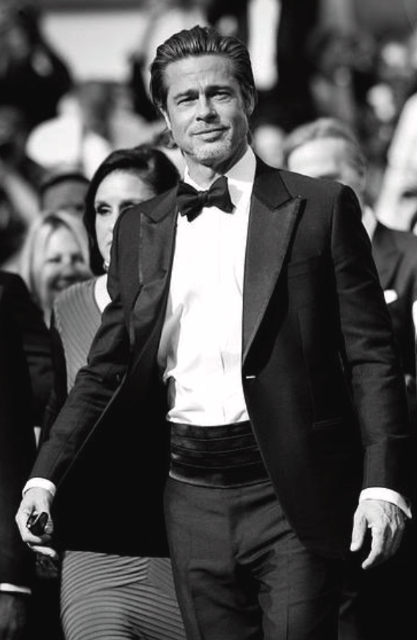
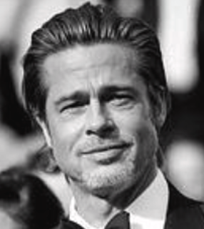
Capture a Face
Using Coordinate
Face Detection Algorithm
Face Recognition Algorithm
Brad Pitt

Slide 3
Face Detection
Retinaface

Slide 4
Face Detection
Retinaface
Low confidence, no human faces
High confidence, human faces

Slide 5
Five key points of the human face

Slide 6
Face Detection
Retinaface

Slide 7


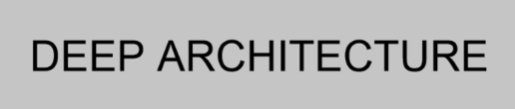


Facenet
Eigenvectors of length 128

Slide 8
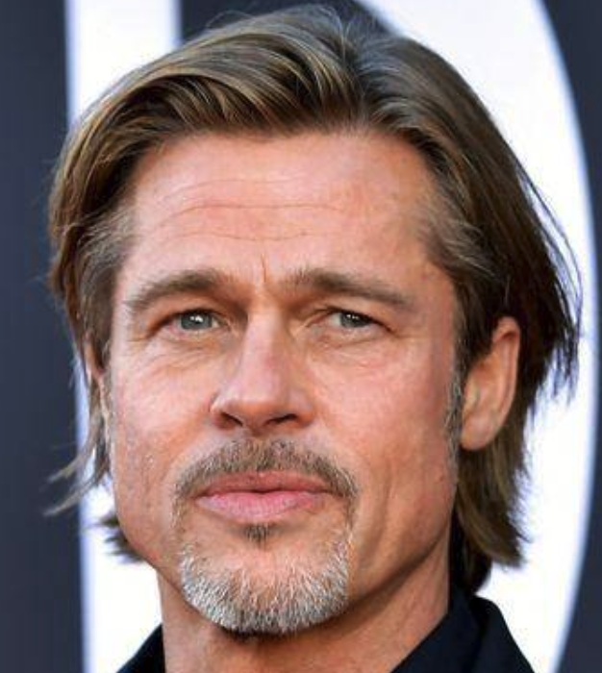
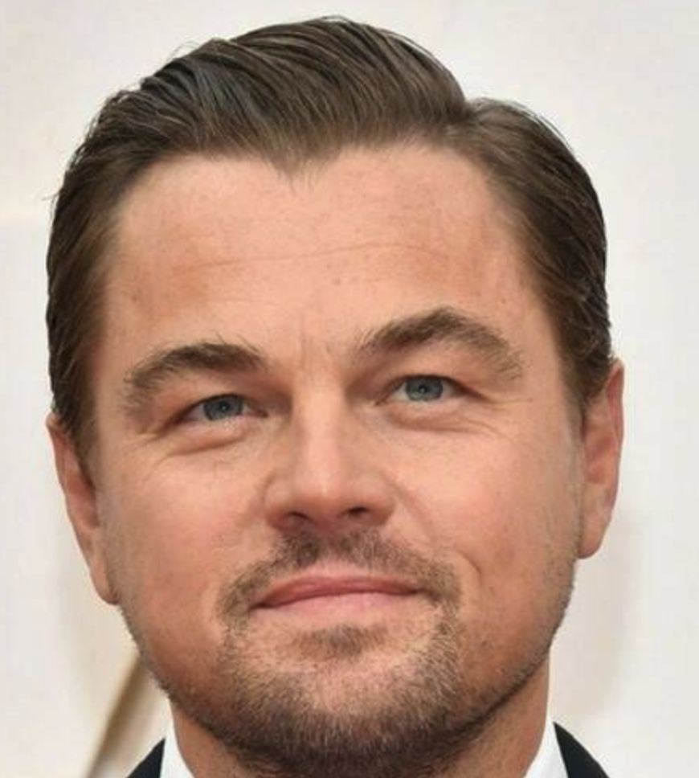
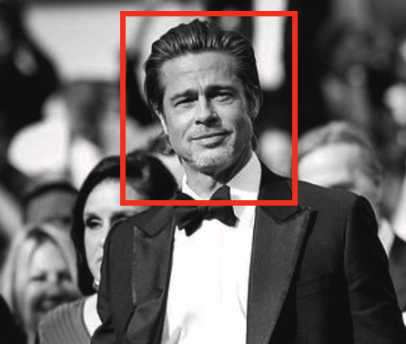
Database
Brad
Leonardo
Facenet
Facenet
Eigenvectors 1
Eigenvectors 2
Eigenvectors
of length 128
Comparison
Distance = 0.2
Distance = 1.2
Threshold = 0.5

Slide 9
Thanks!

