Slide 2
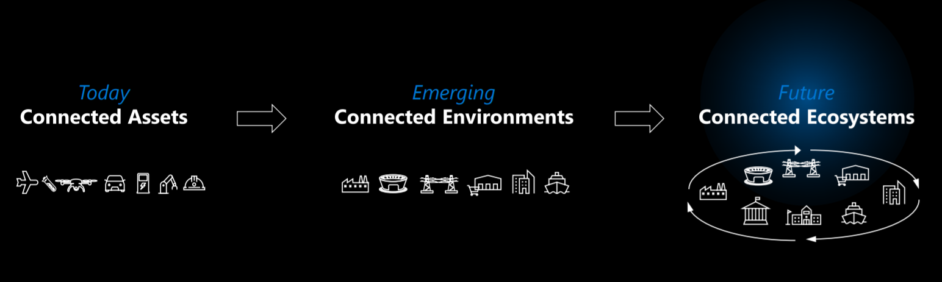
Azure IoT

Slide 3
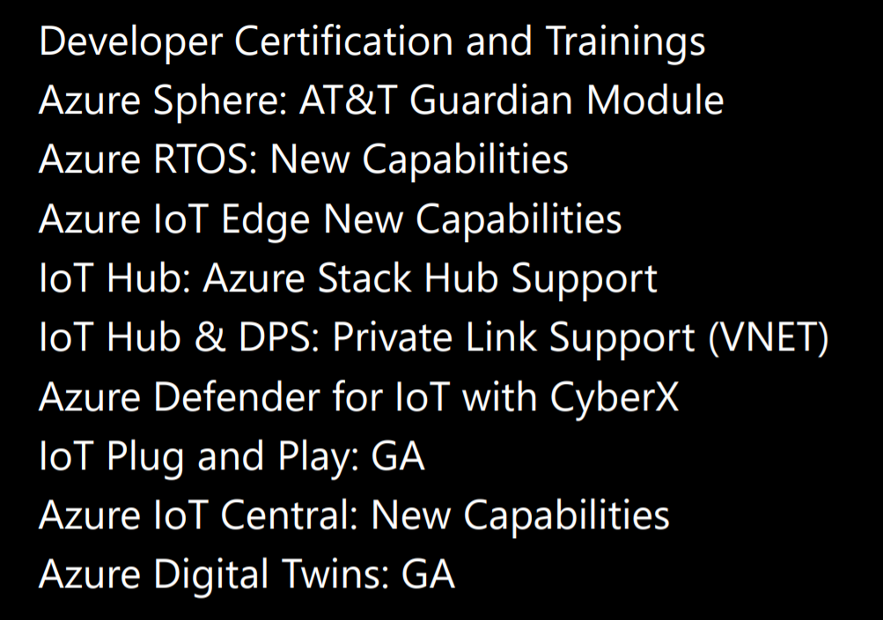
IoT Announcements
Notes:
https://myignite.microsoft.com/sessions/8c90945c-eec6-43ed-b16a-3adf3c2ba37a
https://mediusprodstatic.studios.ms/presentations/IG20/DB116/DB116.pdf?sv=2018-03-28&sr=b&sig=2MTbUetqsUjlItmDlsyoRRwQQ8sHxA%2BoFvvp3ELWD9I%3D&se=2020-10-07T07%3A15%3A06Z&sp=r

Slide 4
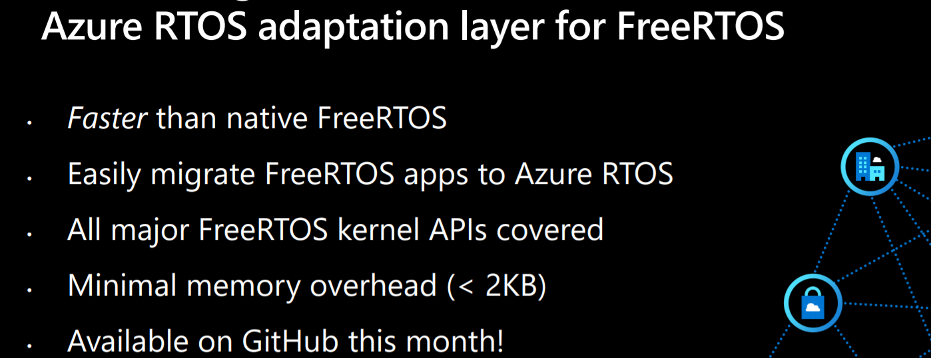

Slide 5
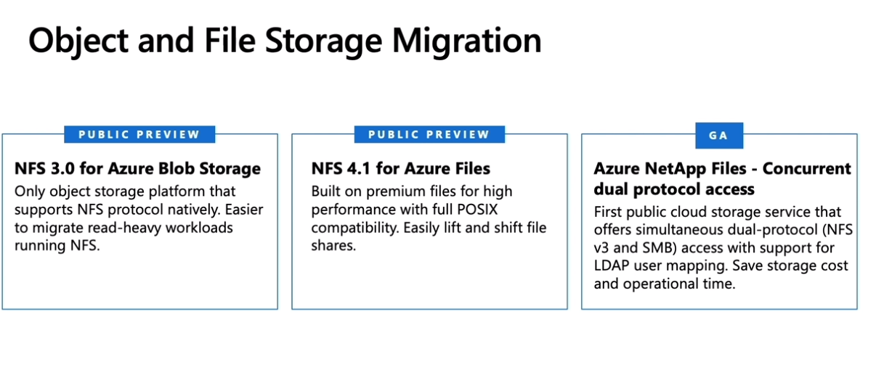

Slide 6
