Slide 1

Some Aspects of Microservices Monitoring in 2020
Igor Sychev
Solution Architect in MSTD BY
https://github.com/SychevIgor/pronet_docker

Slide 2
Monitoring: Overview

Slide 3
Selected Monitoring Technologies
Requirements:
Customer requested DataDog as Enterprise Standard
Collect
infrastructure level Logs (aka CPU utilization)
Kubernetes cluster level information (nodes, containers, pods etc)
Logs (logs of containerized applications from std out)
APM (application performance metrics like – durations, list of urls, sql queries)
RUM (real time user monitoring)

Slide 4
Selected Monitoring Technologies
Requirements:
Minimum efforts on maintains
Flat learning curve
Visualization mechanism
Protect from Disk overflow by logs
Azure Application Insights for Application level Monitoring
Azure Log Analytics for Infrastructure level Monitoring

Slide 5
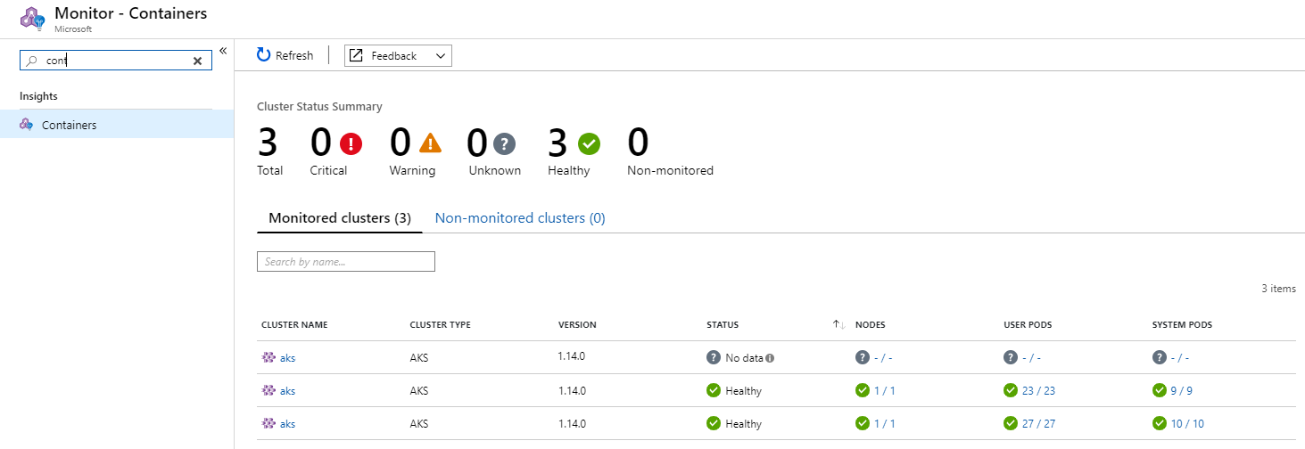
Log Analytics Containers Solution 1

Slide 6
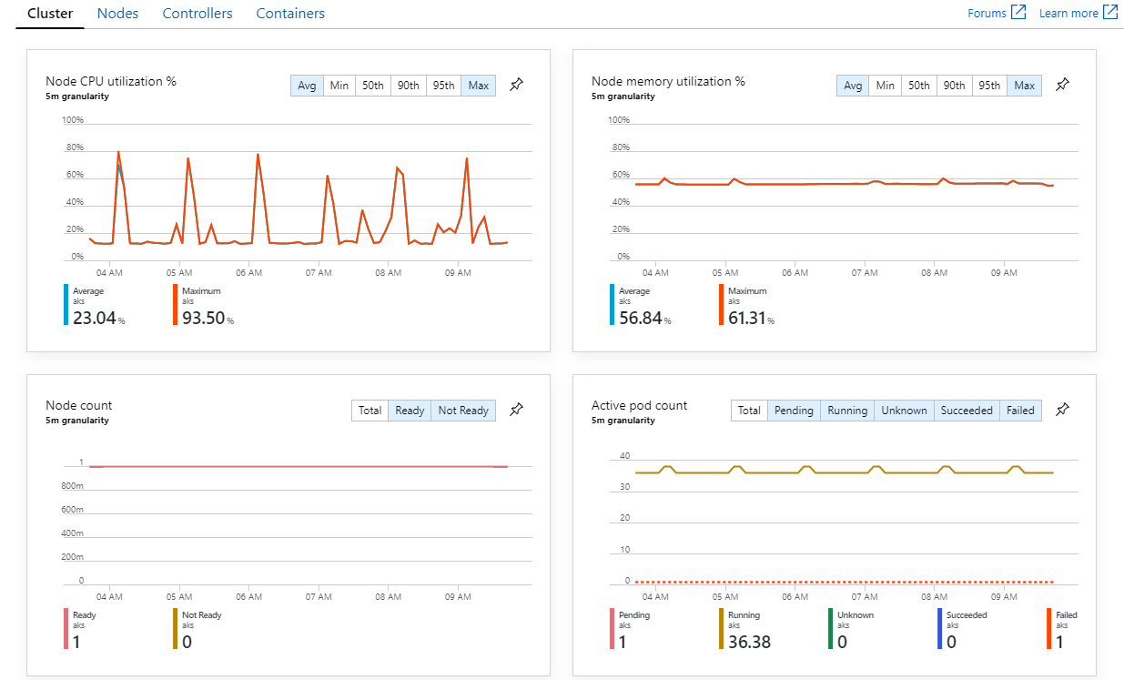
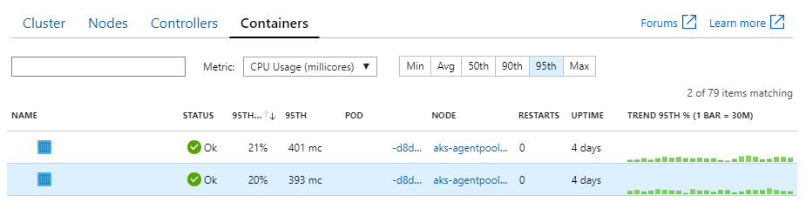
Log Analytics Containers Solution 2

Slide 7
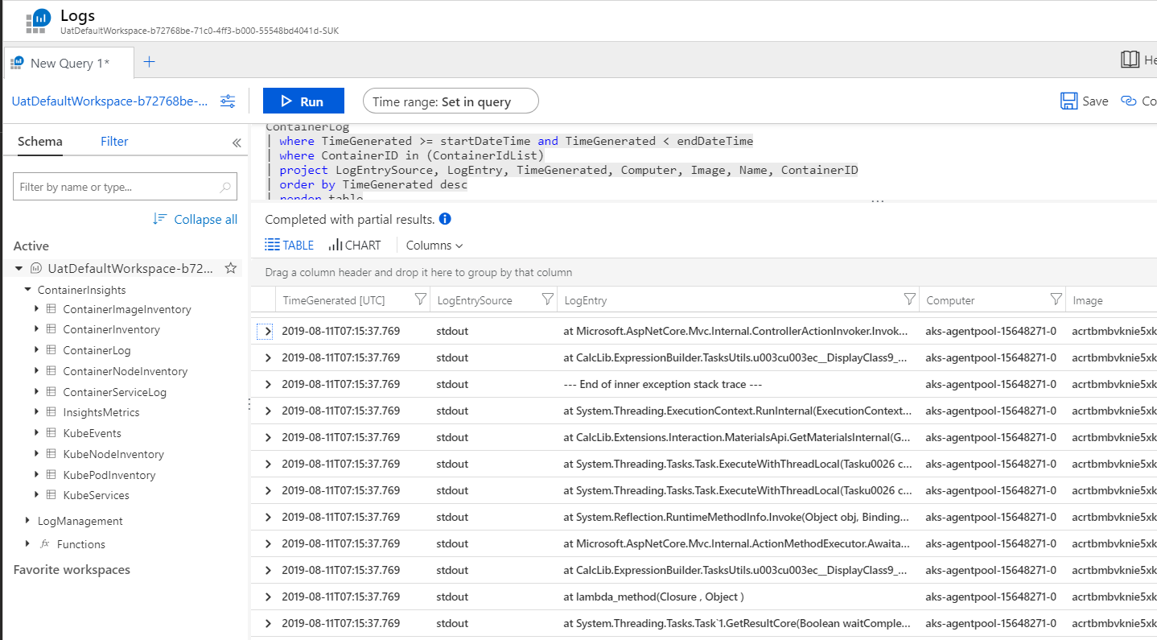
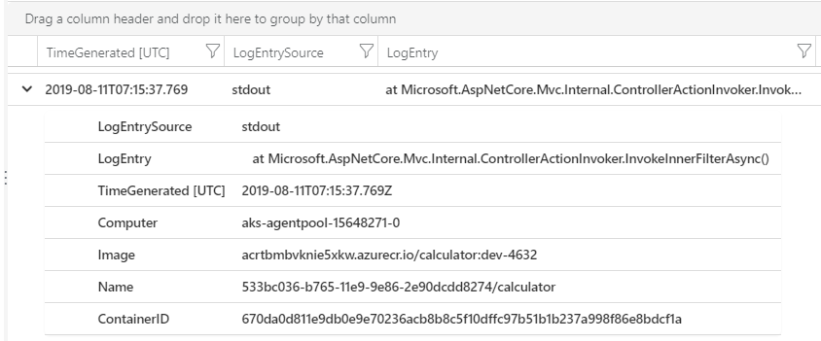
Log Analytics STDOUT

Slide 8
Application Insights

Slide 9
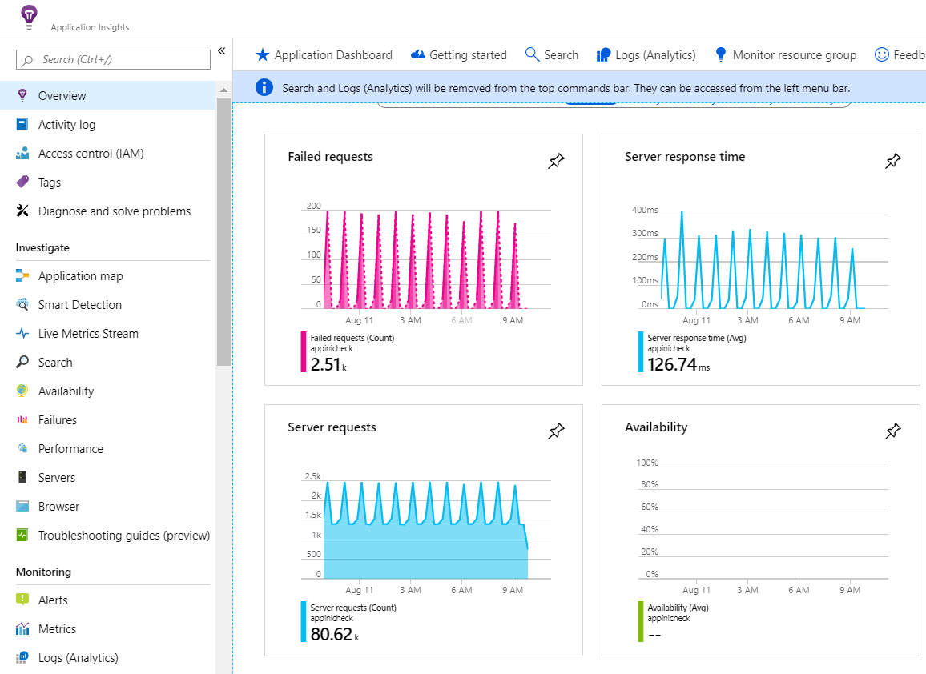
Application Insights Statistics

Slide 10
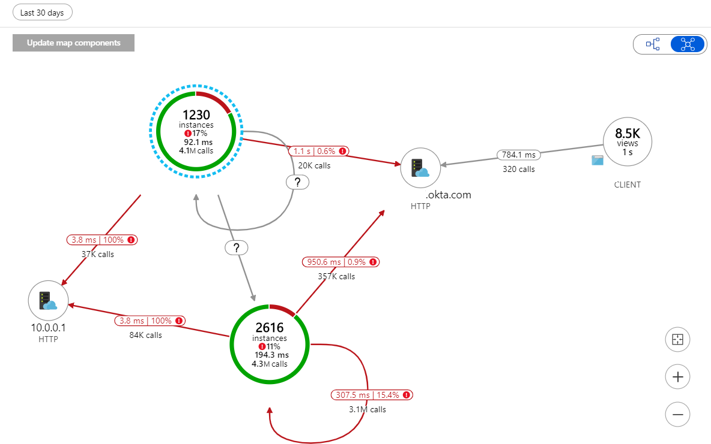
Application Map 1

Slide 11
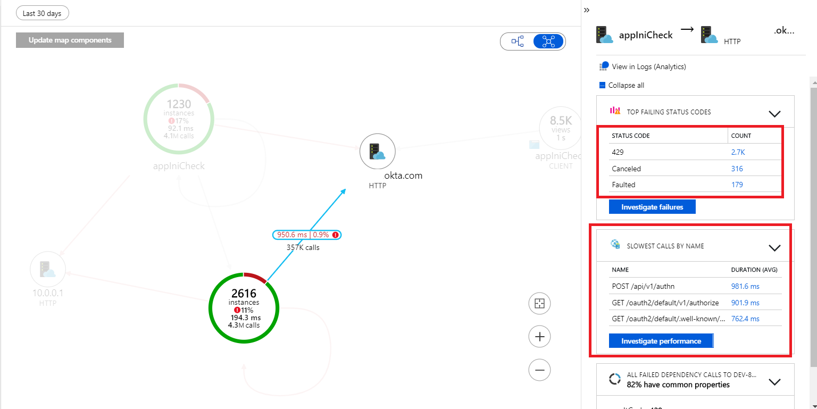
Application Map 2

Slide 12
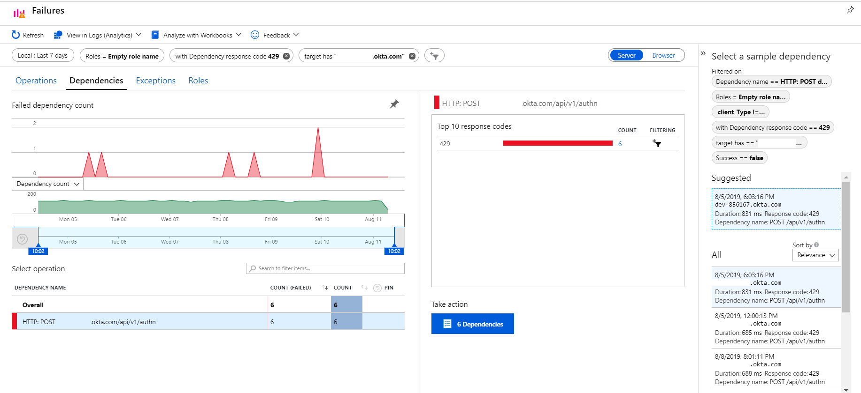
Failures Investigation 1

Slide 13
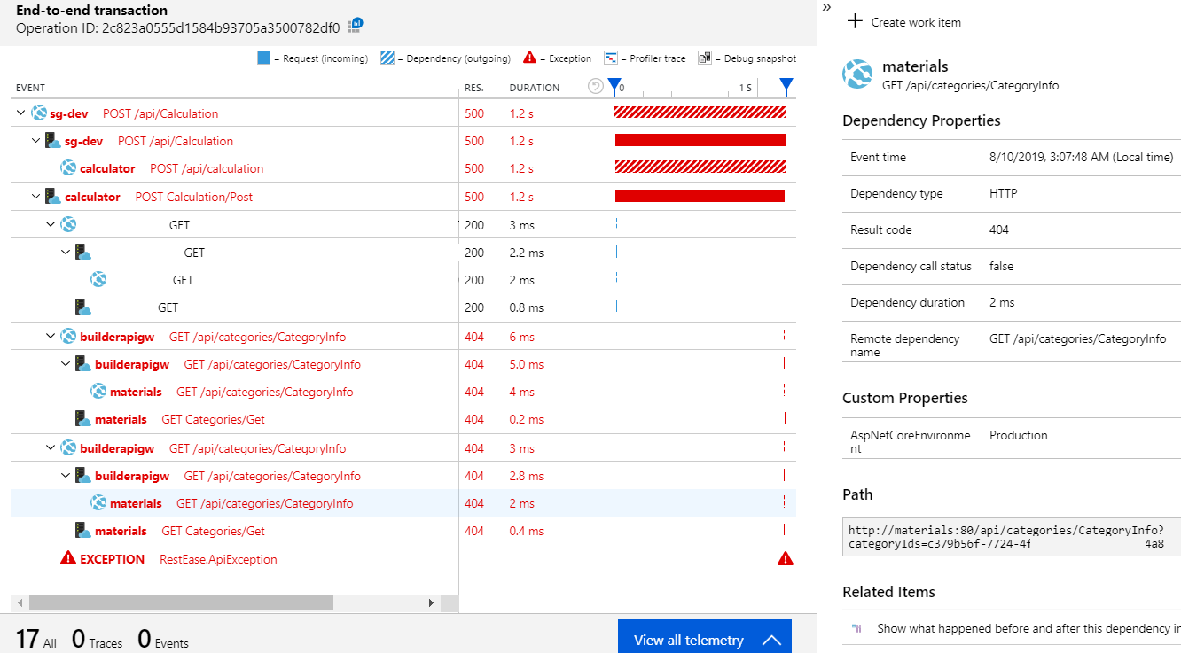
Failures Investigation 2

Slide 14
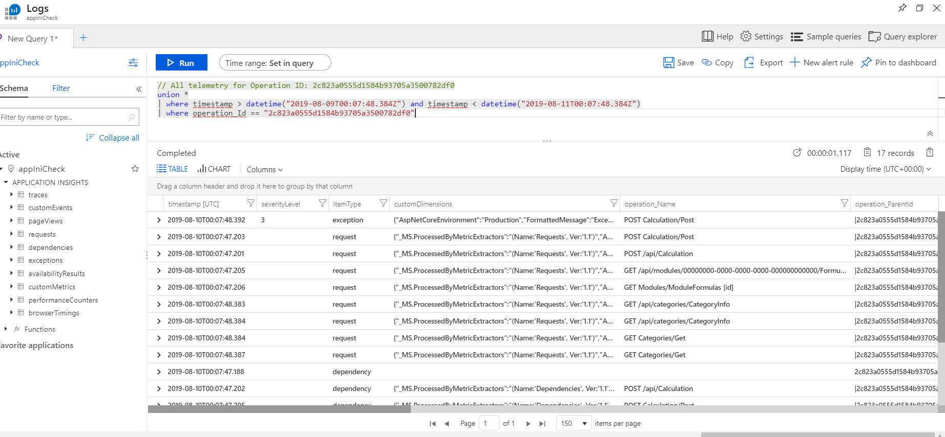
Kusto query Language

Slide 15
Performance troubleshooting or why distributed logging is important

Slide 16
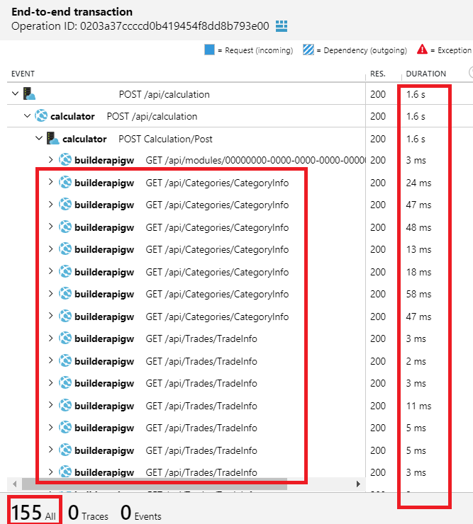
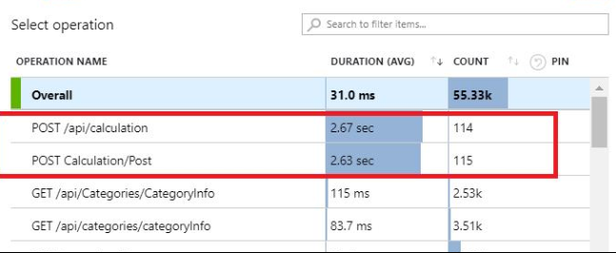
Once, team reported performance issue
In an application was added Application Insights for such moments
Find a lot of nested API calls

Slide 17
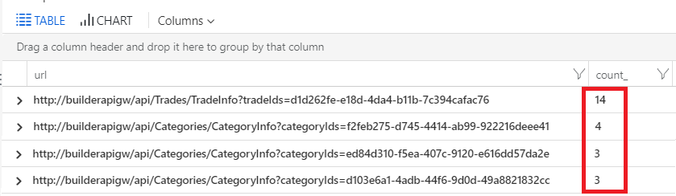
What’s inside http requests?
“Count_” should equal to 1
1 unique request for data per unique ID
How to solve: caching http requests.

Slide 18
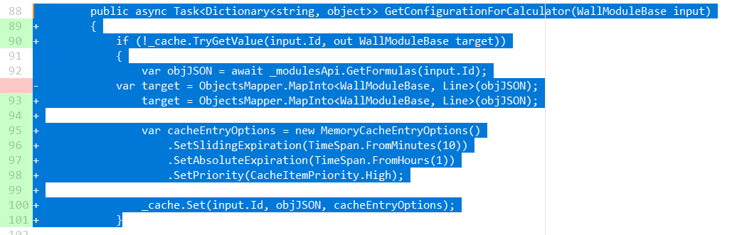
Dummy example how in .Net Core

Slide 19
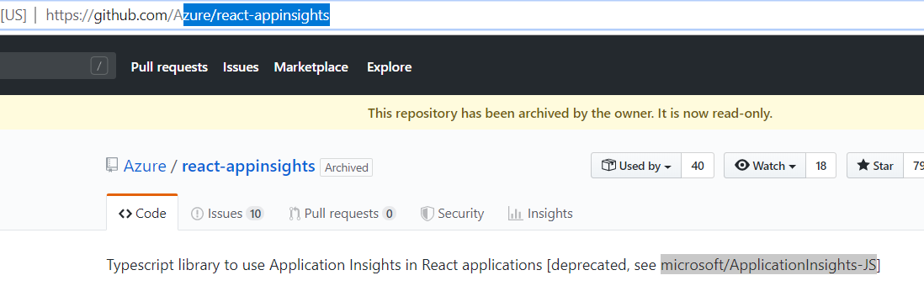
Application Insights for React
React Specific package was deprecated.
In our project we create our own library on top of https://www.npmjs.com/package/applicationinsights-js

Slide 20
Monitoring: Price of a log

Slide 21
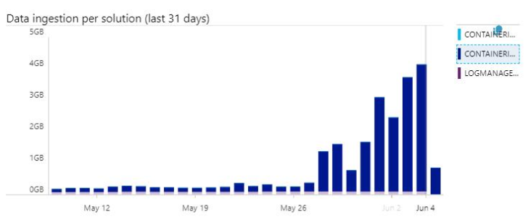
Log Analytics
Costs for Log Analytics started growing exponentially.
Cost per GB – 2.07$ with 4 GB per day.
It was just Development Environment with 1 machines (and average expected logs size from one machine should be ~ 400MB)

Slide 22
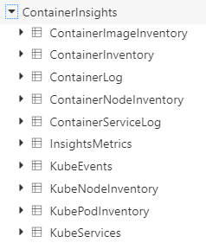
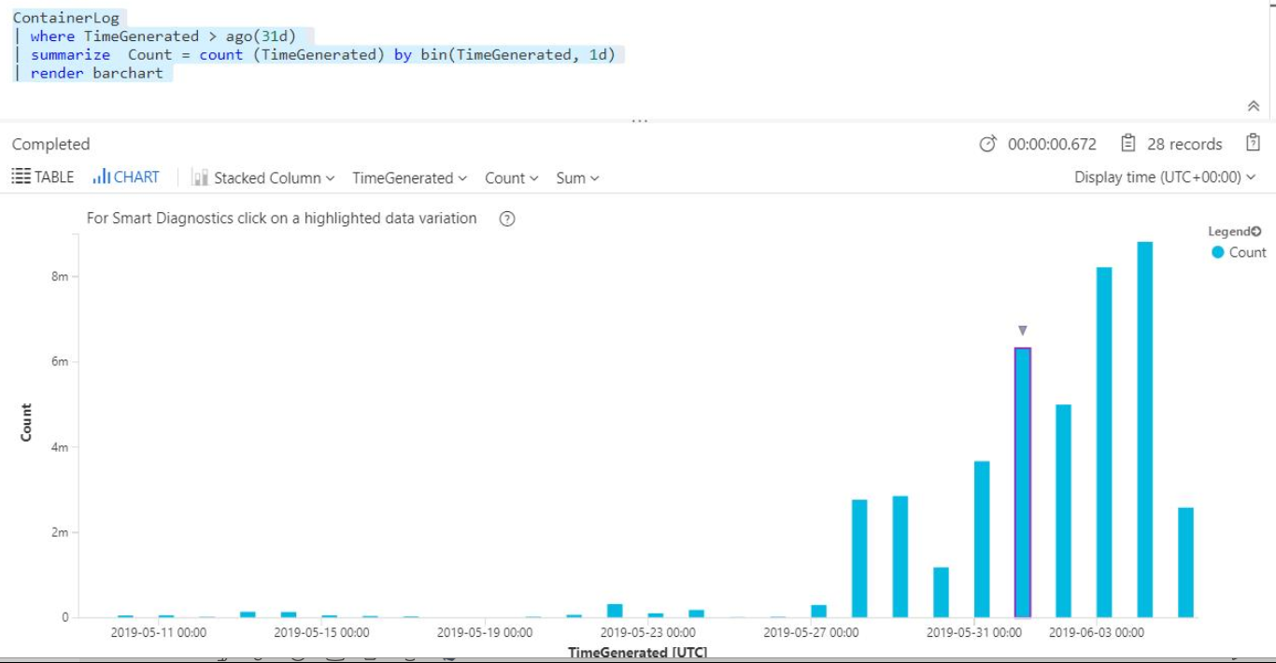
Investigation: find the biggest table and grow trend

Slide 23
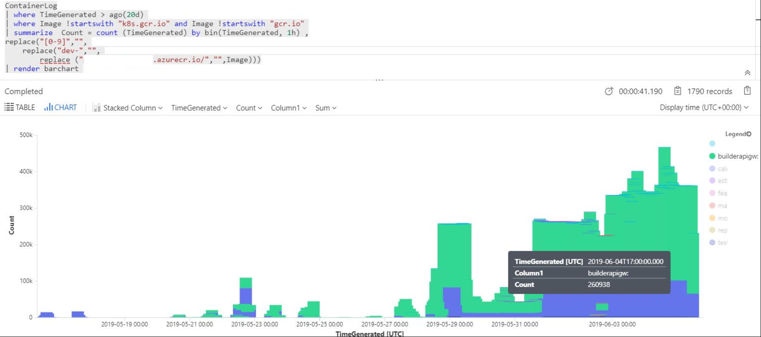
Investigation: Find data distribution per image
“Two noisy boys”: gateway and one more

Slide 24
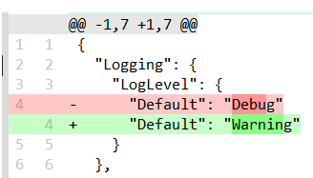
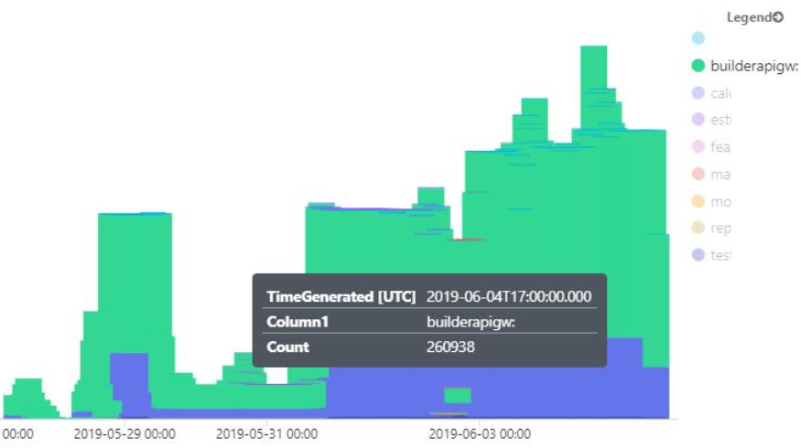
Investigation: To detailed logging (green)

Slide 25
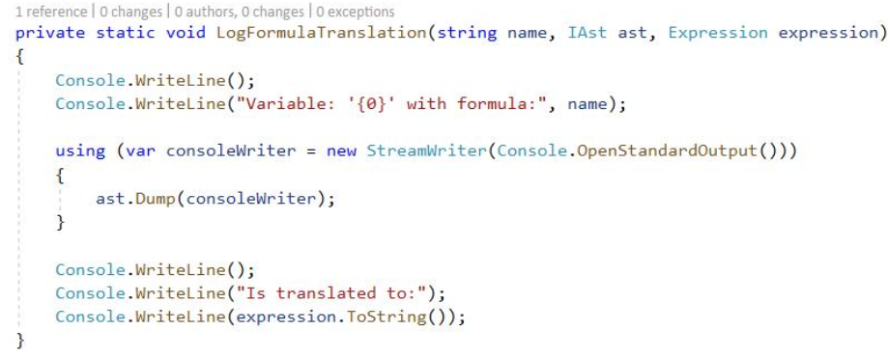
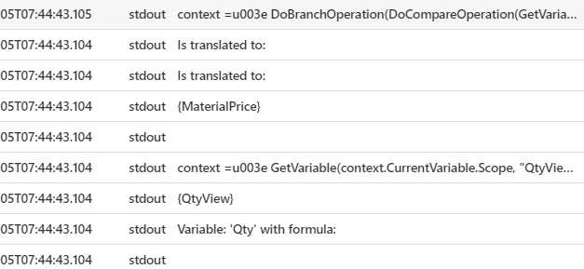
Investigation: Logging without severity filters (blue)

Slide 26
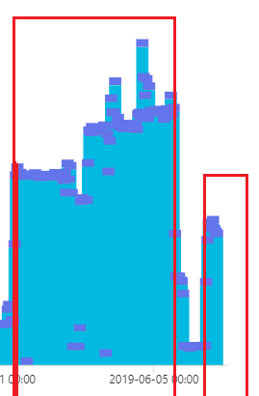
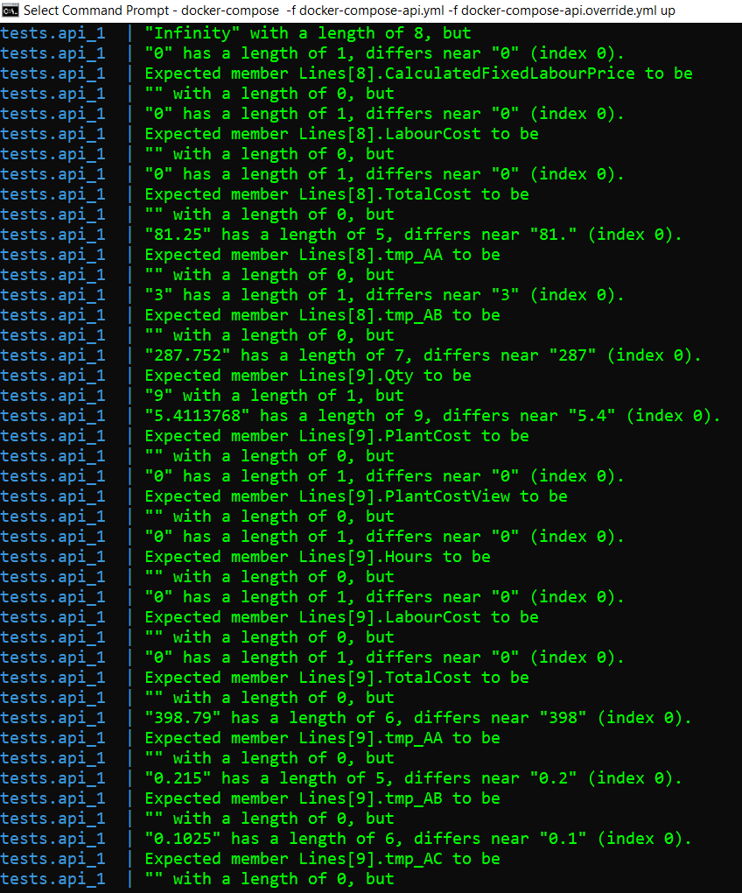
Investigation: FluentAssertion BeEquivalentTo() - Dumped an entire object to logs
actual.Should()
.BeEquivalentTo(referenceObject);

Slide 27
Results:
Invested 4 hours
For Dev Environment
Log sizes decreased from 4GB per day to 100MB per day
Cost Saving: from 248$ to 6.2$
For UAT/Production environments – prevented unhappy, poor customer

Slide 28
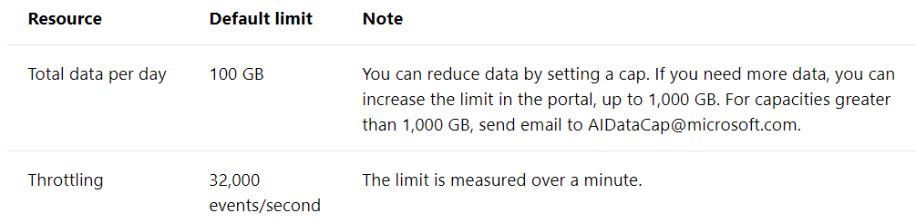
Why not Cadvise+Grafana+InfluxDB+ELK(ElasticSearch+Kibana)?
“If your data rate is high enough to trigger throttling, and sampling or aggregation are not acceptable, consider exporting metrics to a time-series database such as Prometheus or InfluxDB running in the cluster.”©
Azure Monitor is billed per gigabyte (GB) of data ingested into the service. At very high volumes, cost may become a consideration. /**/ For example, many organizations use Fluentd with Elasticsearch.
We don’t need to be Cloud Agnostic, Application Insights limits enough for our project, Data Ingression issue fixed.
Notes:
https://docs.microsoft.com/en-us/azure/architecture/microservices/logging-monitoring

Slide 29
Thank you! Questions!
https://github.com/SychevIgor/pronet_docker

