Slide 1

Azure DevOps for MicroServices App – 4 months of Project Evolution
Igor Sychev
Solution Architect in MSTD BY
https://github.com/SychevIgor/pronet_docker

Slide 2
Why DevOps if I’m not DevOps Engineer?

Slide 3
Introduction to our project
Asp.Net Core based backend microservices
Ractjs based frontend pp
The App should be hosted in Azure (preferred hosting is Managed Kubernetes Cluster)
“Sold” to a customer CI/CD system is Azure DevOps
No clear scope -> Time and Material type of project

Slide 4
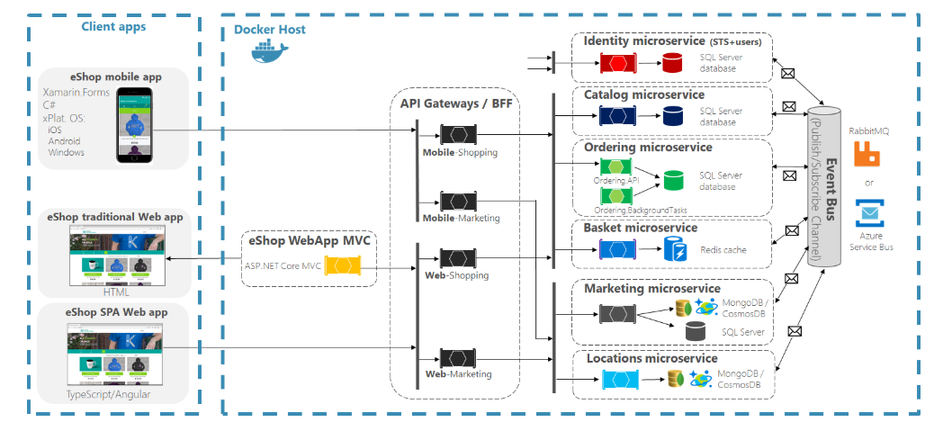
eShopOnContainers as a reference architecture
Used to start, but not covered CI/CD/DEVOPS/ALM questions at the moment https://github.com/dotnet-architecture/eShopOnContainers/issues/949
Used Mono Repository (developed mainly by 1-2 devs at a time)

Slide 5
Mono Build/Release

Slide 6
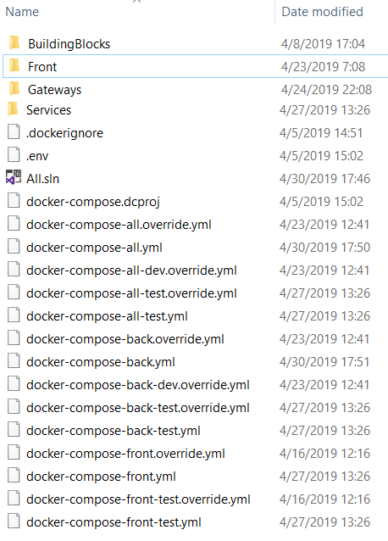
Initial “Trade off” idea – Mono repository
Situation:
Domain boundaries not identified, because scope was not well defined
Team without experience with docker and microservices
Team(20+ devs/qa) distributed across 4 locations
Risk:
To high level of required skills to begin
High risk of “slow start”
Risk Mitigation:
Start from Mono Repository and sacrifice CI/CD for a 1-2 sprints
After 1-2 sprints – replace Mono repository with
sets of repositories for each microservice
Initial Mono repo converted to Meta repository, with git submodules

Slide 7
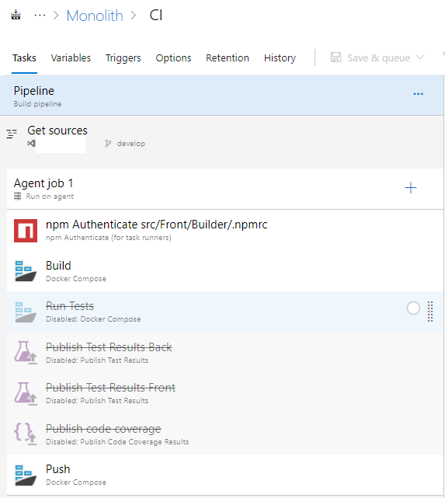
MonoRepo -> MonoBuild
Problem was not in Mono Repository, but in Builds
Each commit/push generated new build.
Each build takes 20 minutes.
Include/Exclude filters for folders doesn’t helped, because “Docker-Compose build” build/pushed to registry images all at once
Can’t release microservices independently
Notes:
Microservices referenced common libraries.

Slide 8
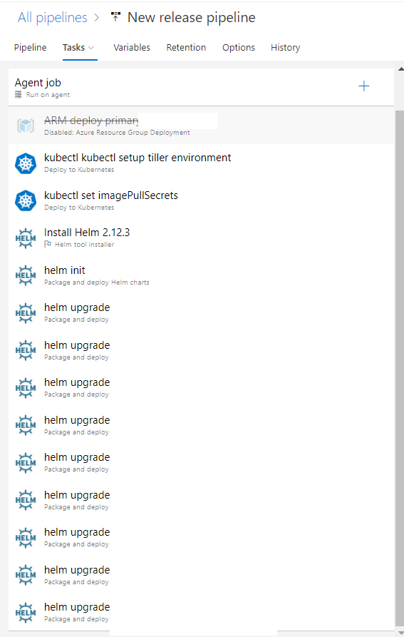
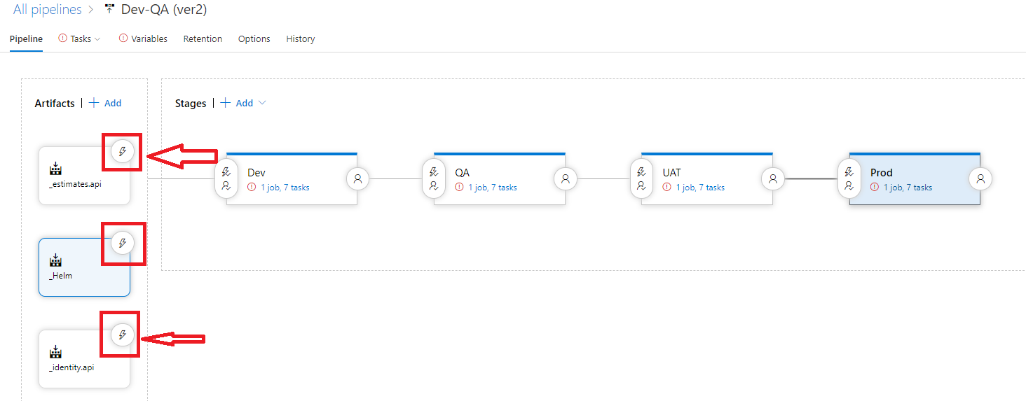
Mono Build -> Mono Release problem
Can’t deploy microservices independently
Advises about “git diffs” – is too sophisticated and not 100% guarantees.
Notes:
Idea about “Custom Condition” and filtering based on “Artifact name” – didn’t work with, because CI (docker-composed) pushed all microservices at once and custom condition make the situation even worse, because created a lot of released, based on single commit.

Slide 9
Build/Release per Microservice

Slide 10
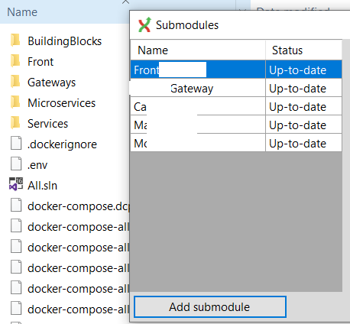
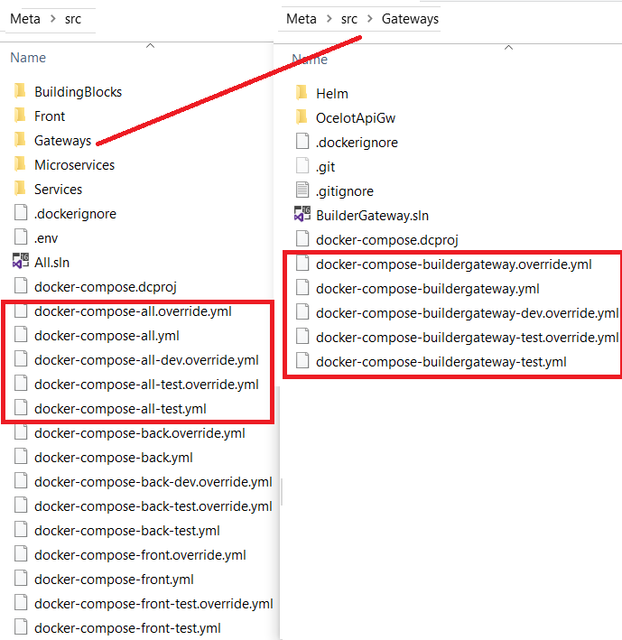
After 2 sprints: Meta Repository + Set of Micro Repositories
Notes:
Convert initial mono repo to Meta Repository (to simplify testing by QA as well as let to dev team a way to debug all together locally)
Microservices with identified domain boundaries moved to separate repositories and added as a git submodules to a Meta repo.

Slide 11
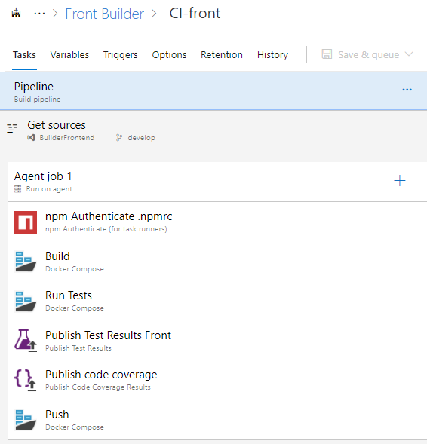
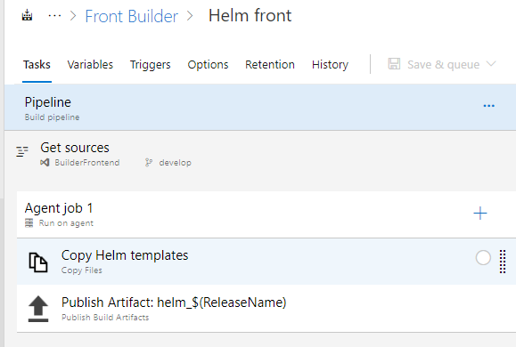
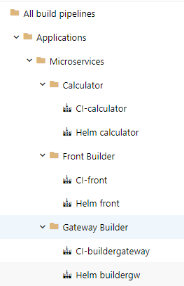
Micro Repositories -> Microservices Build
Notes:
When identified microservices moved to separate repos, next logics step was- create independent build(CI) for each microservice

Slide 12
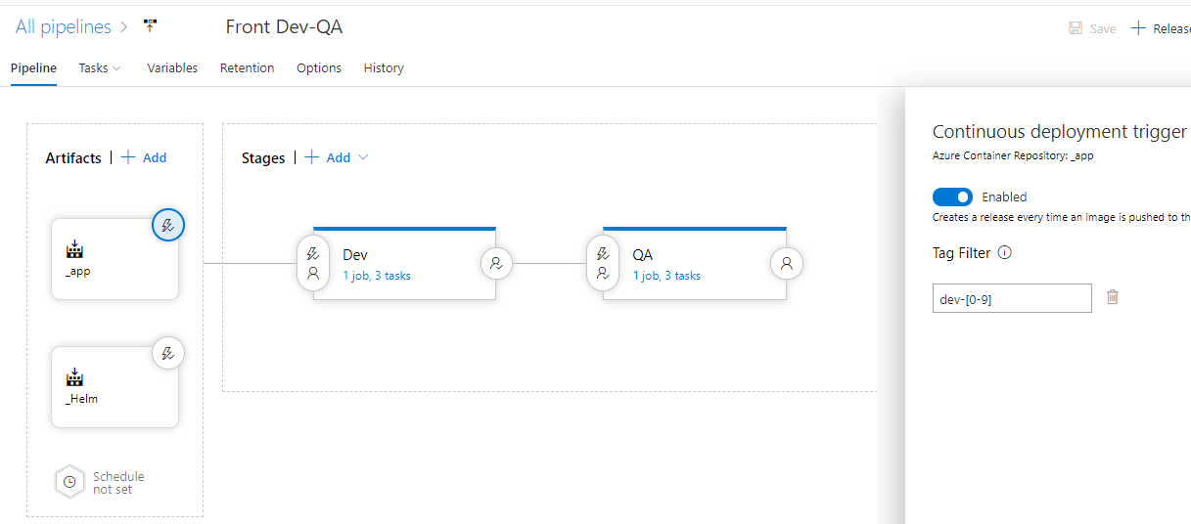
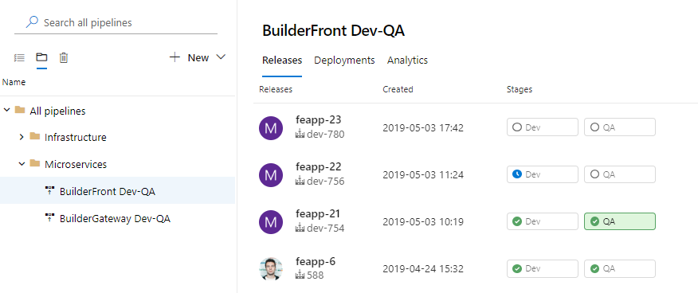
Microservices Build -> Independent Releases

Slide 13
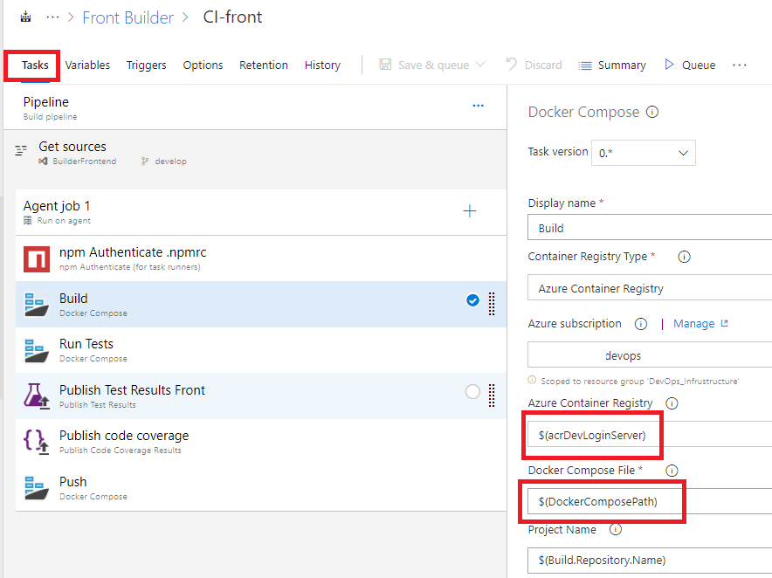
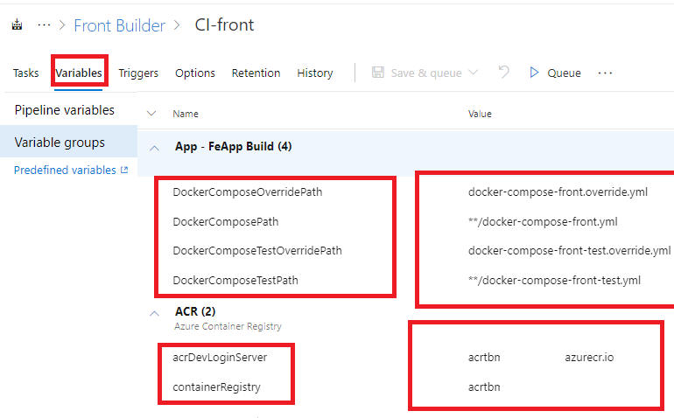
Small Tricks – variables from Libraries in Build

Slide 14
Challenge of managing CI/CD
For 5 Microservices – we created 5 CI pipelines for docker build, and 5 to create helm charts.
For 5 Microservices – we created 5 CD pipelines, with 4 Environment each.
Q: What was the challenge?
A: Make all CI/CD identical for easy/fast modification and improvement.
Q: How?
A:
Standardize names across different “layers”. Names of repositories should match names of Build Artifacts, match k8s Deployments/Services/Pods.
Standardize repository structure(where will be code, where will be helm charts)
Clone CI/CD from one Microservices, replace Variables, Git Repository and

Slide 15
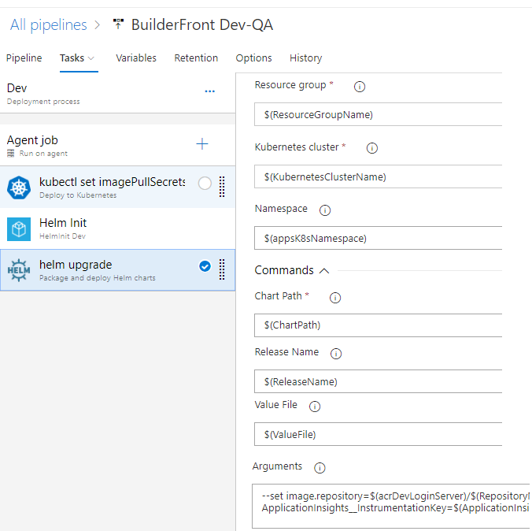
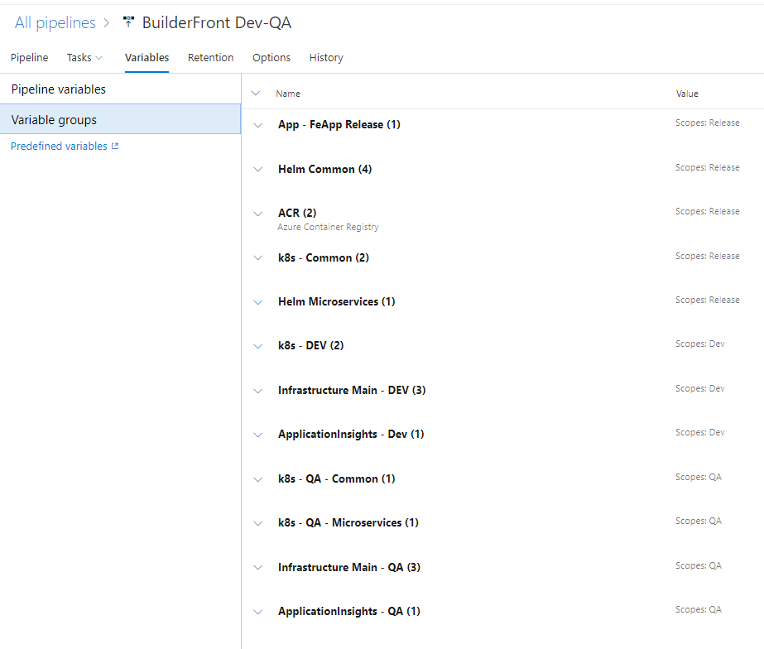
Small Tricks – variables from Libraries in Release

Slide 16
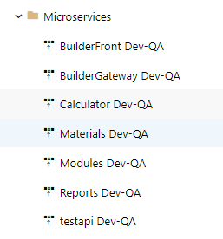
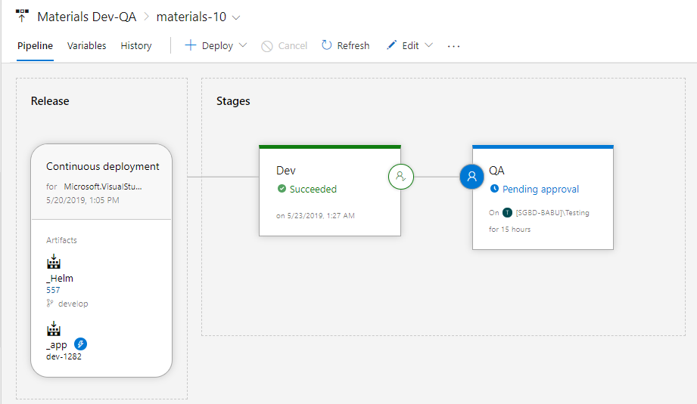
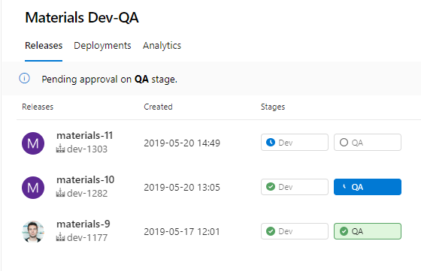
Microservice Releases
Each Microservice independently releasing

Slide 17
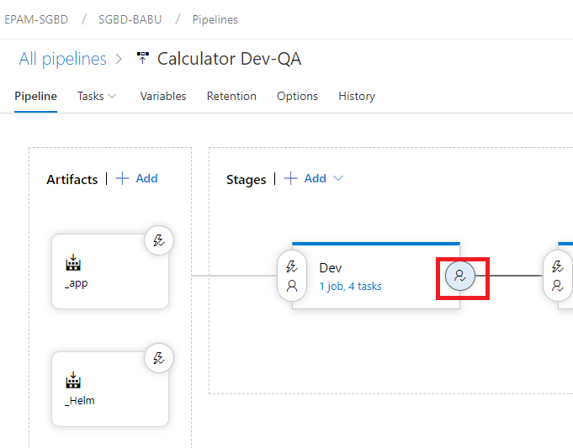
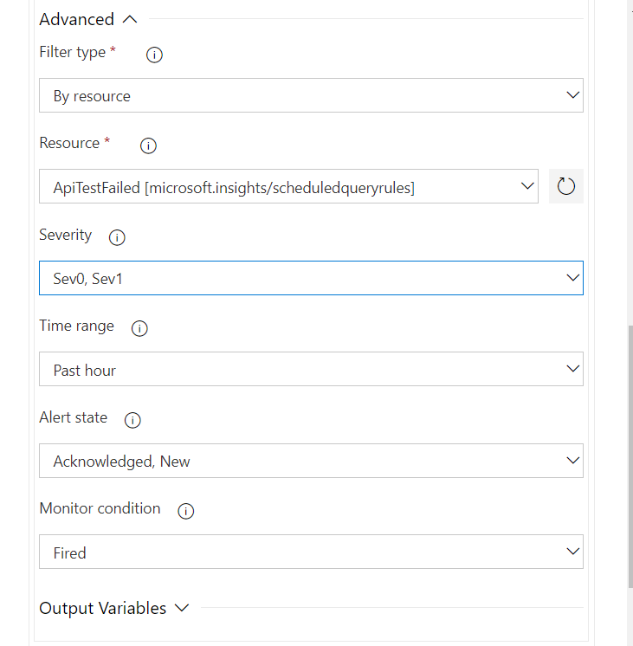
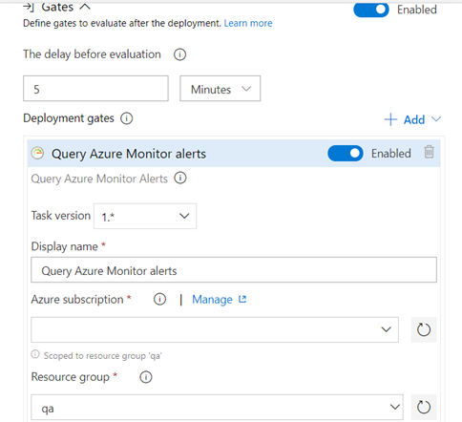
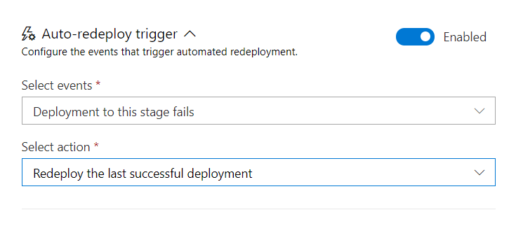
Quality Gates (temporary pause)

Slide 18
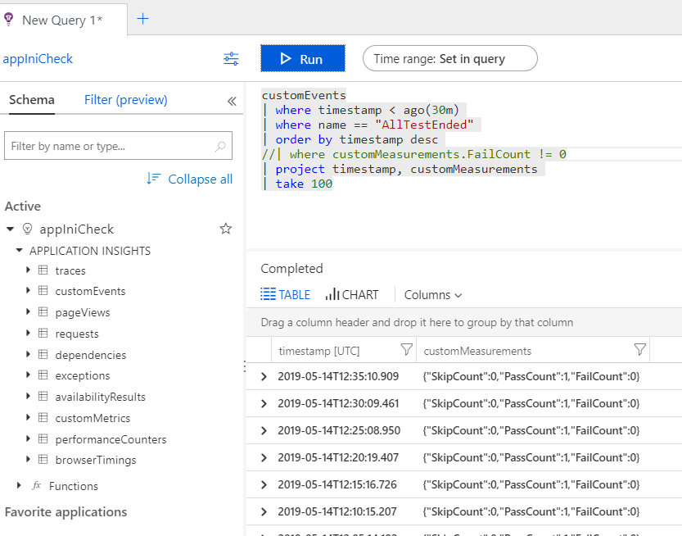
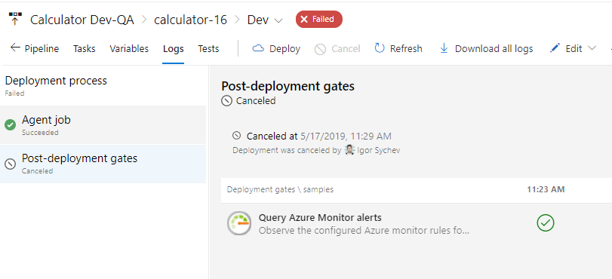
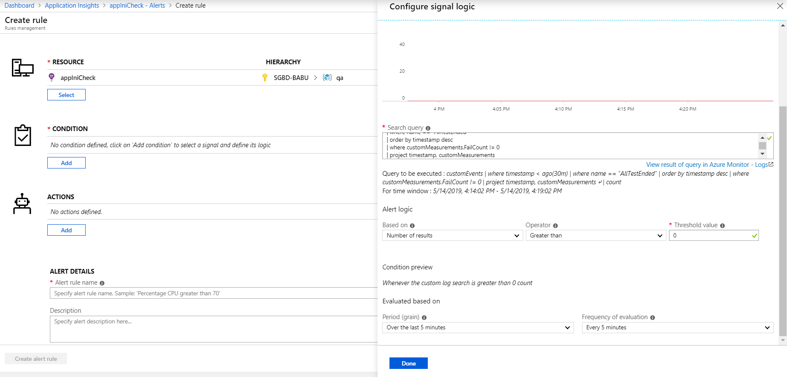
Quality Gates (temporary pause) 2

Slide 19
YAML based Builds

Slide 20
Designer based Builds (and Releases)
Initially we used Designer based builds, because “Click->Click” is faster to start
YAML based builds were introduced relatively recently and we were not confident that it’s not yet another Silverlight, WinPhone
YAML based releases were not available -> no consistency between CI and CD

Slide 21
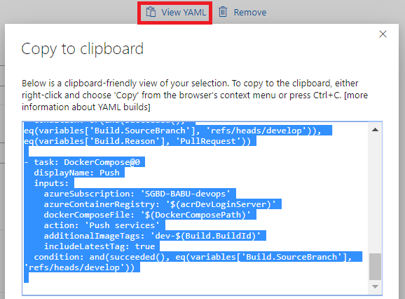
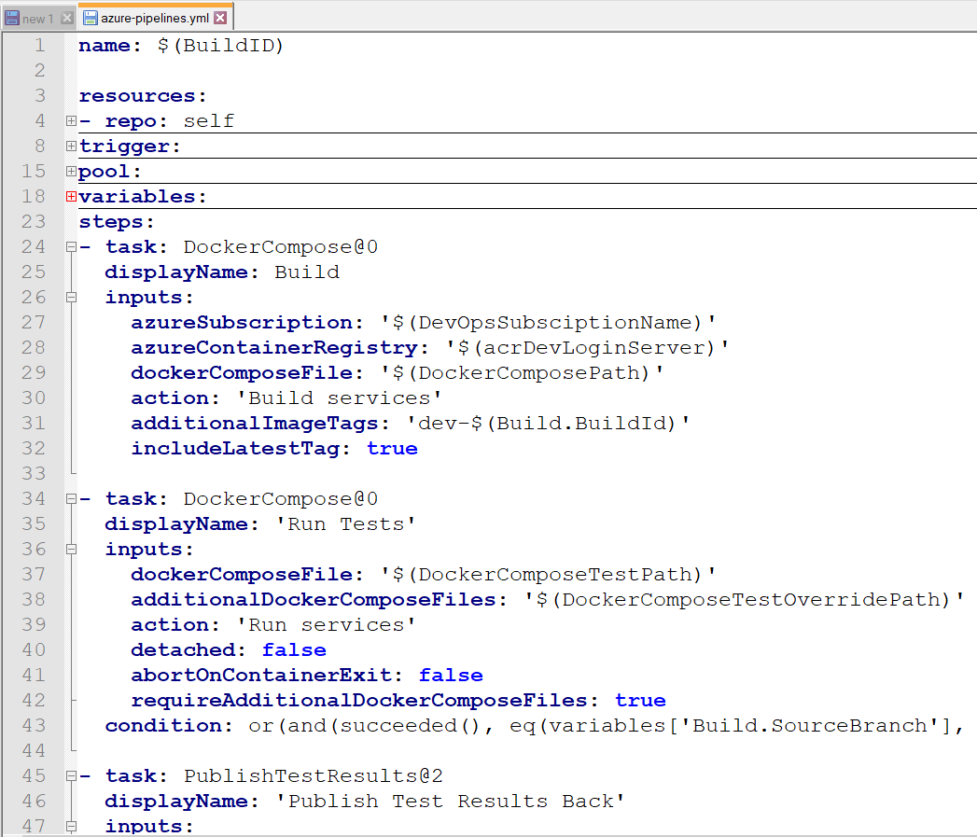
YAML based CI
On a BUILD2019 Microsoft shows “unified pipelines”, triggered us to create YAML based builds. *
Migration of 5 builds takes 2h (without YAML builds skills)
YAML builds – give us 99.9% compatibility between microservices (1 variable is different)
We store YAML build definitions under source control -> CI as Code (infrastructure as Code)
Notes:
* Our project is 10month long, so Microsoft will not have enough time to retire Designer based builds, but we should think about long time goals and support. https://docs.microsoft.com/en-us/azure/devops/release-notes/

Slide 22
Build/Test in Docker

Slide 23
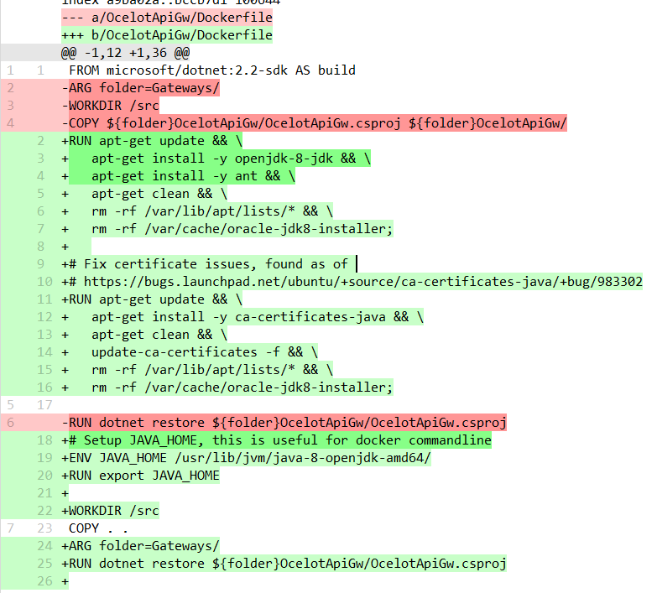
Build in Container
Why, if It’s slower?!
Have you ever seen errors/bug because on one machine software was older/newer than on others?
Have you ever ask- what this dll doing here?
Do your developers all got the 100% same(cloned) machines?
I can build my app in CI, but not locally!
Concurrency tests may work locally, but fail in docker.

Slide 24
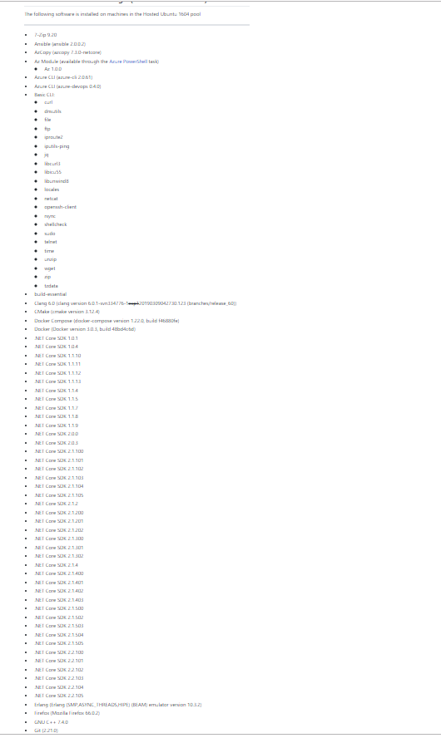
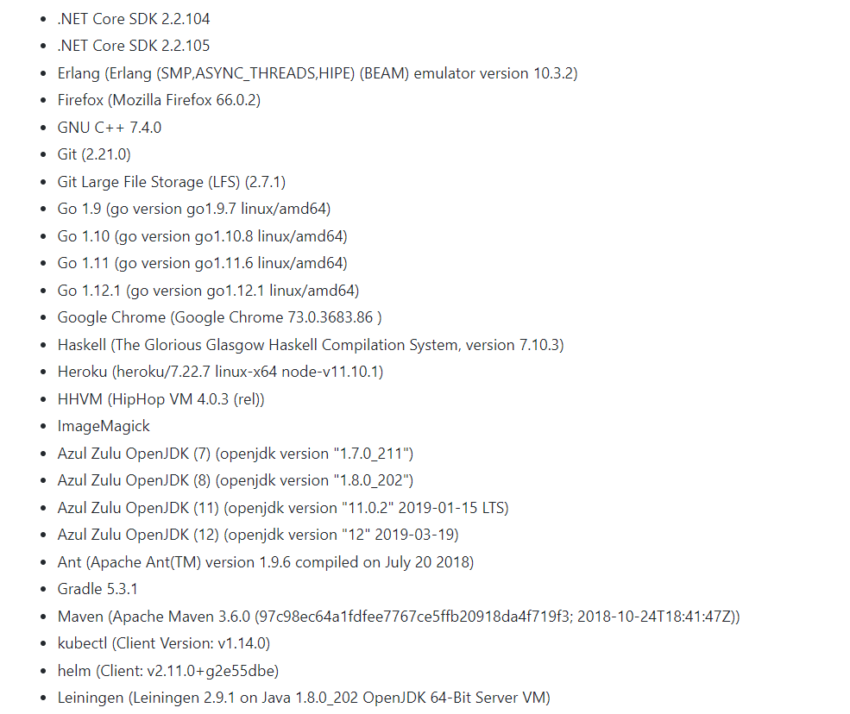
Software Installed on Ubuntu Agent
Do you dev machines got the same version of software that Build Agent in Azure?
https://github.com/Microsoft/azure-pipelines-image-generation/blob/master/images/linux/Ubuntu1604-README.md

Slide 25
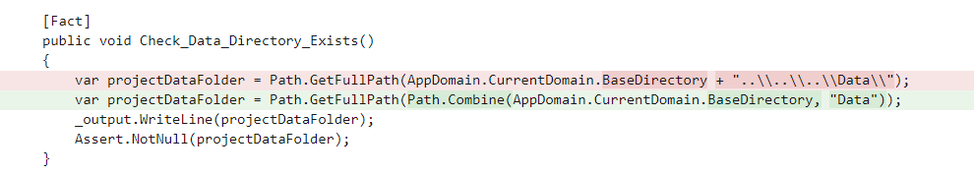
Tests in Container
Why, if It’s slower?
Yes, but apps will be executed in a container, not on your machine!

Slide 26
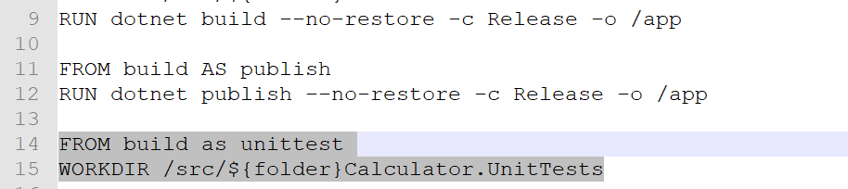
Build/Test in Docker as simple as

Slide 27
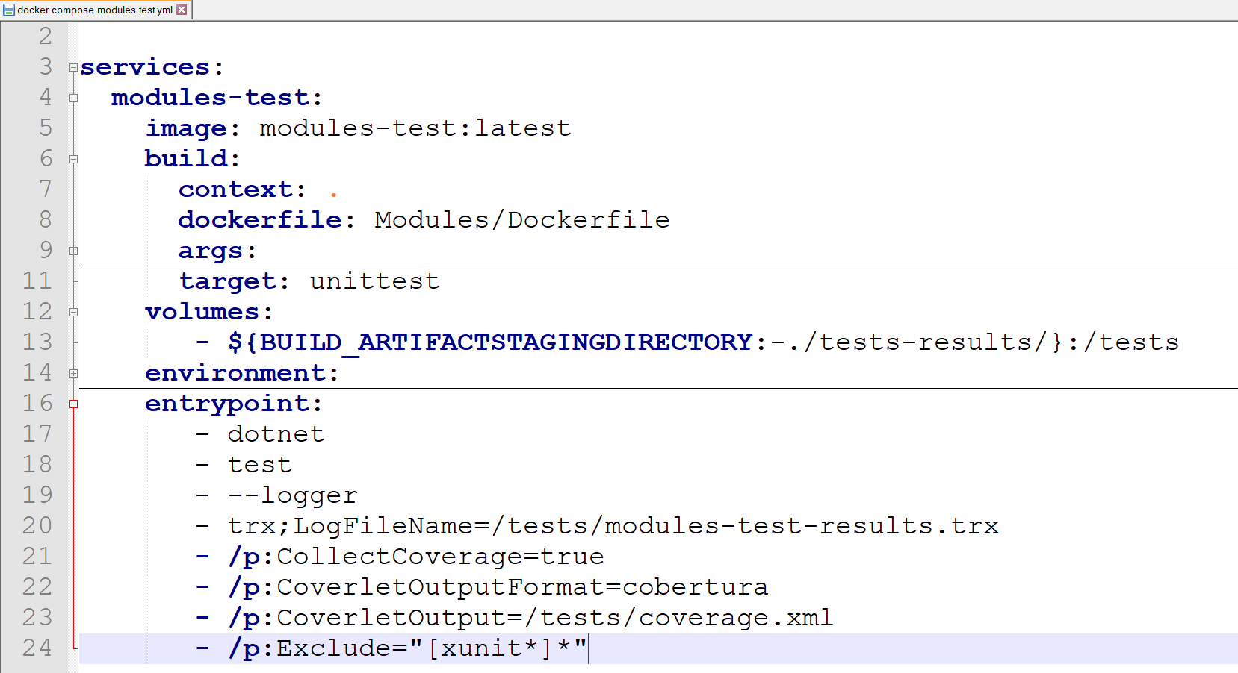
Build/Test in Docker as simple as (part2)

Slide 28
Docker-Compose

Slide 29
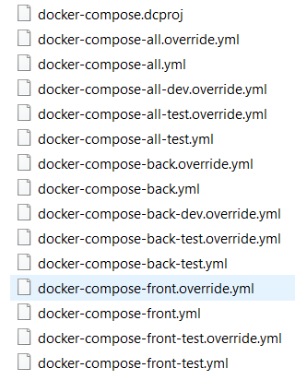
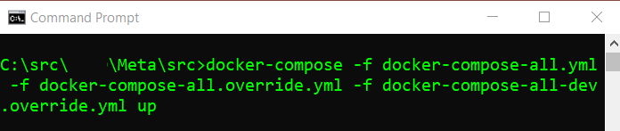
Run MicroServices App Locally from Meta Repository
Multiple Docker-Compose files in a meta repository and in each Microservice Repository
Meta repo:
Run all
Run back
Run front
Run all tests
Run back tests
Run front tests
For Microservices
Run microservices
Run microservice test
Notes:
Front Devs can run all back containers
Back Devs can run front containers
QA team can run everything

Slide 30
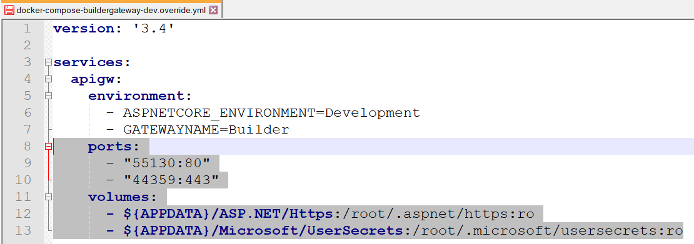
Special Override file to run docker-compose locally
Require to store local ports mapping
In a cluster we used 80-443, but we can’t map on the same port more than 1 MicroService-> we need custom ports mapping from Container ports to Host Ports

Slide 31
SonarQube and technical Debt journey

Slide 32
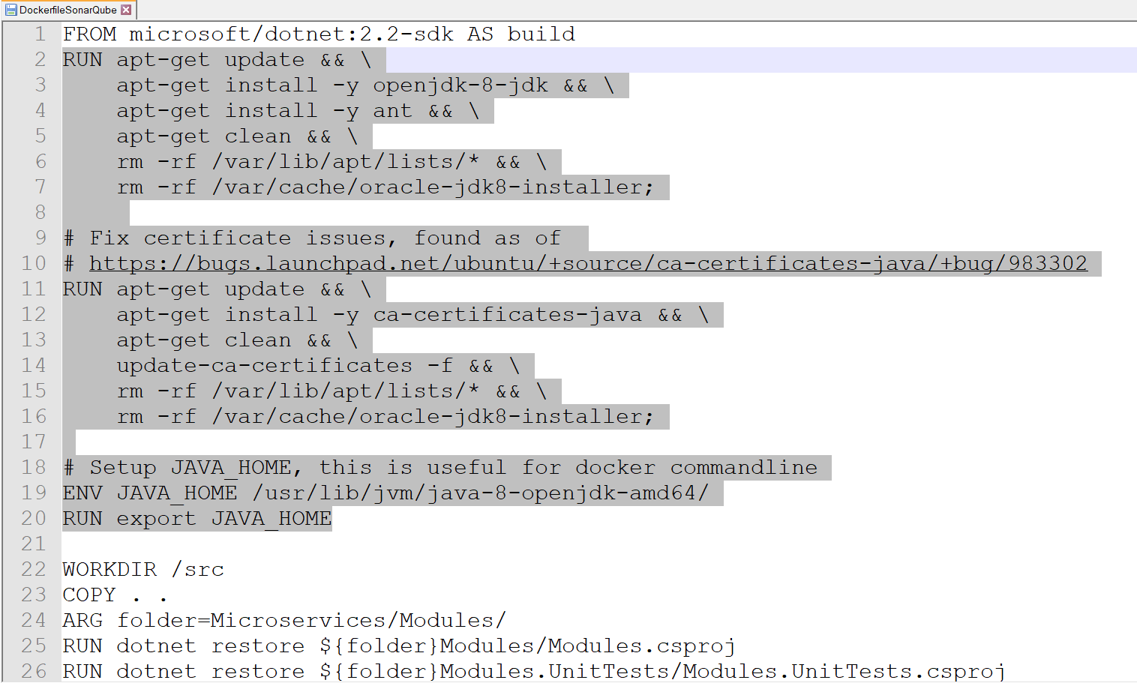
Java in .net core dockerfile
Install Java every time is slow
Create custom base image and maintain it – it’s not secured
Yes, it’s possible to automate base image creating using Azure DevOps Build pipeline, but again- militance

Slide 33
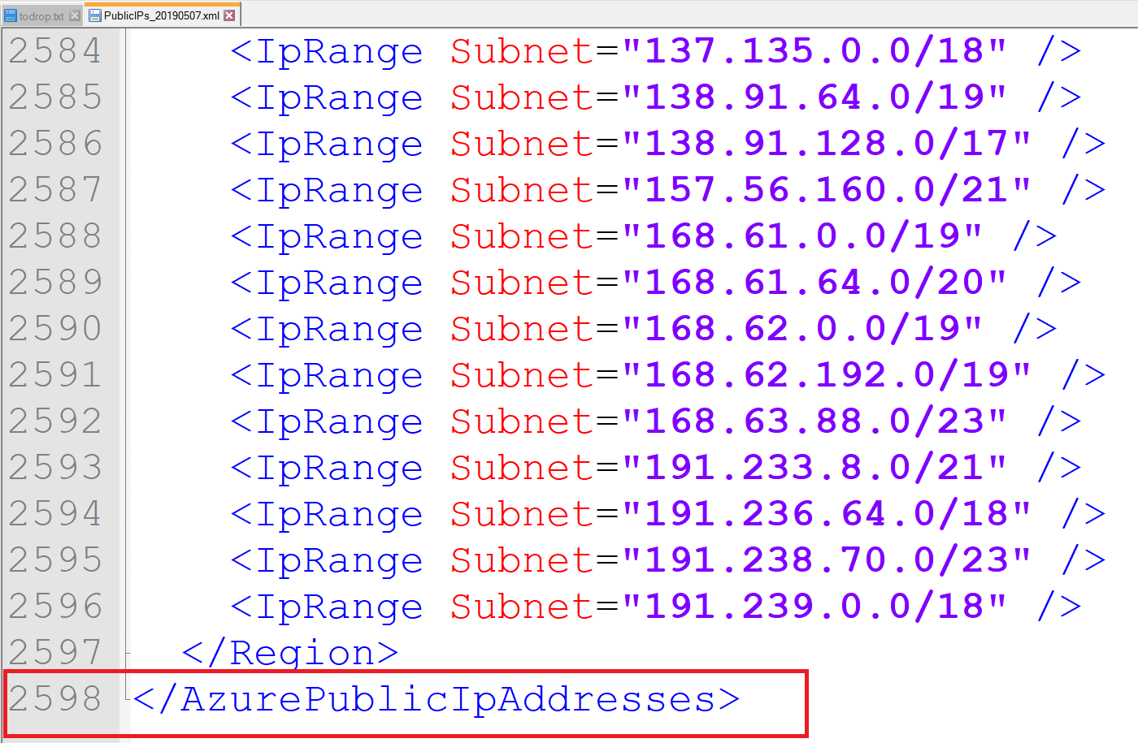
Code technical Debt Story – Problem definition
SonarQube is a tool to manage code technical debt, but….
EPAM’s SonarQube accessible via VPN
Azure DevOps Agents is outside of EPAM network

Slide 34
Code technical Debt Story – Resolution Options:
Use EPAM SonarQube installation
Create Hosted Agent in EPAM network and maintain it? (min 15$ per month to Microsoft+ something to EPAM)
Create Hosted Agent on Azure VM, allocate Public IP (15$+ VM price… +50$ min)
Don’t use EPAM SonarQube installation
SonarQube Cloud and pay per line (disclose your customer’s code outside)
Create your own SonarQube installation and don’t use EPAM’s one
Our dirty decision:
RUN SonarScanner locally few time per week by TeamLeads/QA team

Slide 35
Infrastructure as Code ->CI/CD

Slide 36
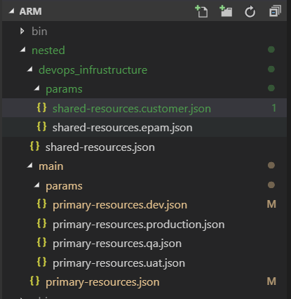
Infrastructure repository for ARM Templates
Azure infrastructure modified only from Azure DevOps CD (releases)
Infrastructure separated on 2 pieces:
DevOps infrastructure (Azure Container Registry, Azure Key Vault)
2 params sets (1 for all EPAM environments and 1 for Customer’s environment)
Main Infrastructure (AKS, Application Insights, Log Analytics)
4+ params sets (dev/qa/uat/prod,etc)

Slide 37
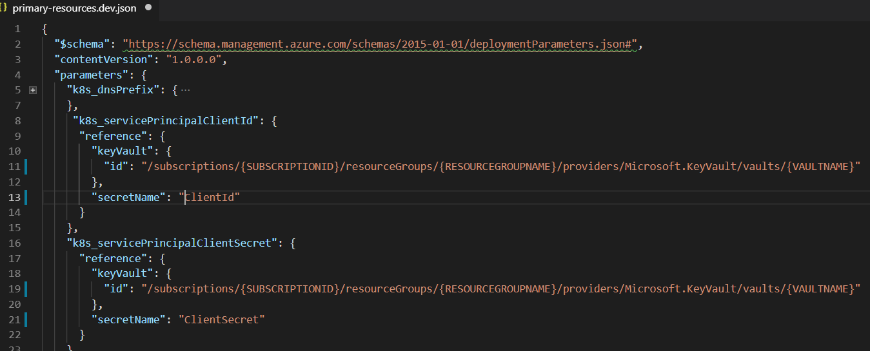
Secrets outside of ARM templates
We choose Azure Key Vault as a storage for Secrets (Service Principal credentials for AKS to access Azure Container Registry and add/remove nodes)
Notes:
Alternative was- store credentials in Azure DevOps (free to use, but harder to protect from access)

Slide 38
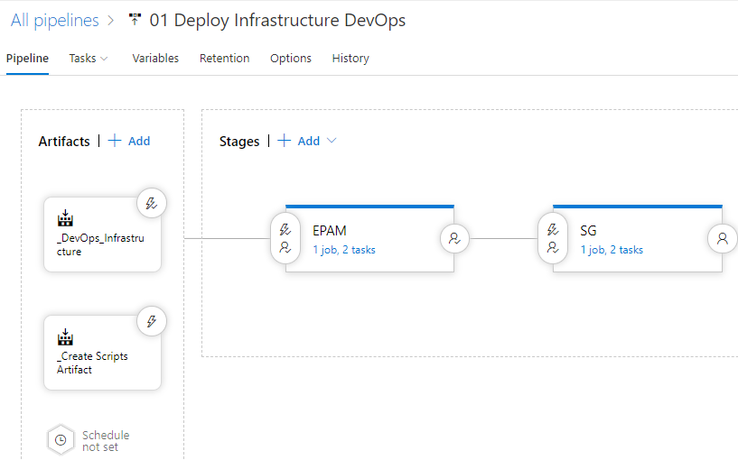
DevOps Infrastructure Rereleases

Slide 39
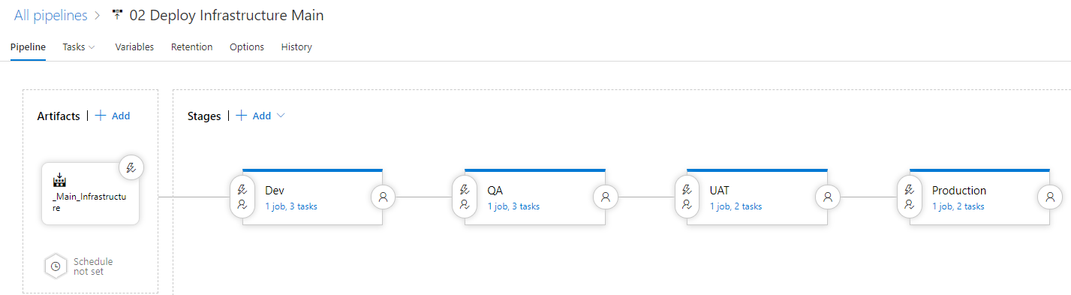
Infrastructure Release Pipelines

Slide 40
Scale in/out (daily spikes handling) challenge
Option 1: scale in/out using ARM templates
Pro: always up-to-date parameters in a repo
Contr: multiple deployments per day (between 2 and N)
Option 2: autoscaling (multiple options to implement via Azure Automation or using Kubernetes operator)
Contr: in theory, against infrastructure as code approach.
Pro: active reaction on load.

Slide 41
Helm

Slide 42
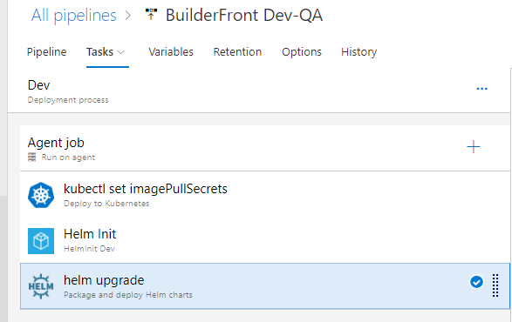
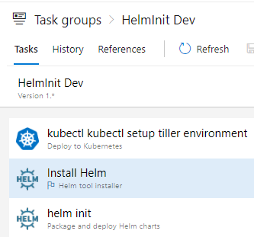
Each Microservice was released via Helm

Slide 43
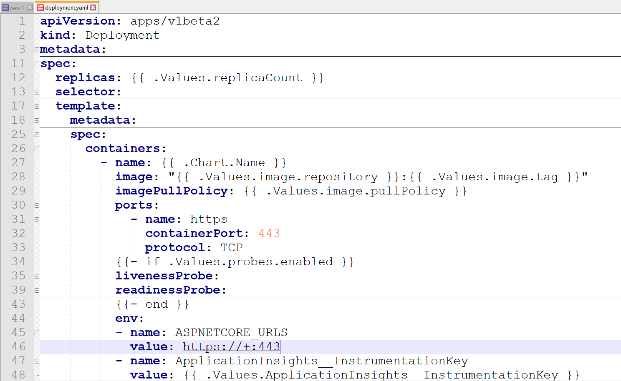
Example of Helm template (used to generace k8s yaml file)

Slide 44
Helm: Why tiller version is important?!

Slide 45
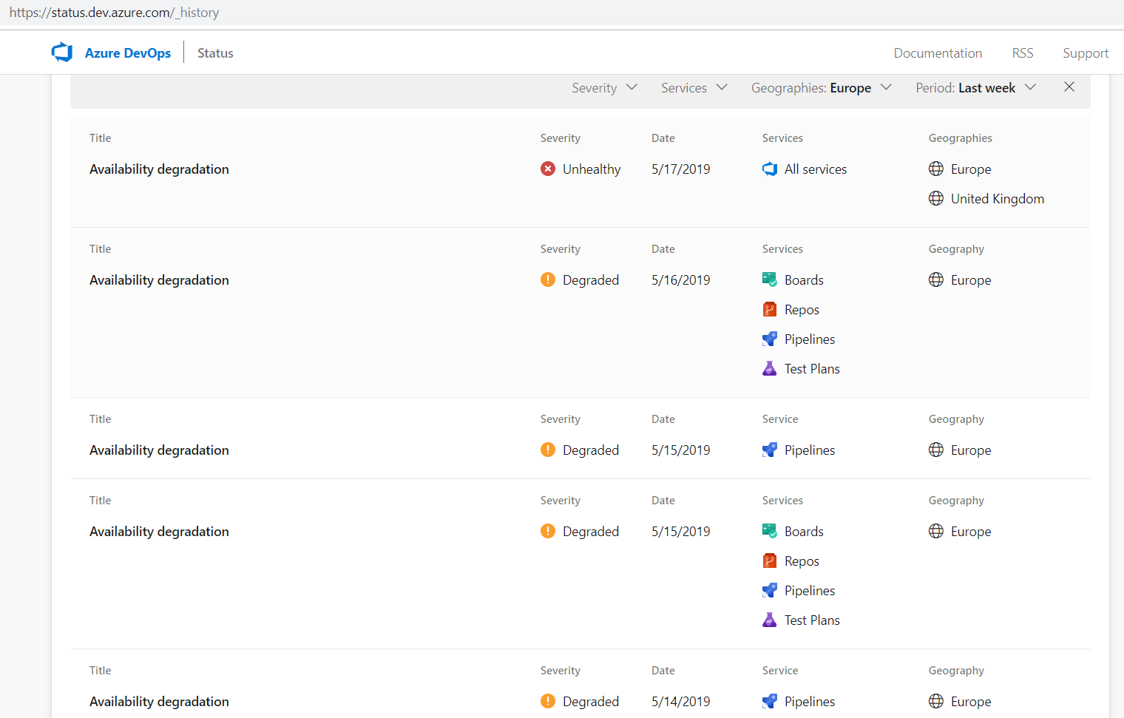
One day, our Release Pipelines started crushing
https://status.dev.azure.com/_history

Slide 46
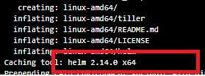

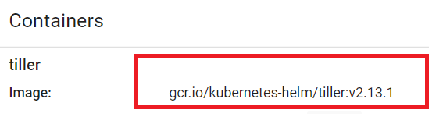
Next day: Azure DevOps reported as healthy
Currently used in CD process:
Last succeeded:

Slide 47

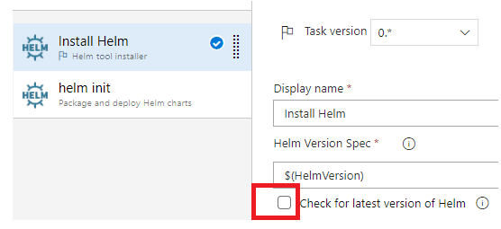
Why version had changed?
https://github.com/helm/helm/releases

Slide 48
Summary: Helm/Tiller Version is important!

Slide 49
Azure DevSpaces
Not used, because in still in preview.

Slide 50
Thank you! Questions!
https://github.com/SychevIgor/pronet_docker

