Slide 1

OpenTelemetry - portable telemetry cloud-native software. Goals and State
Igor Sychev
Solution Architect in MSTD BY
https://github.com/SychevIgor/pronet_docker

Slide 2
Agenda
Current Challenges with vendor-locked telemetry
OpenTelemetry project overview
Results of Research, Contribution (.Net Core) and PoC.

Slide 3
Project overview and requirements

Slide 4
Introduction to our project
Currently hosted in Public Cloud (Azure), Hybrid (on-prem deployment consume cloud hosted components) and fully In-Prem.
Monitoring solution based on Elastic and provided as a feature to customers.
Monitoring part of installation package.

Slide 5
Challenges with current solution
Hard to implement for developers and use in a right way (compare with Azure Application Insights integration)
Developers implementing monitoring only as a “workitem”, not because they will use it for debugging.
Feature was not paid, not configured or misconfigured
Monitoring tool contains a lot of “moving pieces” such “azure service fabric”, “azure event hub”. Moving pieces- are always source of potential issues
RoadMap for Migration from IaaS to PaaS
Customers have their own IT and want to monitor using their “standard” tools

Slide 6
How to solve challenges?
Replace current tools with tools/services that dev teams willing to use even without “workitems”.
Provide monitoring out of the box(without extra license), and avoid complicated configuration
Remove “moving pieces” such as Azure Service Fabric
Provide monitoring for Azure PaaS services based on Azure native tools
Azure Monitor, Metrics, Application Insights, Alerts

Slide 7
But what about “Customers want to monitor using their tools” ?
Customers “mentally” are not Cloud/Azure ready
As a standard tools uses:
DataDog,
ELK,
Grafana,
Zabbix,
NewRelic,
OpenZipkin,
SCOM,
and etc.
No one can be single “chosen one” tool to avoid vendor lock.

Slide 8
Requirements to proposed solution
Easy to integrate with external monitoring tools and compatible with Azure Application Insights.
Supported on All Major dev platforms (.net/java/node)
Production Ready, Battle Tested, OpenSource
We didn’t find solution that will fit with all requirements
But opentelemetry is quite promising technology.

Slide 9
OpenTelemetry Overview

Slide 10
What is OpenTelemetry?
OpenTelemetry is an open source observability framework.
It is a CNCF Sandbox member, formed through a merger of the OpenTracing and OpenCensus projects.
The goal of OpenTelemetry is to provide a general-purpose API, SDK, and related tools required for the instrumentation of cloud-native software, frameworks, and libraries.
OpenTelemetry is designed to make it easy to get critical telemetry data out of your services and into your backend(s) of choice.
https://opentelemetry.io/about/

Slide 11
What about languages?
https://github.com/open-telemetry/opentelemetry-cpp
https://github.com/open-telemetry/opentelemetry-go
https://github.com/open-telemetry/opentelemetry-php
https://github.com/open-telemetry/opentelemetry-java
https://github.com/open-telemetry/opentelemetry-js
https://github.com/open-telemetry/opentelemetry-ruby
https://github.com/open-telemetry/opentelemetry-python
https://github.com/open-telemetry/opentelemetry-rust
https://github.com/open-telemetry/opentelemetry-dotnet
https://github.com/open-telemetry/opentelemetry-erlang
https://github.com/open-telemetry/opentelemetry-swift

Slide 12
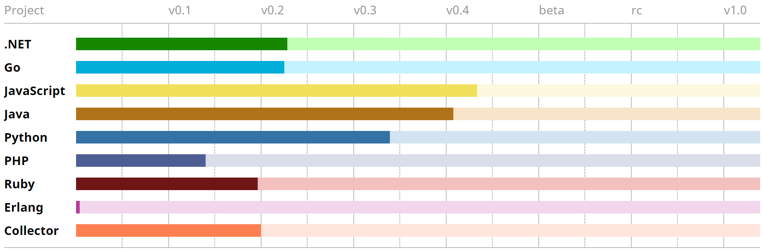
Status
https://opentelemetry.io/project-status/

Slide 13
Results of Research, Contribution (.Net Core) and PoC.

Slide 14
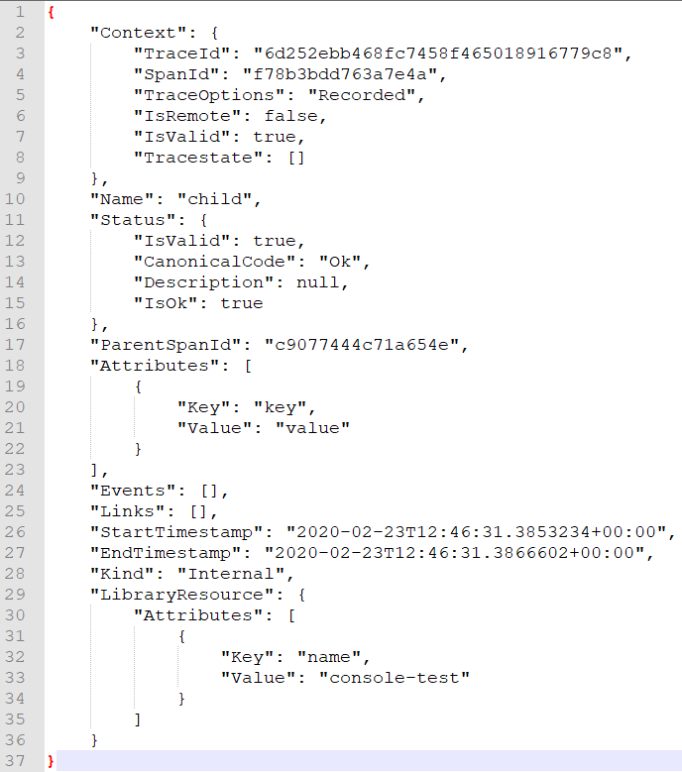
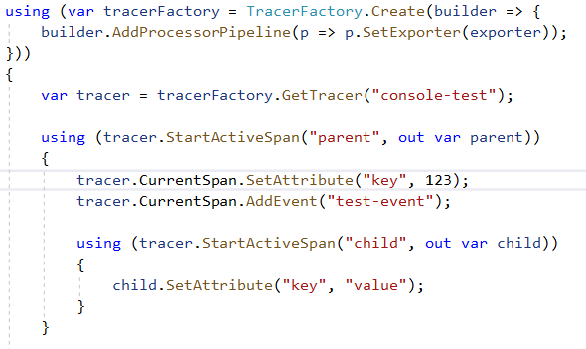
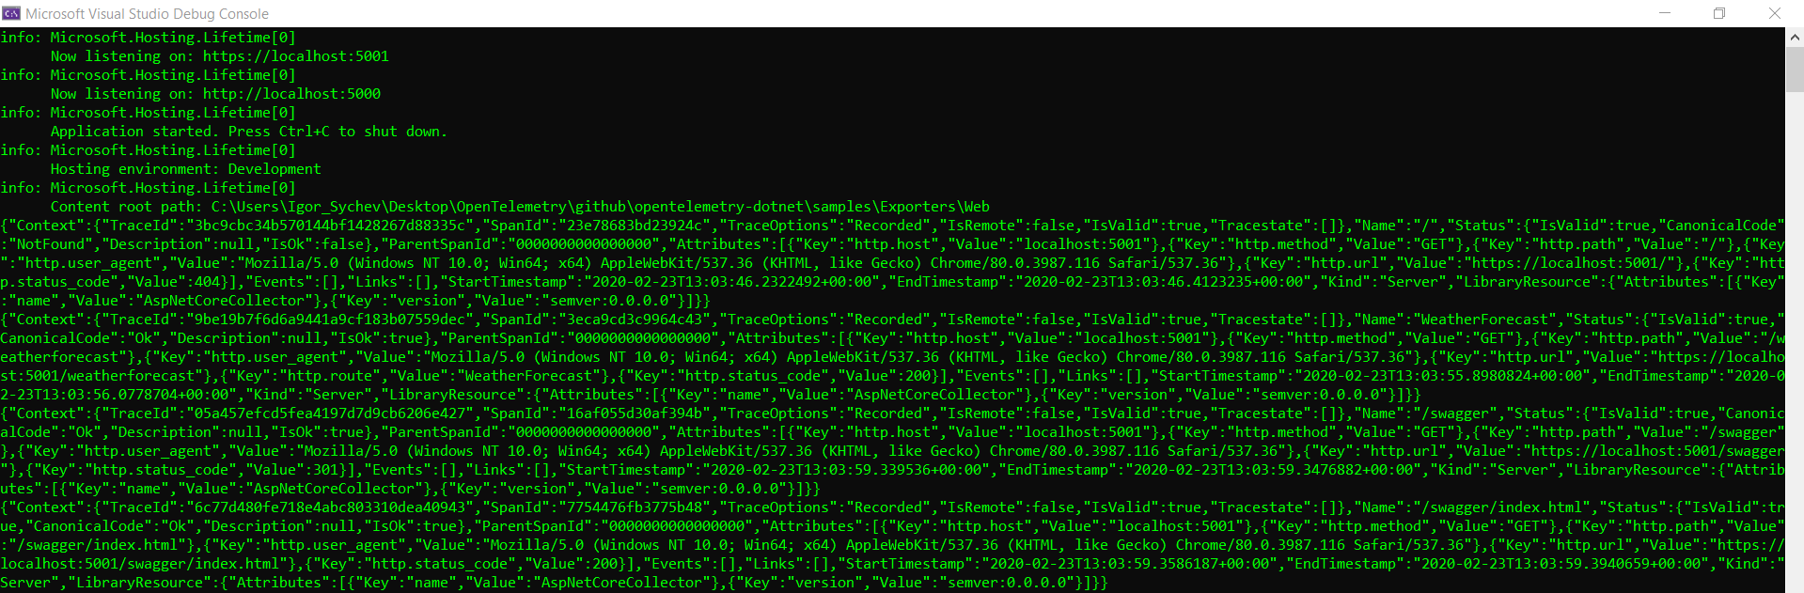
Low level SDK

Slide 15
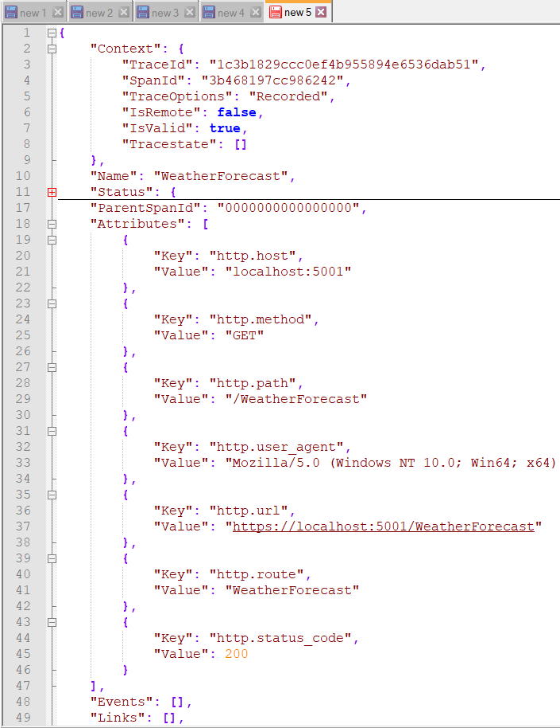
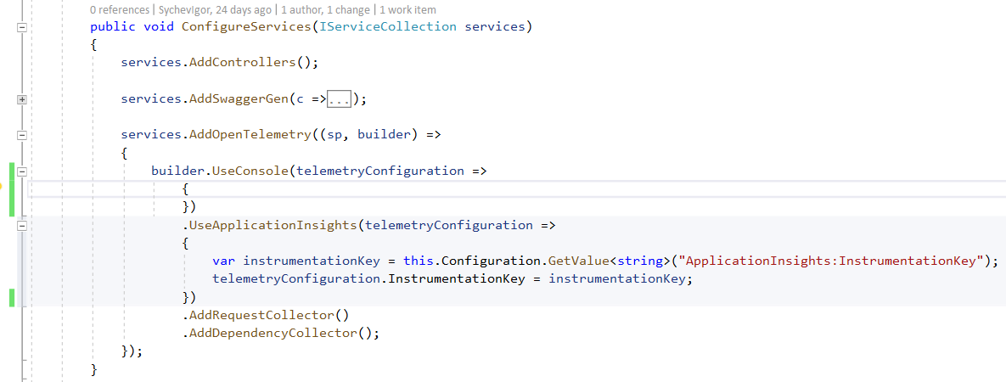
High Level SDK for Asp.Net Core

Slide 16
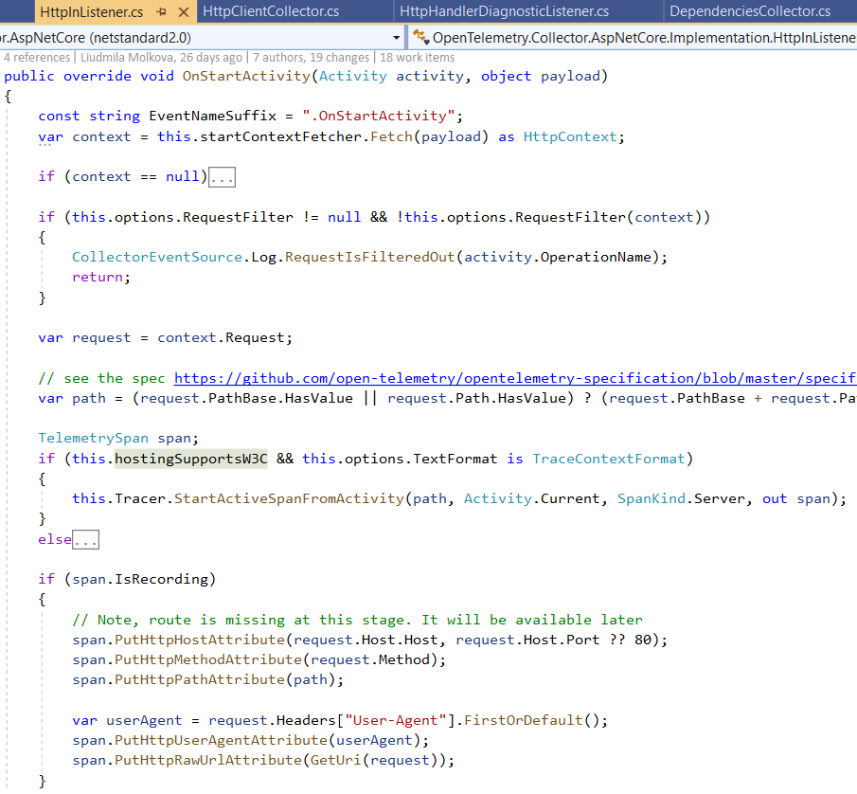
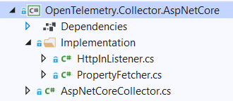
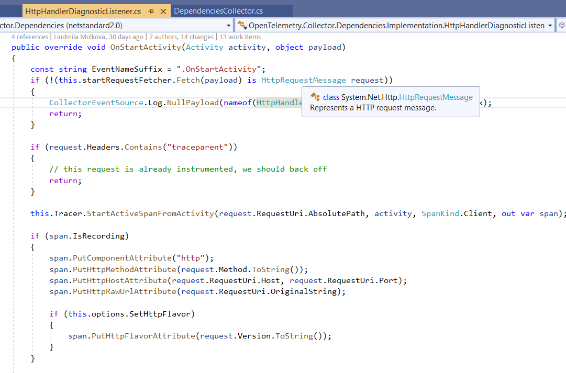
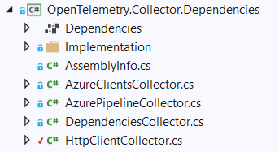
High Level SDK for Asp.Net Core (continue)

Slide 17
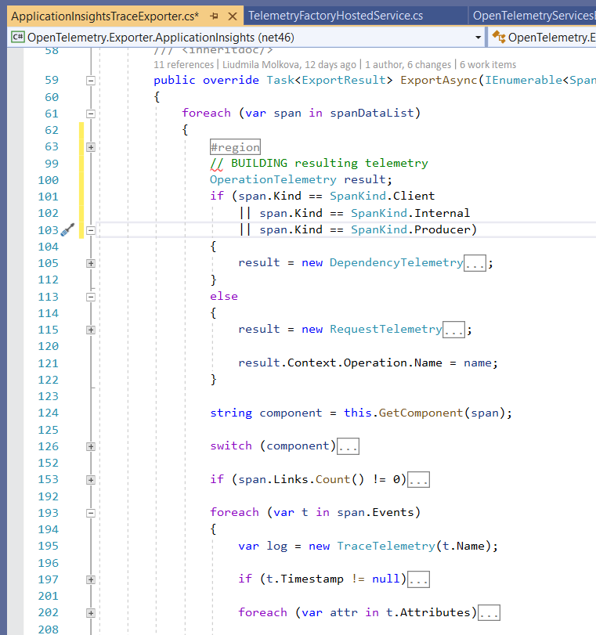
Exporters on .Net + Application Insights example
Enumerate collection and create
Dependency
Request
Trace
No support for App Ins types
Availability Results
Exception
No support for Entity Framework Core, Redis, MongoDB or similar

Slide 18
What about Asp.Net/Entity Frameworks (non-Core)?
Manually instrument your code.
For example: create HttpModule

Slide 19
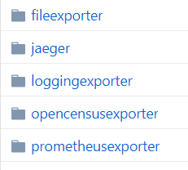
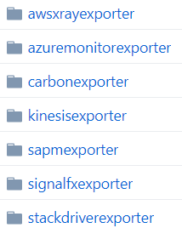
Collectors
Data from different agent, can be collected by collector and forwarded to target
Official:
Contrib:
https://github.com/open-telemetry/opentelemetry-collector/tree/master/exporter
https://github.com/open-telemetry/opentelemetry-collector-contrib/tree/master/exporter

Slide 20
Exporters
Collected telemetry need to be exported.
Each Framework implements its own set of exporters

Slide 21
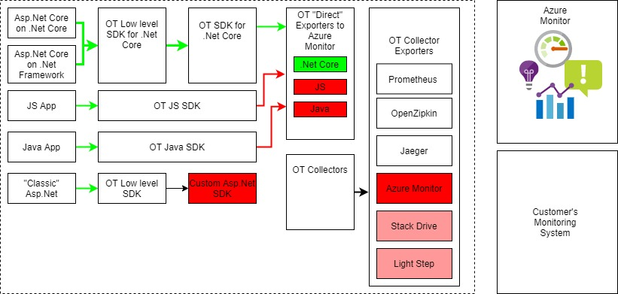
Use “as is” or “develop”?

Slide 22
Summary
Opinion:
Interesting project, but
Not production ready state
Export targets for different languages are different
No easy ways to integrate in Asp.Net Framework (applicable for old frameworks without well designed logging)
Call to action:
Wait official release and Contribute

Slide 23
Thank you! Questions!
https://github.com/SychevIgor/pronet_docker

Slide 24
Application Insights

Slide 25
Selected Monitoring Technologies
Requirements:
Minimum efforts on maintains
Flat learning curve
Visualization mechanism
Protect from Disk overflow by logs
Azure Application Insights for Application level Monitoring
Azure Log Analytics for Infrastructure level Monitoring

Slide 26
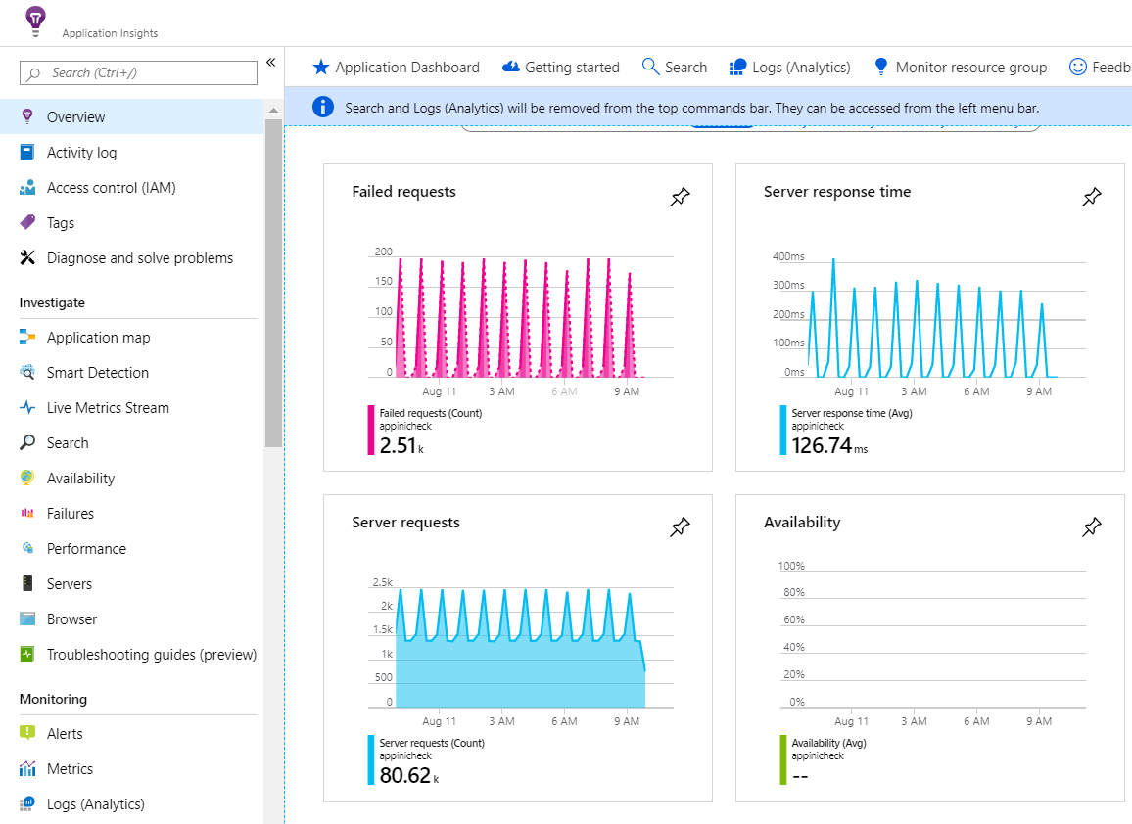
Application Insights Statistics

Slide 27
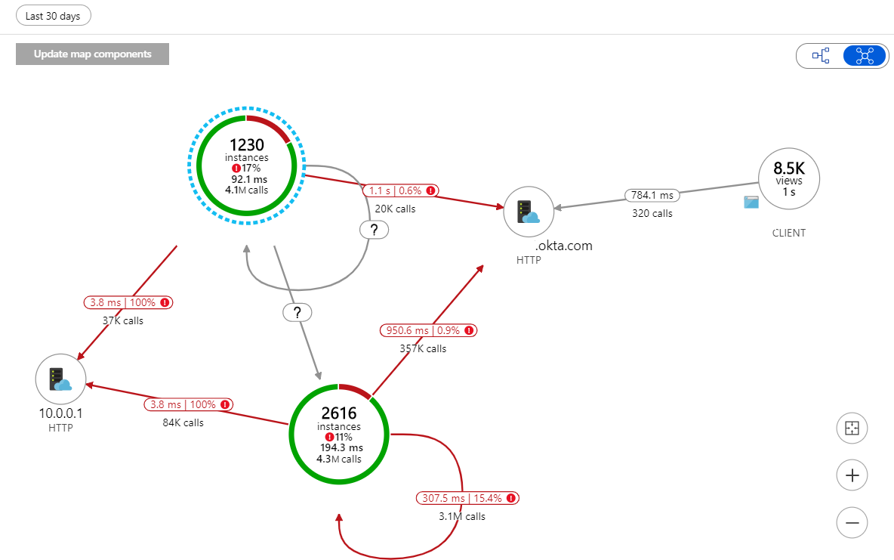
Application Map 1

Slide 28
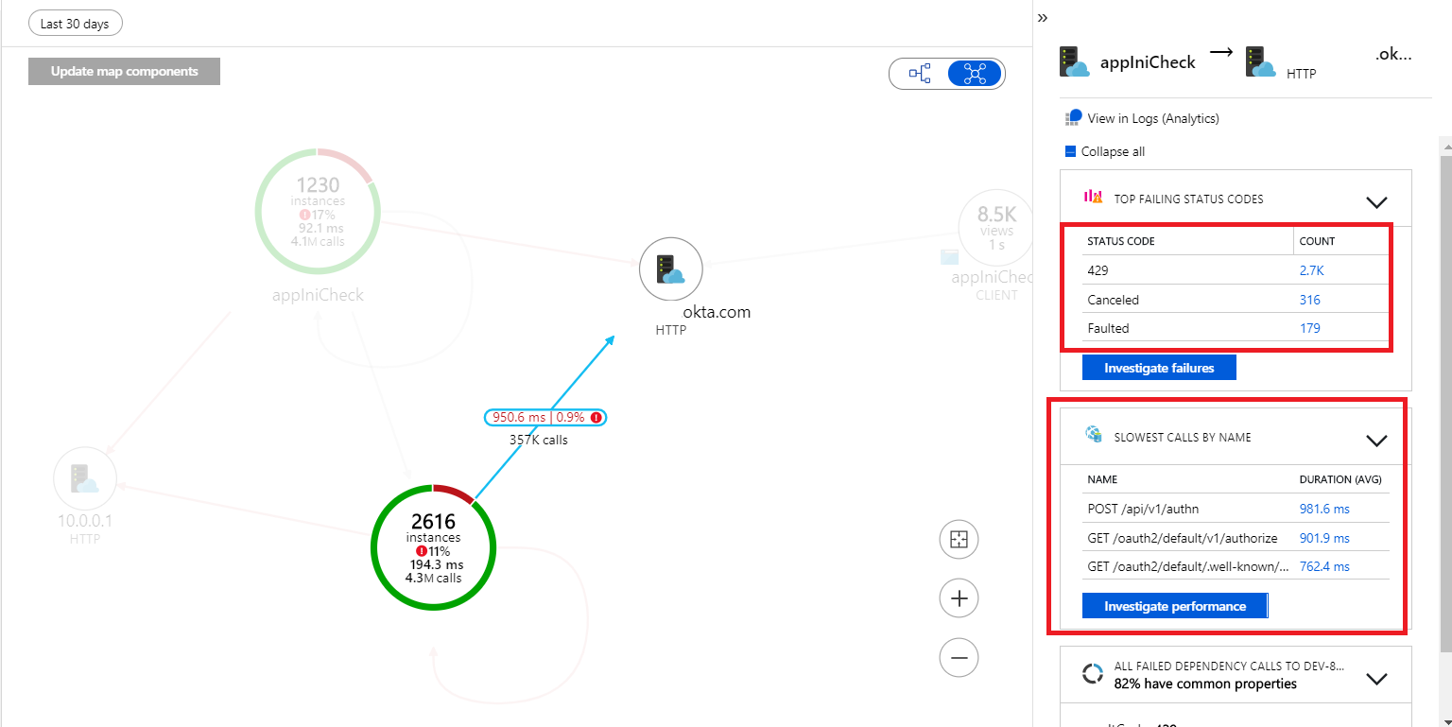
Application Map 2

Slide 29
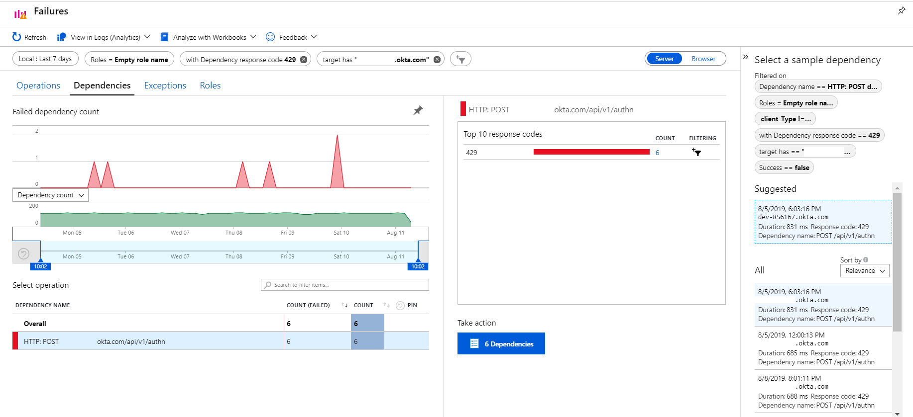
Failures Investigation 1

Slide 30
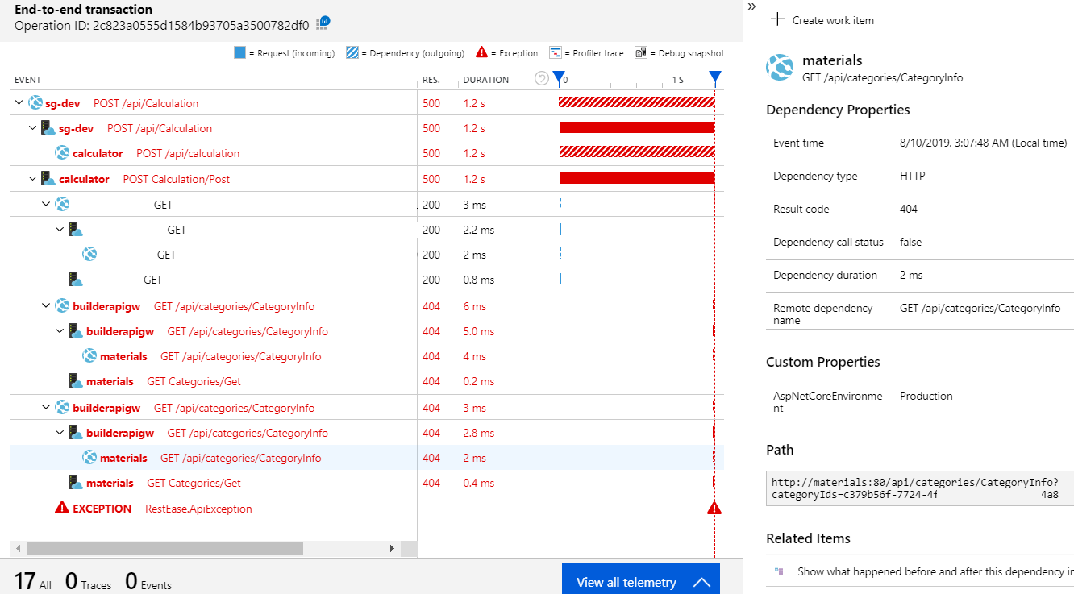
Failures Investigation 2

Slide 31
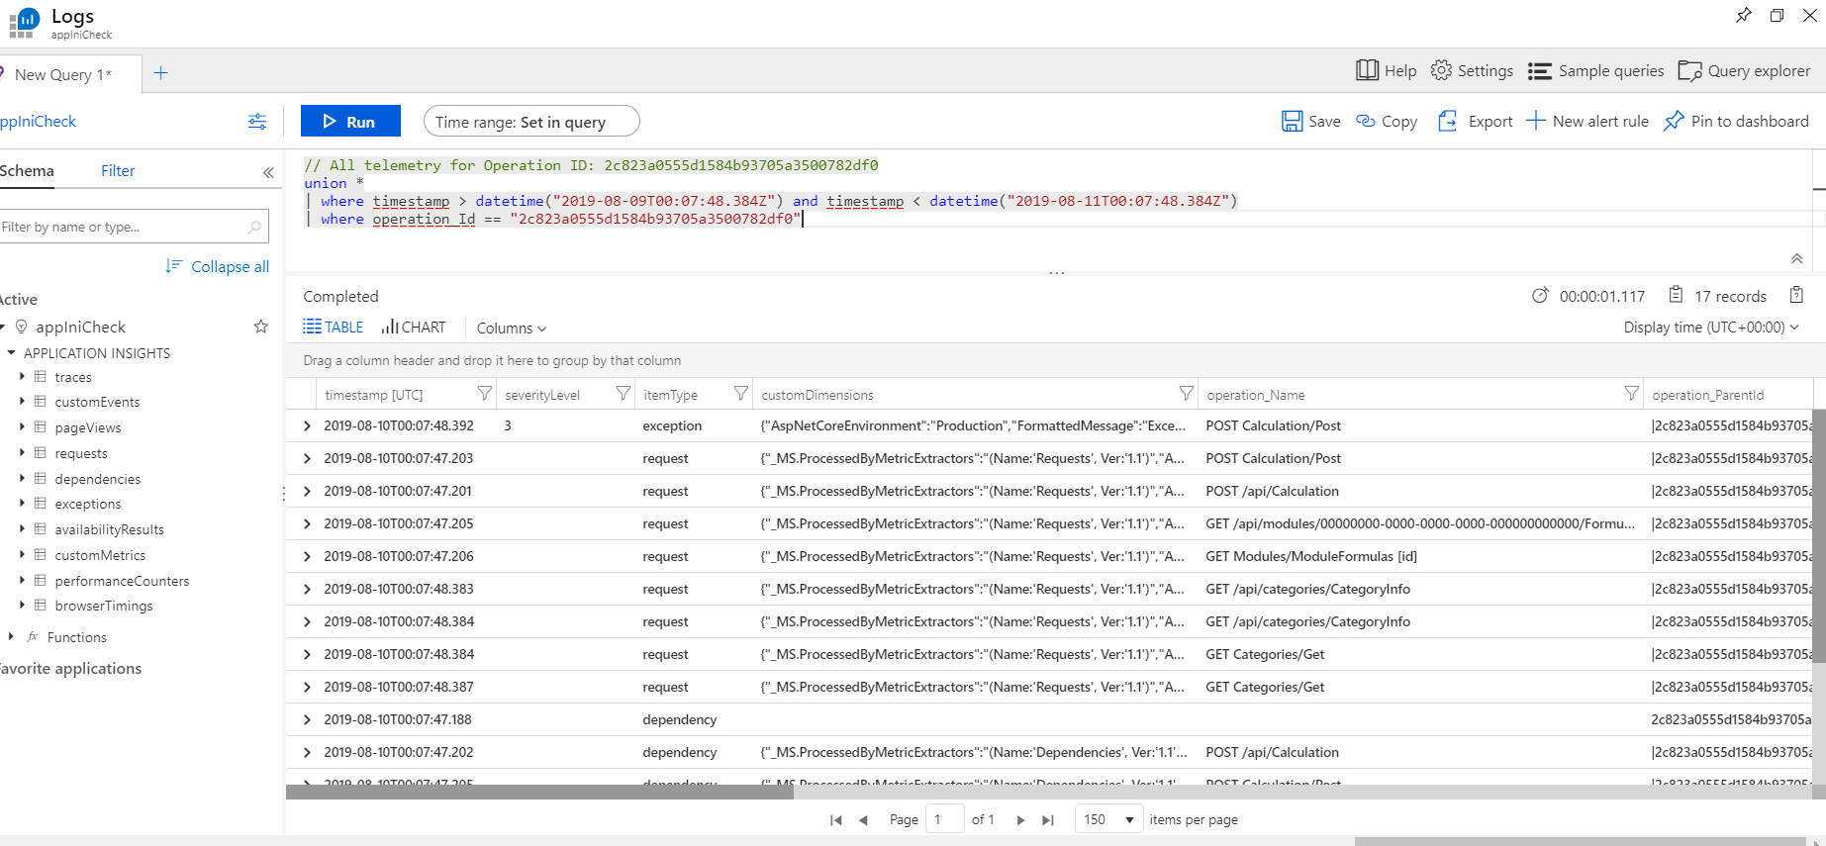
Kusto query Language

