Slide 1
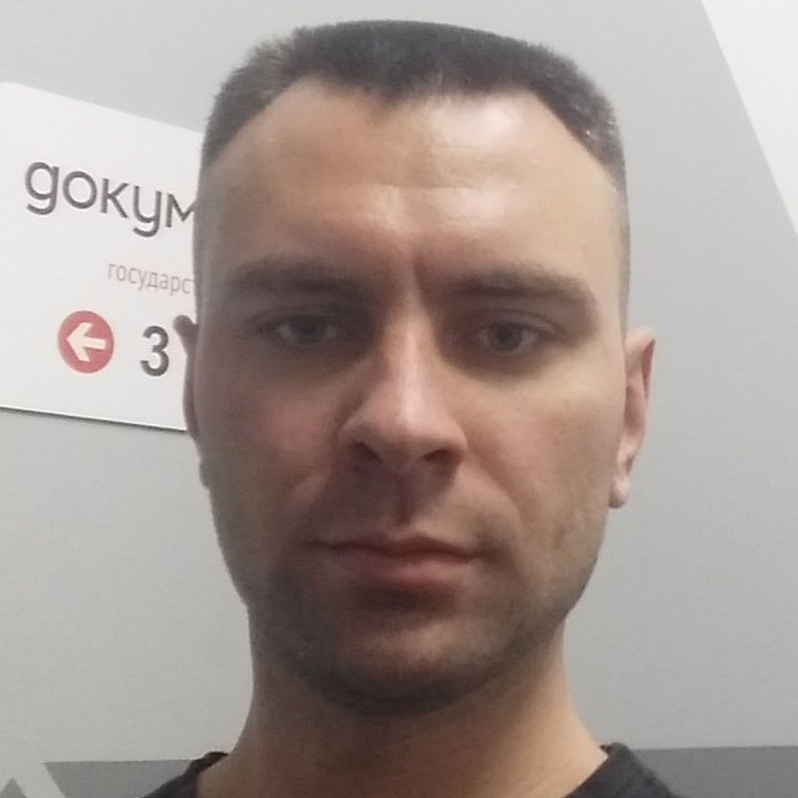
Some Aspects of Microservices in 2020
Igor Sychev
Solution Architect in MSTD BY
https://github.com/SychevIgor/pronet

Slide 2
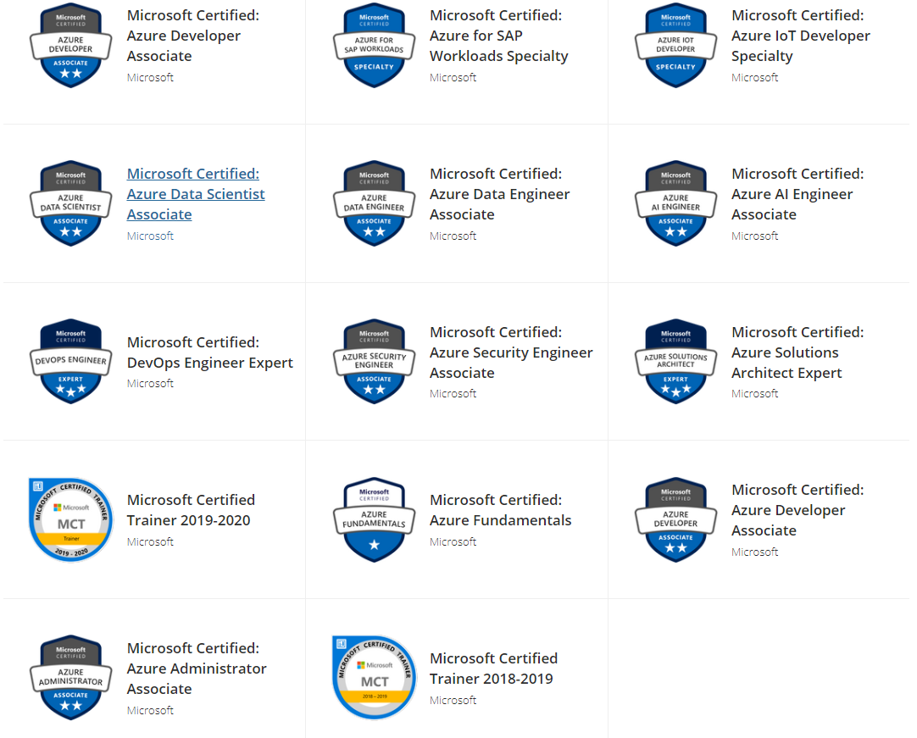
Igor Sychev. Solution Architect. Azure MVP
Azure Certified
Solution Architect
DevOps
Security Engineer
Developer
Administrator
AI Engineer
Data Engineer
Data Scientist
IoT Developer
SAP Specialist
Fundamentals
Notes:
Worked with big chunk of Azure services and can work with almost all existing Azure Services (IaaS/PaaS/Data/IoT)
https://www.youracclaim.com/users/igor-sychev/badges

Slide 3
Agenda

Slide 4
Azure Functions SDK + Kubernetes + Keda
Host Functions App on AKS instead of Azure Functions
Azure Functions Consumption plan - don’t give SLA on delay between event and execution.
Azure Function App Service plan – require to allocate resources in advance and “elastic scaling” lost
Azure Functions – cold start problem
Azure Function Premium plan – solves cold start problem, but cost will be higher
Functions SDK can be used but packaged as docker image and hosted on AKS. Scaled using KEDA

Slide 5
Why not OPENFAAS
It’s really easy to deploy in a first time, but to be effective- still require learning.
Mandatory requirements to Functions Structure (port 8080, endpoint for heath) https://docs.openfaas.com/reference/workloads/#common-properties
Full ignore of Azure (AWS/GCP- at least mentioned)
No support for Azure Messaging services (event hub, event grid, service bus) and limited number of Triggers https://docs.openfaas.com/reference/triggers/
No SDKs/Strong type bindings. Everything as “string”
No Support of Azure DevOps
Scripts/CLI based CI/CD https://docs.openfaas.com/reference/cicd/intro/#github

Slide 6
Scaling

Slide 7
Scale in/out (daily spikes handling) challenge
Option 1: scale in/out using ARM templates
Pro: always up-to-date parameters in a repo
Contr: multiple deployments per day (between 2 and N)
Option 2: autoscaling (multiple options to implement via Azure Automation or using Kubernetes operator)
Contr: in theory, against infrastructure as code approach.
Pro: active reaction on load.

Slide 8
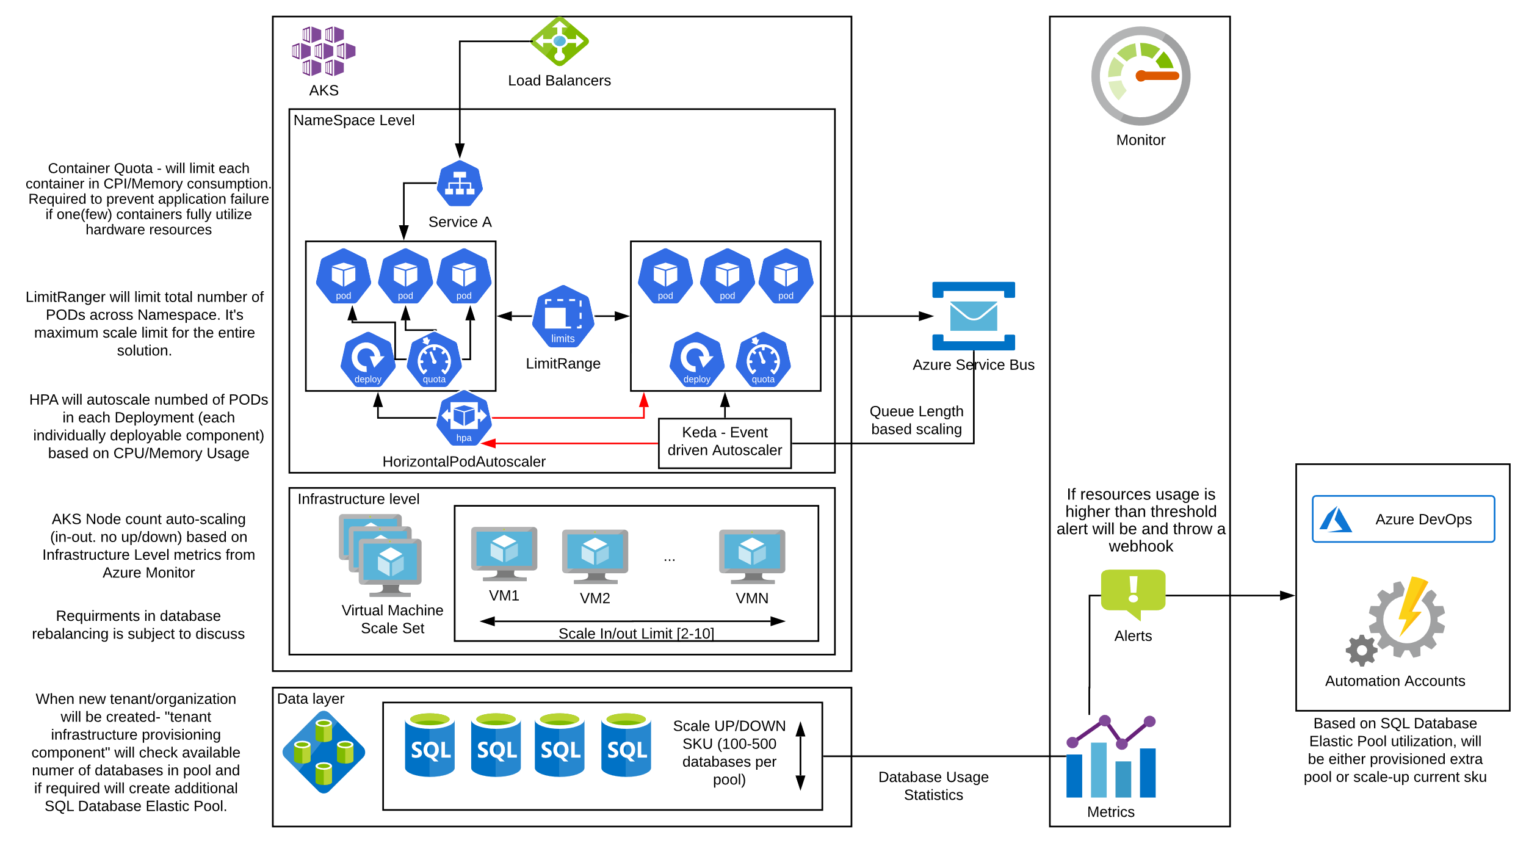
Auto-Scaling

Slide 9
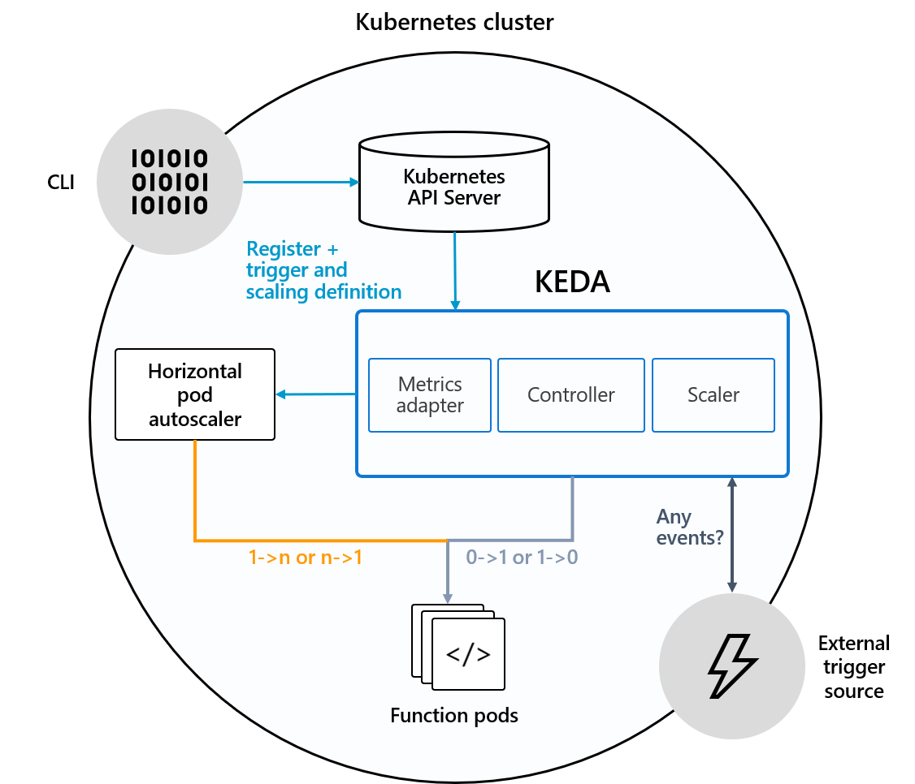
Keda (Kubernetes Event driven Auto-scaling)
Scale not by CPU/Memory usage, but based on number of message in a queue waiting for processing
Can save memory/cpu and decrease number of instances to 0 (ZERO) if no demand
In a case of big chunk of events come- can rapidly scale from zero to N.

Slide 10
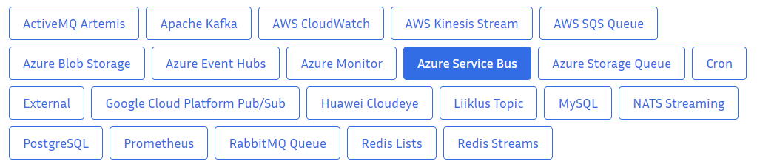
Scalers for KEDA

Slide 11
Kubernetes Network Plugins: Azure CNI vs Kubenet

Slide 12
Thank you! Questions!
https://github.com/SychevIgor/pronet

