Slide 1
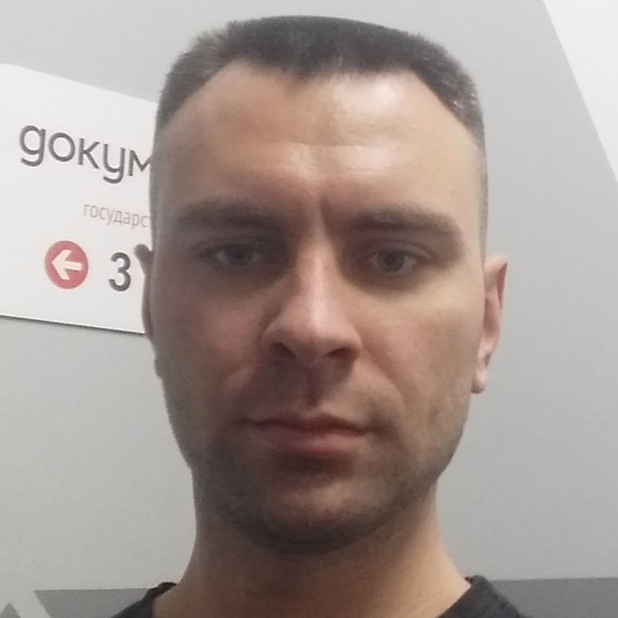
Some Aspects of Microservices in 2020
Igor Sychev
Solution Architect in MSTD BY
https://github.com/SychevIgor/pronet

Slide 2
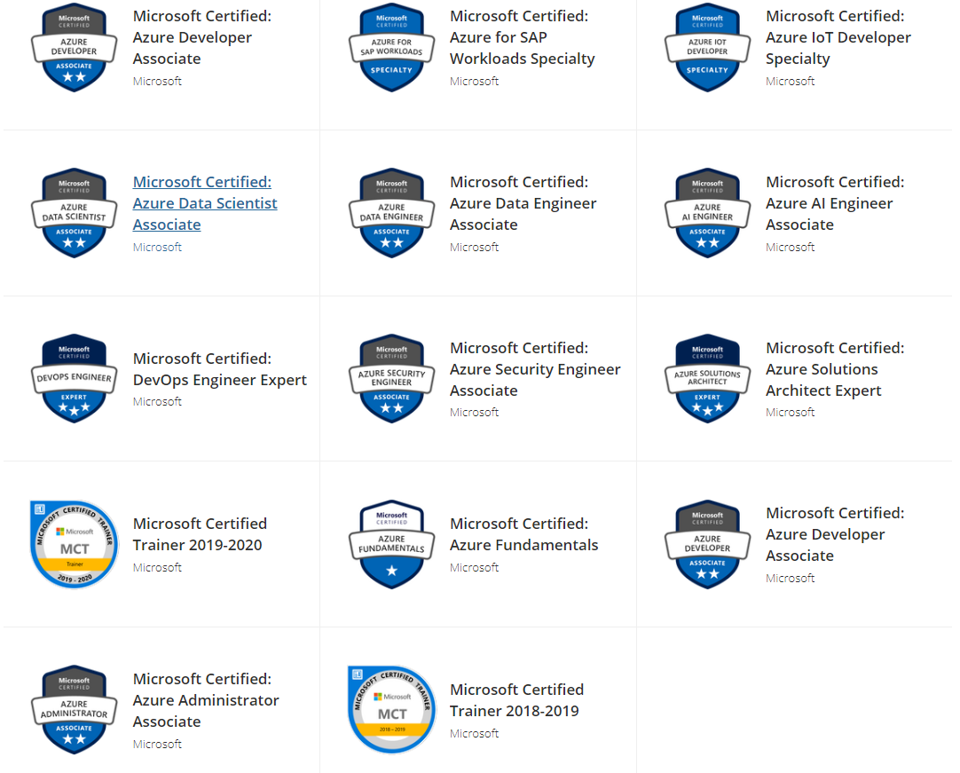
Igor Sychev. Solution Architect. Azure MVP
Azure Certified
Solution Architect
DevOps
Security Engineer
Developer
Administrator
AI Engineer
Data Engineer
Data Scientist
IoT Developer
SAP Specialist
Fundamentals
Notes:
Worked with big chunk of Azure services and can work with almost all existing Azure Services (IaaS/PaaS/Data/IoT)
https://www.youracclaim.com/users/igor-sychev/badges

Slide 3
Agenda

Slide 4
Scaling

Slide 5
Scale in/out (daily spikes handling) challenge
Option 1: scale in/out using ARM templates
Pro: always up-to-date parameters in a repo
Contr: multiple deployments per day (between 2 and N)
Option 2: autoscaling (multiple options to implement via Azure Automation or using Kubernetes operator)
Contr: in theory, against infrastructure as code approach.
Pro: active reaction on load.

Slide 6
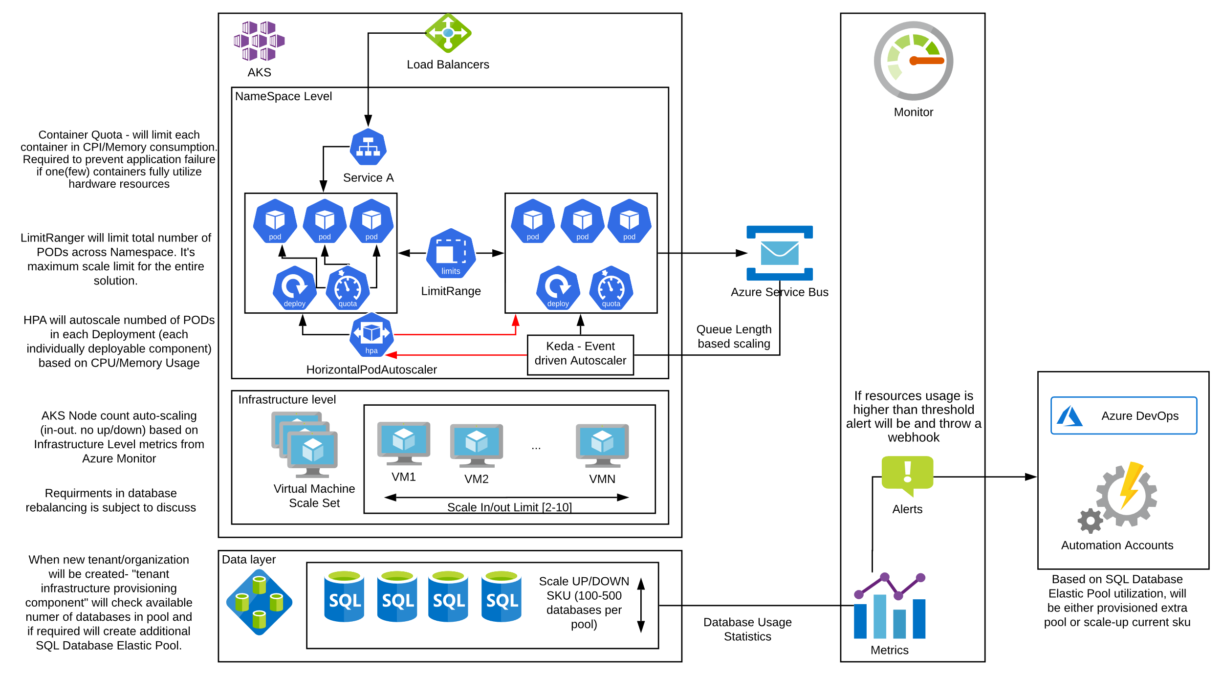
Auto-Scaling

Slide 7
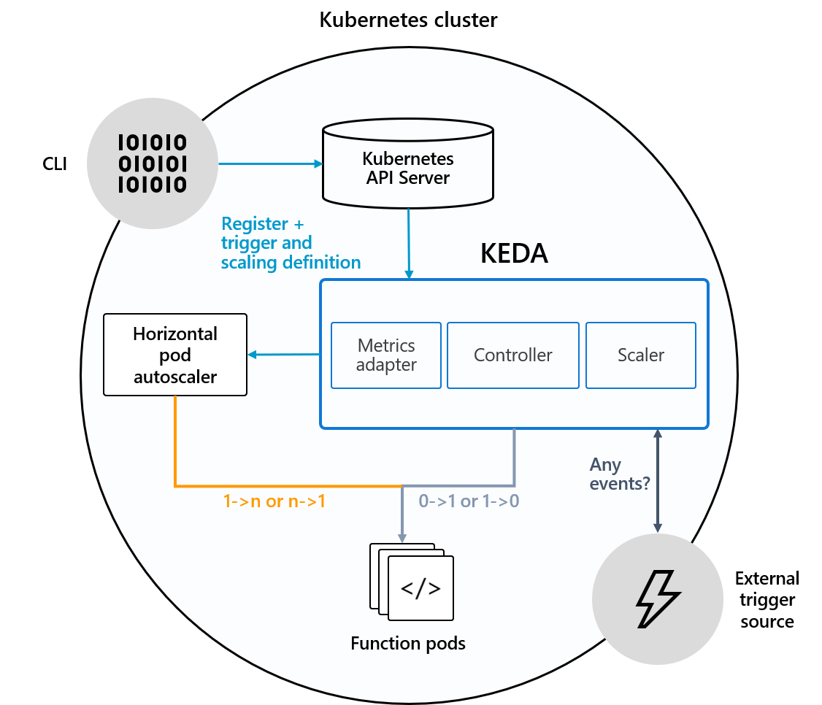
Keda (Kubernetes Event driven Auto-scaling)
Scale not by CPU/Memory usage, but based on number of message in a queue waiting for processing
Can save memory/cpu and decrease number of instances to 0 (ZERO) if no demand
In a case of big chunk of events come- can rapidly scale from zero to N.

Slide 8
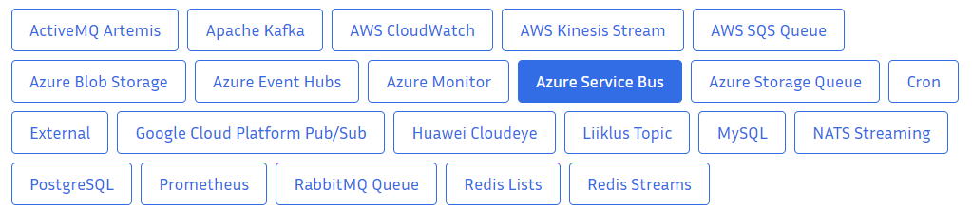
Scalers for KEDA

Slide 9
Kubernetes Network Plugins: Azure CNI vs Kubenet

Slide 10
Thank you! Questions!
https://github.com/SychevIgor/pronet

