Slide 1
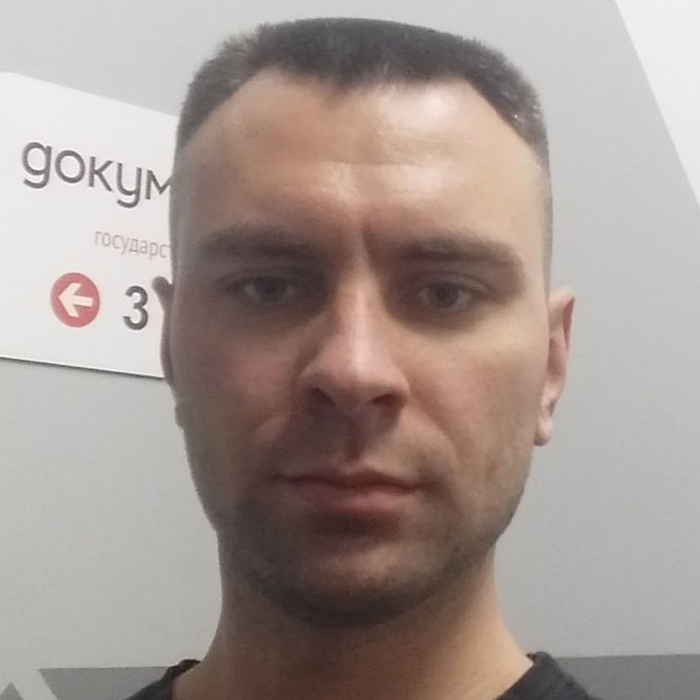
Some Aspects of Microservices in 2020
Igor Sychev
Solution Architect in MSTD BY
https://github.com/SychevIgor/pronet

Slide 2
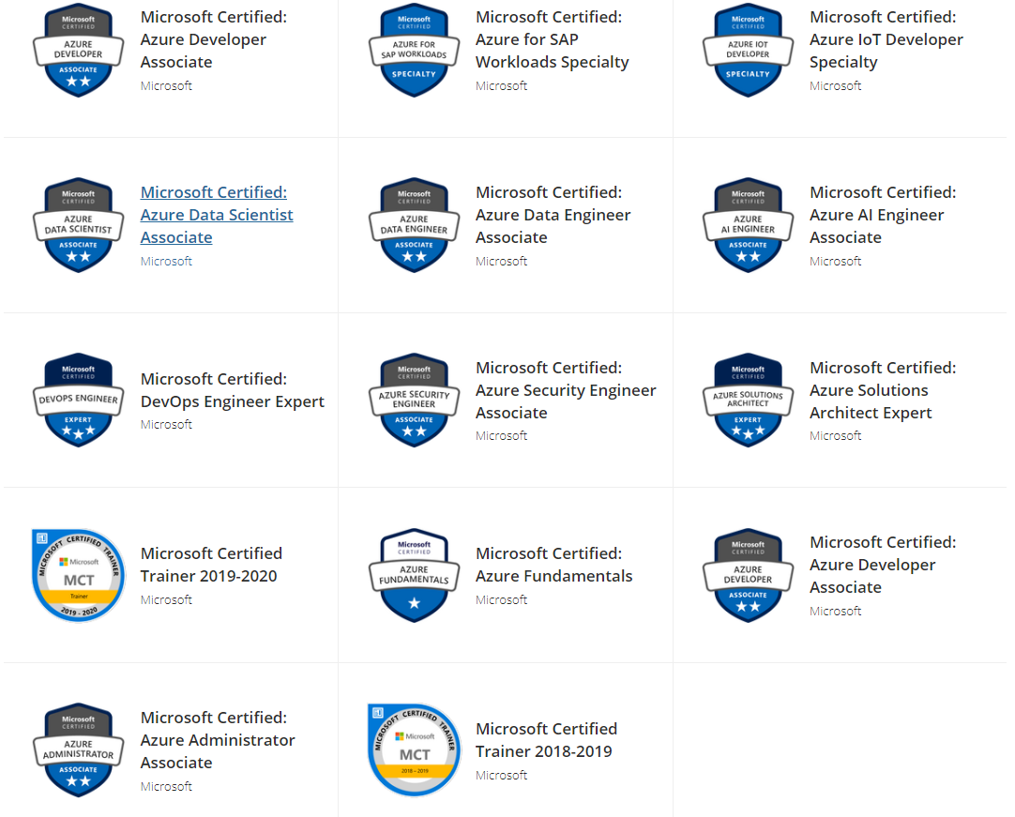
Igor Sychev. Solution Architect. Azure MVP
Azure Certified
Solution Architect
DevOps
Security Engineer
Developer
Administrator
AI Engineer
Data Engineer
Data Scientist
IoT Developer
SAP Specialist
Fundamentals
Notes:
Worked with big chunk of Azure services and can work with almost all existing Azure Services (IaaS/PaaS/Data/IoT)
https://www.youracclaim.com/users/igor-sychev/badges

Slide 3
Agenda

Slide 4
Azure Spring Cloud
Azure Spring Cloud is a platform on top of AKS
All AKS internals hidden from developers/devops
But developers don’t see value in “black box” that can’t be really manage.

Slide 5
Azure Functions SDK + Kubernetes + Keda
Host Functions App on AKS instead of Azure Functions
Azure Functions Consumption plan - don’t give SLA on delay between event and execution.
Azure Function App Service plan – require to allocate resources in advance and “elastic scaling” lost
Azure Functions – cold start problem
Azure Function Premium plan – solves cold start problem, but cost will be higher
Functions SDK can be used but packaged as docker image and hosted on AKS. Scaled using KEDA

Slide 6
Why not OPENFAAS
It’s really easy to deploy in a first time, but to be effective- still require learning.
Mandatory requirements to Functions Structure (port 8080, endpoint for heath) https://docs.openfaas.com/reference/workloads/#common-properties
Full ignore of Azure (AWS/GCP- at least mentioned)
No support for Azure Messaging services (event hub, event grid, service bus) and limited number of Triggers https://docs.openfaas.com/reference/triggers/
No SDKs/Strong type bindings. Everything as “string”
No Support of Azure DevOps
Scripts/CLI based CI/CD https://docs.openfaas.com/reference/cicd/intro/#github

Slide 7
Scaling

Slide 8
Scale in/out (daily spikes handling) challenge
Option 1: scale in/out using ARM templates
Pro: always up-to-date parameters in a repo
Contr: multiple deployments per day (between 2 and N)
Option 2: autoscaling (multiple options to implement via Azure Automation or using Kubernetes operator)
Contr: in theory, against infrastructure as code approach.
Pro: active reaction on load.

Slide 9
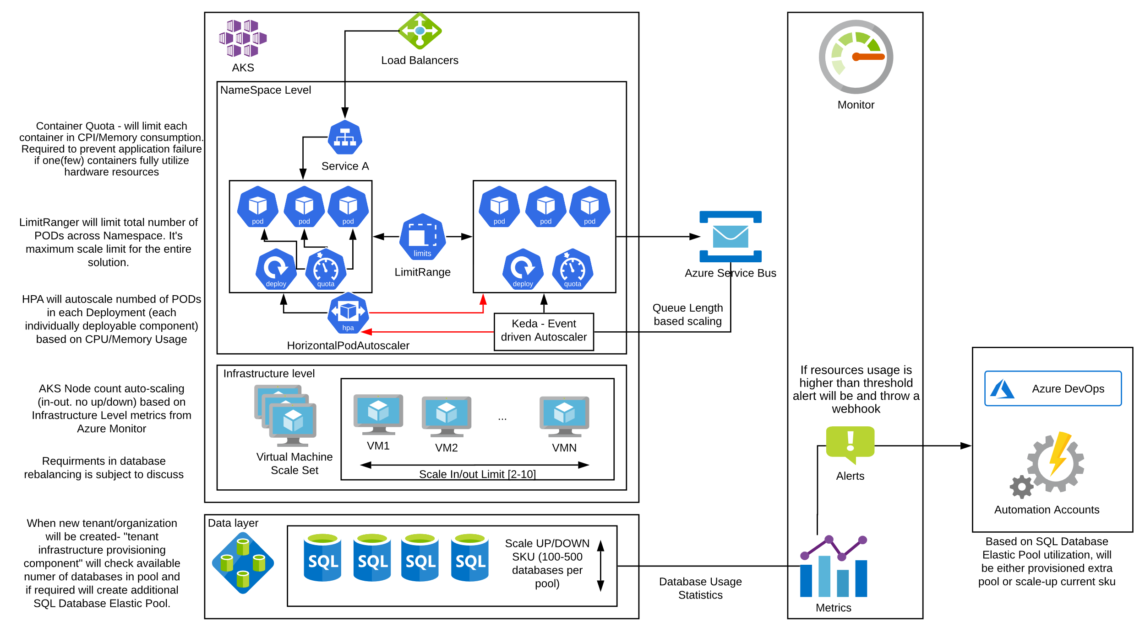
Auto-Scaling

Slide 10
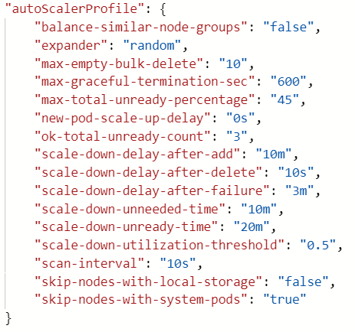
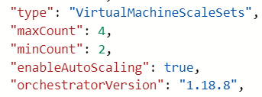
AKS auto-scaling
Need to enable on AKS and on VMSS pool
Challenges:
Can’t create multiple auto-scaler profiles (for app service – it’s possible)
How to scale more than one pool – unclear
Can’t scale by schedule (again - app service)
Can’t scale by memory (important for memory intensive services/platforms)
https://docs.microsoft.com/en-us/azure/aks/cluster-autoscaler#using-the-autoscaler-profile

Slide 11
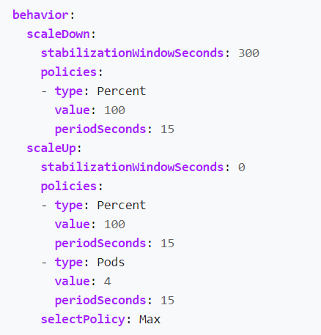
POD Autoscaling
There are 2 types of applications on AKS: with HTTP activation and Message-base activation. Both types will use limits https://kubernetes.io/docs/concepts/configuration/manage-resources-containers/ https://kubernetes.io/docs/concepts/policy/limit-range/
For Http Activation- will be used CPU based auto-scaling with limits on Deployment level
For Message base activation- will be used KEDA (Kubernetes Event-driven Autoscaling) https://keda.sh/docs/1.4/scalers/azure-service-bus/
Both types will be scaled utilizing Horizontal POD auto-scaler (HPA) https://kubernetes.io/docs/tasks/run-application/horizontal-pod-autoscale/
During Performance testing will be identified scaling metric thresholds (for example 70% CPU or queue length) and limits (for example between 3 and 10 PODs).

Slide 12
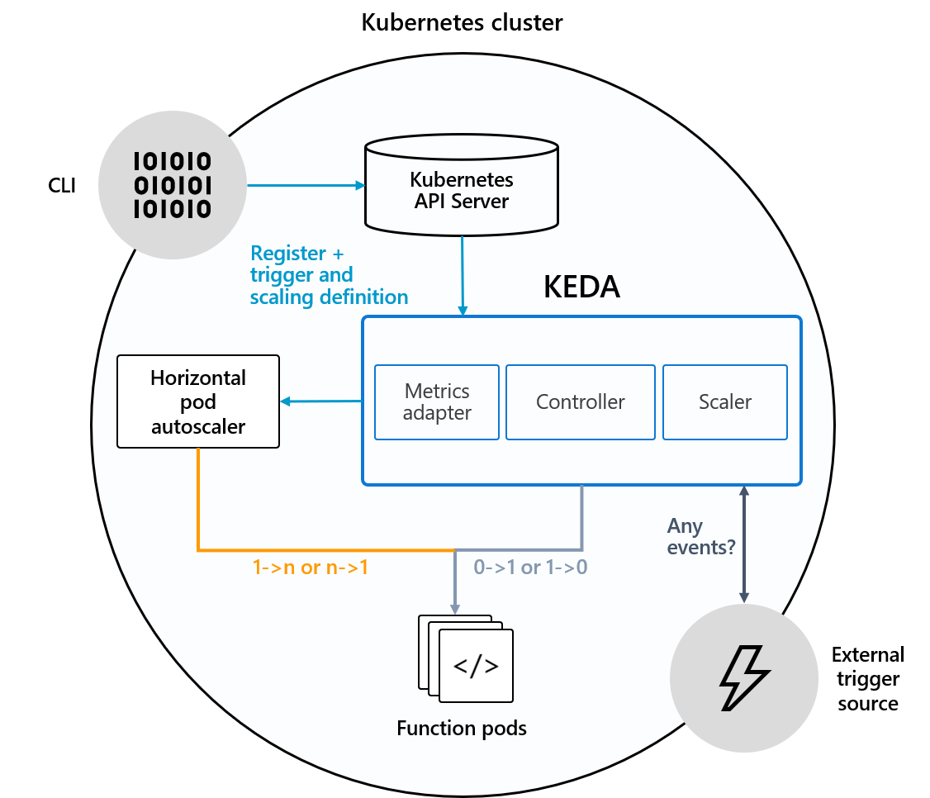
Keda (Kubernetes Event driven Auto-scaling)
Scale not by CPU/Memory usage, but based on number of message in a queue waiting for processing
Can save memory/cpu and decrease number of instances to 0 (ZERO) if no demand
In a case of big chunk of events come- can rapidly scale from zero to N.

Slide 13
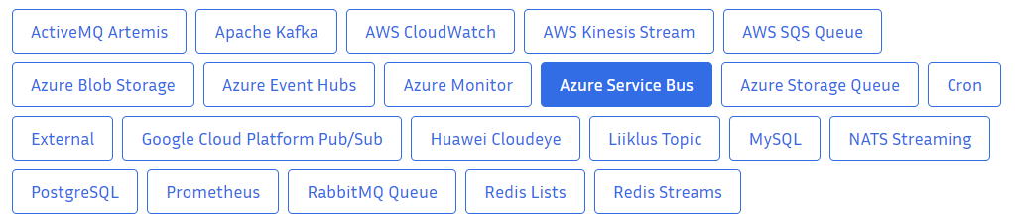
Scalers for KEDA

Slide 14
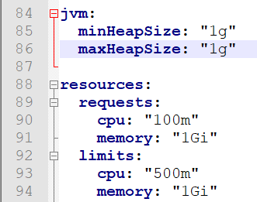
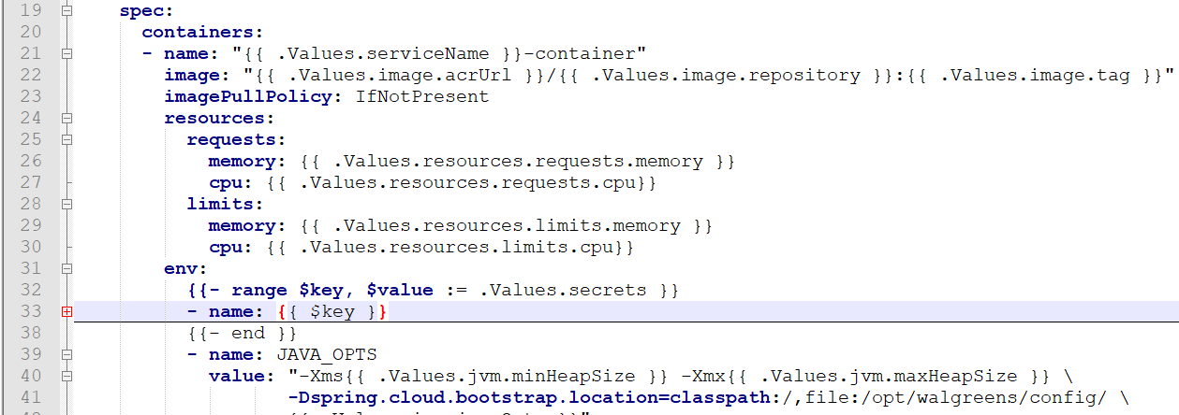
Kubernetes VM type/size selection
Previously mostly worked with .net core projects where memory was not a problem
In java, people wanna specify max heap size that sounds crazy for .net dev.
Traditionally for AKS used D_v2 VMs with CPU:Memory ration 1:3.5 or 1:4
that means that on each node can be run 4*X containers only that is not too high number
For non-production environments, when CPU used not too intensive – we can fall to “not enough memory” situation when CPU not consumed even on 10%. We need nodes with more memory to reduce costs

Slide 15
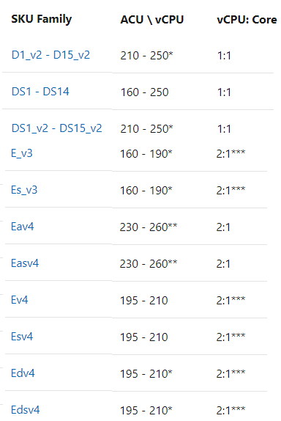
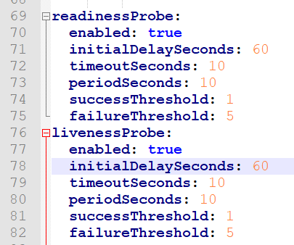
Kubernetes VM type/size selection 2
To solve it instead of D VMs could be used memory optimized VM type E, but E VMs could be slower per core due to Hyper-Threading or vCPU:CPU ratio.
E vms on 15% more expensive but will give twice more memory.
It’s a trade off- performance/costs/utilization
You need to be ready for this performance impact on start and response time.
For example- increase time before first health probe

Slide 16
Kubernetes Network Plugins: Azure CNI vs Kubenet
Microsoft in almost all guides advertising Azure CNI (Azure advanced networking plugin for k8s)
If AKS used Azure CNI – each POD will have IP address visible in azure virtual network
Advantage of Azure CNI:
can be connected to each POD by IP.
Default prerequisite in almost all Microsoft guide
Disadvantage of Azure CNI:
Azure VNET needs to be “ten times” bigger than for kubenet and customs with complex topology don’t want to provide big address space.
Typically, you need to create you own guide, because kubenet setup not documented by Microsoft.

Slide 17
Thank you! Questions!
https://github.com/SychevIgor/pronet

