Slide 1
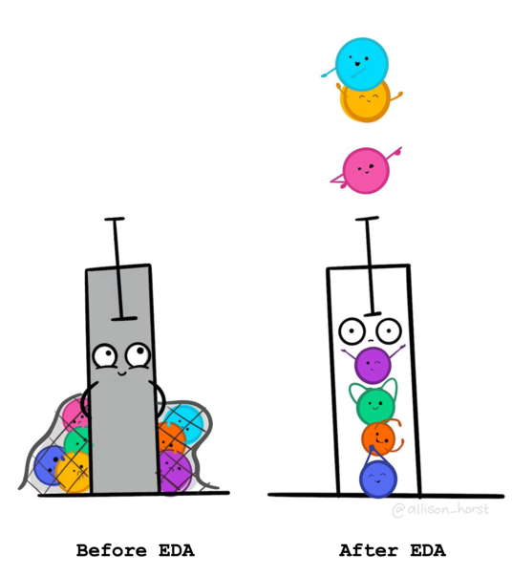
Getting Started with Exploratory Data Analysis (EDA) in R
Dr Giorgia Mori
Dr Darya Vanichkina
Sydney Informatics Hub (SIH)

Slide 2
Code of Conduct
To foster a positive and professional learning environment, we encourage the following kinds of behaviours at all our events and platforms:
Use welcoming and inclusive language
Be respectful of different viewpoints and experiences
Gracefully accept constructive criticism
Focus on what is best for the community
Show courtesy and respect towards other community members
Our full CoC, with incident reporting guidelines, is available at https://pages.github.sydney.edu.au/informatics/sih_codeofconduct/
Notes:
In line with the University of Sydney Codes of Conduct for staff and students,

Slide 3

The dataset
https://survey.stackoverflow.co/

Slide 4
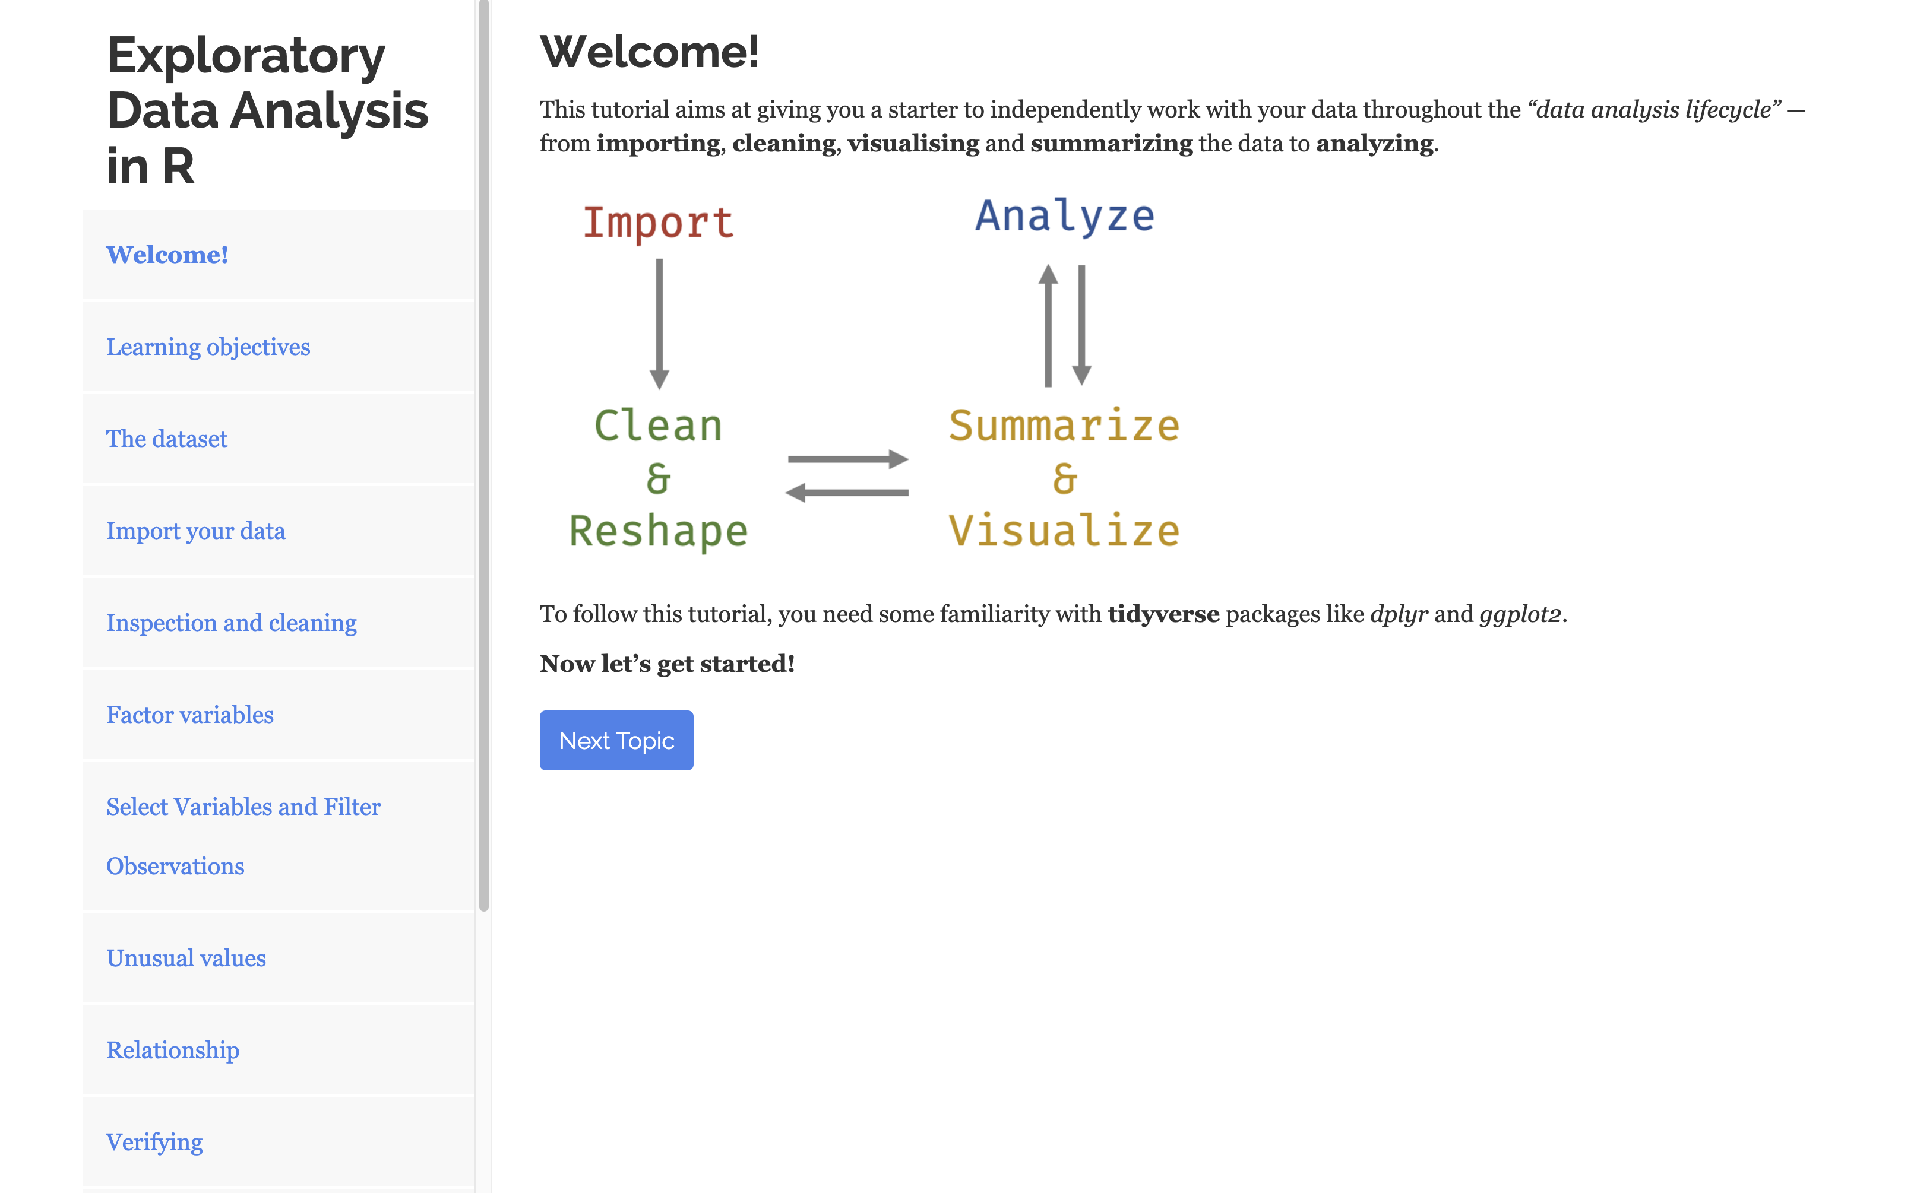
How to use the tutorial
Start Over
Notes:
These tutorials consist of content along with interactive components for checking and reinforcing understanding. Throughout the tutorials you will find:
Narrative, figures and illustrations;
Code exercises that you can edit and execute directly;
Quiz questions...
Each tutorial automatically preserve work done within them, so if you work on a few exercises or questions and then return to the tutorial later, you can pick up right where you have left off.
Each tutorial includes a Table of Contents and it reveals content one sub-section at a time:

Slide 5
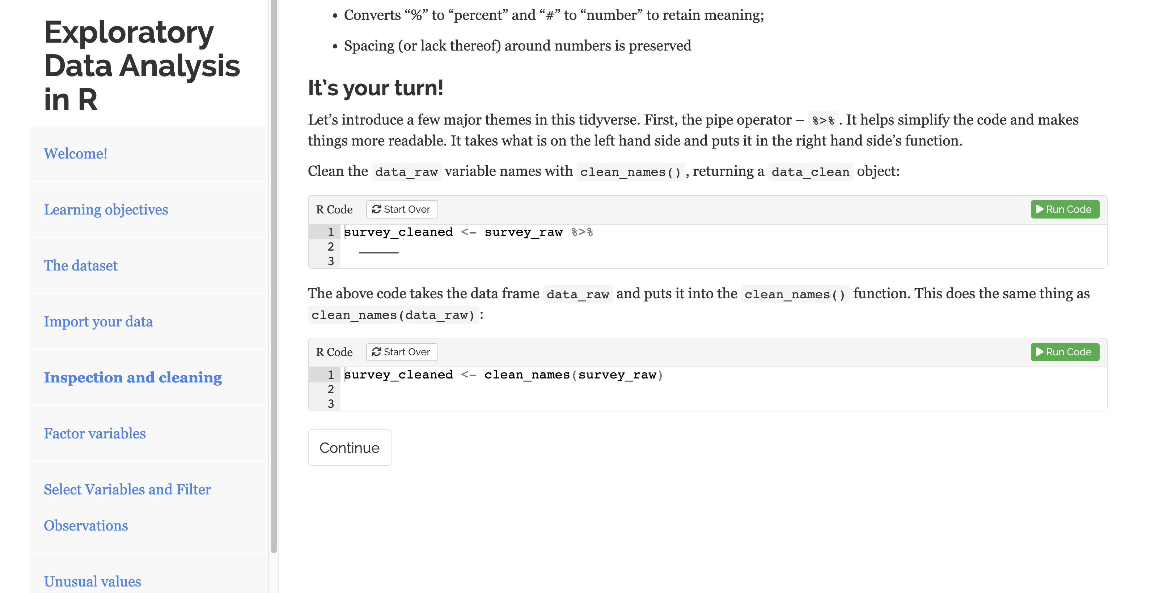
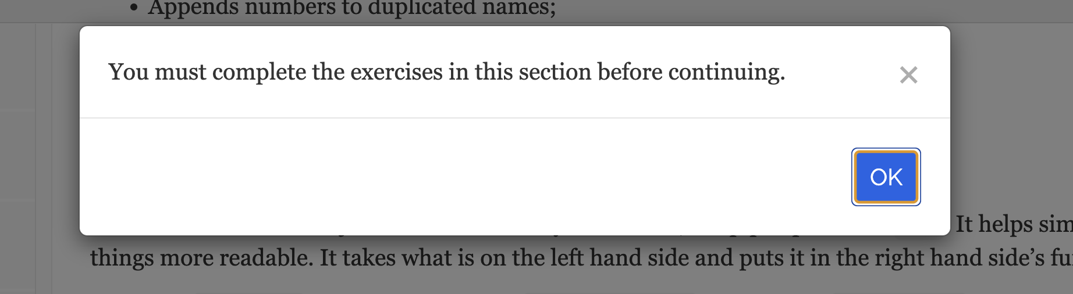
How to use the tutorial

Slide 6
It’s your turn!
Form “teams” within your table;
Share your backgrounds with R and data;
Start the tutorial!

Slide 7
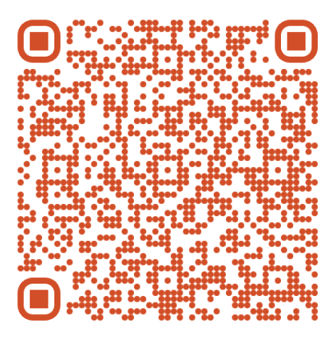
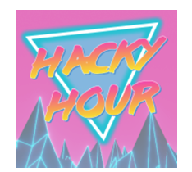


Your feedback is important!
sih.training@sydney.edu.au
https://www.youtube.com/@sydneyinformaticshub1170
Notes:
https://redcap.sydney.edu.au/surveys/?s=FJ33MYNCRR&training=83&training_date=2024-05-02

