Slide 1
Exploratory Data Analysis in R
Dr Angus Fisk
Dr Eden Zhang
Dr Rose Smail
sydney.edu.au/research/facilities/sydney-informatics-hub.html

Slide 2
Acknowledgement of country

Slide 3
Code of Conduct
To foster a positive and professional learning environment, we encourage the following kinds of behaviours at all our events and platforms:
Use welcoming and inclusive language
Be respectful of different viewpoints and experiences
Gracefully accept constructive criticism
Focus on what is best for the community
Show courtesy and respect towards other community members
Our full CoC, with incident reporting guidelines, is available at https://pages.github.sydney.edu.au/informatics/sih_codeofconduct/

Slide 4



Who we are - Sydney Informatics Hub
USER NOTE:
Add alt text for images that convey information. Otherwise, mark them as decorative.
Dr Angus Fisk
Dr Rose Smail
Dr Eden Zhang
Veterinarian
DPhil in sleep at Oxford
Physicist
PhD in physics at Adelaide
Data Scientist
PhD Ecological Conservation

Slide 5
Overview
What is Exploratory Data Analysis?
Load, view and select data in R
Plotting data
Tidy data format
Missing data
Outliers
Saving data

Slide 6
What is exploratory data analysis?
Research Question
Data Question

Slide 7
Exercise
What is your research question?
What is your data question?
Put in google doc

Slide 8
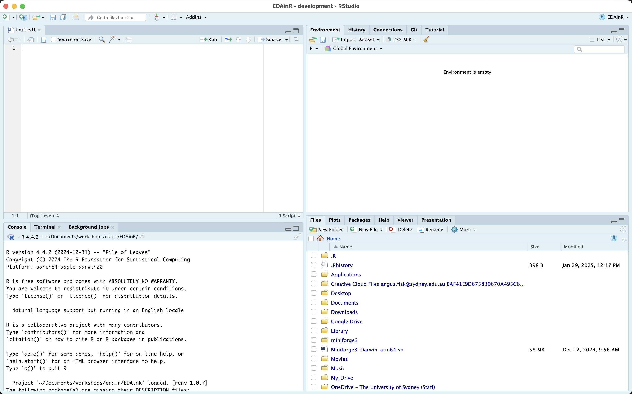
Where to start?

Slide 9
Import the data
read_csv()
~/path/to/data.csv

Slide 10
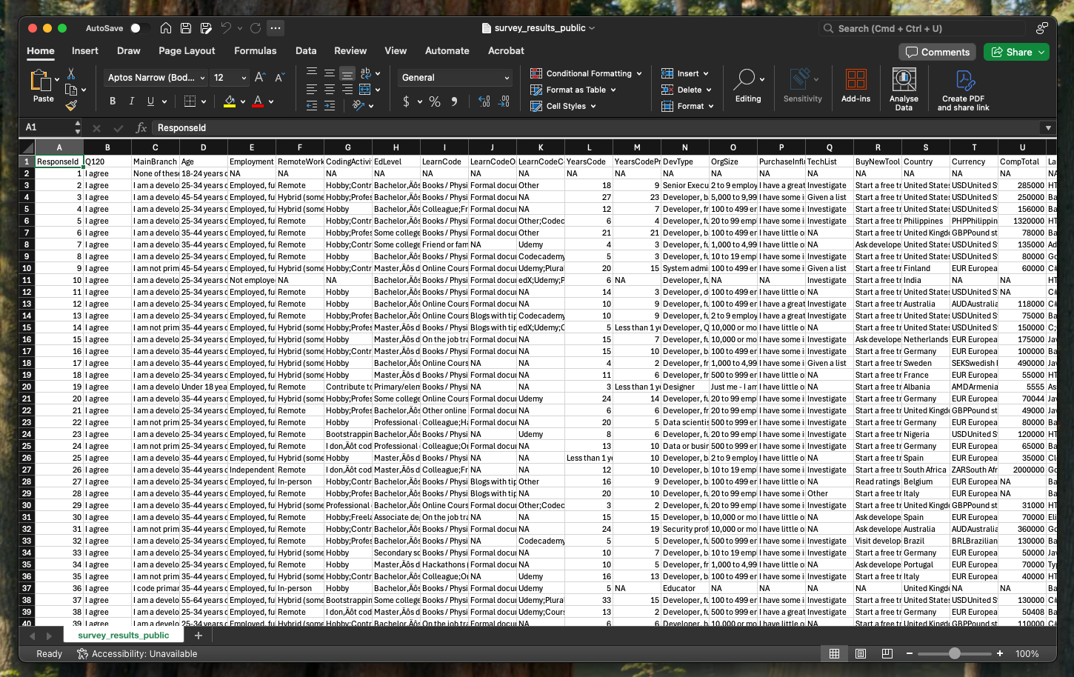
How to view data
USER NOTE:
When adding in a chart, use the default chart style ‘Style 1’. Add alt text and data labels for accessibility.

Slide 11
How to view data
USER NOTE:
When adding in a chart, use the default chart style ‘Style 1’. Add alt text and data labels for accessibility.

Slide 12
How to view data
head()
tail()
colnames()
rownames()

Slide 13
How to view data
Code it!

Slide 14
What are we doing with this data?
StackOverflow Survey Data
Can we predict salary?

Slide 15
Plotting data
Visualise data
Sanity check

Slide 16
Plotting data
ggplot()
Needs aes()
geom_?()
geom_histogram()
geom_point()

Slide 17
Plotting data
Code it!

Slide 18
Exercise
Make a plot!
Use colnames to choose variables
What does this plot mean?
Put answers in google doc

Slide 19
How to select data
Column
Row
Range
Based on label

Slide 20
How to select data
By number?
Rows?
dplyr::slice()
Columns?
dplyr::select()

Slide 21
How to select data
single value
slice(1)
range
slice(1:5)
specific values
slice(c(1,5,10))

Slide 22
How to select data
By name?
Columns
dplyr::select()
data$name
data[name]
Rows
data[name,]

Slide 23
How to select data
Code it!

Slide 24
Exercise
Select the data on your birthday!
Months are columns
Days are rows
Put answer + code in google doc

Slide 25
How to select data
Filter()
filter(column=condition)
filter(column1=condition1 & column2=condition2)

Slide 26
How to alter data
data$column <- value
filter with mutate()
ifelse( condition, value if true, value if false )

Slide 27
Exercise
Change everyone older to you to “old”
filter the data so you only see
younger than you
older than you

Slide 28
Break

Slide 29
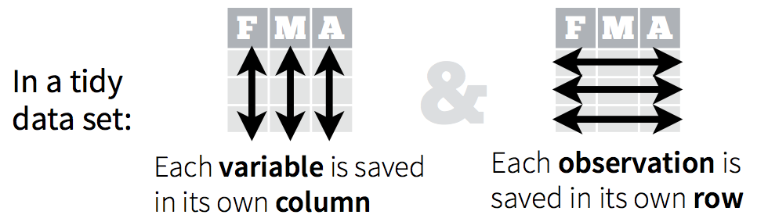
What we want data to look like?
USER NOTE:
When adding in a chart, use the default chart style ‘Style 1’. Add alt text and data labels for accessibility.

Slide 30
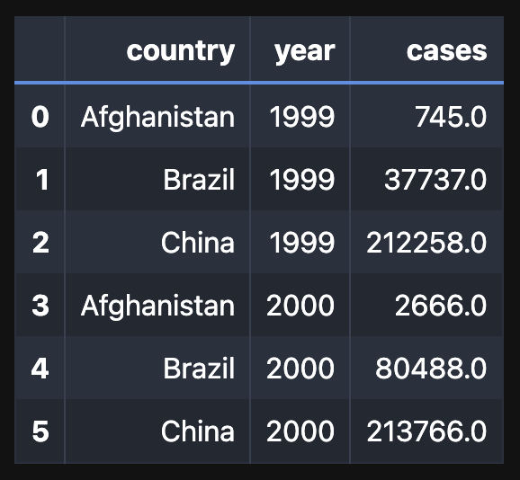
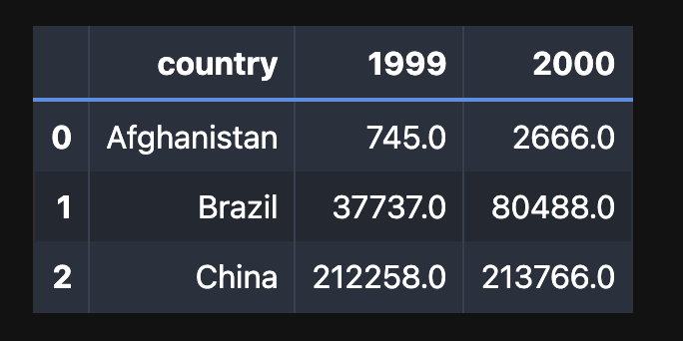
Which is tidy?
USER NOTE:
When adding in a chart, use the default chart style ‘Style 1’. Add alt text and data labels for accessibility.

Slide 31
How to reformat
USER NOTE:
When adding in a chart, use the default chart style ‘Style 1’. Add alt text and data labels for accessibility.
pivot_longer()

Slide 32
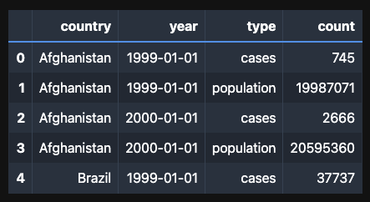
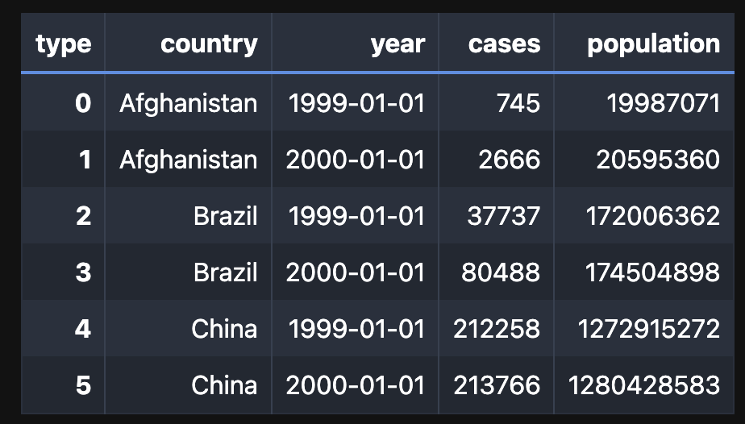
How to reformat
USER NOTE:
When adding in a chart, use the default chart style ‘Style 1’. Add alt text and data labels for accessibility.

Slide 33
How to reformat
USER NOTE:
When adding in a chart, use the default chart style ‘Style 1’. Add alt text and data labels for accessibility.
pivot_wider()

Slide 34
How to reformat
Code it

Slide 35
Exercise
Use relig_income data
Reformat to tidy data

Slide 36
How to clean the data
Missing data
Duplicates
Data types
Outliers

Slide 37
Missing data
NaN <- .is.na()
0 <- ?
999 <- ?
-1 <- ?

Slide 38
Missing data
Ignore
Remove
Replace

Slide 39
Duplicates
Count unique values
Remove

Slide 40
Exercise
Use air quality dataset
Check for missing values and duplicate values
Fix them

Slide 41
Data types
Numeric
Logical
Factors
Character
Datetime

Slide 42
Data types
class()
mutate( ….. as type () )

Slide 43
Exercise
What are data types?
What should they be?
response_id
age
currency
coding activities
knowledge_1

Slide 44
Visualise and summarise data
Plot
describe

Slide 45
Outliers?
How to find them?

Slide 46
Outliers?
Ignore
Remove
Replace
Document

Slide 47
Your turn
Find outliers
Fix them

Slide 48
How to save your data
data.to_csv(‘~/path/to/data_clean.csv’)

Slide 49
Questions?
What was not clear?
What is your next step with your own data?

Slide 50
End slide with university and social links
Sydney Informatics Hub
Dr Angus Fisk
Dr Eden Zhang
Dr Rose Smail
first.last@sydney.edu.au
angus.fisk@sydney.edu.au

Slide 51
How to summarise the data
What do you want to know?
Description
Correlation
Distributions
Notes:
Bonus if we have time

