Slide 1
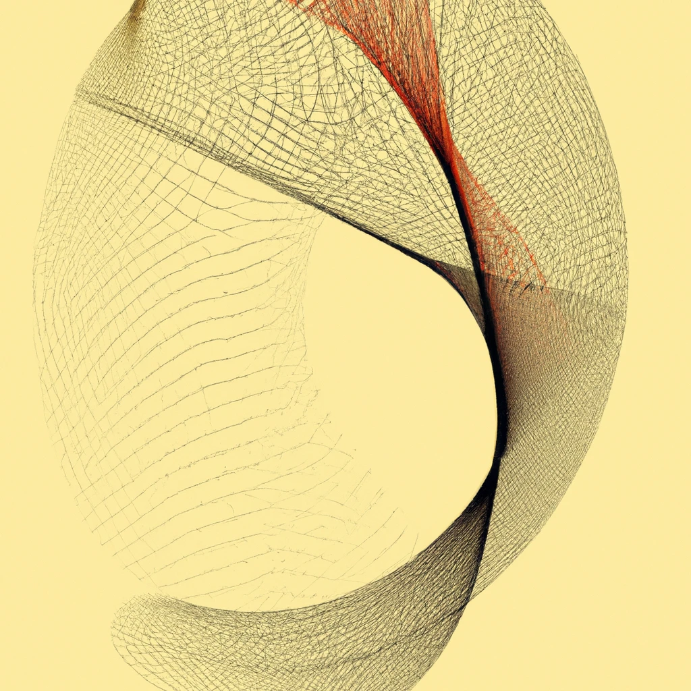
Getting Started with Machine Learning in R
Dr Giorgia Mori
Dr Eden Zhang
Sydney Informatics Hub

Slide 2
Sydney Informatics Hub Empowering researchers with modern data & computational methods
Consultation
Grant application support
Data Science, ML, modelling & analytics
Hacky Hour
Training
Research compute platforms
Research Computing
High performance computing
Bioinformatics & genomics
Modelling & visualisation
Computing training
Statistical Consulting
1-on-1 consultancy for HDR-level and above.
Experiment and survey design.
Statistical model development and testing
Statistics training
Data Science & SWE
Consulting and project collaboration providing analysis & software development for data-driven research.
Notes:
Among the services that we offer, we provide access to research infrastructure such as high-performance computing and storage, supporting researchers by providing data analysis expertise, and building data communities with events such as hacky hours, seminars, and training events like this one.

Slide 3
Code of Conduct
We expect all attendees of our training to follow the University of Sydney’s Staff and Student Codes of Conduct, including the Bullying, harassment and discrimination prevention policy.
To foster a positive and professional learning environment, we encourage the following kinds of behaviours at all our events and platforms:
Use welcoming and inclusive language
Be respectful of different viewpoints and experiences
Gracefully accept constructive criticism
Focus on what is best for the community
Show courtesy and respect towards other community members
Our full CoC, with incident reporting guidelines, is available at https://pages.github.sydney.edu.au/informatics/sih_codeofconduct/
Notes:
In line with the University of Sydney Codes of Conduct for staff and students,

Slide 4
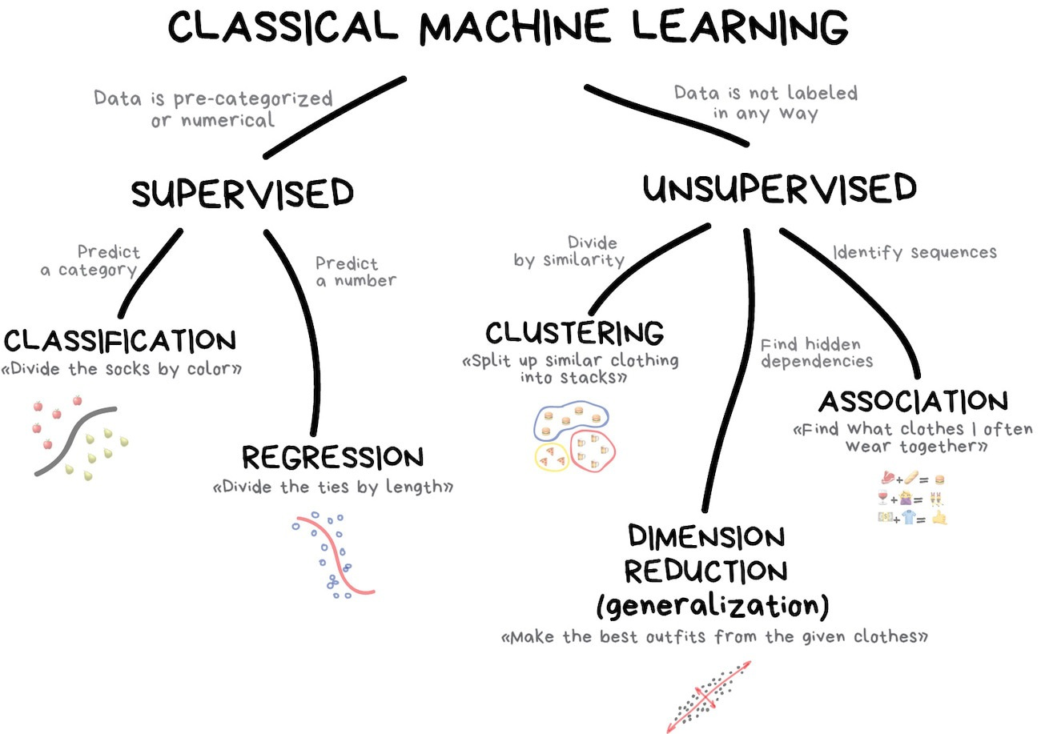
What is machine learning?
Notes:
Classical machine learning is often divided into two categories – Supervised and Unsupervised Learning.
In the first case, the machine has a "supervisor" or a "teacher" who gives the machine all the answers, like whether it's a cat in the picture or a dog. The teacher has already divided (labeled) the data into cats and dogs, and the machine is using these examples to learn. One by one. Dog by cat.
Unsupervised learning means the machine is left on its own with a pile of animal photos and a task to find out who's who. Data is not labeled, there's no teacher, the machine is trying to find any patterns on its own.
Clearly, the machine will learn faster with a teacher, so it's more commonly used in real-life tasks. There are two types of such tasks: classification – an object's category prediction, and regression – prediction of a specific point on a numeric axis.

Slide 5
The whole game
Part of any modelling process is
Splitting your data into training and test set
Using a resampling scheme
Fitting models
Assessing performance
Choosing a model
Fitting and assessing the final model
Notes:
Things you are going to practice in the tutorial

Slide 6
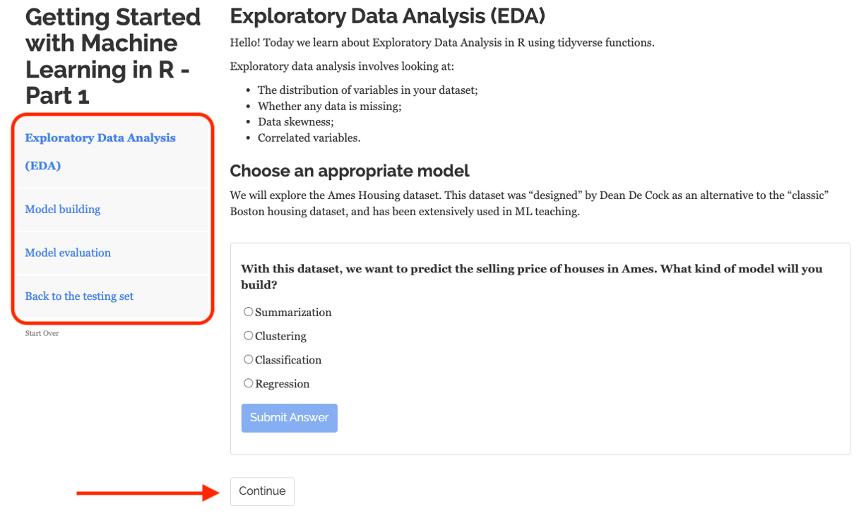
How to use the tutorial
Notes:
These tutorials consist of content along with interactive components for checking and reinforcing understanding. Throughout the tutorials you will find:
Narrative, figures and illustrations;
Code exercises that you can edit and execute directly;
Quiz questions...
Each tutorial automatically preserve work done within them, so if you work on a few exercises or questions and then return to the tutorial later, you can pick up right where you have left off.
Each tutorial includes a Table of Contents and it reveals content one sub-section at a time:

Slide 7
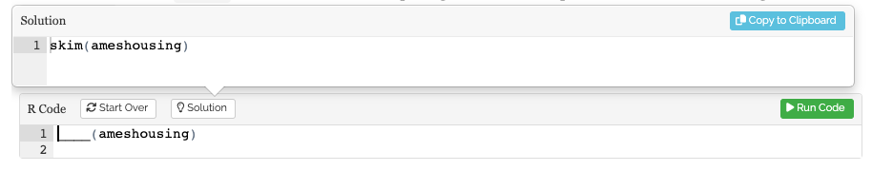
How to use the tutorial
Notes:
Exercises are interactive R code chunks that allow you to directly execute R code and see its results. When a solution code chunk is provided, there will be a Solution button on the exercise that you can click if you are stuck:

Slide 8

Asking for Help
I need help with my computer
I need help understanding something
(which likely means others do too)

Slide 9
Your turn!
Form teams within your table;
Share your backgrounds with R, data, and Machine Learning;
Start the tutorial!

Slide 10






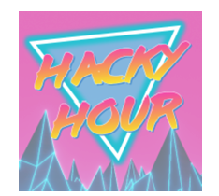
Learn with us!
Sydney Informatics Hub Yammer
@Sydney_CRF
sih.training@sydney.edu.au
https://www.youtube.com/@sydneyinformaticshub1170
https://github.com/Sydney-Informatics-Hub
Notes:
Part 1: https://redcap.sydney.edu.au/surveys/?s=FJ33MYNCRR&training=75&training_date=2023-10-18
Part 2: https://redcap.sydney.edu.au/surveys/?s=FJ33MYNCRR&training=76&training_date=2023-10-19
Part 3: https://redcap.sydney.edu.au/surveys/?s=FJ33MYNCRR&training=77&training_date=2023-10-25

