Slide 1
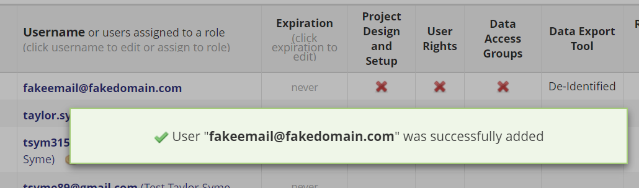
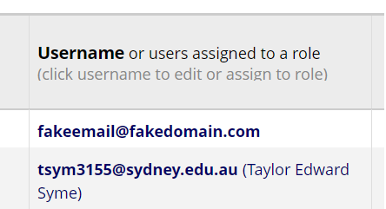
REDCap tells a lie. Typing in a name or email into the Add User box and hitting enter will not add someone, despite messages on the contrary.
Unsuccessful
Successful
To correctly add users, select them from the dropdown menu. Correctly-added users will have their name appear in brackets.

