Slide 1
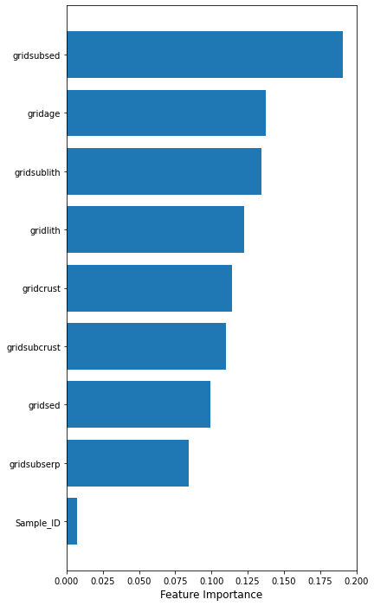
LOCATIONS dfnegsub 713 rows × 9 columns dfsub 851 rows × 9 columns RF 10-fold cross validation Scores: [0.841 0.885 0.79 0.783 0.821 0.808 0.628 0.667 0.596 0.654] SCORE Mean: 0.75 STD: 0.10

Slide 2
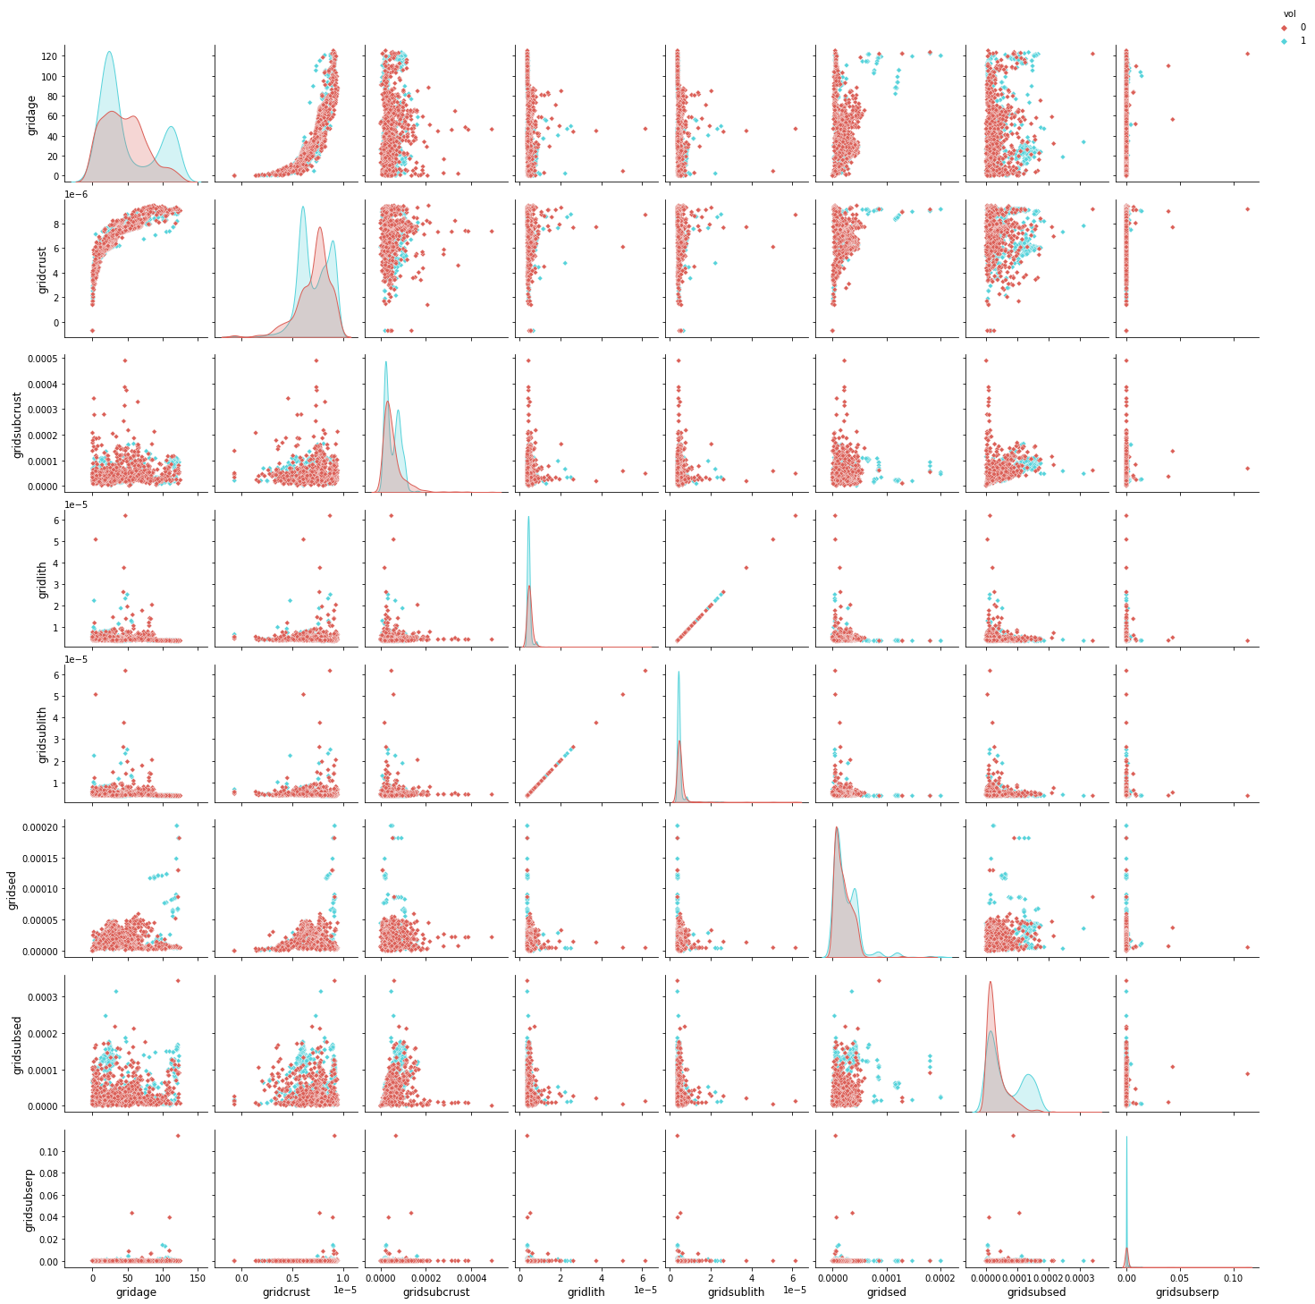

Slide 3
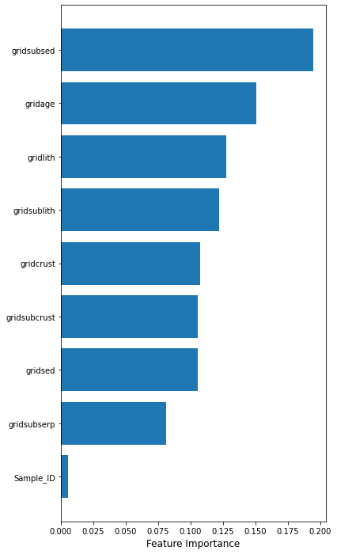
LOCATIONS2 dfnegsub 717 rows × 9 columns dfsub 851 rows × 9 columns RF 10-fold cross validation Scores: [0.847 0.873 0.803 0.777 0.841 0.834 0.669 0.682 0.635 0.705] SCORE Mean: 0.77 STD: 0.08

Slide 4
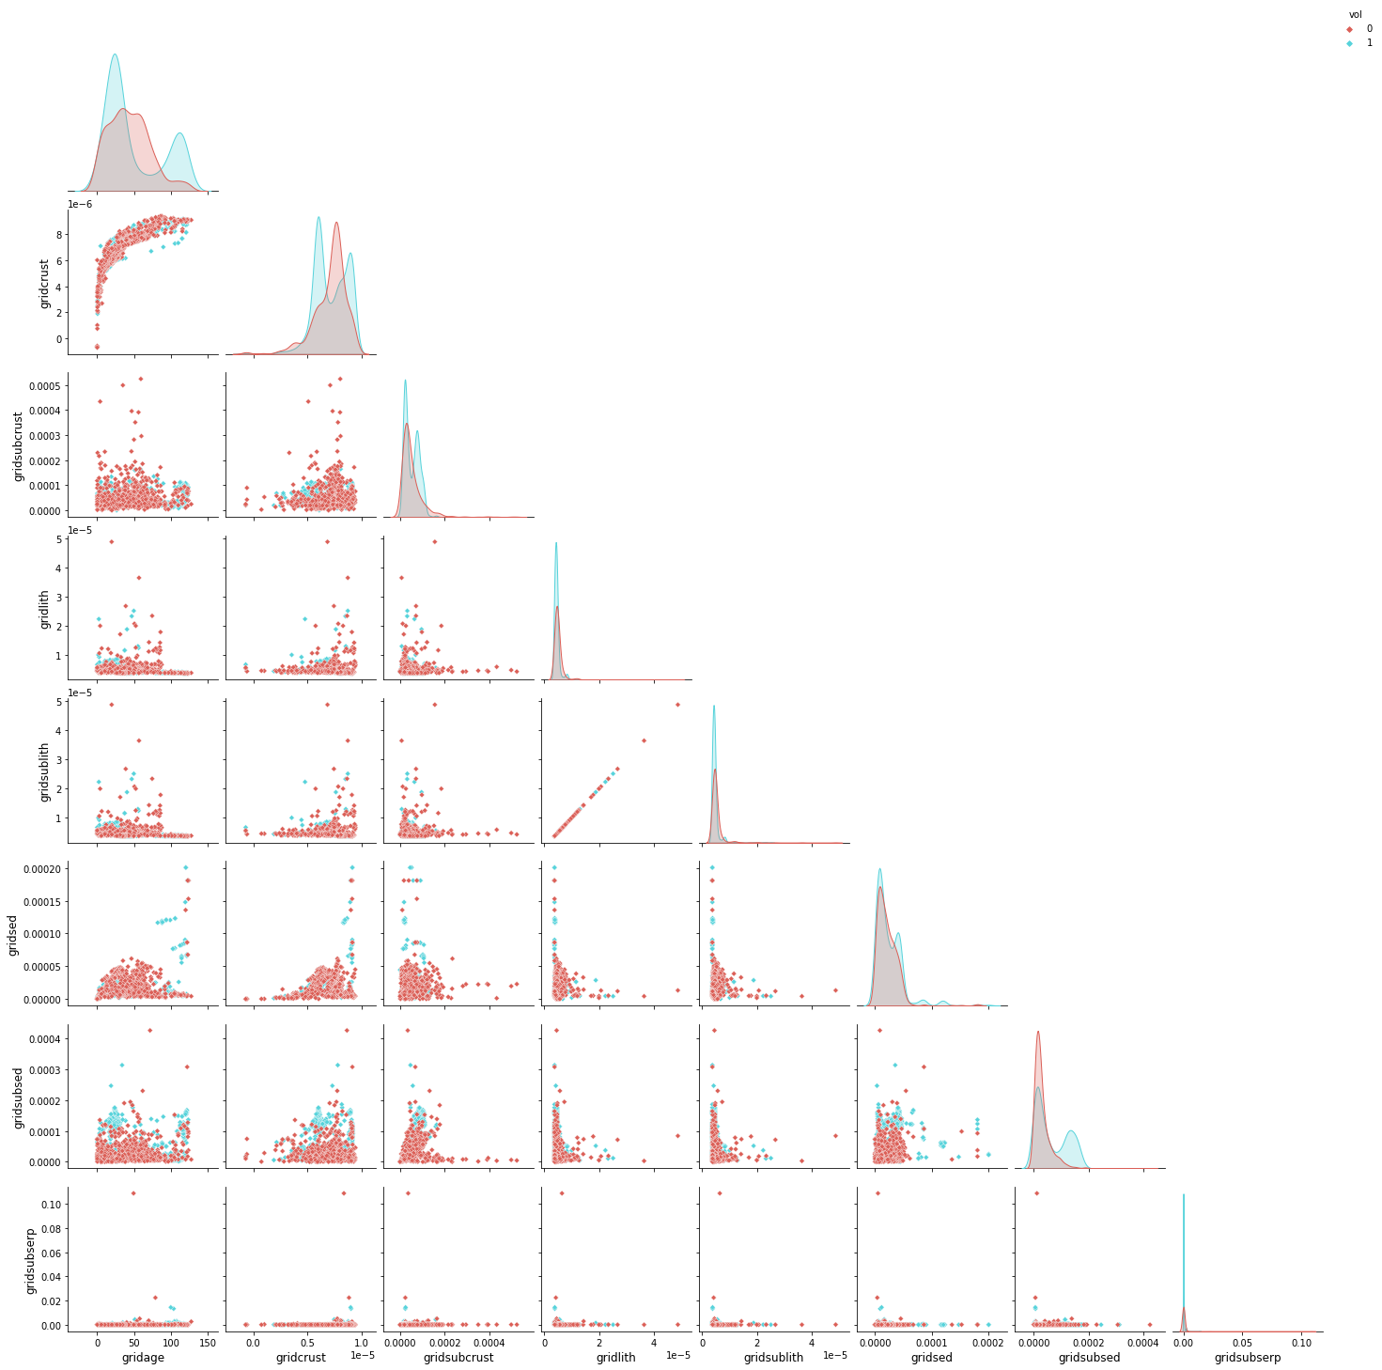

Slide 5
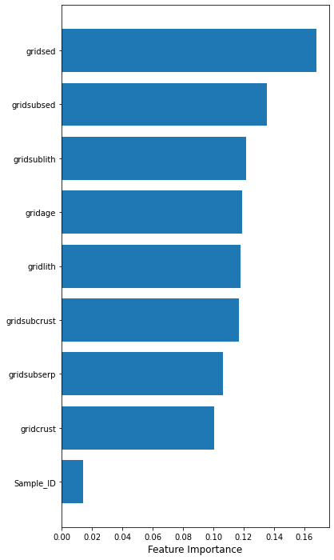
AGES dfnegsub 338 rows × 9 columns dfsub 851 rows × 9 columns RF 10-fold cross validation Scores: [0.723 0.681 0.555 0.571 0.521 0.613 0.672 0.538 0.395 0.22 ] SCORE Mean: 0.55 STD: 0.14

Slide 6
