Slide 1
ML Results
Dataset | Highest Cross-Validation Scroe | ML method with highest score | Benchmark Score
C02 | 30 | Ensemble Kspace KNN | 20
Hf | 31 | Ensemble RUBoostedTrees | 20
Nd | 39.7 | Ensemble Bagged Trees | 20
Nd143Nd144 | 47.4 | Ensemble Bagged Trees | 20
Pb207_Pb204 | 43.4 | Ensemble RUBoosted Trees | 20
Hf176_Hf177 |  | Not enough data | 20
negloc | 82.2 | Ensemble Bagged Trees | 50
negages | 81.9 | Ensemble Boosted Trees | 50

Slide 2
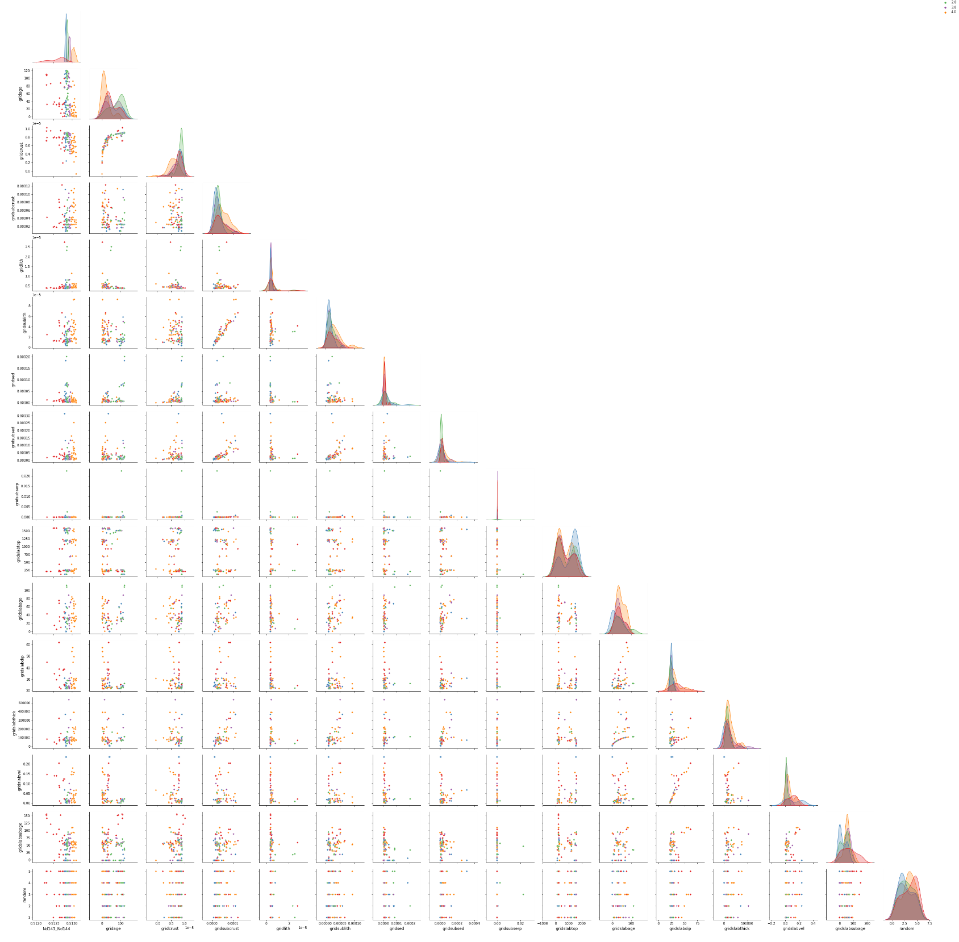

Histogram of Nd143/Nd144 (and all the plots of Nd143/Nd1444 vs X) show 80% of samples have a ratio above 0.5128. But there is a long tail of ratios below 0.5128. The 5 bins (5 colour groups) are chosen by panda’s qcut.
Nd143/Nd144 variables pairplot and histogram
Carbon in the crust VS Age of Subducted lithosphere $√age$ relationship between the two variables.
Also two obvious clusters of Nd143/Nd144 ratios – high Nd143/Nd144 ratios (orange dots) are associated with relatively young lithospheric age and low crustal carbon and medium Nd143/144 ratios (green dots) and high crustal carbon and older lithospheric age.
You can see these two peaks in the standing out in the gridage and gridcrust histogram too.
You could probably break these down into more intelligent groups (instead of the 5 bins used here).

Slide 3
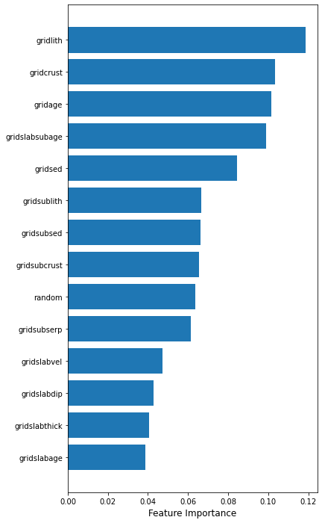
Any feature significantly above the “random” benchmark, in terms of feature importance, I would interpret as aiding classification of each point into their Nd143/Nd144 cluster. Anything below that is likely garbage (for whatever reason, bad data, too many nans, genuinely no physical relationship, etc).
The “gridage” and the “gridcrust” (thankfully) have a significant feature importance for classifying whether a volcanic sample will have a high or low Nd143/Nd144 ratio (i.e. which Nd143/Nd144 cluster the point fits into).
Nd143/Nd144 variable feature importance

Slide 4
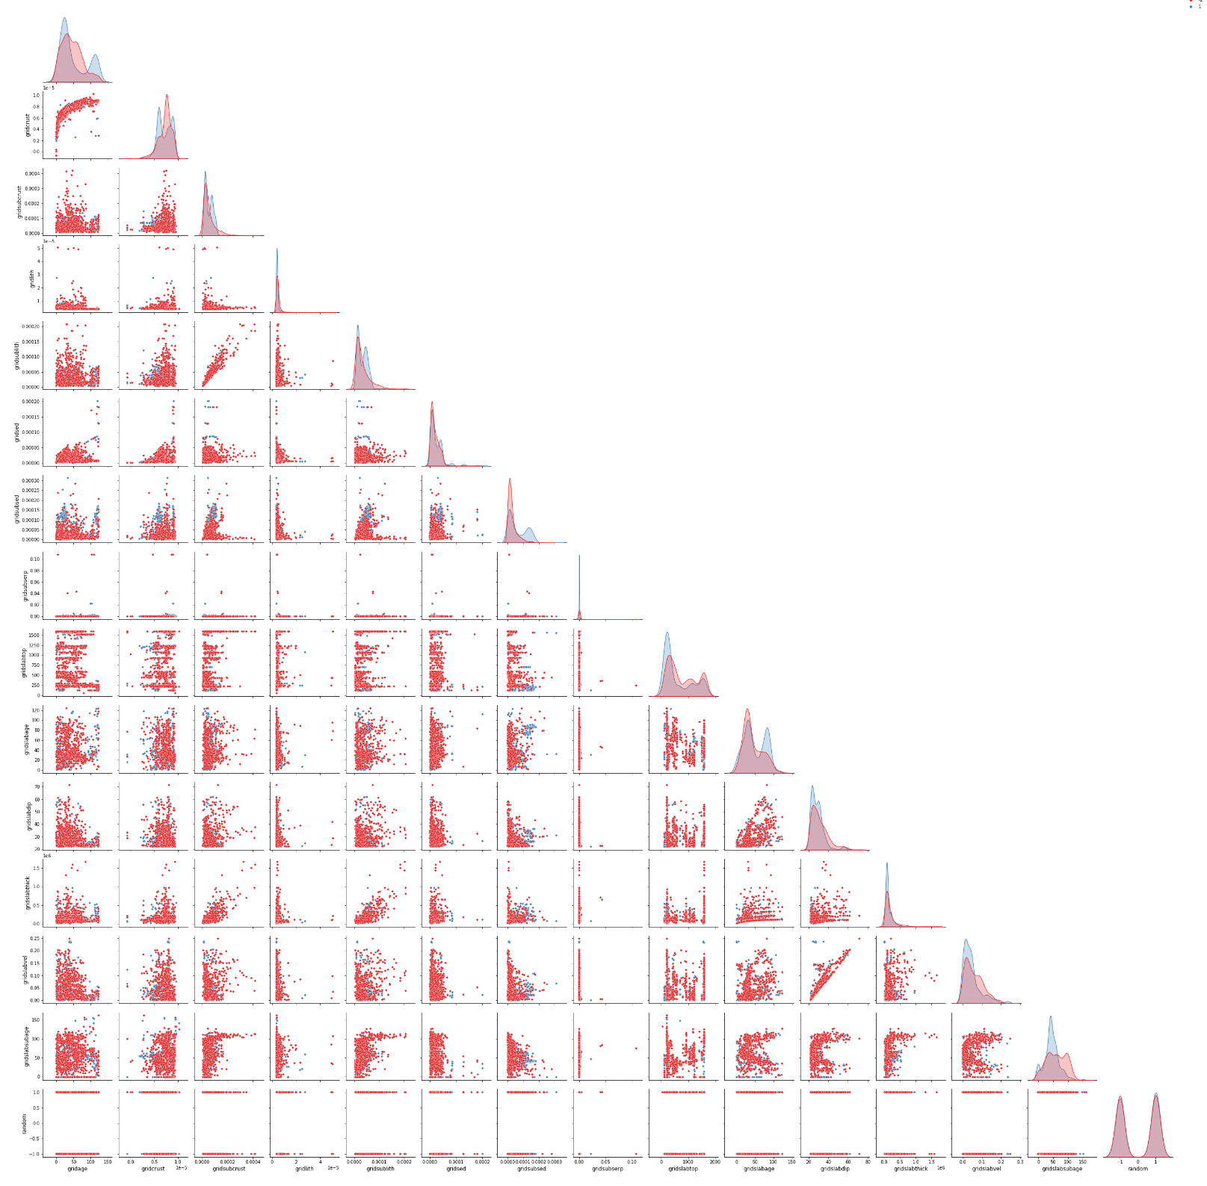
All samples compared with randomised locations variables pairplot and histogram
Histogram of Cumulative Slab Age shows two distinctive clusters of the volcanic samples (around 25Ma and 100Ma) compared with the randomised locations that show the single cluster around 25Ma.

Slide 5
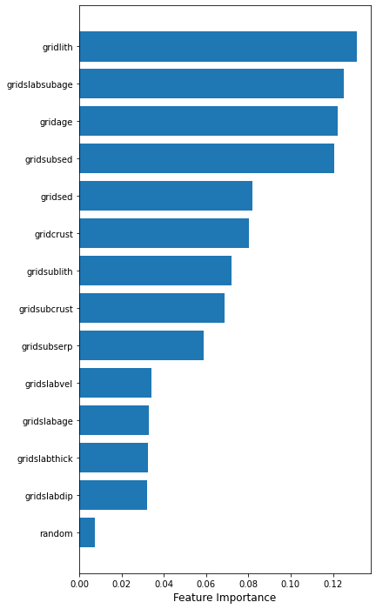
All the features are well above the random benchmark, but there is no single significant feature that stands out I think. If there were, we could make the bold statement, the value of “gridlith” (Carbon in the Lithosphere) can predict volcanism…. But to explain why gridlith has the most significant feature importance….
All samples compared with randomised locations variable Feature Importance.

Slide 6
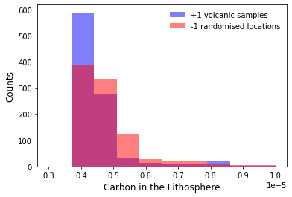
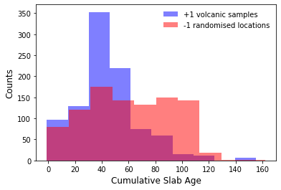
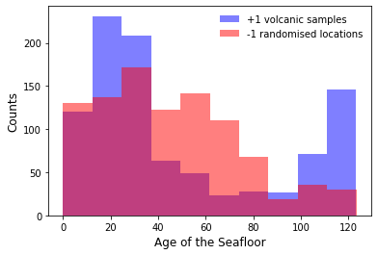
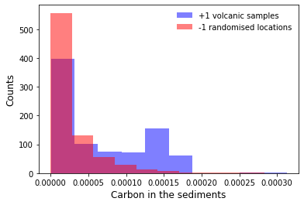
From the pairplots and histograms there are no obvious correlations, but zooming in the histogram of gridlith shows that there are many more (~600) “low values” (~0.00004) for carbon in the lithosphere for the volcanic samples compared with ~400 low values for the randomised location samples. So we can say having less carbon in the lithosphere at the time of subduction is associated with volcanism. BUT also requiring the gridslabsubage (cumulative slab age) to be around 40Ma, the gridage (Age of the seafloor) either around 20Myr or 110Myr, and the gridsubsed (Carbon in the sediments) to be high (>0.0001).

