Slide 1


Hi!
Welcome
Introduction to Machine Learning with the Tidyverse

Slide 2
Sydney Informatics Hub
SIH is a Core Research Facility of the University of Sydney enabling excellence in computational and data-driven research through advanced digital infrastructure, expert data consultancy and analytics training
”
https://sydney.edu.au/sydney-informatics-hub
Notes:
Hi, I’m Xinwei, and I’m going to talk about our team at the Sydney Informatics Hub. We are a core research facility supporting computational and data-driven research across every discipline through a range of services and activities we offer, which I will introduce in the up coming slides.
and we do this by helping to provide access to research infrastructure such as high-performance computing and storage, supporting researchers by providing data analysis expertise, providing training in advanced data analysis and computing, and building data communities with events such as hacky hours, seminars, hackathons and outreach events like this one
Other CRFs:
Research and prototype foundry
Sydney Analytical
Sydney Cytometry
Sydney Imaging
Sydney Manufacturing Hub
Sydney Mass Spectrometry
Sydney Microscopy and Microanalysis

Slide 3
Sydney Informatics Hub Empowering researchers with modern data & computational methods
Consultation
Grant application support
Data Science, ML, modelling & analytics
Hacky Hour
Training
Research compute platforms
Research Computing
High performance computing
Bioinformatics & genomics
Modelling & visualisation
Computing training
Statistical Consulting
1-on-1 consultancy for HDR-level and above.
Experiment and survey design.
Statistical model development and testing
Statistics training
Data Science & SWE
Consulting and project collaboration providing analysis & software development for data-driven research.
Notes:
We can provide support for researchers through the 3 main areas shown here:
First, we providing researchers access to HPC when needed
Secondly, we provide various types of Consultations
It can be one on one, it can be group consultations, it can in a short 1 hours session, or we can also provide long term support for projects
Finally, we also provide data science and software engineering support to researchers who need help with their data driven projects
We also provide addition training in data analysis and computing, and we also aim to build data communities with events such as hacky hours, hackathons and outreach events like this one
working for publication, or working for grant applications

Slide 4
Code of Conduct
We expect all attendees of our training to follow the University of Sydney’s Staff and Student Codes of Conduct, including the Bullying, harassment and discrimination prevention policy.
In order to foster a positive and professional learning environment we encourage the following kinds of behaviours at all our events and platforms:
Use welcoming and inclusive language
Be respectful of different viewpoints and experiences
Gracefully accept constructive criticism
Focus on what is best for the community
Show courtesy and respect towards other community members
Our full CoC, with incident reporting guidelines, is available at https://pages.github.sydney.edu.au/informatics/sih_codeofconduct/
Notes:
In line with the University of Sydney Codes of Conduct for staff and students,

Slide 5
(Examples of) Unacceptable behaviour
Sustained disruption of talks, events or communications
Written/verbal comments which have the effect of excluding people on the basis of membership of any specific group
Causing someone to fear for their safety, such as through stalking, following, or intimidation
Violent threats or language directed against another person
The display of sexual or violent images
Unwelcome sexual attention; non-consensual or unwelcome physical contact
Insults or put downs; excessive swearing
Sexist, racist, homophobic, transphobic, ableist, or exclusionary jokes
Incitement to violence, suicide, or self-harm
Continuing to initiate interaction (including photography or recording) with someone after being asked to stop
Publication of private communication without consent
Notes:
In line with the University of Sydney Codes of Conduct for staff and students, we ask you not to engage in any of these examples of unacceptable behavior.
We’d especially like to point out the first one: “disruption of talks, communications”, since this is something we’ve had issues with in the past. Some of us (and I know I can be guilty of this) have louder voices… So while we’d definitely encourage you to speak out, we have found that if we have students who are more comfortable speaking at full volume with a helper we may ask them to switch their seat so the conversation doesn’t impede the learning of students around them. So please don’t be offended if we ask you to move – we’re really trying to make sure everyone is able to learn effectively. ..

Slide 6
Plan for the workshop
Time | Day 1 | Day 2
9:00 am – 10:30 am | Session 1
10:30 am – 11:00 am | Break | Break
11:00 am - 12:30 pm | Session 2
12:30 pm – 1:30 pm | Lunch | Lunch
1:30 - 3:00 pm | Session 3
3:00 pm - 3:30 pm | Break
3:30 pm – 5:00 pm | Session 4
Your data budget;
What makes a model;
Evaluating models;
Feature engineering;
Tuning hyperparameters;
Wrapping up!

Slide 7

Asking for Help
I’m not stuck
but I need help with my computer
I’m stuck
I need help understanding something
(which likely means others do too)

Slide 8
How are statistics and Machine Learning related?

Slide 9
Statistical modeling is an extension of hypothesis testing
Explains?
Hypothesis
Reality
Matches?
Model
Data
Reject or not

Slide 10
The goal of Machine Learning is to generate accurate predictions
Old Data
Model
TRAIN
New Data
Trained Model
Improve?
Predictions

Slide 11
What is tidymodels?

Slide 12
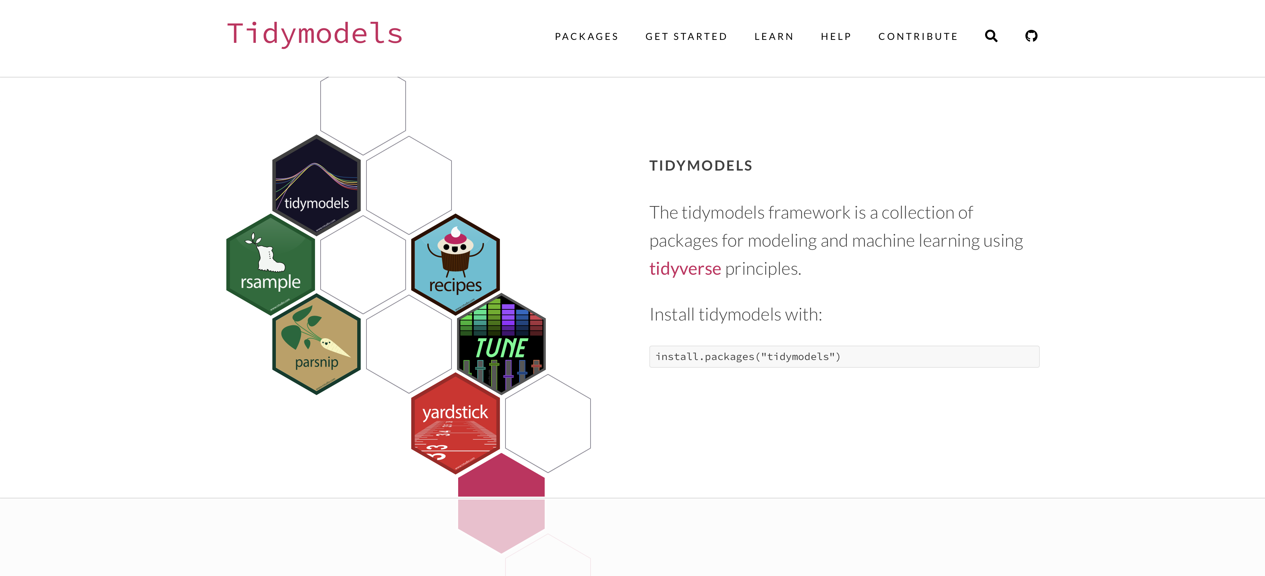

Slide 13
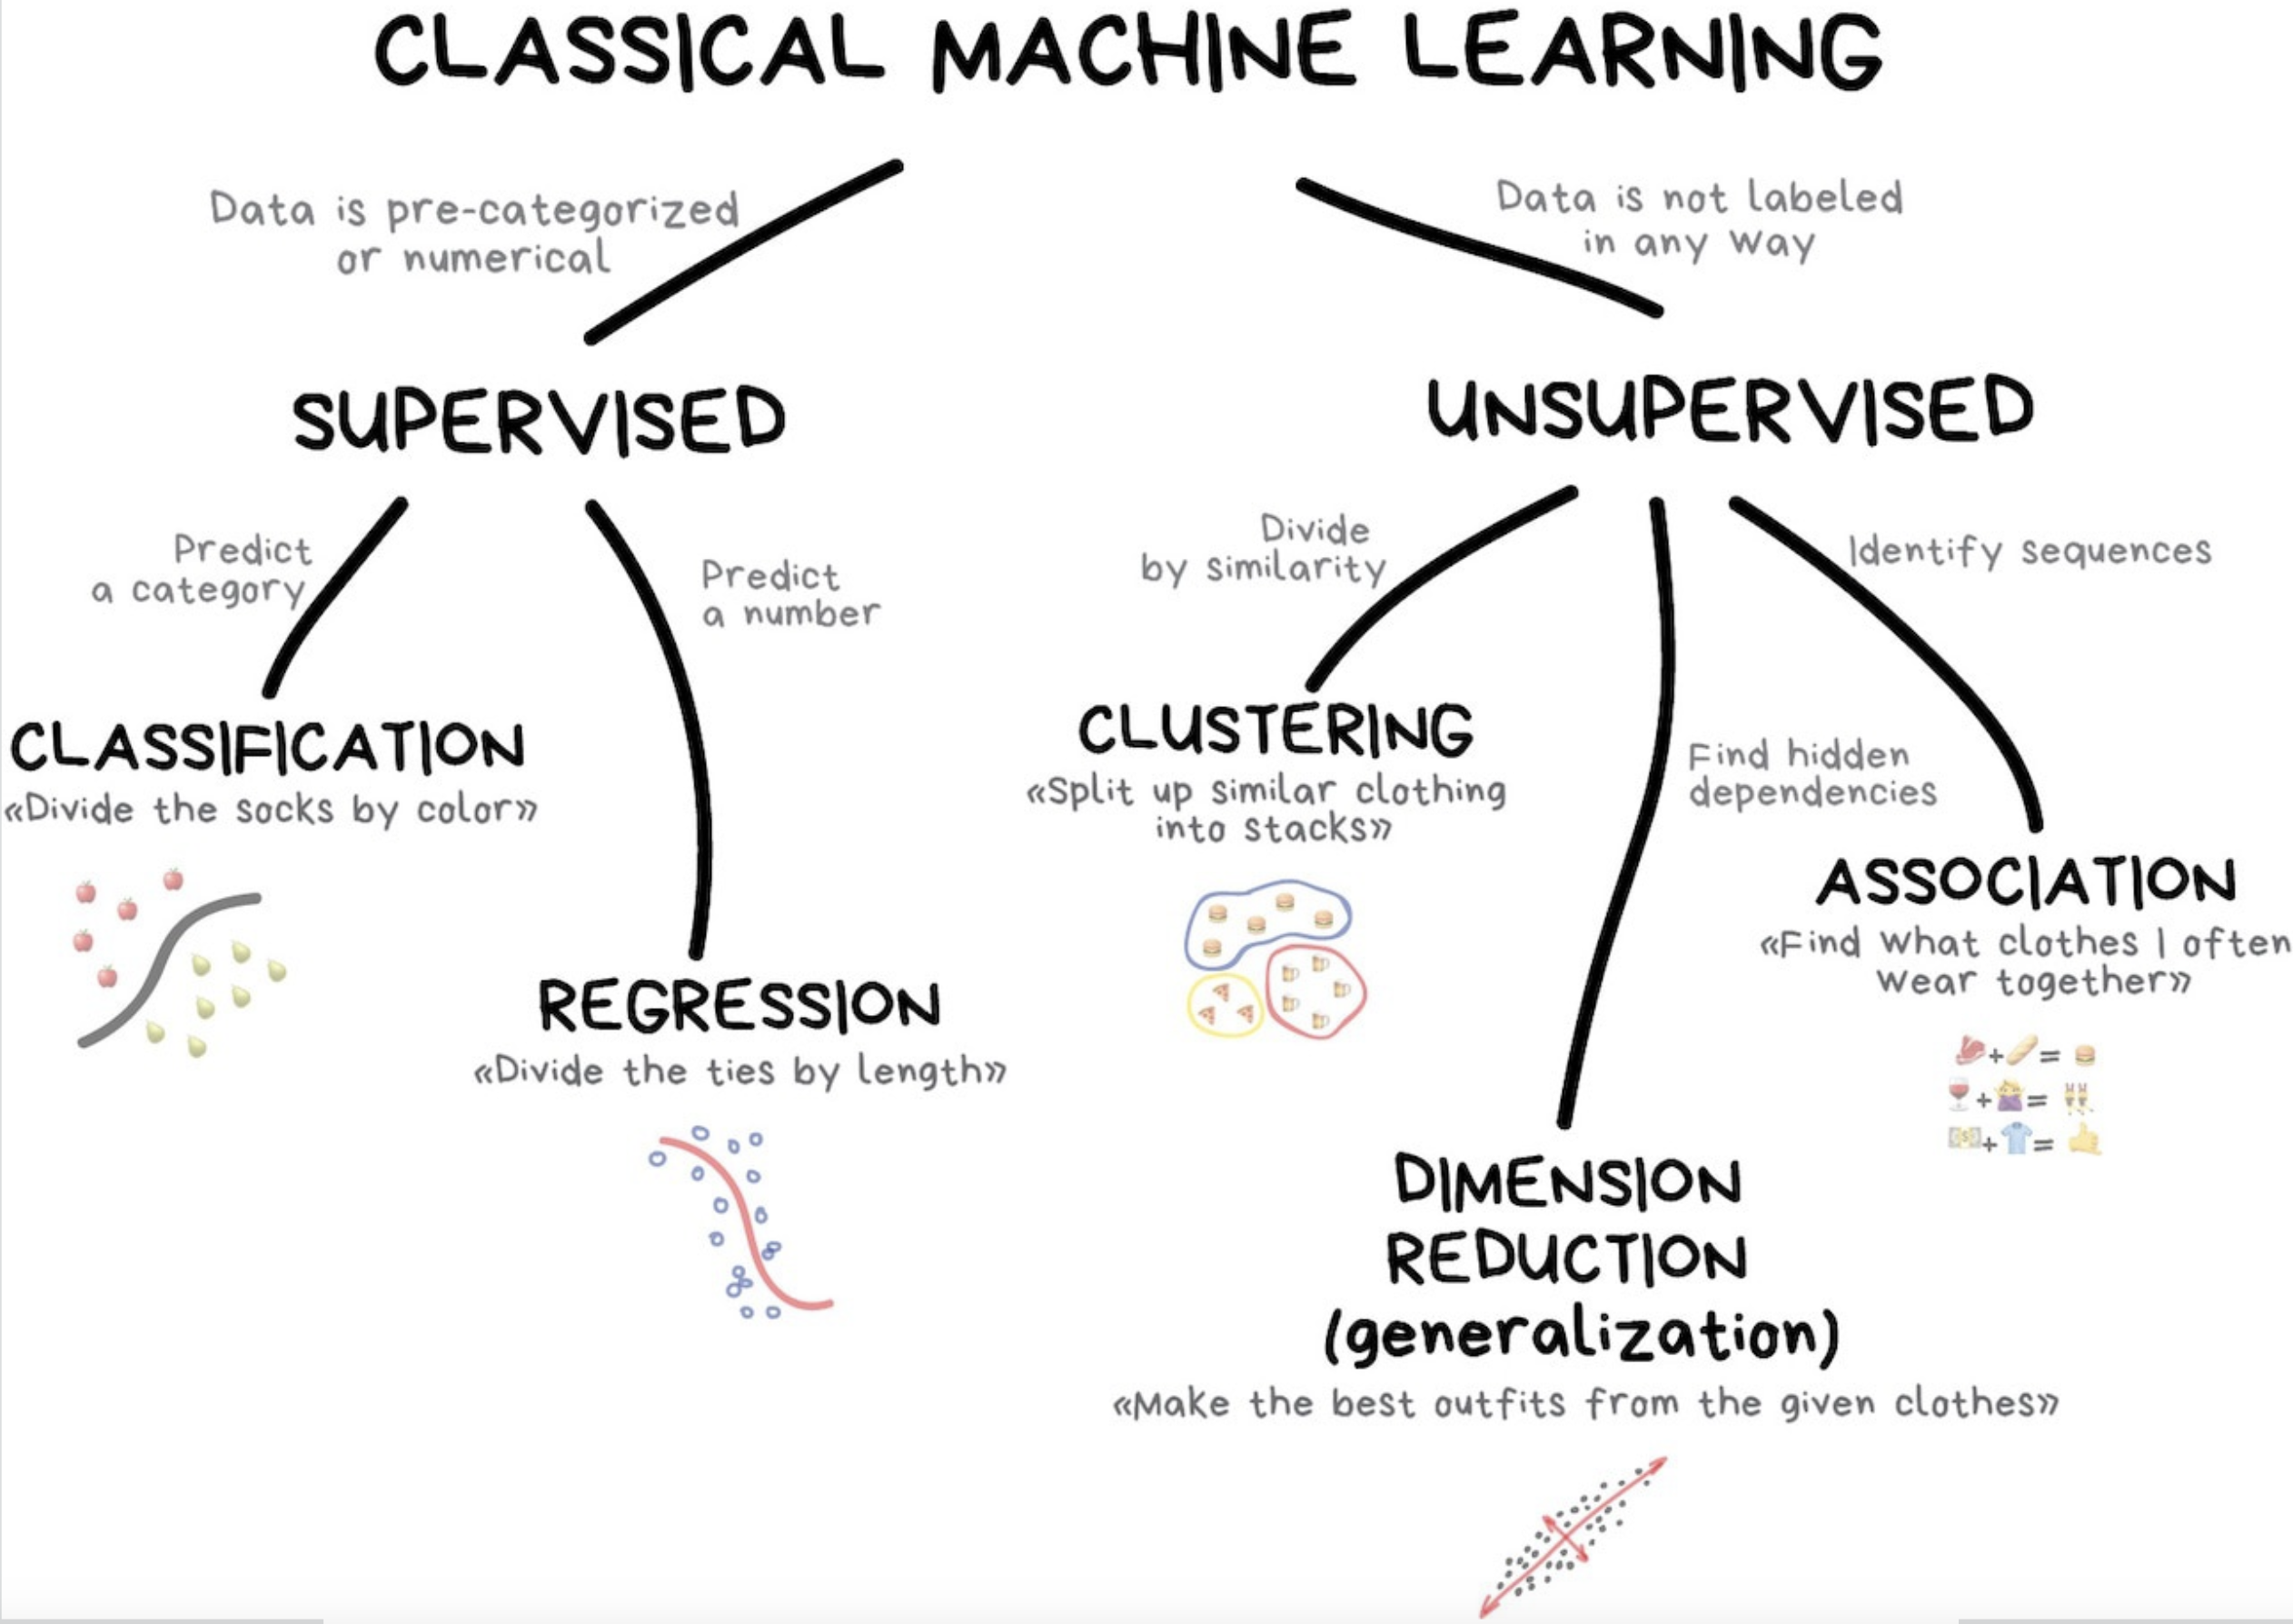
https://vas3k.com/blog/machine_learning/

Slide 14
Your turn
- Form teams of three;
Share your backgrounds with R, data, and Machine Learning;
Then choose a team name.

Slide 15
Dataset - AmesHousing
Descriptions of 2,930 houses sold in Ames, IA from 2006 to 2010, collected by the Ames Assessor’s Office.
#install.packages(“AmesHousing”)
library(AmesHousing)
ameshousing <- AmesHousing::make_ames()

Slide 16
Exploratory Data Analysis (EDA)
Notes:
Follow website, introduce concept of outcome and features/predictors

Slide 17
Tidymodels
Notes:
Follow website and slides

Slide 18
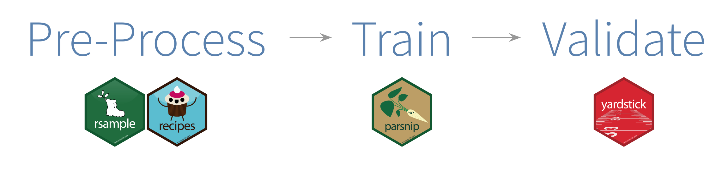

Slide 19

Data splitting and spending
For machine learning, we typically split data into training and test sets:
The training set is used to estimate model parameters.
The test set is used to find an independent assessment of model performance.
Some commonly used cutoffs include:
60% training / 40% testing
70% training / 30% testing
80% training / 20% testing

Slide 20
Data splitting and spending
Spending too much data in training prevents us from computing a good assessment of predictive performance.
Spending too much data in testing prevents us from computing a good estimate of model parameters.

Slide 21
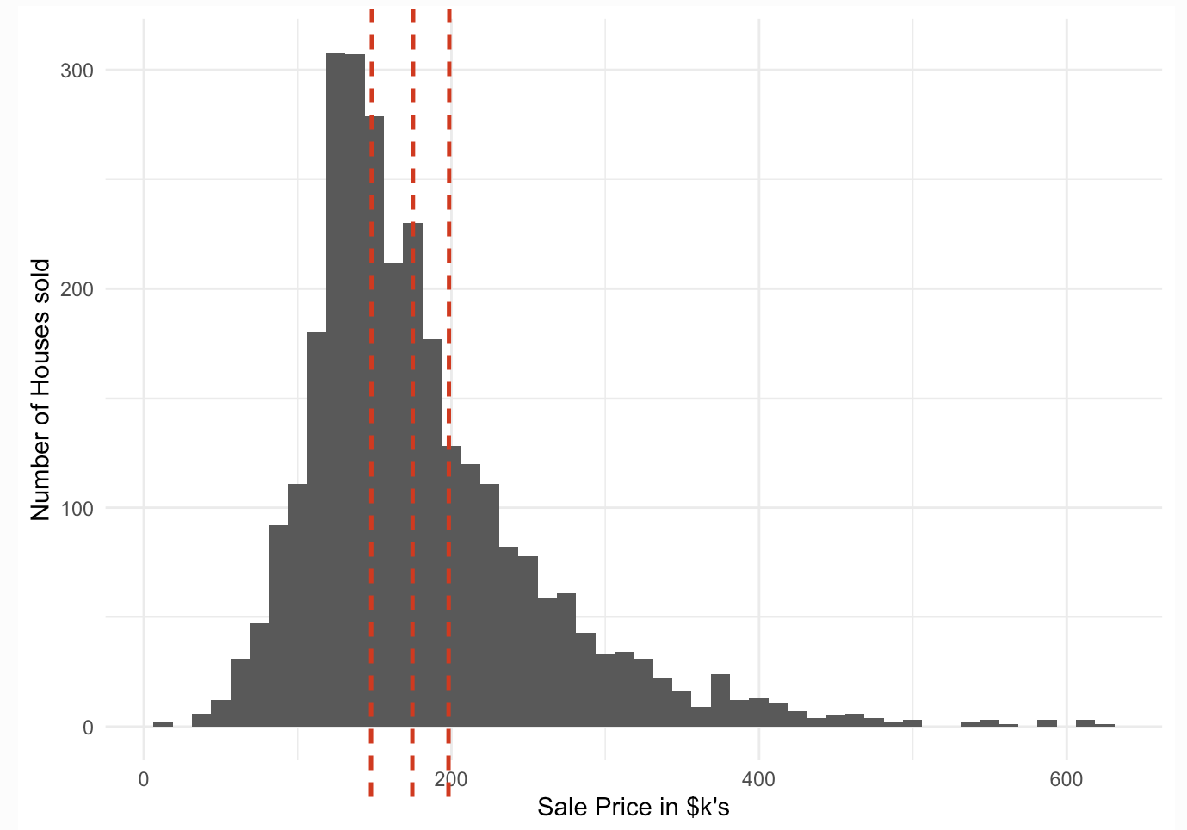
set.seed(42)
ames_split <- ames_data %>%
initial_split(prop = 0.8,
strata = Sale_Price)
ames_train <- training(ames_split)
ames_test <- testing(ames_split)
Notes:
The code here takes an input data set and puts 80% of it into a training dataset and 20% of it into a testing dataset; it chooses the individual cases so that both sets are balanced in selling price.
Stratified sampling would split within each quartile. It ensures that the proportion of the outcome/target variable is maintained in each set.

Slide 22
Data preprocessing and feature engineering
Data preprocessing steps allow your model to fit;
Feature engineering steps help the model do the least work to predict the outcome as well as possible.
The recipes package can handle both!

Slide 23
Prepare your data for modeling
The recipes package is an extensible framework for pipeable sequences of feature engineering steps that provide preprocessing tools to be applied to data.
Statistical parameters for the steps can be estimated from an initial data set and then applied to other data sets.
The resulting processed output can be used as inputs for statistical or machine learning models.

Slide 24
recipe()
ames_rec <- recipe(Sale_Price ~ ., data = ames_train)
The recipe() function assigns columns to roles of “outcome” or “predictor” using the formula;

Slide 25
step_other()
ames_rec <- recipe(Sale_Price ~ ., data = ames_train)%>%
step_other(all_nominal(), threshold = 0.01)
when you have some factor levels with very few observations, all_nominal() selects both characters and factors, pools infrequently occurring values (frequency less than 0.01) into an "other" category;

Slide 26
step_nzv()
ames_rec <- recipe(Sale_Price ~ ., data = ames_train)%>%
step_other(all_nominal(), threshold = 0.01) %>%
step_nzv(all_predictors())
all_predictors() remove predictors that are highly sparse and unbalanced;

Slide 27
step_center(), step_scale()
ames_rec <- recipe(Sale_Price ~ ., data = ames_train)%>%
step_other(all_nominal(), threshold = 0.01) %>%
step_nzv(all_predictors()) %>%
step_center(all_numeric_predictors()) %>%
step_scale(all_numeric_predictors())
step_center() subtracts the column mean from numeric predictors;
step_scale() divides by the standard deviation.
Notes:
The recipe will use the training set to estimate the means and standard deviations of the data.

Slide 28
step_dummy()
ames_rec <- recipe(Sale_Price ~ ., data = ames_train)%>%
step_other(all_nominal(), threshold = 0.01) %>%
step_nzv(all_predictors()) %>%
step_center(all_numeric_predictors()) %>% step_scale(all_numeric_predictors()) %>%
step_dummy(all_nominal_predictors(), one_hot = TRUE)
for any nominal predictor, makes binary indicators…
AND MUCH MORE!
Note that each successive step() function adds a preprocessing step to our recipe object in the order that they are provided. The preprocessing recipe ames_rec has been defined but no values have been estimated.

Slide 29
prep()
The prep() function takes a recipe and computes everything so that the preprocessing steps can be executed. Note that this is done with the training data.
ames_prep <- prep(ames_rec)
ames_prep

Slide 30
bake(), juice()
The bake() function takes a prepped recipe (one that has had all quantities estimated from training data) and applies it to new_data.
The juice() function is a nice little shortcut. When we juice() the recipe, we squeeze that training data back out, transformed in the ways we specified.
bake(ames_rec, new_data = ames_train)
juice(ames_rec)
Notes:
That new_data could be the training data again or it could be the testing data (with the TRAINING parameters);
Note that the juice() output is the same as bake(ames_rep, new_data = ames_train) and is just a shortcut that we are going to use later.

Slide 31
Build the model
In tidymodels, you specify models using three concepts:
Type - differentiates models such as logistic regression, linear regression, and so forth;
Mode - includes common options like regression and classification, some model types support either of these while some only have one mode;
Engine - is the computational tool which will be used to fit the model.
ames_model <- linear_reg() %>% #pick a model
set_engine("lm") #set the engine
All available models are listed at https://www.tidymodels.org/find/parsnip/
Notes:
We will specify the model using the parsnip package

Slide 32
fit() - Train the model
ames_fit <- ames_model() %>% #a parsnip model specifiaction
fit(Sale_Price ~ ., #a model formula
data = juice(ames_prep))#preprocessed training data
Notes:
The code trains our linear regression model on the prepped training data.
In our formula, we have specified that Sale_Price is the response variable and included all the rest as our predictor variables.

Slide 33
predict()
ames_train_results <- predict(ames_fit, #a trained parsnip model object
new_data = juice(ames_prep)) %>%
bind_cols(juice(ames_prep))
Notes:
To assess the accuracy of our trained linear regression model, we must use it to make predictions on new data.
Generally it’s best to combine the new data set and the predictions into a single data frame.
We create a data frame with the predictions on the training data and then use `bind_cols()` to add the preprocessed training data to the results

Slide 34
Metrics for model performance
Root Mean Square Error (RMSE): difference between the predicted (estimate) and observed values (truth) (loss of function);
R-squared (rsq): squared correlation between the predicted and observed values.
train_rmse <- rmse(ames_train_results,
truth = Sale_Price, #observed values
estimate = .pred) #predicted values
train_rsq<- rsq(ames_train_results,
truth = Sale_Price,
estimate = .pred)

Slide 35
initial_split()
training()
testing()
Model
TRAIN
fit()
recipe(), prep(), juice()
Trained Model
predict()
NEW DATA
recipe(), prep(), bake()
Predictions
Metrics
rmse()
rsq()

Slide 36
Your turn
We mentioned earlier that the bake() function takes a prepped recipe (ames_prep) and applies it to new_data. The new_data could be the training data again or it could be the testing data. We just evaluated our model on the training data, let’s try to apply the bake() and predict() functions on the test data and compare the results.
#bake() test data
ames_test_proc <- bake(________, new_data = ______)
#predict() selling price on the test data
ames_test_results <- predict(_____, new_data = _____)
#combine the training data set and the predictions into a single data frame
ames_test_results <- _______ %>% binds_col(_________)
#RMSE on test set
test_rmse <- rmse(________, truth = _____, estimate = _____)
#rsq on test set
test_rsq <- rsq(_______, truth = ______, estimate = ______)

Slide 37
Your turn
We mentioned earlier that the bake() function takes a prepped recipe (ames_prep) and applies it to new_data. The new_data could be the training data again or it could be the testing data. We just evaluated our model on the training data, let’s try to apply the bake() and predict() functions on the test data and compare the results.
#bake() test data
ames_test_proc <- bake(ames_prep, new_data = ames_test)
#predict() selling price on the test data
ames_test_results <- predict(ames_fit, new_data = ames_test_proc)
#combine the training data set and the predictions into a single data frame
ames_test_results <- ames_test_results %>% binds_col(ames_test_proc)
#RMSE on test set
test_rmse <- rmse(ames_test_results, truth = Sale_Price, estimate = .pred)
#rsq on test set
test_rsq <- rsq(ames_test_results, truth = Sale_Price, estimate = .pred)

Slide 38
initial_split()
training()
testing()
Model
TRAIN
fit()
recipe(), prep(), juice()
Trained Model
predict()
NEW DATA
recipe(), prep(), bake()
Predictions
Metrics
rmse()
rsq()

Slide 39
Resampling

Slide 40
Let’s make our life easier!
Notes:
Follow website and slides

Slide 41
initial_split()
training()
testing()
Model
TRAIN
fit()
recipe(), prep(), juice()
Trained Model
predict()
NEW DATA
recipe(), prep(), bake()
Predictions
Metrics
rmse()
rsq()

Slide 42
Create a workflow

Slide 43
last_fit()

Slide 44
collect_metrics()

Slide 45
initial_split()
training()
testing()
Model
TRAIN
fit()
recipe(), prep(), juice()
Trained Model
predict()
NEW DATA
recipe(), prep(), bake()
Predictions
Metrics
rmse()
rsq()

