Slide 1
Power and Sample Size Calculation
Presented by
Jim Matthews
Sydney Informatics Hub
Core Research Facilities
The University of Sydney
Notes:
My name is Jim Matthews and I am a statistical consultant working at the Sydney Informatics Hub supporting the Sydney Uni research community.

Slide 2




During the workshop
Ask short questions or clarifications during the workshop (either by Zoom chat or verbally). There will be breaks during the workshop for longer questions.
Slides with this blackboard icon are mainly for your reference, and the material will not be discussed during the workshop.
Challenge questions will be encountered throughout the workshop.
Notes:
The format of this session will be similar to that of our other foundational workshops, so if you attended Research Essentials or Experimental Design you will be familiar with the format.

Slide 3










General Research Workflow
Hypothesis Generation (Research/Desktop Review)
Experimental and Analytical Design (sampling, power, ethics approval)
Collect/Store Data
Data cleaning
Exploratory Data Analysis (EDA)
Data Analysis aka inferential analysis
Predictive modelling
Publication
Notes:
In this workshop we focus on step 2 of the general research workflow. This is described in more detail in our Research Essentials workshop.

Slide 4
Outline
Statistical power and sample size calculation – concepts
Statistical Workflow for power calculation
Software tools and workflows – Statulator, others
Four worked examples including difference between means and difference between proportions
Power calculation for other designs
References
Notes:
Firstly we are going to look at some of the concepts around power calculation.
We will then introduce the workflow for power and sample size calculation.
Then we’ll have a look at software tools. We used to focus on using G*Power (back in 2022). Now we will look at a couple of online tools, as well as others.
Question: Has anyone used software to do sample size calculation? What did you like or not like?
For the examples we will probably run through a couple of them, but there may not be time to do all four.
This workshop being only 90 minutes is only going to cover a few examples of power calculation, but hopefully you will be able to apply the concepts we cover here to carry out power calculations for a wider range of other scenarios. We will aim to build your confidence to perform a variety of power calculations.
Any other questions before we start?

Slide 5
Why do we need to calculate power and sample size?
Why do we want to estimate the power of a study?
To know that it is worth doing the study
…and make sure we are not wasting our time
To plan the time and resources necessary
To get a grant application approved
To make sure the study design is ethically acceptable (Animal Ethics, Human Ethics)
Notes:
Ask students for responses.

Slide 6
But do I really need to calculate power?
What type of study are you planning?
My study is:
A pilot study
Exploratory (no inferences or generalisation planned)
Estimation based
My study is:
Confirmatory (pilot study already done)
Testing a specific hypothesis
Will make inferences about wider population
perhaps not so formally
YES – Statistical validity is important
Focus on precision-based sample size approach and feasibility
Continue with workshop!
Notes:
Ask students for responses.
Even if you are only doing an exploratory study, a power calculation may aid in the design process.

Slide 7
Exploratory and Confirmatory studies comparison
Aspect | Exploratory Studies | Confirmatory Studies
Primary purpose | Generate hypotheses, assess feasibility, estimate parameters/variances | Test pre-specified hypotheses
Type I error control | Not required | Essential
Key goal of sample size calculation | Achieve reasonable precision; ensure feasibility | Ensure adequate power to detect meaningful effects
Approach | Often precision-based, feasibility-based | Formal power analysis using α, β, effect size, variance estimate
Benefits | More reliable preliminary estimates; avoid unusably small studies; inform future trials | Valid inference; ethical justification; regulatory acceptability; efficiency
Typical sample size | Small-to-moderate | Generally larger
Add table here from copilot

Slide 8
Concepts

Slide 9



What is the power of a study design?
Statistical power: The power to know…
This Photo by Unknown Author is licensed under CC BY-NC-ND
Notes:
What is the power of a study design?
It is not political power.
It is not electrical power.
It is…The power to know…(apologies to the SAS Institute)
or you could say: statistical power forms a part of the inferential power of a statistical method, which itself forms a part of the epistemological power of a knowledge claim of the study.

Slide 10
What do we want to know?
Statistics involves using a sample to estimate (or make inference about) a population parameter (a mean, a mean difference, an odds ratio, or some other property).
Often we want to test a hypothesis: e.g. mean effect of drug X is different to the mean effect of drug Y, (p<0.05).
Sometimes we want to estimate the population property with some level of precision and not perform a hypothesis test. For example: the prevalence of disease A in the population is 10.5% [9.5%-11.5%] where the confidence interval indicates precision.

Slide 11

What do we want to know?
Sample sizes can be calculated for either research goal
In this workshop, examples A-C are based on hypothesis tests of two groups, while example D is based on estimation of a proportion to a specified level of precision
Use for hypothesis test
smallest effect size
Further reading on the use of CI for sample size calc: see chapter 3 of “Determining Sample Size Balancing Power, Precision, and Practicality” by Dattalo
Use for estimation of precision
Confidence interval of mean difference
0 | 1 | 2 | 3 | 4
effect size ($\overline{x_{1}}−\overline{x_{2}}$)
Notes:
Note that the minimum detectable effect size is equivalent to half of the associated confidence interval
If we want to perform a hypothesis test, then we consider what is the min effect size of interest.
If we want to estimate a quantity, then we consider what is the smallest confidence interval of interest for the estimate.

Slide 12
We propose an alternative hypothesis but test a null hypothesis
Start with the hypothesis that you have generated, for example:
”Novel drug X lowers blood pressure more than standard-of-care drug Y”
In statistics, this is referred to as the alternative hypothesis (H₁). This is the hypothesis we are interested in. Classically, we test the veracity of the null (H₀) hypothesis:
”Drug X and drug Y lower blood pressure by the same amount”
A statistical test of the null hypothesis is always subject to uncertainty.

Slide 13

Errors can’t be avoided, but can be controlled
Despite this uncertainty, when we perform a null hypothesis test, we are setting up a binary choice that can result in making a correct decision, or an error
We can’t completely avoid errors, but we can choose the rate of error that is acceptable to us given uncertainty
This Photo by Unknown Author is licensed under CC BY-SA
Notes:
When we perform a null hypothesis test, we are setting up a binary choice that can result in these types of error.

Slide 14
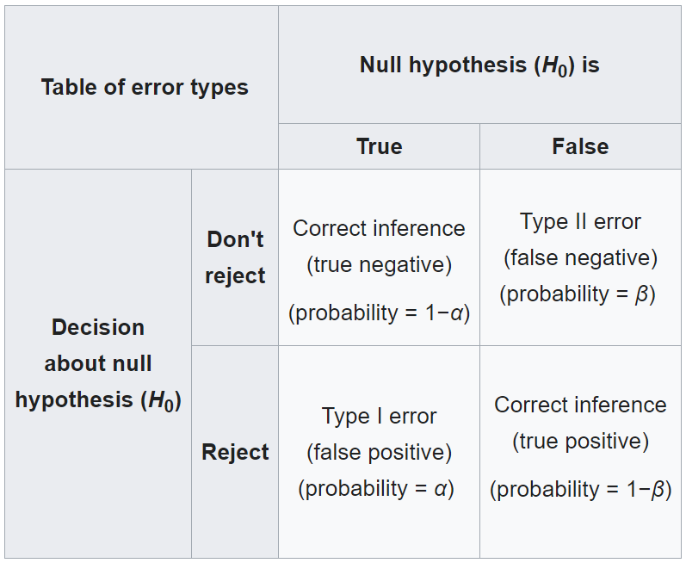
Types of Statistical Error
Reality
Statistical
power!
Notes:
You won’t know if you have made the correct decision, but you should know the probability that you have made or will make the correct decision.

Slide 15
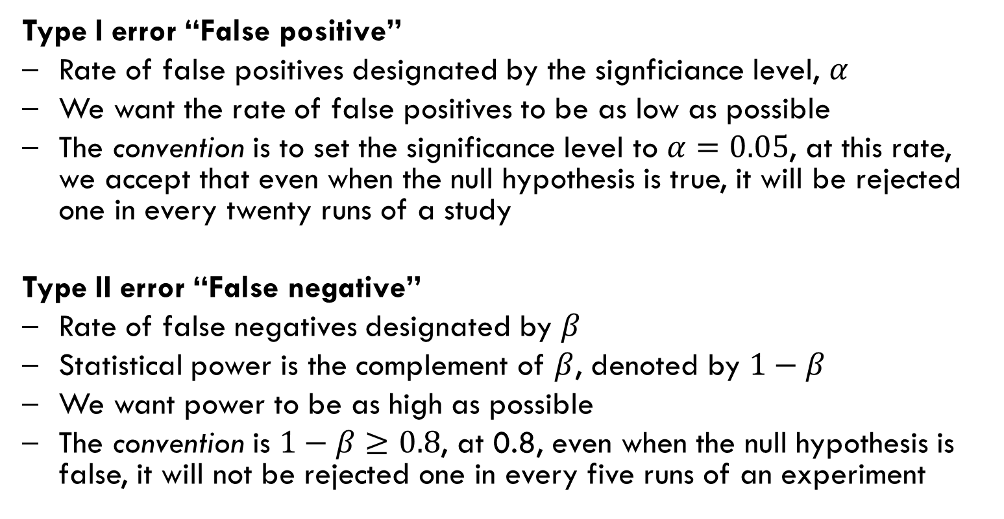
Alpha and beta are our chosen error rates
Type I error “False positive”
Rate of false positives designated by the signficiance level, $α$
We want the rate of false positives to be as low as possible
The convention is to set the significance level to $α=0.05$, at this rate, we accept that even when the null hypothesis is true, it will be rejected one in every twenty runs of a study
Type II error “False negative”
Rate of false negatives designated by $β$
Statistical power is the complement of $β$, denoted by $1−β$
We want power to be as high as possible
The convention is $1−β≥0.8$, at 0.8, even when the null hypothesis is false, it will not be rejected one in every five runs of an experiment
Notes:
There are two types of error that can be made when deciding between two alternative options.
Type I error
Type II error
When we perform a null hypothesis test, we are setting up a binary choice that can result in these types of error.

Slide 16
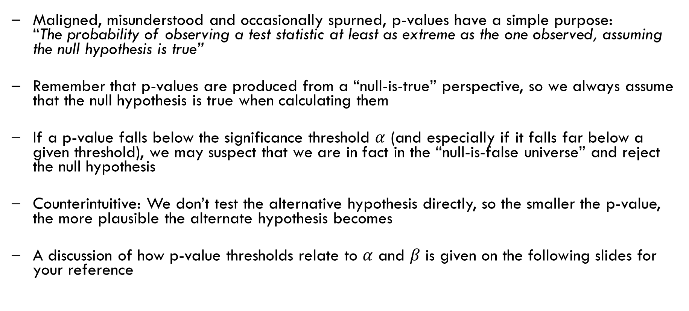
P-values allow us to make decisions and quantify evidence
Maligned, misunderstood and occasionally spurned, p-values have a simple purpose: “The probability of observing a test statistic at least as extreme as the one observed, assuming the null hypothesis is true”
Remember that p-values are produced from a “null-is-true” perspective, so we always assume that the null hypothesis is true when calculating them
If a p-value falls below the significance threshold $α$ (and especially if it falls far below a given threshold), we may suspect that we are in fact in the “null-is-false universe” and reject the null hypothesis
Counterintuitive: We don’t test the alternative hypothesis directly, so the smaller the p-value, the more plausible the alternate hypothesis becomes
A discussion of how p-value thresholds relate to $α$ and $β$ is given on the following slides for your reference

Slide 17
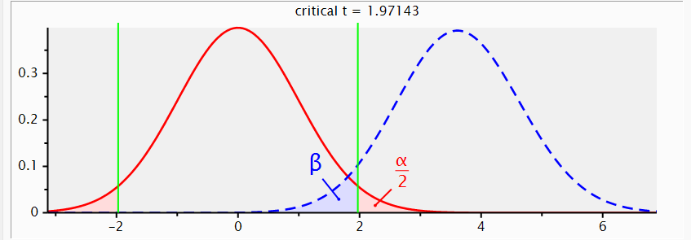
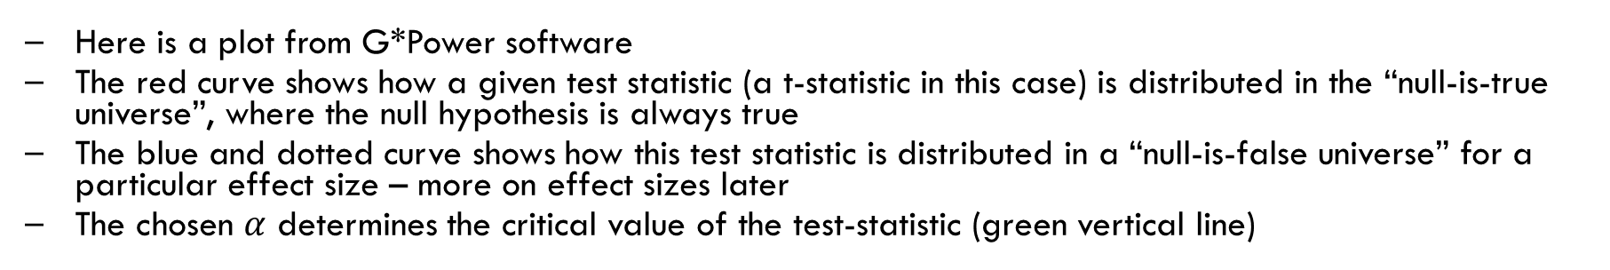
Alpha is also the p-value threshold
Relative frequency
test statistic value
Here is a plot from G*Power software
The red curve shows how a given test statistic (a t-statistic in this case) is distributed in the “null-is-true universe”, where the null hypothesis is always true
The blue and dotted curve shows how this test statistic is distributed in a “null-is-false universe” for a particular effect size – more on effect sizes later
The chosen $α$ determines the critical value of the test-statistic (green vertical line)

Slide 18
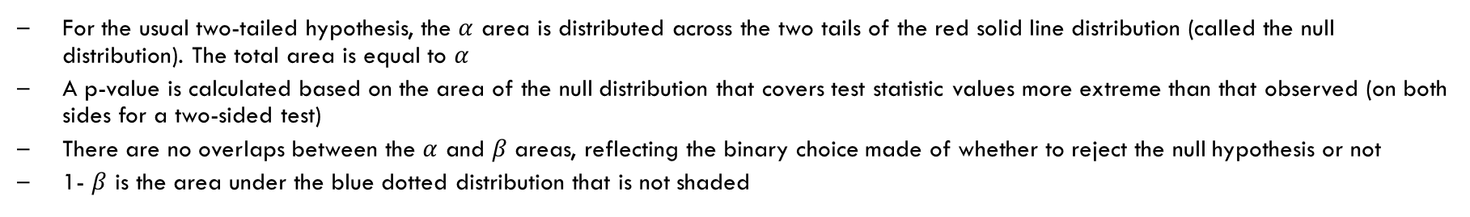
Alpha is also the p-value threshold
Relative frequency
test statistic value
For the usual two-tailed hypothesis, the $α$ area is distributed across the two tails of the red solid line distribution (called the null distribution). The total area is equal to $α$
A p-value is calculated based on the area of the null distribution that covers test statistic values more extreme than that observed (on both sides for a two-sided test)
There are no overlaps between the $α$ and $β$ areas, reflecting the binary choice made of whether to reject the null hypothesis or not
1- $β$ is the area under the blue dotted distribution that is not shaded

Slide 19
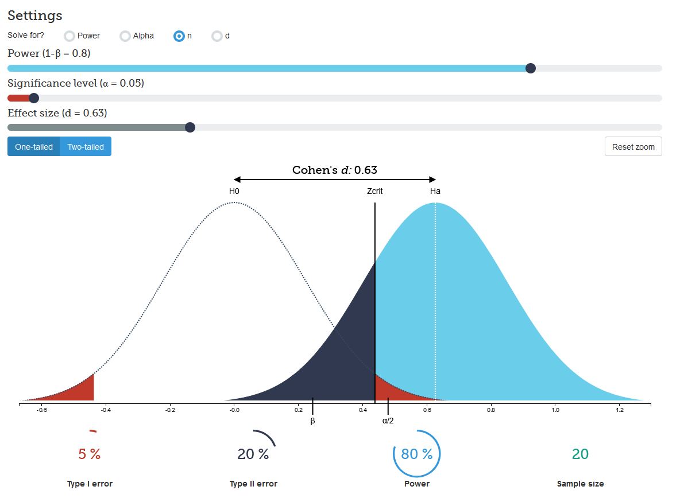
Building your intuition of a deeply unintuitive procedure
For a more interactive view of these distributions to build your intuition check out: https://rpsychologist.com/d3/nhst/
Note that the author is “deeply skeptical about the current use of significance tests”, but null-hypothesis statistical testing (NHST) is a mainstay of modern research. So, we must know how to use it even if we don’t like it.

Slide 20
Not every hypothesis is a superiority test
The most recognised and widely-used hypothesis test is whether two measures are exactly equal or different by any amount (a superiority test).
H₀: Difference = 0 H₁: Difference ≠ 0
Other study objectives will lead to other types of hypothesis test.
The types below are frequently found in clinical trials (e.g. a novel drug performs no worse than the existing drug: Non-inferiority test)
Similar tests:
Equivalence test
Minimum Effect test
See reference for further details: Julious, Steven A. Sample Sizes for Clinical Trials . Boca Raton: CRC Press/Taylor & Francis, 2010. Print.

Slide 21

We need inputs to calculate statistical power
It will depend on:
Sample size
Chosen significance level (α)
Minimum effect size to detect
Variance within groups
Experimental design and type of statistical hypothesis test
Usually, we want to calculate a sample size given a required minimum power.
Decisions regarding the study design can be critically important in determining statistical power.
This is covered in the “Experimental Design” workshop.

Slide 22
Power calculation can become sample size calculation
It will depend on:
Sample size
Chosen significance level (α)
Minimum effect size to detect
Variance within groups
Experimental design and type of statistical hypothesis test
Statistical Power (1-β)
Decisions regarding the study design can be critically important in determining statistical power.
This is covered in the “Experimental Design” workshop.

Slide 23

What Have We Learned So Far?
Why power matters: Avoid wasted effort, ensure ethical design, secure funding
Key concepts: Power = 1 − β; Type I error (α), Type II error (β)
Inputs for power/sample size: α, β, SESOI, variance, design
Effect size & precision: SESOI aligns statistical and scientific significance
Confidence intervals matter for estimation goals

Slide 24
Statistical Workflow
Coming next…
Notes:
Any questions before we move on?

Slide 25
What is a workflow?
Every statistical analysis is different, but all follow similar paths. It can be useful to know what these paths are
We have developed practical, step-by-step instructions that we call ‘workflows’, that can you can follow and apply to your research
We have a general research workflow that you can follow from hypothesis generation to publication
And statistical workflows that focus on each major step along the way including study design and power
Notes:
Are people familiar with the idea from previous workshops?

Slide 26
Statistical Workflows
Our statistical workflow will be outlined within this workshop
Statistical workflows are software agnostic, in that they can be applied using any statistical software
There are accompanying software workflows that show you how to perform the sample size statistical workflow using software packages:
Online calculators: Statulator and PS
G*Power
SPSS
Download these from the Statistical Consulting website

Slide 27

Sample size calculation statistical workflow
Sample size calculation workflow steps
Determine experiment type and statistical test
Set $α$ and $1−β$
Set the smallest effect size of interest
Estimate the variance
Calculate the minimum sample size
Explore scenarios
Notes:
Any questions at this point?

Slide 28
1. Determine experiment type and statistical test
For example:
Experimental design | Main assumptions | Proposed statistical test
Comparison of 2 means | independent groups, normally distributed outcome
Comparison of 2 means | independent groups, no assumption of normality
Comparison of 2 proportions | independent groups
Comparison of means, more than 2 groups | independent groups normally distributed outcome
t-test
Mann-Whitney U test
z-test/Fishers exact
ANOVA, F-test
Notes:
Note that not all assumptions are listed in the table.

Slide 29
1. Determine experiment type and statistical test
Tip from the consulting room:
Your study design may lead to a series of hypothesis tests of interest
You need to choose which of these hypothesis tests should be used to “power your experiment”
A typical example is an ANOVA design experiment
With three groups this would result in four hypothesis tests: an F-test, and three post-hoc t-tests
Drug C: Novel drug
F-test
B vs. C
A vs. C
Drug A: Placebo
A vs. B
Drug B: Standard-of-care
Which of these tests should be used to power the experiment (i.e. ensure sufficient sample size)
Notes:
Note that not all assumptions are listed in the table.
Ask: Which of these tests should be used to power the experiment?

Slide 30

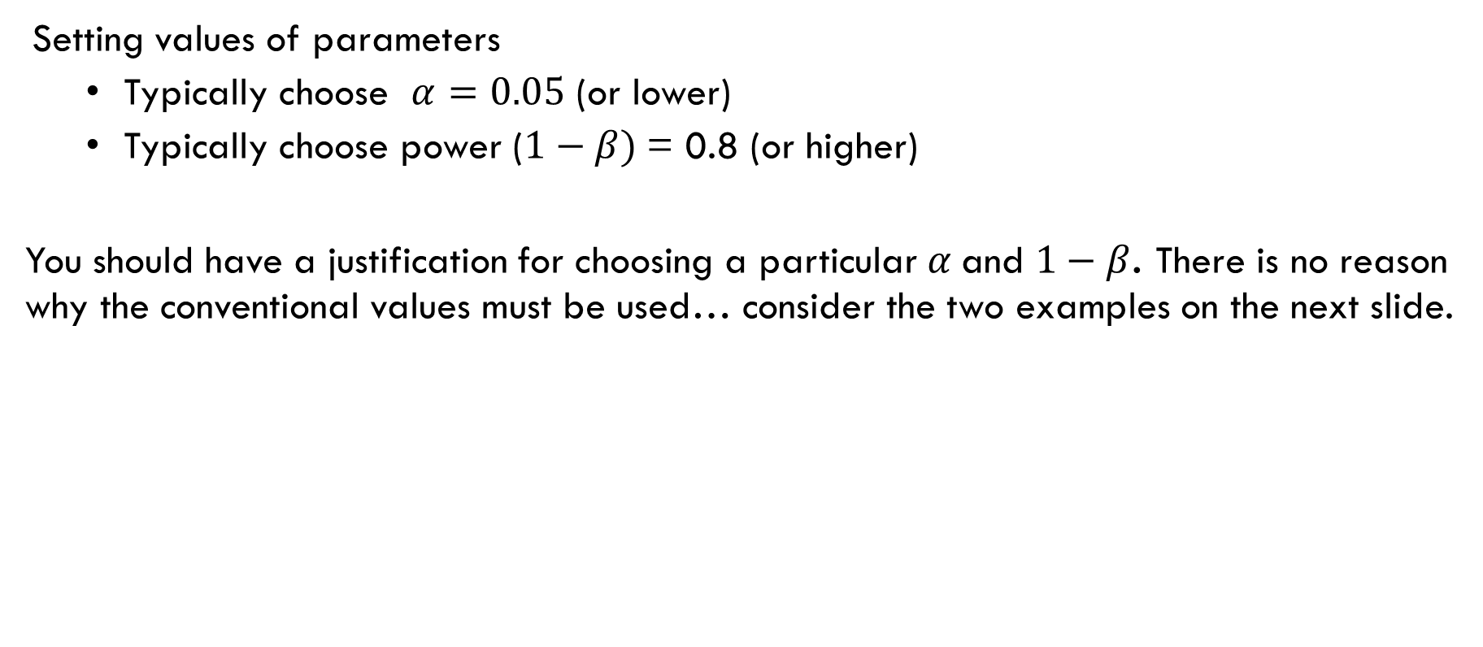
2. Set $α$ and $1−β$
Setting values of parameters
Typically choose $α=0.05$ (or lower)
Typically choose power ($1−β)$= 0.8 (or higher)
You should have a justification for choosing a particular $α$and $1−β$. There is no reason why the conventional values must be used… consider the two examples on the next slide.
Notes:
We choose alpha=0.05 and beta=0.20 because we consider the importance of avoiding a Type I error as 4 times as important as avoiding a Type II error.

Slide 31
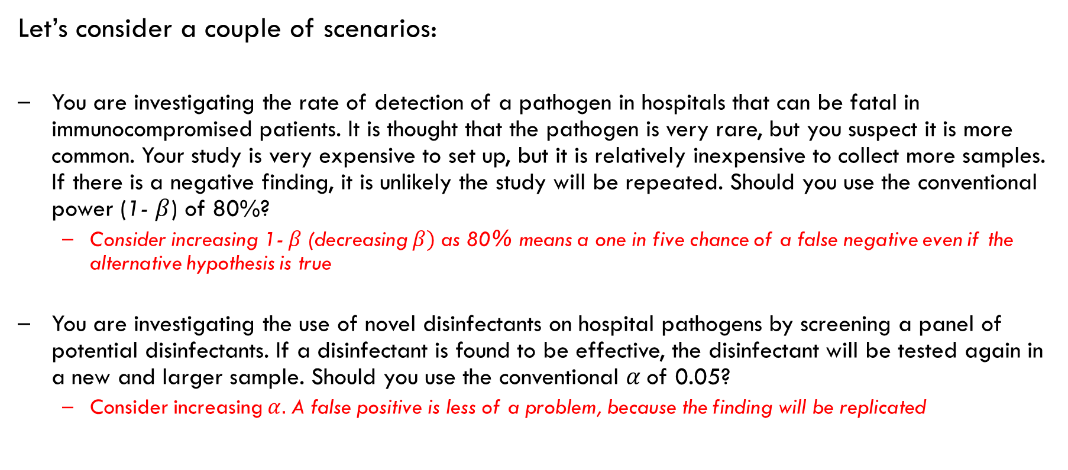
2. Set $α$ and $1−β$
Let’s consider a couple of scenarios:
You are investigating the rate of detection of a pathogen in hospitals that can be fatal in immunocompromised patients. It is thought that the pathogen is very rare, but you suspect it is more common. Your study is very expensive to set up, but it is relatively inexpensive to collect more samples. If there is a negative finding, it is unlikely the study will be repeated. Should you use the conventional power (1- $β$) of 80%?
Consider increasing 1- $β$(decreasing $β)$ as 80% means a one in five chance of a false negative even if the alternative hypothesis is true
You are investigating the use of novel disinfectants on hospital pathogens by screening a panel of potential disinfectants. If a disinfectant is found to be effective, the disinfectant will be tested again in a new and larger sample. Should you use the conventional $α$of 0.05?
Consider increasing $α.$A false positive is less of a problem, because the finding will be replicated
Notes:
We choose alpha=0.05 and beta=0.20 because we consider the importance of avoiding a Type I error as 4 times as important as avoiding a Type II error.

Slide 32
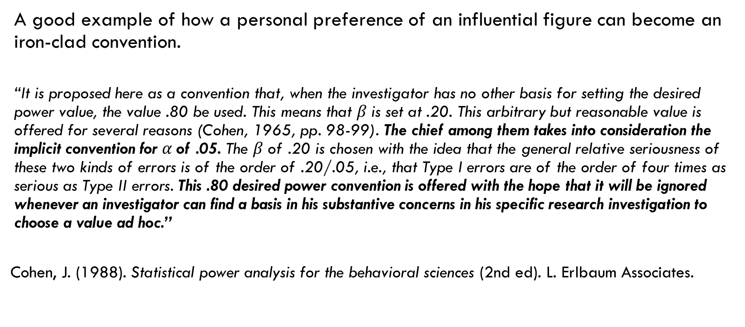
2. Set $α$ and $1−β$
A good example of how a personal preference of an influential figure can become an iron-clad convention.
“It is proposed here as a convention that, when the investigator has no other basis for setting the desired power value, the value .80 be used. This means that $β$is set at .20. This arbitrary but reasonable value is offered for several reasons (Cohen, 1965, pp. 98-99). The chief among them takes into consideration the implicit convention for $α$of .05. The $β$of .20 is chosen with the idea that the general relative seriousness of these two kinds of errors is of the order of .20/.05, i.e., that Type I errors are of the order of four times as serious as Type II errors. This .80 desired power convention is offered with the hope that it will be ignored whenever an investigator can find a basis in his substantive concerns in his specific research investigation to choose a value ad hoc.”
Cohen, J. (1988). Statistical power analysis for the behavioral sciences (2nd ed). L. Erlbaum Associates.
Notes:
We choose alpha=0.05 and beta=0.20 because we consider the importance of avoiding a Type I error as 4 times as important as avoiding a Type II error.

Slide 33

Summary for $α$ and $1−β$
Study type | Primary objective | Recommended α | power (1−β) | Preferred sample-size planning
Pilot / Feasibility | Feasibility, process evaluation, variance/event-rate estimation | De‑emphasize hypothesis testing; if testing is unavoidable, consider α = 0.10–0.20 (two‑sided) with clear caveats (signal detection rather than confirmatory inference). | No standard; when used, 50–70% may be acceptable given learning goals; alternatively, avoid power targets and plan for precision (CI width). | Precision‑based (e.g., target CI width for means/proportions; stable variance estimates); ensure adequate feasibility metrics (recruitment, retention).
Exploratory (hypothesis‑generating) | Preliminary effect sizing; refine endpoints and analysis | Flexible; α often 0.10 (two‑sided) when formal testing is included; otherwise focus on estimation. | Lower power (≈60–80%) is sometimes acceptable; or emphasize precision over power to reduce false leads from underpowered testing. | Precision‑ or feasibility‑driven; consider ranges for effect sizes and variability from literature/pilot data.
Observational (estimation‑focused) | Estimate prevalence /means /associations with prespecified precision | Use α = 0.05 (two‑sided) if testing; otherwise specify CI goals (e.g., ±d around an estimate). | Not mandatory if the design is estimation‑first; when hypothesis tests are planned, ≥80% is common. | Precision‑based (CI width, margin of error) using literature or pilot inputs.
Phase II / Proof‑of‑concept (single or two‑arm) | Detect a promising signal to justify Phase III | Typically α = 0.05 (two‑sided); justify any one‑sided α (e.g., 0.025) if clinically appropriate. | ≥80% power is common; 90% if false‑negatives would be costly for development. | Classical power‑based using best estimates of effect/variance; consider sensitivity analyses across plausible effects.
Confirmatory RCT (Phase III, superiority) | Definitive hypothesis test with strict error control | α = 0.05 (two‑sided) standard; α = 0.025 (one‑sided) in some regulatory settings; adjust for multiplicity (endpoints/interims/arms) to maintain familywise α. | 80–90% power; 90% often preferred when consequences of a false‑negative are high. | Formal power analysis with prespecified endpoints, effect size, variance, and drop‑outs; include alpha‑spending/multiplicity control plan if needed.
Non‑inferiority / Equivalence | Show treatment is not worse than (or equivalent to) control by a margin | α = 0.05 (two‑sided) often expressed as two one‑sided tests at α = 0.025 each, TOST; careful prespecification of the margin is essential. | ≥80–90% depending on clinical stakes and margin width. | Power‑based using NI/EQ margin, anticipated effect, and variance; include sensitivity analyses for plausible margins.

Slide 34
3. Set the smallest effect size of interest
Effect size examples: difference in means, difference in proportions, odds ratio…
What is the smallest effect size of interest?
Decide on a smallest effect size of interest (SESOI) as a target to detect in your hypothesis test. This should be based on the smallest effect size that is of scientific interest/significance
You will need to use your domain expertise to decide this, e.g.:
What constitutes a clinically meaningful difference between patient groups in a score measuring depression?... What is a biologically meaningful difference in gene expression in two different cell types?... What difference in number of seconds to complete a task would you consider important in a mouse behaviour model?
If it is unknown, you may need to consider a range of plausible effect sizes and evaluate the required sample size as each of these (as described in the examples)

Slide 35
3. Set the smallest effect size of interest
too small
Effect size chosen is smaller than necessary
The sample size is larger than necessary
Possible waste of resources
Can achieve statistical significance with an effect that is too small to be interesting or useful
just right
Effect size chosen is based on sesoi
The sample size is just right
If statistical significance is achieved, then it will align with scientific significance
Most efficient use of resources
too large
Effect size chosen is larger than necessary
The sample size is too small
Not able to achieve statistical significance for small effect sizes of interest
May detect large effects only
Possible waste of resources
goldilocks

Slide 36
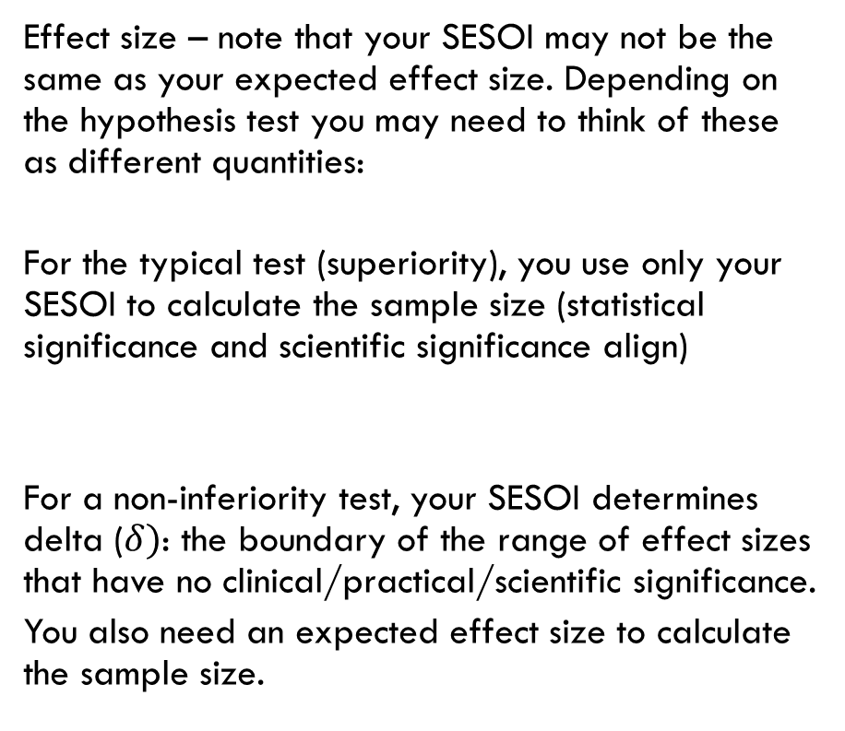


3. The SESOI may not be the only effect size you need
Effect size – note that your SESOI may not be the same as your expected effect size. Depending on the hypothesis test you may need to think of these as different quantities:
For the typical test (superiority), you use only your SESOI to calculate the sample size (statistical significance and scientific significance align)
For a non-inferiority test, your SESOI determines delta ($δ)$: the boundary of the range of effect sizes that have no clinical/practical/scientific significance.
You also need an expected effect size to calculate the sample size.
Expected effect size
and precision
← Less effective treatment
0
More effective treatment →
H₀: Difference = 0
Expected effect size
and precision
← Less effective treatment
$$−δ$$
0
More effective treatment →
H₀: Difference $<−δ$
https://lakens.github.io/statistical_inferences/09-equivalencetest.html
Notes:
Note that the minimum detectable effect size is equivalent to half of the associated confidence interval
If we want to perform a hypothesis test, then we consider what is the min effect size of interest.
If we want to estimate a quantity, then we consider what is the smallest confidence interval of interest for the estimate.

Slide 37
4. Estimate the variance
Within study variance is often the big unknown in a sample size calculation
How to estimate it?
Estimate standard deviation (or proportions) from earlier pilot study
Estimates drawn from published literature
Consider theoretical bounds (eg proportions, for 5pt scale items)
Use estimate from similar outcomes in related conditions
Seek expert/clinical knowledge?
If no idea, may be best to do pilot study

Slide 38
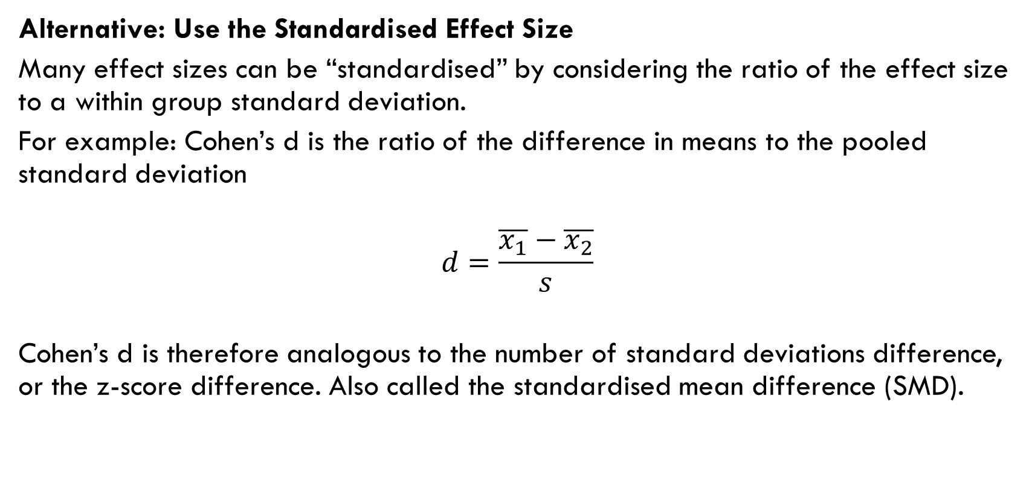
4. Estimate the variance Standardised Effect Size
Alternative: Use the Standardised Effect Size
Many effect sizes can be “standardised” by considering the ratio of the effect size to a within group standard deviation.
For example: Cohen’s d is the ratio of the difference in means to the pooled standard deviation
$$d=\frac{\overline{x_{1}}−\overline{x_{2}}}{s}$$
Cohen’s d is therefore analogous to the number of standard deviations difference, or the z-score difference. Also called the standardised mean difference (SMD).

Slide 39
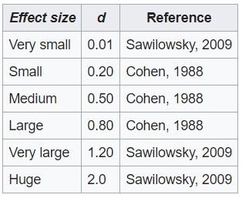
4. Estimate the variance Standardised Effect Size
Alternative: Use the Standardised Effect Size
Instead of deciding on effect size and an estimate of SD, we can choose a value of Cohen’s d based on accepted interpretations of relative size.
Notes:
for other standardised effect sizes use the appropriate rule of thumb.
Interpretation can vary across different fields of study.
Using the rule of thumb is suitable for exploratory studies but not for confirmatory.
https://en.wikipedia.org/wiki/Effect_size#Cohen's_d

Slide 40
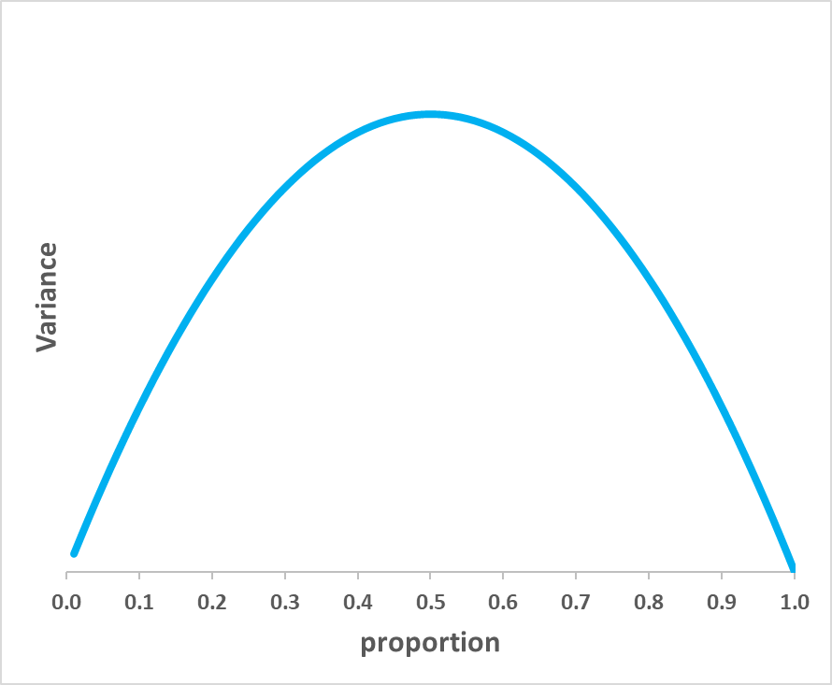

4. Estimate the variance Theoretical upper bound
For proportions the maximum variance occurs when p=50% and is at a minimum when p=0% and 100%.
So we can use p=50% to find a theoretical upper bound.
$$Variance\left(p\right)=p(1−p)$$
Why is this the case?
It might be strange to think about the variance of a proportion. You can think about it as a feature of a binomial (0 or 1) outcome. What proportion of subjects are 0 and how many are 1 for some outcome? (e.g. 0 = non-smoker and 1 = smoker)
Proportions must be between 0 and 1. When our estimate is close to these limits, there is less variability in our estimates for the same number of subjects surveyed.

Slide 41
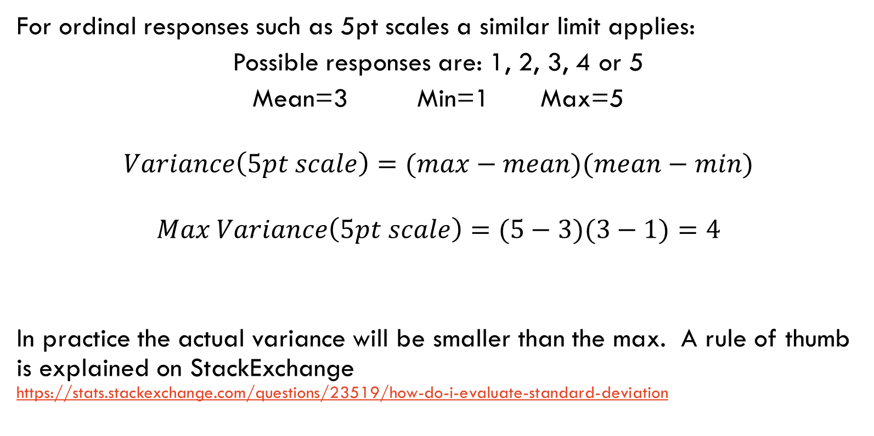
4. Estimate the variance Theoretical upper bound
For ordinal responses such as 5pt scales a similar limit applies:
Possible responses are: 1, 2, 3, 4 or 5
Mean=3 Min=1 Max=5
$$Variance\left(5pt scale\right)=(max−mean)(mean−min)$$
$$Max Variance\left(5pt scale\right)=(5−3)(3−1)=4$$
In practice the actual variance will be smaller than the max. A rule of thumb is explained on StackExchange https://stats.stackexchange.com/questions/23519/how-do-i-evaluate-standard-deviation
This applies especially to Survey Design. See the workshop for details.

Slide 42
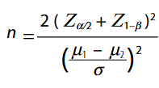
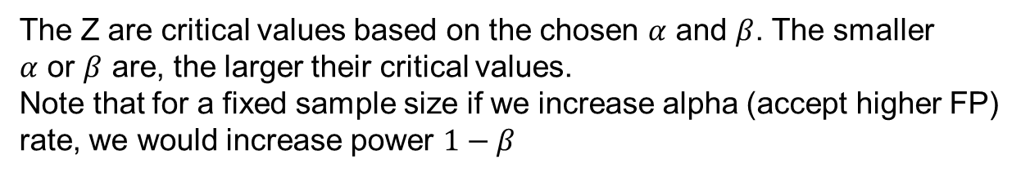
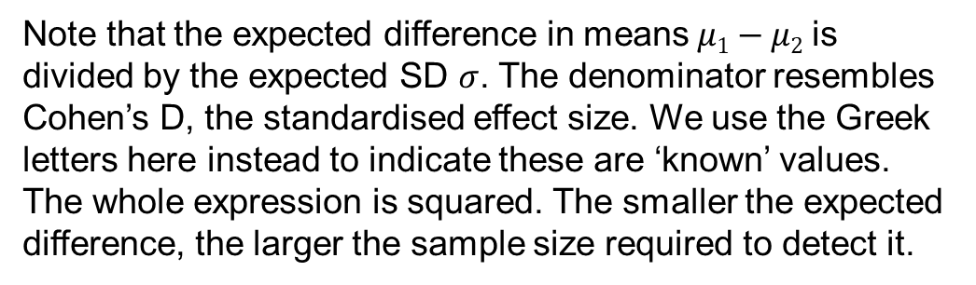
5. Calculate the minimum sample size
This is typically done using a software package
Formulae for the calculation vary with the type of experimental design and the statistical test. We won’t look at these too closely, but let’s note some common features to reinforce the theory we have learned.
The formula below is for a difference in means of two groups, where the standard deviation is known (good for illustration, though not often used in practice).
The Z are critical values based on the chosen $α$ and $β$. The smaller $α$ or $β$ are, the larger their critical values.
Note that for a fixed sample size if we increase alpha (accept higher FP)
rate, we would increase power $1−β$
Note that the expected difference in means$μ1−μ2$ is divided by the expected SD $σ$. The denominator resembles Cohen’s D, the standardised effect size. We use the Greek letters here instead to indicate these are ‘known’ values. The whole expression is squared. The smaller the expected difference, the larger the sample size required to detect it.

Slide 43
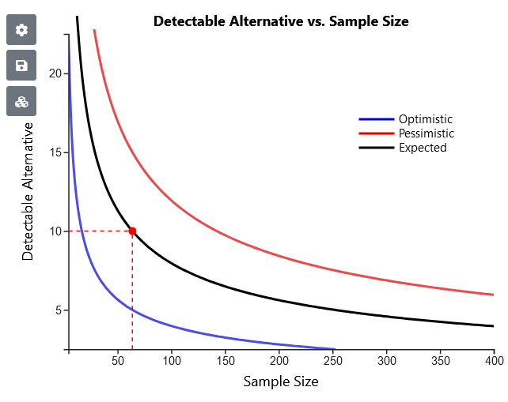
6. Explore scenarios
Tip from the consulting room:
Don’t just calculate a single sample size n for a power calculation
Use the software to calculate n for a range of scenarios to explore uncertainty in the input values used in the calculation. You may have a large uncertainty in the variance, and/or the expected effect size.
A Power Analysis incorporates informative plots to design and plan your study
Useful for experiment planning: Consider also the shape of the cost curve for sample data collection
In the above example increasing sample size up to ~100 yields big effect size detection benefit but increasing sample size beyond ~100 yields diminishing returns. You can use this information in combination with feasibility considerations to choose a target sample size.

Slide 44
Worked Examples
Get ready…

Slide 45
Examples using Statulator
This section shows four simple worked examples:
A: Difference between two means (continuous response)
B: Difference between two means (survey response)
C: Difference between two proportions
D: Estimation of a single proportion
We will step through example A and leave B, C and D for you to do later.
Notes:
Any questions at this point?

Slide 46
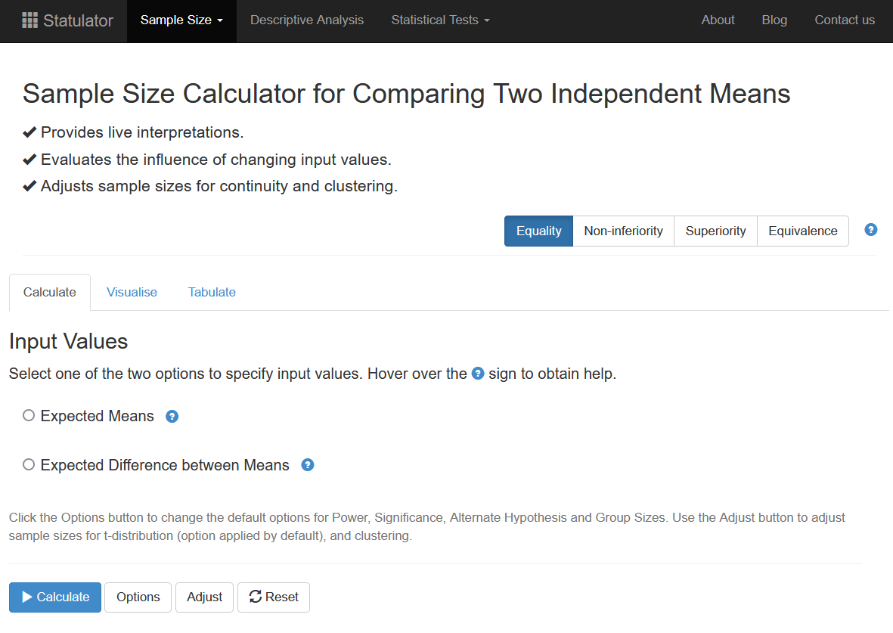
Power calculation software used in this workshop
Statulator
Free on-line statistical calculator
Developed by epidemiologists and biostatisticians at Sydney University
Easy to use
Live interpretation provided for each calculation
Visualisations to help you explore scenarios
Incorporates other types of hypothesis test beyond the usual superiority type
Power and Sample Size (PS)
Free on-line power and sample size calculator
Useful for power analysis plots
Live interpretation provided for each calculation
G*Power
Free download
Easy to use

Slide 47

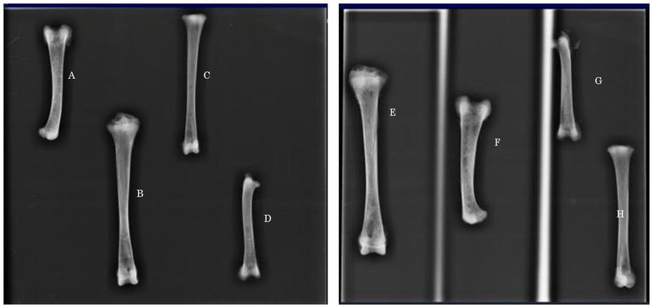
A. Difference between two means
Example: Chicken Welfare – Bone density
The bone density of chickens is an important indication of their welfare. We want to test to see if (mineral) bone density can be improved from 120 to at least 130 mg/cm³
Control Group (1) = normal diet
Treatment Group (2) = high mineral diet
Response variable: Measure the tibia bone density after 6 weeks growth.
How many chickens do I need to detect a difference in bone density of 10 mg/cm³?
What type of statistical test will we perform?
TY - JOUR AU - Mabelebele, Monnye AU - Norris, Dannah AU - Siwendu, Ndyebo AU - Ng'ambi, Jones AU - John, Alabi AU - Mbajiorgu, C.A. PY - 2017/01/01 SP - 1387 EP - 1398
T1 - Bone morphometric parameters of the tibia and femur of indigenous and broiler chickens reared intensively VL - 15 DO - 10.15666/aeer/1504_13871398 JO - Applied Ecology and Environmental Research ER -

Slide 48
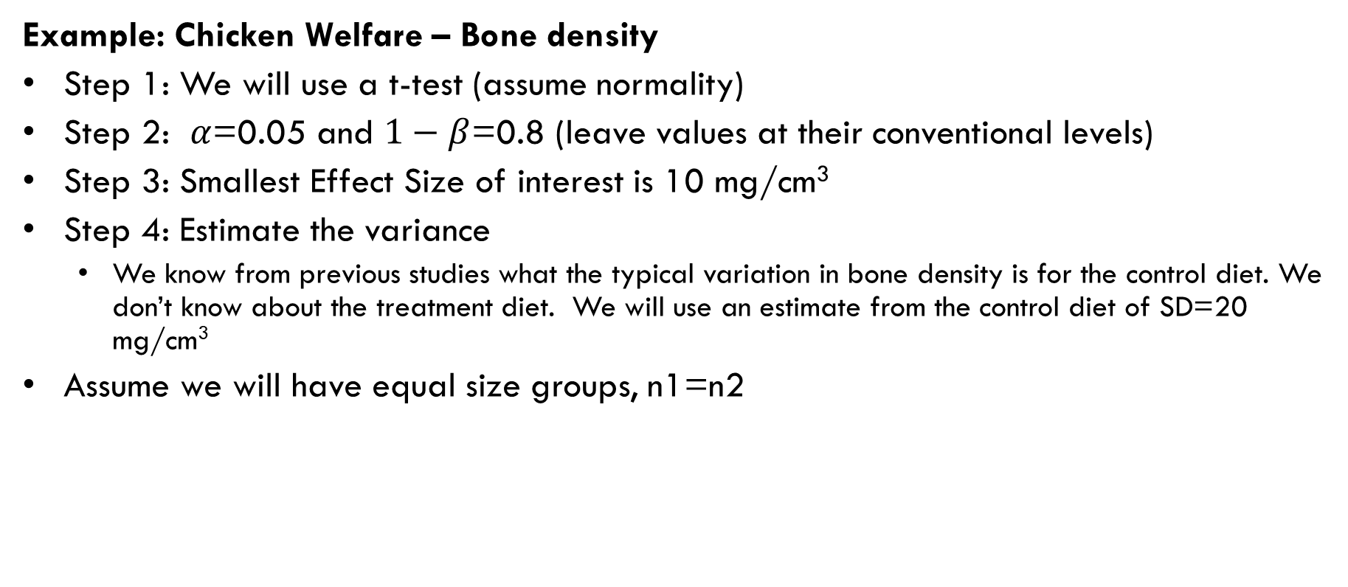
A. Difference between two means
Example: Chicken Welfare – Bone density
Step 1: We will use a t-test (assume normality)
Step 2: $α$=0.05 and $1−β$=0.8 (leave values at their conventional levels)
Step 3: Smallest Effect Size of interest is 10 mg/cm³
Step 4: Estimate the variance
We know from previous studies what the typical variation in bone density is for the control diet. We don’t know about the treatment diet. We will use an estimate from the control diet of SD=20 mg/cm³
Assume we will have equal size groups, n1=n2

Slide 49
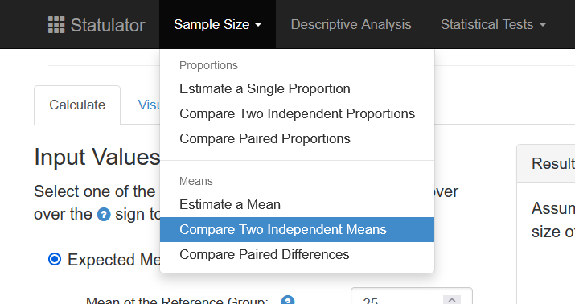
A. Difference between two means
Step 5: Statulator
Select Sample Size -> Compare Two Independent Means
Notes:
The design based approach was added as part of version 3 in 2007 and is an easier way to find the appropriate test.

Slide 50
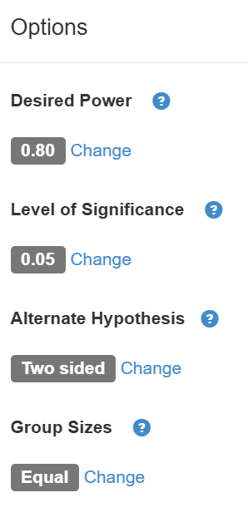
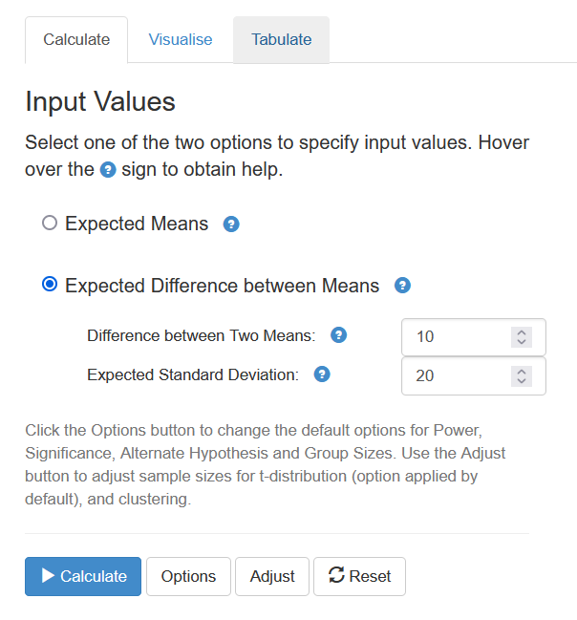
A. Difference between two means
Statulator
Step 5: Calculate the minimum sample size
Put all the information into Statulator
Choose expected difference between the means
Difference between Two Means = 10 mg/cm³
Expected Standard Deviation = 20 mg/cm³
Leave all other Options at their defaults (80% power, 5% alpha, two-sided, equal groups)
Click “Calculate”
1
2
3
4
4

Slide 51
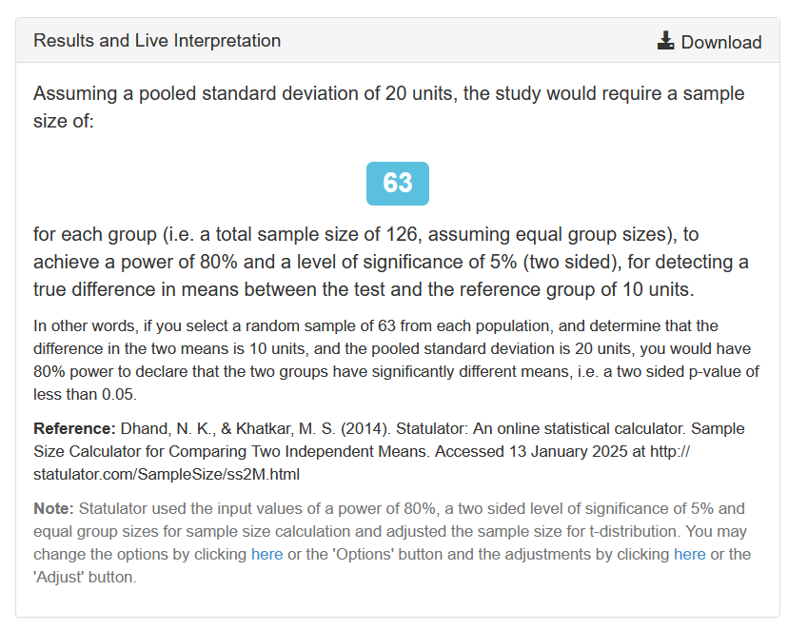
A. Difference between two means
Statulator
Step 5: Calculate the minimum sample size
Group sample sizes are N1=63, N2=63
Statulator provides a plain-English explanation of the calculation. Relevant paragraphs can be included in your grant or ethics application
Also a good opportunity to check that Statulator has done the calculation you think it has (in this case a two-sided test, using a t-distribution)

Slide 52
A. Difference between two means
Example: Chicken Welfare – Bone density
Step 6: Explore scenarios
Power Analysis
It is advisable to explore some different scenarios to incorporate uncertainty in our variance (SD) estimate.
Consider how much your within study standard deviation could vary from your point estimate
Our estimate is SD = 20 mg/cm³ (expected)
Possible min value = 15 mg/cm³ (optimistic)
Possible max value = 30 mg/cm³ (pessimistic, conservative)
Consider scenarios for choice of sesoi.
Our sesoi is 10 mg/cm³
Possible min chosen sesoi value = 5 mg/cm³
Possible max chosen sesoi value = 15 mg/cm³

Slide 53
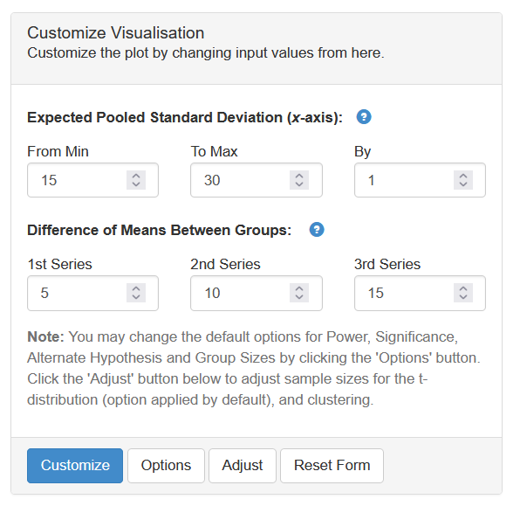
A. Difference between two means
Statulator
Click the visualise tab
Enter the ranges into Statulator and click ‘Customize’
1
2
3
4

Slide 54
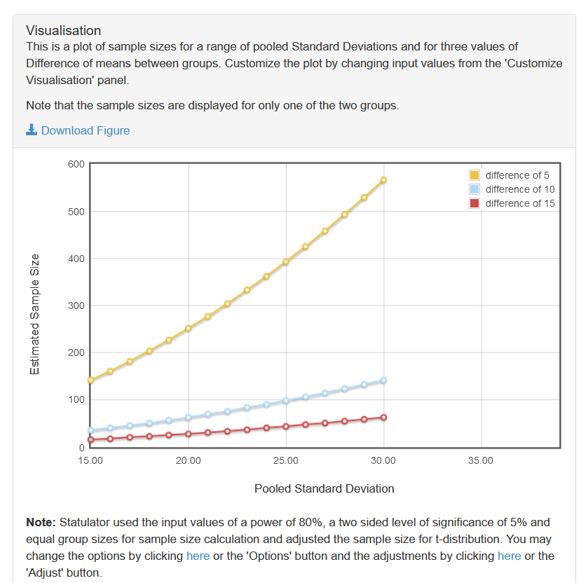
A. Difference between two means
Statulator
We get a plot showing how the specified scenarios affect the required sample size.
Although useful, for some this is not a complete power analysis and you may need additional plots

Slide 55
B. Difference between two means (Mann-Whitney)
The Mann-Whitney U test is a non-parametric version of the t-test for a difference in means. It is based on ranks (also called Wilcoxon rank sum)
This is used when the data are not approximately normally distributed (could be highly skewed), or the underlying distribution is not normal (could be ordinal).
Often used for ordinal data from surveys using Likert response items.
The values of the two groups are combined and ranked. The values are then divided back into the groups and the mean of the assigned ranks for each group is calculated and compared.
The test doesn’t use the information about the size of the effect.
Notes:
Use the non-parametric test in situations such as when analysing survey responses that have ordinal scales (no true scale measure).

Slide 56
B. Difference between two means (Mann-Whitney)
Example: Happiness Survey
You want to measure happiness using the Lyubomirsky & Lepper scale. Each item response ranges from 1 (unhappy) to 7 (happy). The score is the sum of 4 items, so the range is 4~28.
Values
Ranks
A pilot study on two groups produced the following results that can be used for the power calculation (Mean and SD)
Single
Married
Single
Married
12
20
3
1
11
15
4
2
10
9
5
6
6
8
8
7
Mean
9.8
13.0
5
4
SD
2.6
5.6
Notes:
Pronunciation: lube-oh-merr-ski

Slide 57
B. Difference between two means (Mann-Whitney)
Example: Happiness Survey
You want to apply it to different groups of people (e.g. single vs married) to see if there is a difference in scores.
What is a meaningful difference?
Let’s suppose that a minimum difference of 4 points (average of 1pt difference per item) is the smallest effect size of interest.

Slide 58
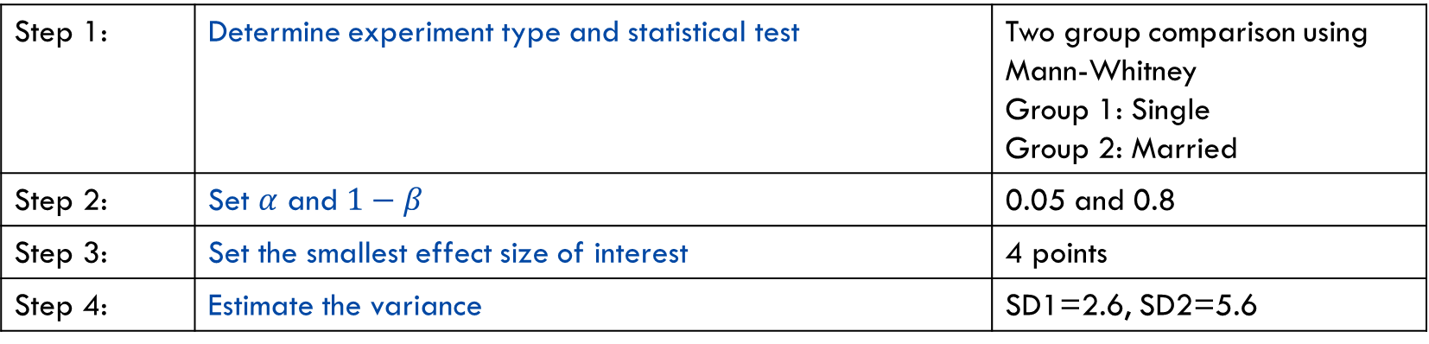
B. Difference between two means (Mann-Whitney)
Example: Happiness Survey
So, what are our first 4 steps?
Step 1: | Determine experiment type and statistical test | Two group comparison using Mann-Whitney Group 1: Single Group 2: Married
Step 2: | Set $α$ and $1−β$ | 0.05 and 0.8
Step 3: | Set the smallest effect size of interest | 4 points
Step 4: | Estimate the variance | SD1=2.6, SD2=5.6

Slide 59
B. Difference between two means (Mann-Whitney)
Example: Happiness Survey
Sample size calculation
Heuristic method
“Do the calculations as if performing the corresponding parametric test (i.e. the t-test), then add 15% to the sample size.”

Slide 60
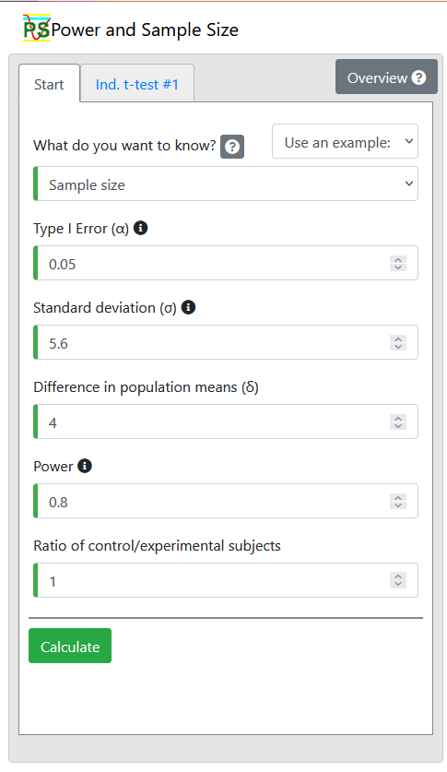
B. Difference between two means (Mann-Whitney)
Example: Happiness Survey
t-test>Independent
Enter Difference in population means=4
Enter the larger SD (Standard deviation=5.6)
Enter other inputs
Click ‘calculate’
1
2
2
2
2
2
3

Slide 61
B. Difference between two means (Mann-Whitney)
Example: Happiness Survey
N=32 per group
Add 15% for non-parametric. N=32x1.15 = 36.8 round up to 37
Notes:
We will use the values for means and SDs from the previous slide.
This means the minimum effect size of interest is 28.75-21.25=7.5 In reality we might choose a different min effect size, but still use SD estimates from a previous study.

Slide 62

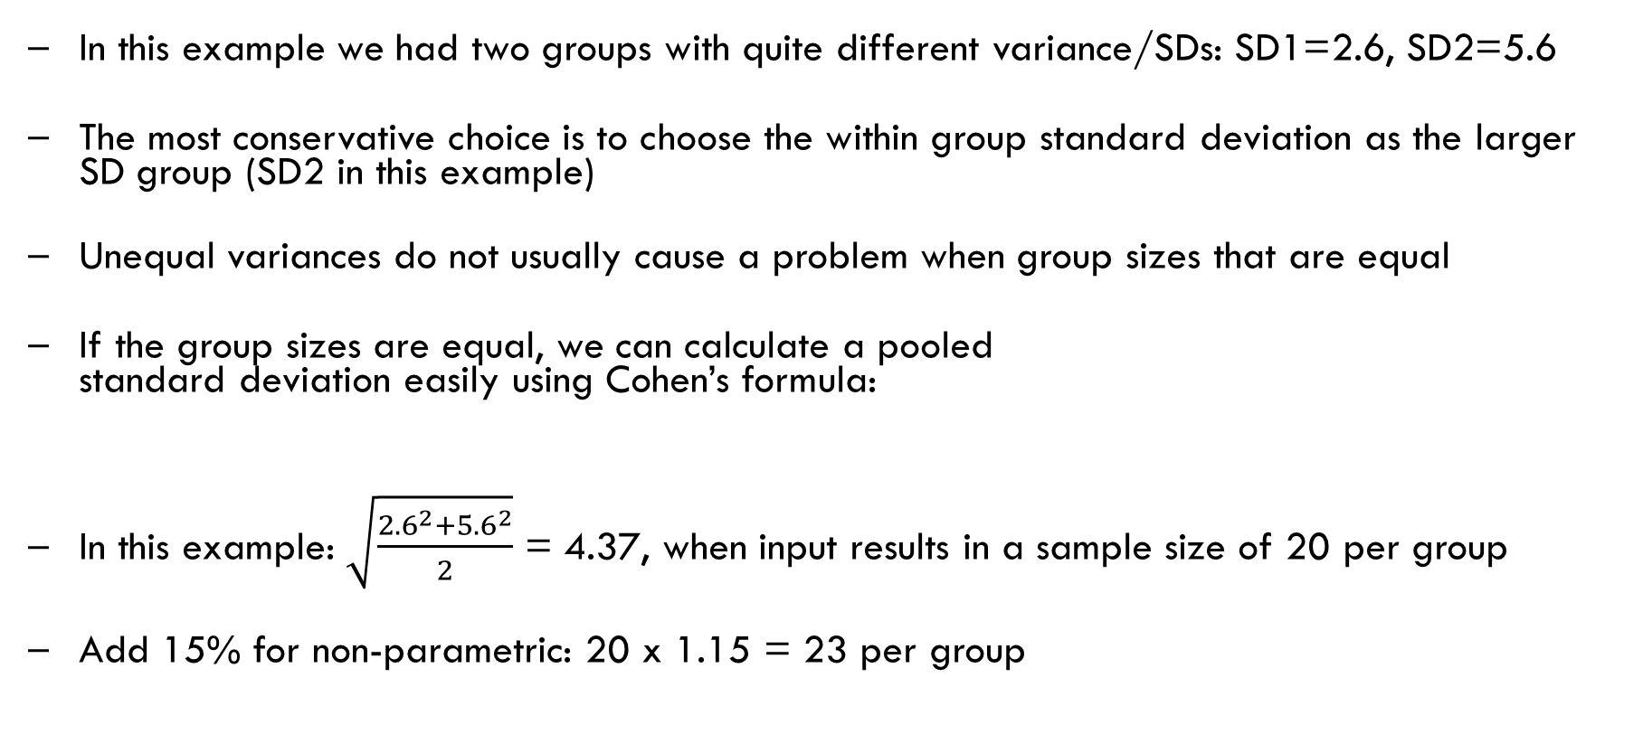
How and why to calculate within-group standard deviation
In this example we had two groups with quite different variance/SDs: SD1=2.6, SD2=5.6
The most conservative choice is to choose the within group standard deviation as the larger SD group (SD2 in this example)
Unequal variances do not usually cause a problem when group sizes that are equal
If the group sizes are equal, we can calculate a pooled standard deviation easily using Cohen’s formula:
In this example: $\sqrt{\frac{{2.6}^{2}+{5.6}^{2}}{2}}$ = 4.37, when input results in a sample size of 20 per group
Add 15% for non-parametric: 20 x 1.15 = 23 per group

Slide 63
C. Difference between two proportions
Example: Happiness survey
The survey scores could also be analysed as proportions by considering how many report a value above a threshold (say >14 means “happy”)
Singles group P1 = proportion of subjects respond “happy”
Married group P2 = proportion of subjects respond “happy”
Effect size: Say we want to find a minimum difference in proportions of P1-P2=0.1 What sample size is required?
We also need to estimate the two proportions. Let’s first assume that there will be maximum variance (p=0.50)
Try using P1=0.55 and P2= 0.45. As p = (p1 + p2)/2.

Slide 64
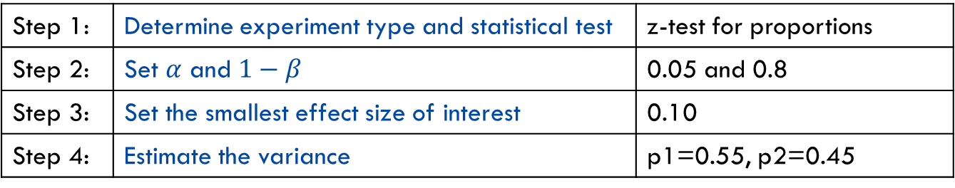
C. Difference between two proportions
Example: Happiness survey
What are our first 4 steps this time?
Note: The variance estimate comes from the proportion estimates and is calculated for you.
Variance = p(1-p).
Step 1: | Determine experiment type and statistical test | z-test for proportions
Step 2: | Set $α$ and $1−β$ | 0.05 and 0.8
Step 3: | Set the smallest effect size of interest | 0.10
Step 4: | Estimate the variance | p1=0.55, p2=0.45

Slide 65
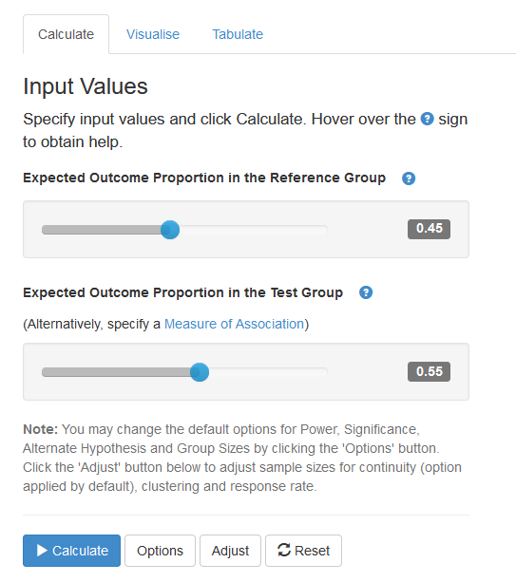
C. Difference between two proportions
Example: Happiness survey
Step 5: Statulator
Select Sample Size -> Compare Two Independent Proportions
Statulator
1
2
3
Notes:
We will choose the z test for difference in proportions between two independent groups.

Slide 66
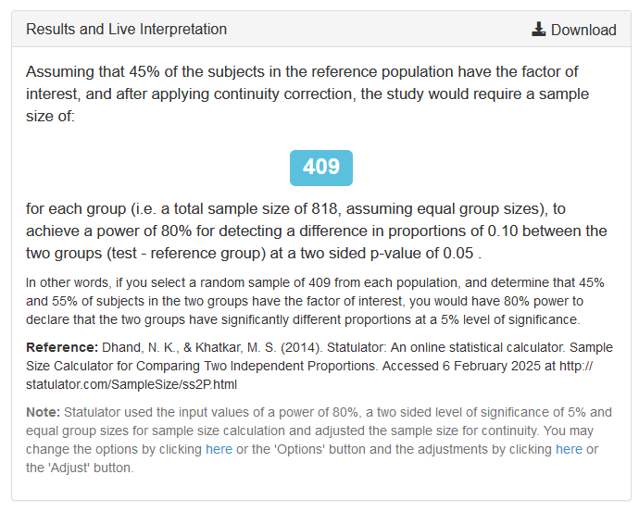
C. Difference between two proportions
The same outcome (happiness) that required 32 per group, with a binary variable requires 409 per group
That’s a lot of people
Tip from the consulting room:
With a binary outcome each subject provides only one [computer] bit of information: 0 or 1
If you do have an option to use the underlying scale as your outcome, your required sample size for a given power will often be drastically smaller

Slide 67
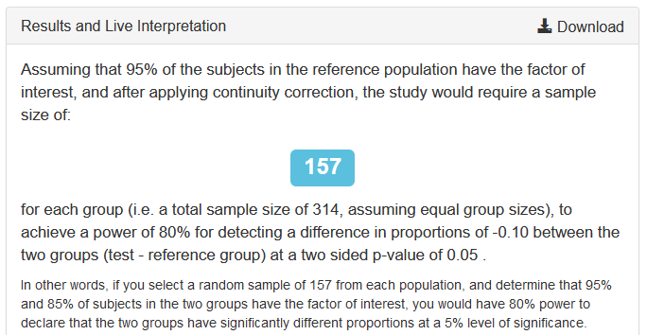
C. Difference between two proportions
We deliberately chose the proportions that would produce the maximum variance in the outcome for a given group difference (of 10%)
What if we collected more pilot data, and saw that our expected proportions were closer to: p1= 95% and p2 = 85%
The required sample size shrinks to 157 per group, which a lot less but still far more than when using the scale outcome directly

Slide 68
D. Estimation of a single proportion
A common sample size calculation that does not involve a hypothesis test
Proportions are encountered often:
Prevalence of disease in a population
Proportion of people failing a screening test
Sensitivity and specificity of a diagnostic test
The sample size calculation is to estimate a proportion to a given level of precision
Precision in this context is the width of the confidence interval (usually 95% confidence interval)
Expected proportion
and precision
0
₁

Slide 69
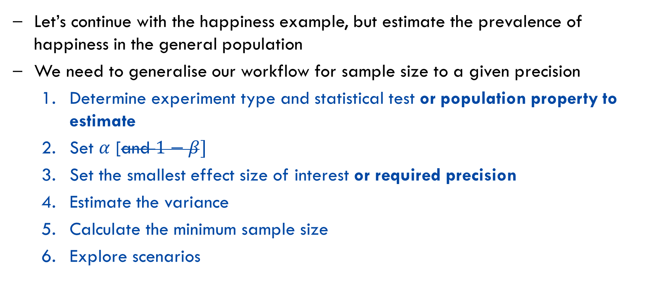
D. Estimation of a single proportion
Let’s continue with the happiness example, but estimate the prevalence of happiness in the general population
We need to generalise our workflow for sample size to a given precision
Determine experiment type and statistical test or population property to estimate
Set $α$ [and $1−β]$
Set the smallest effect size of interest or required precision
Estimate the variance
Calculate the minimum sample size
Explore scenarios

Slide 70
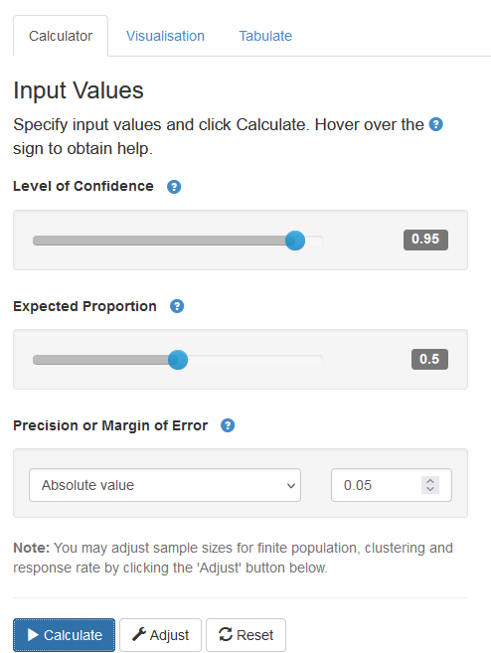
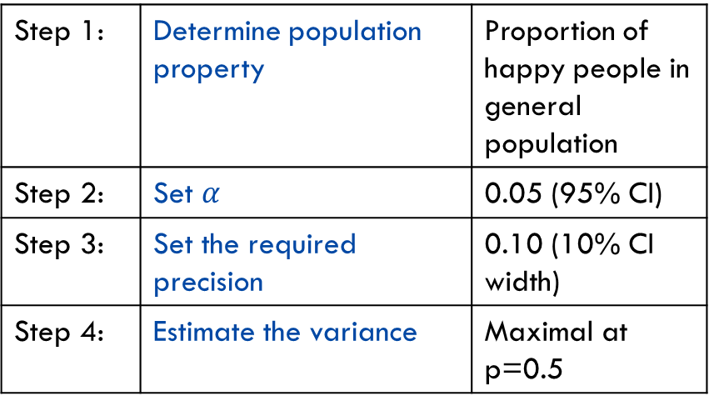
D. Estimation of a single proportion
Statulator
Example: Happiness survey
Step 5: Statulator
Select Sample Size -> Estimate a Single Proportion
1
Step 1: | Determine population property | Proportion of happy people in general population
Step 2: | Set $α$ | 0.05 (95% CI)
Step 3: | Set the required precision | 0.10 (10% CI width)
Step 4: | Estimate the variance | Maximal at p=0.5
2
3
4
The precision, specified here as an ‘absolute value’ is half the width of the desired confidence interval
Notes:
We will choose the z test for difference in proportions between two independent groups.

Slide 71
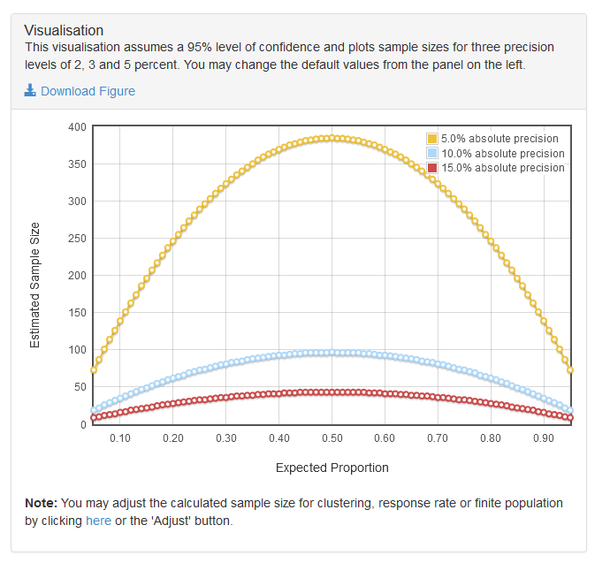
D. Estimation of a single proportion
The sample size required is 385 for a 10% wide confidence interval
Again, the maximal variance is when the p=0.5, so if we have a better idea of our expected p, the required sample size may be less than this

Slide 72
Power Analysis – final points
Dropout/contingency
Multiple testing
Power analysis for more complex designs

Slide 73

Tips from the consulting room: - Underestimating variance → underpowered studies - Ignoring dropout → fewer completers than planned - Choosing unrealistic SESOI → waste resources or miss meaningful effects - Blindly using defaults (α=0.05, power=0.8) - Multiple testing not accounted for → inflated Type I error - Over-reliance on software (or GenAI) without understanding assumptions - Not exploring scenarios → sensitivity to variance/effect size assumptions
Common Pitfalls

Slide 74
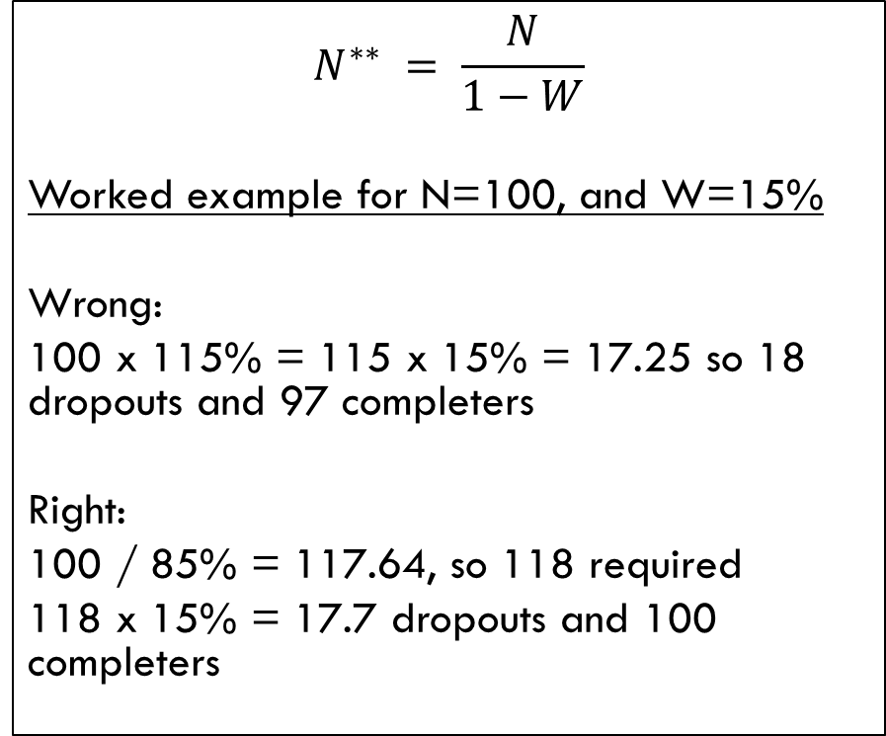
Handling dropout
Tip from the consulting room:
It is common, especially in clinical trials to inflate the required sample size to account for an expected rate of dropout
One pitfall is to inflate the minimum sample number (N) by the expected dropout rate (W). After dropouts this would not achieve the required sample size of completers
Instead we need to use the formula for N** for the inflated sample size that will restore the required sample size of completers after dropouts
$$N^{∗∗} = \frac{N}{1−W}$$
Worked example for N=100, and W=15%
Wrong:
100 x 115% = 115 x 15% = 17.25 so 18 dropouts and 97 completers
Right:
100 / 85% = 117.64, so 118 required
118 x 15% = 17.7 dropouts and 100 completers

Slide 75
Handling multiple testing
Multiple testing corrections must be incorporated into your power analysis
The easiest way to incorporate these is to change the alpha in the sample size calculation to match the reduced ‘per test’ alpha needed to achieve the Family Wise Error Rate (FWER) alpha
For Bonferroni correction, the ‘per test’ alpha is simply the FWER alpha divided by the number of tests
For more complex multiple testing corrections, you may need to chose a different alpha to input
You also need to consider your study goals, and your analysis plan. Feel free to have a consult to discuss further

Slide 76
Power Analysis for other designs
From simple designs to complex designs
So far we have considered power analysis for simple designs where the mathematical calculations are tractable and rely on a limited set of assumptions regarding the data to be obtained.
As design complexity increases, it becomes more difficult or perhaps impossible to find an analytical solution to calculate power.
When no formula exists:
Simplification – determine sample size for a simplified version of the study design and extrapolate this to the more complex design
Simulation – Monte Carlo methods (e.g. R packages: paramtest, simr, superpower), Bayesian simulation methods (e.g. R package: brms)

Slide 77
Power Analysis by simplification
Simplification
ANOVA: Choose the two groups that are most similar and power the post-hoc test to detect the expected difference between them. All other post-hocs and the F test should have sufficient power.
Multiple regression:
For a categorical factor of interest choose the factor of interest and power to detect the difference as a t-test (the same as a univariate model). The addition of covariates should only increase the power of your actual analysis
If you have an idea of the variance explained by your factor of interest and the residual variance you can use the linear multiple regression module of G* Power
Linear mixed models:
If you have a repeated measures experiment, power the study as if you only had one measurement. The addition of repeated measures should only increase the power of your actual analysis
Switch to simulation methods for complex study designs where analysis of a simplified design is not sufficiently rigorous.
Notes:
The options are finite however. Other software tools may be necessary for complex design scenarios.

Slide 78
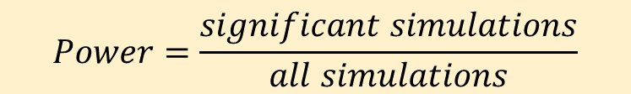
Power Analysis – by simulation
Simulation based power estimation
Simulate (many) data sets
Analyse each data set and test for statistical significance
Calculate the proportion of simulations with significant p values
The ‘trick’ is to set the parameters of the simulation in a sensible, realistic way
$$Power=\frac{significant simulations}{all simulations}$$
https://link.springer.com/article/10.3758/s13428-021-01546-0
Notes:
The options are finite however. Other software tools may be necessary for complex design scenarios.

Slide 79
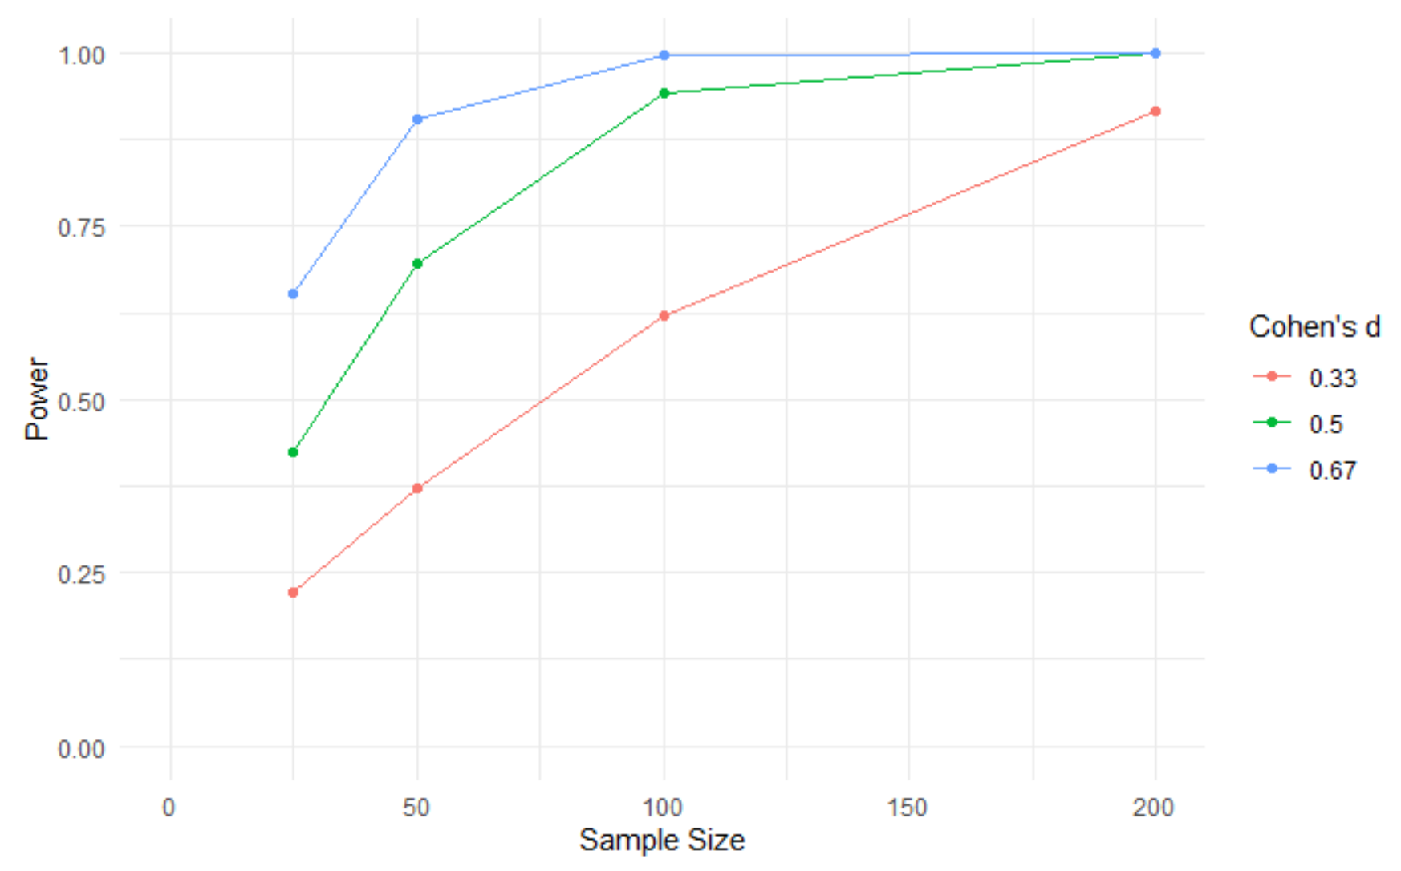
Power Analysis – by simulation
Example A: Chicken Welfare - bone density (difference between two means)
Simulation in R using package “paramtest”
Results for this simple simulation will be very similar to those obtained from G*Power.
See R Markdown files for details
Generalised linear mixed models
You can use the package simr
Specify the model as you would for analysis
simr then simulates data from that model
Notes:
The options are finite however. Other software tools may be necessary for complex design scenarios.

Slide 80
Software for Power Analysis
Tool | Type | Strengths | Limitations | Suitable Use
Statulator | Free online calculator | Simple interface; supports common tests | Limited to standard designs; no advanced trials | Basic medical/clinical sample‑size needs
G*Power | Free software | Easy GUI; common tests (t, ANOVA, correlations) | No advanced models; no survival/cluster support | Standard academic research
R packages | Free/open‑source | Highly flexible; simulation possible | Requires coding; no GUI | Complex or custom modelling
SPSS (Power add‑ons) | Licensed statistical package | Convenient for SPSS users; standard tests | Limited scope; not ideal for advanced designs | Applied social/health sciences
Stata | Licensed statistical package | Strong modelling; supports power commands | Coding required; fewer GUI tools | Regression‑based, longitudinal, survival analyses
PASS | Licensed, dedicated power software | Comprehensive; 680+ procedures, 230+ designs; strong reporting | Cost; complexity beyond basic needs | Clinical trials, regulatory research
Power & Precision | Licensed power‑only tool | Clear UI; excellent teaching and reporting features | Less coverage than PASS; limited complex models | Education, grants, standard designs

Slide 81
Software for Power Analysis – R packages
Package | Main Focus | Strengths | Suitable use
pwr & pwr2 | Classical tests | Simple functions for t‑tests, ANOVA, correlations; easy to learn | Standard designs; classical methods
samplesize | Basic sample‑size formulas | Functions for means, proportions, correlations, and basic regression | Straightforward analytical designs
powerAnalysis | General analytical power | Clean syntax; supports common tests and regression power | Routine academic designs
TrialSize | Clinical‑trial formulas | Many procedures for parallel, equivalence, non‑inferiority, survival | Medical and clinical trial planning
powerSurvEpi | Survival / epidemiology | Power for Cox models, survival comparisons, cohort and case‑control studies | Time‑to‑event and epidemiological designs
WebPower | SEM, multilevel, mediation | GUI + R functions; supports SEM, mediation, and multilevel designs | Psychology, education, social science studies
superpower | Simulation based calculations | ANOVA and Mixed designs, simulation outputs and plots | Complex ANOVA designs, unbalanced designs
simr | Simulation for GLMMs with lme4 | Very flexible simulation features | Prior data exists, Mixed Models and GLMM
clusterPower | Cluster‑randomized designs | Supports CRTs, stepped‑wedge, repeated measures clusters | Public health, implementation science, CRT planning

Slide 82
Power calculation references
G*Power http://www.psychologie.hhu.de/arbeitsgruppen/allgemeine-psychologie-und-arbeitspsychologie/gpower.html
NCSS PASS Statistical software https://www.ncss.com/software/pass/
Causal Evaluation https://www.causalevaluation.org/power-analysis.html
Epi Tools for disease prevalence (by AUSVET) http://epitools.ausvet.com.au/content.php?page=SampleSize
Demidenko (Dartmouth) for logistic regression https://www.dartmouth.edu/~eugened/power-samplesize.php
National Institutes of Health (NIH – USA) for cluster randomised trials https://researchmethodsresources.nih.gov/SampleSizeCalculator.aspx
UCSF Clinical and Translational science institute (Survival for clinical research) http://www.sample-size.net/sample-size-survival-analysis/
Lakens, D. Open Science Framework https://osf.io/ixGcd/

Slide 83
Power Analysis – library references
Cohen, Jacob. Statistical Power Analysis for the Behavioral Sciences. Burlington: Elsevier Science, 2013. Print. https://sydney.primo.exlibrisgroup.com/permalink/61USYD_INST/14vvljs/alma991005702359705106
Dattalo, Patrick. Determining Sample Size Balancing Power, Precision, and Practicality Oxford: Oxford University Press, 2008. Print. https://sydney.primo.exlibrisgroup.com/permalink/61USYD_INST/14vvljs/alma991015395569705106
Julious, Steven A. Sample Sizes for Clinical Trials Boca Raton: CRC Press/Taylor & Francis, 2010. Print. https://sydney.primo.exlibrisgroup.com/permalink/61USYD_INST/14vvljs/alma991000960739705106
Ryan, Thomas P., and Thomas P Ryan. Sample Size Determination and Power. Somerset: John Wiley & Sons, Incorporated, 2013. Web. https://sydney.primo.exlibrisgroup.com/permalink/61USYD_INST/1367smt/cdi_askewsholts_vlebooks_9781118439203

Slide 84

Further Assistance at Sydney University
SIH
Statistical Consulting website: containing our workshop slides and our favourite external resources (including links for learning R and SPSS)
Hacky Hour an informal monthly meetup for getting help with coding or using statistics software
1on1 Consults can be requested on our website (click on the big red ‘contact us’ link)
SIH Workshops
Create your own custom programmes tailored to your research needs by attending more of our Statistical Consulting workshops. Look for the statistics workshops on our training page.
Other SIH workshops
Sign up to our mailing list to be notified of upcoming training
Other
Open Learning Environment (OLE) courses
Linkedin Learning

Slide 85

A reminder: Acknowledging SIH
All University of Sydney resources are available to Sydney researchers free of charge. The use of the SIH services including the Artemis HPC and associated support and training warrants acknowledgement in any publications, conference proceedings or posters describing work facilitated by these services.
The continued acknowledgment of the use of SIH facilities ensures the sustainability of our services.
Suggested wording for use of workshops and workflows:
“The authors acknowledge the Statistical workshops and workflows provided by the Sydney Informatics Hub, a Core Research Facility of the University of Sydney.”

Slide 86

Authors
Jim Matthews (current owner)
Alex Shaw

