Slide 1




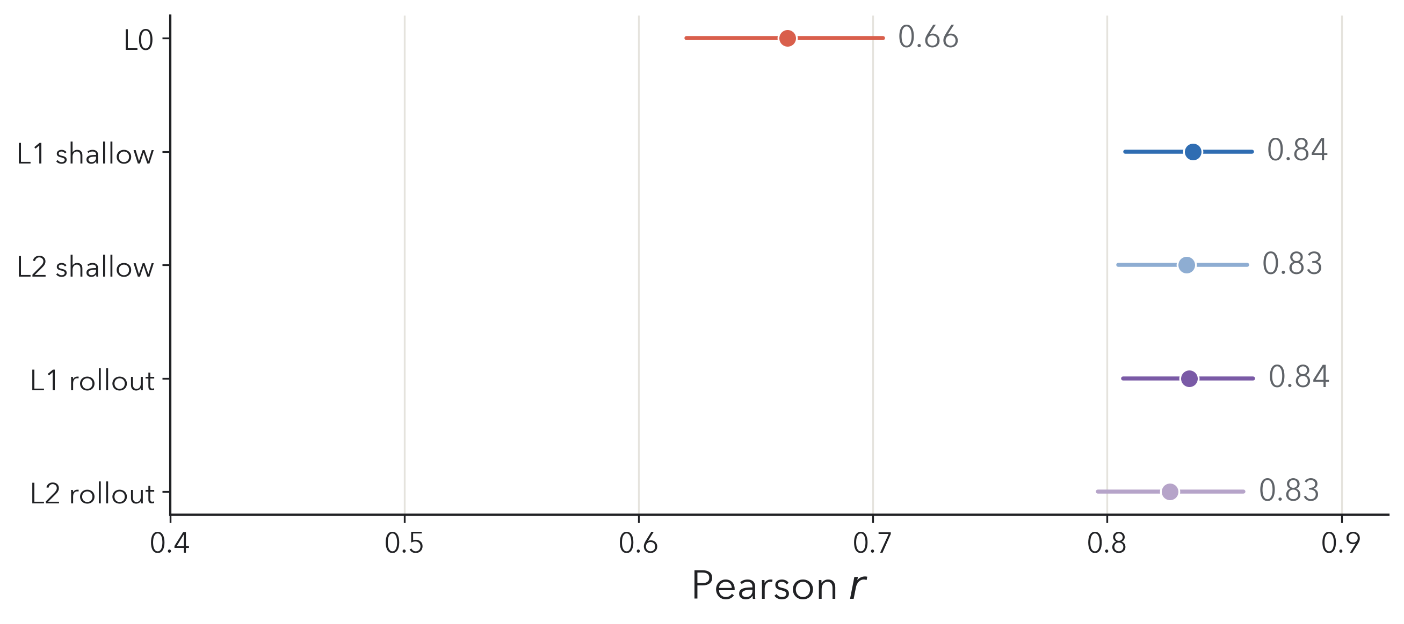
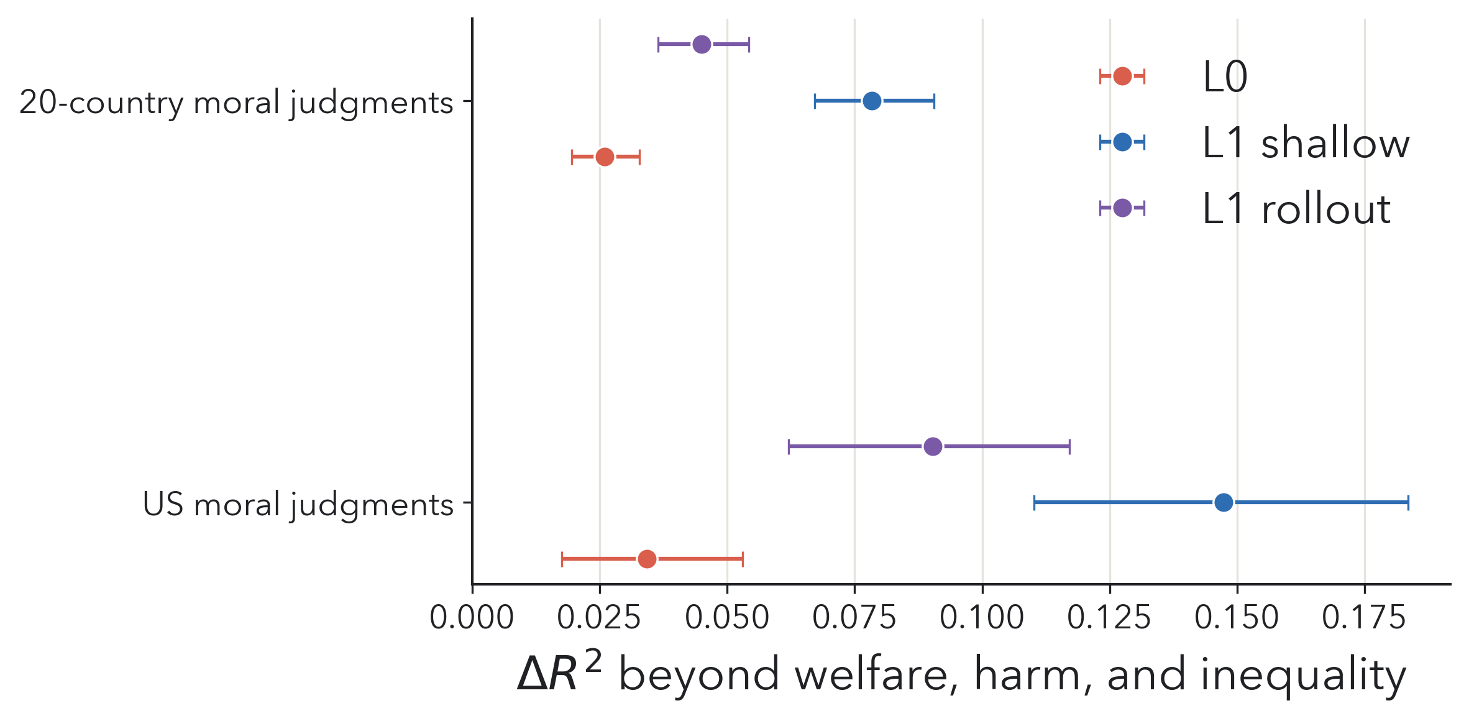
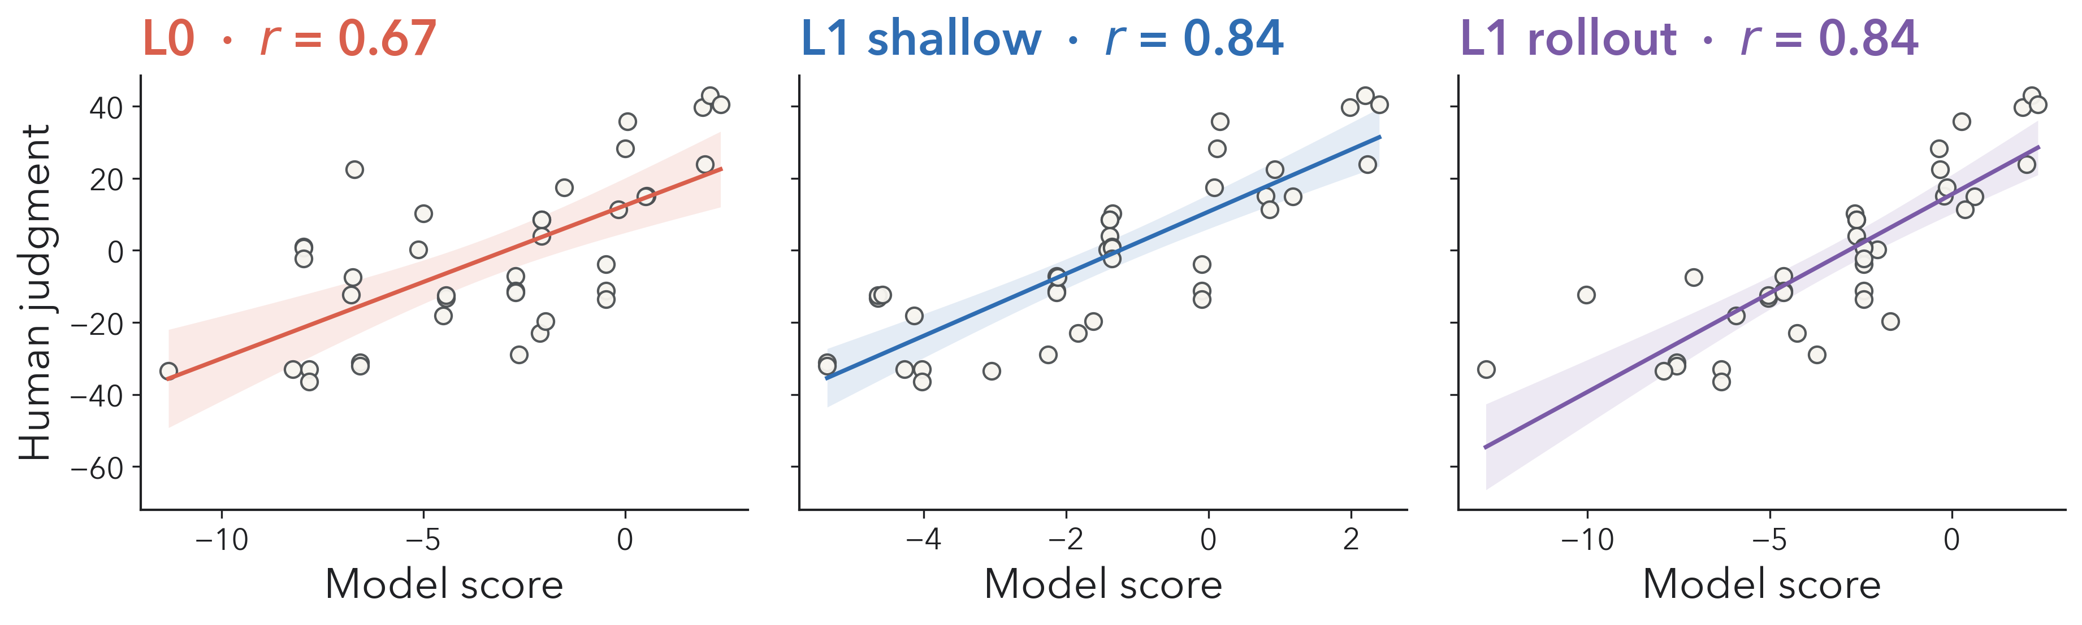
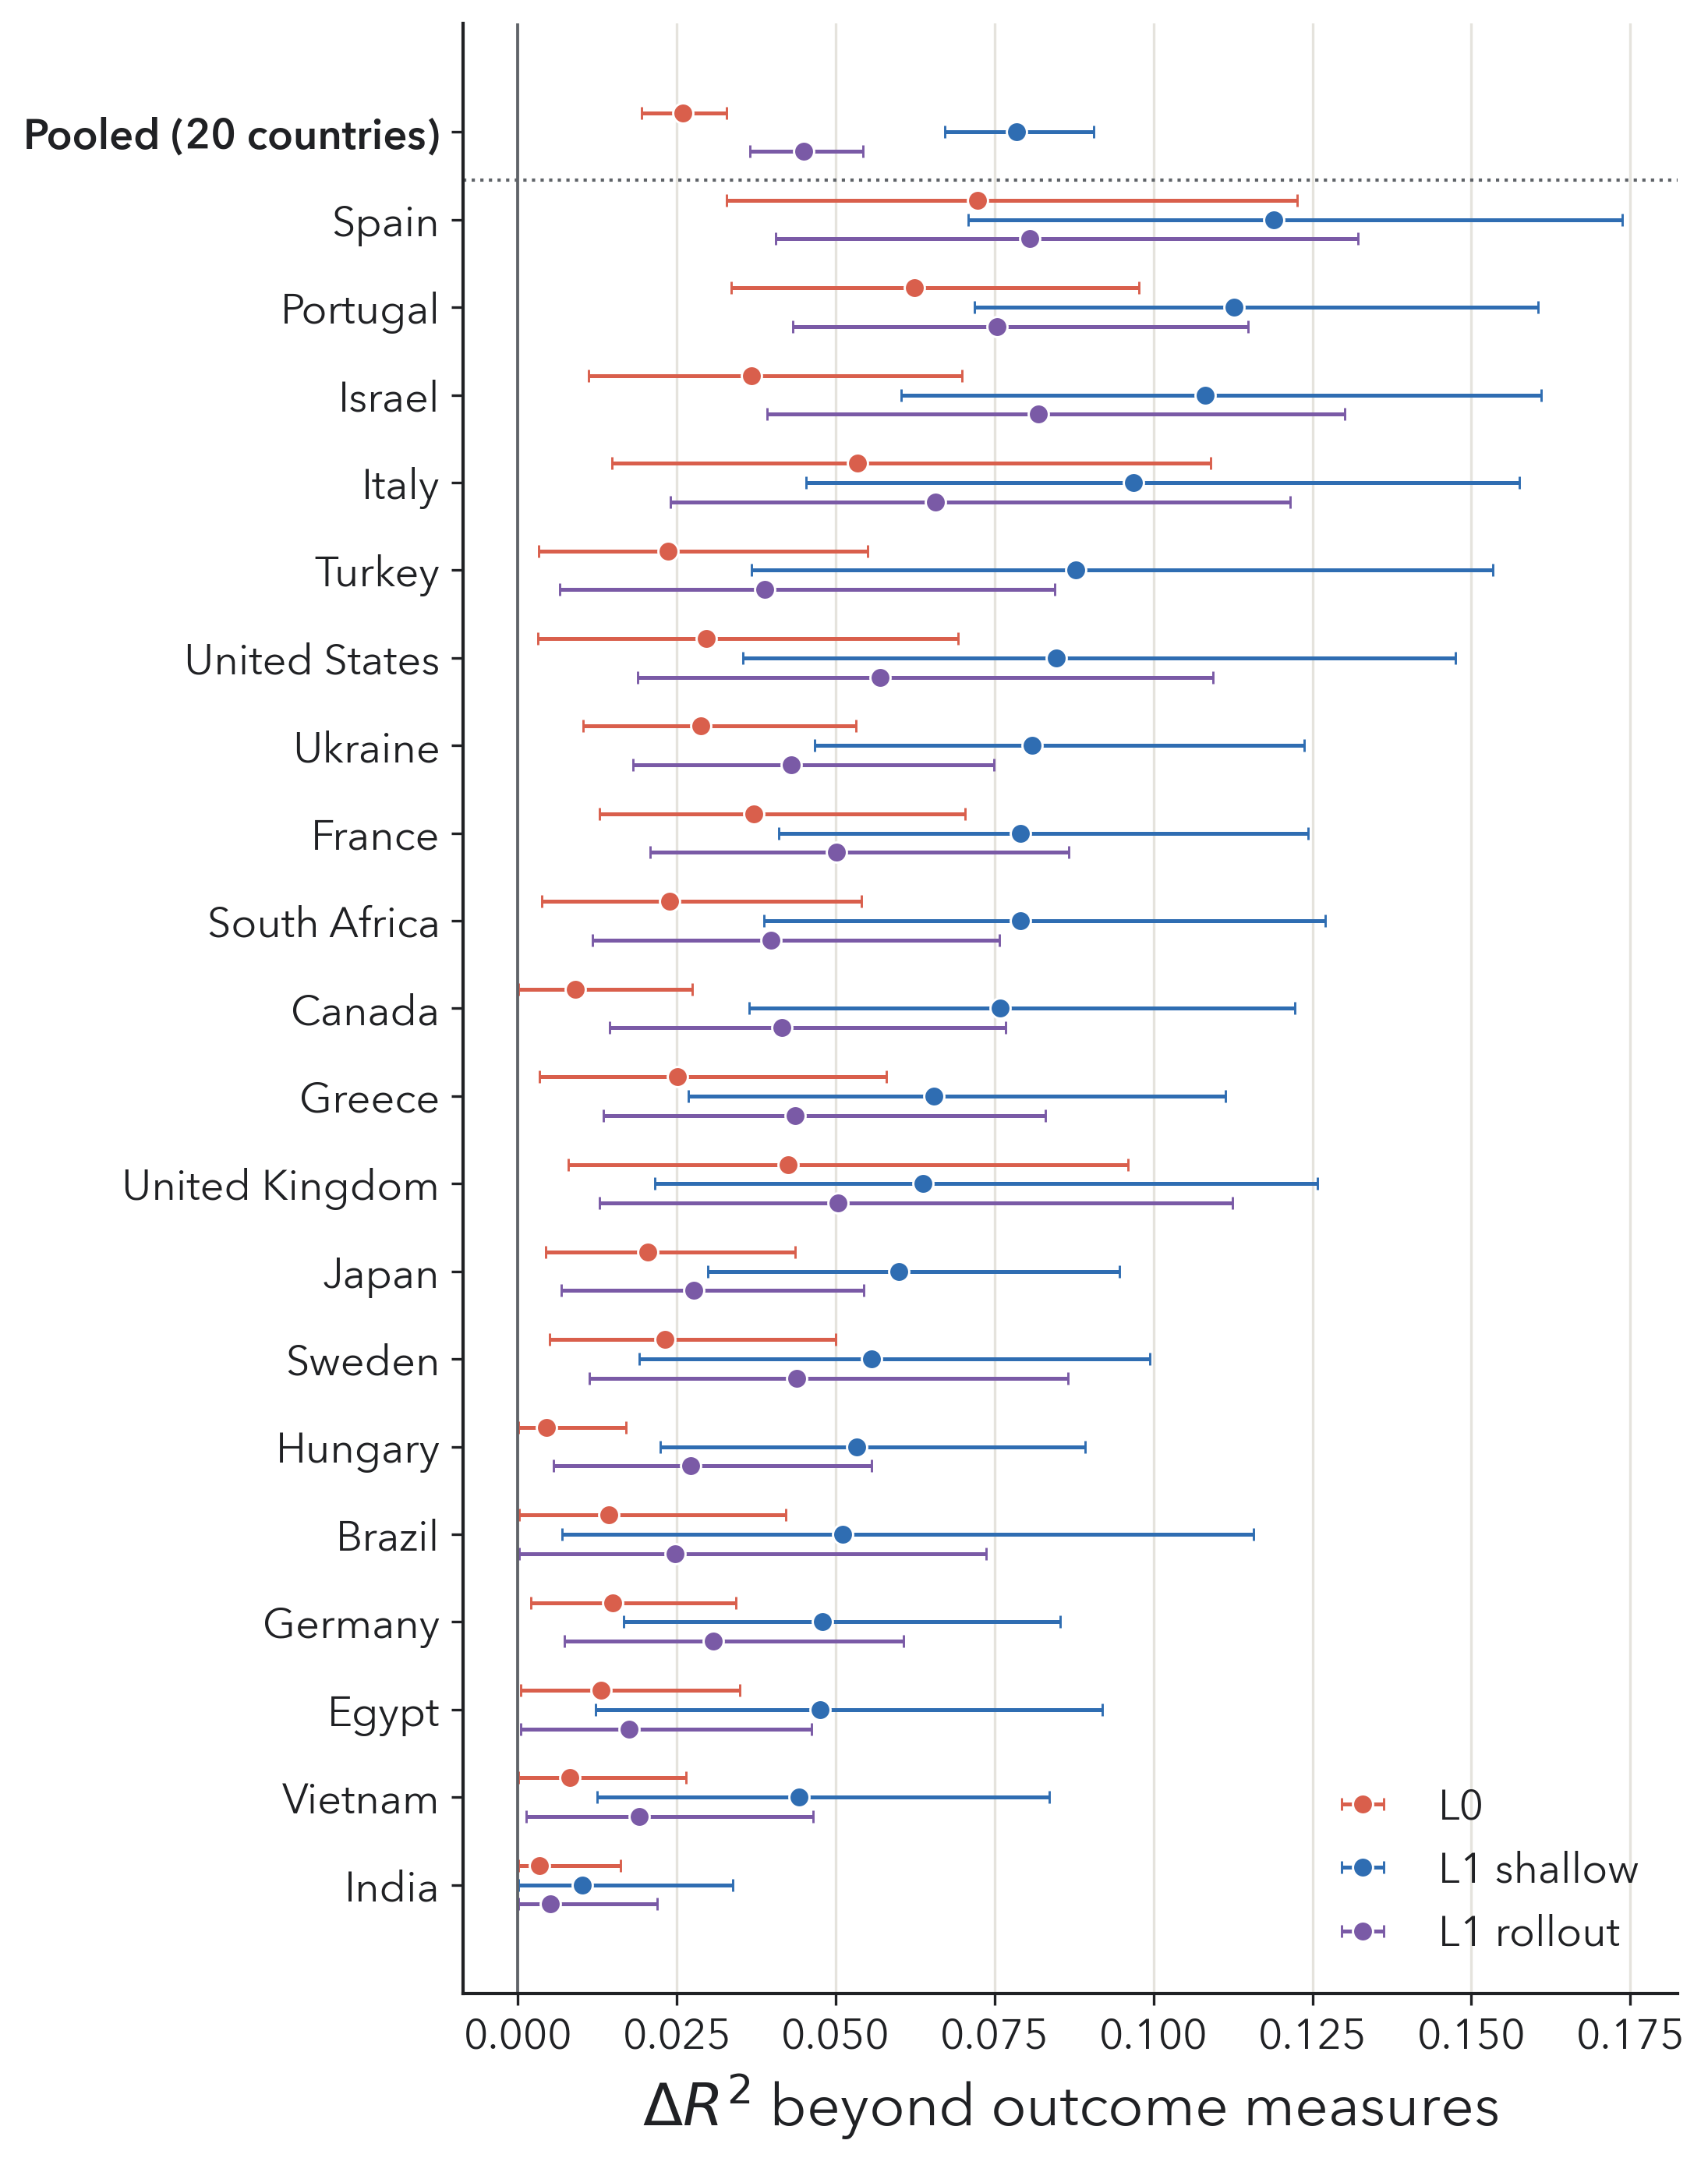
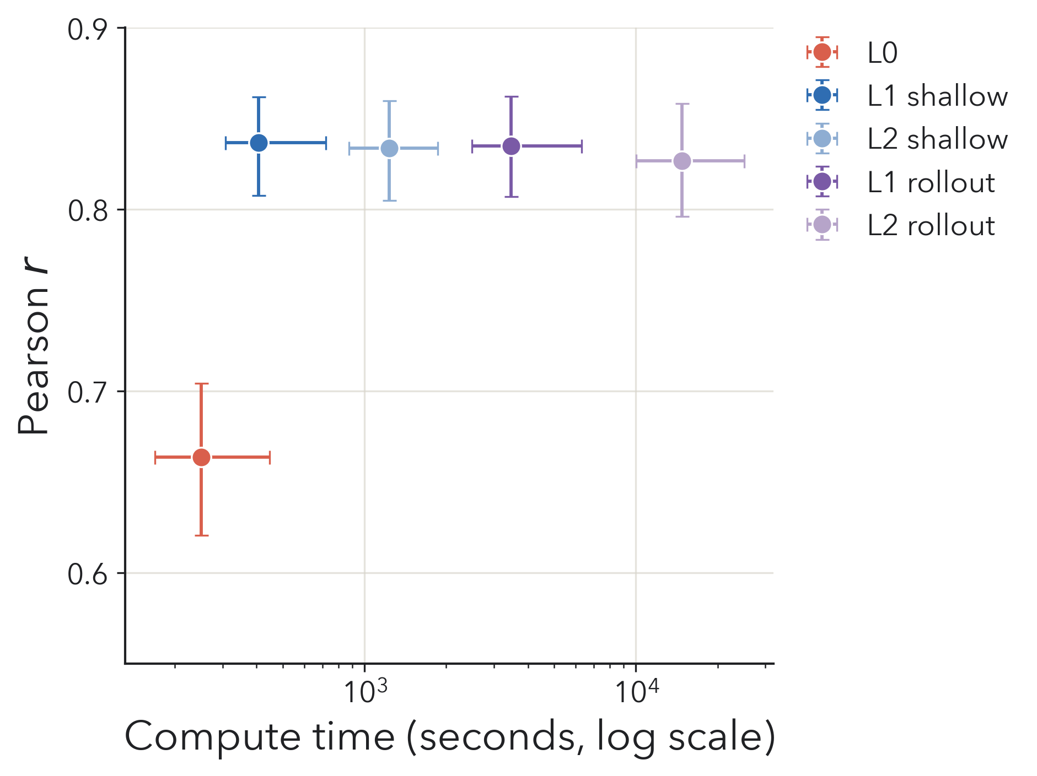
How do people universalize?
Comparing resource-rational models of moral reasoning
Julien Lie-Panis¹˒² · Logan A. Walls³ · Joshua B. Tenenbaum¹ · Katherine M. Collins¹ · Sydney Levine³
¹ Center for Brains, Minds and Machines, MIT ² Institut de Biologie de l’Ecole Normale Supérieure, ENS–PSL ³ Department of Psychology, New York University
CogSci 2026 · Rio de Janeiro · Poster P1-M-122 · Session 1, Thu July 23
a
To decide when it’s OK to break a rule, people can universalize, asking “What if everyone could do that?”
b
A shallow prediction heuristic best captures people’s universalizability judgments (n=43)
c
The same heuristic helps explain moral judgments across 20 countries (n=2,059)
How do people compute the universalized world?
Model: simulating the universalized world
Universalization requires imagining a counterfactual social world in which a familiar rule no longer constrains behavior. When someone cuts in line, observers may evaluate the action by imagining a world in which people stop respecting the queue entirely. In that world, each person plans while anticipating the movements of others, who may themselves be doing the same. How much of that world do people actually represent? We compare models that vary how far agents predict ahead and how they represent others.
We simulate all eight agents leaving the line and pursuing water for themselves, using A* planning. Models vary in how far agents predict ahead and what reasoning they attribute to others.
No prediction
Predict next actions
Evaluate by rollout
others don’t
predict (level 0)
others stay at current positions
plan around predicted positions
simulate a round per candidate action
Task: What if everyone left the line?
L0
L1 shallow
L1 rollout
Participants each watched 39 different videos in which agents collect water and fill buckets, earning more the faster they finish. One focal agent leaves the line (red path); the others wait their turn (blue path). They then judged the universalized counterfactual.
others predict next
actions (level 1)
—
L2 shallow
L2 rollout
Columns vary how the focal agent plans; rows vary the reasoning attributed to others.
Universalizability judgment
Universalizability score
“What if everyone felt at liberty to leave the line and try to get water faster for themselves? How much better or worse off would everyone be compared to if they all stayed in line instead?”
ΔWᵤ =
Σᵢ Cᵢ(b) − Σᵢ Cᵢ(s)
maxᵢ Cᵢ(b)
Much worse off
Much better off
Time saved (or lost) by the whole group in the universalized simulation (Cᵢ(s)) versus the everyone-stays-in-line baseline (Cᵢ(b)), normalized by the slowest baseline finisher.
−50
0
+50
Scores averaged over 10 runs for all 28 maps
50 participants (7 excluded) · 39 scenarios · data from Kwon et al. (2023)
Results: shallow prediction is enough
Universalization predicts moral judgments — in 20 countries
Prediction improves fit; rollout adds little
Does the universalization score explain moral judgments beyond direct outcomes — welfare, harm, and inequality? ΔR² measures this added contribution.
1,924 participants in 20 countries; each rated 13 scenarios drawn from the 39 (Walls et al., 2026).
US sample (Kwon et al., 2023)
Dots show mean Pearson correlations; whiskers show 95% participant-bootstrap CIs; grey band: split-half noise ceiling.
L1 shallow − L0: Δr = .173, 95% CI [.142, .203], p < .001
L1 rollout − L1 shallow: Δr = −.002, 95% CI [−.015, .013], p = .80
Incremental R² from adding each universalization score beyond welfare, harm, and inequality; whiskers show 95% participant-bootstrap CIs.
Shallow prediction captures the scenario-level pattern
Across 20 countries (Walls et al., 2026)
US: L1 shallow − L0 = .113 [.087, .140]; L1 shallow − rollout = .057 [.042, .074]
20 countries, pooled: L1 shallow − L0 = .052 [.044, .062]; L1 shallow − rollout = .033 [.028, .039]
All paired contrasts p < .001.
Each point is one scenario; lines show OLS fits with 95% confidence bands.
Deeper rollout sharply increases compute time
↳ Companion poster: Walls et al., “How universal is universalization?” — details of the cross-cultural experiment and outcome-based controls.
Median runtime and mean bootstrap r. Horizontal whiskers show runtime IQR; vertical whiskers show 95% bootstrap CIs.
Points show country-specific ΔR² with 95% participant-bootstrap CIs. The pooled estimate is shown first; individual-country estimates are noisier and presented descriptively.
References: Levine et al. 2020 PNAS · Kwon et al. 2023 CogSci · André et al. 2022 · Levine et al. 2024 Cognition · Lie-Panis et al. 2026 PNAS · Walls et al. 2026 CogSci · Lieder & Griffiths 2020 BBS
Contact: julien.lie-panis@ens.psl.eu

