Slide 1
Update: the stimulus subset, robustness checks, and what they surfaced
I went looking at two things: what the restricted stimulus set does to our model comparisons, and how robust those comparisons are to the model's assumptions. The second found implementation problems. So:
1
The models and what they assume
a reminder, and the assumptions I'd like your view on
2
The headline result: fit vs compute
under the current implementation
3
What the subset does to it
the figure from Slack
4
What surfaced, and what I'll do
two implementation points, one sensitivity; the plan
Nothing to decide on the stimuli today; I'd like to agree on the checks first and know when Logan needs an answer.
Notes:
Opening, in your words: I wanted to update you on what the stimulus restriction does to our model comparisons. Looking at robustness and at the implementation has made me less confident in the precise numbers, for reasons I understand and can fix, so I don't think we should change the subset on their basis yet. I'll show the comparison, say what needs checking, and what I'll do. What would help most today is your view on the main modelling assumptions and agreement on the validation work.

Slide 2
The models: how do people approximate a world where everyone cuts the line?
L0
plans around others' current positions
L1 shallow
predicts the next move of agents ahead of it in the order, then plans
L1 rollout
also plays an imagined round forward and evaluates each candidate action
L2 versions
same, but others are modelled as L1 rather than L0
What the world assumes
Everyone wants the water for themselves; all plan a route (A*) given their picture of the others
Everyone observes the same round-start state; actions resolve in a fixed order 1→8, which also decides who can anticipate whom
Choices are near-deterministic (T = 1e-4); agents who have filled stay in the world as obstacles
A stimulus's universalization score is the group outcome averaged over 50 simulated runs
Notes:
These are the intended models. 'Shallow' refers to how others are predicted, not to route planning: all models plan a full route with A*. The order convention is a device for simultaneous decisions with conflicts, not an obligation to queue. The assumptions I'd like your view on: the fixed order, near-deterministic choice (the robustness work says it matters), ghosts, and whether the score should be the expected outcome or the typical one. Bring these up as they come; not all need equal time.

Slide 3
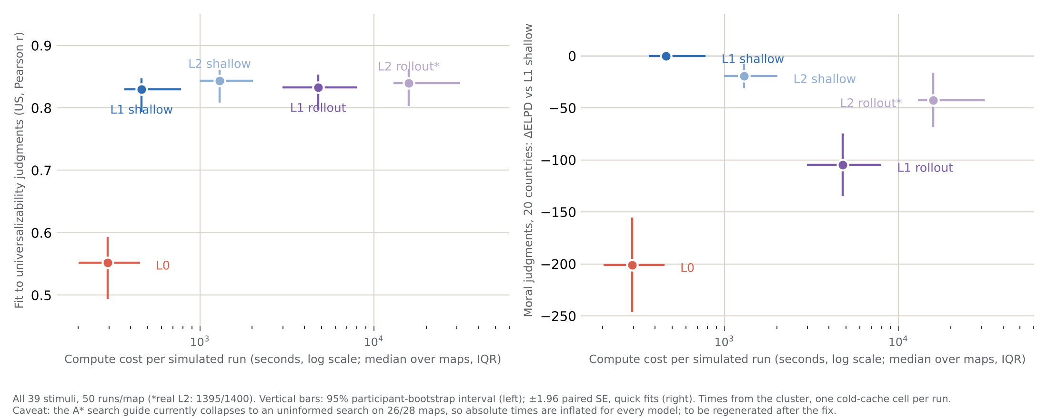
Headline: one step of prediction is enough; deeper costs more and fits worse
Current implementation, all 39 stimuli, 50 runs/map (*real L2 1395/1400). Left: fit to universalizability judgments (US), 95% participant bootstrap. Right: Logan's model on the 20-country moral judgments, ΔELPD vs L1 shallow ± 1.96 SE. x: seconds per run, median over maps with IQR.
Notes:
Under the current implementation: L1 shallow costs about twice L0 and reaches the plateau on universalizability (r .83); the L2 model of others (3x more) adds nothing; rollout (10x and 35x) is no better on universalizability and clearly worse on moral judgments (ΔELPD −105 ± 15 and −42 ± 13). Two qualifications that come on slide 5: absolute times are inflated for every model (the route calculator), so the x-axis will shift after the fix, though the ranking comes from the number of planner calls; and the L0 point depends on near-deterministic agents.

Slide 4
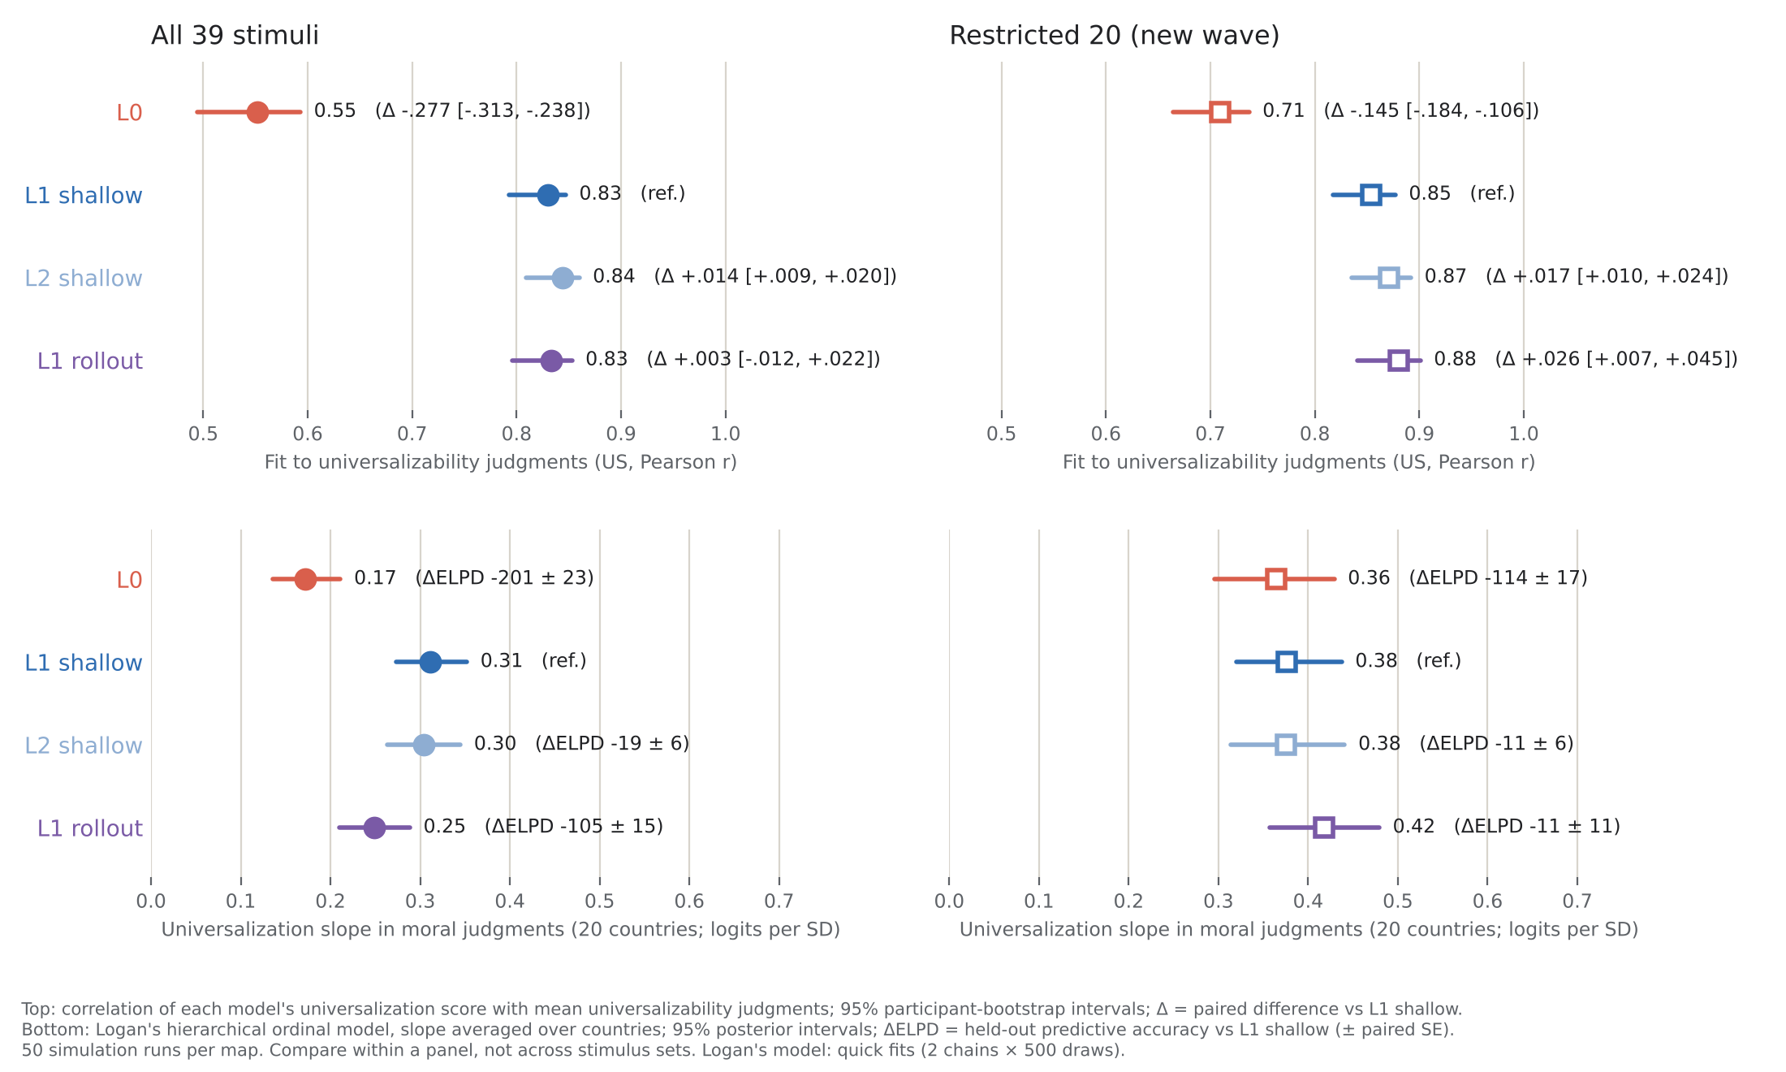
What the restriction does: the figure from Slack
Same two outcomes, all 39 stimuli (filled) vs the 20 of the new wave (open). Top: universalizability fit, paired Δ vs L1 shallow. Bottom: Logan's model, slope and ΔELPD vs L1 shallow. Current implementation.
Notes:
One minute. On the 20: the L0 contrast shrinks but stays; the shallow-vs-rollout contrast disappears (tie on moral judgments, small rollout edge on universalizability whose interval includes 0 once run noise is resampled). The per-stimulus decomposition (backup) says the depth signal sits on the dropped stimuli, and one map, yes_line_8, holds most of it. So the 20 can test 'predict others or not', not 'how deep'. I'm not asking Logan for anything on this basis yet: the numbers are provisional for the reasons on the next slide. What I'd like to know is when he needs a final answer.

Slide 5
What surfaced during the checks
Route calculator inconsistent with the simulation's goal
The planning helper inherited with the code costs a trip to a 'finish' square that the current goal (fill the tank) doesn't require, and mis-costs a just-filled agent. On 26 of 28 maps it silently falls back to an uninformed but correct search; on the 2 maps with finish squares it can pick longer routes. Compute times are inflated for every model.
Imagined agents see more than real agents do
When a model predicts the agents ahead of it, each imagined agent sees the imagined moves of the ones before it; real agents all choose from the same round-start snapshot. This is in my prediction code and affects every model that predicts. Its effect on the scores is unmeasured.
The comparisons are sensitive to action noise
With noisier choices (T = 0.5), L0 stops jamming and its scores coincide with L1 shallow's. At that noise level shallow and rollout also use different final choice rules, so that comparison doesn't isolate depth. Under the near-deterministic configuration, shallow fits moral judgments better than rollout in every variant tried (order, obstacles, scoring rule).
Notes:
Calm version. The first is a mismatch between an inherited helper and the current simulation goals; it has reproducible counterexamples and a limited behavioural footprint, but it invalidates the compute-cost axis until fixed. The second is mine; the fix is a few lines (form all intentions from the snapshot, resolve in order) and the size is unknown until rerun. The third is not a bug: it's an assumption that turned out to matter. Two independent reviews of the source (GPT's audit, Claude's verification) agree on all three. A July diagnosis in my notes was also wrong (no data affected). Neither 'the story is safe' nor 'the story has collapsed': results resting on large differences are likely to survive, small ones may move.

Slide 6
What I'll do
1
Make the code match the intended model
route calculator; imagined agents' information; same choice rule for shallow and rollout so noise can be varied for both
2
Check on simple examples and a small map panel
the 2 affected maps + the congested ones; each correction alone and together; then decide the full rerun
3
Recompute the comparisons; regenerate the compute-cost figure
and settle the noise level and the scoring rule as stated choices, with a dose-response for noise
4
Test whether the planned 20-stimulus design can tell the corrected models apart
simulate judgments from each model, refit; this is what answers the data-collection question
For you: are the assumptions on slide 2 the ones you'd want tested? When does Logan need a final word on the stimuli? And I'll need his anonymized export of the 20-country data.
Notes:
Keep it at the level of outcomes; details (2x2 panel, h=0 reference tests, matched-noise arms, model recovery) only if asked. Step 1–2 are days; step 2 decides whether the big rerun is needed. The current subset stays as it is meanwhile. If Logan launches before the checks are done, the one cheap thing worth asking for is yes_line_8.

Slide 7
Backup

Slide 8
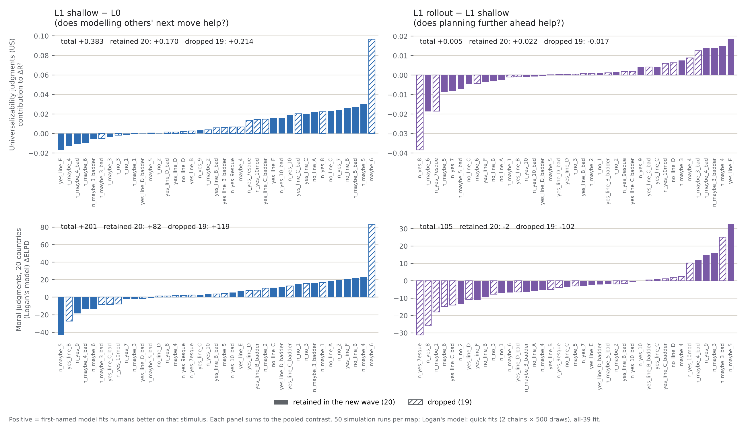
Backup: what the restriction removes, per stimulus
Per-stimulus contribution to each contrast; hatched = dropped from the new wave. Top: universalizability fit. Bottom: Logan's model ΔELPD. Current implementation.
Notes:
L0 contrast spread across stimuli (dropped 19 carry ~55–60%). Shallow's advantage over rollout on moral judgments sits almost entirely on the dropped 19 (102 of 105 units); yes_line_8 alone holds the universalizability tie.

Slide 9
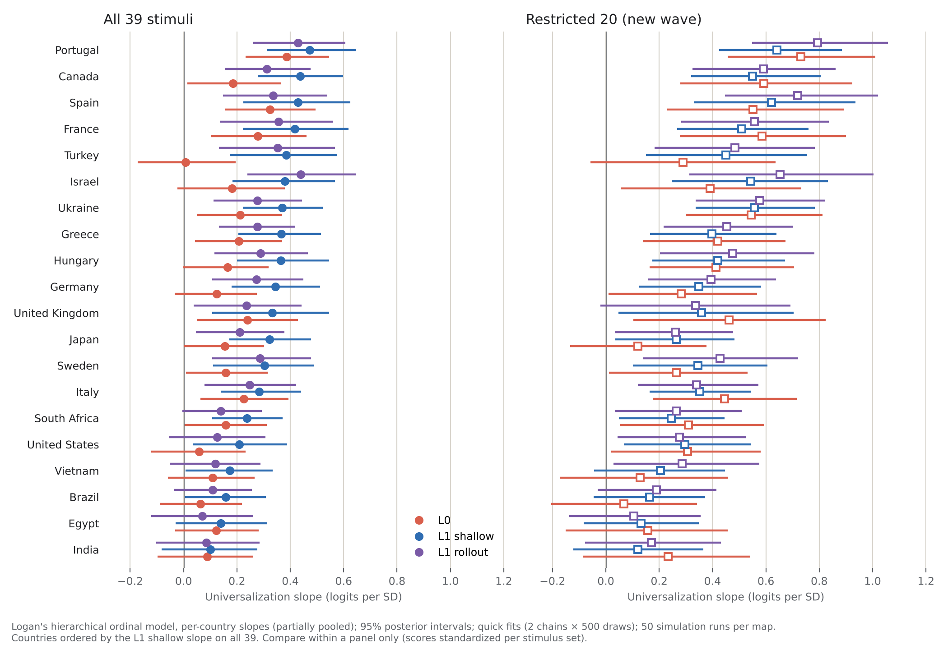
Per country: the pooled picture, repeated 20 times
Per-country universalization slopes (partially pooled), 95% posterior intervals. At the trial level: L0 worse than shallow by >2 SE in 10/20 countries, better in none; rollout worse in 9/20, better in none; on the 20, L0 is still worse than shallow beyond 2 SE in 7/20 countries; rollout vs shallow goes either way (8 up, 12 down), nothing consistent.
Notes:
No country goes the other way and none drives the result. Portugal highest, India/Egypt/Brazil near zero for every model. Shrinkage: small-sample countries (Turkey, Israel, UK) sit closer to the mean than their raw data would. Show only if Sydney asks whether a few countries carry the effect.

Slide 10
Backup: candidate maps and options (pending corrected scores)
Map | In the 20? | Rollout − shallow gap (SD) | Shallow − L0 gap (SD) | Why
yes_line_8 | no | −1.72 (largest of all) | −0.62 | the depth question; rollout's worst map (fill 145 vs 75 steps)
maybe_6 | no | −0.30 | +2.58 (largest of all) | the L0 question; L0's noisiest map (5/50 runs stuck)
7esque | no | +0.46 | −0.49 | largest single ΔELPD for shallow over rollout (+31)
new_maybe_1 | no | +0.44 | −0.10 | ΔELPD +18 for shallow over rollout
yes_line_E, F, new_maybe_6, new_maybe_5 | yes | 0.5–0.9 | 1.3–2.4 | already in: the retained set keeps most discriminating maps
Gap = difference between the two models' standardized scores on that map (model predictions only, no human data). Dropped maps carry 34% (L0) / 42% (rollout) of the total disagreement.
Options
(a) Ask Logan for yes_line_8 (+ maybe_6, 7esque, new_maybe_1) if the wave can take them. Cost is to his design: 13 trials/person over 20 stimuli, D-optimal for his question
(b) Accept that the wave tests "model others or not" only; the existing 20-country data stays the depth test (scope agreed Sept 29: no new stimuli)
(c) Later: a small separate US wave on all 39, which also replicates Joe 2023 with a modern sample
Notes:
One map does most of it: yes_line_8 is the most rollout-discriminating map by a factor of two and it is out. The Oct 5 list holds. Framing: (a) is cheap insurance if feasible, (b) costs nothing and is already the agreed scope, (c) optional. Caveat: maybe_6 is the most fragile map (dominates shallow − L0 at trial level, highest L0 run noise); a replication built on it is built on the shakiest map. The ΔELPD decomposition uses human data (in-sample); the standardized-gap ranking does not; both single out yes_line_8.

Slide 11
Backup: robustness checks, in plain words
Agent order (8→1 instead of 1→8): changes little. L0's map scores shift slightly; the others not at all.
High temperature (noisier choices): matters, because it unsticks L0. With noise L0 never jams, and without its jams L0 and L1 shallow produce the same worlds.
Zap (no ghosts) at low temperature: L0 jams far more (20 of 140 runs vs 2), because wandering ghosts were the only thing that ever broke a jam. Since jammed runs are excluded, L0 then looks better than it is.
Across all arms (poster screen, moral judgments): shallow ahead of rollout everywhere; shallow ahead of L0 at low temperature, tied with it at high temperature.
Notes:
Why L0 jams: on congested maps several deterministic L0 agents end up swapping between two cells in lockstep, a two-step loop, because each recomputes its shortest route from the others' positions at the same instant. The stuck detector looks for three identical states, so it cannot see a two-state loop; the run goes to the time limit. Ghost wandering sometimes changes the geometry and breaks the loop late, which is why a few runs finish around step 400. Noise breaks it in a step or two. Takeaway: the temperature and the exclusion rule are doing real work in the L0 result; they are assumptions to state, and the T = 0.2 arm would show where the L0 effect appears.

Slide 12
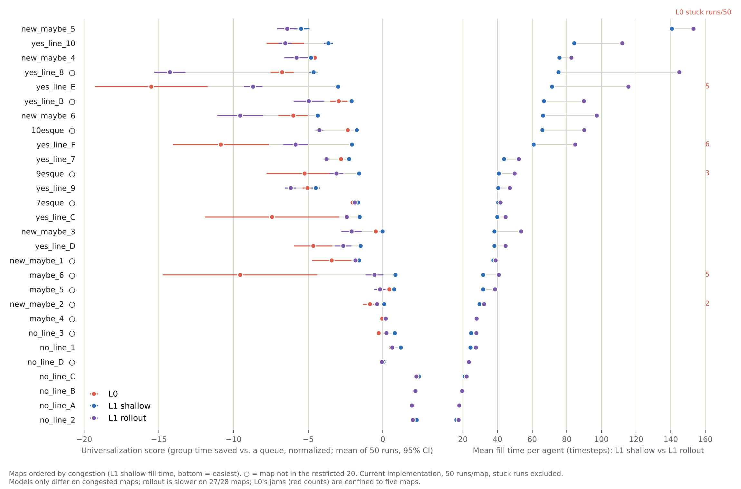
Backup: where the simulated worlds differ, map by map
Left: each model's universalization score on every map (mean of 50 runs, 95% CI), maps ordered by congestion. Right: mean fill time of finished runs, all three models; red counts = L0 runs that never finish. ○ = not in the restricted 20. Current implementation.
Notes:
Backup; use it to make the modelling question tangible: on easy maps the three models produce the same world; on congested maps rollout takes much longer (yes_line_8: 145 vs 75 steps) and L0 sometimes never finishes. The question for Sydney: are these plausible crowd dynamics for the world people imagine when they universalize? Rollout's slowness comes from evaluating candidates with the others frozen at their projected positions, so a temporary blockage looks permanent and it yields; that is a hypothesis to test on the trajectories after the fixes, not an established explanation.

Slide 13
Backup: six arms × three claims
claim | baseline (50 runs) | baseline, first 5 runs | T = 0.5 | reversed order | zap + T = 0.5 † | zap
shallow − L0, univ Δr | +.28 | +.26 | −.01 | +.21 | −.01 | −.05
shallow − L0, moral US ΔΔR² | +.14 | +.14 | .00 | +.15 | −.01 | +.02
shallow − L0, moral 20 countries ΔΔR² | +.08 | +.07 | .00 | +.08 | .00 | +.01
shallow − L0, Logan ΔELPD | +201 ± 23 | — | +9 ± 7 | — | — | —
rollout − shallow, univ Δr | .00 | −.02 | .00 | −.05 | +.01 | −.05
rollout − shallow, moral US ΔΔR² | −.07 | −.07 | −.04 | −.08 | −.05 | −.06
rollout − shallow, moral 20 countries ΔΔR² | −.04 | −.04 | −.02 | −.04 | −.03 | −.03
rollout − shallow, Logan ΔELPD | −105 ± 15 | — | +7 ± 15 ‡ | — | — | —
L0 stuck runs / 140 | 21 (of 1400) | 2 | 0 | 2 | 8 † | 20
L0 ↔ shallow score correlation (28 maps) | .63 | .68 | .99 | .66 | .99 | .74
Every arm: 5 runs × 28 maps, frozen config except the named knob; all bootstrap intervals exclude 0 except the univ ties. Moral ΔΔR² = poster method, used as a screen; Logan's model run on the decisive arm only
With noise at T = 0.5, L0 stops jamming and its scores coincide with L1 shallow's (r = .99): the L0 distinction changes substantially between the near-deterministic and the noisier configuration, in the current implementation
Shallow > rollout on moral judgments holds across order, ghosts/zap and aggregation rule at T = 1e-4. ‡ At T = 0.5 the comparison does not isolate depth: shallow picks actions by Boltzmann sampling, rollout by argmax, so the two have different decision noise at the same T (rollout faster on 19 of 28 easy maps, still slower on the 5 congested ones). Matched-rule rerun needed
† zap + T = 0.5: the stuck detector fires on a lone noisy last agent (all 17 L1h "stuck" runs have exactly one unfinished agent); rerun with a longer patience window
Notes:
The honest reading: the result that survives everything so far is that forward simulation never beats one-step prediction and is worse on moral judgments with deterministic agents. 'No prediction is worse' depends on determinism. Temperature has moved from 'an assumption' to 'the assumption that decides a result'; a T = 0.2 dose-response arm for L0/L1h is cheap and would show where the L0 effect appears. Aggregation rule (mean vs median): shallow vs rollout and L0 vs shallow on moral judgments survive it; L0 vs shallow on universalizability does not (r .55 → .80 under the median).

Slide 14
Backup: code review, three implementation points
Finding | What the code does | Scope | Fix
A* search guide (WaterCollectionHeuristic) | adds a tank-to-finish leg not in the goal; costs a just-filled agent as needing water again; sentinel-integer overflow | behaviour on the 2 maps with finish objects (no_line_1, yes_line_7); elsewhere the guide collapses to 0 = correct but uninformed search → compute-cost figure invalid everywhere | zero at goal, no finish leg for a fill goal, no sentinel arithmetic; h = 0 reference tests
Imagined L0 ≠ actual L0 | inside L1's prediction, imagined predecessor j sees predecessors 1..j−1's imagined moves; real agents all choose from the round-start snapshot | every predicting model (all but L0); size unmeasured — in congestion a small change in predicted movement can change which passage looks open | form all L0 intentions from the snapshot, resolve in priority order; test: imagined L0 reproduces actual L0 at matched seed
Rollout's action selection (controlled comparison, not a bug) | shallow: Boltzmann at T; rollout: argmax over candidate values with random ties | at T > 0 the two have different decision noise at the "same" T, so the T = 0.5 arm does not isolate depth | separate settings for own-action noise and imagined-others noise; match them for the comparison
July "Zeno" diagnosis (notes only) | at depth 2 EVAL_STEPCOST subtracts 1 from every candidate: cannot change a choice; the cited frozen waiter was a finished ghost | no data affected (both knobs on); the July improvement came from random tie-breaking | correct STATUS.md; isolate tiebreak vs stepcost in a 2×2 if the paper cites it
Also from the review, agreed: joint participant × run resampling widens the restricted-set intervals (rollout − shallow +.026 → [−.014, +.058]); replace the May-CSV session reconstruction with Logan's export; drop the per-model ΔR²-vs-zero tests (done: ΔR² is no longer a headline analysis).
Notes:
Two independent reviews (GPT's code audit, Claude's verification against the source) agree on the three points. Position: repairable, worth continuing, effect on the conclusions unmeasured until the rerun. Results resting on large differences (L0's jams; rollout slower on 27/28 maps; the T = 0.5 finding, which involves no prediction) are the ones most likely to survive; results resting on small differences (univ tie, L2 vs L1, the exact per-stimulus split) are the ones that could move. Neither 'safe' nor 'collapsed'.

Slide 15
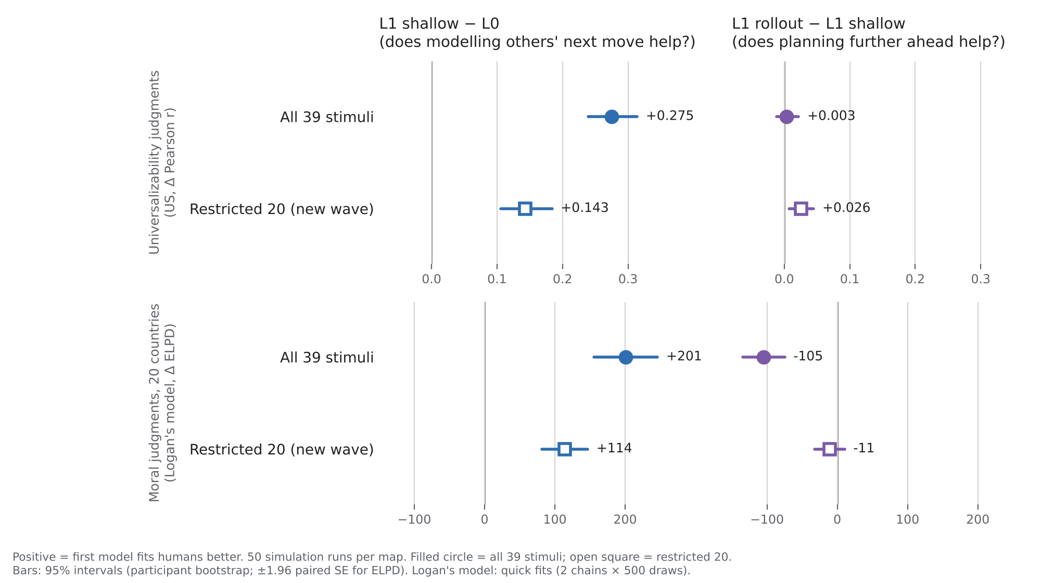
Backup: the two contrasts, all 39 vs restricted 20
Same numbers as the headline figure, arranged by contrast.
Notes:
Alternative view of slide 5.

Slide 16
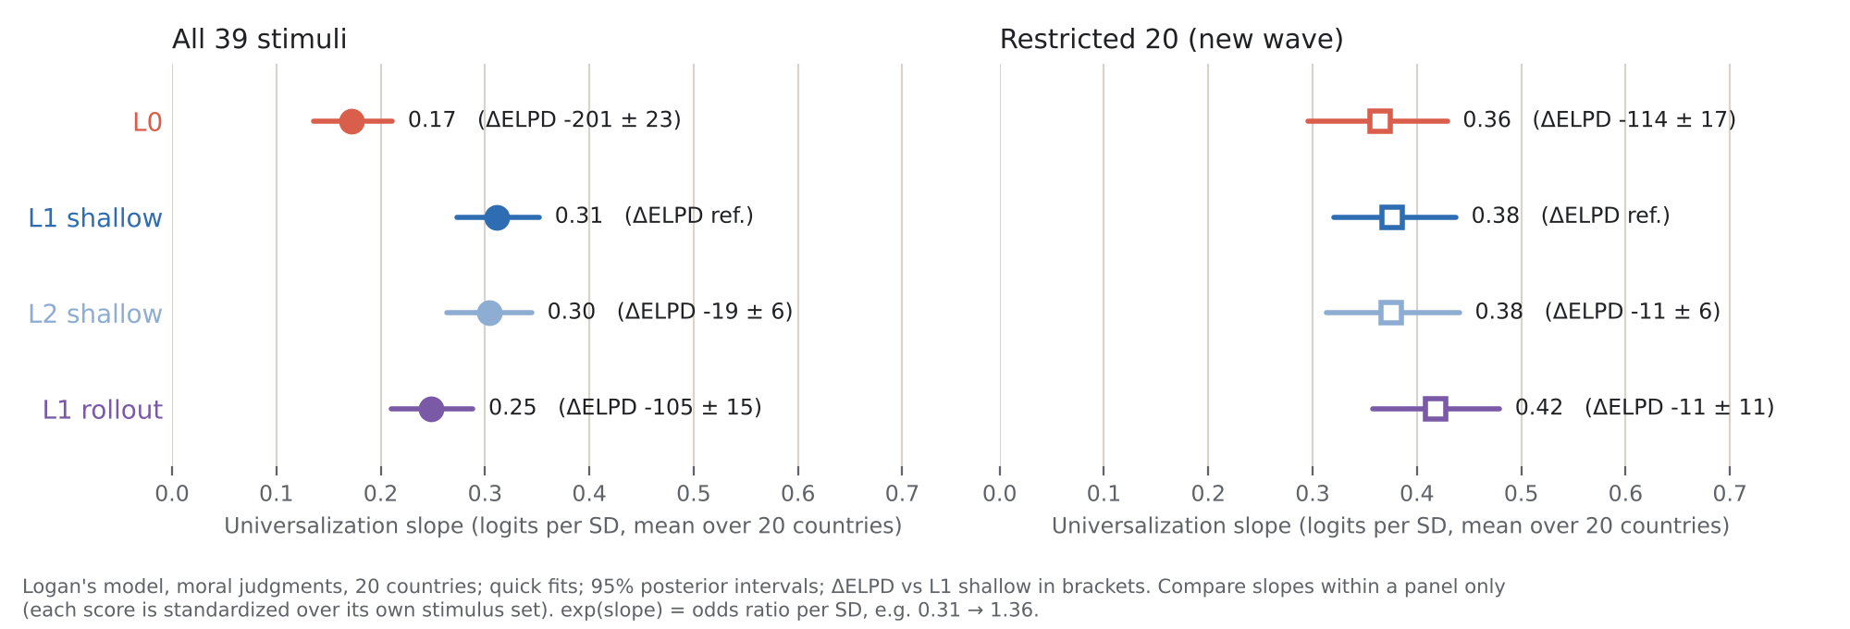
Backup: slopes in Logan's model, with ΔELPD
exp(slope) = odds ratio per SD of the model's score, e.g. 0.31 → 1.36.
Notes:
Slope for effect size, ΔELPD for comparison. On the 20, L0's slope equals shallow's while ΔELPD is −114.

Slide 17
Backup: 10 vs 50 runs, and the US moral judgments (poster method)
Contrast | 10 runs · all 39 | 10 runs · 20 | 50 runs · all 39 | 50 runs · 20
Δr univ: shallow − L0 | +.173 [.142, .204] | +.041 [.013, .072] | +.275 [.239, .314] | +.143 [.106, .184]
Δr univ: rollout − shallow | −.001 [−.015, .014] | +.004 [−.014, .021] | +.003 [−.012, .022] | +.026 [.007, .045]
ΔΔR² moral US: shallow − L0 | +.113 [.087, .140] | +.063 [.039, .090] | +.140 [.107, .173] | +.133 [.096, .174]
ΔΔR² moral US: rollout − shallow | −.057 [−.074, −.042] | −.028 [−.042, −.015] | −.065 [−.082, −.049] | −.028 [−.040, −.017]
ΔΔR² moral 20 countries: shallow − L0 | +.052 [.044, .062] | +.026 [.018, .034] | +.076 [.065, .086] | +.060 [.050, .072]
ΔΔR² moral 20 countries: rollout − shallow | −.033 [−.039, −.028] | −.013 [−.017, −.009] | −.036 [−.042, −.031] | −.013 [−.017, −.009]
Logan model ΔELPD: L0 − shallow | −122 ± 22 | −100 ± 15 | −201 ± 23 | −114 ± 17
Logan model ΔELPD: rollout − shallow | −123 ± 15 | −42 ± 11 | −105 ± 15 | −11 ± 11
Bootstrap rows: participant bootstrap, 95% CI (notebook section 9). ΔΔR² = difference in incremental R² beyond welfare, harm and inequality (poster method; kept here as backup only). Logan-model rows: quick fits.
Notes:
Everything that was in the poster-era pipeline, before and after the restriction, at 10 and 50 runs. Use if asked about the US moral data or about what changed with more runs.

