Slide 1
AVIATION ANALYSIS FINDINDS

Slide 2
INTRODUCTION
The company is expanding in to new industries to diversify its portfolio. Specifically, it has interests in purchasing and operating airplanes for commercial and private enterprises, In order to pursue this venture, the company has to be in the know of potential risks of aircraft. This includes the number of accidents that each aircraft has had over the years, the market demand and the safety of the aircraft. I have been charged with determining which aircraft are the lowest risk for the company to start this new business endeavor. I will thereby translate my findings into actionable insights that the head of the new aviation division can use to help decide which aircraft to purchase.

Slide 3
What are the objectives of the project?
Analyze accident data to guide investment and safety decisions
Special focus on Cessna aircraft, due to their popularity
Focus on understanding risks across different aircraft makes and models

Slide 4
Business understanding
Companies want to minimize risk and maximize return on investment.
Identifying safer, more popular aircraft models helps make smarter purchases.
Investors need to understand which aircraft have better safety records.

Slide 5
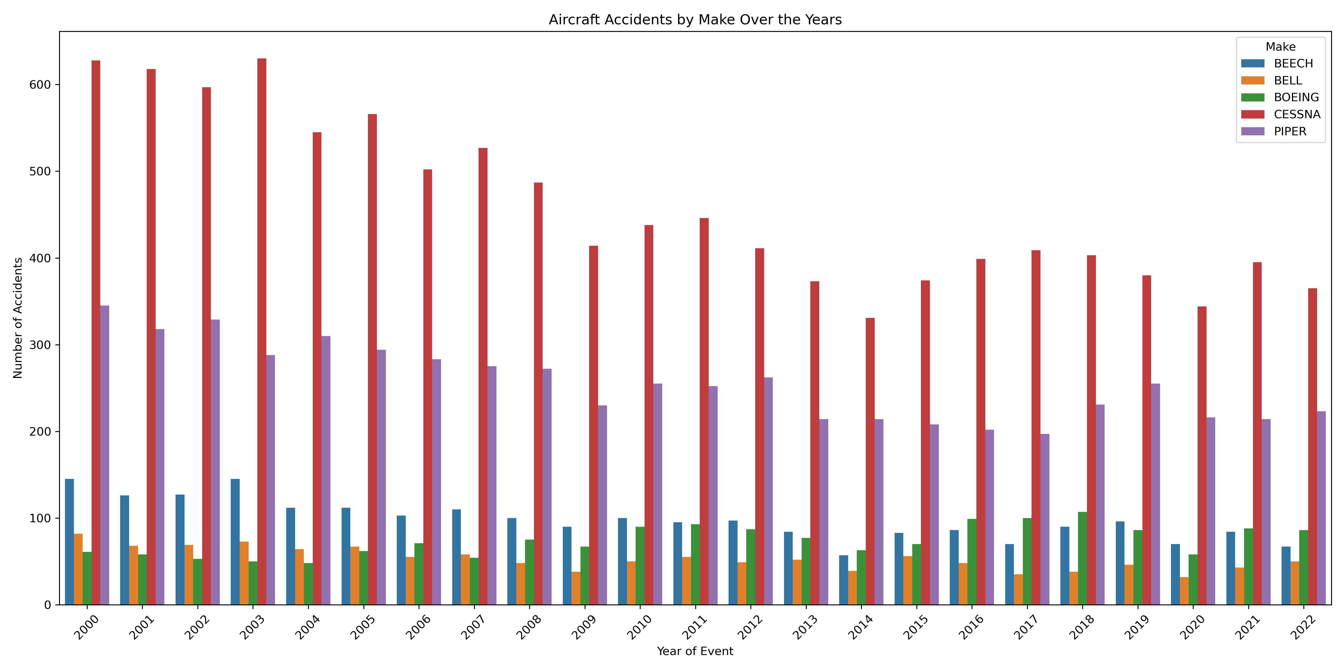
Visualizations Airplane accidents by make

Slide 6
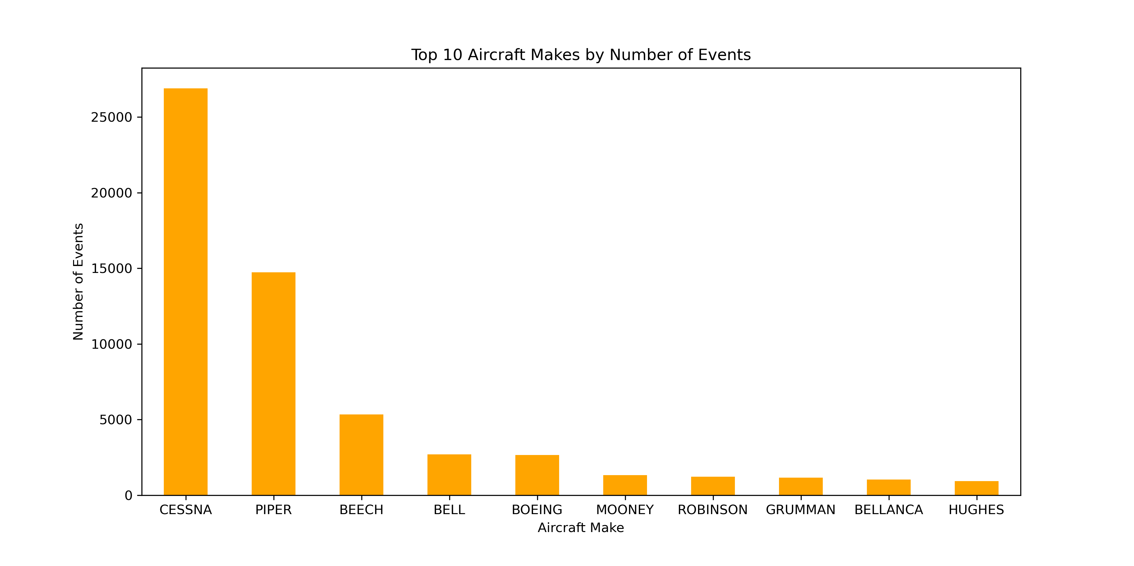
Top 10 Aircraft Makes by Number of Events

Slide 7
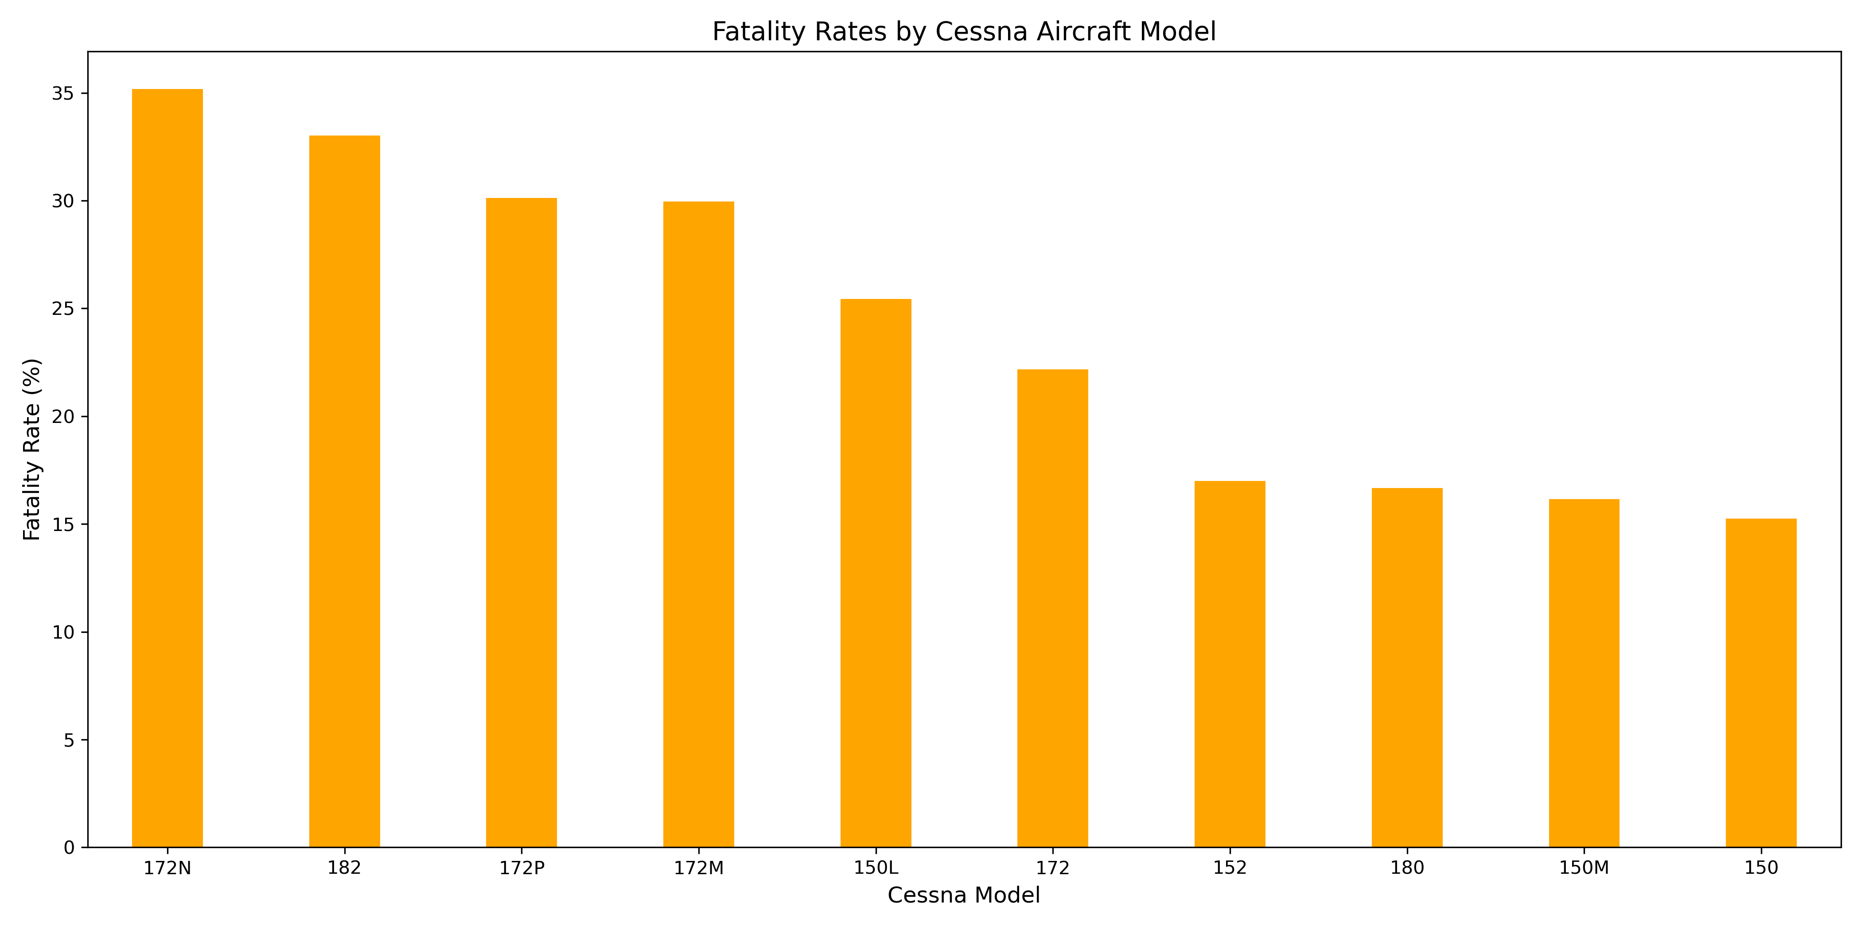
Fatality rate of Cessna

Slide 8
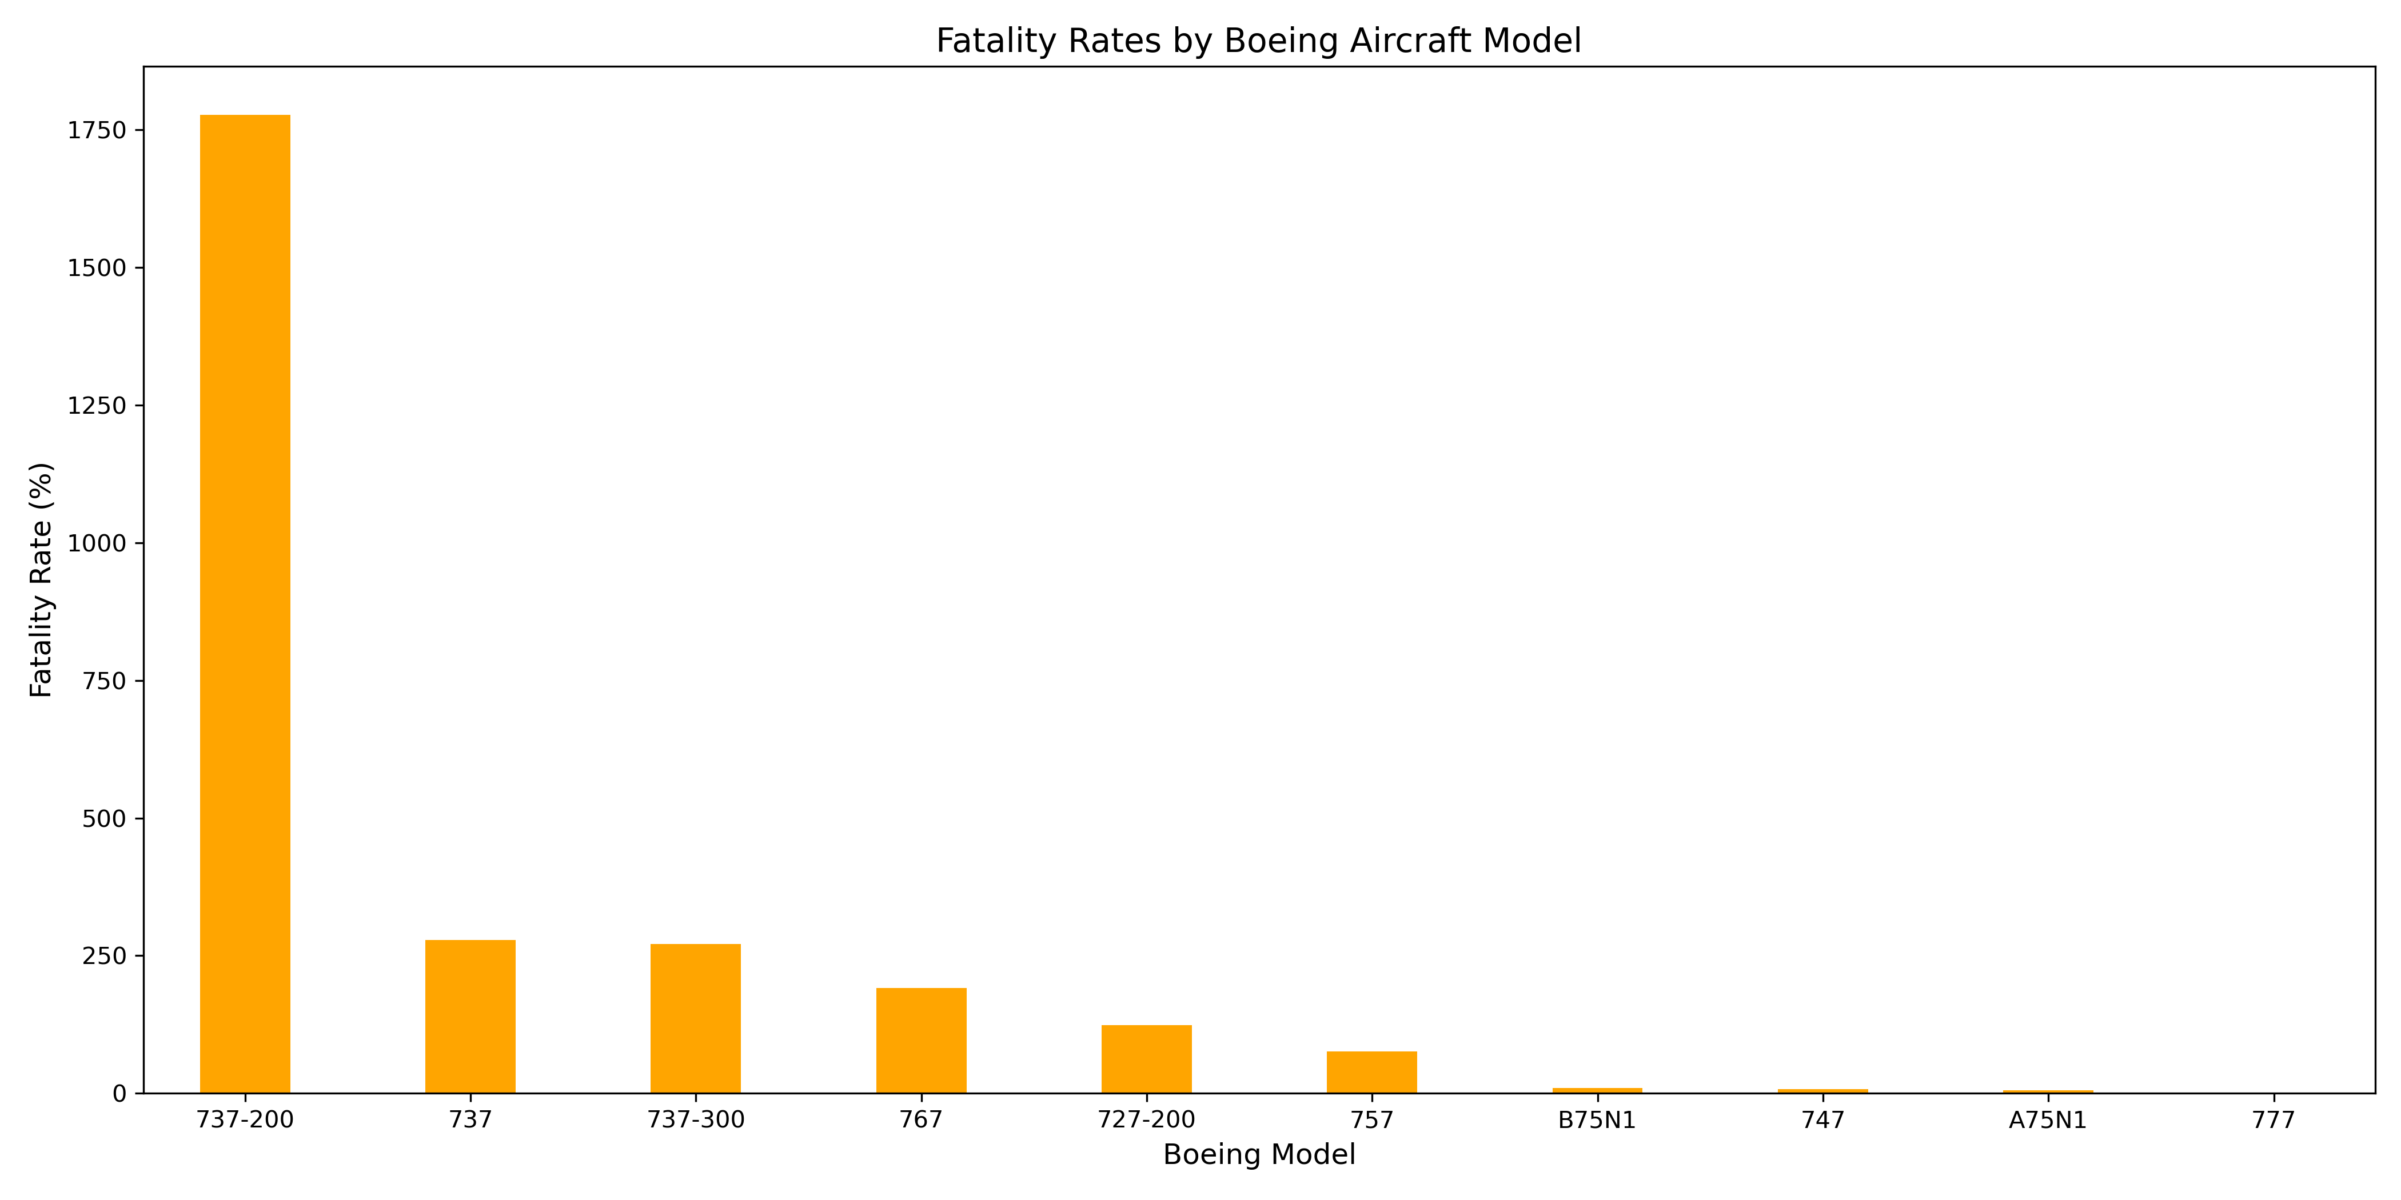
Fatality rate of Boeing

Slide 9
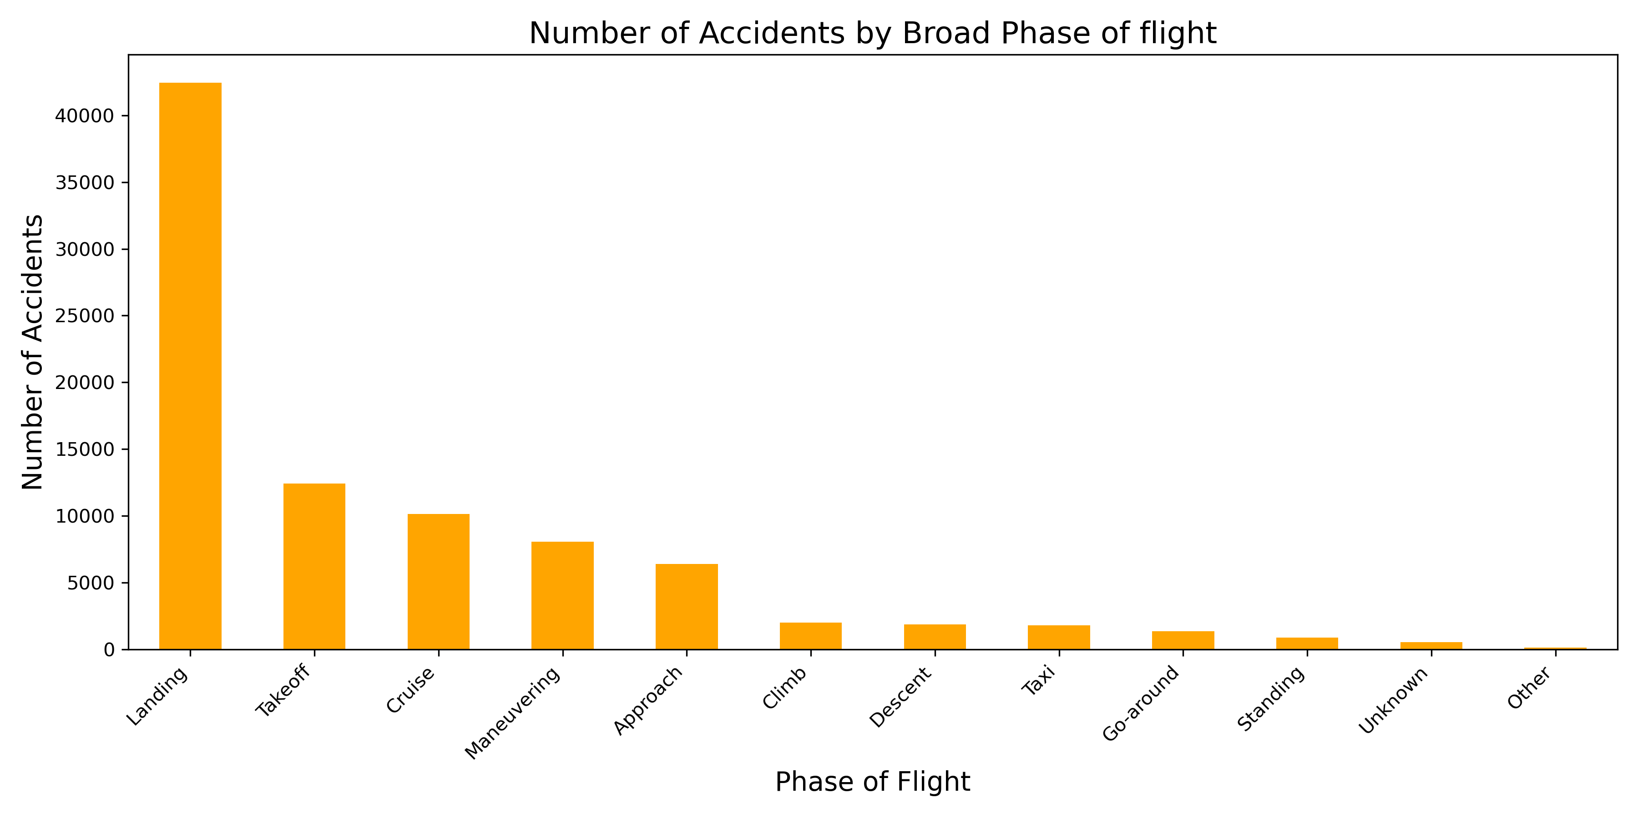
Accidents based on face of flight

Slide 10
Recommendations and findings
Basing on this analysis, the Two most used models basing on the number of reported incidences are CESSNA and BOEING.
CESSNA'S most used model tends to be the 172 but it is not the safest model. Safe ones are the 180,150M,150
BOEING'S most used model tends to be 737-200 but it is not the safest model. Safe ones are the 747,A75N1 and 777
CESSNA is the most used airplane since 2000 to 2022
All other airplanes are safer because they have a smaller number of accidents

Slide 11
ACTIONABLE INSIGHTS
It would therefore be ideal if the company invests in this two airplane because they are the most used brands in the market thereby making them reliable.
For short flights that only carry a smaller number of people, CESSNA 172N would do an incredible job. BOEING 737-200 would be ideal for long commercial flights that carry a good number of people.
To avoid accidents, the company should always do regular check ups on both planes specifically on its landing ability and take off because this is when most accidents occur. Employing well experienced pilots would also avoid such incidences.
All the other airplanes are also reliable if the company wouldn’t want to consider market demand.

Slide 12
THANK YOU!
Name; Sydney Were
Linked in profile: https://www.linkedin.com/in/sydney-were-3a0894303/

