Slide 1
Review of single-cell benchmarking

Slide 2
Motivation

Slide 3
Project background
Read single cell benchmarking papers
Examine their evaluation from multiple aspects:
Accuracy
Stability
Interpretability
Etc
Write a review paper
Suggest guidelines for an ideal evaluation framework
Collected 82 single cell benchmarking papers
Need crowdsourcing in a structured way
Notes:
So some background about this project
We are planning to read a bunch of single cell benchmarking papers
Look at how these papers perform method evaluation
For example, how did they benchmark accuracy of methods
Did they benchmark the stability of methods
Did they comment on the interpretability of the methods etc
And after we read those papers
We want to come up with a review papers,
propose a set of guidelines what an ideal evaluation framework look like, if people are to perform single cell benchmarking study
So far we have collected 82 benchmarking papers, for single cell methods benchmarking
Because that’s quite a lot of papers, we are really hoping to get everyone’s input in this project to make it more feasible

Slide 4
Why contributing to this project
Your effort will be acknowledged
We will include a table of people who contributed to the reading.
With this guideline paper, our group can then claim we are expert in the benchmarking field
Get fundings -> new servers
Reading benchmarking papers in your areas also help with your own project
Notes:
So you are probably asking, why is it relevant to me, why should I contribute
First of all, your effort will be acknowledged, we will include a table showing the people who has contributed to the reading
And once we publish this guideline paper, then we call us an expert in the benchmarking field
That means it helps to get fundings, and fundings means we get money to buy new servers
Also, say you are working on your next single cell project, reading the benchmarking paper in the relevant area will help you with your own project

Slide 5
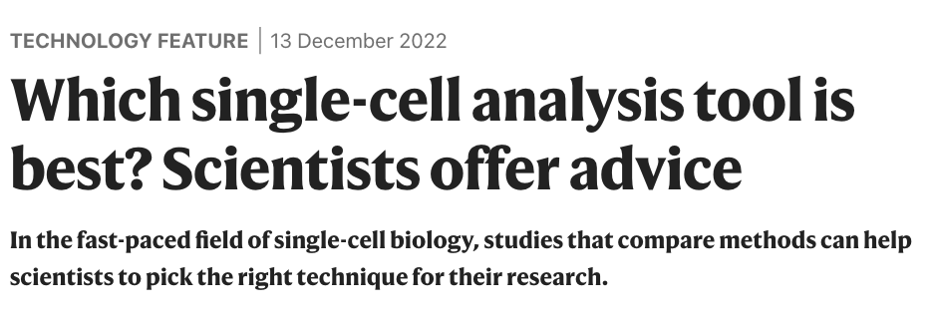
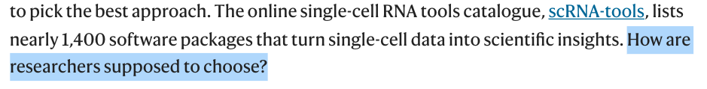
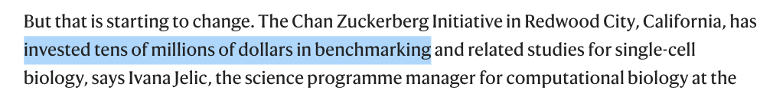
Notes:
Actually this paper just came out this week, in Nature Technology Feature, talking about the importance of benchmark papers
It mentions that, because single cell is such a rapidly developing field, now there are over a thousands and 400 packages being developed and it’s really causing a headache when a researchers want to pick something to run some analysis.
So now benchmarking studies are getting more acknowledgement in the research field, because of their values to the field.
For example, the Chan Zuckerberg initiative is now giving tens of millions of dollars for such benchmarking study.

Slide 6
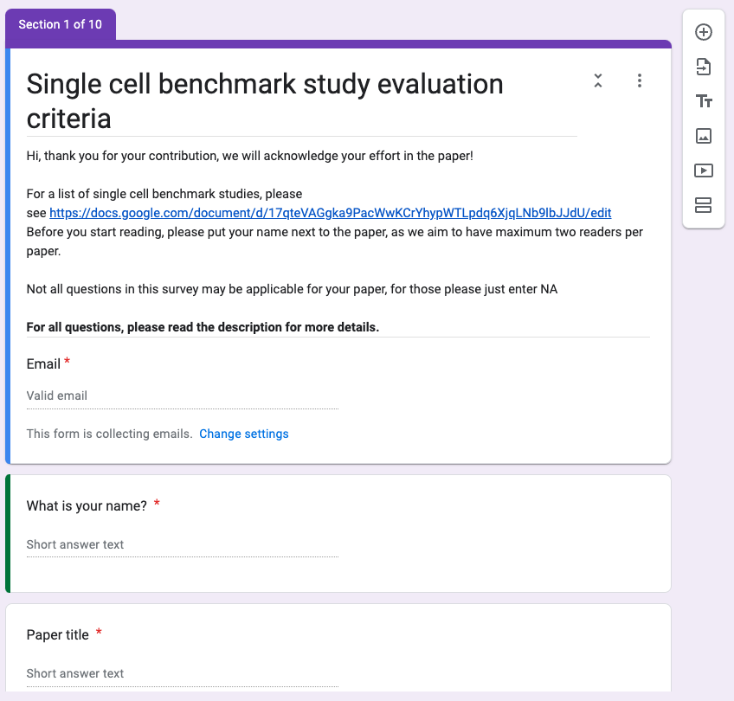
Notes:
Hopefully I have now convince you the importance of benchmark
If you thinking of contributing,
We have set up this google form for people to fill in various information about the benchmarking paper you have read.

Slide 7
Paper
Notes:
So now I will explain each sections of the form, so it makes life easier when you are filling the form

Slide 8
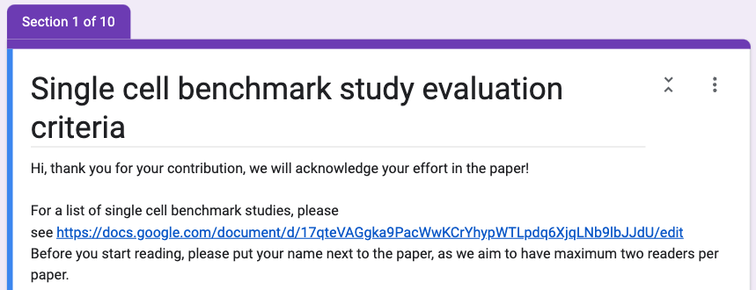
Choosing the paper
Suggest to choose from the list of 82 benchmarking papers or add yours to the list
Notes:
Starting with paper
We have curated a quite an extensive list, and the list can be found at the very top of this google form.
You can pick a paper from the list or add a new paper in

Slide 9
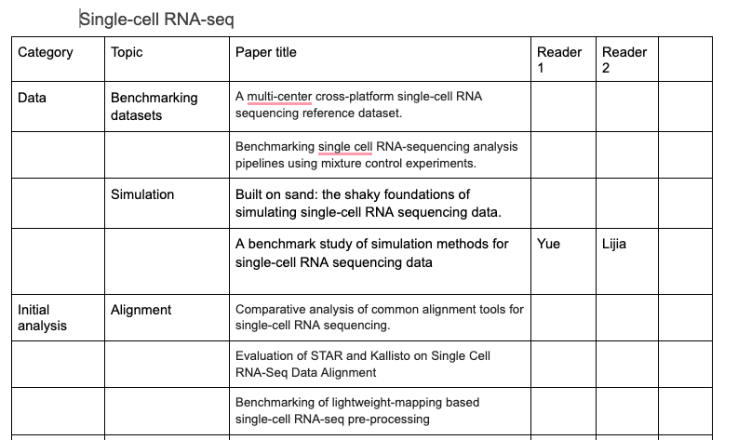
Before reading, please put your name next to the paper
We would like to limit to maximum of 2 readers per paper
Notes:
We have put all the papers into a table, that looks like this
We would really appreciate if you could put your name next to the paper you decide to read
This is for the purpose of acknowledging your contribution
And also, we would like to limit to a maximum of 2 readers for a paper, so we can get more paper covered

Slide 10
Is this paper:
1. Pure benchmarking papers (all the papers in the list falls here)
2. Benchmarking included as part of new method development
Some questions maybe more/less relevant depending on 1 or 2
Notes:
In the form, it will ask you to tick, whether the paper you have selected is a pure benchmarking paper, and actually all the papers in the curated list falls here
Or whether it’s a benchmarking section included as part of new method development, because maybe you want to add a paper where it is about a new method, but the evaluation section is really good.
So in the form, we would like to keep track of it.
And some question maybe more or less relevant depending if its one or two.

Slide 11
Dataset
Notes:
Now moving the questions about the datasets

Slide 12
Only refer to the datasets used for main result (eg, for assessing accuracy of model)
Don't consider datasets used for scalability
scalability assessment typically involves sampling additional datasets
generating various number of cells from the same dataset
Notes:
In here, we are only asking about the datasets used for the main result, for comparing the accuracy of methods
And we don’t consider datasets used for scalability
Because for scalability, you usually generate say various number of cells from the same dataset, and we don’t count those as proper datasets

Slide 13
Number of experimental datasets
Straightforward in most cases
For batch correction, datasets are often grouped in collections. In such cases, please specify by writing "xxx collections with a total of xxx individual datasets".
Notes:
So one of the question in the dataset section will ask you about the number of experimental datasets

Slide 14
Number of synthetic datasets
perturbations (ie, different settings) on the same dataset are counted as separate datasets.
eg, we simulated a dataset and tuned the sparsity between 80% to 99%.
count as 20 different datasets.
Notes:
For the synthetic datasets
This include simulation dataset and perturbation on datasets
For perturbation, like changing different setting. On the same dataset, we count them as separate datasets
For examples, we changed the sparsity of a datasets to be between 80% to 99%
Even thought this is from the same dataset, we will count it as 20 different datasets

Slide 15
Accuracy

Slide 16
We define accuracy as whether the methods do what they were intended to do.
Eg, What criteria the benchmark paper used to measure whether trajectory inference methods accurately capture the trajectory.
Notes:
For the accuracy section, this xxxx
We have came up with some criteria for people totick

Slide 17
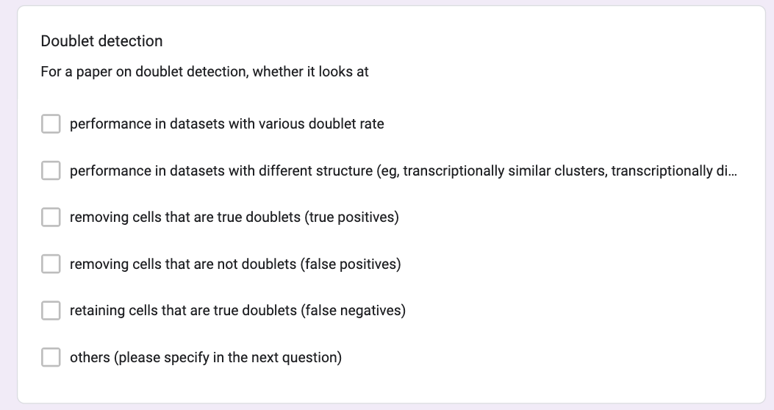
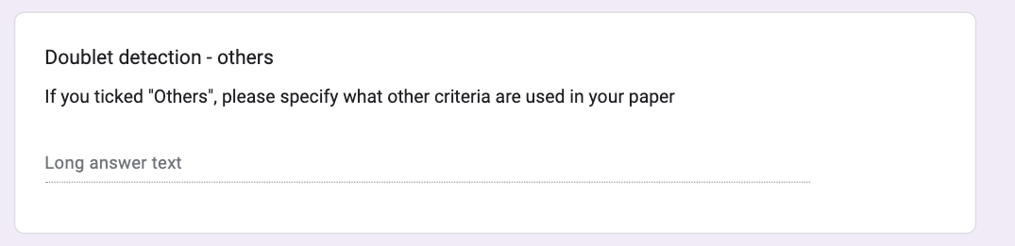
For some topics (eg, DE, doublet detection, batch correction…), we have listed some common criteria
If you found new criteria in the paper, please also tick “others” and fill in the details in the next tab
For topics that were not included, please write down the criteria
Notes:
For some

Slide 18
Scalability

Slide 19
Memory
Speed
Maximum number of cells

Slide 20
Stability

Slide 21
Evaluating stability by giving similar input data (eg, by subsampling the data)
Parameter tuning when comparing the methods

Slide 22
Downstream

Slide 23
This is asking whether the paper went one step further apart from just looking at performance of method itself.
For example, after data integration, did they evaluate the impact of data integration on trajectory analysis, DE analysis, etc

Slide 24
Context specific confirmation/ discovery

Slide 25
This section may be more applicable for benchmarking studies conducted as part of new methods development
Did the paper confirm any existing knowledge. Eg, we recapitulate known marker genes
Did they make (or claim) new biological discovery, eg, a new rare cell type?
Did they perform any web lab experiment to validate?
If the answer is “Yes”, please also briefly write down the detail (can just copy and paste the relevant text from paper)

Slide 26
Communication

Slide 27
Did the paper provide recommendation to the readers?
Did the paper discuss applicability?
Did the paper discuss trade-offs?
Future directions?
For these questions, because they can be subjective to personal interpretation, please copy the sentence from the paper where you feel this sentence has answered the question.

Slide 28
Availability of data and code

Slide 29
Is there a website for displaying/exploring the result
Is there a data package/data link provided? (not just the accession ID)
Is there a software package or code available for performing the benchmark workflow?

