Slide 1
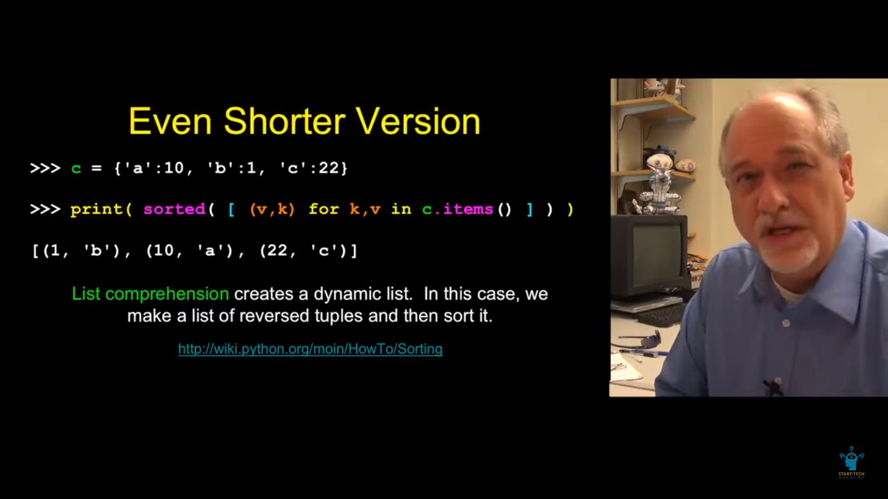

Slide 2
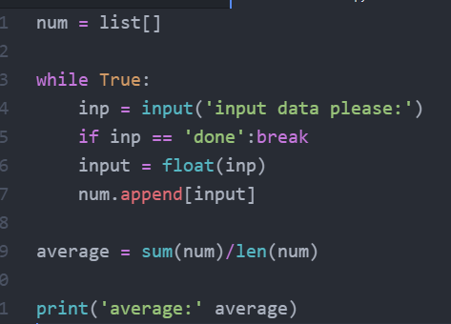
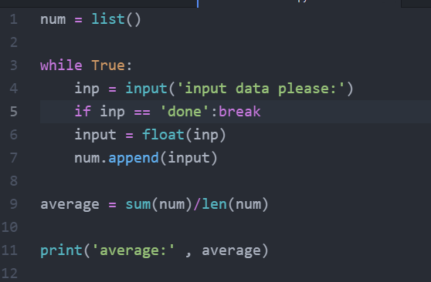
dapat list( )
Yung ginamit mong variable yung ‘input’ mali yon. Kasi reserved word yan e for function input()

Slide 3
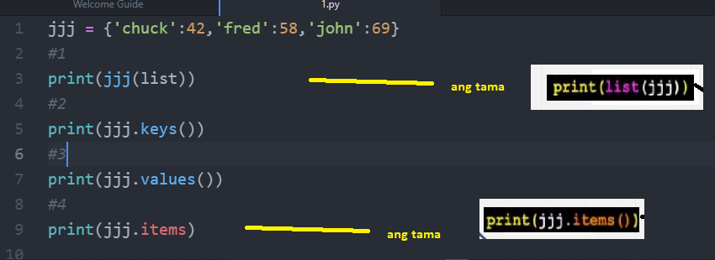

Slide 4
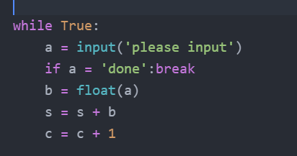
Sa line 3: == hindi lang =

Slide 5
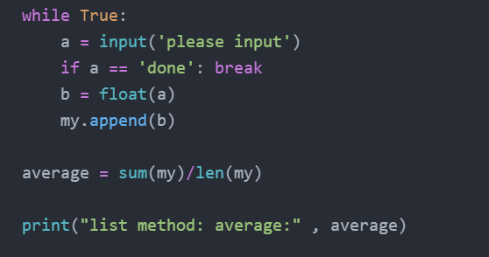
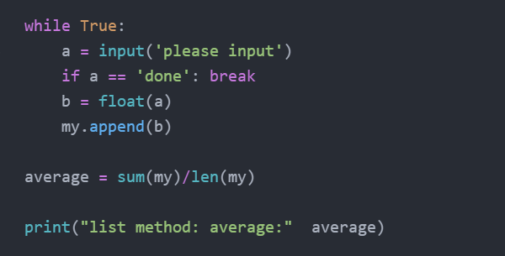
In so far as the line item ‘print’ is concern which one is right?
Tama
Mali = walang kama dito
String concatenate with number requires comma

Slide 6
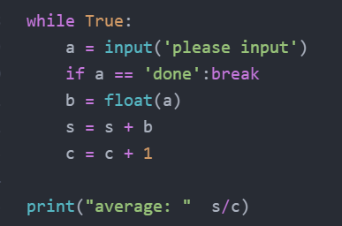
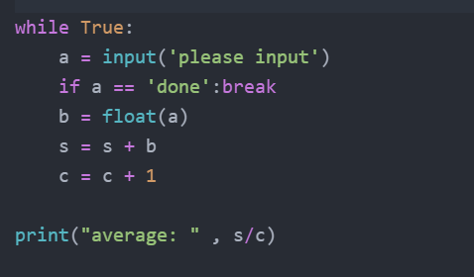
In line item print: which one is wrong? Why?
Correct, dapat may kama ito kasi
String mixed with formula
Wrong, walang kama

Slide 7
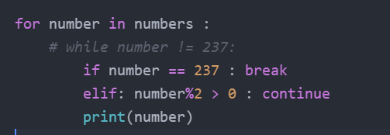
Walang colon after ‘elif’, tanga.

Slide 8
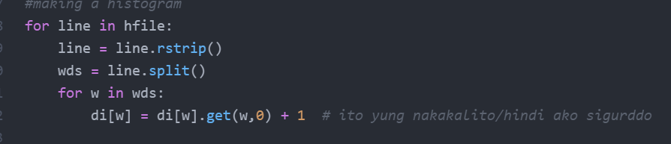
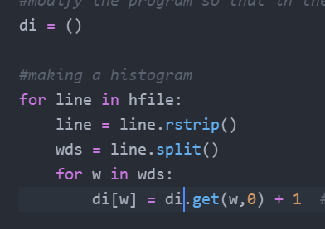
mali
Wala dapat [w]
Eto ang tama

Slide 9





wrong
correct
(k,v) dapat

Slide 10
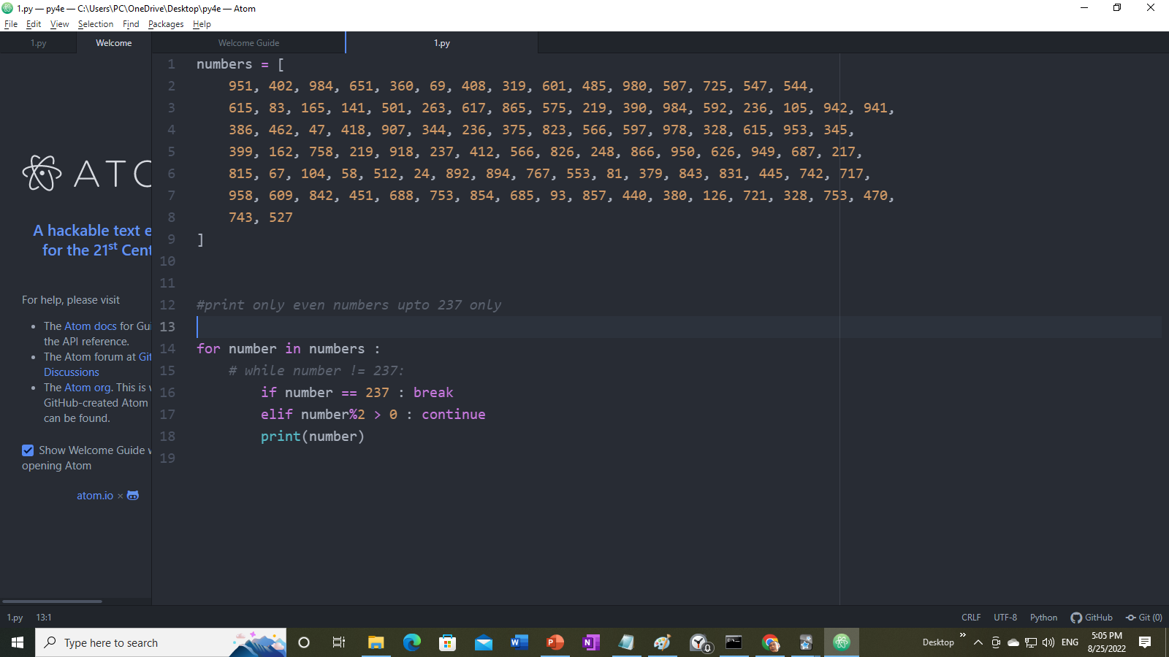
This one works

