Slide 1
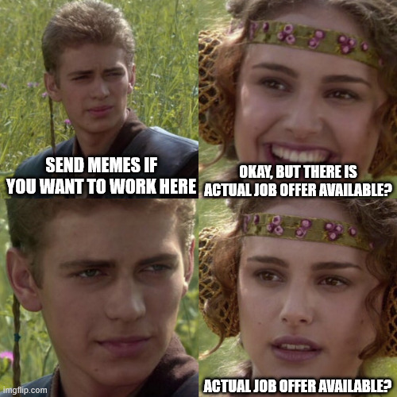
SYDORYK OLEH
3D Environment Artist
+48 793 198 675
sydorykoleh@gmail.com
Krakow, Poland
szczeniaczki Don’t taunt me with memes, this supposed to be serious business. Right? Right?
Hi,
Looks like we are a good fit. I have extensive experience in the 3D industry (9+ years), and I’m fully comfortable working on assets and environments for the background.
Here are the few reasons why I’m a strong match for the 3D Environment Artist position:
I have over 9 years of experience in the CG industry, and I can handle every step of in environment creation - from modeling, texturing, optimization to set dressing, and lighting/FX. I worked mostly in Maya, Unreal. Currently working fully in Houdini. I can build procedural workflows to optimize assets(to different platforms, LODs), build complex scattering systems and automation(PDG) to process and validate assets and expand studio library. I can also export HDAs from Houdini directly into Unity so that artists can use custom tools without technical knowledge. I also Houdini to create custom terrains to be used inside Unreal Engine for movie production: https://sydoryk.com/detail/Mars/ I used SpeedTree long time ago to create all vegetation for this short movie: https://sydoryk.com/detail/Safari/ I’m comfortable using Git or Perforce. My personal website is hosted on GitHub.
With TD at previous job, we built a pipeline to transition traditional movie production into a real-time workflow (Unreal Engine 5). In Unreal I learned every aspect required to successfully finish short movie. Here is showreel: https://sydoryk.com/detail/Showreel/ First 25 seconds is movie done completely in Unreal 5. Other movies used traditional rendering.
Why I’m not a perfect match:
I don’t have much practice using Substance, I build procedural shaders in engine materials directly without texture baking. I’m confident I can quickly adapt to studio workflow and contribute to team. I would love to have a call, or even better meeting in the office to discuss this opportunity further.
Sincerely,
Sydoryk Oleh

